Slide 1
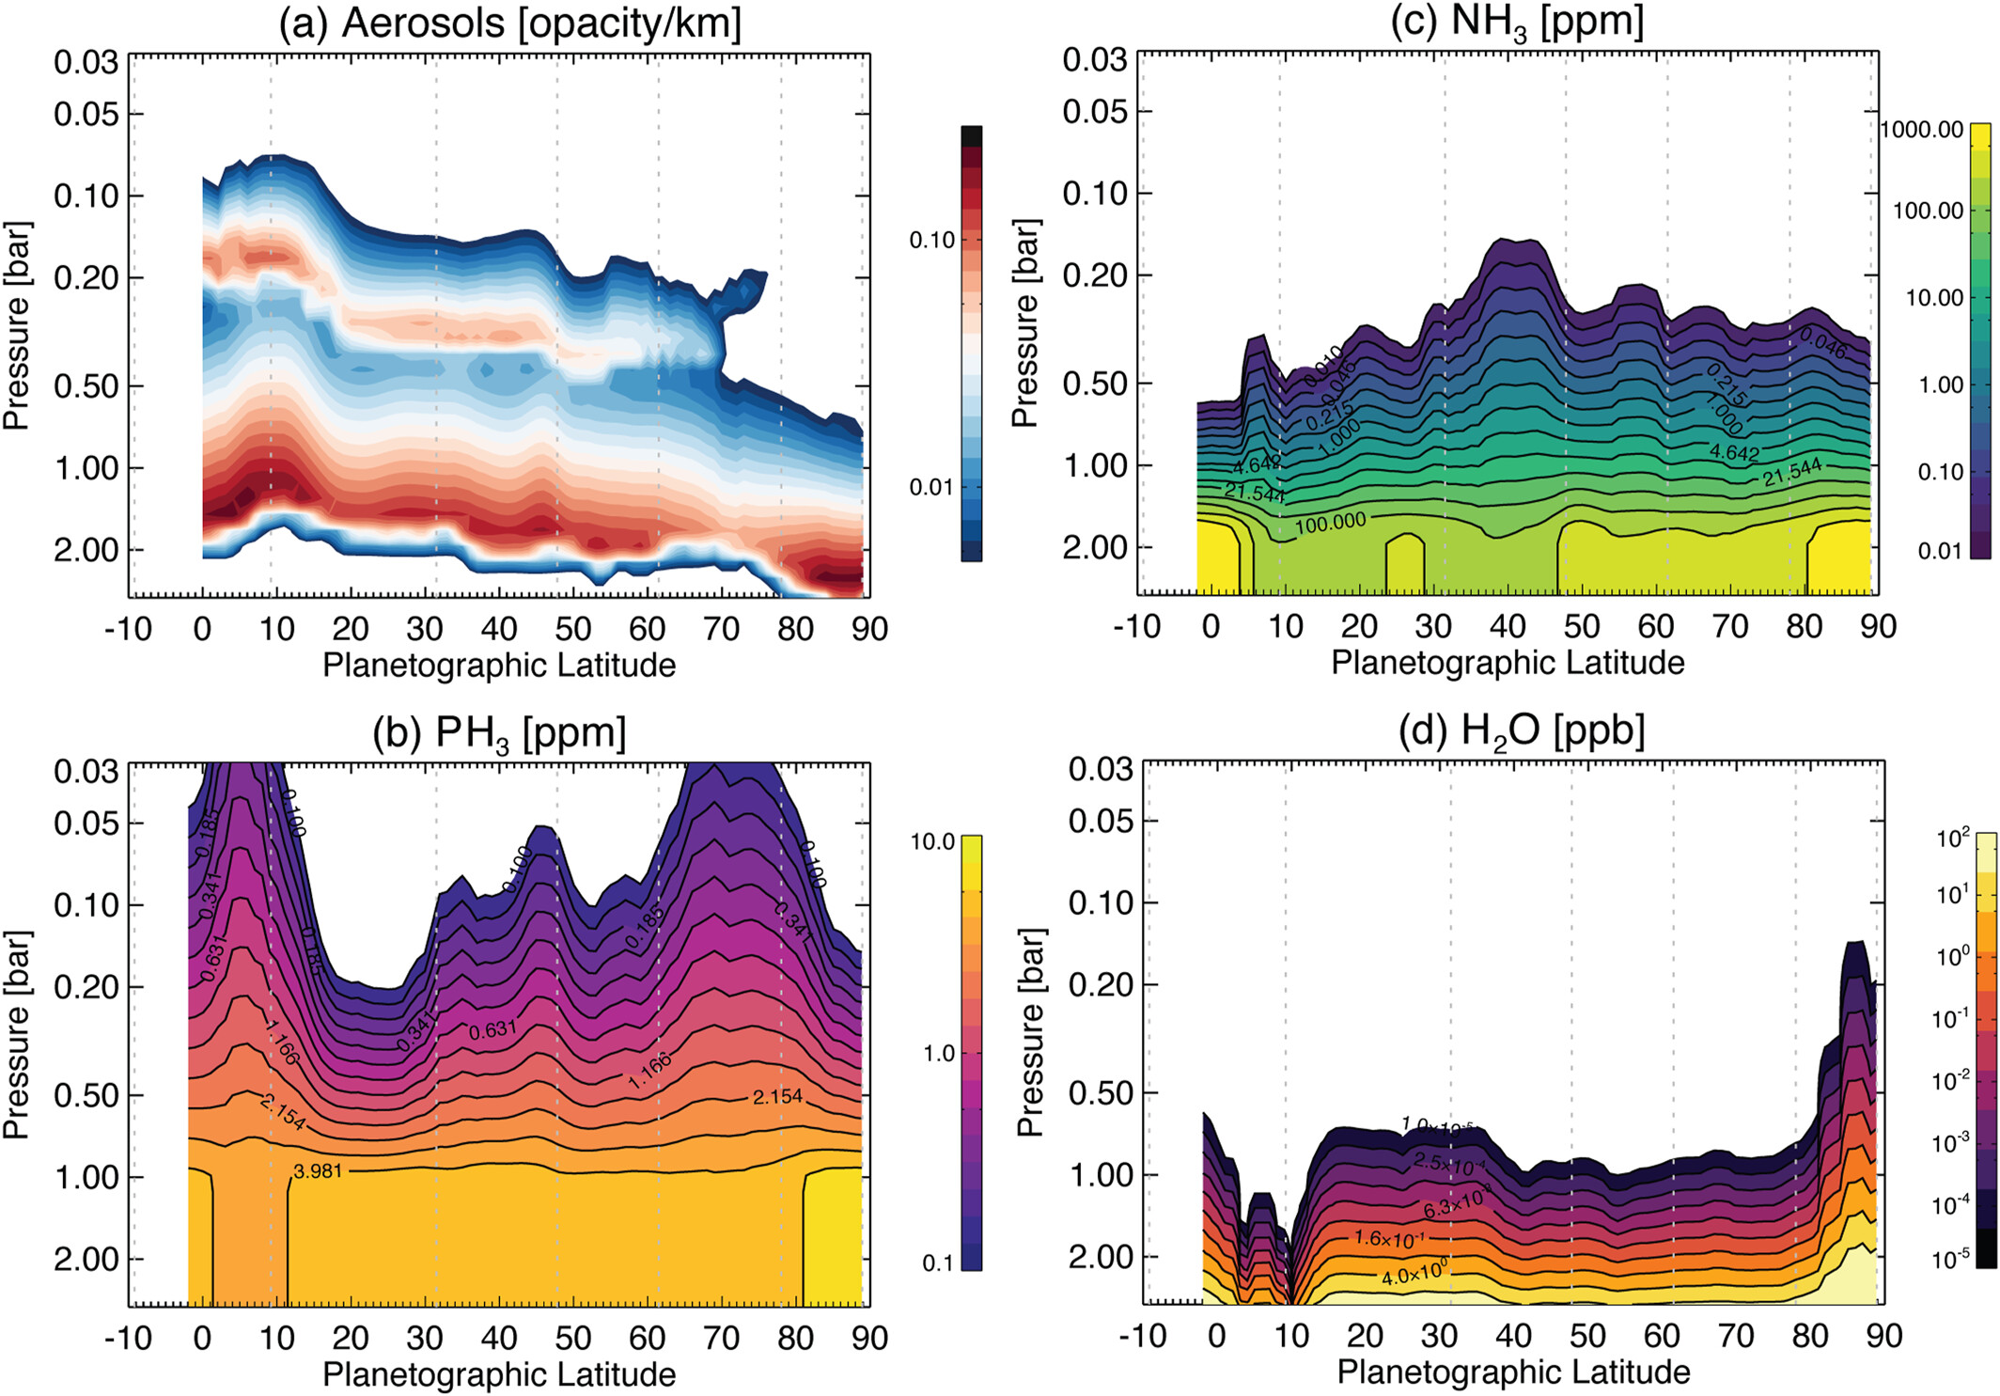
Saturn's Atmosphere in Northern Summer Revealed by JWST/MIRI
JGR Planets, Volume: 128, Issue: 9, First published: 12 September 2023, DOI: (10.1029/2023JE007924)
Notes:
Aerosols, phosphine, ammonia, and water derived from the 4.9–7.3 μm region. Aerosols in panel (a) are plotted in opacity/km at a reference wavelength of 5 μm, calculated following the scheme in Appendix C of Irwin et al. (2022). A logarithmic color bar is used to show structure within the aerosol cross‐section. For the gases in panels (b–d), the contours are also logarithmic to allow for the rapid decline of the abundance with altitude. PH3 and NH3 are provided in ppm, H2O is given in ppb. Vertical dotted lines show the latitudes of tropospheric eastward jets.
IF THIS IMAGE HAS BEEN PROVIDED BY OR IS OWNED BY A THIRD PARTY, AS INDICATED IN THE CAPTION LINE, THEN FURTHER PERMISSION MAY BE NEEDED BEFORE ANY FURTHER USE. PLEASE CONTACT WILEY'S PERMISSIONS DEPARTMENT ON PERMISSIONS@WILEY.COM OR USE THE RIGHTSLINK SERVICE BY CLICKING ON THE 'REQUEST PERMISSIONS' LINK ACCOMPANYING THIS ARTICLE. WILEY OR AUTHOR OWNED IMAGES MAY BE USED FOR NON-COMMERCIAL PURPOSES, SUBJECT TO PROPER CITATION OF THE ARTICLE, AUTHOR, AND PUBLISHER.

