Slide 1
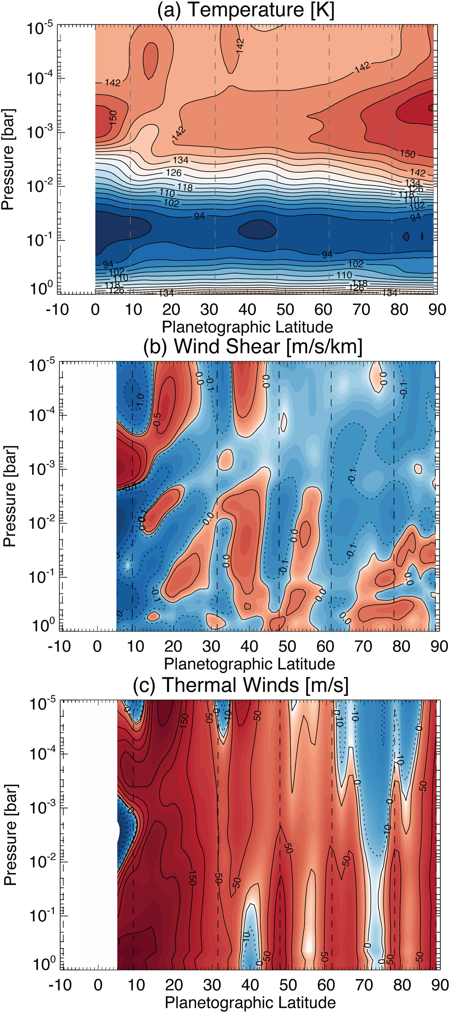
Saturn's Atmosphere in Northern Summer Revealed by JWST/MIRI
JGR Planets, Volume: 128, Issue: 9, First published: 12 September 2023, DOI: (10.1029/2023JE007924)
Notes:
Temperatures, windshear, and thermal winds as a function of latitude derived from Mid‐Infrared Instrument/Medium Resolution Spectrometer spectroscopy. The peaks of cloud‐tracked eastward winds are shown as vertical dashed lines for context. In panels (b, c), regions of negative windshear/westward winds are shown as blue with dotted contours; regions of positive windshear/eastward winds are shown as red with solid contours. Temperature contours are every 4 K; windshear and wind contours are logarithmic to show structure, but windshears are labeled at ± 0.1, ±0.5, and ±1.0 m/s/km; winds are labeled at 10, 50, 100, 150, and 200 m/s. Absolute values for derived thermal winds are subject to significant uncertainties related to the integration of the thermal wind equation (Fletcher et al., 2016), so should be used as a guideline to trends only.
IF THIS IMAGE HAS BEEN PROVIDED BY OR IS OWNED BY A THIRD PARTY, AS INDICATED IN THE CAPTION LINE, THEN FURTHER PERMISSION MAY BE NEEDED BEFORE ANY FURTHER USE. PLEASE CONTACT WILEY'S PERMISSIONS DEPARTMENT ON PERMISSIONS@WILEY.COM OR USE THE RIGHTSLINK SERVICE BY CLICKING ON THE 'REQUEST PERMISSIONS' LINK ACCOMPANYING THIS ARTICLE. WILEY OR AUTHOR OWNED IMAGES MAY BE USED FOR NON-COMMERCIAL PURPOSES, SUBJECT TO PROPER CITATION OF THE ARTICLE, AUTHOR, AND PUBLISHER.

