Slide 1
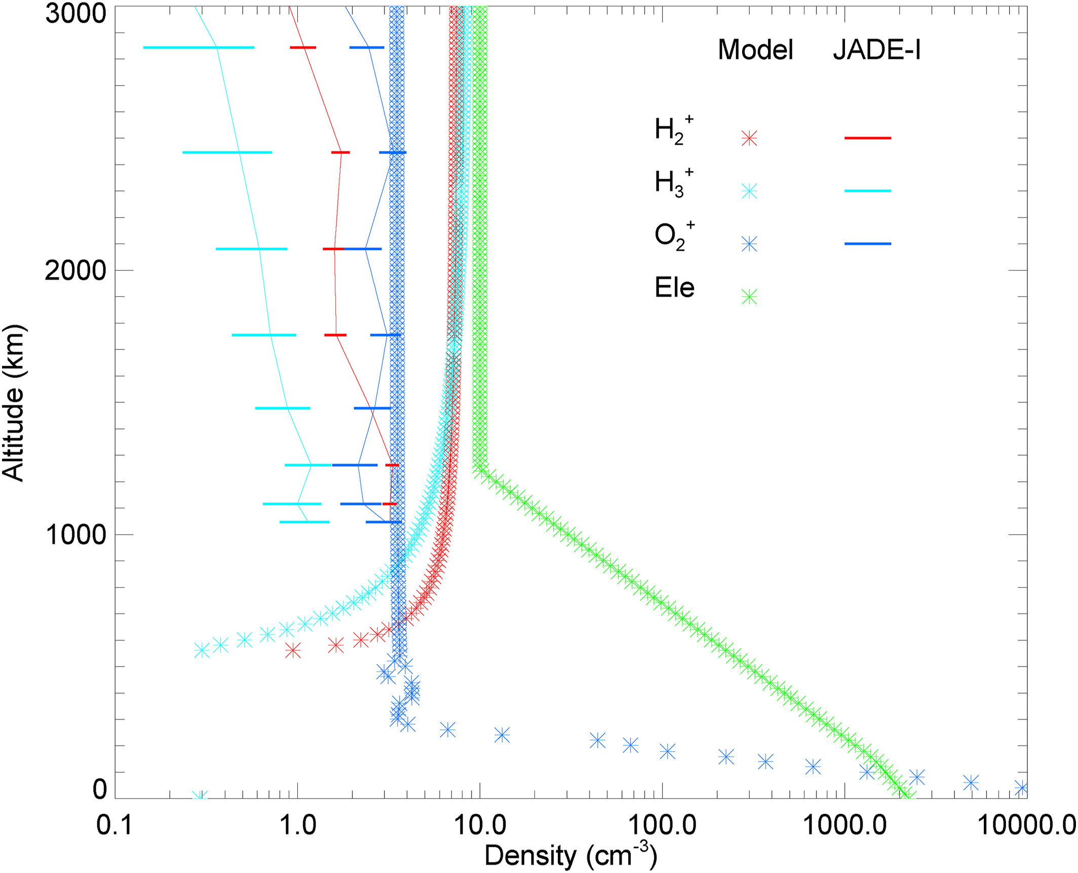
Magnetospheric‐Ionospheric‐Atmospheric Implications From the Juno Flyby of Ganymede
JGR Planets, Volume: 129, Issue: 4, First published: 08 April 2024, DOI: (10.1029/2023JE007859)
Notes:
The modeled ionospheric profiles of H2+ (red), H3+ (magenta), and O2+ (blue) are compared to the acquired JADE ion outflow data (same colors, but marked with lines and error bars) in the northern polar cap. Also shown for comparison are the Juno egress (green) radio occultation profiles (Buccino et al., 2022: Dustin Buccino, 2022; Buccino, 2016). The ionospheric variance is indicated by the disagreement in the total ion density of the model when compared to the total radio ‐ occultation electron density. Note that the JADE I ion densities have been reduced by a factor of 2.5 to match the plasma wave derived densities. The factor of 2.5 reduction represents a further uncertainty that is approximately the difference between the model and JADE‐I.
IF THIS IMAGE HAS BEEN PROVIDED BY OR IS OWNED BY A THIRD PARTY, AS INDICATED IN THE CAPTION LINE, THEN FURTHER PERMISSION MAY BE NEEDED BEFORE ANY FURTHER USE. PLEASE CONTACT WILEY'S PERMISSIONS DEPARTMENT ON PERMISSIONS@WILEY.COM OR USE THE RIGHTSLINK SERVICE BY CLICKING ON THE 'REQUEST PERMISSIONS' LINK ACCOMPANYING THIS ARTICLE. WILEY OR AUTHOR OWNED IMAGES MAY BE USED FOR NON-COMMERCIAL PURPOSES, SUBJECT TO PROPER CITATION OF THE ARTICLE, AUTHOR, AND PUBLISHER.

