Slide 1
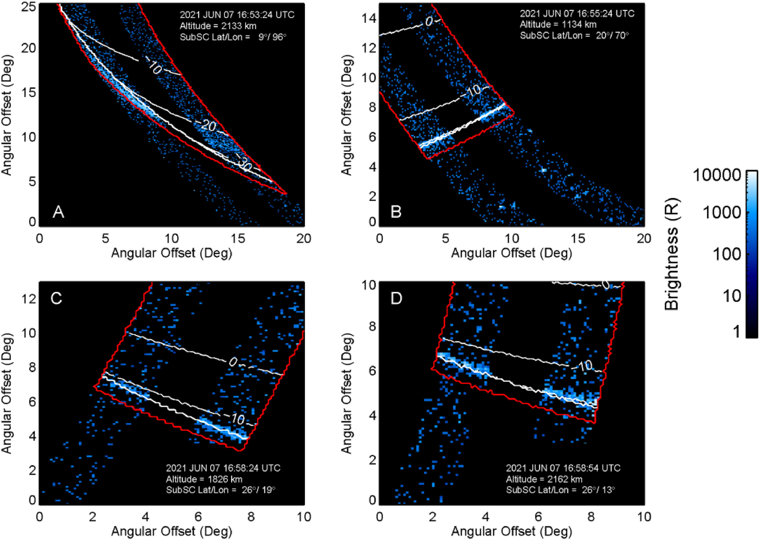
Magnetospheric‐Ionospheric‐Atmospheric Implications From the Juno Flyby of Ganymede
JGR Planets, Volume: 129, Issue: 4, First published: 08 April 2024, DOI: (10.1029/2023JE007859)
Notes:
Similar to Figure 2 from Greathouse et al. (2022), this figure shows the mapping of the auroral emissions relative to Ganymede's limb using only a −17 ms shift in time instead of the −34 ms shift originally used. The white contours show latitudes on Ganymede with the thick bottom most nearly horizontal line of the limb. The red contour shows the 50 km altitude mapping. Only the wide slit emissions are shown for clarity (no data from narrow‐wide slit, see (Greathouse et al., 2022) for further details).
IF THIS IMAGE HAS BEEN PROVIDED BY OR IS OWNED BY A THIRD PARTY, AS INDICATED IN THE CAPTION LINE, THEN FURTHER PERMISSION MAY BE NEEDED BEFORE ANY FURTHER USE. PLEASE CONTACT WILEY'S PERMISSIONS DEPARTMENT ON PERMISSIONS@WILEY.COM OR USE THE RIGHTSLINK SERVICE BY CLICKING ON THE 'REQUEST PERMISSIONS' LINK ACCOMPANYING THIS ARTICLE. WILEY OR AUTHOR OWNED IMAGES MAY BE USED FOR NON-COMMERCIAL PURPOSES, SUBJECT TO PROPER CITATION OF THE ARTICLE, AUTHOR, AND PUBLISHER.

