Slide 1
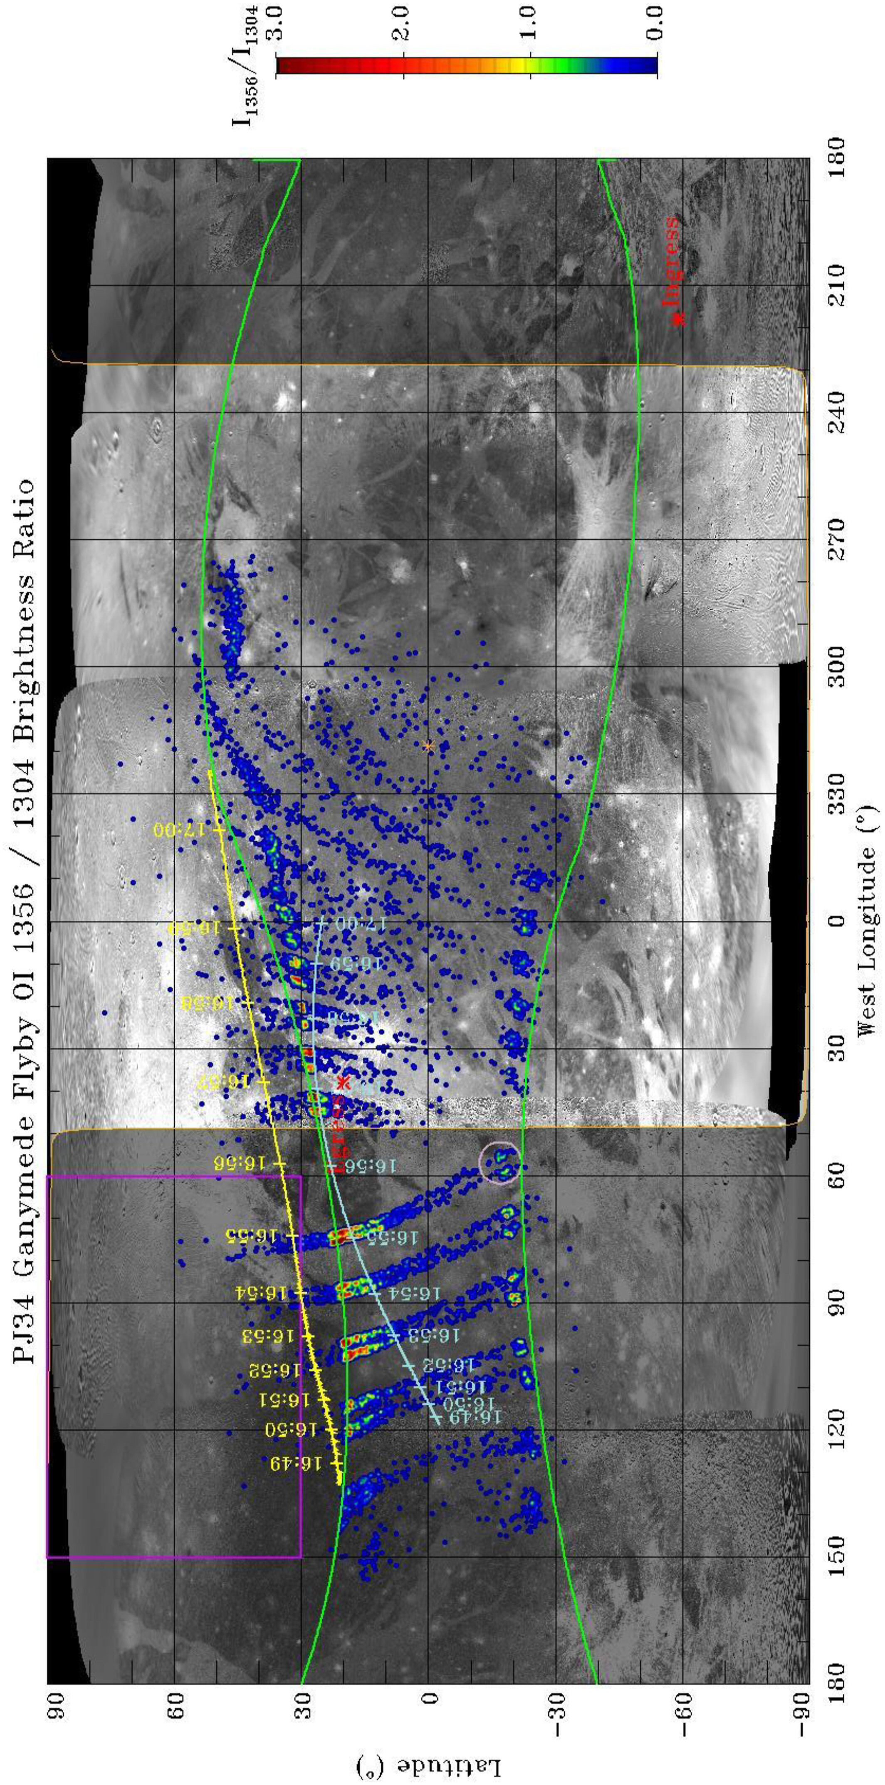
Magnetospheric‐Ionospheric‐Atmospheric Implications From the Juno Flyby of Ganymede
JGR Planets, Volume: 129, Issue: 4, First published: 08 April 2024, DOI: (10.1029/2023JE007859)
Notes:
Brightness ratio map (with color bar on right) of Ganymede's atomic oxygen 130.4 and 135.6 nm emissions observed by Juno‐UVS (Greathouse et al., 2022) on 7 June 2021, overlaid on a USGS map of Ganymede. https://astrogeology.usgs.gov/search/map/Ganymede/Voyager‐Galileo/Ganymede_Voyager_GalileoSSI_global_mosaic_1km. The 130.4/135.6 nm brightness ratio of the better‐observed northern aurora decreases at locations nearer to the sub‐solar point (orange asterisk). This decrease is expected for a global O2 atmosphere that becomes dominated by sublimated H2O in the sub‐solar region (Roth et al., 2021). The poleward edge of the auroral emissions is expected to be in close proximity to the last closed field lines of Ganymede's magnetosphere, and MHD models based on flyby conditions (Duling et al., 2022) (green lines) predict auroras in good agreement with the Juno‐UVS observations, at least in the downstream hemisphere. The sub‐spacecraft (aqua line) and MHD model (Duling et al., 2022) magnetic (yellow lines) footprints of Juno during the flyby are shown, with 1‐min tick marks labeled by the UTC time (hh:mm). The ingress and egress ionospheric occultation locations are noted with red symbols at the position of their minimum ray path (Buccino et al., 2022). Note that the average subsolar coordinates over the UVS interval 16:50:39 to 17:04:39 are: latitude = 0.06°, longitude = 318.74°. The deep purple box in the northern open field line region indicates the box over which the emission data was averaged to produce a comparison with the emission model described in the paper. Likewise, the light purple circle shows the location of the auroral vertical profile that was used in comparison with the auroral emission model analysis and is the region that contains the observations displayed in Figure 4.
IF THIS IMAGE HAS BEEN PROVIDED BY OR IS OWNED BY A THIRD PARTY, AS INDICATED IN THE CAPTION LINE, THEN FURTHER PERMISSION MAY BE NEEDED BEFORE ANY FURTHER USE. PLEASE CONTACT WILEY'S PERMISSIONS DEPARTMENT ON PERMISSIONS@WILEY.COM OR USE THE RIGHTSLINK SERVICE BY CLICKING ON THE 'REQUEST PERMISSIONS' LINK ACCOMPANYING THIS ARTICLE. WILEY OR AUTHOR OWNED IMAGES MAY BE USED FOR NON-COMMERCIAL PURPOSES, SUBJECT TO PROPER CITATION OF THE ARTICLE, AUTHOR, AND PUBLISHER.

