Slide 1
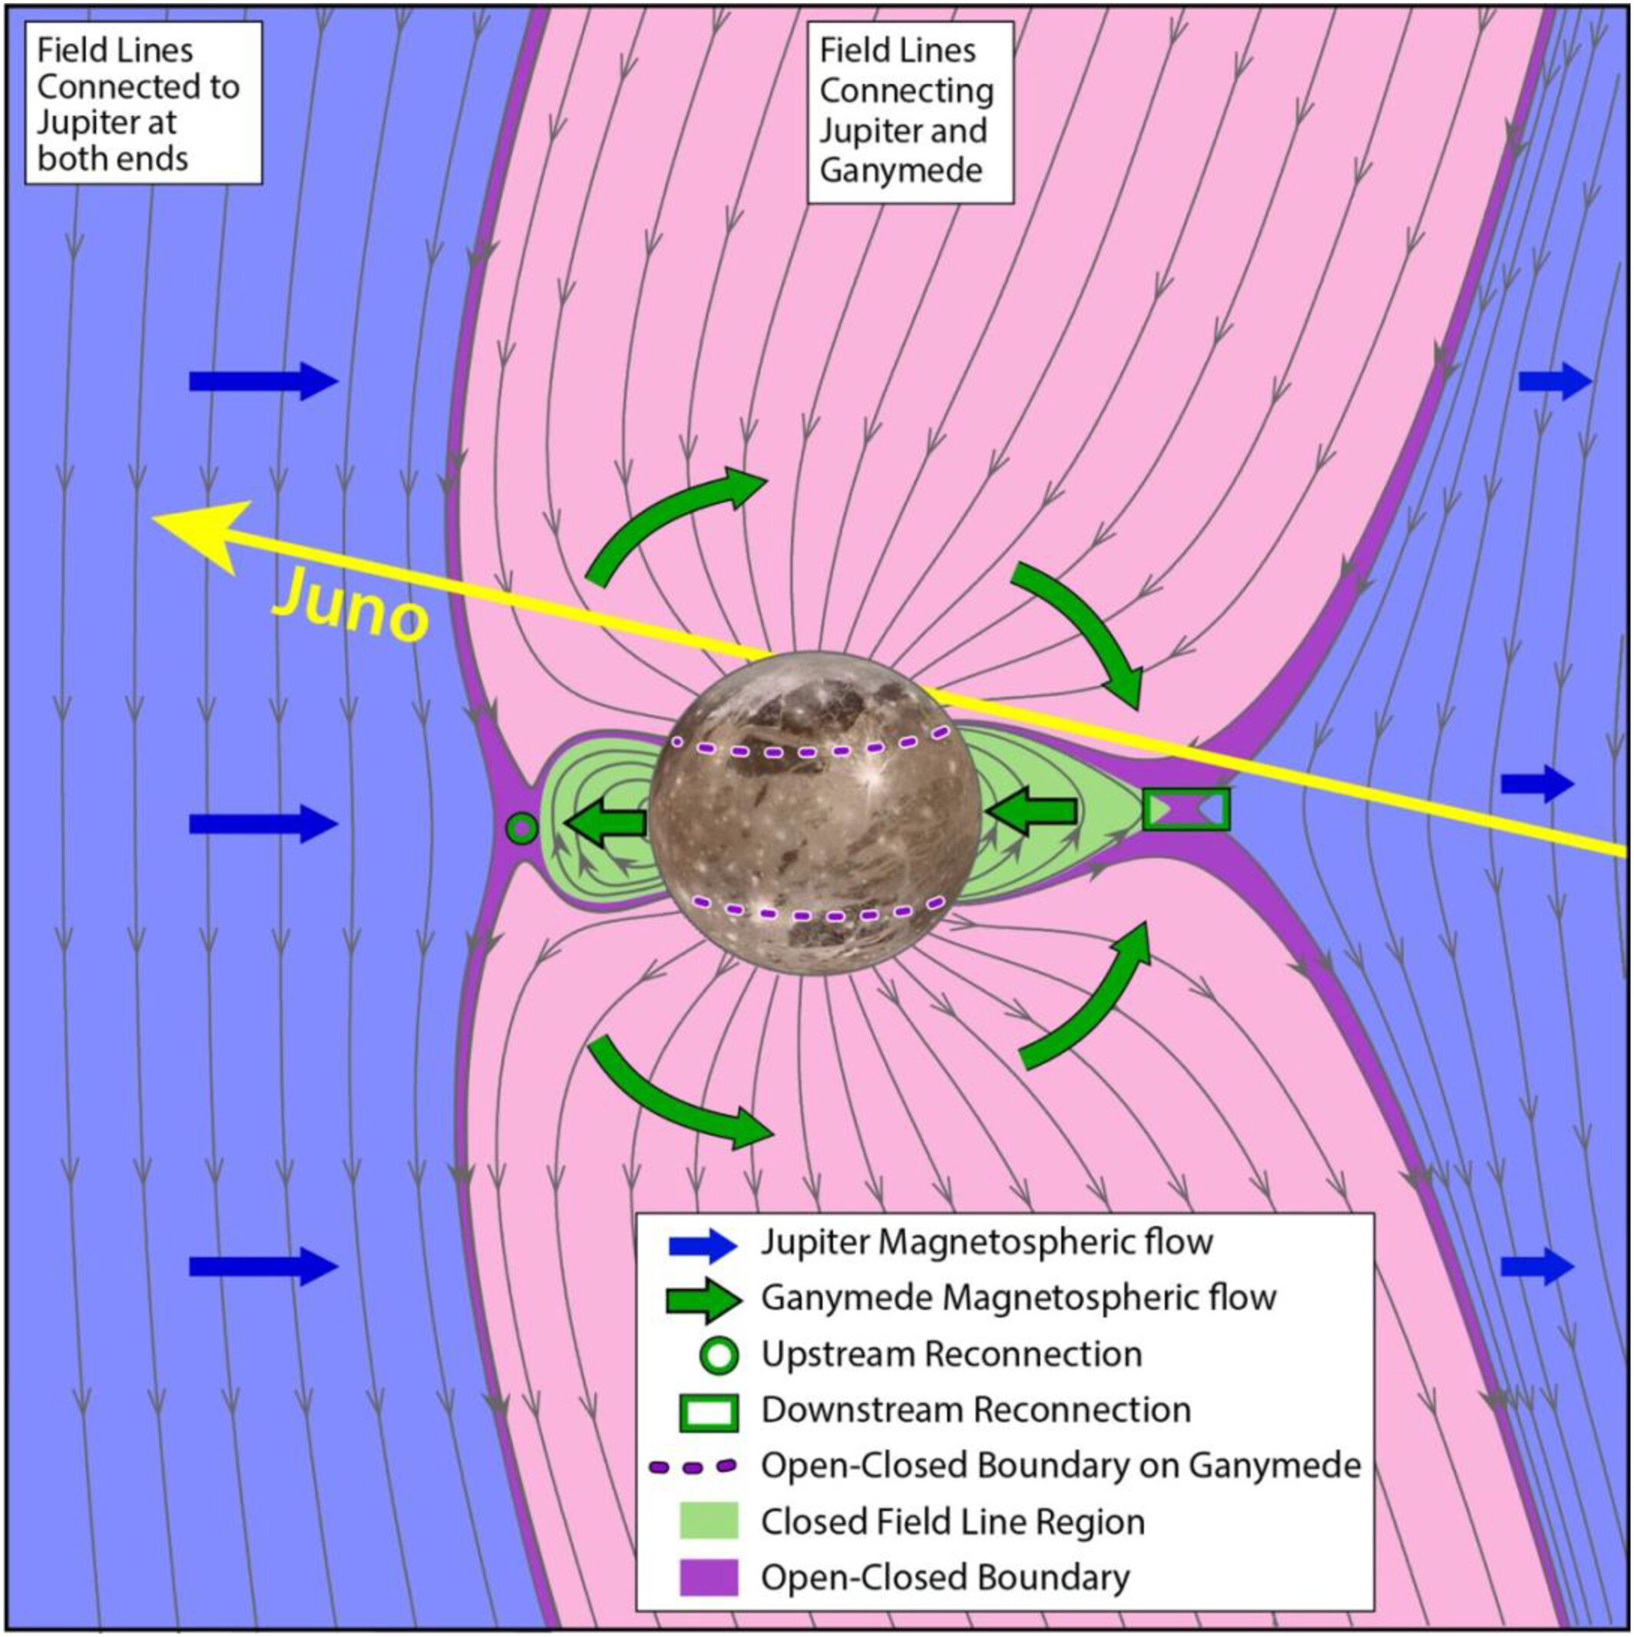
Magnetospheric‐Ionospheric‐Atmospheric Implications From the Juno Flyby of Ganymede
JGR Planets, Volume: 129, Issue: 4, First published: 08 April 2024, DOI: (10.1029/2023JE007859)
Notes:
Artist rendering of the flyby from a magnetospheric interaction point of view. Note; 1) the position in solar local time of Ganymede in its orbit about Jupiter is 22 hr. 2) The angular offset of the plasma disk with respect to the orbital plane is ∼10° and Ganymede's relative position in the plasma disk during the flyby is approximately 1.8° south of the center at the time of encounter. The figure illustrates the plasma and magnetic field directions near Ganymede relative to the Juno spacecraft trajectory. The yellow arrow of Juno's motion has a component in the plasma flow direction (which is all we illustrate here). But note by examining the 3D trajectory in Figure 2, Juno is also moving toward Jupiter during the encounter.
IF THIS IMAGE HAS BEEN PROVIDED BY OR IS OWNED BY A THIRD PARTY, AS INDICATED IN THE CAPTION LINE, THEN FURTHER PERMISSION MAY BE NEEDED BEFORE ANY FURTHER USE. PLEASE CONTACT WILEY'S PERMISSIONS DEPARTMENT ON PERMISSIONS@WILEY.COM OR USE THE RIGHTSLINK SERVICE BY CLICKING ON THE 'REQUEST PERMISSIONS' LINK ACCOMPANYING THIS ARTICLE. WILEY OR AUTHOR OWNED IMAGES MAY BE USED FOR NON-COMMERCIAL PURPOSES, SUBJECT TO PROPER CITATION OF THE ARTICLE, AUTHOR, AND PUBLISHER.

