Slide 1
Philosophical consequences of Quantum Mechanics
Grzegorz Karwasz
Professor of experimental physics
Nicolaus Copernicus University, Torun, Poland
Chair of Didactics of Physics
dydaktyka.fizyka.umk.pl
https://dydaktyka.fizyka.umk.pl/nowa_strona/?q=node/1100
https://dydaktyka.fizyka.umk.pl/Physics_is_fun/

Slide 2
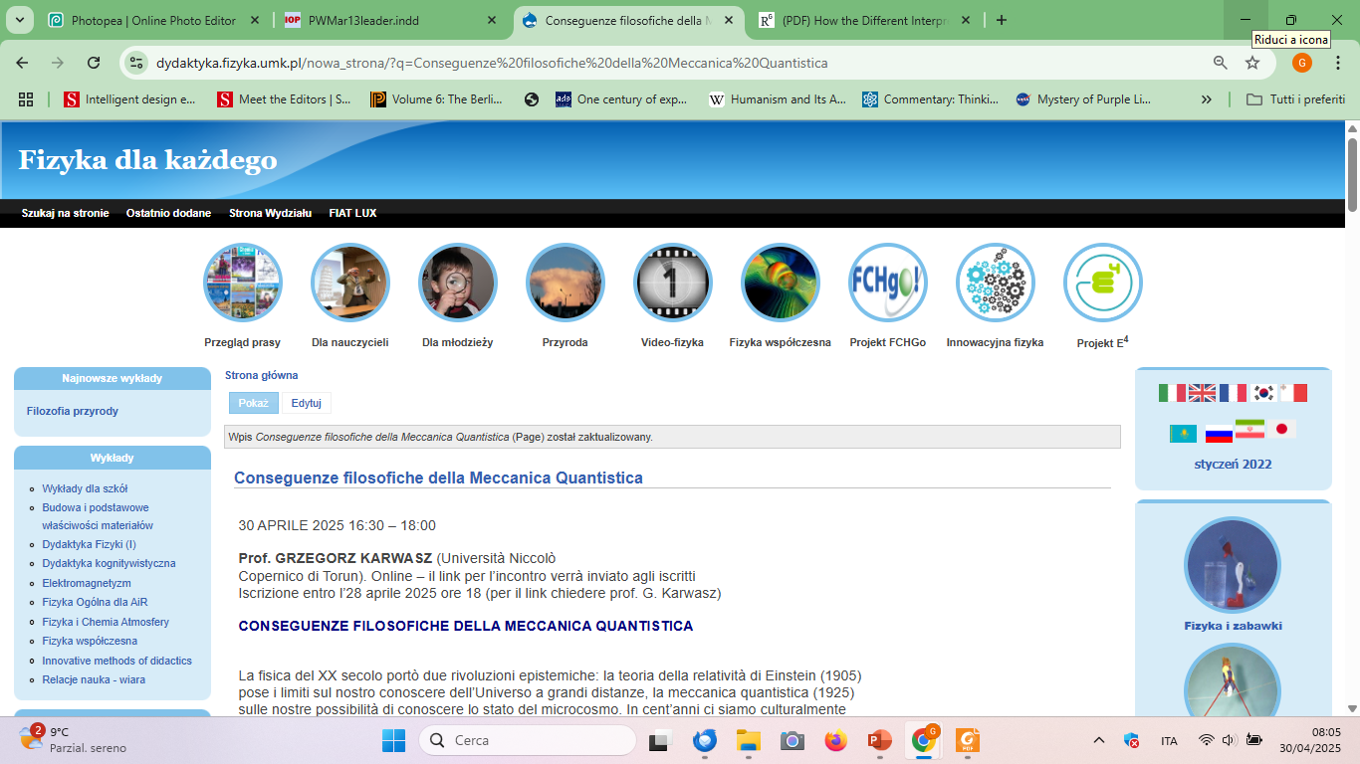
dydaktyka.fizyka.umk.pl

Slide 3
Abstract
PHILOSOPHICAL CONSEQUENCES OF QUANTUM MECHANICS
Twentieth-century physics brought two epistemic revolutions: Einstein's theory of relativity (1905) placed limits on our knowledge of the Universe at great distances, quantum mechanics (1925) on our possibilities of knowing the state of the microcosm. In a hundred years we have culturally become accustomed to this situation of uncertainty. Indeed, Heisenberg's principle of indeterminacy is recalled in various articles not only on physics, but also on philosophy and even theology. Not always in a sensible way.
It seems, however, that we will soon face other challenges. The so-called Einstein-Podolsky-Rosen paradox (1935), confirmed with the Nobel Prize for the experimental works of Aspect, Clauser and Zeilinger (2022), binds the microstates of two objects (e.g. photons) at any distance. From the theoretical works comes a disturbing result: between free will, the principle of causality and the location of events we have to abandon one of three. The difficult choice is yours!

Slide 4
Outline
Teaching physics in Poland
„What Heisenberg’s principle is?”
Lev Pitaevskij: “Do we really need to know everything?”
Galileo: “God speaks to us in two way”
Einstein: “Subtle is the Lord”
GK: “Explain as simple as possible, and even simpler”
A. Raczynski: “Quantum physics still awaits its Copernicus”

Slide 5

EU (2007) „Rocards’ Report”
EU: 50% fall in 10 years

Slide 6
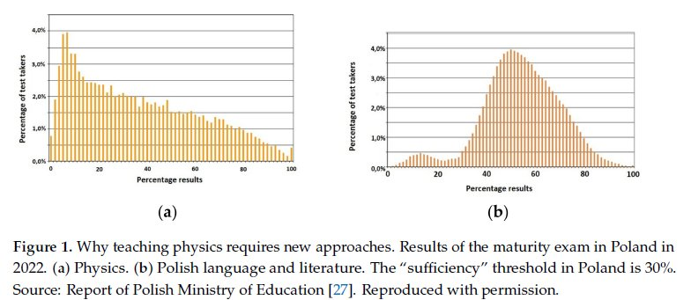
Maturity exam in physics, 2022
(a) Physics (b) Polish language and literature
Zh. Akimkhanova, K. Turekhanova, G. Karwasz, Education sciences, 2023
«Houston, we have a problem»

Slide 7
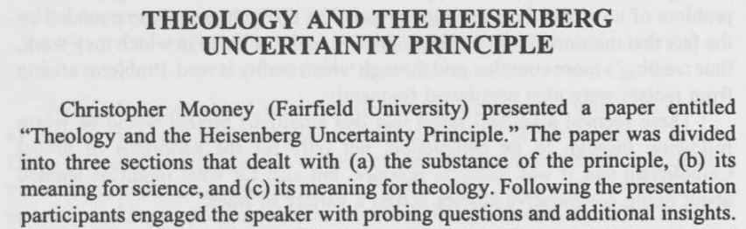
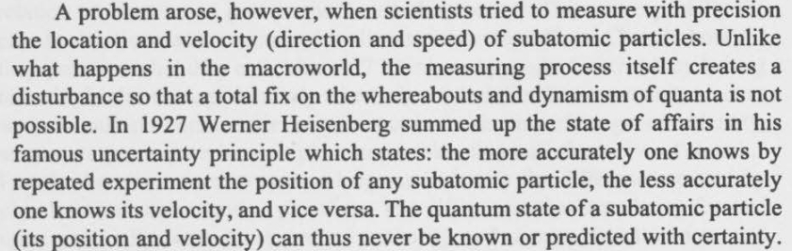
Heisenberg’s principle and God of gaps
Lizabeth Johnson, Fordham University, CTSA Proceedings, 47-1992
https://ejournals.bc.edu/index.php/ctsa/article/download/3763/3337/6771

Slide 8
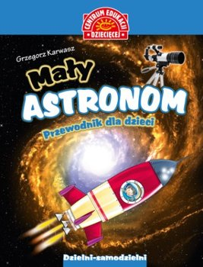
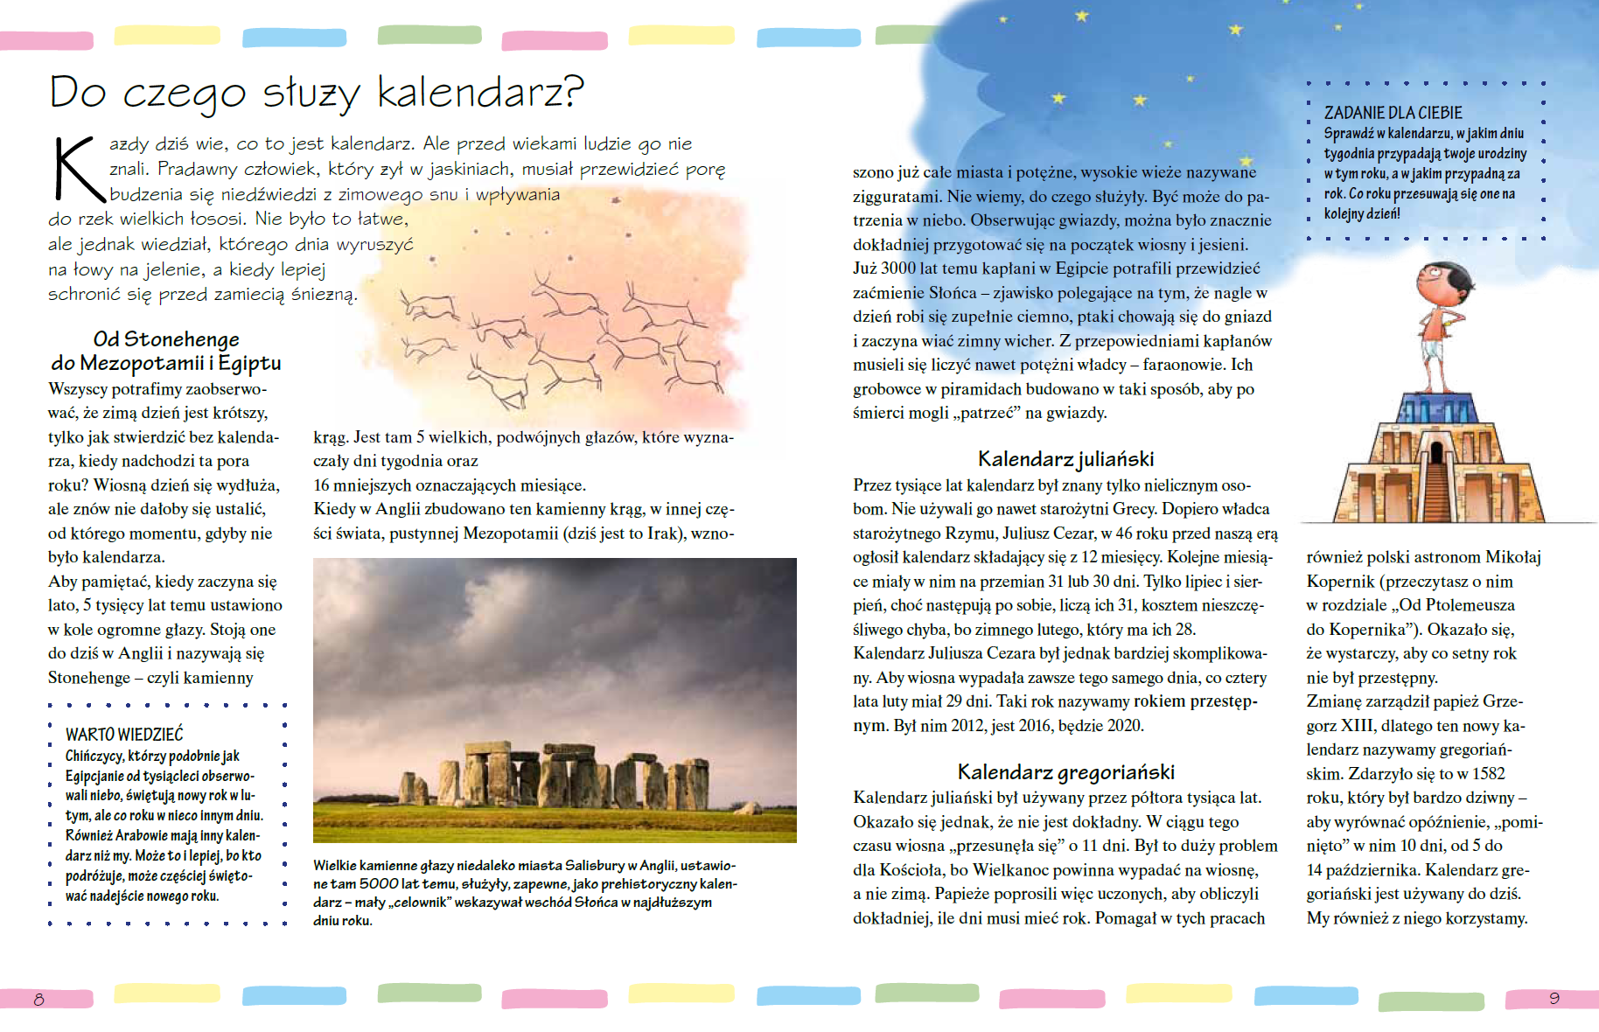
Why do we need a calendar?
G. Karwasz, Astronomy for Kids, Publicat, 2022

Slide 9
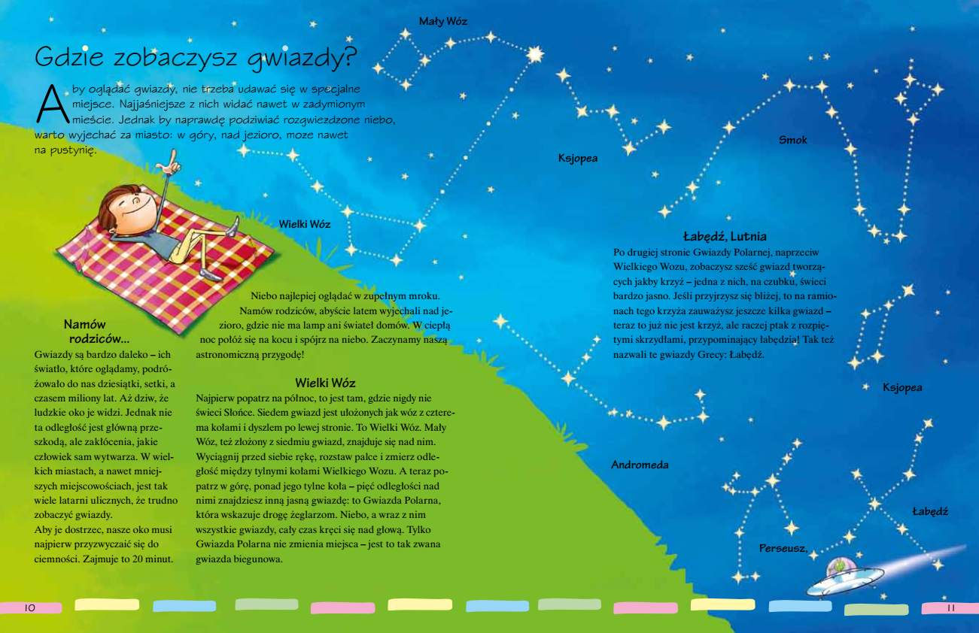
In summer, lay down on a blanket…
G. Karwasz, Astronomy for Kids, Publicat, 2022

Slide 10
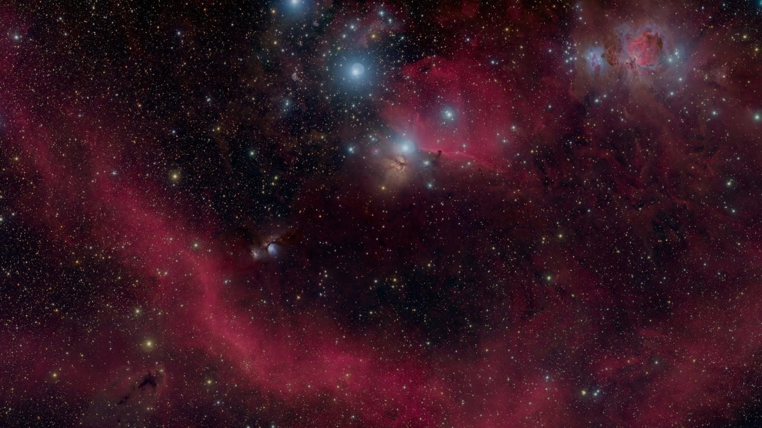
Copernicus: “and what could be more beautiful than the sky?”
„Nebulosa” di Barnard (costellazione di Orione)

Slide 11
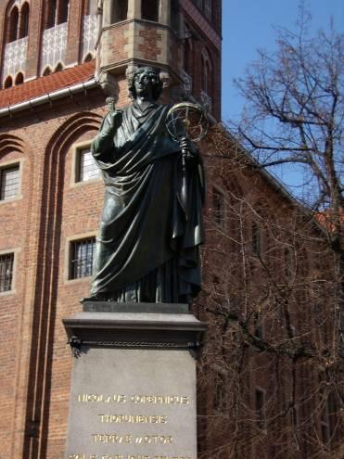
De Revolutionibus (1543)
Among the many and varied studies of letters and arts, with which the minds of men are nourished, I think we should especially embrace—and cultivate with the greatest love—those which deal with the most beautiful and most worthy of knowledge. That is, those which treat of the divine revolutions of the world and of the course, of the magnitudes, of the distances, of the rising and setting of the stars and of the causes of the other celestial phenomena, and which, finally, explain the whole order.
For what is more beautiful than heaven, which contains all beautiful things? Which, moreover, the names Caelum and Mundus themselves indicate, the former referring to purity and ornamentation, the latter to chiselling. Most philosophers, precisely because of his exceptional beauty, have called him visible God.
1473 (Toruń)
-1543 (Frombork)
https://www.saveriocantone.net/profcantone/fisica/pdf/copernico_DE_RIVOLUTIONIBUS_sottolineato.pdf
Nicolao Copernico, Opere, UTET, 1979

Slide 12
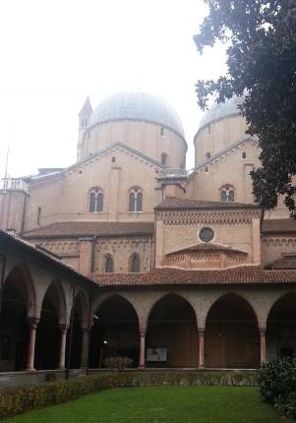
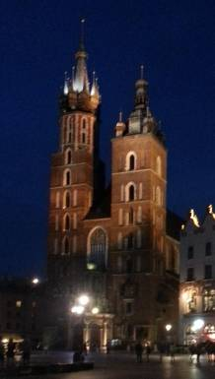
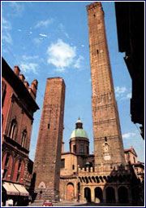
Nicolao Copernico – un bravo (?) studente
Cracovia (1492-1496)
Cattedrale SS. Maria
Canonic law
Doctor in canonic law, Ferrara 30/05/1503
Bologna (1496-1500)
Torre degli Asinelli
Civic law
Padova (1501-1503)
Basilica di S. Antonio
Medicine

Slide 13
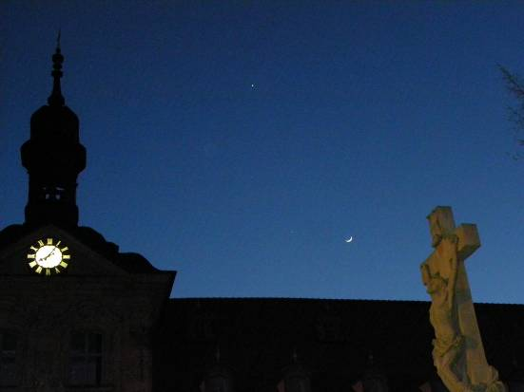
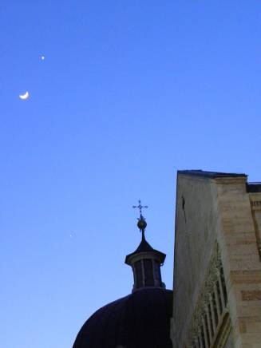
Look into sky: Moon and planets are moving!
Jupiter, Venus and Moon
Bamberg, Germany, 25.03.2012
Trento, Italy, 26.03.

Slide 14
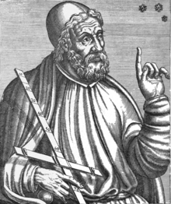
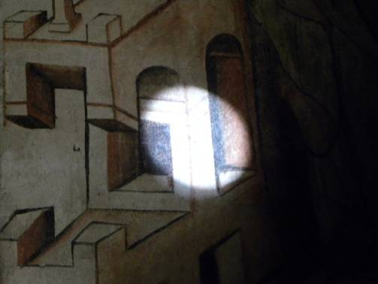
Ptolemeus (151-212): Sun and stars are moving
Katedra Wniebowzięcia NMP w Toruniu

Slide 15
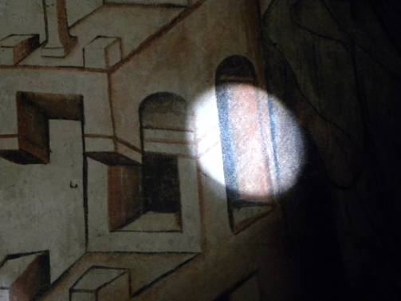
Ptolemeus (151-212): Sun and stars are moving
Katedra Wniebowzięcia NMP w Toruniu

Slide 16
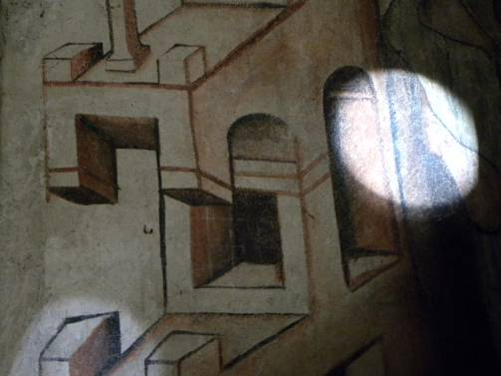
Ptolemeus (151-212): Sun and stars are moving
Katedra Wniebowzięcia NMP w Toruniu

Slide 17
Planets, or wandering stars
G. Karwasz, Toruń’s ex-book, 2020

Slide 18

Roger Bacon (1197):
„Devil induced this error!”
I will now discuss a problem which should become the duty of the Church to solve, which introduces danger and chaos and should no longer be tolerated. What I am aiming for is to improve the calendar that the Church uses.
And since the true equinox is constantly shifting, so that about the year 1481 will be the V Idi Martii (March 5), and so moving further in the direction to the beginning of March and beyond March ... it is necessary that Easter should be about the beginning of March or in February. And this is absolutely impossible, because [...] the real beginning of Lent of the Forty Days will move forward, and in this way, in the real season of Lent, Christians will eat meat, which is the most absurd.
These things are terrible in themselves, and all the more so they are extremely stupid and worthy of ridicule, for it was probably the devil himself who caused this to happen to the Church as a result of his ignorance and carelessness.
(Roger Bacon, Major Treaty, 1197, s. 451)

Slide 19
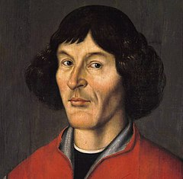
Principle of relativity
“So we leave to the natural philosophers the question of whether the world is finite or infinite. It is enough for us to know that the Earth is closed by poles and a spherical surface. Why, then, do we hesitate to admit to him a movement which corresponds to his own nature, rather than accept the movement of the whole world, the limits of which we do not and cannot know?
Why not say clearly that this phenomenon of daily rotation is something evident in the sky and in the reality on earth, and that the question is just as Aeneas expressed it when he said in Virgil: "We move away from the port, lands and cities recede"?
Because when a ship sails on a calm sea, everything outside, they see people sailing on it, as if it were moving like the movements of a ship, and on the contrary, it seems to them that they themselves are standing still with everything that is with them.
The same can undoubtedly be true of the Earth's movement, and give the impression that the whole world is spinning.”
[1] Ci allontaniamo dal porto, e terre e città retrocedono
https://ilcrepuscolo.altervista.org/php5/index.php?title=Biblioteca:Virgilio,_Eneide,_Libro_III

Slide 20

Justification of the Earth's threefold motion
“In general, it must be assumed that it is threefold. The first, which the Greeks, as we have said, call nychtomerinos, that is, the night-day movement, is a rotation peculiar to day and night, taking place around the earth's axis from west to east, so that one has the impression that the world is turning in the opposite direction.
The second is the annual movement of the center of the earth, which circles the zodiac around the sun, also from west to east, that is, following the order of the signs of the game, running – as we have said – between Venus and Mars with everything that belongs to the earth [flowers, houses, people].
In turn, therefore, the inclination movement goes as the third movement of the Earth, also with a one-year period, but contrary to the order of the zodiac, that is, going in the opposite direction from the movement of the center of the Earth. Thus, because the two motions are almost equal and at the same time opposite, the axis of the earth and the greatest parallel on it, the equator, are turned almost constantly to one and the same side of the world, as if they were motionless. (p.24)”
He calculated the period of the precession as 28512 years: i.e. the correction of the Julis calendar is 3 days every 400 years,

Slide 21
The Four Seasons
G. Karwasz, Toruń’s tex-book for physics, 2020

Slide 22
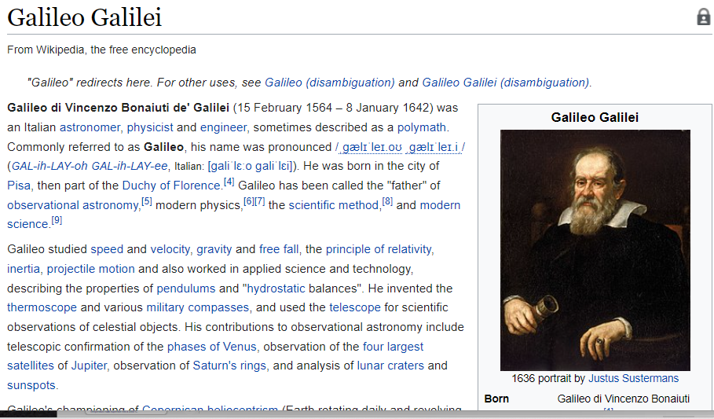
Padre della scienza moderna

Slide 23
Principio di relatività
"Shut yourself up with some friends in the largest room that is under the cover of some large ship, and there make sure that you have flies, butterflies and similar flying animals: let there also be a large pot of water, and in it some little fish; a few buckets should also be suspended at the top, which drop by drop pour water into another vase with a narrow mouth that is placed at the bottom; and while the ship is stationary, watch diligently how those little flying animals with equal speed go towards all parts of the room. [..]
Observe that you will have all these things diligently, although there is no doubt while the vessel is stationary they must not happen in this way: make the ship move as fast as you want; for (even if the motion is uniform and not fluctuating hither and thither) you will not recognize the slightest change in all the effects named; nor will you be able to tell from any of them whether the ship is moving or standing still.“
Dialoghi sopra due massimi sistemi del mondo

Slide 24
Le trasformazioni di Galileo
v’ = v + u
u
Y
Y’
v
v’
O
X
O’
X’
All observers moving at a constant speed are equivalent

Slide 25
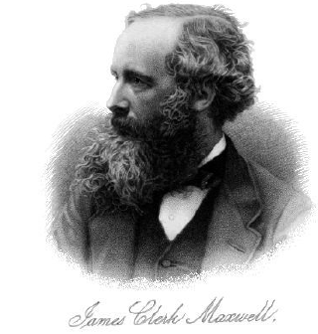
Maxwell’s equations (~1865)
God said:
and there was light!

Slide 26
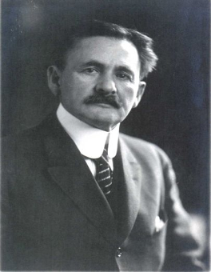
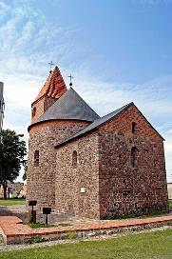
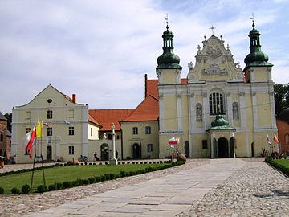
Abraham Michelson – Experiment on the motion of the Earth (Potsdam, 1881)
Born in Strzelno (50 km from Toruń) in 1852.
The family moved with his parents to the United States when he was 3 years old.
First American Nobel Prize (1907)

Slide 27
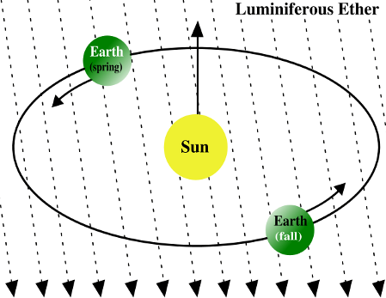
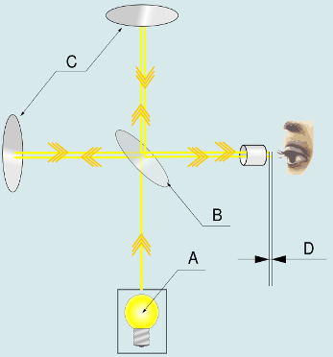
Abraham Michelson – how does the speed of the Earth change in a year?
The speed of the Earth in orbit is 30 km/s.
The speed of light is 300 000 km/s.
We can measure it – with a methodùà based on the interference of light.

Slide 28
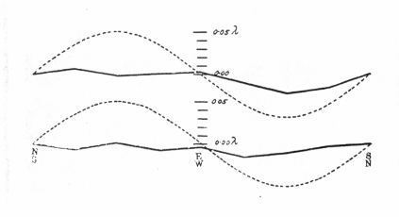
Abraham Michelson & Morley (1887 Cleveland):
The Earth does not move!
Result:
No orbit velocity, within 0.1 of the expected values
? The Earth does not move
? There is no ether
? There's something wrong with the speed of light

Slide 29
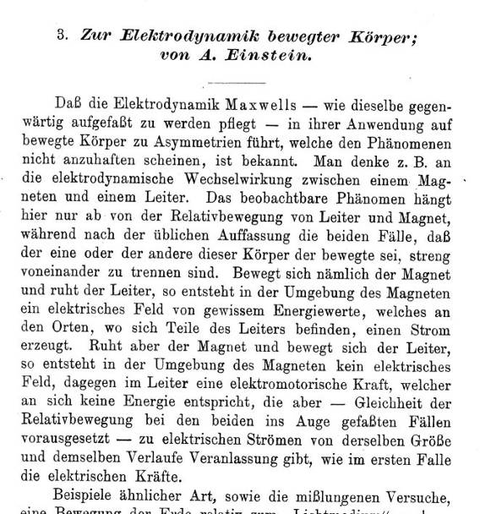
On electrodynamics of moving bodies
(Albert Einstein, June 1905)
Come si trasformano le leggi di Maxwell in un sistema di riferimento in moto (uniforme)?

Slide 30
Einstein, September 1905: "Does the mass of a body depend on its energy?
The speed of light is constant, regardless of stillness or movement
The speed of light is the limit with which we can transport information
We can at will transform energy into mass
E=mc ²

Slide 31
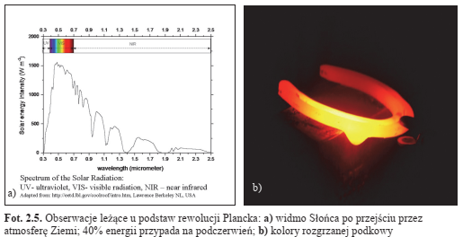

The birth of Quantum Physics (?)
Thursday, 14.12.1900, 4:30 p.m., Berlin, Prussian Academy of Sciences
Where do the colors of the rainbow come from?
To explain this, Planck proposed a model of a black body (a box, with a slit through which the light comes out), at temperature T
But the model didn't work: it had to be assumed, that the EM vibrations inside the box are quantized E = hv (where v is the frequency). For geometric reasons, certain frequencies are not possible.

Slide 32
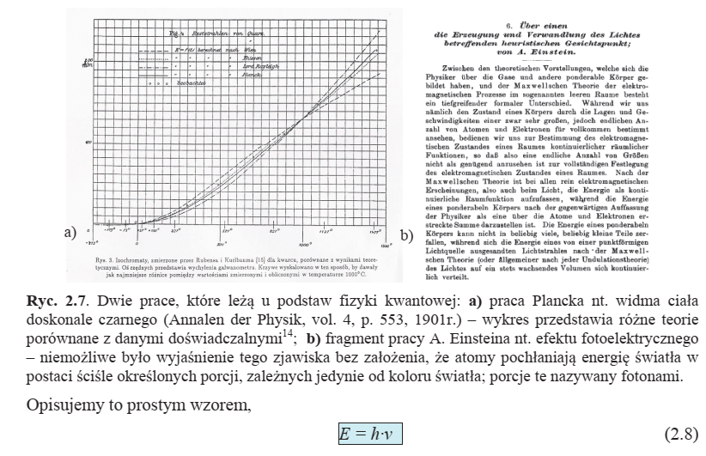
«La fisica è completa»
The framework of Physics is now complete. A few decimal places remain to be filed(? Lord Kelvin ? Abraham Michelson)
Infrared blackbody emission: experimental data and various theories
The whole revolution happened because of this small difference
GK, Torunski porecznik do fizyki. IV Fizyka wspolczesna i astrofizyka, UMK, 2022

Slide 33
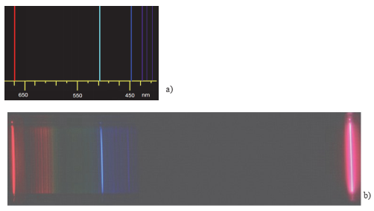
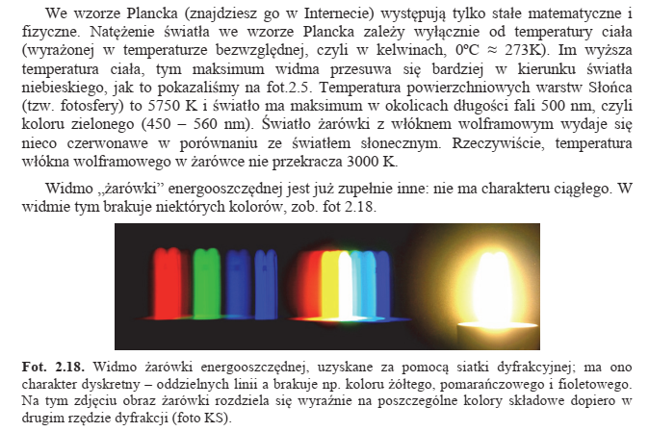
La luce è quantificata
Light emission
is quantified

Slide 34
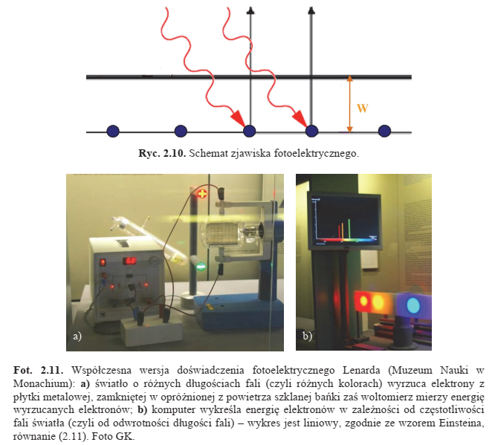

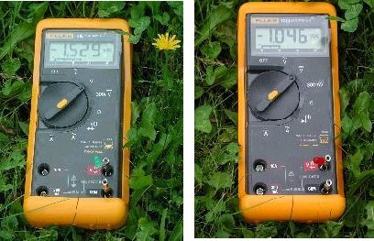
Photoelectric effect: light is a particle
PV potentials
- green diode 1.5 V
- red diode 1.04 V
0.8 V is lost at the junction n-p
Museo di Scienze, Monaco di Baviera, Foto GK
https://cdn.prod.website-files.com/61544fc115d00da1bdba6bbb/627d1f665629d0caa4c0e606_ormeggiare%20una-barca-a-vela.jpg

Slide 35
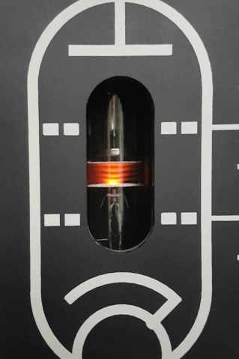
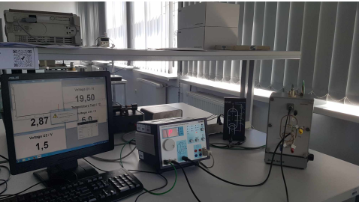
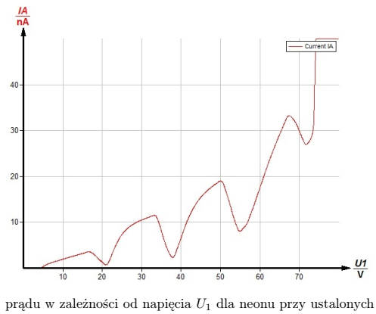
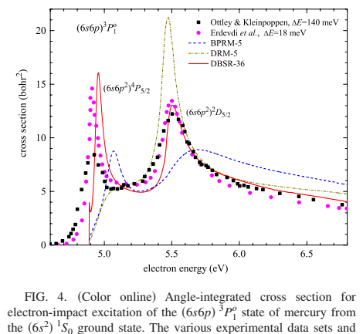
Franck-Hertz’s experiment
I-V dependence in Ne
(B. Jezierska, 2025)
Cross sections for electron scatteirng in Hg
O Zatsarinny, K. Bartschat, PRA (2009)
The loss of energy is quantified
Special thanks to dr Finn Kraft, from Phywe
https://cdn.prod.website-files.com/61544fc115d00da1bdba6bbb/627d1f665629d0caa4c0e606_ormeggiare%20una-barca-a-vela.jpg

Slide 36
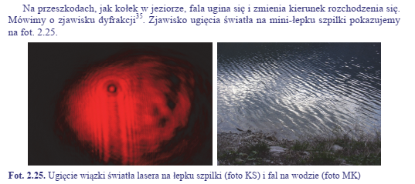
Duality: Light is a wave
Light diffraction on the pin
Lago di Terlago (TN): foto Maria Karwasz
GK, Torunski porecznik do fizyki. IV Fizyka wspolczesna i astrofizyka, UMK, 2022

Slide 37
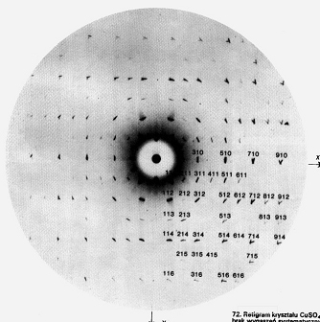
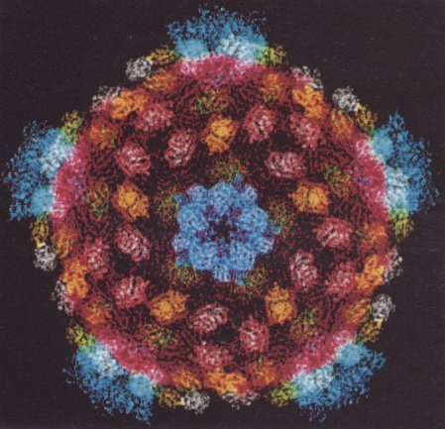
Duality: X-rays are waves
X-ray diffraction
Structure of a virus
https://dydaktyka.fizyka.umk.pl/Wystawy_archiwum/z_omegi/dna.html
https://www.nature.com/articles/43403

Slide 38
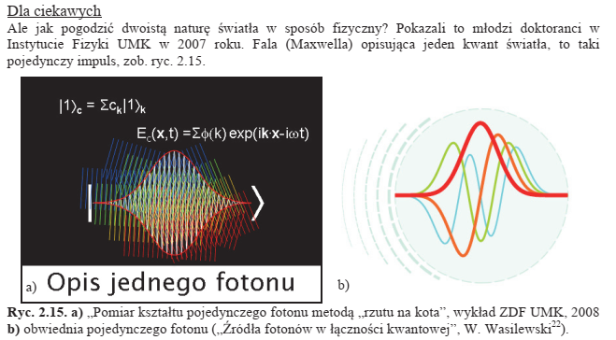
A single quantum of light
GK, Torunski porecznik do fizyki. IV Fizyka wspolczesna i astrofizyka, UMK, 2022

Slide 39
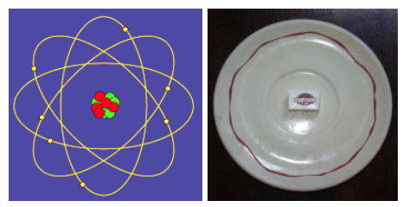
Maybe an electron is also a wave?
Caffeteria Gay Lussac a Parigi
Luise, 7th Comte de Broglie (graduated in history), doctorate in physics (1924):
If light is lichquanten, maybe an electron is also a wave?
λ=h/p
The idea did not appeal to physicists, but to Albert Einstein – yes.
Four years later it was verified with the electron diffraction experiment.
At this point: is Bohr's model simple a circular and standing wave?

Slide 40
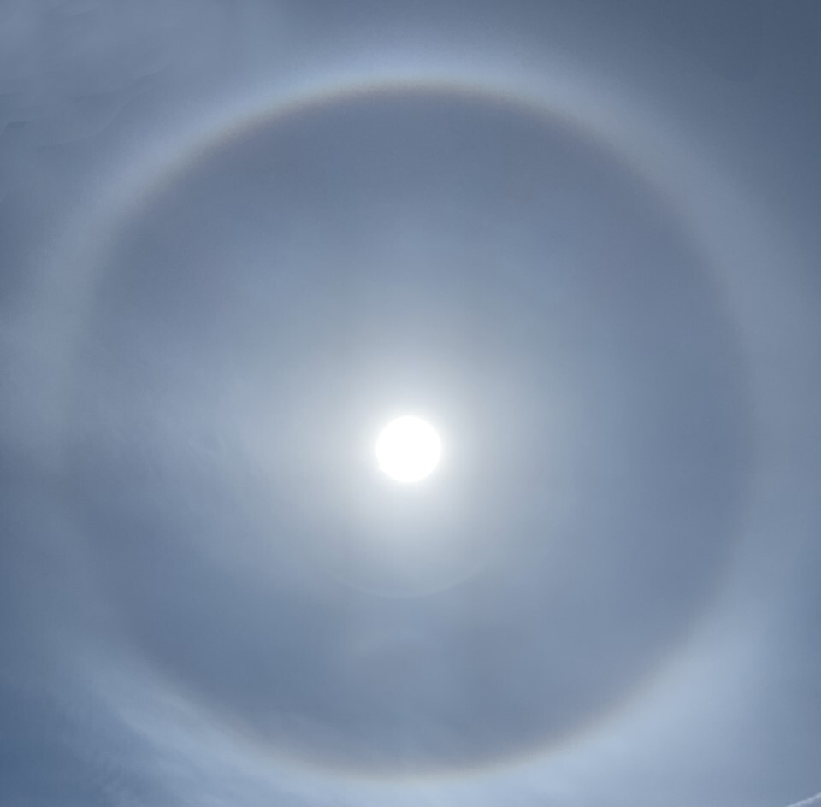
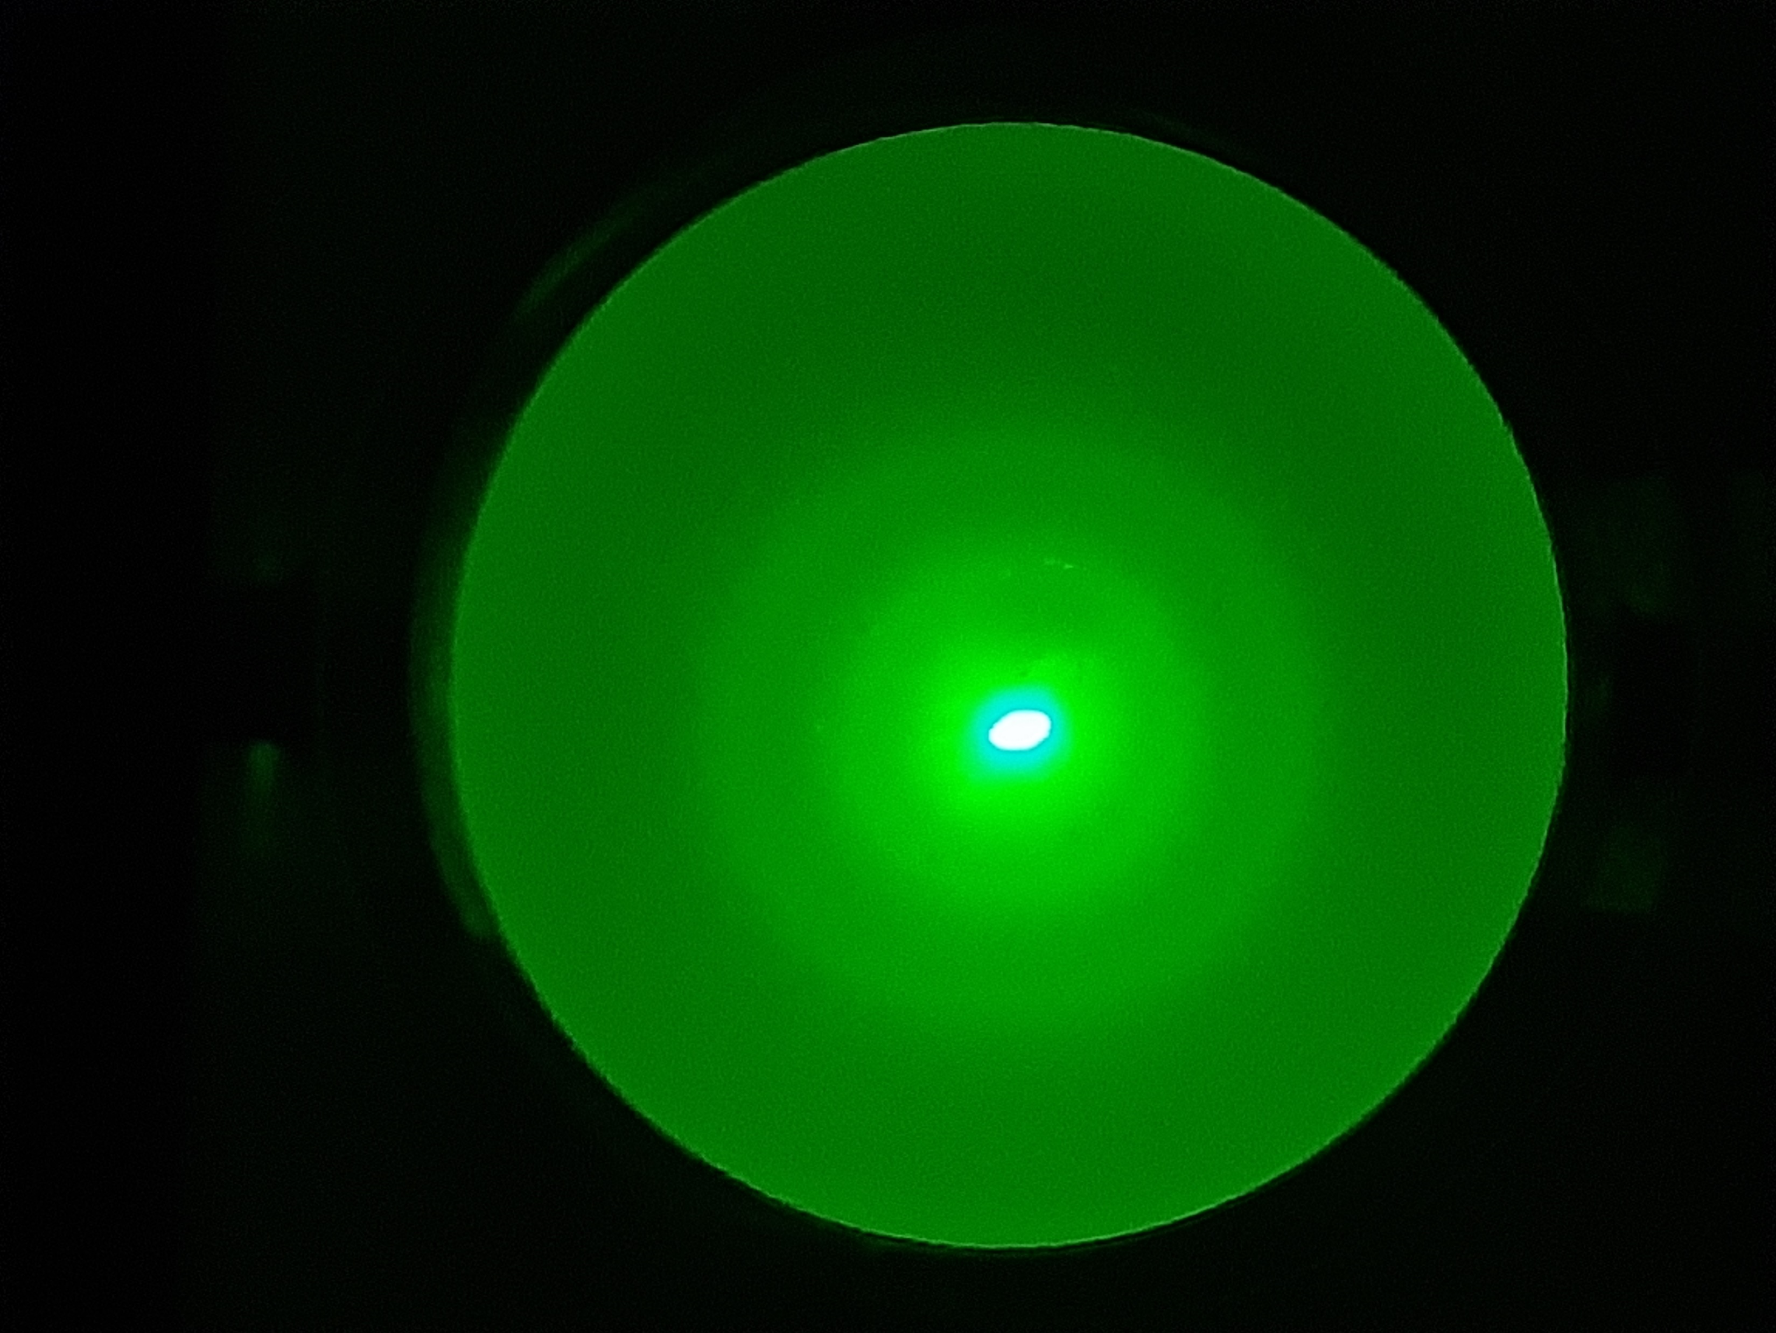
Duality: electron is a wave
Electron diffraction (2 keV) on the Nickel crystal(UMK student lab)
https://www.tmj4.com/news/local-news/eye-to-the-sky-did-you-see-the-sun-halo

Slide 41
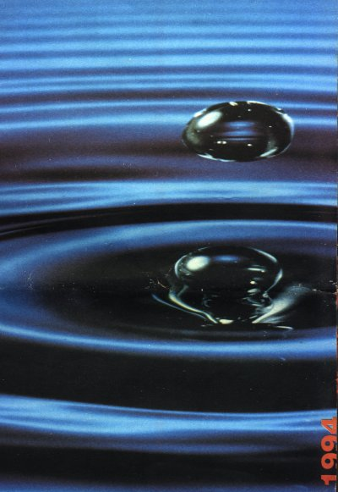
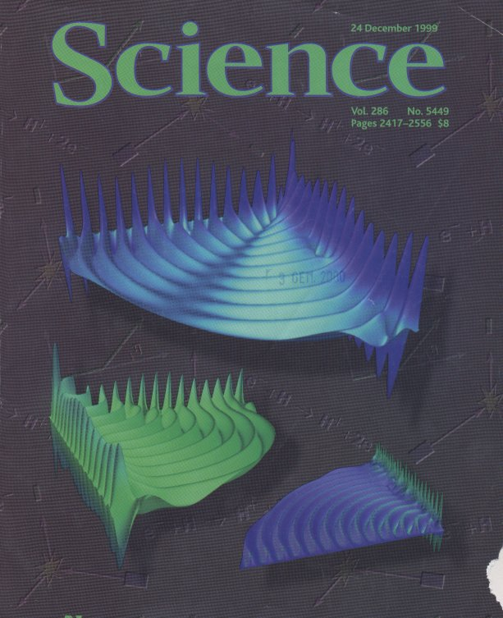
Duality: An electron is a wave
Propagation of an electron after ionization of the hydrogen atom
https://dydaktyka.fizyka.umk.pl/Wystawy_archiwum/z_omegi/dna.html

Slide 42
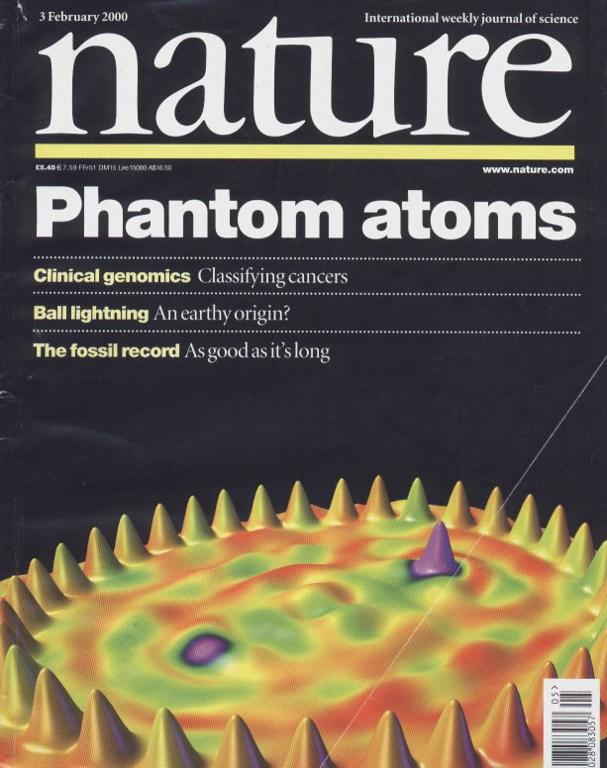
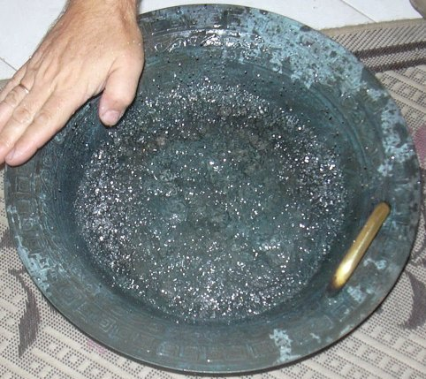
Duality: Light is a wave
https://dydaktyka.fizyka.umk.pl/Wystawy_archiwum/z_omegi/dna.html

Slide 43
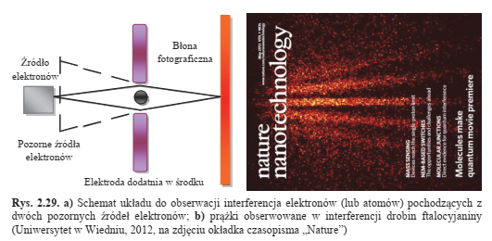
Duality: atoms are also waves
Phthalocyanine Beam Diffraction and Interference (University of Vienna)GK, op. cit.

Slide 44

Electron scattering
Diffusion of electrons in noble gases: argon, krypton and xenon become transparent for electrons at energy about 0.3 eV. The effect discovered by Ramsauer (published 1919 in Danzig, not explainable by Planck's quantum mechanics. Misure GKt.

Slide 45



Schrödinger’s cat
Overlapping principle:
Ψ= √½ ( Ψ+ + Ψ- )
alive and dead at the same time
But when opening the box: it's just alive or just dead
Theoretical physicists speak of the collapse of the wave function.
GK speaks of the projection of the "state in itself" on the level of our observation, that is, of the experiment set up by the scientist. The world is not an isolated entity
More: the wave function is a mathematical (ideal, Platonic) construction, and the cat is a physical reality.
https://dydaktyka.fizyka.umk.pl/Physics_is_fun/posters/koziol6.ppt

Slide 46


Heisenberg: path of an electron?
ΔxΔp ≥ ћ (?)
ΔxΔp ≥ ћ/2 (?)
ΔxΔp ≥ ћ/4 (?)
Two quantities that do not comutate, e.g. energy and time
We have to choose what we want to know.
https://dydaktyka.fizyka.umk.pl/Wystawy_archiwum/z_omegi/kulki.html

Slide 47




Where is the electron?
Interference image, such as the fringes of light observed in a diffraction grating
Do electrons, i.e. particles, behave like light, i.e. like waves?
Or is an electron a wave? What does "is" mean?
https://www.youtube.com/watch?v=PanqoHa_B6c
https://www.hitachi.com/rd/research/materials/quantum/doubleslit/index.html
https://dydaktyka.fizyka.umk.pl/zabawki/files/optyka/okulary.html

Slide 48






Wave function
Soluzione:
u (x, t ) = A sin(ωt – kx), wher A l’ampiezza d’onda, ω – frequenza, ω = 2π/T, dove T – il periodo, k – vettore d’onda, k = 2π/λ, con λ – lunghezza d’onda
Equazione di Schrödinger
Ψ (x, t) – funzione d’onda: il quadrato del suo modulo è la probabilità di trovare l’elettrone nel posto x nel momento t, i – unità immaginaria, h – costante di Planck
https://en.wikipedia.org/wiki/Wave_equation
https://en.wikipedia.org/wiki/Schrodinger_equation

Slide 49
Wrong question
Position of the electron?
Experimental physicist: let's measure it! Let's send a photon and see where it comes back.
Theoretical physicist: insert a position operator x: <x>=∫ Ψ* x Ψ dx
In other words, according to Schrödinger's equation, we do not know where an electron is currently located; we only know the probability that if we measure its position, the (possible) result will be described by the Schrödinger equation. But probability is a distribution of outcomes, with a large number of measures.
Schödinger's equation does not describe the electron, but only provides a possible result of the measurement (made) of its position (credits: Prof. Lev Pitaevski)
And what is the reason why the electron "chooses" a certain path? The question is asked incorrectly. Schrödinger's equation gives us only one probability.
In other words, nature "defends" itself, so as not to provide us with complete information.
Aristotle: the difference between potentiality and actuality

Slide 50


Quantum eraser
We can know through which slit the electron has passed, if we illuminate it with photons. But at this point the image of interference disappears.
If we give up this information, the image reappears. The effect is called the«quantum eraser».
https://en.wikipedia.org/wiki/Quantum_eraser_experiment

Slide 51




Paradosso EPR (1935)
If two quantum states remain entangled even at great distances, and the measurement on one state affects the distant state, then does a dirty (spooky) interaction occur that violates special relativity?
"spukhafte Fernwirkung"
Normal game <3/4
With corellated photons
Einstein wanted to prove that the quantum description is not complete.
But as intrinsic assumptions he assumed: 1) realism (a measure corresponds to physical reality), 2) causality (things do not happen without cause), 3) locality (phenomena occur in a certain place in space-time), 4) the free will of the experimenter. Do they really hold all the assumptions?
Alain Aspect, Closing the Door on Einstein and Bohr’s Quantum Debate, https://physics.aps.org/articles/v8/123
https://en.wikipedia.org/wiki/Bell%27s_theorem

Slide 52
Realism, locality, completeness
"Entanglement is one of the properties of quantum mechanics that led Einstein and others to question its principles. In 1935 Einstein himself, Boris Podolsky and Nathan Rosen, formulated the famous "EPR paradox", a thought experiment that highlighted, precisely as paradoxical, the phenomenon of entanglement. It arose from the assumption of three hypotheses:
the principle of reality, the principle of locality and the completeness of quantum mechanics. For the paradox to be solved, it was necessary that one of the three hypotheses fall, but considering the first two certainly true, as they are evident, the authors came to the conclusion that quantum mechanics is incomplete (i.e. it contains hidden variables)."
"In philosophy, realism is the belief that a reality exists independently of our conceptual schemes, our linguistic practices, our beliefs."
"In physics, the principle of locality states that distant objects cannot have instantaneous influence on each other: an object is directly affected only by its immediate vicinity."
"In mathematical logic, the concept of completeness expresses the fact that a set of axioms is sufficient to prove all the truths of a theory and therefore to decide the truth or falsity of any statement that can be formulated in the language of the theory."
https://it.wikipedia.org/wiki/Entanglement_quantistico

Slide 53

D’accordo di non essere d’accordo (2013)
The quantum state exists before
of the measure?
The answers were 50/50
Maximilian Schlosshauer 2013 Phys. World 26 (03) 29DOI 10.1088/2058-7058/26/03/32
https://iopscience.iop.org/article/10.1088/2058-7058/26/03/32/meta

Slide 54

Quantum certainties?
After a hundred years? Even worse!
But: Today quantum theory underlies all modern technology: from transistors, light-emitting diodes and photovoltaics, to nuclear power, magnetic-resonance imaging, lasers and atomic clocks. It is a seemingly inexhaustible source of new ideas and applications. Quantum-information science, for example, is a fresh take on information processing, and promises computers faster than anything we could currently imagine
Physics World March 2013

Slide 55
Arrow of time?
"In order to be able to predict (in the sense of probability calculation) the result of the repeated measurement, with the result of the first measurement known, we must consider the wave function φ (q) of the state that has formed as the result of the first measurement and the wave function Ψ (q) of the state that we are interested in and that is formed as the result of the second measurement. […]
We see that in quantum mechanics the measurement process has a dual character – it performs different roles for past and future events. For the past – tests the probability of different predicted outcomes based on the measurements taken. For the future – create a new state. In the very nature of the measurement process there is a strong irreversibility.
This irreversibility has an important, indeed – essential significance. As we will see, the fundamental equations of quantum mechanics have symmetry with respect to the inversion of the arrow of time; In this sense, quantum mechanics does not differ from classical mechanics. However, the irreversibility of the measurement process leads to quantum phenomena the physical inequality of the two directions of the arrow of time, i.e. it induces the difference between the future and the past."
In other words: the action of the physique (of a human) changes the arrow of time.
L.D. Landau, E.M. Lifszyc, Meccanica quantistica, PWN Warszawa 1979, p. 34.

Slide 56
David Hume (1711-1776):
Empirical foundation of the causal relationship
The famous analysis of causality begins, which makes Hume one of the great critics of the metaphysical tradition. The discussion has given and continues to give philosophers and epistemologists a lot of trouble, so much so that the problem considered here even in our days is far from resolved. The excerpts are taken from Treatise on Human Nature, cit. pp.86-90, 91-92. 100-06
Let us look at two of those objects which we call cause and effect . . . in order to find that impression which produces such a prodigious idea. I see at once that I don't have to look for it in any of the particular qualities of the objects. […] The idea of causality must derive from some relationship existing between objects. In the first place, they must be contiguous, and that nothing could act on anything else if there were the least interval of time and space between them. […] consists of the time priority of the cause over the effect.
Relations of contiguity and succession are essential.
Nicola Abbagnano, Giovanni Fornero, Protagonisti e testi delle filosofia, Paravia, Torino, 1996, vol. II, p. 526-7

Slide 57
GK: Causality is the most important law, not only in the material world
All modern science criticizes Hume's ideas: belief in the principle of causality is the basis and motivation of all research. "I literally can't see the cause-and-effect relationship between the mosquito on my arm and the itching that follows its departure. But my cause-and-effect reasoning is based on a strong and fundamental belief," writes Patricia Churchland [2016] in How Biology Influence Philosophy.
"Proving" causality is a difficult, or more accurately, impossible task. In other respects, it is enough to prove the existence of an example, say a unicorn, to prove that they exist. Normally, it is more difficult to show the non-existence of unicorns, because you would have to look at the entire globe. In the case of causation, you need to find an event that occurred without cause. The question is always the same: there was no cause, or we simply cannot identify the cause.
G. Karwasz, Between physics and metaphysics – on determinism, arrow of time and causality, Philosophy and Cosmology, vol. 24 (2020) 15-24.
Ontological causality or just epistemic?

Slide 59
The world may be totally deterministic, but we will never know.
The arrow of time could go backwards, but it would be very expensive.
The higher law of natures seems to be causality (!).

Slide 60
Conclusions (I): scientific revolutions
History of Copernicus, Galileo, Copernicus shows that scientific revolutions are made on a social demand
In the case of Copernicus, the reason was the need for the reform of the (ecclesiastical) calendar
Beyond the social necessity, we need a young genius (26 years old Einstein, 27 years old Copernicus) who does not look at the traditional "authorities" (see the case of the young Galileo)
You also need a good teacher (Domenico Novara) with whom the young person (Copernicus) can work

Slide 61
Conclusions (II): matter and form
With E=mc² it loses the sense "is made of". A proton turns into a neutron and vice versa: you just need to provide the energy.
But the processes are regulated by mathematical formulas, so-called Cabbibo-Kobauashi-Maskawa matrices
Are the matrices real or are they ideas?
It also loses its meaning "is found at": it is not found, but it could be found if an appropriate experiment were carried out.
Aristotle's distinction between the actual and the potential resonates here.

Slide 62
Conclusions (III): causality
Ockham, (and later Hume) probably a bit out of spite, in order to refute Thomas' "proofs" for the existence of God, questioned the reasoning: cause → effect, essential in Aristotle's "Physics".
The denial of cause-and-effect relationships would be the end of science, not to mention the devastating consequences for ethics.
In spite of Hume, today's physics has refuted many "certain" concepts, such as empty space-time or the location of events. But not causality.
GK also posits causality as the fundamental law of nature, of course, being a metaphysical statement, i.e. impossible to prove
GK also extends the principle of causality to the immaterial world, i.e. beyond the boundaries of time and space (!)

Slide 63
Conclusions IV: epistemic*
The two revolutions in physics at the beginning of the twentieth century have ousted many physical/philosophical/common-sense terms:
- The absolute character of space and time, bringing them closer to Kant's conception, which are forms of our knowledge, that is, individual
- The certainty of classical physics in its optimistic epistemic determinism
- Certainties in the distinctions between the forms of matter (wave vs. particle)
- It overturned the objectivity (immutability) of the physical world, making it subject to variation due to the cognitive action of man
- Even the locality of events could be "sacrificed" in order to maintain human free will
The only certainty (intuition) that is saved seems to be causality: nothing happens by chance, and indeed – we never know – what our (good and bad) actions can cause

Slide 64


Lev Pitaevski:
«Do we really need to know everything?»
… pianto due alberi: uno per dare la vita e l’altro per infondere la conoscenza di tutto.
GK, On the track of Modern Physics,
https://dydaktyka.fizyka.umk.pl/Physics_is_fun/posters/BEC6.ppt

Slide 65



Paweł Horodecki: «The point is that we know how to operate it, but we do not understand how it works»
This holistic property of compound quantum systems, which involves nonclassical correlations between subsystems, has potential for many quantum processes, including canonical ones: quantum cryptography, quantum teleportation, and dense coding. Entanglement is considered to be the most nonclassical manifestation of quantum formalism.
(1) measurement results are determined by properties the particles carry prior to, and independent of, the measurement realism”; (2) results obtained at one location are independent of any actions performer at spacelike separation „locality”; and 3) the setting of local apparatus is independent of the hidden variables
which determine the local results „free will”

Slide 66
Conclusions (V): philosophical, i.e. existential
Man influences the world, including the arrow of time: for example, through the irreversibility of quantum measurement (Landau), not talking about the irreversibility of man as a biological (and mental) entity
Man would like to dominate the world, but he cannot:
- not for lack of his desire for omnipotence
- but for very precise limits of its science (omniscience), set by the two revolutions of the twentieth century: quantum mechanics and the theory of relativity
Twentieth-century physics teaches us scientific humility: Lev Pitaevski "Do we really have to know everything?"
"Quantum mechanics is still waiting for its Copernicus"
(Andrzej Raczynski, 2024)
What the 21st century will bring? without a doubt, even more surprising revolutions
«Ai posteri l’ardua sentenza.» (Alessandro Manzoni, Il Cinque Maggio ,1821)

Slide 67


The (epistemic) limits of our knowledge
The Earth, no matter how big the sphere is, is nothing compared to the
to the greatness of the sky, of whose limits we do not know,
and probably we can't even know ...
Nicolaus Copernicus, De revolutionibus, Norimberga, 1543
I know, that I don't know nothing
(Socrate 470-399 a.C)
Thank you for your infinite patience!

Slide 68




Tek-books
Astronomy for kids (Poznan, 2018) Scienze e Fede (Roma, 2019)

Slide 69
Test (secondary school & Theology Faculty)
Have you heard of Heisenberg's uncertainty principle?
No
Yes, it says that we cannot get to know the micro world
Yes, it says that we cannot measure with arbitrary precision, for example, the position and momentum of an electron
Yes, it is our cognitive limitation, more philosophical than physical
What does the term wave-corpuscular duality mean?
I do not know
It means that an electron is a wave and a particle
It means that an electron can be a particle and a wave at the same time
This means that, depending on the experiment carried out, wave or corpuscular aspects manifest themselves, e.g. of the electron

Slide 70
Test (secondary school & Theology Faculty)
3. Have you heard of Schrodinger's cat?
a) No
b) Yes, it's a cat that's both alive and dead
c) Yes, it is a cat whose mathematical description is a combination of two wave functions
d) Yes, it's a cat that can be alive or dead when you open the box
4. Have you heard of quantum teleportation?
a) No
b) Yes, you can transmit signals over a distance in instant time
c) Yes, it will be possible to transport humans to distant galaxies in the future
d) Yes, it's a poetic term for quantum entanglement

Slide 71
Tests: results (Liceum, 4th yr)
All together: not bad results
Thanks to Maja Meyer and Marta Nowicka

Slide 72


Lectures for schools
Not phenomenology, but a didactic path:
interactive, constructivist

Slide 73


Interactive exhibitions
«Gong downhill",Rogoźno, 2014

Slide 74


From the real world to its mathematical representation (abstraction)
VIII LO Toruń, fot. J. Kosicki

Slide 75
School competition

Slide 76



Interactive theatre: «Robot’s fairytales» by S. Lem

Slide 77

Einstein: “Explain everything as simple as possible, but not simpler”
«Dear Albert: Leave the didactics to experts in didactics»
hyper-constructivism
neo-realism

Slide 78
Bibliografia
P.T. Mathews, Introduction to Quantum Mechanics, McGraw, New York, 1963
L.D: Landau, E.M. Lifshitz, Short Course of Theotetical Physics, Mosca, 1972l
Jean-Jaccques Greffet, Physique, Ecole Centrale Paris, 1ere Année, 2003-2004
Lev D. Landau, Evgenij M. Lifsits, Fisica Teorica 3. Meccanica quantistica. Teoria non relativistica, Editori Riuniti Univ. Press, 1982
James Walker, 3 Dialogo con la Fisica, Pearson Education, 2018
Antonio Cafario, Aldo Ferilli, Nuova Fisica per licei scientifici, vol3, Le Monnier 2001.
Leonard Susskind, Art Friedman, Meccanica quantistica. Il minimo indispensabile per fare (buona) fisica. Raffaello Cortina, Milano, 2015.
Sredniawa, Mechanika kwantowa, PWN 1980
Werner Heisenberg, Der Teil und das Ganze. Gespräche im Umkreis der Atomphysik, Carl Hauser, Munchen, 1977
Gian Carlo Ghirardi, Un’occhiata alle carte di Dio. Gli interrogativi che la scienza moderna pone all’uomo, Il Saggiatore, Milano 2009
https://it.wikipedia.org/wiki/Teorema_di_Bell
https://physicsworld.com/a/curiouser-and-curiouser-delving-into-quantum-cheshire-cats/

