Slide 1

University of Trento
Master of Science in Environmental Meteorology https://international.unitn.it/environmental-meteorology
A.A. 2023-24
Environmental Physical Chemistry
Biogeochemical cycles
Daniela Ascenzi
Dept. Physics, University of Trento, Italy
e-mail: daniela.ascenzi@unitn.it
Notes:
Books:
Jacobson-Charlson Earth System Science: chapt 1.5, chap.4, chap. 11, 12, 13, 14 for the elements cycles
Hewitt-Jackson Chap.4 (but very generic)
TO BE ADDED>

Slide 2
Bibliography
Book chapters:
Jacobson-Charlson “Earth System Science”
chapt 1.5, chap.4, chap. 11, 12, 13, 14 for the elements cycles
Hewitt-Jackson (Chap.4)
Wallace & Hobbs «Atmospheric Science» (Chap. 2 – The Earth system)
Notes:
+ Jacobson p.279
+ Hewitt Jackson p89
https://www.slideshare.net/maleigh/grade-11-earth-life-science-earth-systems-subsystems
+ L8 biogeochem
+ Lec20
+ Biogeo_Clect

Slide 3
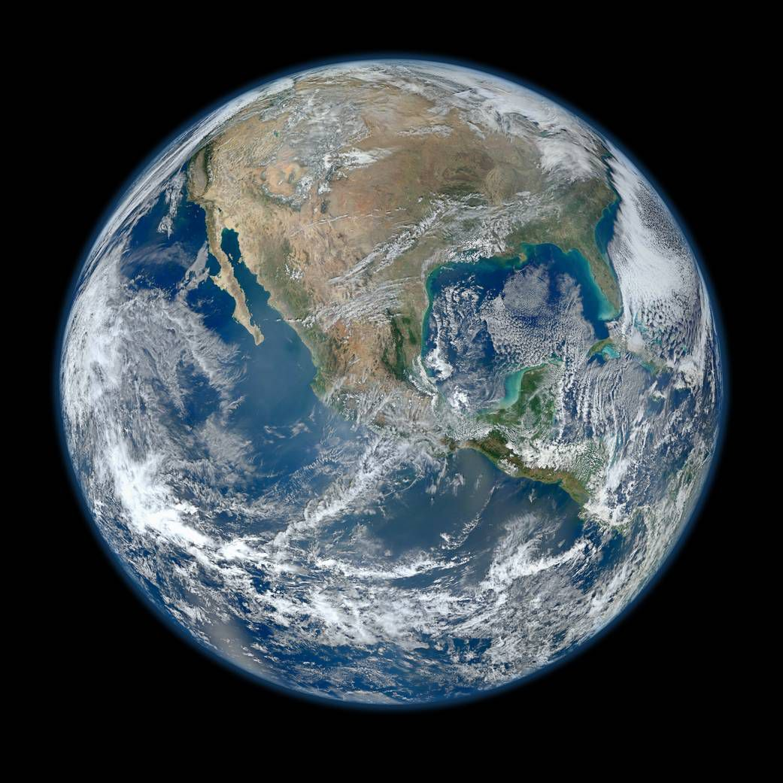
Earth: matter does not come and go
Our planet is a thermodynamic CLOSED system
System: a set of interconnected components that are interacting to form a unified whole
CLOSED: exchange of energy but no exchange of matter

Slide 4
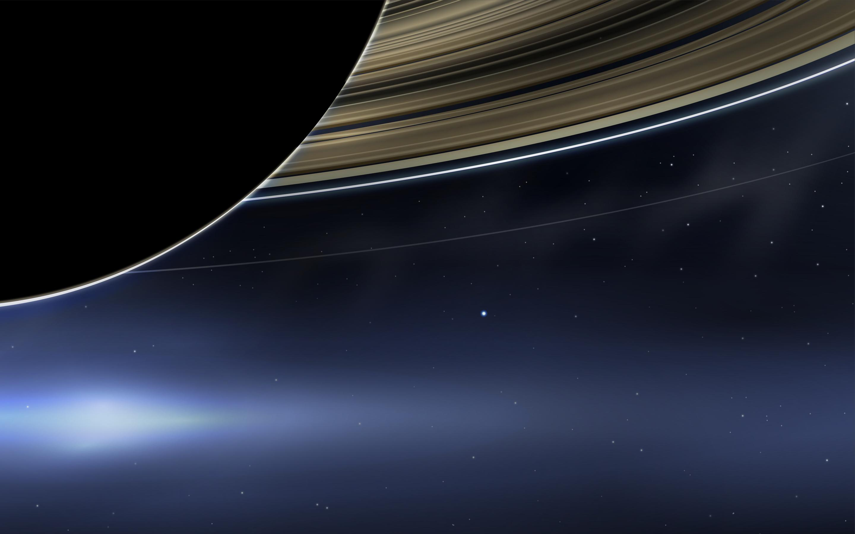
Earth: a CLOSED system
The Earth as seen from Saturn (picture from the Cassini probe)

Slide 5
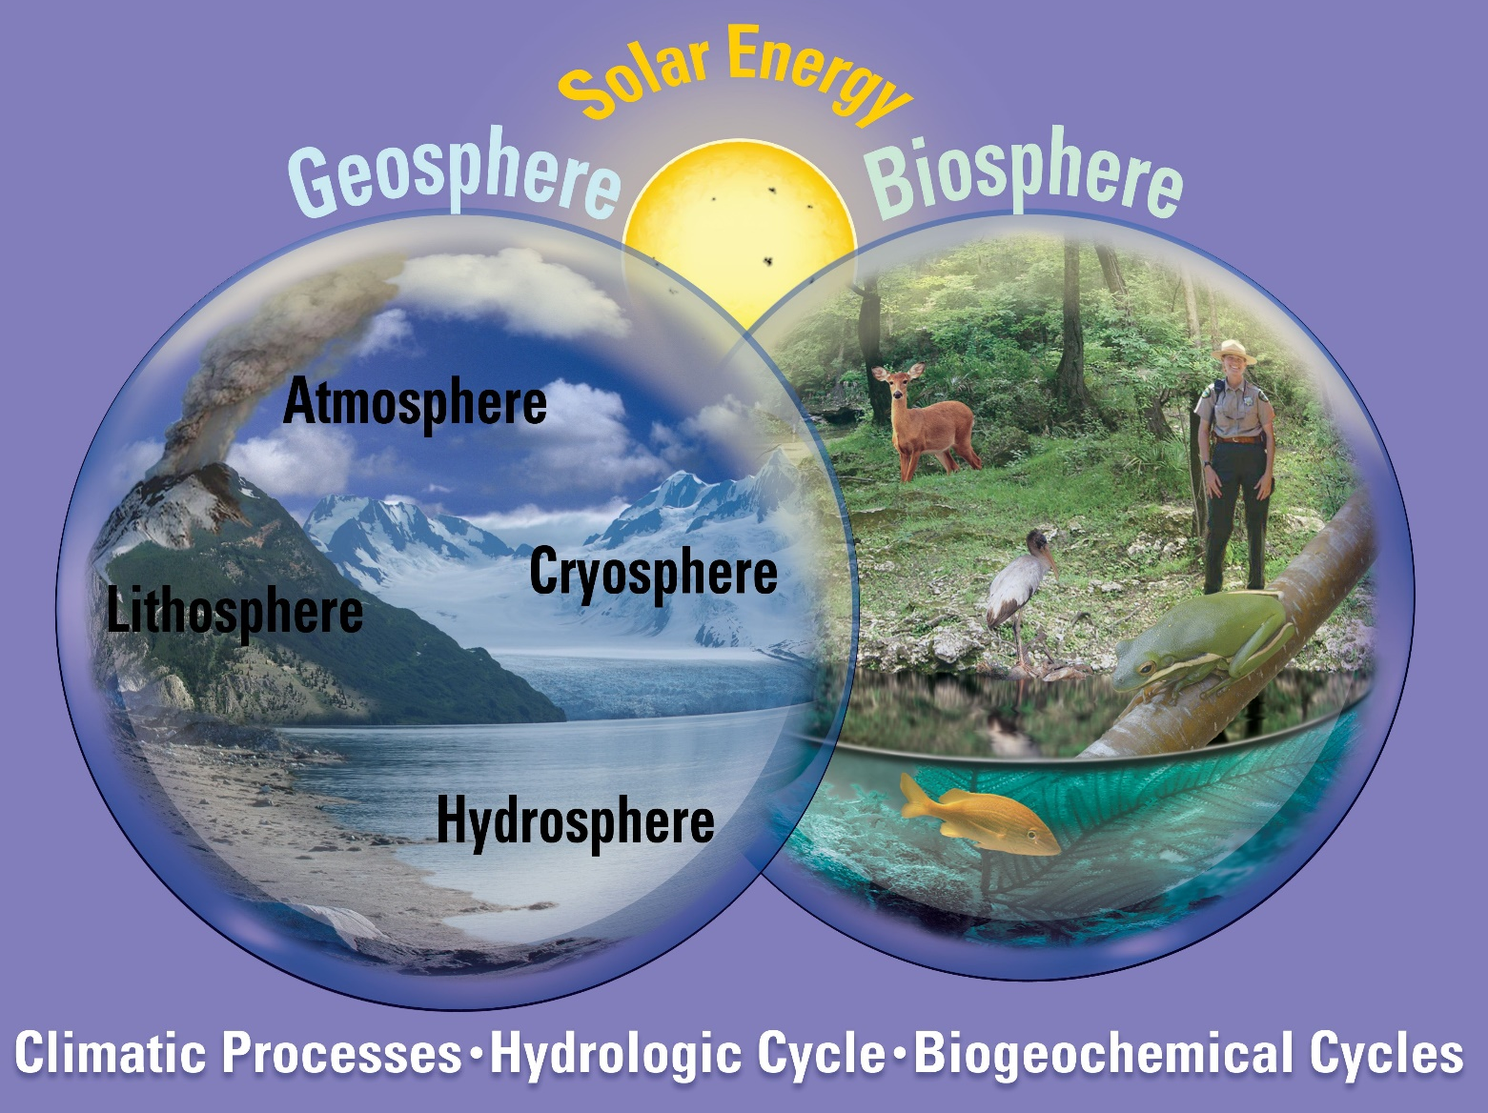
The Earth as a system: subsystems
Matter (chemical elements) is continually redistributed among the various subsystem via numerour physico-chemical cycles
Notes:
The major elements on Earth cycle between the atmosphere, hydrosphere, and lithosphere. We've already discussed the water cycle, driven by solar energy, and we've touched on aspects of the carbon cycle.
Biosphere: collection of all living organisms on our planet (life/death cycle)

Slide 6
The water cycle
Ev+Tr: H₂O from liquid (on land + ocens) into vapour (in atmosphere)
Precipitation
Transpiration
Pr: H₂O from vapour into liquid/solid (rain/snow)
Precipitation
Evaporation
R.off: H₂O dissolves minerals and carry them to river, lakes, ocen
Runoff
Absorption
Ab: H₂O absorbed from surface to interior of land (groundwater)
«All the rivers run into the sea; yet the sea is not full»
Ecclesiastes 1:7
Notes:
Water Water also transports heat fis constantly cycling between the liquid and gaseous states and this takes a lot of energy. The evaporation of water uses 12.5 x 10²⁰ kJ/yr of the solar energy that is incident on Earth. Much of this energy is given off to the atmosphere when water vapor precipitates. Note that all photosynthesis on the planet, by contrast, uses only 0.085 x 10²⁰ kJ/yr.
rom the equator to the poles through ocean currents. Due to its high heat capacity, water can store more energy than most other liquids.
See
http://butane.chem.uiuc.edu/pshapley/environmental/L23/1.html

Slide 7
Earth: a dynamic system
Earth is in a state of continual physical, chemical and biological evolution due to the dynamic transports and transformations of matter
Sun is the major energy source (external)
Cyclic processes and fluxes between the major reservoirs on Earth
Radioactive decay in the core is a minor energy source (internal)
Notes:
The combined effect of these dynamic transports and transformations is a planet that is in a state of continual physical, chemical and biological evolution. A bird's eye, cartoon view of the dynamic Earth system is shown in Plate 1.
Energy generated by radioactive is minimal

Slide 8
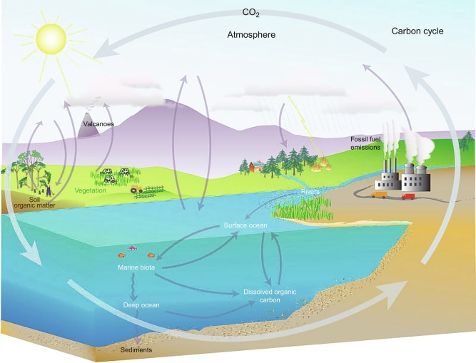
Biogeochemical cycle
A biogeochemical cycle is the pathway by which a chemical substance or element cycles (is turned over or moves through) the various subsystems (biotic and abiotic) of Earth.
Biogeochemical: refers to the consideration of the biological, geological and chemical aspects of each cycle
Notes:
Biogeochemical cycle, any of the natural pathways by which essential elements of living matter are circulated. The term biogeochemical is a contraction that refers to the consideration of the biological, geological, and chemical aspects of each cycle.

Slide 9
Biogeochemical cycles: the example of C
What happens to the organic matter that is «produced» on Earth during the photosynthetic processes?
The organic material (formed by CO₂+H₂O) does not keep accumulating. It is consumed and degraded, making a balance on the C atoms (CO₂ is released back into the atmosphere by respiration)
This balance is a result of the biologically driven, characteristic cycling of C among biotic forms (e.g. sugars, cellular building blocks) and abiotic forms (e.g. CO₂, carbonate rocks)
Cycling between biotic and abiotic forms is not limited to C
Notes:
C cycles allows to understand what happens
Short time cycle (respiration/plant photosyntesis) + longer term cycle (degradation of organic material and creation of fossil fuels)

Slide 10
Biogeochemical cycles
Cycles can be constructed for all the major elements found in a biological organism, as well as for trace/minor elements
Example: list of all the elements present in a cell of Escherichia Coli
Major elements:
Minor elements:
Trace elements:
Carbon
Oxygen
Hydrogen
Nitrogen
Sulfur
Phosphorous
Potassium
Calcium
Magnesium
Chlorine
Iron
Manganese
Molybdenum
Cobalt
Copper
zinc
Applications: understanding and mitigating global environmental issues (e.g. CO₂ accumulation in the atmosphere, acid rains...)
Notes:
Applications: issues and modification of the natural cycled due to antropogenic effects

Slide 11
Main components of a biogeochemical cycle
Reservoir (pools): amount of material defined by a certain physical, chemical or biological character, that can be considered homogeneous
O₂ in the atmosphere
CO in the southern emisphere
S in rocks
H₂O in oceans
Burden (or content) of a reservoir is the total mass of a substance (element) in the reservoir. The content of a reservoir is denoted with M (with dimensions in mass or moles)
C content in land biota
Flux: amount of material transferred from one reservoir to another per unit time (F)
Rate of evaporation of H₂O from ocean surface/year
Rate of release of CO₂ in atmosphere/year
Rate of deposition of P on marine sediments/years
Notes:
Reservoir for a chemical elements is the chemical species/material that contain that specific element. It can be a global one or more geographycally defined.
Flux: usually norna

Slide 12
Main components of a biogeochemical cycle
Source: a flux (Q) of material into a reservoir
Sink: a flux (S) of material out of a reservoir (very often assumed proportional to the content of the reservoir)
Q
S=kM
A single reservoir M with one source flux and one sink flux
M
Turnover time (τ₀): the ratio of the content of a reservoir (M) to the sum of its sinks. It is the time it will take to empty the reservoir in the absence of sources, if the sinks remain constant.
It is a measure of the average time spent by individual chemical species in the reservoir
For a single sink:
if
analogous to first order chemical reactions
For multiple sinks i:
and given that:
Notes:
For one reservoir I can have more than one source and sink and the important point in creating a cycle is to estimate the vaues of Q and S

Slide 13
Turnover time: example
In this (simplifed) model of the C cycle, what is the τ₀ of C in biota found in the ocean surface water?
Two sinks:
S₁ (resp&decomp)=36
S₂ (detritus)=4
Units of M: 10¹⁵ g (Pg) of C (burden)
Units of F(fluxes): 10¹⁵ g (Pg) of C/year
Notes:
In this slide a simplified model of the C cycles where rectangles are the various reservoirs and arrow represent fluxes Pg= petagrams
Rectangles are the various reservoir of C with the burden indicated inside in units of Pg= petagrams

Slide 14
Main components of a biogeochemical cycle
Budget: a balance sheet of all sources and sinks of a reservoir. If all Q (sources) and S (sinks) balance and the amount M does not change with time → the reservoir is in a steady state
The equation describing the rate of change of the content of a reservoir is:
Notes:
If we take into account all sources and sinks we generare a budget for the reservoir.

Slide 15
Main components of a biogeochemical cycle
steady state condition:
we get that
The burdern remains constant with time and
Accumulation condition:
The burdern increases with time
(e.g. CO₂ in atmosphere)
Depletion condition:
The burdern decreases with time
(e.g. CFC in atmosphere after their ban)

Slide 16
Main components of a biogeochemical cycle
Response time of a reservoir:
Q
S=kM
M
If a reservoir M is initially in a steady state
with fluxes Q₀ and S₀ and content M₀, its turnover time is:
If the source strenght is suddenly changed to a new value Q₁, how long it will take to the reservoir to reach a new steady state M₁ = Q₁/k? Need to solve the differential equation
with the initial condition
Change of M with time from M₀ to M₁:
The solution is:
And the response time of the reservoir is k⁻¹ which is equal to the turnover time τ₀
Notes:
The example refers to a reservoir with a burden M0 at t=0 which is suddenly perturbed by increasing to soure to a new value Q1.
Response time is

Slide 17
Response time: example
Response time of a reservoir
The content of sulfate in the oceans is ∼M₀=1.3x10⁹ Tg (of S). Its main source is river runoff (pre-industrial value Q₀=100 Tg of S/year) and the main sink is incorporation into the litosphere (S₀=100 Tg of S/year).
If we assume that the present runoff is increased to Q₁=200 Tg of S/year, due to man-made activites and it will continue indefinitely, how fast would the new sulfate concentration in the ocean adjust to a new steady-state value?
The timescale of the adjustment will be
years
The new M₁ value eventually reached will be given by:
Notes:
Incorporation of S into the sulfate rocks is a slow process, it takes a geological time.
Importance of the cycles: if we are able to estimate the changes to the sources or sinks into a reservoir
CO2 examble:

Slide 18
Sources and sinks in atmosphere
Sources (emissions)
Primary: when the compound is released directly into the atmosphere
Primary: when the compound is released directly into the atmosphere
Secondary: when the compound is generated «in situ» in the atmosphere from some other precursor
Sinks
Depositional: or physical (wet and dry deposition)
Photochemical: compound is removed via photochemical reaction

Slide 19
Biogeochemical cycles: schemes
a.k.a. turnover time
10¹⁵ g= 1 petagram = 1 Pg
Notes:
Bgochem cycles are usually represented via schemes such as this one, in which reservoirs (also termed pools) are indicated in rectangles and fluxes in various forms

Slide 20
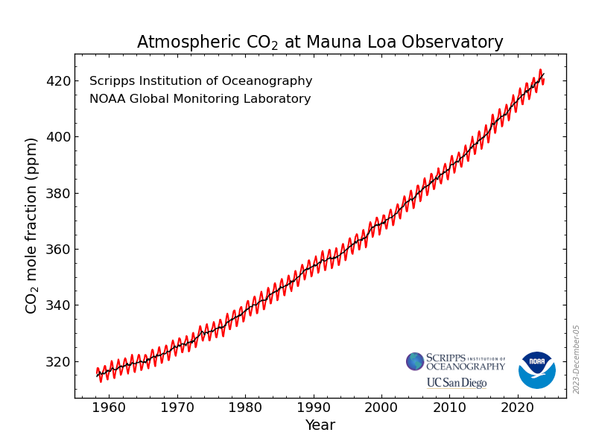
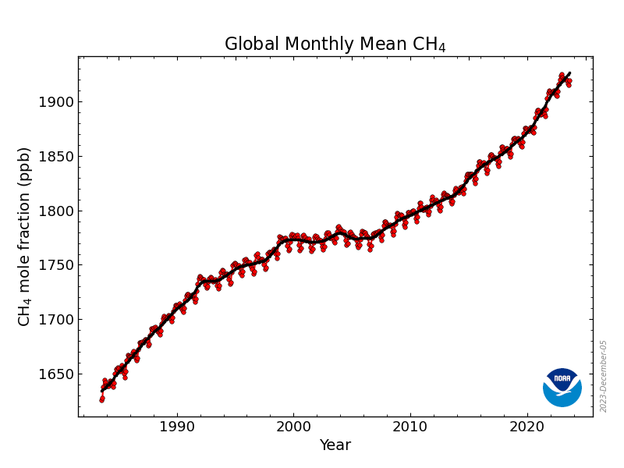
The C cycle
The easiest one to use as an example of anthropogenic changes in the Earth system: due to extensive use of fossil fuels (C-based), deforestation and land use change we have removed C from one reservoir (the litosphere) and placed it directly into another (the atmosphere)
Major reservoir of C in atmosphere:
CH₄
CO₂
August 2023: 1919.41 ppb
November 2023: 420.46 ppm
CO
VOCs
90% from natural sources
from incomplete combustion of fuels+deforestation fires (∼0.1 ppm)
(variable e.g. isoprene in forest up to 0.015ppm)
https://www.esrl.noaa.gov/gmd/ccgg/trends/
Notes:
CO2 sources fossil fuel burning, deforestation, change in land use. Deforestation and change of land use have decreased the sinks of CO2 from the atmosphere
CO2 sinks:

Slide 21
The C cycle
Global CO₂ budget (average 2009-2018):
Gt=10⁹ g
9.5±0.5
4.9±0.1
increased by 2.7 times from 1960s
1.5±0.7
2.5±0.6
Land uptake (forest regrowth)
3.2±0.7
11.0±1.2
10.6±1.4
0.4
Global CH₄ budget (IPCC2001):
Units: Tg (CH4) year⁻¹
Notes:
CO2 sources fossil fuel burning, deforestation, change in land use
CO2 sinks:
Big issues. How do you estimate?

Slide 22
The C cycle
C: the fourth most abundant element in the Universe (after H, He, O)
C cycles through land, ocean, atmosphere, Earth's interior
Global cycle splits into 2 categories:
Geological (large time scales -millions of years)
biological/physical (shorter time scales - days to thousands of years)
Red numbers and arrows: annual anthropogenic fluxes (averaged 2000-2009)
Black numbers and arrows: estimated pre-industrial reservoir and fluxes
Notes:
On Earth, carbon cycles through the land, ocean, atmosphere, and the Earth's interior in a major biogeochemical cycle. The global carbon cycle can be divided into two categories: the geological, which operates over large time scales (millions of years), and the biological/physical, which operates at shorter time scales (days to thousands of years).

Slide 23
The C cycle: C reservoirs
1. The largest is the litosphere: sedimentary rocks (carbonates of Ca, Mg and Fe) contain ∼90 000 000 PgC
Timescale for redistribution of carbonates from litosphere to other reservoirs is 10⁶ years (slow geological processes) → Litosphere is an inactive component of the global C cycle
Active C reservoirs:
2. The hydrosphere (oceans) is the second largest with ∼40 000 PgC
(deep ocean, surface ocean, marine biota, dissolved organic C)
3. The terrestrial biosphere contains ∼2190 PgC (vegetation, living biota, soil with dead organic matter)
4. The atmosphere contains ∼830 PgC (CO₂, CH₄, CO, VOCs)
5. Fossil fuels in the litosphere ∼1500 PgC (gas, oil, coal)
Notes:
Inactive component: because it is so large and processes that remove it from the litosphere is so slow that the burden remains practically constants.

Slide 24
Fast and slow C cycles
Fast domain (biological/physical):
Large exchange fluxes and rapid reservoir turnovers of C in the atmosphere, hydrosphere (oceans, freshwaters) and terrestrial biosphere (vegetation, soil).
Turnover times: few years (CO₂ in atmosphere) – 10-1000 years (land, soil, ocean)
intermediate domain (ocean «respiration»):
Fast: dissolution of CO₂ in surface water
Slow: mixing between surface and deep ocean waters
Slow domain (geological cycle):
Carbonate rocks in litosphere exchange with the fast domain via volcanic emission and chemical weathering, erosion, sediment formation on the seafloor
Turnover times: > 10 000 years
Notes:
Large and rapid flus of material due to growth&dead of biological systems
CHANGE: ADD the TIME DOMAIN of OCEAN respiration that is intermediate between fast and slow
For the ocean the slow part is due to the mixing between surface and deep ocean
CO2is emitted via volcanic eruptions . Chemical weathering: formation of C containing aerosols

Slide 25
Fast and slow C cycles
Natural exchange fluxes between the slow and the fast domain are relatively small (<0.3 PgC yr^{–1}) and can be assumed constant in time
BUT
Since the beginning of the Industrial Era, fossil fuel combustion has transferred significant amount of fossil carbon from the slow domain into the fast domain, thus causing an unprecedented, major human-induced perturbation in the carbon cycle
Notes:
CHANGE: ADD the TIME DOMAIN of OCEAN respiration that is intermediate between fast and slow
For the ocean the slow part is due to the mixing between surface and deep ocean
CO2is emitted via volcanic eruptions

Slide 26
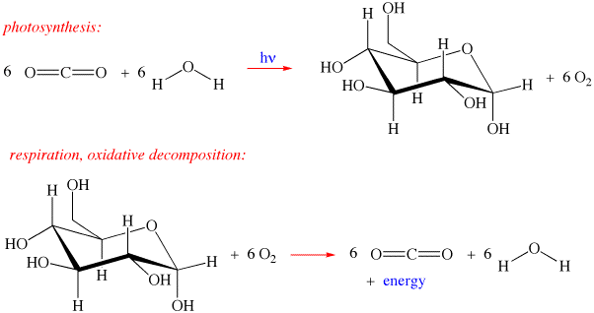
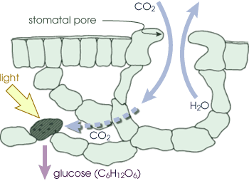
Photosynthesis and respiration (fast)
CO₂ is trapped from the atmosphere to produce glucose (energy storage).
Glucose is used to make other organic molecules and is used as a source of energy in respiration.
Glucose is used as a source of energy in respiration - CO₂ is emitted again in atmosphere
The amount of C taken up and released by photosynthesis/respiration each year is 1,000 times greater than the amount of C that moves through the geological cycle per year
Notes:
Prior to the industrial era the sources and sinks of CO2 via the biological cycle is via photosynthesis and respiration
Photosynthesis traps CO2 from the atmosphere to produce glucose and it stores energy. Glucose, of course, is used to make other organic molecules and is used as a source of energy in respiration.

Slide 27
The CO₂ reservoir
The C in atmosphere (∼830 PgC) is several order of magnitudes smaller than C in the oceans (∼40 000 PgC) and litosphere (∼90 000 000 PgC)
The C most available for photosynthesis (i.e. to enter in the biosphere) is in the smallest of the reservoirs. Hence it is the smallest reservoir that is most actively cycled
Oscillations in atmospheric CO₂
Seasonal activity of photosynthesis
Notes:
During the daytime in the growing season, leaves absorb sunlight and take up CO2 from the atmosphere. Plants, animals and soil microbes consume the carbon in organic matter and return carbon dioxide to the atmosphere.
When conditions are too cold or too dry, photosynthesis and respiration slows down along with the movement of carbon between the atmosphere and the land surface.
The amounts of carbon that move from the atmosphere through photosynthesis, respiration, and back to the atmosphere are large and produce oscillations in atmospheric carbon dioxide concentrations.
The reason for the oscillation if that according to season the photosyntetic activity slows down in the winter.

Slide 28
Fast and slow C cycles
The removal of all the human-emitted CO₂ from the atmosphere by natural processes will take a few hundred to thousands of years
Necessity of alternative/additional CO₂ mitigation techniques
Notes:
This is the natural cycle of C. But on top of that we have added the antropogenic

Slide 29
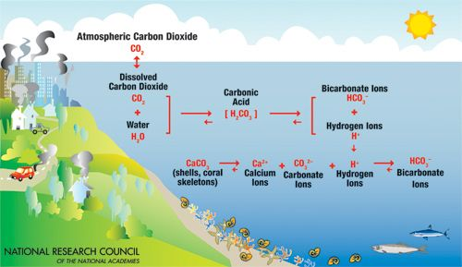
Ocean chemistry of C
Ocean acts as a buffer for CO₂: exchange is driven by the difference in the partial pressure of CO₂ in air and water. Dissolution of
C in the ocean leads to H₂CO₃, HCO₃⁻ and CO₃²⁻ (DIC: dissolved inorganic C) and decrease in the pH (ocean acidification)
Ocean acidification
mixing of surface and deep waters
But the buffer capacity of the ocean decreases with increasing CO₂ dissolution. Need to wait for the reaction with CaCO₃ (slow)

Slide 30
Silicate (mineral) weathering
Reaction of CO₂ with metal oxides (MO, M=Ca, Mg, Fe) the corresponding carbonates (with low solubility in H₂O) are formed exothermically
Reactions are thermodynamically favoured at low T (⇒ spontaneous) but very slow (geological times)
Challenge for CO₂ mitigation: find ways to accelerate the carbonation process
Notes:
When CO2 reacts with metal oxides the corresponding carbonate is formed and heat is released according to the following chemical reaction:
MO + CO2 → MCO3 + heat
Since the reaction releases heat, the formation of carbonates is thermodynamically favoured at low temperature, whereas at high temperature the reverse reaction, that is calcination, is favoured.
Even at the low partial pressure of atmospheric CO2 and at ambient temperature, carbonation of metal oxide bearing minerals occurs spontaneously, though on geological time scales.
Limitations arise from the formation of silica or carbonate layers on the mineral surface during carbonation that tend to hinder further reaction and to limit conversion and from the rate of CO2 uptake from the gas phase in the case of aqueous reactions.
The challenge for mineral carbonation is to find ways to accelerate carbonation and to exploit the heat of reaction within the environmental constraints, for example with minimal energy and material losses.

Slide 31
CO₂ capture and storage (CCS)
Series of processes consisting of:
the separation of CO₂ from industrial and energy-related sources
transport to a storage location
long-term isolation from the atmosphere or
use of the CO₂ in other industrial processes
An option in the portfolio of mitigation actions for stabilization of atmospheric GHG concentrations
Energy efficiency improvements
Transition to less-C intensive fuels
Renewable energy sources, nuclear power
Enhancement of biological sinks
Reduction of non-CO₂ GHG emissions

Slide 32
The N cycle
Chemical reservoirs for N
Molecular nitrogen N₂ gas
N oxides NO, NO_{2,} N₂O gas
Nitrates/nitrites NO₃⁻, NO₂⁻ H₂O solution
Ammonia NH₃ gas
Ammonium ion NH₄⁺ H₂O solution
Urea CO(NH₂)₂ liquid
organic N amines, peptides, amminoacids
N₂ is 78% of gases in atmosphere (the largest burden of N)
N is necessary for the synthesis of bioorganic molecules (e.g. proteins, nucleic acids). N is 4th most common elements in cells (12% of cell dry weight)
N₂ is inaccessible to most organisms
N-fixation is the first step in the N biological cycle
Notes:
The stable, elemental form of nitrogen is inaccessible to most organisms. Molecular nitrogen is very unreactive and, in the atmosphere, it only reacts with O₂ in lightning strikes.
Nitrogen must be "fixed" by soil bacteria living in association with the roots of plants like legumes, clover, alfalfa, soybeans, peas, peanuts, and beans. Living on nodules around the roots of legumes, the bacteria chemically combine nitrogen in the air to form nitrates and ammonia making it available to plants. An iron-molybdenum metalloenzyme called nitrogenase reduces the nitrogen molecule by 6 electrons in the biological nitrogen fixation.
See also
http://butane.chem.uiuc.edu/pshapley/environmental/L29/3.html

Slide 33
Biological transformations of N
They are the primary mover in terrestrial and oceanic N. The internal biological N cycle accounts for about 95% of all N fluxes
N fixation: any process by which N₂ reacts to form any N compound. Enzime-catalyzed reduction to NH₃/NH₄⁺ in microorganisms
NH₃ assimilation: uptake of NH₃/NH₄⁺ by an organism to become part of its biomass (production of organic N-compounds)
Nitrification: oxidation of NH₃/NH₄⁺ to NO₂⁻/NO₃⁻ by an organism, as a means of producing energy
Assimilatory N reduction: reduction of NO₂⁻/NO₃⁻ followed by uptake of N by the organism as biomass
fixation
denitrification
Ammonification: breaking down of organic N compounds into NH₃/NH₄⁺
nitrification
NH₃
assimilation
Assimilatory N reduction
Denitrification: reduction of NO₃⁻ to any gaseous N species (generally N₂, N₂O)
ammonification
Notes:
Nitrification:

Slide 34
N cycle

Slide 35
N fixation
Industrial synthesis of NH₃: Bosch-Haber syntheis
Is a highly energy intensive process
N₂ is very unreactive (due to triple bond). High activation energy
H₂ is not directly available on Earth
NH₃ production is favoured at room T (ΔG⁰<0) but rate is very small due to the high barrier
Necessity to use catalysts
Biological N-fixation
Only organisms with highly developed catalytic systems are able to do it (via the enzyme nitrogenase)
Fixation is a reduction, highly sensitive to the presence of O₂ hence, only organisms living in anaerobic environments (e.g. cyanobacteria) can do it

Slide 36
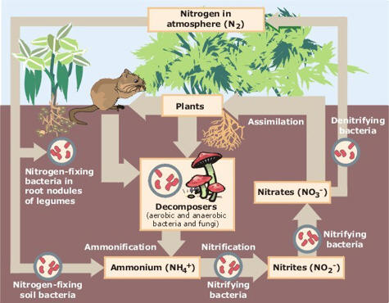
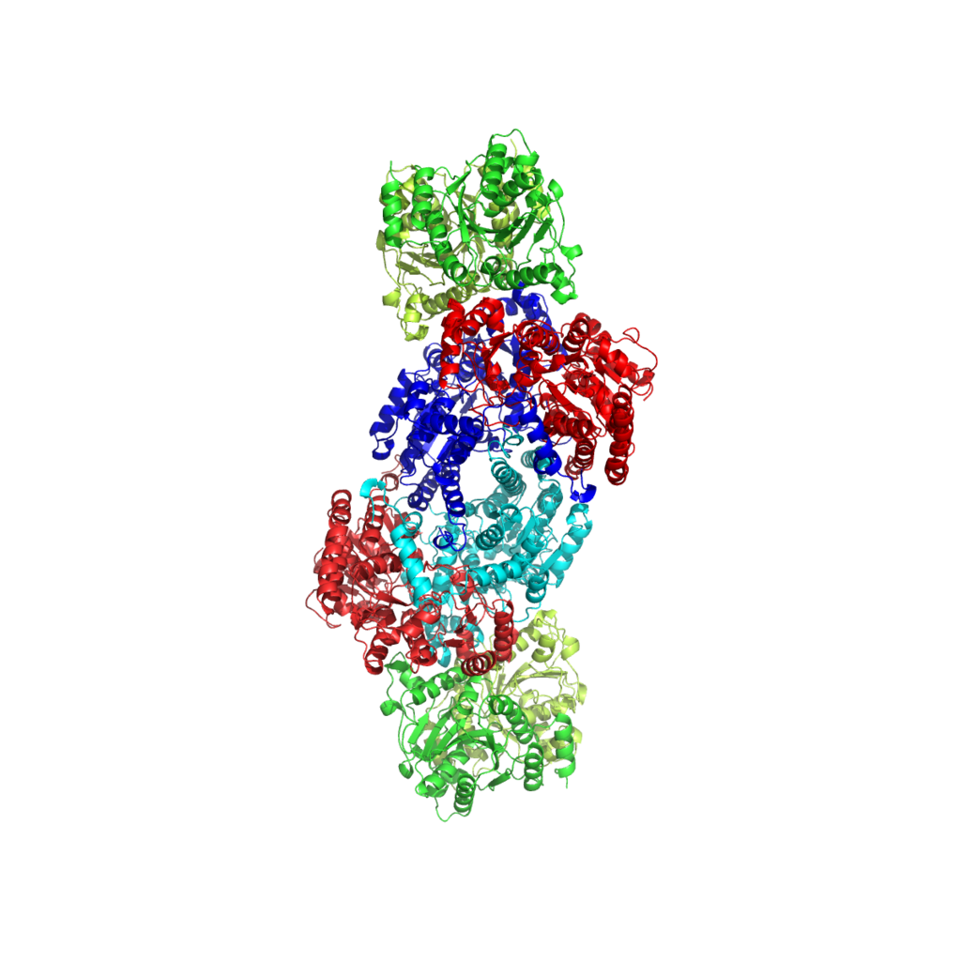
Biological N cycle
Nitrogenase: an iron-molybdenum metalloenzyme

Slide 37
Global N cycle
Notes:
N in Ocean: dissolved N2 (95%) + NO3- and dead organic matter
N in soil: dead organic matter

Slide 38
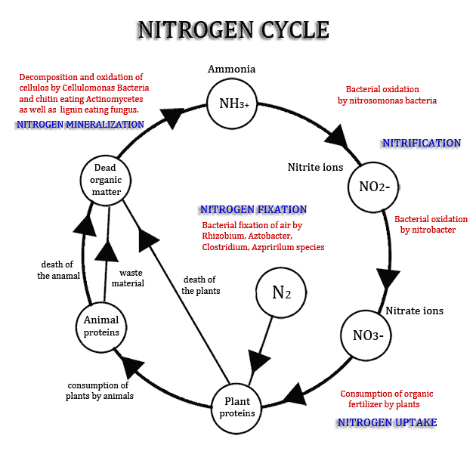
Biological N cycle

Slide 39
The ammonia-ammonium subcyle
NH₃ in atmosphere: ammonification and volatilization from animal excreta

Slide 40
The NO_{x}-NO₃⁻ subcycle
NO_{x}/NO₃⁻: principal sources are anthropogenic combustion (industrial, fuel, biomass)

Slide 41
Anthropogenic modifications to N cycle
Use of fertilizers and cultivation of nitrogen-fixing crops expanded exponentially during the last century. Anthropogenic contributions of N compounds to the biosphere is roughly equivalent to the total flux of fixed nitrogen from all natural sources.
Anthropogenic release may be linked to adverse consequences at local, regional, and global scales

Slide 43
+ Jacobson p.279
+ Hewitt Jackson p89
https://www.slideshare.net/maleigh/grade-11-earth-life-science-earth-systems-subsystems
+ Wallace Hobbs p58
+ file L8.-Biogeochemical-Cycles) da cui si può prendere materiale per migliorare N cycle ed aggiungere S cycle
+ Lec20
+ Biogeo_Clect

