Slide 1
Questionnaire for the evaluation of the Environmental Physical Chemistry course
Please open the following link (on Moodle) and fill in the questionnaire:
https://docs.google.com/forms/d/1Wue93hIVmVUkBTk8VQUBoGWAWf6Yw0JFUDYDesZJ00U/edit?ts=6575de14

Slide 2
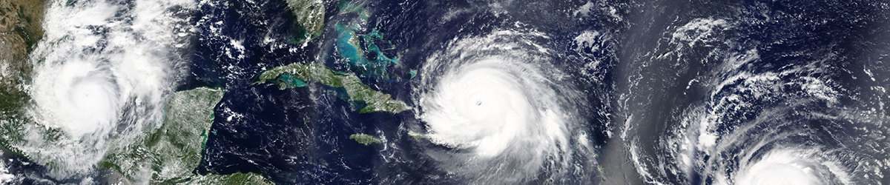
University of Trento
Master of Science in Environmental Meteorology https://international.unitn.it/environmental-meteorology
A.A. 2023-24
Environmental Physical Chemistry
Clouds & particles formation
Daniela Ascenzi
Dept. Physics, University of Trento, Italy
e-mail: daniela.ascenzi@unitn.it
Notes:
Queste slides ispirate da:
https://www.e-education.psu.edu/meteo300/node/803
https://www.weather.gov/jetstream/formation
Books: Sanchez Lavega Chapt 5 p. 250
Wallace&Hobbs Atmospheric science chapt 6
Hewitt Jackson chapt 6

Slide 3
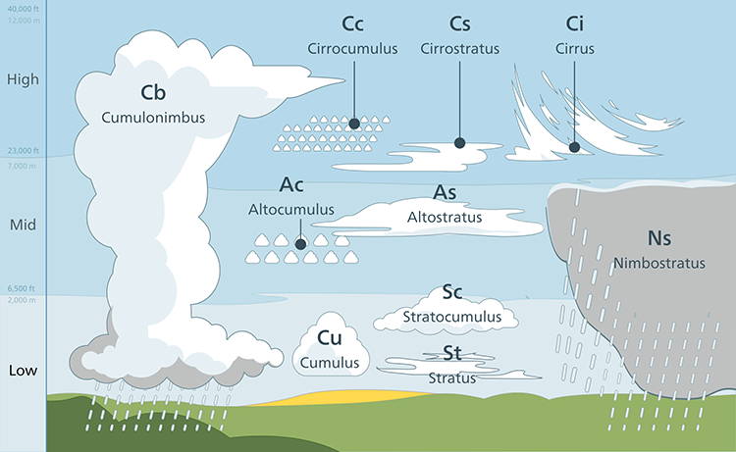
Overview: clouds
Clouds come in different sizes and shapes
depending on:
atmospheric motions
composition (solid/liquid H₂O)
temperature
https://www.weather.gov/jetstream/cloudchart

Slide 4
Clouds microphysics
Clouds formation is driven by processes occurring on the microscale, where H₂O molecules and small particles collide
Necessary ingredients for cloud formation:
1. Moisture
2. Aerosol
3. Cooling
If any one of these is missing, a cloud will not form
Koehler theory
To explain the formation of cloud and their life cycle from formation to precipitation:
clouds will form or not?
Will they precipitate or not?
Notes:
We call these microscale processes “cloud microphysics” and microphysics is the focus of this lesson.

Slide 5
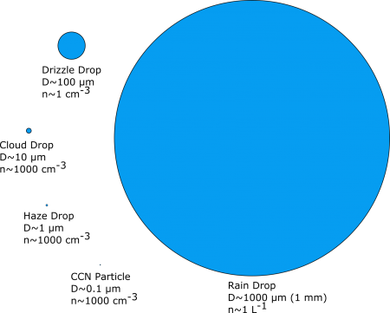

Clouds definition
Cloud: a (visible) suspension of small particles in the atmosphere
Particles come in a wide range in size, volume, and numbers.
Larger particles grow by adding H₂O water molecules but still contain the original CCN
The smallest particles: little water content, made up of hydrophilic substances
${LWC=wL=\frac{mass of liquid H2O}{volume of air}}^{}$in g/m³
Typical values LWC= 0.1–0.9 g/m³
Notes:
We call these microscale processes “cloud microphysics” and microphysics is the focus of this lesson.

Slide 6
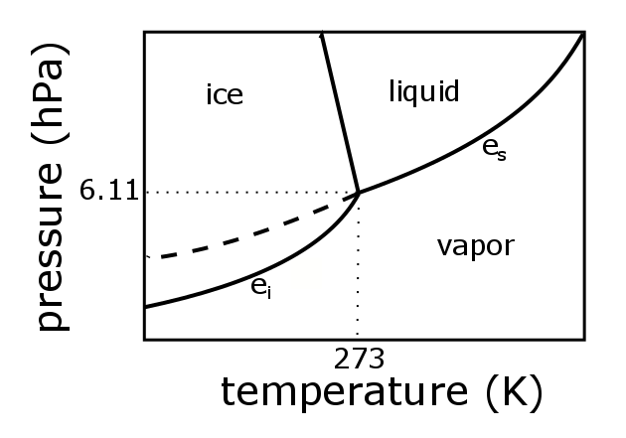
Vapour pressure and saturated v.p.
From Clausius-Clapeyron: saturation vapour pressure over ice (e_{si}) or liquid water (e_{s}) increses with T
Saturation ratio of an air parcel (with respect to a flat liquid surface):
S = e/e_{s}
S <1 non saturated
S =1 saturated
S>1 supersaturated
e_{si}
s <0 non saturated environment
s =0 saturated env.
s >0 supersaturated env.
Supersaturation
s =S-1 = e/e_{s} -1
A small supersaturation (s>0) is actually needed to form clouds
Notes:
The above equations apply only for a flat surface of pure liquid water. When we get into situations where the water has a curved surface (as in a cloud drop), contains a solute, or is in solid form, we need to think about the saturation ratio and the supersaturation relative to the equilibrium value of e, e_{eq}, which can be different from e_{s}. So, depending on the circumstances, e_{eq} can be e_{s} (flat liquid water), e_{sc} (curved liquid water), e_{sol} (curved solution), e_{i} (flat ice), or some combination. We will see that a small supersaturation is actually needed to form clouds.
SUPERCOOLED WATER: water can exist in liquid form even below the freezing point. This supercooled liquid needs ice nuclei (IN) in order to become ice, although at a temperature of about –40 ºC, the liquid can freeze homogeneously (without IN).
SUPERSATURATION We will see that a small supersaturation is actually needed to form clouds. Note that it is possible to have the relative humidity be greater than 100%, which makes the supersaturation positive. This condition can't last long because condensation will exceed evaporation until they become equal. But how can supersaturation happen?
Supersaturation of water in air can occur when air cools either via Radiation, Uplift, or Mixing.
See https://www.e-education.psu.edu/meteo300/node/624

Slide 7
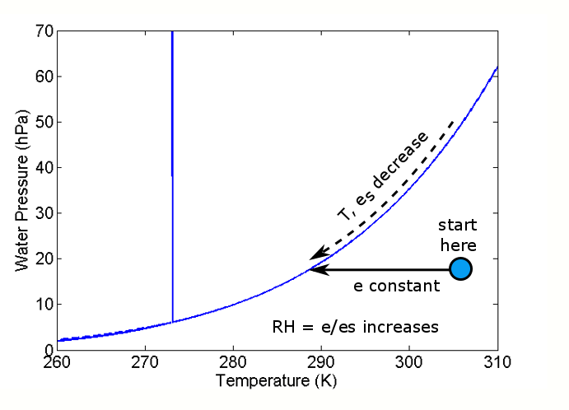
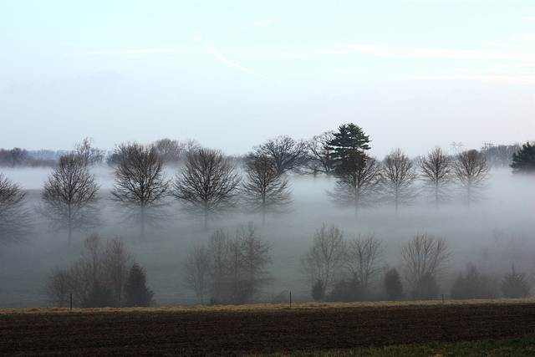
How can supersaturation be achieved?
Three basic mechanisms for cooling the air:
1. Radiation
2. Mixing
3. Uplifting
1. Radiative cooling
An air parcel that radiates energy (mostly in the IR part of the spectrum), cools down at constant P. The amount of water vapor does not change.
COOLING: air parcel cools but does not change its vapor pressure (e).
T decrease, so e_{s} decrease. At some point e > e_{s} and supersaturation is achieved (s>0)
START: an undersaturated air parcel (e<e_{s} , s<0)
Radiation fog: moist air cools at night with almost constant mixing ration (w)
Notes:
Radiation happen at constant pressure (isobaric). When an air parcel radiates this energy (mostly in the infrared part of the spectrum), it cools down, but the amount of water vapor does not change.
We can understand this process by using the water phase diagram in the figure below. Consider a situation in which an air parcel is undersaturated, which is represented by the blue dot. As the air parcel emits radiation, the air parcel cools but does not change its vapor pressure. Hence, the blue dot moves to the left on the diagram. However, because the temperature drops, es drops. When es becomes slightly less than e, a cloud forms.

Slide 8
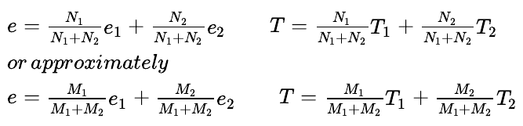
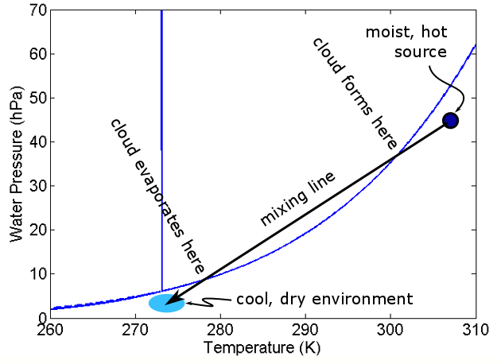
How can supersaturation be achieved?
2. Mixing
Two air parcels with different T (T₁, T₂) and water vapor partial pressures (e₁, e₂, both < e_{s}) are at the same total pressure. When they mix: T and e become weighted averages according to the moles of air (N₁, N₂) that each parcel contributes
M₁, M₂ : masses of the air parcels
START: a warm moist air parcel mixing into the environment of colder and drier air
COOLING: T and e of the mixed parcel lies along the mixing line. As the warm, moist parcel is mixed into the colder, drier environment, the size of the mixed air parcel grows and the temperature and vapor pressure follow the mixing line toward the environmental temperature and vapor pressure eventually hitting the Clausius-Clapeyron curve
Notes:
Think about a single warm, moist air parcel mixing into the environment of colder, drier air. As the parcel mixes into more and more of the environmental air, it gets increasingly diluted but the mixed parcel grows in size. As the amount of environmental air in the mixed parcel increases, the average e and T of the mixed parcel decreases to be closer to the environmental values and the mixed parcel’s e and T follow a mixing line. Starting in the upper right near the initial warm parcel, as the mixed parcel continues to grow, eventually the e and T will hit the Clausius–Clapeyron curve. As the mixed parcel continues to push into the liquid portion of the phase diagram and become supersaturated, a mixing cloud will form. The cloud will stay as long as the mixed e and T put the parcel above the Clausius–Clapeyron curve. However, once the mixed parcel comes below the curve, the cloud will evaporate.

Slide 9


How can supersaturation be achieved?
2. Examples of mixing clouds
Breathing on a on a cold day
Jet contrails
But also: fog that forms when cold, dry air moves over warm, moist ground, e.g. just after rain
Notes:
Think about a single warm, moist air parcel mixing into the environment of colder, drier air. As the parcel mixes into more and more of the environmental air, it gets increasingly diluted but the mixed parcel grows in size. As the amount of environmental air in the mixed parcel increases, the average e and T of the mixed parcel decreases to be closer to the environmental values and the mixed parcel’s e and T follow a mixing line. Starting in the upper right near the initial warm parcel, as the mixed parcel continues to grow, eventually the e and T will hit the Clausius–Clapeyron curve. As the mixed parcel continues to push into the liquid portion of the phase diagram and become supersaturated, a mixing cloud will form. The cloud will stay as long as the mixed e and T put the parcel above the Clausius–Clapeyron curve. However, once the mixed parcel comes below the curve, the cloud will evaporate.
Contrail lenghts give yuo information about the T and P of environmental air

Slide 10
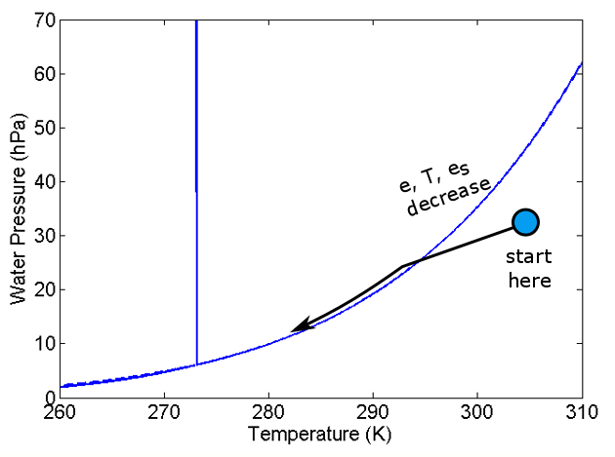
How can supersaturation be achieved?
3. Uplifting
Uplifting (adiabatic ascent) driven by convection, or by less dense air mass overriding a more dense one, or by air flowing up and over a mountain
The water vapor mixing ratio (w) remains the same but e drops as p drops. This reduces the possibility to achieve saturation (e = e_{s}).
But because also T drops, e_{s} also drops.
Which one drops faster?
It turns out that e_{s} drops faster and they converge so a cloud forms as soon as e > e_{s}
s>0 is not stable so more vapor is converted into liquid H₂O as uplift continues, and e ~ e_{s}
Notes:
The uplift of air can lead to cloud formation, as we know from the skew-T. Uplift is generally the same as adiabatic ascent. This adiabatic ascent can be driven by convection, by a less dense air mass overriding a more dense one, or by air flowing up and over a mountain. The following happens:
The water vapor mixing ratio remains the same, but e drops as p drops, thus reducing the possibility that RH = e/e_{s} will reach 100%.
The temperature drops in accordance with Poisson’s Relations (Lesson 2) so that e_{s} also drops.
The question is “Does e or e_{s} drop faster?" It turns out that e_{s} drops faster. As a result, in uplifted air, e and e_{s} converge at the lifting condensation level (LCL) and a cloud forms just at that level. As the parcel continues to rise, it continues to cool and water vapor continues to condense so that the parcel stays close to saturation and hence travels along the saturation vapor pressure curve.

Slide 11
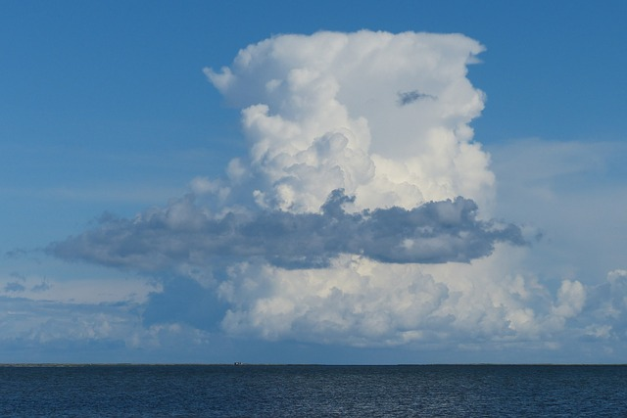
How can supersaturation be achieved?
3. Examples of clouds due to uplifting
All convective clouds (clouds with vertical extent) will form this way
A cumulus cloud
Notes:
All convective clouds, that is clouds with vertical extent, form this way. An example of adiabatic uplift is a cumulus cloud, as seen in the figure below.

Slide 12
Why supersaturation is needed?
Two effects most strongly determine the amount of supersaturation that each particle must experience in order to accumulate enough water to grow into a cloud drop.
1. A physical effect related to the change in the equilibrium water vapor pressure with the curvature of the liquid surface (droplet)
2. A chemical effect of the aerosol (a solute) dissolving in the growing water drop and reducing its vapor equilibrium pressure (Raoult’s law)

Slide 13
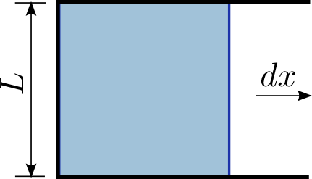

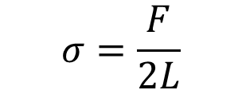
Surface tension
Surface tension σ : force per unit length (units N/m or J/m²)
Surface tension will pull the blue bar to the left; the force F required to hold the movable side is proportional to the length L and depends on the intrinsic properties of the liquid (composition, temperature, etc.)
$$σ=\frac{F}{2L}$$
the factor 2: the film has two sides (two surfaces)
In terms of work/energy:
Surface tension: the ratio of the change in the energy of the liquid to the change in the surface area of the liquid.
The work done by a force F to keep the slide moving to the right at constant speed is W = FΔx
The total area of the film increases by ΔA = 2LΔx
$$σ=\frac{W}{∆A}=\frac{F∆x}{2L∆x}$$

Slide 14
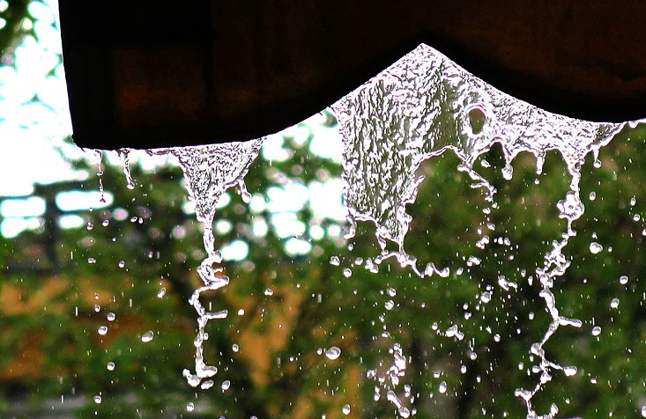
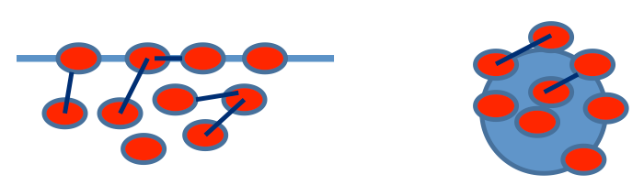
Curvature effect: the Kelvin effect
Surface tension σ (units N/m or J/m2): the tendency of liquid surfaces to shrink into the minimum surface area possible. At water–air interfaces, surface tension results from the greater attraction of liquid molecules to each other (due to H bonding, intermolecular forces) than to the molecules in the air
On a curved surface the amount of bonding that can go on between H₂O molecules on the surface is reduced ⇒ greater probability that a H₂O can escape from the liquid into the vapor phase
⇒ Evaporation rate increases ⇒ it takes less energy to remove a molecule from a curved surface than it does from a flat surface
Saturated vapor pressure over a curved surface is higher than over a flat surface

Slide 15
Theory: homogeneous nucleation
From the definition of the chemical potential (μ) of water in vapour phase (μ_{v}) and liquid phase (μ_{l}) :
For one molecule of water vapour at a pressure e
For one molecule of water vapour at its saturation vapour pressure (e_{s})
For liquid water in equilibrium with its vapour
Boltzmann constant
From the three above eqs. it can be obtained:
The formation of a pure water droplet by condensation from its vapour (chance collisions of gaseous H₂O molecules to form a small embryonic “stable” droplet)
Homogeneous nucleation:
Nucleation requires the formation of an interface between gas and liquid
Free energy (ΔG) is the balance of two terms: volume formation of the liquid + formation of the interface
Notes:
Stable means that its large enough not to evaporate back into the gas phase.

Slide 16
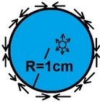
Theory: homogeneous nucleation
Assume the embryonic water droplet to have:
surface area A=4πr²
Volume V=4/3πr³
n: number of molecules per unit volume of liquid
(number density of liquid water)
r
1. Change in the Gibbs free energy due to formation of the water droplet of volume V by condensation is:
2. Change in the Gibbs free energy due to formation of the interface is:
σ is the surface energy (or tension): the work/unit area required to create the droplet interface
Notes:
Stable means that its large enough not to evaporate back into the gas phase.

Slide 17
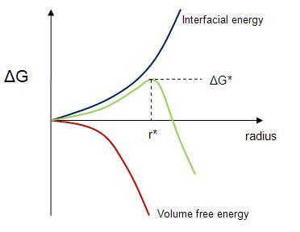
Theory: homogeneous nucleation
For a spontaneous process ΔG<0
In non saturated air:
s<0 which means e/e_{s} <1
ΔG is always > 0 (blue curve) for every r value. The larger the droplet that forms, the greater is the increase in ΔG
Droplet formation is NOT spontaneous (droplets will form but they will evaporate)
Increase in the Gibbs energy of a system due to the formation of a water droplet of radius r from water vapor with pressure e; e_{s} is the saturation vapor pressure with respect to a plane surface of water at the temperature of the system.
Notes:
Stable means that its large enough not to evaporate back into the gas phase.

Slide 18
Theory: homogeneous nucleation
For a spontaneous process ΔG<0
In supersaturated air:
s>0 which means e/e_{s} >1
ΔG initially increases with r until it reaches a maximum (at r*) and then decreases with increasing r (green curve)
Embryonic droplets with r<r* will tend to evaporate (ΔG>0)
Droplets that manage to grow to r>r* will continue to grow by condensation from the gas phase (ΔG<0)
The maximum position (r*) can be calculated by:
Notes:
DG can be + or – depending on r. DG initially increases with r until it reaches a maximum and then decreases with increasing r. Hence: embryonic droplets with

Slide 19
Theory: homogeneous nucleation
when:
The droplets with r=r* is in equilibrium with the vapour phase (it will not grow or evaporate)
The Kelvin equation
Exercise: what is the relative humidity (R.H.) at 10 °C just above the surface of a water droplet with radius r=0.010μm? If the droplet were placed in an enclosure having this same R.H., would the droplet be in stable or unstable equilibrium?
(at 10°C)=0.076 J⋅m⁻²: n=3.3x10²⁸ molec⋅m⁻³ k=1.381x10⁻²³ J⋅K⁻¹⋅molec⁻¹
Hint: Kelvin eq. determines the r of a droplet in equilibrium with its vapour phase. But if the droplet remains stable is because the pressure just above its surface is equal to e.
Notes:
DG can be + or – depending on r. DG initially increases with r until it reaches a maximum and then decreases with increasing r. Hence: embryonic droplets with

Slide 20
Theory: homogeneous nucleation
Solution:
so RH=112% (or 110, with 2 significant digits)
If the droplet is placed in air with R.H.=110% it will be in equilibrium.
If there is a small evaporation, R.H. just above the surface will increase >110% , the vapour will diffuse to drier air and the droplet will carry on evaporating.
If a small condensation occurs (grow), by the same argument the droplet will carry on growing
The droplet is in unstable equilibrium
Notes:
DG can be + or – depending on r. DG initially increases with r until it reaches a maximum and then decreases with increasing r. Hence: embryonic droplets with

Slide 21


Curvature effect: the Kelvin effect
The Kelvin equation can be rearranged as:
e_{sc}: equilibrium vapor pressure over a curved surface of pure water
e_{s}: equilibrium vapor pressure over a flat surface of pure water
σ: water surface tension
n_{L}: number of moles of liquid water unit per unit volume
R*: universal gas constant
r_{d} : radius of the droplet
T: temperature in K
e_{sc} is a function of temperature and of the droplet radius
The smaller the droplet, the higher e_{sc}
Since σ and n_{L} are relatively weak functions of temperature+ R* is constant ⇒
Using: σ = 0.0756 J/m² (value at 0 °C) and n_{L} (5.55x10⁴ mol/m³)

Slide 22

Curvature effect: the Kelvin effect
We may expand the exponential in series
Using the relation:

Slide 23
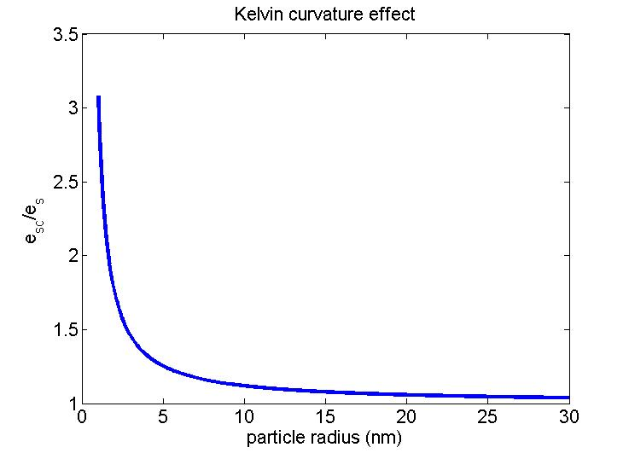
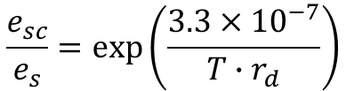
Curvature effect: the Kelvin effect
Dependence of the ratio of the saturation vapor pressure over a curved surface to the saturation vapor pressure over a flat surface on the droplet radius (at fixed T)
$$\frac{e_{sc}}{e_{s}}=\exp\left(\frac{3.3×{10}^{−7}}{T∙r_{d}}\right)$$
Rapid increase in equilibrium vapor pressure for particles with r_{d}<10 nm: all small clusters of water vapor and CCN start out at this small size
The Kelvin effect is important only for tiny droplets BUT it is important because all droplets start out as tiny and must go through that stage
Notes:
Cloud drops start as nanometer-size spherical drops, but the vapor pressure required for them to form is much greater than e_{s} until they get closer to 10 nm in size. The Kelvin effect is important only for tiny drops; it is important because all drops start out as tiny drops and must go through that stage. As drops gets bigger, their radius increases and e_{sc} approaches e_{s}.
So, is it possible to form a cloud drop out of pure water? This process is called homogeneous nucleation. The only way for this to happen is for two molecules to stick together, then add another, then another, etc. But the radius of the nucleating drop is so small that the vapor pressure must be very large. It turns out that drops probably can nucleate at a reasonable rate when the relative humidity is about 440%. Have you ever heard of such a high relative humidity?
Because the supersaturations that develop in natural clouds due to the adiabatic ascent of air rarely exceed a few percent (see Section 6.4.1), it follows from the preceding discussion that even if embryonic droplets of pure water as large as 0.01 micro in radius formed by the chance collision of water molecules,
they would be well below the critical radius required for survival in air that is just a few percent supersaturated.
Consequently, droplets do not form in natural clouds by the homogeneous nucleation of pure water. Instead they form on atmospheric aerosol by
what is known as heterogeneous nucleation.

Slide 24
Curvature effect: the Kelvin effect
Homogeneous nucleation: phase transition (e.g. condensation, solidification) occurring spontaneously without preferential nucleation sites
Heterogeneous nucleation: introduction of a foreign phase or surface, (nucleating agent) for the condensed phase to grow on
Can a cloud from out of pure water?
The Kelvin effect explains why homogeneous nucleation requires strong supersaturation (less probable/slower than heterogeneous nucleation)
When two molecules stick together the resulting “droplet” is very small, so the equilibrium vapour pressure must be very high for condensation to occur
Droplets can nucleate homogeneosly at a reasonable rate only when R.H. ≥ 440% (i.e. s = e/e_{s} -1=RH-1=4.4-1=3.4)
But supersaturation in natura clouds (via e.g. uplifting) is s~1-10%
Clouds form via heterogeneous nucleation on atmospheric aerosols
Notes:
Because the supersaturations that develop in natural clouds due to the adiabatic ascent of air rarely exceed a few percent (see Section 6.4.1), it follows from the preceding discussion that even if embryonic droplets of pure water as large as 0.01 micro in radius formed by the chance collision of water molecules,
they would be well below the critical radius required for survival in air that is just a few percent supersaturated.
Consequently, droplets do not form in natural clouds by the homogeneous nucleation of pure water. Instead they form on atmospheric aerosol by
what is known as heterogeneous nucleation.

Slide 25
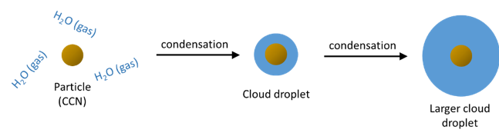
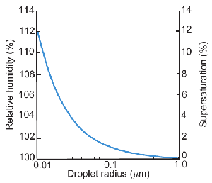
Heterogeneous nucleation
If water condenses onto a particle (r=0.3 μm) to form a thin film of water over the surface, the water film will be in (unstable) equilibrium with air when s ~ 0.4%. When s > 0.4%, water will condense onto the film of water and the droplet would increase in size
Some of the particles in air are soluble in water ⇒
they dissolve in H₂O (wholly or in part), generating a solution droplet, rather than a pure water droplet

Slide 26
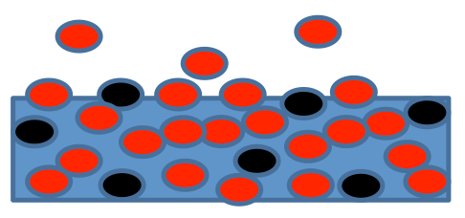


Chemical effect: Raoult’s law
Effect of a solute (e.g. a soluble CCN) with negligible vapour pressure (e.g. a salt) on the vapour pressure over a flat surface of the solution
Raoult’s law:
e_{sol}: equilibrium vapour pressure of the solution
e_{s}: equilibrium vapour pressure of pure H2O
n_{w}: number of moles of water per unit volume of solution
n_{s}: number of moles of solute per unit volume of solution
n_{L}: number of moles of water per unit volume of pure water
Raoult’s law can be approximated for a reasonably dilute solution as:
V_{drop}: volume of the solution droplet N_{s} : total moles of solute
i: Van’t Hoff factor. Accounts for the splitting of some solutes into components when they dissolve. E.g. NaCl, which splits into two ions in solution (Na⁺ and Cl–) has i = 2

Slide 27
Koehler theory
By putting together the curvature effect and the Raoult’s law the equilibrium vapor pressure for a water drop containing a solute is the triple product of:
saturation vapor pressure for pure water over a plane surface (e_{s})
x
curvature (e_{sc})
x
solute effect (e_{sol})

Slide 28
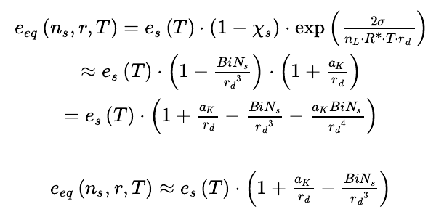
Koehler theroy
The resulting expression is called the Koehler equation:
It gives the equilibrium vapor pressure (e_{eq}) that a droplet will have for a given droplet radius (r_{d}) and given number of moles of solute (N_{s}).
There are two competing effects: the curvature or Kelvin effect that depends on the inverse of r_{d} and the solute or Raoult effect that depends on the inverse of the droplet r_{d}³

Slide 29
Koehler theroy
Saturation ratio S = e/e_{s}
We define a new saturation ratio and supersaturation for a particle, S_{k} and s_{k} ( “k” stands for “Koehler”) as:
Supersaturation s =S-1 = e/e_{s} -1
This is the Koehler equation applied to the individual droplets. Each droplet has its own Koehler curve because each droplet has its own amount of solute of a given chemical composition.
No two Koehler curves are alike, just as no two snowflakes are alike

Slide 30
Koehler curve
Koehler curve: the supersaturation of a particle as a function of the particle radius The radius increases as the particle takes on water
Kelvin wins
Raoult wins
s_{k} is the supersaturation of the particle, not the atmosphere
At the smallest r_{d} (~tens of nm), the Raoult solute effect (–1/r_{d}³) is stronger than the Kelvin effect ⇒ s_{k} is negative
As r_{d} gets bigger as water is added to the particle, the Kelvin effect (+1/r_{d}) starts to win out over the solute term (–1/r_{d}³) ⇒ s_{k} becomes positive

Slide 31
Koehler curve
As r_{d} gets very large, then the surface begins to look “flat” + the solution becomes so dilute that the solution approaches “pure” water: s_{k} tends to 0, which means that e_{eq} tends to e_{s}
s_{c} is called critical supersaturation. The particle cannot activate and grow into a cloud drop until the atmospheric supersaturation, s, exceeds s_{c}.
s_{c} occurs at the critical radius r_{c}, for activation. Drops that reach this radius can activate and grow into a cloud drop. Those that don’t won’t

Slide 32
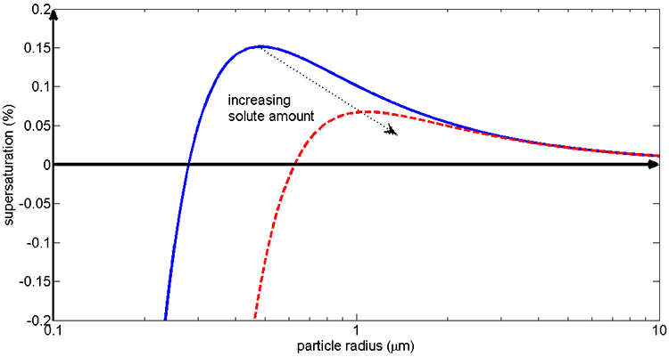
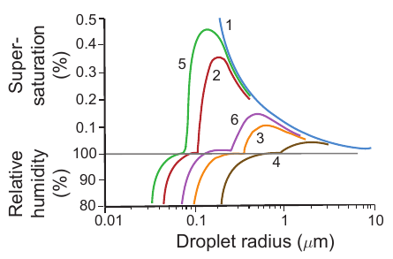
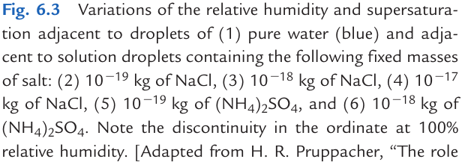
Koehler curve
How does the Koehler curve changes with the amount of solute (N_{s})?
The greater N_{s}, the lower s_{c}, and the greater r_{c}
supersaturation s = e/e_{s} -1=RH-1

Slide 33
Nucleation vs evaporation
What happens to the drop in the atmosphere?
Compare the Koehler curve for each drop to the ambient supersaturation (s) of the environment (= amount of water vapor available in the environment).
Koehler curve is the equilibrium supersaturation (s_{k}) for each drop and it varies as a function of the drop size.
When s_{k} = s, the drop is in equilibrium with the environment (condensation rate=evaporation rate)
When s > s_{k} net condensation will occur and the droplet will grow
no matter what the r value is
Notes:
To see what happens to the drop in the atmosphere, we need to compare the Koehler curve for each drop to the ambient supersaturation of the environment. The Koehler curve is the equilibrium supersaturation, s_{k}, for each drop and it varies as a function of the drop size. The ambient supersaturation, s, is the amount of water vapor available in the environment. When s_{k} = s, the drop is in equilibrium with the environment. The drop will always try to achieve this equilibrium condition by growing (condensing ambient water vapor) or shrinking (evaporating water) until it reaches the size at which s_{k} = s if it can! Another way to think about s_{k} is that it is telling us something about the evaporation rate for each drop size and temperature. For the drop to be in equilibrium with the environment, the condensation rate of atmospheric water vapor must equal the evaporation rate of the drop. If s_{k} < s, then net condensation will occur and the drop will grow. If s_{k} > s, then net evaporation will occur and the drop will shrink.
Interpretation of the figure:
The ambient supersaturation does not depend on the radius of the particle and so is a straight line on the graph.
The basic concept is the particle supersaturation is constrained to the s_{k} curve, the particle grows or shrinks in an effort to have s_{k} = s, that is, to have the particle condensation and evaporation be in equilibrium with the environment’s water vapor.
If s > s_{c}, then the condensation of ambient water vapor is greater than the evaporation from the drop no matter what the drop radius is.
The particle continues to grow, becomes a critical nucleus, and then continues to add water and grow into a cloud drop.
The drop can start at any size and it will grow into a cloud drop as long as the ambient supersaturation is greater than the Koehler curve.

Slide 34
Nucleation vs evaporation
When s < s_{k} net evaporation will occur and the droplet will shrink
s < s_{c} and the droplet radius is very small: drop grows to a value r on the left side of s_{c} and stops when s_{k} = s (haze drops formation, they do not nucleate to become cloud drops)
If a drop finds itself in an environment where s < s_{k} (e.g. by mixing with drier air) then the evaporation from the drop would exceed the condensation from the environment and the drop would shrink until s = s_{k}
Notes:
If s < s_{c} and the drop radius is very small, then the drop grows to a radius on the left side of s_{c} and stops when s_{k} = s.
The drops are called haze drops. They do not nucleate to become cloud drops but instead stay a smaller size. You have probably often seen haze on a warm, moist summer day.
If a drop finds itself in an environment where s < s_{k}, (as could happen if the drop's air is mixed with drier air), then the evaporation from the drop would exceed the condensation from the environment and the drop would shrink until s = s_{k}.
If a drop happens to find itself in an environment where s = s_{k}, the drop can shrink back into a haze drop or grow into a cloud drop, depending on the drop radius. If r < r_{c}, then the drop will shrink until it has a radius for which s = s_{k}. If r > r_{c} and s = s_{k}, then the drop is in unstable equilibrium and can either grow into cloud drops by adding a water molecule or can shrink all the way back to a haze drop with a radius that matches the radius for s = s_{k}.
If s = s_{c} (which is a special case of s = s_{k}) then the drop will grow to radius r = r_{c} and then with the random addition of a little water will grow a little bit more so that s_{k} < s. At this point, there will be net condensation and the drop will activate and continue to grow.

Slide 35
Nucleation vs evaporation
If a drop happens to find itself in an environment where s = s_{k}, the drop can shrink or grow into a cloud drop, depending on the radius:
For r < r_{c}, the drop will shrink until it has a radius for which s = s_{k}.
For r > r_{c} and s = s_{k}, then the drop is in unstable equilibrium and can either grow into cloud drops by adding a water molecule or can shrink all the way back to a haze drop with a radius that matches the radius for s = s_{k}.
Notes:
If s < s_{c} and the drop radius is very small, then the drop grows to a radius on the left side of s_{c} and stops when s_{k} = s.
The drops are called haze drops. They do not nucleate to become cloud drops but instead stay a smaller size. You have probably often seen haze on a warm, moist summer day.
If a drop finds itself in an environment where s < s_{k}, (as could happen if the drop's air is mixed with drier air), then the evaporation from the drop would exceed the condensation from the environment and the drop would shrink until s = s_{k}.
If a drop happens to find itself in an environment where s = s_{k}, the drop can shrink back into a haze drop or grow into a cloud drop, depending on the drop radius. If r < r_{c}, then the drop will shrink until it has a radius for which s = s_{k}. If r > r_{c} and s = s_{k}, then the drop is in unstable equilibrium and can either grow into cloud drops by adding a water molecule or can shrink all the way back to a haze drop with a radius that matches the radius for s = s_{k}.
If s = s_{c} (which is a special case of s = s_{k}) then the drop will grow to radius r = r_{c} and then with the random addition of a little water will grow a little bit more so that s_{k} < s. At this point, there will be net condensation and the drop will activate and continue to grow.

Slide 36
Nucleation vs evaporation
If s = s_{c} (which is a special case of s = s_{k}) then the drop will grow to radius r = r_{c} and then with the random addition of a little water will grow a little bit more so that s_{k} < s. At this point, there will be net condensation and the drop will activate and continue to grow.
Notes:
If s < s_{c} and the drop radius is very small, then the drop grows to a radius on the left side of s_{c} and stops when s_{k} = s.
The drops are called haze drops. They do not nucleate to become cloud drops but instead stay a smaller size. You have probably often seen haze on a warm, moist summer day.
If a drop finds itself in an environment where s < s_{k}, (as could happen if the drop's air is mixed with drier air), then the evaporation from the drop would exceed the condensation from the environment and the drop would shrink until s = s_{k}.
If a drop happens to find itself in an environment where s = s_{k}, the drop can shrink back into a haze drop or grow into a cloud drop, depending on the drop radius. If r < r_{c}, then the drop will shrink until it has a radius for which s = s_{k}. If r > r_{c} and s = s_{k}, then the drop is in unstable equilibrium and can either grow into cloud drops by adding a water molecule or can shrink all the way back to a haze drop with a radius that matches the radius for s = s_{k}.
If s = s_{c} (which is a special case of s = s_{k}) then the drop will grow to radius r = r_{c} and then with the random addition of a little water will grow a little bit more so that s_{k} < s. At this point, there will be net condensation and the drop will activate and continue to grow.

Slide 37
Bibliography
Wallace & Hobbs , “Atmospheric Science” Chapter 6 – Cloud microphysics
Hewitt& Jackson, Atmospheric Science For Environmental Scientists Chapt. 6 on Cloud formation and chemistry
https://www.e-education.psu.edu/meteo300/node/803

