Slide 1

University of Trento
Master of Science in Environmental Meteorology https://international.unitn.it/environmental-meteorology
A.A. 2023-24
Environmental Physical Chemistry
Particles in the atmosphere
Daniela Ascenzi
Dept. Physics, University of Trento, Italy
e-mail: daniela.ascenzi@unitn.it
Notes:
2021: NUOVO LINK UTILE PER RIVEDERE LE LEZIONI
https://www.dwd.de/EN/research/observing_atmosphere/composition_atmosphere/aerosol/aerosol_node.html;jsessionid=04FD958C9ED5BD5188F4A159211F4EBC.live21073
European Environment Agency: data on air pollution emissions by Country in EU:
https://www.eea.europa.eu/data-and-maps/dashboards/air-pollutant-emissions-data-viewer-1
http://cires1.colorado.edu/jimenez/AtmChem/
http://elte.prompt.hu/sites/default/files/tananyagok/AtmosphericChemistry/ch09.html
http://iopscience.iop.org/article/10.1088/0957-0233/21/8/085901/meta
https://www.ipcc.ch/publications_and_data/ar4/wg1/en/ch2s2-9-2.html
https://www.narsto.org/pm_science_assessment: scaricati una serie di file
Riferimento: NARSTO (2004) Particulate Matter Science for Policy Makers: A NARSTO Assessment. P. McMurry, M. Shepherd, and J. Vickery, eds. Cambridge University Press, Cambridge, England. ISBN 0 52 184287 5.
Libri Hewit Jacskon 169
Seinfeld Pandis: 720 per Rayleigh scattering
Aerosol lecture CHEM-5151_S05
Aerosol light scattering _lesson

Slide 2
Bibliography
Finlayson-Pitt et al. “Chemistry of the Upper and Lower Atmosphere” Chapt. 9 “Particles in the troposphere”
J.H. Seinfeld, S.N. Pandis “Atmospheric Chemistry and Physics-From air pollution to climate change”:
Chapt. 8 Properties of atmospheric aereosols
Chapt. 9 Dynamics of single aereosol particles
Chapt. 11 Nucleation
Chapt. 14 Organic atmospheric aereosols
Chapt. 15 Interaction of aereosols with radiation
Hewitt-Jackson “Atmospheric Science For Environmental Scientists”, Chapt. 7 “Particulate matter in the atmosphere”
NARSTO Assessment 2004 Particulate Matter Science for Policy Makers, Cambridge University Press https://www.narsto.org/pm_science_assessment
Notes:
Small enough to be suspended in the atmosphere, so rain and hail are not falling inside this definition because they precipitate too quickly.
Size range from nm to 100 micrometers, but the lower end of the size not clearly defined (at what point a cluster of molecules become a particle?)
NARSTO (NARSTO stands for North American Research Strategy for Tropospheric Ozone) and is a public / private partnership dedicated to improving management of air quality in North America.

Slide 3
Atmospheric particles: definitions & terminology
“system of solid or liquid particles suspended in a mixture of gases, with a negligible terminal fall speed”
aerosols*
total suspended particles (TSP)
particulate matter (PM): PM10, PM2.5 ...
coarse, fine and ultrafine particles
primary and secondary particles
inhalable, thoracic and respirable particles
black smoke
fog, clouds, pollens, dirt, dust ...
* Usually the term aerosol include both the particles and the gas in which they are suspended (multiphase systems)
Notes:
Small enough to be suspended in the atmosphere, so rain and hail are not falling inside this definition because they precipitate too quickly.
Size range from nm to 100 micrometers, but the lower end of the size not clearly defined (at what point a cluster of molecules become a particle?)

Slide 4
More on terminology
Notes:
Small enough to be suspended in the atmosphere, so rain and hail are not falling inside this definition because they precipitate too quickly.
Size range from nm to 100 micrometers, but the lower end of the size not clearly defined (at what point a cluster of molecules become a particle?)

Slide 5
More on terminology
Notes:
Small enough to be suspended in the atmosphere, so rain and hail are not falling inside this definition because they precipitate too quickly.
Size range from nm to 100 micrometers, but the lower end of the size not clearly defined (at what point a cluster of molecules become a particle?)

Slide 6

Aerosols
Aerosol particles can be classified according to:
Their genesis
Their origin
Particle size
Sampling technique
Effects and impacts on climate, health, meteo
Optical and physical properties
Chemical composition

Slide 7
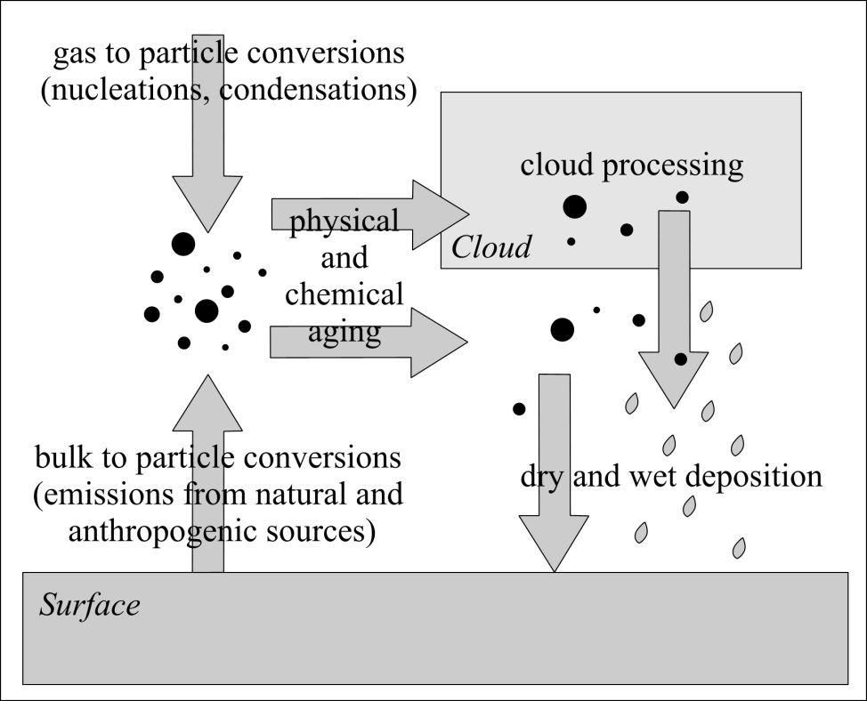
Genesis (+transformation and sinks)
Primary particles: directly emitted in the atmosphere
Secondary particles: formed in situ by nucl’n, cond’n, chemical reactions (e.g. sulphates from SO₂ emission of power plants)
Emission: primary particles
Emission: secondary particles
Processing
Removal from the atmosphere: wet
Notes:
Following the genesis of aerosol particles we classify primary aerosols such as dust or sea salt, while secondary aerosols are typically generated by either chemical reactions of trace gases (ammonium nitrate, ammonium sulphate) or spontaneous condensation and crystallization from the gas phase. Secondary aerosol particles are for example generated by condensation of sulphuric acid, oxidized hydrocarbons and chemical precursors of nitrate.
“Secondary” particles, on the other hand, are formed in the atmosphere from chemical reactions involving primary gaseous emissions. These particles can form at locations distant from the sources that release the precursor gases.
Ex: sulfates formed from SO2 emissions from power plants and industrial facilities and nitrates formed from nitrogen oxides released from power plants, mobile sources, other combustion sources.
Unlike coarse PM, a much greater portion of fine PM (PM 2.5) contains secondary particles.
After the emission of aerosol particles, they undergo various physical and chemical processes. During these processes, size, composition and structure of particles can be changed. Finally, they can be removed from the atmosphere to the surfaces by dry or wet deposition processes.
Aerosols can be removed from the atmosphere by different ways in the function of their size and disposition. Two main types of removing processes of aerosol particles are wet and dry deposition. In an annual global mean, about 80–90% of aerosol particles are removed from the atmosphere by in-cloud and below-cloud scavenging (wet deposition). Remaining part of particles is removed by different ways of dry deposition.
Wet deposition processes (the main sink of atmospheric aerosol particles):
Rain-out and washout: a part of cloud droplets form precipitation which reaches Earth’s surface removing aerosols from cloud and from the column of air below the cloud.
Cloud deposition: deposition form of aerosols in high elevation ecosystems due to interception of cloud droplets by vegetation.
Dry deposition processes (less important on a global scale):
Turbulent diffusion: for larger particles (with a diameter larger than 1 µm) eddy diffusivity becomes important.
Gravitational settling (sedimentation): larger particles are influenced more by gravity and fall back to the surface. This process becomes increasingly important for particle sizes above 1 µm.
Impaction: if a particle cannot follow the flow streamline around an obstacle (e.g. a larger particle), small particle can hit this obstacle (Figure 9.3).
Interception: if an object is not directly in the path of particle moving in the gas stream (as in case of impaction), but particle approaches the edge of the obstacles, it may collected by the obstacle (Figure 9.4).
Brownian diffusion: randomly moving smaller particles bump each other (thermal coagulation^{[21]}) or to a larger obstacles (Figure 9.5). This process dominates for particle sizes below 0.2 µm. Brownian diffusion coefficients increase as particle diameter decreases. Additionally, in a very thin (about 1 mm) layer over the surface, the Brownian diffusion becomes more important for larger particles too.

Slide 8
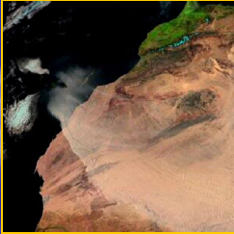
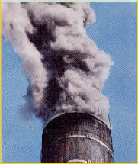
Origin: aerosol sources
Natural sources
Anthropogenic sources
Wind erosion
Marine and oceans
Volcanic eruptions
(natural) biomass burning
Biological material: pollens, bacteria, spores, microorganisms
Fossil fuel combustion (from power plants)
Industrial processes
Biomass burning (including waste incinerators)
Transports, house-hold heating
Notes:
According to the origin of aerosols we distinguish between natural and anthropogenic particles. Typical anthropogenic aerosols such as soot and sulphate and ammonium-based particles originate from combustion processes in industrial environment, the traffic sector and human agricultural activities. Natural sources of aerosols are often erosion processes but also (natural) biomass burning, generation of sea salt particles from sea spray and volcanoes for volcanic ash. The size spectrum of aerosol particles extends across six magnitudes. It starts at the lower end with molecule clusters being smaller than a nanometre (10⁻⁹m) and ends with visible dust particles, plant matter, Pollen, algae, bacteria, fungal spores or precipitation in the millimetre range.

Slide 9

Aerosols from sea: bubble bursting
Bubble bursting: air bubble burst generates small (film droplets 5-30 μm) or larger (jet drops ∼15% of the air bubble diam).
Upon water evaporation maritime aerosol particles are generated, with diameters 0.3-2 μm
NaCl, MgSO₄, KCl, (NH4)₂SO₄
Notes:
Bubble bursting is the mayor mechanims for aerosol generation over oceans. Both small and larger droplets can be ejected into the air when an air bubble burst at the surface.

Slide 10
Global emission source strengths (Tg year⁻¹)
*
* Production in large amount from natural sources but mainly coarse → minor health issues

Slide 11
Sources and trends: the EU situation
% contribution to EU-28 PM10 and PM2.5 emissions from main source sectors in 2016

Slide 12
Terms and sampling techniques
Total Suspended Particles (TSP)
Sampling by collection on a glass-fiber filter. Includes particles
of various sizes (up to 50-160 μm in diameter). Not a good indicator of health-related exposure (some particles too large to enter human respiratory tract)
PM10 and PM2.5
Fine particulates with dimensions smaller than 10 μm (PM10) or 2.5 μm in aerodynamic diameter. Sampling by size-selective inlets. Ambient standards use PM10 and PM2.5 rather than TSP
Black smoke
Sampled by measuring light reflectance from stain caused by deposition of particulate on a white filter paper (used in areas where coal smoke is the main source of airborne particulate)
Notes:
Usually the terminology is also related to the sampling techniques

Slide 13
PM10 and PM2.5
Air quality in terms of particulates is today given by PM10 and PM2.5
World Health Organization (WHO) standards
European Union standards
Source: Air quality in Europe -2020 report https://www.eea.europa.eu//publications/air-quality-in-europe-2020-report

Slide 14
Effects of atmospheric aerosols
Notes:
Bubble bursting is the mayor mechanims for aerosol generation over oceans. Both small and larger droplets can be ejected into the air when an air bubble burst at the surface.

Slide 15
Effects of particulate matter
visibility (light scattering and absorption)
climate (light scattering alters the amount of solar radiation reaching the surface)
health
“PM affects the world population in a continuous way more than any other pollutants…About 90% of the population living in cities in 2016 was exposed to PM in concentrations exceeding the WHO air quality guidelines”

Slide 16
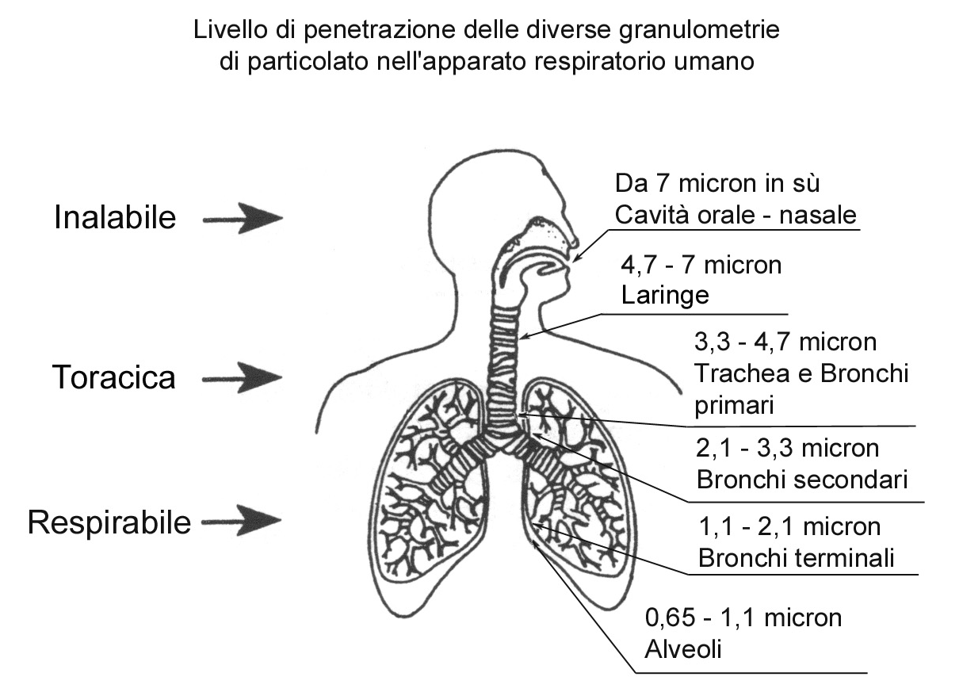
Health effects: direct
PM are split into three groups according to their health risk in relation to interaction with cardiovascular and respiratory system
Penetration levels of the various sizes of PM in respiratory system
> 7 μm (micron)
Oral/ nasal cavities
inhalable particles
larynx
PM₁₀
thoracic particles
windpipe/primary bronchi
secondary bronchi
respirable particles
terminal bronchi
PM_{2.5}
pulmonary alveoli
See also http://www.who.int/news-room/fact-sheets/detail/ambient-(outdoor)-air-quality-and-health
Notes:
Inhalable fraction – the mass fraction of total airborne particles which is inhaled through the nose and mouth.
•Extrathoracic fraction – the mass fraction of inhaled particles failing to penetrate beyond the larynx.
•Thoracic fraction – the mass fraction of inhaled particles penetrating beyond the larynx.
•Respirable fraction – the mass fraction of inhaled particles penetrating to the unciliated airways
Accumulation-mode aerosols (0.1-2 pm diameter) are those that penetrate most deeply into the lung. The observations that acidic ionic species and toxic and mutagenic compounds such as metals and PAHs are found primarily in this size
fraction raise issues with respect to the health effects of fine particulate matter.
Ambient (outdoor) air pollution in both cities and rural areas was estimated to cause 4.2 million premature deaths worldwide per year in 2016; this mortality is due to exposure to small particulate matter of 2.5 microns or less in diameter (PM_{2.5}), which cause cardiovascular and respiratory disease, and cancers.

Slide 17
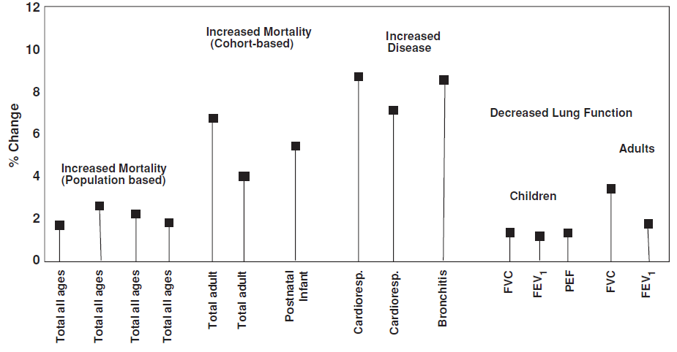
Health effects: direct
Deposition efficiencies (here corrected for size-dependent inhalability) in the major regions of the human respiratory tract depends on the particle diameter
NOPL: naso-oro-pharyngo-laryngeal region
TB: tracheobronchial region
P: pulmonary region
Chronic exposure study: % change in health issue per 5 μg/m³ increase in PM2.5 exposure
Notes:
From Chapt2 NARSTO: A considerable and growing body of evidence shows an association between adverse health outcomes, especially of the cardio-respiratory system,
and short- and long-term exposures to ambient PM, especially PM2.5. Evidence, from both opportunistic studies of significant reductions in ambient PM over short time periods as well as long-term studies, also
suggests that health improves when the ambient concentration of PM is reduced.
Hypotheses that explain how the various chemical and physical characteristics of PM cause specific adverse health impacts have been proposed and partially tested. Continuing to test these hypotheses will require ongoing close collaboration between the atmospheric and health-science communities.
Studies from 1999

Slide 18
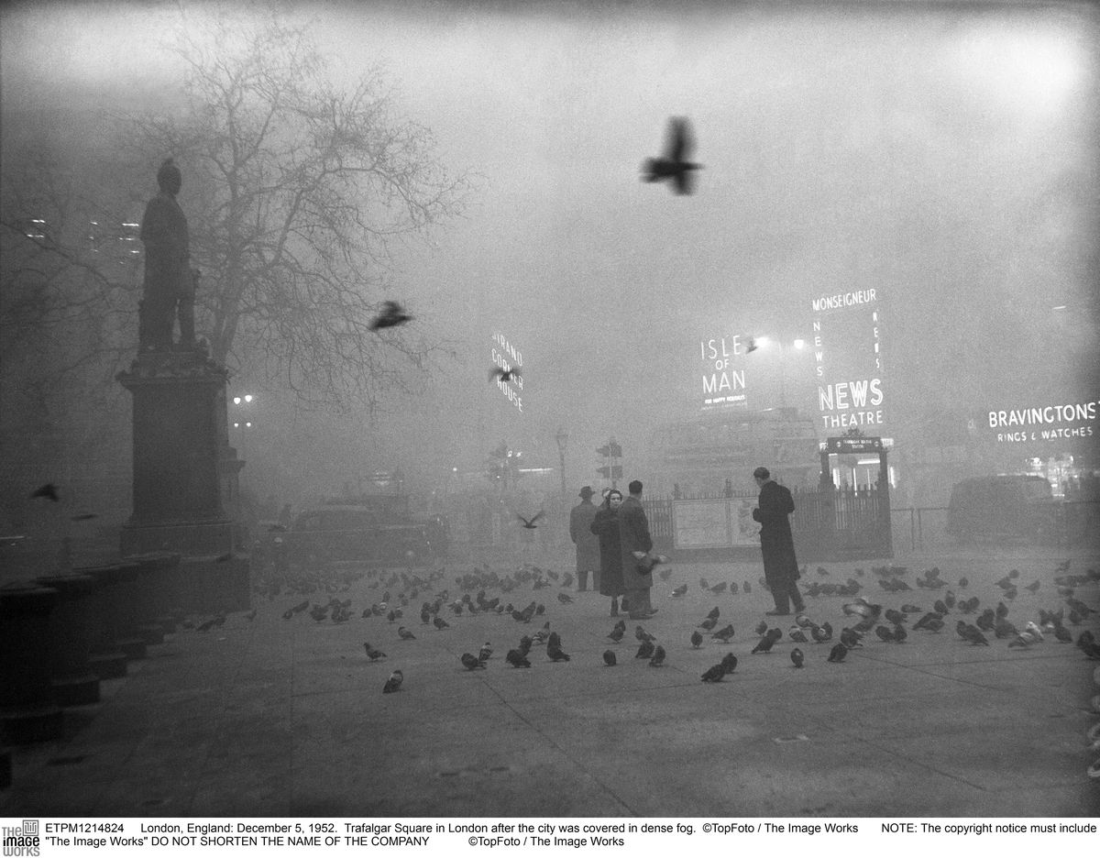
The Great Smog of London 1952
5-9 December 1952: the worst air-pollution event in European history
Cold weather + coal burning + meteo conditions (anticyclone, no wind, T inversion)
4,000 dead as a direct result of the smog and more than 100,000 ill. More recent estimate: 6,000 more died in the following months
Start of environmental research & regulatory policy/ public awareness on air pollution (Clean Air Act 1956)
https://www.cbsnews.com/news/londons-1952-killer-fog-cause-revealed/
Notes:
The Great Smog of London, or Great Smog of 1952, was a severe air-pollution event that affected the British capital of London in early December 1952. A period of cold weather, combined with an anticyclone and windless conditions, collected airborne pollutants—mostly arising from the use of coal—to form a thick layer of smog over the city. It lasted from Friday, 5 December to Tuesday, 9 December 1952 and then dispersed quickly when the weather changed.
It caused major disruption by reducing visibility and even penetrating indoor areas, far more severe than previous smog events experienced in the past, called "pea-soupers". Government medical reports in the following weeks, however, estimated that up until 8 December, 4,000 people had died as a direct result of the smog and 100,000 more were made ill by the smog's effects on the human respiratory tract. More recent research suggests that the total number of fatalities was considerably greater; about 6,000 more died in the following months as a result of the event.^{[1]}
London had suffered since the 13th century from poor air quality,^{[2]} which worsened in the 1600s,^{[3][4]} but the Great Smog is known to be the worst air-pollution event in the history of the United Kingdom,^{[5]} and the most significant in terms of its effect on environmental research, government regulation, and public awareness of the relationship between air quality and health.^{[1][3]} It led to several changes in practices and regulations, including the Clean Air Act 1956.

Slide 19
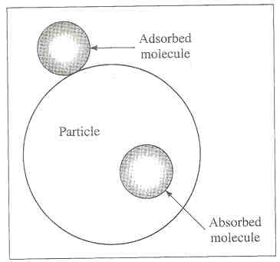
Health effects: indirect
Indirect health related issue due to transport and catalysis
Suspended solid particles (e.g. carbonaceous particles) are very active as catalysts for gas phase reactions (heterogeneous catalysis) and as transport vehicles for gaseous pollutants (adsorbed on particles)
Surface/volume ratio is a critical parameter

Slide 20
Effects: interaction with e.m. radiation
Mechanisms of interaction between incident radiation and a particle
I₀(incident) = I_{abs}+I_{scattered}
Three type of scattering processes:
elastic scattering: λ₀(scatt) = λ₀ (incident)
quasi-elastic scattering λ₀ shifts due to Doppler effects and diffusion
inelastic scattering: λ(emitted) ≠ λ₀ (incident) - loss of energy following absorption
Notes:
Electromagnetic radiation incident on an aerosol interacts with the electric fields of the electrons and protons in a process known as scattering, described by Maxwell’s equations. Light scattering by an aerosol particle may be elastic, where the emitted light is the same wavelength as the incident radiation, or inelastic, where the wavelength of the emitted light is increased due to a loss of energy following absorption. The processes by which particles interact with light are shown here schematically. The optical properties of an individual aerosol particle determine the amount of scattering and absorption which take place during its interaction with light and depend upon the size, shape, morphology and refractive index of the particle and the wavelength of the light.

Slide 21
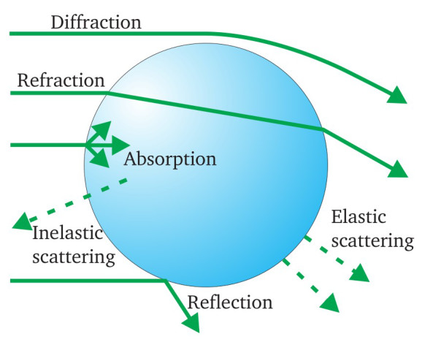
Effects: interaction with e.m. radiation
The amount of scattering and absorption depends on:
size
shape
morphology
refractive index
Particle:
Light:
wavelength
visibility
climate
Interaction of particles with light affects:
1. Very large particles: (dimensions>> λ) act as bulk samples (scattering treated using geometric lens optics)
2. Very small particles (dimensions<< λ): Rayleigh scattering
3. Intermediate particles (dimensions ≈ λ): Lorenz-Mie solution of Maxwell eq.’s (scattering of a plane wave by an homogeneous sphere)
Notes:
Electromagnetic radiation incident on an aerosol interacts with the electric fields of the electrons and protons in a process known as scattering, described by Maxwell’s equations. Light scattering by an aerosol particle may be elastic, where the emitted light is the same wavelength as the incident radiation, or inelastic, where the wavelength of the emitted light is increased due to a loss of energy following absorption. The processes by which particles interact with light are shown here schematically. The optical properties of an individual aerosol particle determine the amount of scattering and absorption which take place during its interaction with light and depend upon the size, shape, morphology and refractive index of the particle and the wavelength of the light.
Very large particles act like a bulk sample and simple geometric lens optics may be applied to understand their interactions with light. For very small particles, with radius much smaller than the wavelength of light, Rayleigh scattering theory can be applied and scattered radiation is emitted uniformly in all directions. When particles are in the size regime with radii 20 – 100x the wavelength of light, more complex scattering treatments must be employed to describe the interactions.
Picture from https://allaboutaerosol.com/optical-properties/

Slide 22
Effects: interaction with e.m. radiation
Relationship among particle radius and light wavelength
Scattering is maximum for a particle radius corresponding to the wavelength of radiation. Larger particles scatter radiation efficiently, while smaller particles are inefficient scatterers
Aereosol particles in the 0.01-1 μm range are efficient scatterers of solar radiation
Notes:
Electromagnetic radiation incident on an aerosol interacts with the electric fields of the electrons and protons in a process known as scattering, described by Maxwell’s equations. Light scattering by an aerosol particle may be elastic, where the emitted light is the same wavelength as the incident radiation, or inelastic, where the wavelength of the emitted light is increased due to a loss of energy following absorption. The processes by which particles interact with light are shown here schematically. The optical properties of an individual aerosol particle determine the amount of scattering and absorption which take place during its interaction with light and depend upon the size, shape, morphology and refractive index of the particle and the wavelength of the light.
Very large particles act like a bulk sample and simple geometric lens optics may be applied to understand their interactions with light. For very small particles, with radius much smaller than the wavelength of light, Rayleigh scattering theory can be applied and scattered radiation is emitted uniformly in all directions. When particles are in the size regime with radii 20 – 100x the wavelength of light, more complex scattering treatments must be employed to describe the interactions.
Picture from https://allaboutaerosol.com/optical-properties/

Slide 23
Effects on visibility
Visibility of objects is determined by contrast with background (2 vs 3). Contrast is reduced by elastic scattering processes from particles: scattering in the line of sight (1) and scattering of radiation from the object out of the line of sight (4)
Particles having dimensions similar to wavelenght of solar radiation (VIS 0.4-0.8 μm) give biggest effects
Notes:
Visual range is defined as the distance at which a black object can just be distinguished against the horizon.
Two factors enter into visual range: visual acuity and contrast. In the daytime atmosphere, particles reduce the contrast perceived by an observer by scattering light from the object out of the line of sight to the observer's eyes; simultaneously, sunlight is scattered into the line of sight, making dark objects appear lighter. The result is a decrease in the contrast between the object and the horizon.

Slide 24
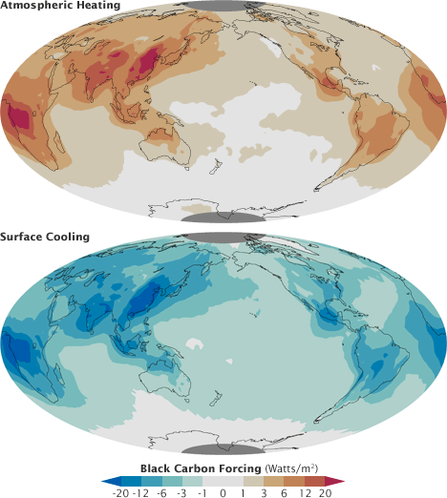
Effects on climate
Aerosol presence influences the energetic balance of the atmosphere (radiative forcing= a natural or anthropogenic perturbation in the radiative energy budget of Earth’s climate system)
Direct effect: aerosols absorb and scatter solar radiation and IR radiation from Earth
Dependence on the aereosol composition (most aereosol reflect light, but some absorbe it)
Overall effect is not simple to predict
Impact on regional scales (localized emiss.)
bright-colored/ translucent particles
(sulfates/nitrates)
reflect radiation back to space (negative forcing)
absorb radiation (warm the top layers of the atmosphere but cool the surface)
Dark aerosols (black smoke, volcanic eruptions)
Notes:
Black carbon aerosols, similar to the soot in a chimney, absorb sunlight rather than reflecting it. This warms the layer of the atmosphere carrying the black carbon, but also shades and cools the surface below. Aereosol deposition can alter the albedo of the planet.
Aerosols are recognized as a major factor influencing global and regional climate change owing to their ability to scatter When the black smoke lands on snow dramatically change the reflectivity of the surface. Long-term accumulation of black carbon aerosols in the Arctic and Himalaya is leading to increased melting of snow.and absorb solar radiation.
Aerosol emissions can be very localized (e.g. emission of a volcano) so it is more complex to predict the impact at a global scale.
Read more at: https://phys.org/news/2018-02-scientists-impacts-aerosol-radiative.html#jCp
See also https://earthobservatory.nasa.gov/Features/Aerosols/page3.php

Slide 25
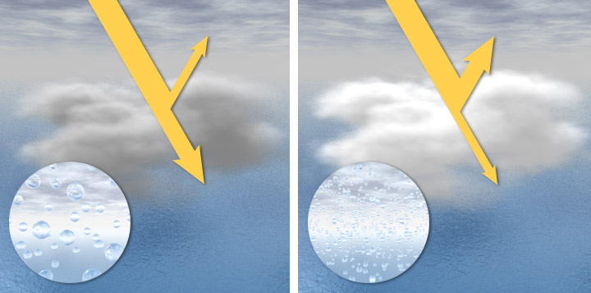
Effects on climate
Indirect effect: aerosols act as cloud condensation nuclei, affecting cloud formation and properties
global scale: typically negative forcing
Twomey effect
Clean air - small number of large droplets (mostyl poor soluble particles) - dark and translucent clouds
Reduced reflectivity→ More light from Sun is transmitted to Earth
Polluted air large number of small droplets (high conc. of water-soluble particles) - dense, very reflective, bright white clouds
Block sunlight from reaching Earth’s surface producing a net cooling
Notes:
Indirect effect: they modulate Earth's energy balance by altering cloud properties—in particular, cloud droplet size—by serving as cloud condensation nuclei, which further influence the cloud fraction, height and lifetime. All these aspects result in modification of the planetary albedo and hydrological cycle. Some important environmental issues, such as haze, acid rain and tropospheric ozone pollution, are also closely correlated with aerosol pollution.
Per Twomey effect vedere il file twomey effect 1974 e twomey effect slides in directory my directory «aerosols particles clouds»
https://en.wikipedia.org/wiki/Twomey_effect
Indirect: not directly related with absorption/scattering of radiation.
https://earthobservatory.nasa.gov/features/Aerosols/page4.php
Natural aerosols—often sulfates, sea salt or ammonium salts—are the most common condensation nuclei in pristine environments. Polluted air, in contrast, usually contains much higher concentrations of water-soluble particles, which means pollution-rich clouds tend to have more numerous, but smaller, droplets. The small droplets make polluted clouds look brighter than they would otherwise be. Just as many bits of crushed ice give light more surfaces to reflect off—appearing brighter than a solid cube of ice—if the water in a cloud is divided into a larger number of smaller droplets, it will scatter more light and become more reflective.
Brighter clouds, in turn, block sunlight from reaching Earth’s surface, shading the planet and producing net cooling. This cloud brightening effect—called the “cloud albedo effect”—may have a big impact on the climate, though only in recent years has it been possible to start quantifying the effect.

Slide 26
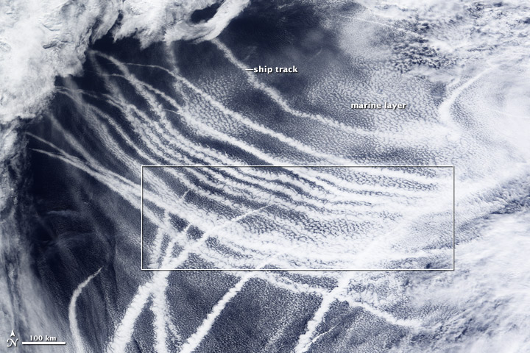
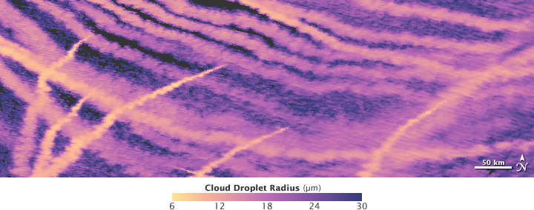
Effects on climate
Effect on clouds visible in ship tracks:
Dense, bright marine clouds formed by the exhaust of passing ships.
Bright white clouds
(top) and a map of cloud droplet radius (bottom).
Where ship exhaust mixed with the cloud layer, droplets became much smaller
https://earthobservatory.nasa.gov/features/Aerosols/page4.php
Notes:
https://earthobservatory.nasa.gov/features/Aerosols/page4.php
Natural aerosols—often sulfates, sea salt or ammonium salts—are the most common condensation nuclei in pristine environments. Polluted air, in contrast, usually contains much higher concentrations of water-soluble particles, which means pollution-rich clouds tend to have more numerous, but smaller, droplets. The small droplets make polluted clouds look brighter than they would otherwise be. Just as many bits of crushed ice give light more surfaces to reflect off—appearing brighter than a solid cube of ice—if the water in a cloud is divided into a larger number of smaller droplets, it will scatter more light and become more reflective.
Brighter clouds, in turn, block sunlight from reaching Earth’s surface, shading the planet and producing net cooling. This cloud brightening effect—called the “cloud albedo effect”—may have a big impact on the climate, though only in recent years has it been possible to start quantifying the effect.

Slide 27
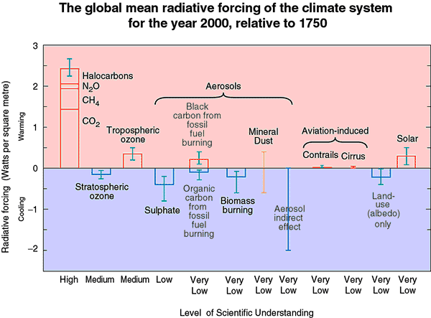
Effects on climate
Forcing depends on chemical composition of the aerosols
Uncertainty in whether aerosol presence causes a net increase or decrease in average global T
https://www.ipcc.ch/publications_and_data/ar4/wg1/en/ch2s2-9-2.html
Notes:
Left portion of the figure: global, annual mean radiative forcings (W/m2) for the period from pre-industrial (1750) as given by the IPCC. The height of each rectangular bar denotes a best estimate value while its absence denotes no best estimate is possible+estimated uncertainties. Level of scientific understanding represents the subjective judgment of the IPCC working group on radiative forcing of the reliability of the forcing estimate. Bars and I-beams at right denote estimates of total aerosol forcing, total forcing, and associated uncertainties. First bar denotes total aerosol forcing evaluated as algebraic sum of IPCC aerosol forcings, with mineral dust and aerosol indirect forcings taken as 0; for second bar, these
forcings are taken as the midpoints of the IPCC uncertainty ranges. Third and fourth bars denote total forcing evaluated in the same way, again with mineral dust and aerosol indirect forcings taken as 0 and as the midpoints of the IPCC uncertainty
ranges, respectively. For each bar, two uncertainty estimates are provided. Upper and lower limits of the first (larger) uncertainty range are calculated as algebraic sum of upper and lower limits, respectively, of the uncertainties of the several
forcings. Upper and lower limits of the second (smaller) uncertainty range are calculated as the square root of the sum of the squares, respectively, of the of the upper and lower uncertainty ranges relative to the estimated forcings denoted by the bars.
Figure 7.10 illustrates recent estimates of the mean annual radiative forcing for various climate-change mechanisms, averaged globally for the period 1750–2000 (IPCC, 2001). When viewed on a global scale, shortwave radiative forcing
from anthropogenic aerosols is considered to offset part of the longwave radiative forcing due to greenhouse gases. However, the same argument cannot be applied on a regional scale for a number of reasons. First, greenhouse gases have lifetimes measured in decades to centuries and are globally well mixed, in contrast to aerosols, which have lifetimes of less than one week on average and are geographically variable in extent. Second, aerosol forcing responds more rapidly to changes in aerosol emissions than
greenhouse forcing, which is still infl uenced by accumulated past emissions. Third, aerosol radiative forcing is more restricted to source and downwind regions, which may then experience an overall negative forcing. Last, greenhouse-gas
forcing is not as diurnally and seasonally variable as aerosol forcing, which has a greater infl uence during: (i) daylight, (ii) cloudless conditions and (iii) summer. Such difficulties greatly hinder the modelling of aerosol direct and indirect effects
Su radiative forcing guardare anche sito IPCC https://www.ipcc.ch/publications_and_data/ar4/wg1/en/ch2s2-9-2.html

Slide 28
Physical and chemical properties
Size distribution, shape
Mass concentration
Structure
Chemical composition
Notes:
http://elte.prompt.hu/sites/default/files/tananyagok/AtmosphericChemistry/ch09.html
http://iopscience.iop.org/article/10.1088/0957-0233/21/8/085901/meta
http://cires1.colorado.edu/jimenez/AtmChem/
https://www.ipcc.ch/publications_and_data/ar4/wg1/en/ch2s2-9-2.html

Slide 29
Shape and dimensions
PM toxicity (deposition efficiencies are size dependent)
Light scattering (0.1-1 μm most efficient for scattering solar radiation)
Surface reactions & absorptions (with same PM mass, smaller particles higher total surface area)
PM lifetime (faster sedimentation of bigger PM, loss via coagulation for small PM)
Size matters!
scattering coefficient of a single particle per unit volume as a function of the particle diameter (spheres with a refractive index of 1.50 and light with λ= 550 nm)
Notes:
Most of the light scattering by particles in the atmosphere is due to particles in the size range 0.1-1 microm as
shown by calculations carried out during World War II for screening smoke particle sizes. This can be seen in Fig. 9.22, which shows the scattering coefficient of a single particle per unit volume as a function of the particle diameter for spheres with a refractive index of 1.50 and light of wavelength 550 nm.
The portion of the total extinction coefficient due to particle scattering, bsp, can be obtained by combining
the curve in Fig. 9.22 with the particle volume size distribution, that is, by the curve of AV A log D vs
log D.

Slide 30
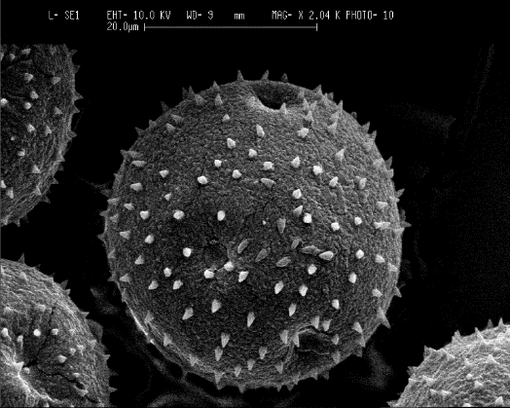
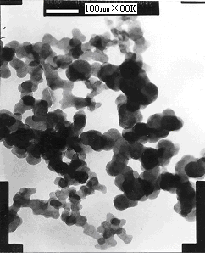
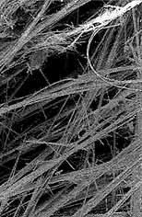
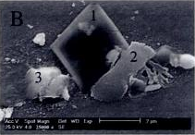
Shape and dimensions
Particle sizes usually reported as diameters
Dimensions: from 1-2 nm (0.001-2 μm) to 100 μm
Yet many particles have irregular shapes ⇒ assume spherical particles and use equivalent/effective diameters
Biogenic
pollens
Organic
soot
Inorganic
2. sea-salts
3. aluminosilicate
Fibre
asbestos
Notes:
What is the size of an aerosol particle? Throughout this chapter, the size of a particle is classified by its diameter, d. Diameter immediately implies that a particle is spherical. However, dry aerosol particles are rarely spherical. Figure 7.2 shows images from an electron microscope of four different aerosol types. It can clearly be seen that the particles are not spherical, so how should they be categorized?
This is where the notion of equivalent diameters is used.

Slide 31
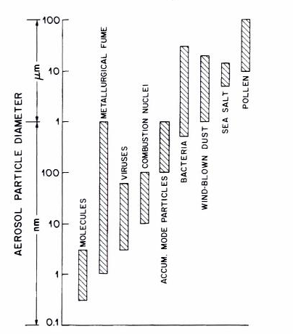
Shape and dimensions
Typical dimensions of various aerosol particles
Detection level limit for
human eye
0.4-0.8 μm: detection level limit for an optical microscope
Detection level limit for an electronic microscope
Size range of aerosols extends over more than 4 decades!

Slide 32
Aerosol diameters
Equivalent diameter: the diameter of a spherical particle that has some of the same physical properties as the one being studied
Commonly used effective diameters:
Aerodynamic equivalent diameter D_{a}: The diameter of a spherical particle of unit density (ρ₀=1 g⋅cm⁻³) with the same terminal velocity as the one of interest.
Stokes diameter D_{s}: The diameter of a spherical particle with the same terminal velocity and density as the one of interest (ρ_{P})
Optical equivalent diameter D_{o} : The diameter of a spherical particle with the same optical properties as the one of interest
Electrical mobility diameter D_{m} : The diameter of a charged spherical particle with the same migration velocity as the one of interest in a constant electric field at atmospheric pressure
Notes:
In generale le particelle hanno forma qualunque. Per semplificare si assumono sferiche.
Aerodynamical: assume the density of water (renormalize as if it is made of water)
Stokes: takes into account the density

Slide 33
Stokes equivalent diameter
Assumption: laminar flow (no turbolence)
viscous resistance force F_{D}
Particle
diameter D_{S}
density mass m_{P}
Viscous and continuous fluid
viscosity η
density ρ
ρ_{P}=6m_{P}/πD_{a}³
Newton’s law:
F_{G} = m_{P} g
force of gravity F_{G}
v = particle velocity relative to the fluid
Stokes law:
C_{c} = Cunningham slip correction factor (accounts for the non-continuity of the fluid when D_{a} is small )
Terminal (settling) velocity (neglecting buoyancy effect of air, i.e. ρ_{P}>>ρ_{air}) is given by equating F_{G} = F_{D}
Notes:
Assumiamo che le forze viscose siano dominanti su quelle inerziali (numero di Reynolds R_{e}<<1) Re=ρ<v>d/μ
With *<v>=macroscopic velocity
ρ è la massa volumica densità (kg/m³);
d= lunghezza caratteristica del fenomeno considerato
μ è la viscosità dinamica (Pa·s o N·s/m² o kg/(m·s));
the Cunningham correction factor or Cunningham slip correction factor is used to account for noncontinuum effects when calculating the drag on small particles. The derivation of Stokes' law, which is used to calculate the drag force on small particles, assumes a no-slip condition which is no longer correct at high Knudsen number. The Cunningham slip correction factor allows predicting the drag force on a particle moving a fluid with Knudsen number between the continuum regime and free molecular flow.

Slide 34
Aerodynamic equivalent diameter
D_{a} is the one of widespread use because:
It governs transport and removal of particles from the atmosphere
It governs their deposition in the respiratory system
It is associated with the PM chemical composition and their sources
Conversion between D_{a} and D_{s} (Stokes)
Assumption of large particles (D>1μm) so that C_{c}=1
Terminal (settling) velocity:
Notes:
The aerodynamics can be extracted from the Stokes one
Il Da è quello maggiormente utilizzato in quanto:
governa il trasporto e la rimozione delle particelle dall’aria;
governa la loro deposizione nel sistema respiratorio;
associato alla loro composizione chimica e la loro possibile sorgente

Slide 35
Aerosol diameters
Mobility diameter (D_{m})
Aerodynamic diameter (D_{a})
Diesel soot diameter measurements
Notes:
In generale le particelle hanno forma qualunque. Per semplificare si assumono sferiche.

Slide 36
Aerosol size distributions
Aerosol size distribution are determined by:
source processes
transformation mechanisms
removal (sink) processes
Size fractions are divided in:
Coarse (D>1-2 μm)
Fine (D<1-2 μm)
further divided in :
accumulation (D≈0.1-1 μm)
Aitken (D≈0.01-0.1 μm)
nucleation/ultrafine (D<0.01 μm)
Notes:
Aerosol size is one of the most important parameters in describing aerosol properties and their interactions with the atmosphere and each other, and its determination and use is of fundamental importance.
Characterization of the life cycle of atmospheric aerosols is a complex and much faceted issue.
In the picture we see: aerosols sized and their connections to:
(i) aerosol sources; (ii) transformation mechanisms and (iii) aerosol sink processes.
Size fraction with diameter d > 1–2 μm is usually referred to as the coarse mode
the fraction d < 1–2 μm is the fine mode. The latter mode can be further divided into the accumulation mode (d ≈ 0.1–
1.0 μm), Aitken (d ≈ 0.01–0.1 μm) and nucleation (d < 0.001 μm) modes.
The volume (and mass) of a particle is proportional to d3, hence the coarse mode is typified by a maximum volume concentration.
The surface area of the aerosol is proportional to d2 and has a maximum in the accumulation mode, whereas the Aitken and nucleation modes are typified by maximum number concentrations.

Slide 37
Production, growth and removal
Nucleation: clustering of gas molecules to produce ultrafine aerosols
Condensation & coagulation:rapid growth up to the fine aerosol range dimensions
Notes:
Gas molecules are typically in the 10-4-10-3 microm size range.
Clustering of gas molecules (nucleation) produces ultrafine aerosols in the 10-3-10-2 microm size range. These ultrafine aerosols growrapidly to the 0.01-1 microm fine aerosol size range by condensation of gases and by coagulation (collisions between particles during their random motions).
Growth beyond 1 microm is much slower because the particles are by then too large to grow rapidly by condensation of gases, and because the slower random motion of large particles reduces the coagulation rate.
Aerosol particles originating from condensation of gases tend therefore to accumulate in the 0.01-1 mm size range, often called the accumulation mode (as opposed to the
ultrafine mode or the coarse mode). These particles are too small to sediment at a significant rate, and are removed from the
tmosphere mainly by scavenging by cloud droplets and subsequent rainout (or direct scavenging by raindrops).

Slide 38
Secondary particles production
Condensation: gas to particle process
gas
Coagulation: particle to particle process
Notes:
Sources and chemical composition of FINE and COARSE particles are different.
COARSE are generated by mechanical processes and consist of soil dust, sea salt, fly ashes,m tire wear particles.
FINE particles contain primary particles (e.g. combustion) but also secondary ones (sulfate, nitrate, ammonium, secondary organics) formed by chemical reactions (gas to particle conversion processes) and coagulation of smaller particles

Slide 39
Production, growth and removal
Growth > 1μm slows down due to:
slower random motion of larger particles that reduces coagulation rate.
Particles are too large to grow substantially by condensation
So particles tend to accumulate in the (D≈0.01-1 μm) size range called accumulation mode
Notes:
Gas molecules are typically in the 10-4-10-3 microm size range.
Clustering of gas molecules (nucleation) produces ultrafine aerosols in the 10-3-10-2 microm size range. These ultrafine aerosols growrapidly to the 0.01-1 microm fine aerosol size range by condensation of gases and by coagulation (collisions between particles during their random motions).
Growth beyond 1 microm is much slower because the particles are by then too large to grow rapidly by condensation of gases, and because the slower random motion of large particles reduces the coagulation rate.
Aerosol particles originating from condensation of gases tend therefore to accumulate in the 0.01-1 mm size range, often called the accumulation mode (as opposed to the ultrafine mode or the coarse mode). These particles are too small to sediment at a significant rate, and are removed from the atmosphere mainly by scavenging by cloud droplets and subsequent rainout (or direct scavenging by raindrops).

Slide 40
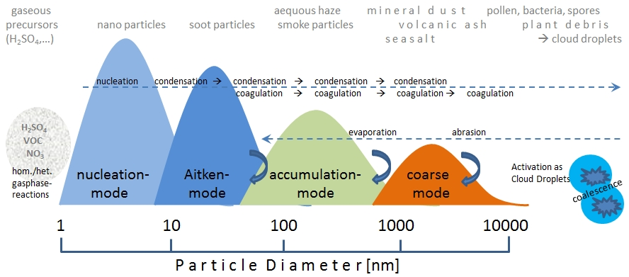
Particle number size distributions
Fragmentation and evaporation can move numbers of particles from the larger dimensions (coarse) to smaller (accumulation)
Notes:
The particle number size-distribution (PSD) and even more distinct the surface- and the volume size-distribution of the particle size typically exhibit one or several modes which result from different source and sink mechanisms. These modes overlap in the size spectrum, because the particles sizes continuously change due to condensation, coagulation, fragmentation and evaporation. In Fig. 1 a schematic view of a multi-modal particle size distribution illustrates the different growth- and shrink processes: The smallest particles form by Gas-to-particle conversion (nucleation mode) and grow through condensation of gases and water vapour, initially relatively fast (Aitken mode) and from size of 50-100 nm diameter (accumulation mode) slower in size by coagulation and coalescence. Beyond particle sizes of several 100 nm the efficiency of thermodynamic (evaporation, sublimation) and mechanical sink mechanisms (e.g. sedimentation, deposition/impaction) strongly increases. Simultaneously, fragmentation/grinding- and evaporation processes act against a growth of particle sizes. The activation of cloud condensation nuclei, the oxidation-induced increase of solubility, incorporation into cloud- and rain droplets followed by scavenging (wet deposition) are the most important processes which remove particles from the atmosphere.

Slide 41
Aerosol size distribution functions
Discrete distribution functions (usually normalized by the width of the size range): give the number of particles having diameter within a certain bin range
For large number of particles ⇒ continuous distribution functions
number of particles per cm³ of air having diameters in the range D_{p} to (D_{p} +dD_{p})
μm
unitn μm⁻¹cm⁻³
total number of particles per cm³

Slide 42
Logarithmic scale based distributions
PM diameters usually vary over several order of magnitude ⇒ the horizontal axis is scaled in log intervals for clarity (semilog charts)
Linear-linear graph of n_{N}(D_{p})
Semilog graph of n_{N}(D_{p})
Problem: semilog plots give distorted picture of the aerosol distribution. The area below the curve is no longer the aerosol number concentration

Slide 43
Logarithmic scale based distributions
PM diameters usually vary over several order of magnitude ⇒ the horizontal axis is scaled in log intervals for clarity (semilog charts)
Linear-linear graph of n_{N}(D_{p})
Semilog graph of n_{N}(D_{p})
Problem: semilog plots give distorted picture of the aerosol distribution. The area below the curve is no longer the aerosol number concentration

Slide 44
Logarithmic scale based distributions
Solution: express the distributions as a function of lnD_{p} or logD_{p} rather then D_{p}:
number of particles per cm³ of air in the size range lnD_{p} to (lnD_{p} +dlnD_{p})
lnD_{p} actually means ln(D_{p}/1) (logarithm function needs a dimensionless argument)
Units n_{N}^{e}(lnD_{p} ) are cm⁻³, since ln(D_{p}/1) is dimensionless
The total number concentration of particles is given by:
Integral is from –∞ because the independent variable is lnD_{p}

Slide 45
Logarithmic scale based distributions
Number distribution
Surface area distribution
Volume distribution

Slide 46
Surface area, volume and mass distributions
Some aerosol properties depend on the particle surface area or volume distribution (rather than particle number) with respect to particle size
Surface area distribution function:
surface area of particles per cm³ of air having diameters in the range D_{p} to (D_{p} +dD_{p})
spherical particles
within the range D_{p} to (D_{p} +dD_{p}) the diameter is constant and equal to D_{p}
Assuming:
Each particle has a surface area=
There are in this size range, so their surface area is
unit: μm⋅cm⁻³
total surface area of aerosol per cm³ of air (unit: μm²⋅cm⁻³)

Slide 47
Surface area, volume and mass distributions
Volume distribution function:
Volume of particles per cm³ of air having diameters in the range D_{p} to (D_{p} +dD_{p})
spherical particles
within the range D_{p} to (D_{p} +dD_{p}) the diameter is constant and equal to D_{p}
Assuming:
Each particle has a volume =
There are in this size range, so their volume is
unit: μm²⋅cm⁻³
total volume of aerosol per cm³ of air (unit: μm³⋅cm⁻³)

Slide 48
Surface area, volume and mass distributions
mass distribution function:
mass of particles, per cm³ of air, having diameters in the range D_{p} to (D_{p} +dD_{p})
If the particles all have density ρ_{p} (g⋅cm⁻³) then the distribution of particle mass with respect to particle size is:
unit: μg⋅μm⁻¹⋅cm⁻³
The 10⁶ factor to convert density units from g⋅cm⁻³ to μg⋅μm⁻³

Slide 49
Mathematical description of size distribution
Normal distribution (Gaussian function, bell shape)
The variance of the distribution is
The total number of particles is the integral below the bell shape:

Slide 50
What about a log normal distribution?
For further details: see Seinfeld, Pandis AtmChem&Phys Chap. 8
D value for which ½ particles are smaller and ½ are larger

Slide 51
Size distributions of aerosols: modes
Aerosol distributions can be described as a sum of several log normal distributions
Notes:
As a result of particle emission, in-situ formation, and subsequent processes, the atmospheric particle distribution is characterized by a number of modes.
The volume or mass distribution is dominated in most areas by two modes (lower panel): the accumulation mode (from around 0.1 to around 2 μm)
and the coarse mode (from around 2 to around 50 μm). Accumulation-mode particles result from primary emissions, condensation of secondary
sulfates, nitrates, and organics from the gas phase, and coagulation of smaller particles. In a number of cases the accumulation mode consists of two
overlapping sub-modes, the condensation and droplet
mode (lower panel)

Slide 52
Size distributions of aerosols: modes
The number distribution is dominated by the nucleation mode (small particles)
The volume (or mass) distribution is dominated by two modes:
1. accumulation mode (0.1-2.5 μm)
2. coarse mode
Notes:
As a result of particle emission, in-situ formation, and subsequent processes, the atmospheric particle distribution is characterized by a number of modes.
The volume or mass distribution is dominated in most areas by two modes (lower panel): the accumulation mode (from around 0.1 to around 2 μm)
and the coarse mode (from around 2 to around 50 μm). Accumulation-mode particles result from primary emissions, condensation of secondary
sulfates, nitrates, and organics from the gas phase, and coagulation of smaller particles. In a number of cases the accumulation mode consists of two
overlapping sub-modes, the condensation and droplet
mode (lower panel)

Slide 53
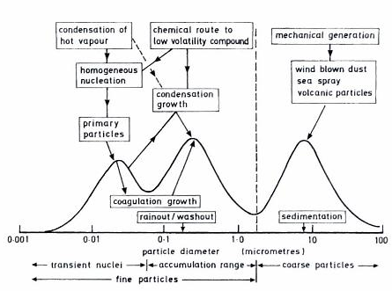
Modes and formation dynamics
Sources (and chemical compositions) of FINE and COARSE particles (in volume/mass distributions) are different:
Accumulation mode:
Chemical reactions (gas to particle conversion)
condensation submode: primary+growth by coagulation and condensation
tire wear
combustion
droplet submode: cloud processing of particles (aqueous reactions)
of secondary particles
Notes:
Sources and chemical composition of FINE and COARSE particles are different.
COARSE are generated by mechanical processes (e.g. wind erosion) and consist of soil dust, sea salt, fly ashes, tire wear particles, pollens.
FINE particles contain primary particles (e.g. combustion) but also secondary ones (sulfate, nitrate, ammonium, secondary organics) formed by chemical reactions (gas to particle conversion processes) and coagulation of smaller particles
The condensation sub-mode results from primary particle emissions and growth of smaller particles by coagulation and vapor condensation. The droplet sub-mode is created during the cloud processing of some of the accumulation-mode particles.
Aqueous reactions (in fog/cloud droplets) are responsible for the bimodal distribution of the accumulation mode (i.e. for the droplet submode).

Slide 54
Modes in number distributions
Modes are different in the number distribution
PM with D>0.1 μm (that contributed practically all the mass distribution) are negligible in numbers
Nucleation mode:
fresh, created in-situ from the gas phase by nucleation processes
Aitken mode:
originate as primary particles, and secondary material condenses on them as they are transported. They form the accumulation mode in the mass distribution
Notes:
A different picture of the ambient PM distribution is obtained if one focuses on the number of particles instead of their mass. Particles with D>0.1 μm that contribute practically all the PM mass are negligible in number compared to the particles smaller than 0.1 μm. Two modes usually dominate the PM number distribution in urban and rural areas: the nucleation mode (particles smaller than 0.01 μm or so) and the Aitken nucleus mode (particles with diameters between 0.01 μm and 0.1 μm or so).
The nucleation-mode particles are usually fresh, created in-situ from the gas phase by nucleation. A nucleation mode may or may not be present in a particular aerosol, depending on the atmospheric conditions.
Most of the Aitken nuclei start their atmospheric life as primary particles, and secondary material condenses on them as they are transported through the atmosphere. Nucleation-mode particles have negligible mass (for example 100,000 particles per cubic centimeter with a diameter equal to 0.01 μm
have a mass concentration of less than 0.05 μg/m3) while the larger Aitken nuclei form the accumulation mode in the mass distribution.

Slide 55
Modes in number distributions
Large number
Negligible mass
Large mass
Negligible number

Slide 56
Aerosol distributions in various atmospheres
Large range in N according to the geography/environment (polar <20 particles⋅cm⁻³, urban >10⁵ particles⋅cm⁻³)
Large changes with altitute (tropospheric vs stratospheric aerosols)
Urban aerosol
Mix of primary anthropogenic + secondary (gas-to-particle)
Bimodal mass mode (coarse+accumulation)
Number distribution for various atmospheric aerosols
Notes:
The total n. of particles depends on the location, but ranges from few 10-100 of particles per cc (ex in free troposphere) to about 10^5 in urban areas

Slide 57
Aerosol distributions in various atmospheres

Slide 58
Chemical composition
H₃O⁺
H₂O_{(l/s)}
salts (sulfates, nitrates, chlorides...) of various cations (ammonium, sodium...)
organic species (C,H,N,O,S)
oxides (mineral dust/sand)
soot (only C)
Notes:
Sulphate and organics are the major aerosol components of urban and remote continental
regions and sodium chloride of remote marine regions.

Slide 59
Chemical composition
Water-soluble (hygroscopic) particles
insoluble (hydrophobic) particles

Slide 60
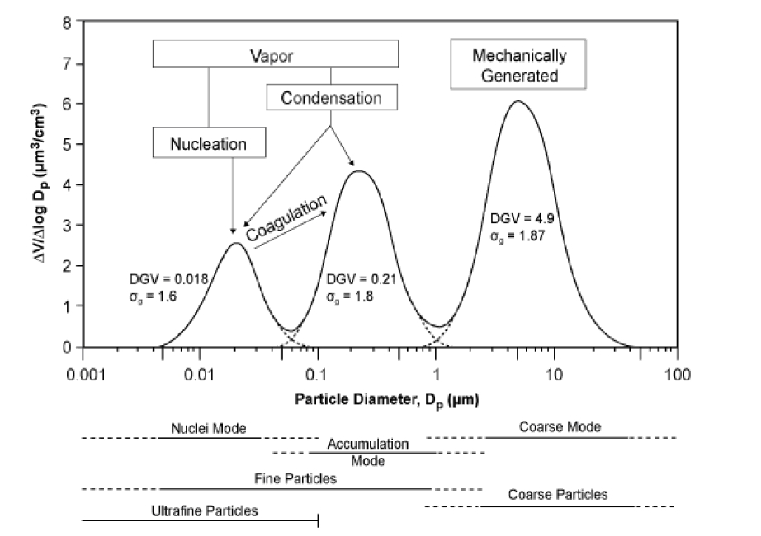
Chemical composition
Inorganic components: salts, oxides, inorganic C (e.g. carbonates)
Metals from the Earth crust: Fe, Si, Al, Ca, Mg
Organic species: VOC, PAHs, ....
Trace metals: Pb, Zn, Mn, Cu, Ni, Cr, V, As, Cd, ...
Size dependent composition of urban aerosols:
Nitrates (both coarse and fine)
sulphate, ammonium (fine)
Metals from the Earth crust (coarse)
Organic, elemental C, trace metals (fine)
Notes:
sulfate, ammonium, organic and elemental carbon, and certain transition metals are found
predominantly in the fine particles.
The sulfate in the accumulation mode are a signature of the fact that are secondary aerosols generated by nucleation/condensation/coagulation, but a small fraction (the one in the coarse mode) comes from primary processes

Slide 61
Chemical processes for inorganic particle formation
Solid oxides from inorganic solids in fuels (e.g. coal)
Gases reacting to produce liquid-forming compounds (gas-to-particle processes)
hygroscopic, forms aerosol droplets
Salt formation (via acid-base reactions)
in defect of NH₃, acidic droplets
Notes:
In combustion processes of inorganic solids (here for instance iron sulfide, or Calcium carbonate)
Gas to particle: remember
NH3 from industrial exhaust but also from agricultural (manure evaporates ammonia)

Slide 62
Formation of H₂SO₄ and sulphates (SO₄²⁻)
Two main pathways:
1. Gas phase oxidation of SO₂ (homogeneous reaction)
slow
2. Aqueous phase oxidation of SO₂ (heterogeneous reaction)
fast
Notes:
The formation of SO4= from the oxidation of SO2 is an important process
There are three different pathways for this transformation:
1. The oxidation of SO2 in the gas phase by the hydroxyl radical,
OH. This occurs at an average rate of 0.1 percent to 1 percent of SO2 per hour (with peak
rates up to 5 percent per hour) during the daytime. Nighttime conversion via this pathway is essentially negligible.
2. The dissolution of SO2 in cloud, fog, or rain water and subsequent aqueous-phase
oxidization. After the cloud evaporates, the SO4= remains in the particles and is eventually deposited to the surface. Aqueous phase production can be very fast: in some cases all the available SO2 can be oxidized in less than an hour. Near SO2 sources the process is usually limited by the availability of oxidants such as hydrogen peroxide, H2O2. An oxidation mechanism that generally takes place more slowly than oxidant-driven transformation of dissolved SO2 is catalysis by transition heavy metals such as manganese and iron.
3. The oxidation of SO2 in reactions in the water of the aerosol particles themselves. This process
takes place continuously, but only produces appreciable SO4= in alkaline (dust, sea salt) coarse
particles (Sievering et al., 1992). Oxidation of SO2 has been also observed on the surfaces of
black carbon and metal oxide particles.
NARSTO chap.3

Slide 63
Formation of HNO₃ and nitrates (NO₃⁻)
Formation scheme for HNO₃ and particulate
NO₃⁻
HNO₃ continuously transferred between the gas and the condensed phases
Favored by:
availability of NH₃
low T
High relative humidity
1.
2.
Notes:
Vedi NARSTO chap.3 e Finlayson-Pitts
Nitrates are formed from the oxidation of NO and NO2 (NOx) either during the daytime (reaction with
OH) or during the night (reactions with ozone and water). Nitric acid is continuously transferred between the gas and the condensed phases (condensation and evaporation) in the atmosphere (Figure 3.8). It naturally prefers the gas phase (when left alone), but reactions with gas phase NH3, sea salt, and dust result in its transfer to the condensed phase.
The formation of aerosol NH4NO3 is favored by availability of NH3, low temperatures, and high
relative humidity. The resulting NH4NO3 is usually in the sub-micrometer particle range. Reactions with
sea salt and dust lead to the formation of NO3- in the coarse particles. The availability of significant HNO3 vapor in an area (even if the particulate NO3-
concentrations are low or zero) is an indication of the potential for the future formation of NO3-
containing particles. Heterogeneous reactions and perhaps photolysis lead to the reduction of particulate
NO3- and return nitrogen oxides to the gas phase.

Slide 64
Chemical composition of particles
Water soluble secondary species (e.g. H₂SO₄ , HNO₃) can condense on pre-existing insoluble primary particles
Such “transformed” aerosols have differing optical properties
Notes:
Insoluble particles may develop a water-soluble coating of substances with low vapour pressure (e.g. sulphuric acid, H₂SO₄, or nitric acid, HNO₃) which may further adsorb other more volatile substances thus leading to changing particle properties. Such coated particles have differing optical properties and may act as cloud condensation nuclei, despite their hydrophobic nature.

Slide 65
Aerosol processes and dynamics

Slide 66
Aerosol formation processes
Gas-to-particle conversion
Heterogeneous nucleation
Gases can condense on existing aerosol particles. This is what usually happens for water condensation. Almost all water vapor condenses on pre-existing aerosols of some other chemical composition
Homogeneous nucleation
Gases can condense molecule by molecule to form an aerosol Some chemical species (e.g. sulfuric acid or organic acids) can form aerosols by homogeneous and heterogeneous nucleation
Notes:
Si può vedere un riassunto qui:
https://personal.ems.psu.edu/~brune/m532/meteo532_ch6_atmospheric_particles.htm

Slide 67
Chemical processing & secondary aerosols

Slide 68
Chemical processing

Slide 69
Organic aerosols
Bibliography:
Seinfeld, J.H., and J.F. Pankow, Organic atmospheric particulate material, Annual Review of Physical Chemistry, 54, 121-140, 2003 (see moodle).
Seinfeld & Pandis book, chap. 13
Finlayson-Pitt book, chap. 9.C.2, 9.D
Notes:
From file: Aerosol lecture_CHEM-5151_S05
Required reading: Seinfeld, J.H., and J.F. Pankow, Organic atmospheric particulate material, Annual Review of Physical Chemistry, 54, 121-140, 2003.
Recommended reading: 1) S&P chapter 13 2) F-P & P chapters 9.C.2, 9.D
Aerosol particulate material (PM) in the atmosphere affects the climate by absorbing
and scattering solar radiation, and by altering the properties and lifetimes of
clouds (1). It has also been implicated in human disease and mortality (2). Atmospheric
particles range in diameter from a few nanometers to tens of micrometers,
and contain a myriad of chemical species. The major categories of atmospheric
PM are inorganic salts, siliceous crustal minerals, carbonaceous materials, and
water. Whereas the inorganic salt and mineral fractions are generally amenable
to good chemical characterization, and reliable techniques certainly exist to measure
particulate-phase water, the great complexity of the carbonaceous fraction
poses analytical problems that currently prevent the compositional determinations
needed by those interested in predicting/modeling the chemical, physical, and
concentration aspects of atmospheric PM.

Slide 70
Primary and secondary organic aerosols
Notes:
Vedi NARSTO chap.3 e Finlayson-Pitts
POA( primary organic aerosol): Particulate organic PM emitted directly into the atmosphere, for example as products of fossil fuel combustion or biomass burning
SOA (secondary organic aerosol): particulate organic PM that is formed in the atmosphere when the oxidation products of certain volatile organic
compounds (VOCs) condense on pre-existing aerosols
The organic component of ambient particles is a complex mixture of hundreds or even thousands of
organic compounds. These organic compounds are either emitted directly from sources (primary organic aerosol) or can be formed in-situ by condensation of low-volatility hydrocarbon-oxidation products (secondary organic aerosol). As organic gases are oxidized by species such as OH, ozone, and NO3, their oxidation products accumulate. Some of these products have low volatilities and condense on available particles (Figure 3.9).

Slide 71
Organic, elemental and carbonate C
Carbon in PM comes in three fractions:
elemental carbon (EC)
organic carbon (OC)
carbonate carbon
Impure graphite emitted directly into atmosphere from combustion
strong absorber of VIS & near-IR light ⇒ “black carbon”
wholly nonvolatile, exist only in the particle phase
operative definition: portion of PM carbon that is resistant to decomposition under high-T conditions
C mixed with others (H, O, N)
wide variety of compounds with different volatility ⇒ can exist in both particle and gas phase
thousands of compounds, extremely complex
from soil dust (e.g. CaCO₃)
Notes:
From file: Aerosol lecture_CHEM-5151_S05
Required reading: Seinfeld, J.H., and J.F. Pankow, Organic atmospheric particulate material, Annual Review of Physical Chemistry, 54, 121-140, 2003.
Recommended reading: 1) S&P chapter 13 2) F-P & P chapters 9.C.2, 9.D
Aerosol particulate material (PM) in the atmosphere affects the climate by absorbing
and scattering solar radiation, and by altering the properties and lifetimes of
clouds (1). It has also been implicated in human disease and mortality (2). Atmospheric
particles range in diameter from a few nanometers to tens of micrometers,
and contain a myriad of chemical species. The major categories of atmospheric
PM are inorganic salts, siliceous crustal minerals, carbonaceous materials, and
water. Whereas the inorganic salt and mineral fractions are generally amenable
to good chemical characterization, and reliable techniques certainly exist to measure
particulate-phase water, the great complexity of the carbonaceous fraction
poses analytical problems that currently prevent the compositional determinations
needed by those interested in predicting/modeling the chemical, physical, and
concentration aspects of atmospheric PM.
The fact that particulate OC is always an aggregate mix of countless individual
compounds that possess a wide range of chemical and thermodynamic properties
makes measurements of particulate OC concentration difficult using any single direct
analytical technique.

Slide 72
Elemental carbon
Black C / graphitic C:
similar to graphite but more complex, 3D struct, with small amounts of other elements
crystallites of 2-3 nm in dimensions with graphitic layer structure
defects/dislocations/discon-tinuities (edges) ⇒ unpaired electrons/active sites ⇒ highly reactive ⇒ incorporate other elements (up to 10% H + traces of N, O)
Notes:
black or graphitic carbon, often referred to as elemental carbon. On a practical level, this is the
aerosol component that is insoluble in organic solvents and is not oxidized at temperatures below 400~
(Penner and Novakov, 1996). However, as discussed by Chang et al. (1982), carbon particles in the air are
made up of a number of crystallites 2-3 nm in diameter, with each crystallite consisting of several carbon
layers having the hexagonal structure of graphite. Because of the presence of defects, dislocations,
and discontinuities, there are unpaired electrons that constitute active sites in the carbon; during the formation
of the carbon particle in combustion processes, these active sites can react with gases to incorporate
other elements such as oxygen, nitrogen, and hydrogen into the structure. Thus elemental, black, or graphitic
carbon found in atmospheric particles is not chunks of highly structured pure graphite, but rather is a related,
but more complex, three-dimensional array of carbon with small amounts of other elements. As discussed later, the presence of polar groups on the surface is
believed to play an important role in determining their properties, such as uptake of water.

Slide 73
Elemental carbon, OC and soot
Soot: by-product of combustion of hydrocarbons. Contains both EC and OC. Present as chain agglomerate of small roughly spherical elementary carbonaceous particles.
density ∼2g⋅cm⁻³; dimension (of a single particle 20-30 nm)
Notes:
black or graphitic carbon, often referred to as elemental carbon. Pybproducts of combustion of liquid and gaseous fuels. Sooth is agglomerate of roughly spherical EC particles, diameters in the range 20-30 nm, that cluster with each other
On a practical level, this is the aerosol component that is insoluble in organic solvents and is not oxidized at temperatures below 400~
(Penner and Novakov, 1996). However, as discussed by Chang et al. (1982), carbon particles in the air are
made up of a number of crystallites 2-3 nm in diameter, with each crystallite consisting of several carbon
layers having the hexagonal structure of graphite. Because of the presence of defects, dislocations,
and discontinuities, there are unpaired electrons that constitute active sites in the carbon; during the formation
of the carbon particle in combustion processes, these active sites can react with gases to incorporate
other elements such as oxygen, nitrogen, and hydrogen into the structure. Thus elemental, black, or graphitic
carbon found in atmospheric particles is not chunks of highly structured pure graphite, but rather is a related,
but more complex, three-dimensional array of carbon with small amounts of other elements. As discussed
later, the presence of polar groups on the surface is believed to play an important role in determining their
properties, such as uptake of water.

Slide 74
Elemental carbon, OC and soot
Notes:
black or graphitic carbon, often referred to as elemental carbon. Pybproducts of combustion of liquid and gaseous fuels. Sooth is agglomerate of roughly spherical EC particles, diameters in the range 20-30 nm, that cluster with each other
On a practical level, this is the aerosol component that is insoluble in organic solvents and is not oxidized at temperatures below 400~
(Penner and Novakov, 1996). However, as discussed by Chang et al. (1982), carbon particles in the air are
made up of a number of crystallites 2-3 nm in diameter, with each crystallite consisting of several carbon
layers having the hexagonal structure of graphite. Because of the presence of defects, dislocations,
and discontinuities, there are unpaired electrons that constitute active sites in the carbon; during the formation
of the carbon particle in combustion processes, these active sites can react with gases to incorporate
other elements such as oxygen, nitrogen, and hydrogen into the structure. Thus elemental, black, or graphitic
carbon found in atmospheric particles is not chunks of highly structured pure graphite, but rather is a related,
but more complex, three-dimensional array of carbon with small amounts of other elements. As discussed
later, the presence of polar groups on the surface is believed to play an important role in determining their
properties, such as uptake of water.

Slide 75
Soot formation
3.
Coagulation of the aggregates in chains of dimensions up to 100 nm
2.
Clustering of the precursor molecules + surface growth by attachment of other gas phase molecules
1.
Gas phase reactions lead to formation of precursor molecules (catene olefinic and polyiins chains, PAH)
“Formation of polycyclic aromatic hydrocarbons and their growth to soot—a review of chemical reaction pathways” H. Richter, J.B. Howard,
Prog. Energy & Comb. Science 26, 565, (2000)
Notes:
Arrivata qui il 11 dicembre 2023

Slide 76
Soot formation
“Timescale” for soot formation
Coagulation and condensation
t ~ 10 s
carbonaceous nanoparticles
Molecular zone
t = ps ~ ms

Slide 77
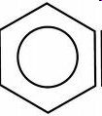
1. Formation of precursor molecules
Degradation of high molecular weight fuel in smaller species (pyrolisis).
Smaller species react (via radical reactions) to form:
poly-ynes C_{2n}H₂ (polyacetylenes)
benzene
An example of a radical reaction leading to benzene formation:
Sequential addition of C₂H₂ molecules
C₂H₃⋅
(etylene radical)

Slide 78
1. Formation of precursor molecules
Growth of other aromatic rings fused to the first one
An example of radical reaction leading to the growth of the second ring (napthalene) :
HACA model (Hydrogen Abstraction, Acetilene Addition)

Slide 79
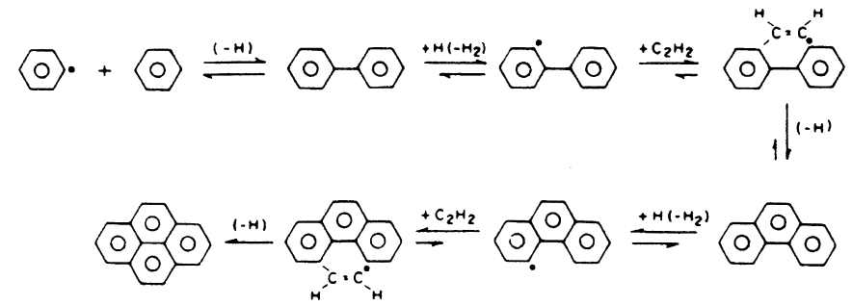
1. Formation of precursor molecules
Another example of radical reaction leading to the growth of a three ring system (phenanthrene) :
C₆H₅
phenil radical
Fusion of single rings

Slide 80
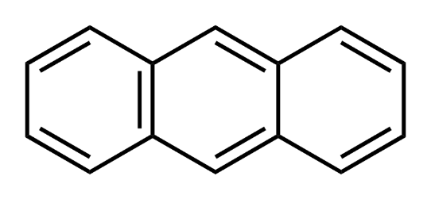
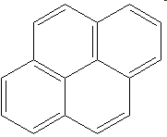
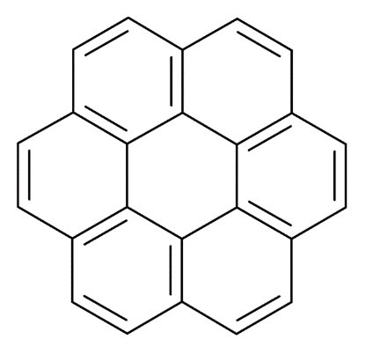
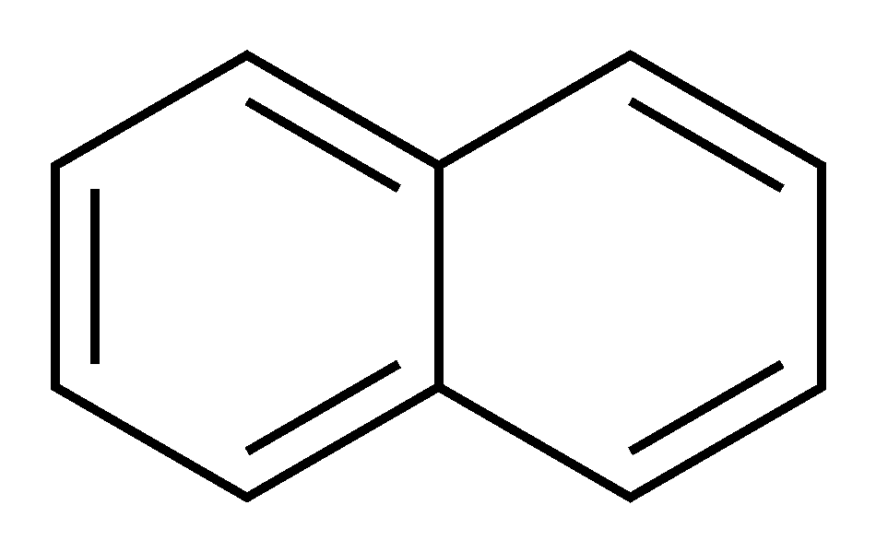
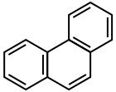
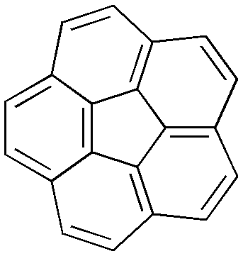
1. Formation of precursor molecules
Further growth and synthesis of PAHs
anthracene
pyrene
naphtalene
coronene
phenanthrene
corannulene

Slide 81
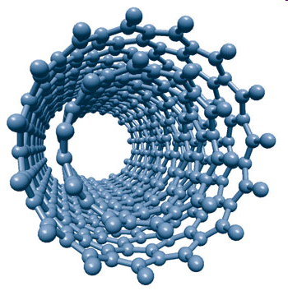
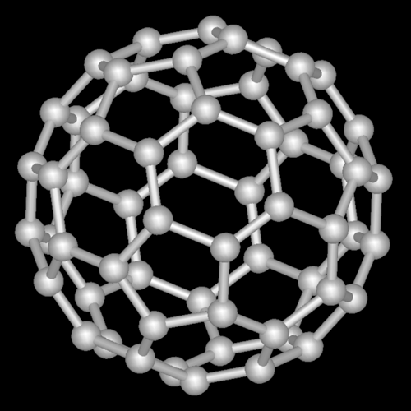
1. Formation of precursor molecules
When PAHs grow big enough the most stable structures are bent, semicircular ones
Carbon nanoparticles
nanotubi di carbonio
fullerenes

Slide 82
2. Clustering/surface growth
Planar (or quasi-planar) PAHs of large dimensions cluster together to form aggregates having layered structures (graphite-like structures) and almost spherical shape
10⁵-10⁶ atoms of C
3. Coagulation
The aggregates cluster together forming chain-like particles with dimentions up to 50-100 nm
Other (organic/inorganic) material can deposit on the surface of the aggregates

Slide 83
Why soot forms?
Soot formation critically depends on the C/O ratio during the combustion of hydrocarbon/air mixture.
Assuming a mixture with insufficient O₂ to form CO₂ but sufficient to form CO, the stochiometry is:
The C/O ratio is C/O=m/2a
For C/O =1 m-2a=0 and no sooth (C_{s}) is formed
For C/O <1 m<2a and the extra O is used to oxidize CO into CO₂ and no sooth is formed
For C/O >1 m>2a and sooth is formed
To minimize soot formation the HC/air mixture should be air rich (but this decreases the efficiency of the engine)

Slide 84
Why soot forms?
Soot formation critically depends on the fuel composition
Sooting tendencies are:
naphthalenes > benzene > aliphatics
Soot
(in fuel)

Slide 85
Why soot forms?
Soot formation critically depends on the type of fuels
Soot

Slide 86
Primary Organic Carbon
Chemical composition is extremely varied!!
continue →
Notes:
Estimated global annual emissions of primary organic PM, elemental carbon (EC), and gaseous precursors to secondary organic PM.
Globally, 45% of all EC emitted and 55% of all primary OC emitted are estimated to originate from fossil fuel burning

Slide 87
Primary Organic Carbon
Chemical composition is extremely varied!!
continue →
Notes:
Estimated global annual emissions of primary organic PM, elemental carbon (EC), and gaseous precursors to secondary organic PM.
Globally, 45% of all EC emitted and 55% of all primary OC emitted are estimated to originate from fossil fuel burning

Slide 88
Primary Organic Carbon
Chemical composition is extremely varied!!
Notes:
Estimated global annual emissions of primary organic PM, elemental carbon (EC), and gaseous precursors to secondary organic PM.
Globally, 45% of all EC emitted and 55% of all primary OC emitted are estimated to originate from fossil fuel burning

Slide 89
Estimated global annual emissions
From fossil fuel burning:
55% of POA
POA
45% of EC
Gaseous precursors to SOA
Notes:
Estimated global annual emissions of primary organic PM, elemental carbon (EC), and gaseous precursors to secondary organic PM.
Globally, 45% of all EC emitted and 55% of all primary OC emitted are estimated to originate from fossil fuel burning

Slide 90
For the following concepts:
Polarity of organic molecules (VOCs) and intermolecular forces
Effects of the intermolecular forces on molecular properties (vapour pressure, boling/freezing points, solubility in water
Principal types of VOCs: hydrocarbons, O-containing organics, N-containing organics
see the lecture on «Brief summary of organic chemistry»

Slide 91
Secondary organic aerosol formation
Notes:
Secondary organic PM is formed when VOCs are oxidized in the atmosphere to form higher polarity and therefore lower volatility reaction products that then
condense and thereby increase the mass concentration of PM

Slide 92
Effect of oxidation on vapour pressures
Changes to vapor pressure of an organic compound upon
addition of common functional groups
Addition of O- containing group has a greater effect on v.p. than an increase in the size of the carbon skeleton by one C atom
Ketone+aldehydes have smallest effects (due to low polarity)
Addition reactions of polar groups, with little C-C fragmentation, are most likely to lead to SOA
Notes:
The vapor pressure of a molecule is determined largely by its polarity and size. As a result, a key determinant of the volatility of an oxidation product is the importance of reactions that add polar functional groups relative to those that break the carbon skeleton.
Owing to variations in polarity, the identity of the added functional group also plays a major role in volatility. Shown in
Table 1 are the approximate effects of common functional groups on the vapor pressure of organics, as predicted by the group-contribution model
proposed by Pankow and Asher (2007). The addition of any oxygen-containing functional group has a greater effect on vapor pressure than an
increase in the size of the carbon skeleton by one carbon atom. However, this change is moderate for
aldehydes and ketones, which are relatively nonpolar.
Much larger decreases in volatility result from the addition of hydroxyl, hydroperoxyl, nitrate, and acid groups, each of which may lower
vapor pressure by over two orders of magnitude.
Thus the reaction pathways that lead to the addition of these polar functional groups to the carbon skeleton, with little to no fragmentation by the
breaking of C–C bonds, are those most likely to lead to the formation of low-volatility organics and hence SOA.

Slide 93
Effect of oxidation on vapour pressures
Notes:
The reduction in volatility that accompanies the conversion of a “parent” VOC to an oxidized product is a result of the fact that adding oxygen
and/or nitrogen to organic molecules reduces volatility. This is true regardless of whether the addition places alcohol, aldehyde, ketone, alkyl nitrate, nitro, and/or
carboxylic acid groups on the parent compound.

Slide 94
Secondary organic aerosol formation
Fraction (F) of the oxidation product in the particle phase increases with decreasing of the vapour pressure of the substance
Notes:
Route of formation of secondary organic particulate matter. Products of sufficiently low volatility, so-called “semi-volatile,” may condense on pre-existing particles,
which generally consist of inorganics, organics, and water, or nucleate homogeneously to form new particles.
Because significant secondary organic PM will not condense unless low-vapor pressure products are formed, in general only those parent organic molecules with six or more carbon atoms are capable of producing oxidized products that are important in the formation of secondary organic PM.

Slide 96
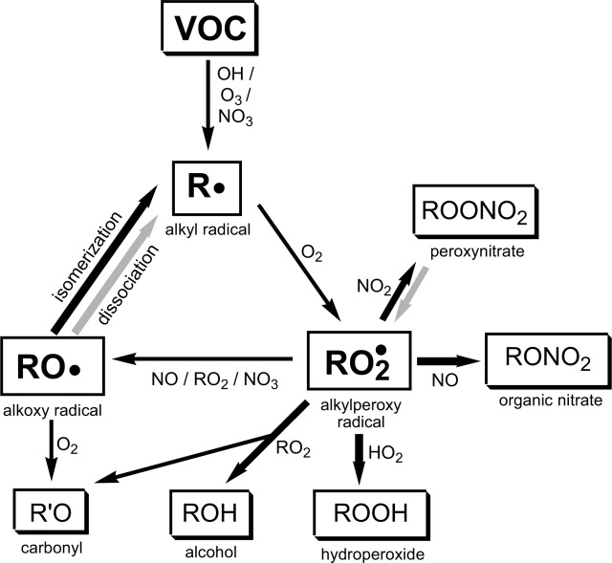
Oxidation mechanisms of generic VOC
major recognized oxidants during daytime (photolytic generation)
oxidation
Contributes at night (strong absorption in the visible + photodissociation)
NO₃ formation:
NO₂+O₃ → NO₃+O₂
Notes:
FinlaYSON pag 200 pdf. Organic species get oxidized
The major recognized oxidants for organics in the
troposphere are OH and 03, with a contribution from
NO 3 at night.
OH: mechanisms of formation oxidant during daytime due to photolytic generation
O3: gia visto
NO3: The nitrate radical is formed by the reaction of NO 2
with O3“ NO 2 + 03 ~ NO 3 + 0 2. ( 8 )
NO 3 only exists in sufficient concentrations to play a role in nighttime chemistry,
due to its strong absorption of light in the visible and subsequent photodissociation.
HO2:

Slide 97
Oxidation rates for organic species
Notes:
FinlaYSON pag 204
Tabelle delle rate di ossidazione delle sostanze organiche in base alla loro classe a seconda del tipo di
ossidante

Slide 98
New particle formation
?
nucleation takes place at sizes below the detection limit of traditional instruments
Notes:
Problem: The fact that nucleation takes place at sizes below the detection limit of traditional instruments and is therefore not directly accessible to measurements has so far hampered the elucidation of the nucleation process.
the growth of clusters to a detectable size is restricted by the availability of condensable vapour

Slide 99
New particle formation models
H₂SO₄ is a major driver of the first steps of New Particle Formation (NPF)
Nucleation and subsequent growth process for atmospheric binary homogeneous nucleation of H₂SO₄ and H₂O
Notes:
According to current knowledge, sulfuric acid is a major driver of the first steps of NPF in most environments

Slide 100
New particle formation models
NH₃ / amines are important due to ability to cluster efficiently with H₂SO₄
Ions may enhance clustering (for unstable neutral clusters, low vapour concentrations
Notes:
Base compounds, such as ammonia and amines, are also important due to their ability to cluster efficiently with
sulfuric acid and stabilize the initial nanoparticles. In addition, electric charge may enhance clustering when electrically
neutral clusters are unstable or vapor concentrations are low

Slide 101
New particle formation: observations
NPF happens just about everywhere one looks!
M. Kulmala et al. Aerosol Science 35 (2004) 143–176
Notes:
In this study we review more than 100 publications that report observations of ultra$ne particles in
the atmosphere. Global map. The dots indicate observation sites, the dashed lines and rectangles indicate regions where airborne
or ship observations have been made.
Low volatile organic vapors have long been considered responsible for growing the freshly formed particles to larger sizes Furthermore, recent experimental results show
that highly oxidized organic species, formed by oxidation of monoterpenes, can participate in NPF already at nanometer sizes. However understanding of the physics and chemistry of NPF involving organic compounds is still very limited, largely because the identities and properties of the organic species are
poorly known

Slide 102
New particle formation: observation
Measurements strategies for particles in the nucleation mode (3-20nm)
In addition to:
concentration measurements of nucleating gases (or their precursors)
composition of freshly nucleated particles
Notes:
In this study we review more than 100 publications that report observations of ultrafine particles in
the atmosphere. Global map. The dots indicate observation sites, the dashed lines and rectangles indicate regions where airborne
or ship observations have been made.
Technique for the measurement of gas phase sulphuric acid at concentrations down to about 104 cm−3 is available (Eisele & Tanner, 1993), and techniques for measuringammonia in the ppt range with
high time resolution have recently been deployed.
Low volatile organic vapors have long been considered responsible for growing the freshly formed particles to larger sizes Furthermore, recent experimental results show
that highly oxidized organic species, formed by oxidation of monoterpenes, can participate in NPF already at nanometer sizes. However understanding of the physics and chemistry of NPF involving organic compounds is still very limited, largely because the identities and properties of the organic species are poorly known

Slide 103
New particle formation: nucleation
Several mechanisms have been proposed to describe the initial particle formation (generation of nm-sized clusters)
heterogeneous nucleation of organic vapors
heterogeneous reactions between clusters and organic vapors
adsorption of organics on cluster surface
nano-Köhler-type mechanism
activation of nanometer-sized inorganic clusters to growth by condensation of organic vapor (soluble in the inorganic compound and water)
J. Kontkanen, T. Olenius, M. Kulmala et al.
Atmos. Chem. Phys., 18, 13733–13754, 2018
Notes:
In this study we review more than 100 publications that report observations of ultra$ne particles in
the atmosphere. Global map. The dots indicate observation sites, the dashed lines and rectangles indicate regions where airborne
or ship observations have been made.
Low volatile organic vapors have long been considered responsible for growing the freshly formed particles to larger sizes Furthermore, recent experimental results show
that highly oxidized organic species, formed by oxidation of monoterpenes, can participate in NPF already at nanometer sizes. However understanding of the physics and chemistry of NPF involving organic compounds is still very limited, largely because the identities and properties of the organic species are poorly known

Slide 104
Nano-Koehler theory
Comparison between Koehler theory and nano-Koehler theory
Notes:
In this study we review more than 100 publications that report observations of ultra$ne particles in
the atmosphere. Global map. The dots indicate observation sites, the dashed lines and rectangles indicate regions where airborne
or ship observations have been made.
Low volatile organic vapors have long been considered responsible for growing the freshly formed particles to larger sizes Furthermore, recent experimental results show
that highly oxidized organic species, formed by oxidation of monoterpenes, can participate in NPF already at nanometer sizes. However understanding of the physics and chemistry of NPF involving organic compounds is still very limited, largely because the identities and properties of the organic species are poorly known

Slide 105
Evidence of the role of H₂SO₄ in NPF
Lab measurements of new particles (d down to 1.5 nm) observed immediately after their formation at atmospherically relevant [H₂SO₄]
Correlations between measured nucleation rates J and [H₂SO₄] suggest that freshly formed particles contain one to two H₂SO₄ molecule
average slope p=1.5
Notes:
Nucleation is a fundamental step in atmospheric new-particle formation. However, laboratory experiments on nucleation have systematically failed to demonstrate sulfuric acid particle
formation rates as high as those necessary to account for ambient atmospheric concentrations, and the role of sulfuric acid in atmospheric nucleation has remained a mystery. Here, we report
measurements of new particles (with diameters of approximately 1.5 nanometers) observed immediately after their formation at atmospherically relevant sulfuric acid concentrations.
Furthermore, we show that correlations between measured nucleation rates and sulfuric acid concentrations suggest that freshly formed particles contain one to two sulfuric acid molecules, a
number consistent with assumptions that are based on atmospheric observations. Incorporation of these findings into global models should improve the understanding of the impact of secondary
particle formation on climate.

Slide 106
Evidence of the role of H₂SO₄ in NPF
Notes:
Nucleation is a fundamental step in atmospheric new-particle formation. However, laboratory experiments on nucleation have systematically failed to demonstrate sulfuric acid particle
formation rates as high as those necessary to account for ambient atmospheric concentrations, and the role of sulfuric acid in atmospheric nucleation has remained a mystery. Here, we report
measurements of new particles (with diameters of approximately 1.5 nanometers) observed immediately after their formation at atmospherically relevant sulfuric acid concentrations.
Furthermore, we show that correlations between measured nucleation rates and sulfuric acid concentrations suggest that freshly formed particles contain one to two sulfuric acid molecules, a
number consistent with assumptions that are based on atmospheric observations. Incorporation of these findings into global models should improve the understanding of the impact of secondary
particle formation on climate.

Slide 107
Evidence of the role of organics in NPF
Nucleation occurs at [H₂SO₄] concentrations similar to those found in the ambient atmosphere
Nucleation rates J are proportional to the product of the concentrations of H₂SO₄ and an organic molecule.
Gray data: ambient. Colours: lab exp at different (but roughly constants) [organic]
Notes:
Vedere anche How do organic vapors contribute to new-particle formation?
Neil M. Donahue,*ª Ismael K. Ortega,^{b} Wayne Chuang,ª Ilona Riipinen,^{abcd} Francesco Riccobono,^{f} Siegfried Schobesberger,^{b} Josef Dommen,^{f} Urs Baltensperger,^{f} Markku Kulmala,^{b} Douglas R. Worsnop^{be} and Hanna Vehkamaki^{b}
Faraday Discussions Volume 165, 2013
New particle formation in the atmosphere is an important parameter in governing the radiative forcing of atmospheric aerosols.
However, detailed nucleation mechanisms remain ambiguous, as laboratory data have so far not been successful in explaining atmospheric nucleation. We investigated the formation of new particles in a smog chamber simulating the photochemical formation of H2SO4 and organic condensable species. Nucleation occurs at H2SO4 concentrations similar to those found in the ambient atmosphere during nucleation events. The measured particle formation
rates are proportional to the product of the concentrations of H2SO4 and an organic molecule. This suggests that only one H2SO4 molecule and one organic molecule are involved in the rate-limiting step of the observed nucleation process. Parameterizing
this process in a global aerosol model results in substantially better agreement with ambient observations compared to control
runs.
In the figure: estimated nucleation rates (J1.5) from this study and atmospheric nucleation rates from Hyytiälä, Finland (7) as a function of gaseous H2SO4
concentration. Colored symbols: this study; gray symbols: ambient data. The black lines represent log(J1.5)= m · log(H2SO4)+ b with slopes of m=1 and 2. The colored lines indicate the slope of the nucleation rate as a function of the H2SO4 concentration at roughly constant NucOrg, which
is binned to concentration intervals
The scatter of the atmospheric nucleation rates is attributed to varying temperature, humidity, or varying contributions of unknown species in the nucleation process (29). Our laboratory data
agree surprisingly well with nucleation rates observed in the atmosphere

Slide 108
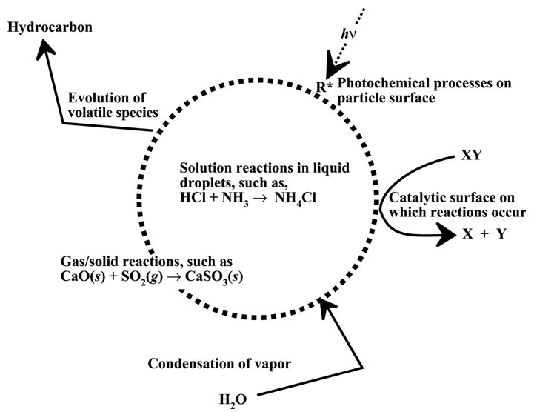
Reactions involving particles
Particles provide active surface upon which heterogeneous reactions can occur
Nucleation bodies for the condensation of water vapour
Notes:
Heterogeneous reactions are those involving more than one phase, such as reactions of gaseous molecules
with compounds on a solid or liquid surface or in bulk liquids. Some reactions that are unfavourable in the gas phase are able to occur on the surfaces or in the bulk of atmospheric aerosol particles.
There are two different implications when considering heterogeneous chemistry, they modify the aerosol composition and they influence gas-phase chemistry. The most basic example of a heterogeneous
Reaction is the adsorption of a gaseous molecule onto a solid particle surface The adsorbed molecule may also undergo a chemical reaction on/in the aerosol, resulting in either an altered aerosol composition or a release of
a reaction product into the gas phase, or both.

Slide 109
Removal of aerosols

Slide 111
Secondary organic aerosol formation
Oxidation products S₁ and S₂ of a VOC (e.g. hydrocarbon) form SOA by mass transfer from the gas phase into the particle phase
Mass transfer is governed by the partitioning equilibria gas/particle (G/P) constant K_{p}:
Mass transfer is proportional to the differences between concentrations of species S_{i} (with i=1,2) in the gas phase (c_{g}) and at the particle surface (c_{eq})
If c_{g} = c_{g}: the species is in G/P equilibrium ⇒ no net transfer
If c_{g} > c_{eq}: gas phase is supersaturated ⇒ part of the S_{i}^{g} will condense on the particle and SOA will form
Notes:
Secondary organic PM is formed when VOCs are oxidized in the atmosphere to form higher polarity and therefore lower volatility reaction products that then
condense and thereby increase the mass concentration of PM

Slide 112
Life-cycle of atmospheric particles
Aqueous-phase chemistry
SECONDARY
POLLUTANTS *
reactions
dispersion
ATMOSPHERIC
PARTICLES
PRIMARY
POLLUTANTS
Emissions
Interaction with gas and aqueous phases
* Transport: secondary particles can form at locations distant from the sources that release the precursor gases
Notes:
Aerosols can be removed from the atmosphere by different ways in the function of their size and disposition. Two main types of removing processes of aerosol particles are wet and dry deposition.
In an annual global mean, about 80–90% of aerosol particles are removed from the atmosphere by in-cloud and below-cloud scavenging (wet deposition). Remaining part of particles is removed by different ways of dry deposition.
Wet deposition processes (the main sink of atmospheric aerosol particles):
Rain-out and washout: a part of cloud droplets form precipitation which reaches Earth’s surface removing aerosols from cloud and from the column of air below the cloud.
Cloud deposition: deposition form of aerosols in high elevation ecosystems due to interception of cloud droplets by vegetation.
Dry deposition processes (less important on a global scale):
Turbulent diffusion: for larger particles (with a diameter larger than 1 µm) eddy diffusivity becomes important.
Gravitational settling (sedimentation): larger particles are influenced more by gravity and fall back to the surface. This process becomes increasingly important for particle sizes above 1 µm.
Impaction: if a particle cannot follow the flow streamline around an obstacle (e.g. a larger particle), small particle can hit this obstacle (Figure 9.3).
Interception: if an object is not directly in the path of particle moving in the gas stream (as in case of impaction), but particle approaches the edge of the obstacles, it may collected by the obstacle (Figure 9.4).
Brownian diffusion: randomly moving smaller particles bump each other (thermal coagulation^{[21]}) or to a larger obstacles (Figure 9.5). This process dominates for particle sizes below 0.2 µm. Brownian diffusion coefficients increase as particle diameter decreases. Additionally, in a very thin (about 1 mm) layer over the surface, the Brownian diffusion becomes more important for larger particles too.

Slide 113
Chemical composition
Notes:
From Hewitt-Jackson: Atmospheric aerosol may be composed of a range of chemical species. When particles are chemically
distinct from one another, they are termed as externally mixed. Alternatively, when particles have a similar composition they are known as internally
mixed. The degree of internal mixing of ambient particles is complex, and can range from a complete chemical mixing (e.g. all components dissolved
in a cloud droplet) to less well mixed (e.g. sulphate coating on soot aerosol).

Slide 114
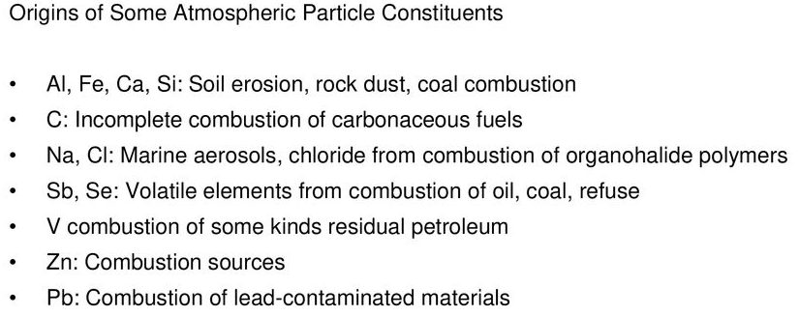
Chemical composition of particles

Slide 115
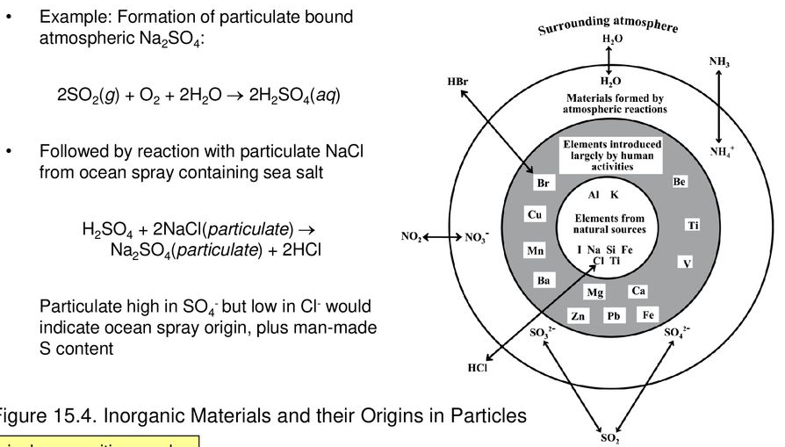
Composition of inorganic particles
Chemical composition can be used to identify source (and age) of aerosols
Notes:
Most of the elements found in coarse particles over land or sea are involatile and relatively chemically
inert; however, for a few elements, such as the halogens this is not true.
It was noted that marine aerosols on the Florida coast that the particles contained nitrate and that the NO3/Cl ratio was
highest when the wind direction was from the land and lowest when it was from the ocean; presumably the
breeze from the land contained anthropogenic pollutants that could react with the particles.
Numerous investigators have observed such a chloride ion deficiency relative to the sodium concentration,
and it has generally been ascribed to reactions of acids (e.g. H2SO4, HNO3) with NaCl to produce gaseous HCl
Other reactions that can consume Cl-:
2NO2 + NaCl -> ClNO(g)+NaNO3(s) gaseous nitrosyl chloride, ClNO
A number of different gaseous oxides of nitrogen, including N205
and ClONO2, also react rapidly with NaCl to generate NaNO3 and gaseous products such as ClNO2 and Cl2
(see Fynlayson p. 383 and Cap 7)

