Slide 1
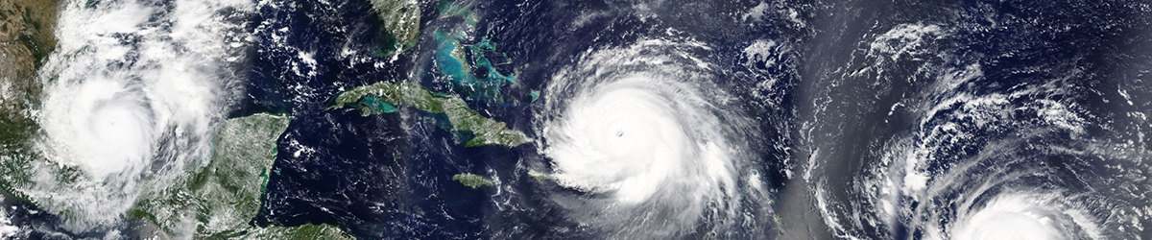
University of Trento
Master of Science in Environmental Meteorology https://international.unitn.it/environmental-meteorology
A.A. 2023-24
Environmental Physical Chemistry
Thermodynamics of solutions
Bibliography: e.g. P. Atkins, Physical Chemistry
Notes:
Relevance: droplets in air can contain substances that are soluble in water (e.g. sea sprays contains salts)
https://www.slideserve.com/seth/the-thermodynamic-description-of-mixtures-partial-molar-quantities-the-thermodynamics-of-mixing-the-chemical-potential
Atkins pag pdf pag 123

Slide 2
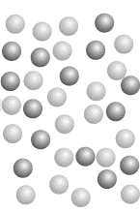
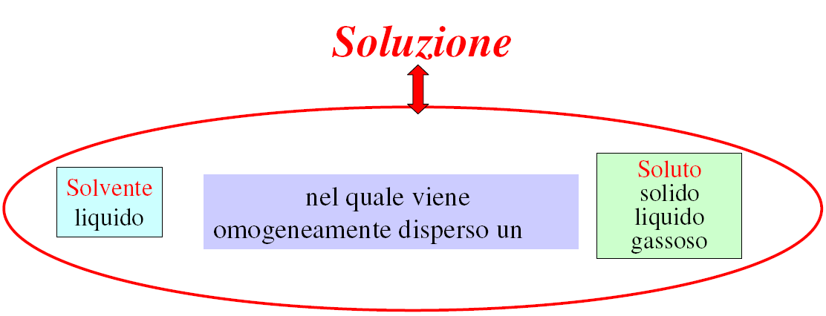
Solutions (or mixtures)
Homogeneous mixture of two (or more) chemical species
Physical state of a solution can be solid, liquid or gas, but the most common ones (to be treated thermodynamically) are liquid solutions
Notes:
Atkins pag pdf pag 123

Slide 3
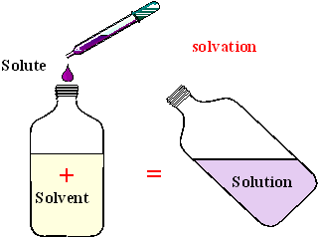
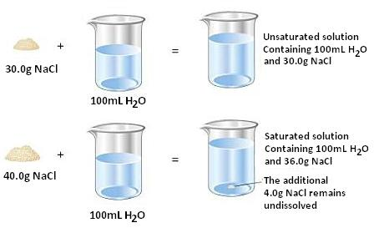
Solutions (or mixture)
When the components are all in the same physical state (e.g. liquids) the solvent is the component present in the largest quantity
Unsaturated and saturated solutions
Solubility: maximum amount of solute that can be dissolved in a fiexd amount of solvent until saturation
Notes:
Atkins pag pdf pag 123

Slide 4
Concentration units
Three major units in use the thermodynamic description of mixture:
Letting J stand for one component in a solution (e.g. the solute)
Molarity
[J] = n_{J}/V_{solution} (V_{solution} in liters)
n_{J}: mole of J
Molality
m_{J}= n_{J}/m_{solvent}
m_{solvent} in kg
Mole fraction
x_{J}= n_{J}/n_{tot}
mixing ratio
n_{tot} =total number of moles of all species present in sample

Slide 5
Thermodynamic description of mixtures
Partial molar properties: The contribution (per mole) that a substance makes to an overall property of a mixture
Partial molar volume
The partial molar volume of a water/ethanol mixture at varying composition of the mixture
For a two component mixture (A and B) the total volume V of the mixture is:
Notes:
The partial molar volume at an intermediate composition of the water/ethanol mixture is an indication of the volume the H2O molecules occupy when they are surrounded by a mixture of molecules representative of the overall composition
(half water, half ethanol, for instance, when the mole fractions are both 0.5). The partial molar volume of ethanol varies as the composition of the mixture is changed, because the environment of an ethanol molecule changes from pure ethanol to pure water as the proportion of water increases and the volume occupied by the ethanol molecules varies accordingly. Figure 6.1 shows the variation of the two partial molar volumes across the full composition range at 25°C.

Slide 6
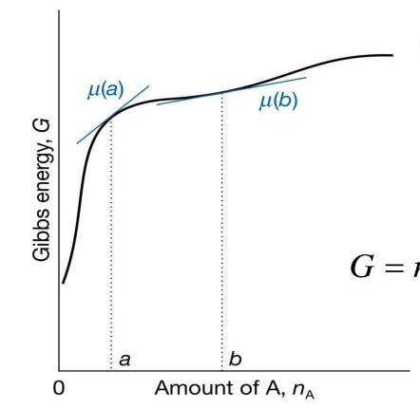
Partial molar Gibbs energy
The contribution that the component J (per mole of J) makes to the total Gibbs energy of a mixture
Partial molar Gibbs energy
The partial molar Gibbs energy is given the name of chemical potential (symbol μ):
For a two component mixture (A and B) the total G is:
μ_{J} is a measure of the ability of J to bring about physical and chemical change

Slide 7
Partial molar Gibbs energy
Variation of the molar Gibbs energy for an ideal gas (pure)
derivation
p_{f}→pressure of interest
p_{i}→standard pressure (p∅=1 bar)
For a mixture of ideal gases:
p → partial pressure
G_{m} → partial molar Gibbs energy
NB: in most text ∅ is replaced by °

Slide 8
Fundamental equations of chemical thermodynamics
for a pure substance
How does it modify for a solution of components A, B, ...Z?
At constant T and P:

Slide 9
The thermodynamics of mixing
Gases mix spontaneusly, but how can it be demonstrated thermodynamically?
Spontaneity criterium:
Given two ideal gases A (n_{A} moles) and B (n_{B} moles) at the same T and p, initially separated, the G of the system is:
When the separation is removed the total pressure is still p but Dalton’s law gives:

Slide 10
The thermodynamics of mixing
The final Gibbs energy for the system G_{f}:
Given that:
Since x_{A},x_{B}<1 ⇒ lnx_{A}<0, lnx_{B}<0
Hence:
and gases mix spontaneusly

Slide 11
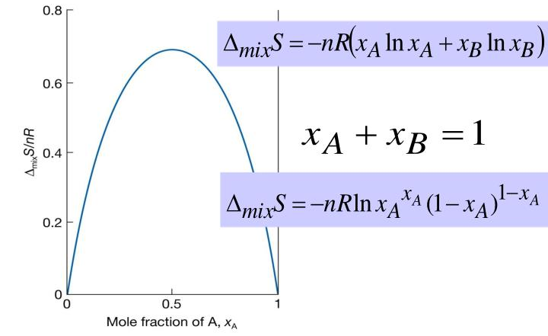
The thermodynamics of mixing
By comparing the equation of mixing with the eq. relating G to H and S:
It can be concluded that for an ideal gas:
driving force of the mixing is the increse in entropy of the system

Slide 12
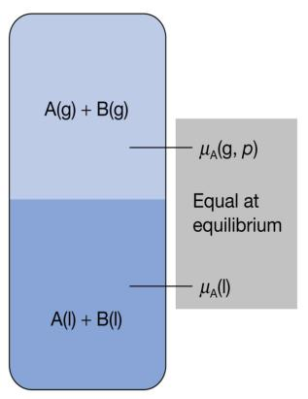
Ideal solutions
For a pure substance at (liquid-gas) equilibrium the chemical potential of the liquid and gas phases are equal
vapour pressure of J
For an ideal solution: the vapour phase will also be a mixture
Raoult’s law for ideal solution:
The partial vapour pressure of a substance in a liquid mixture (p_{J}) is proportional to its mole fraction (x_{J}) in the solution and its vapour pressure when pure
Notes:
In chemistry we are concerned with liquids as well as gases, so we need an expression for the chemical potential of a substance in a liquid solution. We can anticipate that the chemical potential of a species ought to increase with concentration, because the higher its concentration the greater its chemical ‘punch’.

Slide 13
Raoult’s law
Ideal solution: a mixture which obeys Raoult’s law throughout its whole range of composition (from x_{J}=0 to x_{J}=1)
For a binary mixture of solvent (A) and solute (B)
The total pressure p of the vapour phase is the sum of the two partial vapour pressures:
Raoult’s law can be used to relate chemical potential to the composition of a solution
Independent of the mixture composition: we call it chemical potential of the pure liquid A
Notes:
In chemistry we are concerned with liquids as well as gases, so we need an expression for the chemical potential
of a substance in a liquid solution. We can anticipate that the chemical potential of a species ought to increase with concentration, because the higher its concentration the greater its chemical ‘punch’.

Slide 14
Raoult’s law
Because:
The chemical potential of a species in a solution is lower than in the pure liquid
Molecular interpretation: effect of the solute on the entropy (S) of the mixture
Presence of more than one component (e.g. A and B) in the solution influences the liq-gas equilibrium of the pure components:
A_{(l)}
A _{(g)}
In an ideal solution, the presence of a solute increases the entropy of the solution (with respect to pure solvent). The solution has a lower tendency of acquiring an higher entropy by vaporization of its components
Notes:
Variation of mu of A (solvent) with the composition of the solution. Note: the chemical potential of the solvent is lower in the mixture than for the pure liquid (for an ideal system). This behaviour is
likely to be shown by a dilute solution in which the solvent is almost pure (and obeys Raoult’s law).
Molecular origin of Raoult’s law: the effect of the solute on the entropy of the solution. In the pure solvent, the molecules have a certain disorder and a corresponding entropy; the vapour
pressure then represents the tendency of the system and its surroundings to reach a higher entropy.
When a solute is present, the solution has a greater disorder than the pure solvent because we cannot be sure that a molecule chosen at random will be a solvent molecule. Because the entropy of the solution is higher than that of the pure solvent, the solution has a lower tendency to acquire an even higher entropy by the solvent vaporizing.
In other words, the vapour pressure of the solvent in the solution is lower than that of the pure solvent.

Slide 15
Ideal solution
Is mixing spontaneous also for ideal solutions?
Spontaneity criterium:
Given two species A (n_{A} moles) and B (n_{B} moles) at the same T, initially separated, the initial G of the system is:
The final G is:
Hence:
and ideal solutions are formed spontaneusly
for ideal solution

Slide 16
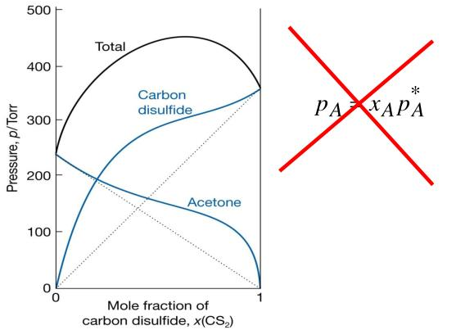
Raoult’s law and non-ideal solutions
However, Raoult’s law is obeyed for the solvent in case of very dilute solutions (see lines on the right and left of the graphs)
But what about the solute?
Notes:
If solutions are formed by mixing liquids of different types (in terms of moelcular interactions, eg. a polar liquid such as water with a non polar liquid such as an hydrocarbon) the solution will not be IDEAL

Slide 17
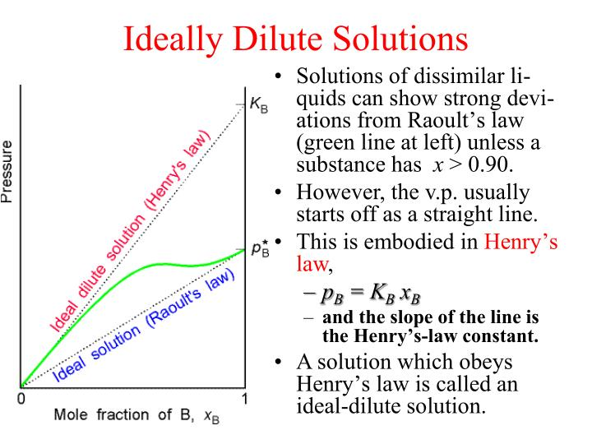
Henry’s law is a good approximation for the vapur pressure of a solute in a dilute solution (solute is NOT almost pure)
Notes:
Raoult’s law provides a good description of the vapour pressure of the solvent in a very dilute solution, when the solvent A is almost pure. However, we cannot in general expect it to be a good description of the vapour pressure of the solute B because a solute in dilute solution is very far from being pure.
In a dilute solution, each solute molecule is surrounded by nearly pure solvent, so its environment is quite unlike that in the pure solute and except when solute and solvent are very similar (such as benzene and methylbenzene) it is very unlikely that its vapour pressure will be related in a simple manner to that of the pure solute.
However, it is found experimentally that in dilute solutions the vapour pressure of the solute is in fact proportional to its mole fraction, just as for the solvent. Unlike the solvent, though, the
constant of proportionality is not in general the vapour pressure of the pure solute. This linear but different dependence was discovered by the English chemist William Henry in 19th century

Slide 18
Raoult’s law and non-volatile solutes
Example: salts dissolved in water
Let’s assume to have a salt (s) and water as a solvent (H₂O), by applying Raoult’s law the vapour pressure (p) over the solution will be given by:
The presence of a solute lowers the vapour pressure of pure water
Hence:
The relative lowering is equal to the molar fraction of the solute
COLLIGATIVE PROPERTY

Slide 19
Colligative properties
For ideal solutions (ΔH_{mix}=0) the presence of the solute affects the entropy of the solvent (=disorder) and modify the physical properties of the solution
Increase in disorder independent on the identity of the solute, but only on the number of solute particles
Colligative properties = depending on the collection
COLLIGATIVE PROPERTIES
Lowering of the vapour pressure of the solvent
(see previous slide)
boiling point elevation
freezing point depression
Gives rise to an osmotic pressure

Slide 20
Boiling point elevation and freezing point depression
Not volatile solute ⇒ it does not appear in the vapour phase
Solute is insoluble in the solid solvent ⇒it does not appear in the solid phase
T_{freeze} of solution
T_{boil} of pure solvent
T_{freeze} of pure solvent
T_{boil} of
solution
Presence of solute lowers the μ of the liquid. Because vapour and solid remain pure their μ remains constant
Notes:
To derive an expression we need two assumptions.
In the graph we represent the chemical potential of a solvent as a pure liquid (orange line). In the lesson on the pure substances we have seen that the molar Gibbs free energy decreases with increasing T. The red line represent it for the liquid in the gas phase. The crossing point is the boilT of the pure solvent.
Raoult’s law says that the presence of a solute lowers the chemical potential of the solvent in the solution (this is the green line). The new Tboil is where the green line crosses the red line (vapour phase, which contains only the solvent, since the solute is non volatile).

Slide 21
Real solutions: activity
For ideal solutions the chemical potential of the component J:
Activity (a) of a substance is a kind of «effective» concentration (dimensionless) defined so that a similar espression is true at ALL concentrations for both solutes and solvent
For ideal solutions:
For non-ideal solutions:
for the solvent
for the solute
activity coefficient (dimensionless). They depend on the composition of the solution
Notes:
Because the solvent behaves more in accord with Raoult’s law as it becomes pure, γA→1 as xA→1.
Because the solute behaves more in accord with Henry’s law as the solution becomes very dilute,
γB → 1 as [B] → 0.

Slide 22
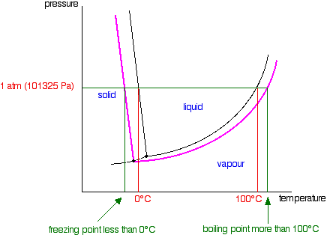
Phase diagrams of solutions
Maps (P-T graph) showing the conditions of temperature and pressure at which the various phases of a substance are thermodynamically most stable
The example of water:
pure water (liquid)
solution (liquid)
The presence of a solute elarges the range of existence of water in the liquid phase

Slide 23
Phase diagrams and phase rule
Phase rule is a general principle that governs systems in thermodynamic equilibrium
It allows to determine the number of independent variables (or degrees of freedom) N that determine the thermodynamic equilibrium of a system with a number C of chemical components and a number P of different phases
The phase rule is:
N = C + 2 - P
For pure systems:
For pure water in thermodynamic equilibrium between two phases (e.g. along the lines of the phase diagram liquid-gas) we have:
C=1 and P=2 so that N=1. The equilibrium is determined by one independent variable, i.e. at a given T there is only one vapour pressure possible for which the liquid and gas phase are in equilibrium

Slide 24
Phase rule for solutions
For solutions:
N = C + 2 - P
For water plus one solute in thermodynamic equilibrium between two phases (e.g. along the lines of the phase diagram liquid-gas) we have:
C=2 and P=2 so that N=2
There are two independent variables that define the vapour pressure over the solution:
temperature
composition of the solution (i.e. mole fraction of the solute)
Relevance for atmospheric processes
If a salt is dissolved in water the saturation vapour pressure over the solution is lower than for pure water at the same T (and it decreases as the NaCl mole fraction increases)

Slide 25

Relevance for atmospheric processes
C=2 (H₂O and NaCl) → N=2
The two independent variables that define the vapour pressure over water (e.g. sea water) are temperature and composition of the solution (i.e. mole fraction of NaCl)
Solutions of H₂O and NaCl (e.g. sea droplets) exist at equilibrium in atmosphere at R.H. less than 100%
Sea salt aerosol particles injected to the atmosphere by wave action (sea sprays) can start to take up water at R.H. as low as 75%*
The resulting swelling of particles by uptake of
surrounding water molecules produces the
atmospheric phenomenon of haze
* limit determined by the finite solubility of NaCl in water
Same effect can be obtained also with other solutes soluble in water

Slide 26

Exercise n. 1
If the vapor pressure of water at 293 K is 17.5 mmHg, what is the vapor pressure of water at 300 K?
The enthalpy of vaporization of water is ΔH_{vap}= 44 kJ·mol-1 and R (gas constant) is 8.3143 J·mol-1·K-1

Slide 27
Exercise n. 1
Solution:
We need to use the Clausius Clapeyron equation:
ln(P₂/P₁) = ΔH_{vap}/R·(1/T₁ – 1/T₂)
Assume 293 K to be T₁ and 17.5 mmHg to be P₁ and 300 K to be T₂. By plugging everything in we have:
ln(P₂/17.5)=44000/8.3143·(1/293 –1/300) = =5292.087·(0.0034129 – 0.0033)=0.42107
Hence
P₂/17.5=e^{0.42107} =1.52359 and P2=17.5*1.52359 = = 26.66 mmHg

Slide 28
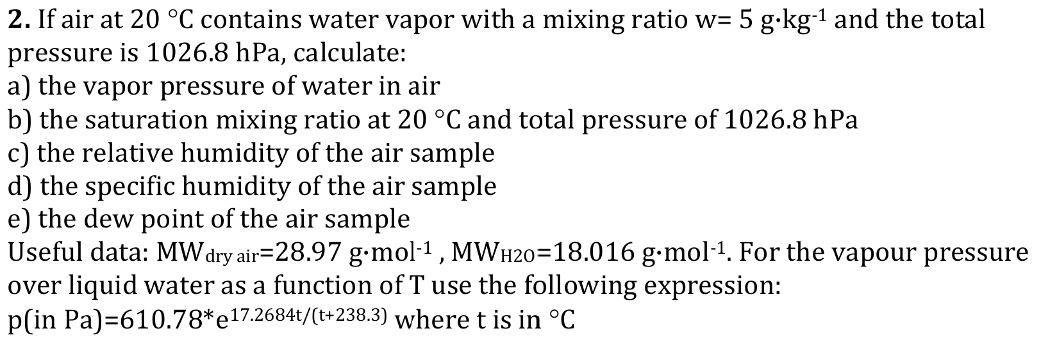
Exercise n. 2

Slide 29
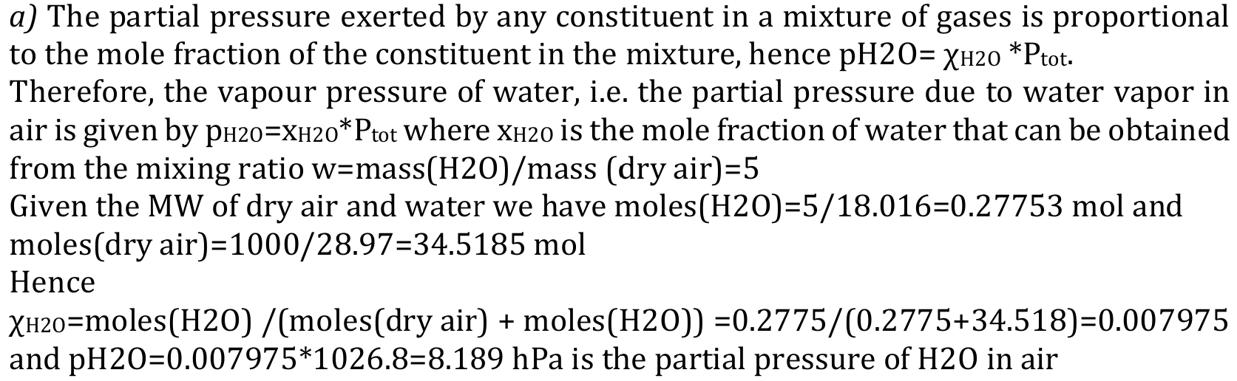
Exercise n. 2
Solution:

Slide 30
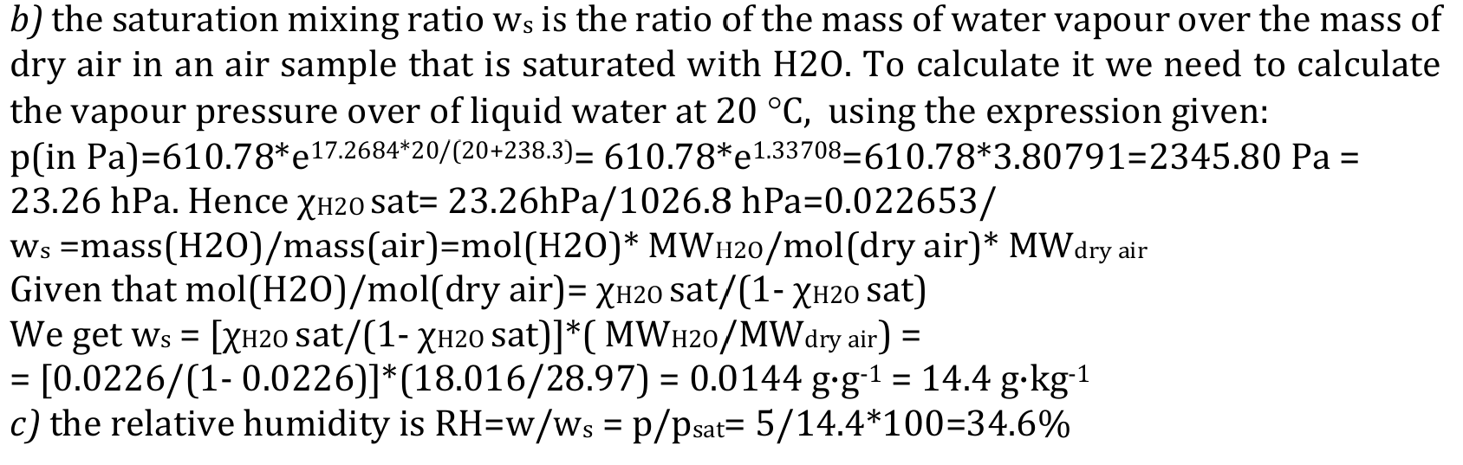
Exercise n. 2
Solution:

Slide 31
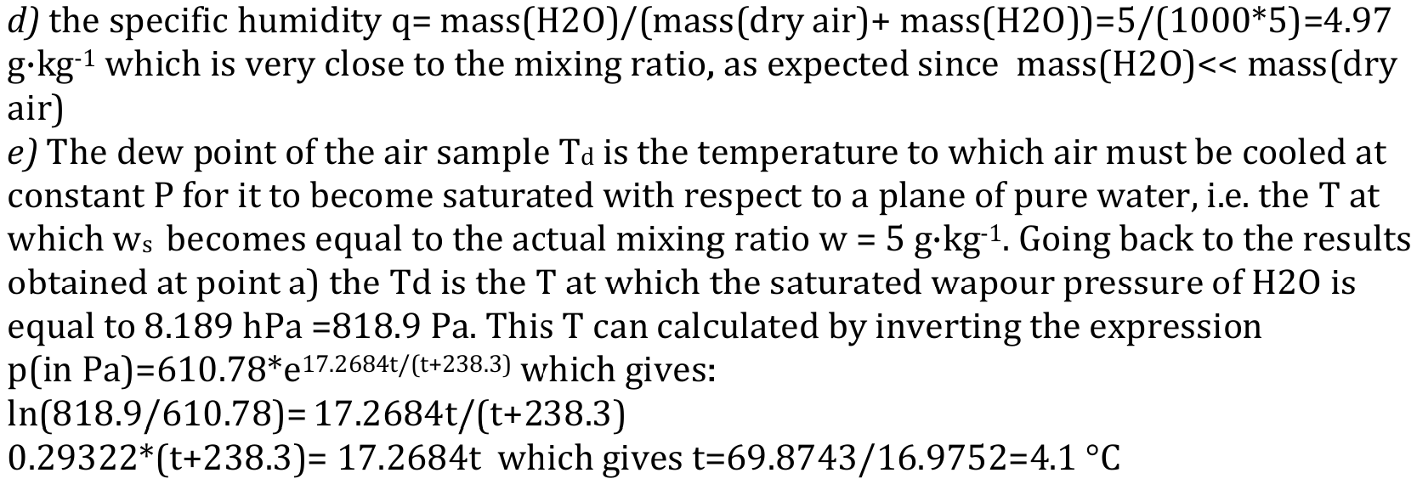
Exercise n. 2
Solution:

Slide 32
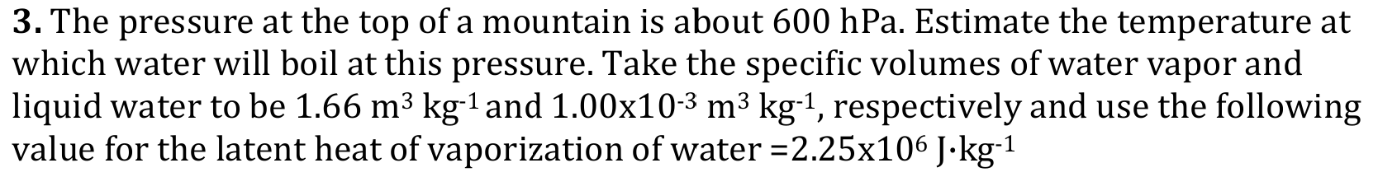
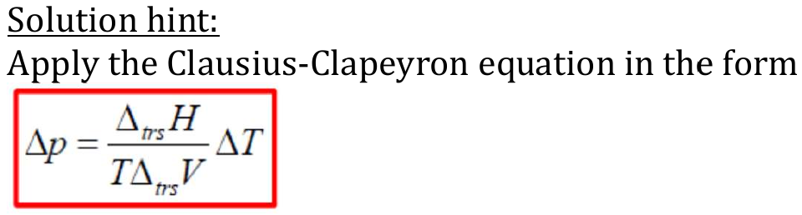
Exercise n. 3

Slide 33
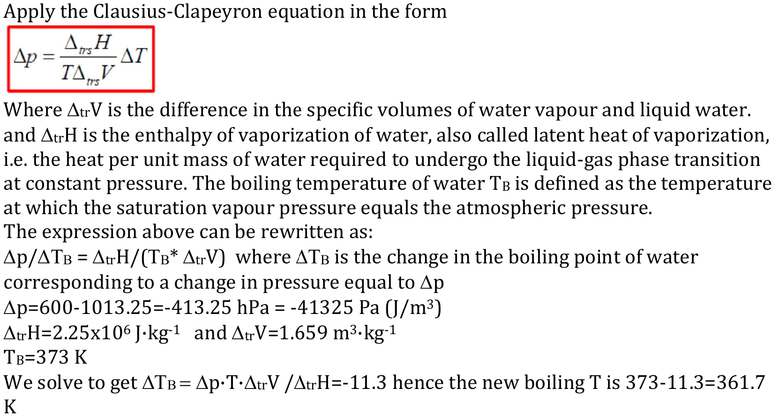
Exercise n. 3
Solution:

Slide 35
The Gibbs-Duhem equation
The total differential of the above expression is:
Combining the two expressions:
Which simplifies in the Gibbs-Duhem equation (at T and P constant):
Or more generally (T and P non constant):

