Slide 1

University of Trento
Master of Science in Environmental Meteorology https://international.unitn.it/environmental-meteorology
A.A. 2023-24
Environmental Physical Chemistry
Ozone in the atmosphere:
stratospheric and tropospheric O₃
Daniela Ascenzi
Dept. Physics, University of Trento, Italy
e-mail: daniela.ascenzi@unitn.it

Slide 2
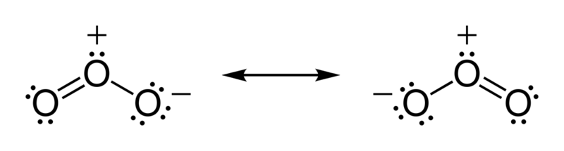
What is ozone?
O₃ – Lewis structure
a gas composed by 3 O atoms
A bluish gas that is harmful to breath
O₃ in the atmosphere is mostly (~90%) present in the stratosphere (O₃ layer at 15-30 km altitude, naturally produced), but it can be generated also in the troposphere (~10%)
The O₃ depletion problem (stratospheric O₃)
O₃ as atmospheric pollutant (tropospheric O₃)
Notes:
The photolysis of ozone, which drives tropospheric chemistry, is particularly sensitive to the overhead column of
stratospheric ozone.
Photolysis of ozone throughout the atmosphere leads to the formation of OH,
O3 + h v -> O (1 D ) + O2
O(1D)+H20-> OH+OH
which in turn is responsible for initiating the oxidation of a wide variety of atmospheric trace constituents, for example, methane:
OH + CH4 -> CH3 + H20
The photochemistry of ozone is very complex, as the relatively weak chemical bonds in ozone allow excited states of the O and O2 photoproducts
to be accessed. In fact, only now is a consensus being reached on the quantitative aspects of this photochemistry, particularly near the energy threshold
for O(lD) production near 310 nm. It is now believed (Ravishankara et al., 1998, and references therein) that four different photolysis channels are
occurring in the 290-350 nm spectral region, the region of importance for the generation of OH in the lower atmosphere, with the quantum yields for
these four channels varying with wavelength and temperature:
For atmospheric considerations, the key channels are those which produce O(1D), that is, those which lead to OH production. Interestingly, the energy
threshold for channel (C) is at about 308 nm, yet this process still occurs to longer wavelengths as a result of internal energy (vibrational and rotational)
contained in the ozone molecule itself, while channel (D) is a quantum mechanically“spin-forbidden” process whose occurrence was thought to be
unlikely. The figure below shows the O(’D) quantum yields near 200 K and 300 K (Filled circles = 203 K; open circles = 298 K). Channel (C) dominates below about 320 nm at 300 K, but is strongly
temperature dependent, while the near-constant contribution of the spin-forbidden channel (quantum yield about 0.06) is evident beyond about 320 nm.

Slide 3
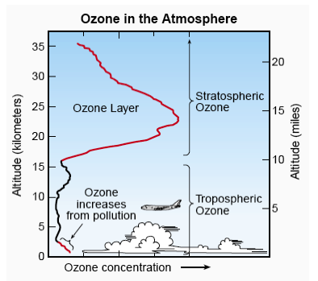
The Ozone distribution in the atmosphere
O prevails
90%
O₂ prevails
10%
Notes:
Most ozone (about 90%) is found in the stratosphere. The stratospheric region with the highest ozone
concentration is commonly known as the “ozone layer”. The ozone layer extends over the entire globe with some variation in altitude and thickness.
Most of the remaining ozone, about 10%, is found in the troposphere. Ozone molecules have a low relative abundance in the
atmosphere. In the stratosphere near the peak concentration of the ozone layer, there are typically a few thousand ozone molecules for every billion air molecules
In the troposphere near Earth’s surface, ozone is even less abundant, with a typical range of 20 to 100 ozone molecules for each billion air molecules. The highest surface values result when ozone is formed in air polluted by human activities.
See http://acmg.seas.harvard.edu/people/faculty/djj/book/bookchap10.html
Creation: an oxygen molecule is split (photolyzed) by higher frequency UV light (top end of UV-B, UV-C and above) into two oxygen atoms (see figure):O₂ + ℎν → 2 O•Each oxygen atom then quickly combines with an oxygen molecule to form an ozone molecule:O• + O₂ → O₃
The ozone–oxygen cycle: the ozone molecules formed by the reaction above absorb radiation having an appropriate wavelength between UV-C and UV-B. The triatomic ozone molecule becomes diatomic molecular oxygen plus a free oxygen atom (see figure):O₃ + ℎν_{(240–310 nm)} → O₂ + OThe atomic oxygen produced quickly reacts with another oxygen molecule to reform ozone:O + O₂ → O₃ + E_{K}where E_{K} denotes the excess energy of the reaction which is manifested as extra kinetic energy. These two reactions form the ozone–oxygen cycle, in which the chemical energy released when O and O₂ combine is converted into kinetic energy of molecular motion. The overall effect is to convert penetrating UV-B light into heat, without any net loss of ozone. This cycle keeps the ozone layer in a stable balance while protecting the lower atmosphere from UV radiation, which is harmful to most living beings. It is also one of two major sources of heat in the stratosphere (the other being the kinetic energy released when O₂ is photolyzed into O atoms).
Removal: if an oxygen atom and an ozone molecule meet, they recombine to form two oxygen molecules:O₃ + O· → 2 O₂
And if two oxygen atoms meet, they react to form one oxygen molecule:
2 O· → O₂
This reaction is known to have a negative order of reaction of -1. The overall amount of ozone in the stratosphere is determined by a balance between production by solar radiation and removal. The removal rate is slow, since the concentration of O atoms is very low.
The net reaction will be 2 O₃ → 3 O₂
Certain free radicals, the most important being hydroxyl (OH), nitric oxide (NO) and atoms of chlorine (Cl) and bromine (Br), catalyze the recombination reaction, leading to an ozone layer that is thinner than it would be if the catalysts were not present.
Most of the OH and NO are naturally present in the stratosphere, but human activity, especially emissions of chlorofluorocarbons (CFCs) and halons, has greatly increased the Cl and Br concentrations, leading to ozone depletion. Each Cl or Br atom can catalyze tens of thousands of decomposition reactions before it is removed from the stratosphere.

Slide 4
Importance of Ozone
Plays a central role in atmospheric chemistry
Highly reactive
Highly toxic (health effects in humans)
Crop degradation (economic losses in agriculture)
Absorbs IR:
  greenhouse potential
Absorbs UV:
  Shielding effect from shortwave UV (200-300 nm)
  Its pholysis produces O(¹D) which then yields OH
    OH is the most important tropospheric oxidant
  Photolysis to O(³P) regenerates O₃ -> it is not relevant
Notes:
O3 is a very efficient absorber of solar radiation between 200 and 300 nm and its formation and presence controls the stratospheric temperature profile.
The ozone layer absorbs 97 to 99 percent of the Sun's medium-frequency ultraviolet light (from about 200 nm to 315 nm wavelength), which otherwise would potentially damage exposed life forms near the surface
O3 photolysis drives tropospheric chemistry

Slide 5
Stratospheric Ozone
O₃ vertical and latitudinal distribution:
The ozone layer extends over the entire globe with some variation in altitude and thickness.
Notes:
Most ozone (about 90%) is found in the stratosphere. The stratospheric region with the highest ozone
concentration is commonly known as the “ozone layer”. The ozone layer extends over the entire globe with some variation in altitude and thickness.
Most of the remaining ozone, about 10%, is found in the troposphere. Ozone molecules have a low relative abundance in the
atmosphere. In the stratosphere near the peak concentration of the ozone layer, there are typically a few thousand ozone molecules for every billion air molecules
In the troposphere near Earth’s surface, ozone is even less abundant, with a typical range of 20 to 100 ozone molecules for each billion air molecules. The highest surface values result when ozone is formed in air polluted by human activities.
See http://acmg.seas.harvard.edu/people/faculty/djj/book/bookchap10.html
Creation: an oxygen molecule is split (photolyzed) by higher frequency UV light (top end of UV-B, UV-C and above) into two oxygen atoms (see figure):O₂ + ℎν → 2 O•Each oxygen atom then quickly combines with an oxygen molecule to form an ozone molecule:O• + O₂ → O₃
The ozone–oxygen cycle: the ozone molecules formed by the reaction above absorb radiation having an appropriate wavelength between UV-C and UV-B. The triatomic ozone molecule becomes diatomic molecular oxygen plus a free oxygen atom (see figure):O₃ + ℎν_{(240–310 nm)} → O₂ + OThe atomic oxygen produced quickly reacts with another oxygen molecule to reform ozone:O + O₂ → O₃ + E_{K}where E_{K} denotes the excess energy of the reaction which is manifested as extra kinetic energy. These two reactions form the ozone–oxygen cycle, in which the chemical energy released when O and O₂ combine is converted into kinetic energy of molecular motion. The overall effect is to convert penetrating UV-B light into heat, without any net loss of ozone. This cycle keeps the ozone layer in a stable balance while protecting the lower atmosphere from UV radiation, which is harmful to most living beings. It is also one of two major sources of heat in the stratosphere (the other being the kinetic energy released when O₂ is photolyzed into O atoms).
Removal: if an oxygen atom and an ozone molecule meet, they recombine to form two oxygen molecules:O₃ + O· → 2 O₂
And if two oxygen atoms meet, they react to form one oxygen molecule:
2 O· → O₂
This reaction is known to have a negative order of reaction of -1. The overall amount of ozone in the stratosphere is determined by a balance between production by solar radiation and removal. The removal rate is slow, since the concentration of O atoms is very low.
The net reaction will be 2 O₃ → 3 O₂
Certain free radicals, the most important being hydroxyl (OH), nitric oxide (NO) and atoms of chlorine (Cl) and bromine (Br), catalyze the recombination reaction, leading to an ozone layer that is thinner than it would be if the catalysts were not present.
Most of the OH and NO are naturally present in the stratosphere, but human activity, especially emissions of chlorofluorocarbons (CFCs) and halons, has greatly increased the Cl and Br concentrations, leading to ozone depletion. Each Cl or Br atom can catalyze tens of thousands of decomposition reactions before it is removed from the stratosphere.

Slide 6
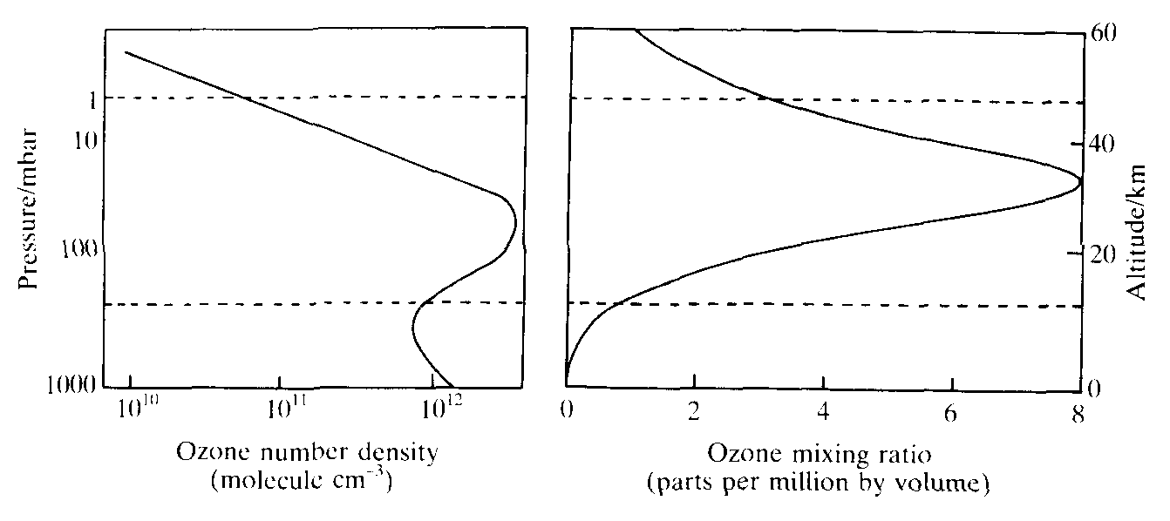
Structure of the Ozone Layer
Concentration of Ozone in the stratosphere
Observations: (i) O₃ is NOT the most concentrated gas in the ozone layer (ii) maximum concentration is in the middle stratosphere.
Why does the ozone layer exist in the stratosphere? What processes are responsible for its formation and maintenance?
Notes:
note difference in profile due to absolute and relative concentrations. Absolute conc is more important in terms of ability to absorb UV light and in terms of reaction rates.
absolute conc profile peaks around 25-30 km (lower-to-mid stratosphere)
typical VMRs for ozone in the stratosphere: 1 – 10 ppmv. Typical number densities: 10¹¹ – 10¹² /cc
questions: why does the ozone layer exist? Is it connected with the fact that there is a thermal inversion throughout the stratosphere? (Answer: dioxygen photodissociation essentially provides the heating mechanism for the stratosphere.

Slide 7
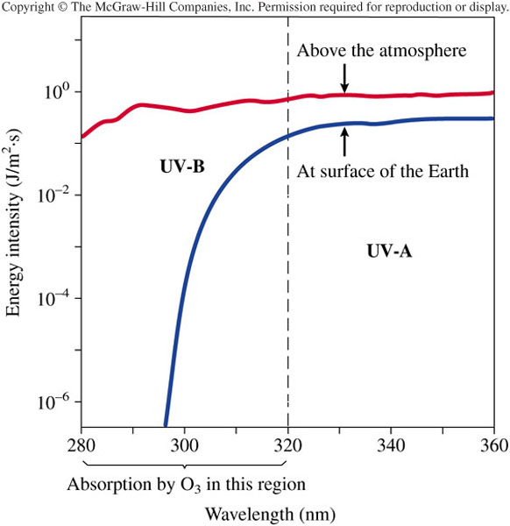
Ozone layer: function
  What does the ozone layer do for us?
  Ozone is the only major atmospheric constituent that absorbs significantly between 210 and 290 nm.
  Without it life would have remained underwater
  The ozone layer is a consequence of oxygen-only chemistry. It formed once photosynthetic marine organisms (cyanobacteria) began “polluting” the atmosphere with oxygen.

Slide 8
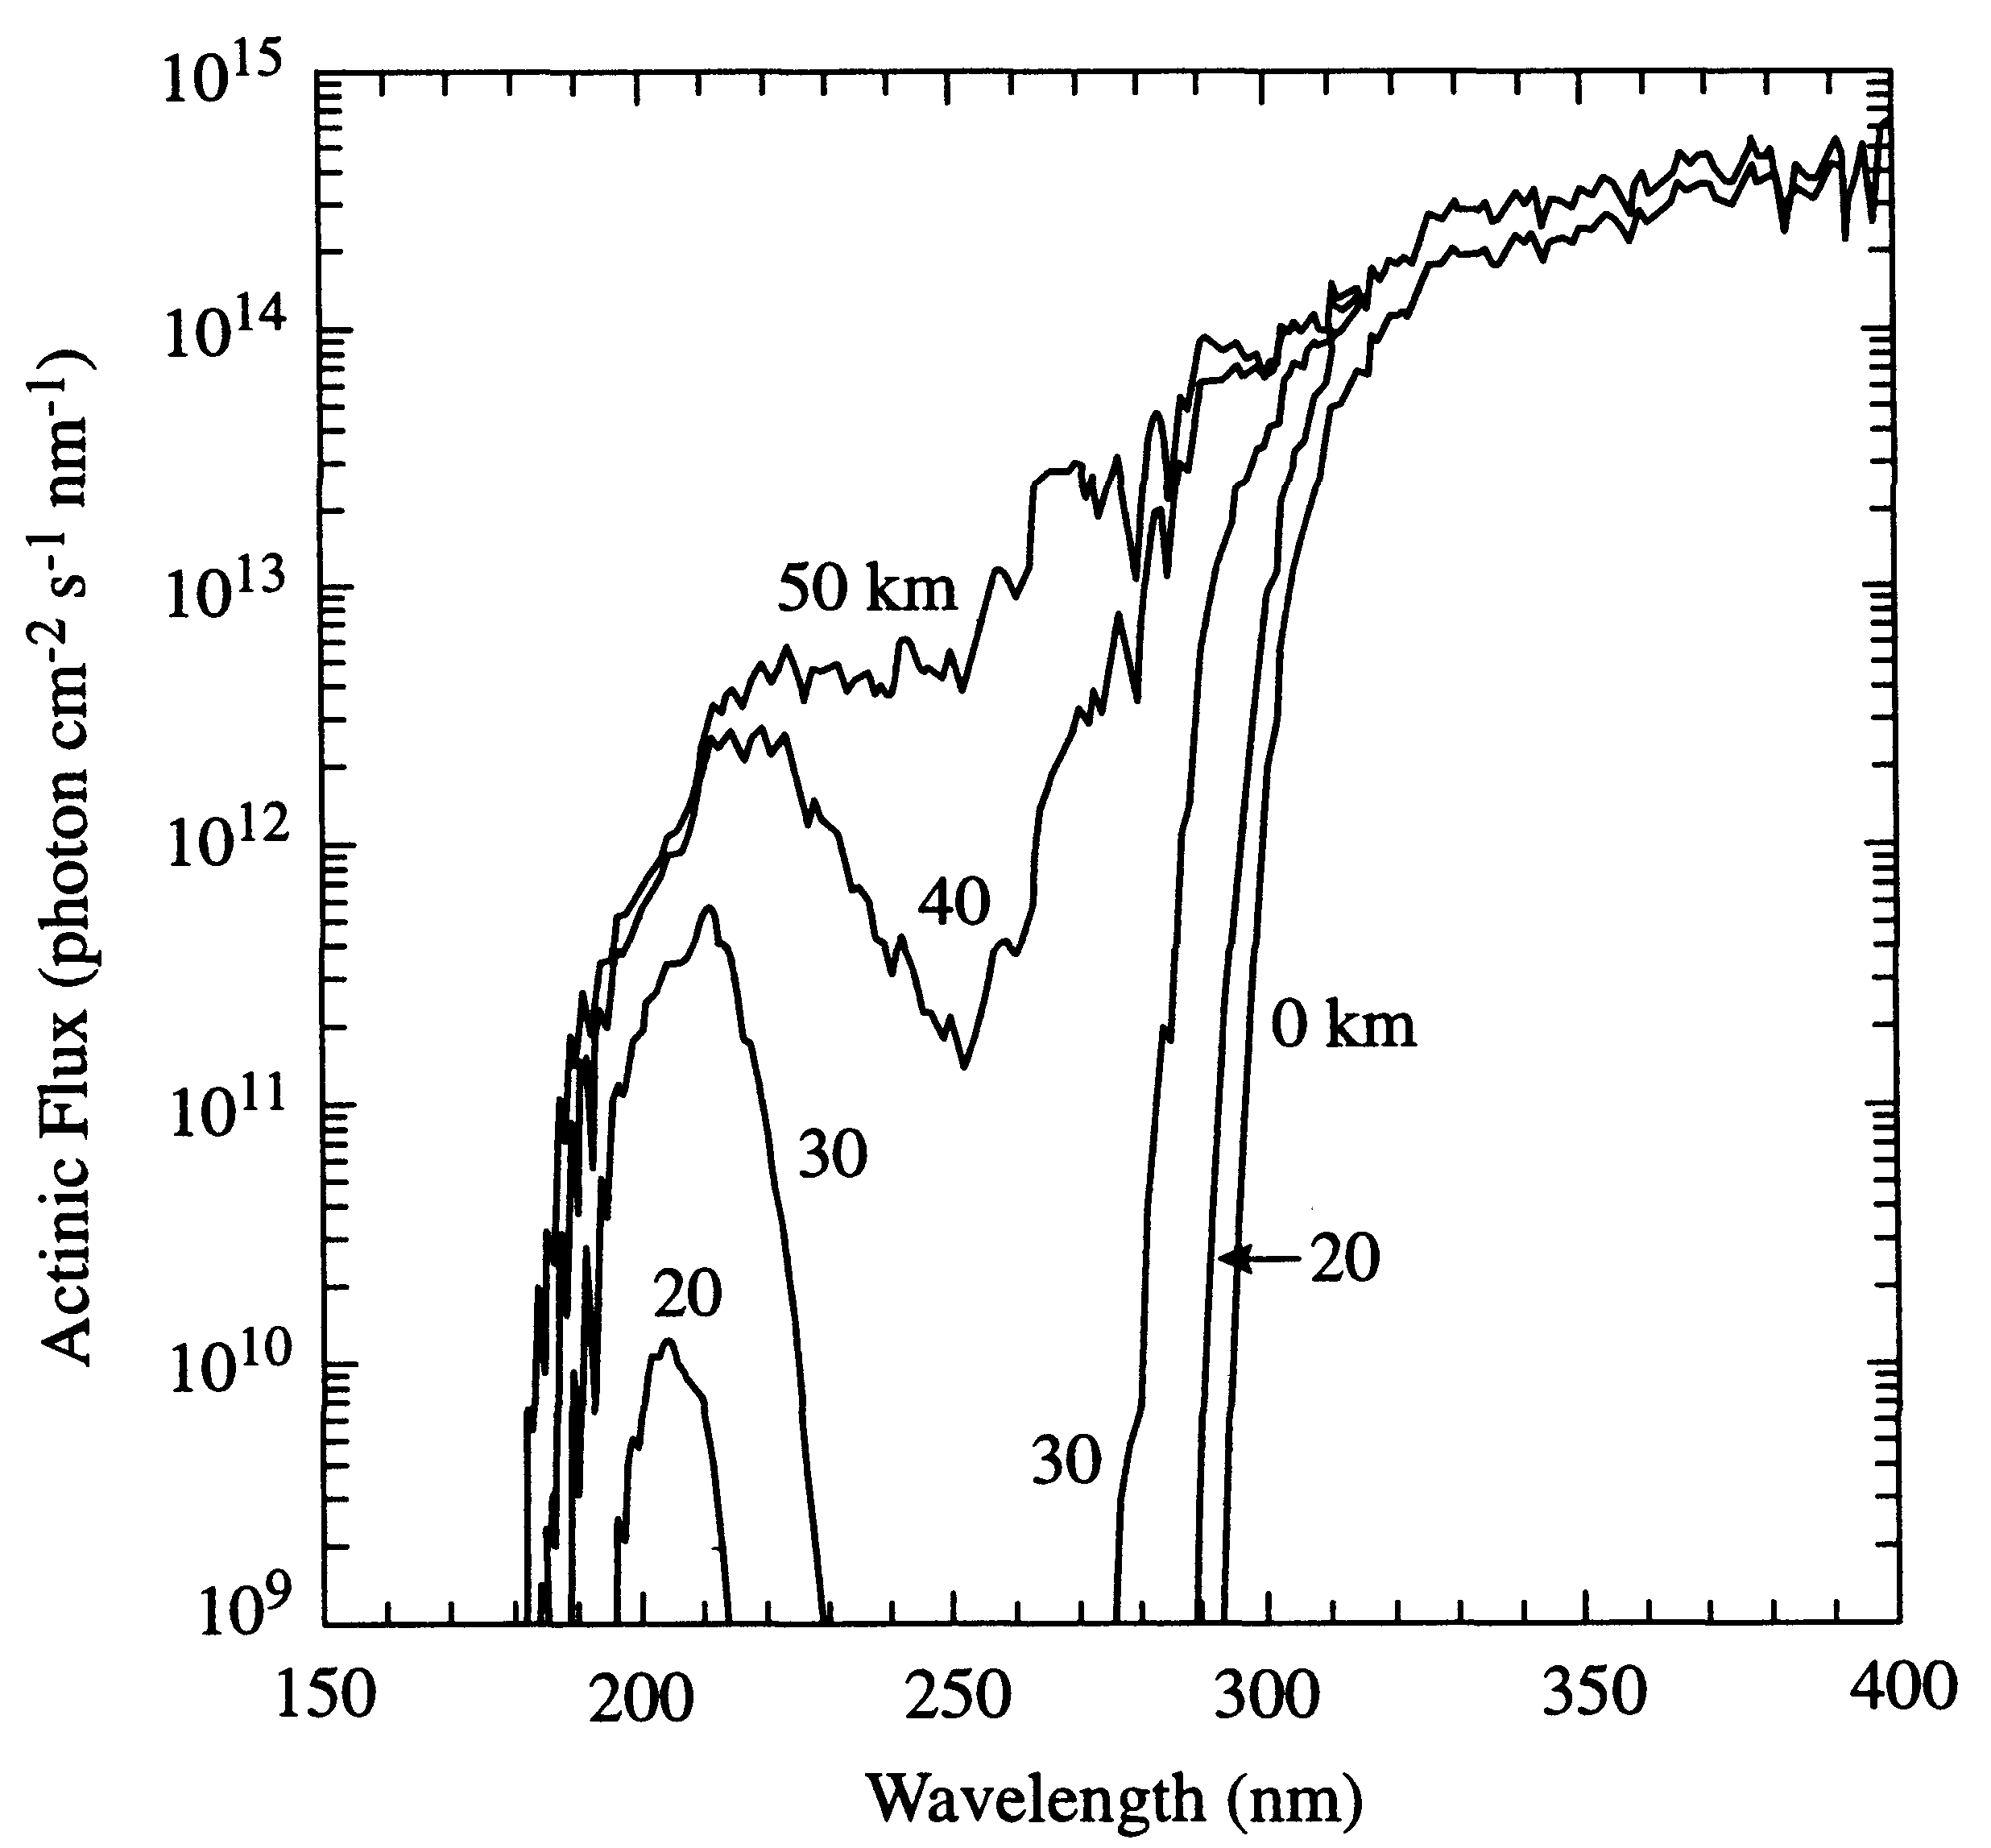
Attenuation of Solar flux in the stratosphere
Ground-level sunlight is limited to λ < 290nm
Stratosphere filters out light between 180 and 290 nm
There is a “spectral window” centered at 205 nm where UV light penetrates more deeply into the stratosphere
Notes:
sunlight incident on Earth is very roughly: 10% uv, 40% visible, 50% ir. The atmosphere is mostly transparent to the visible (except for scatter). But there are important absorbing species in the uv and nir that filters the sunlight and warms the atmosphere.
main absorbing species: O2 and O3 in the uv, H2O, CO2 and O3 in the nir.
50km: the stratopause. Light is limited to wavelengths > 180 nm or so.
0km: light is limited to wavelengths above 290 nm or so. This figure shows what happens between. Think of a weather balloon with a spectrometer recording sunlight specta as it ascends – that’s what this figure is

Slide 9
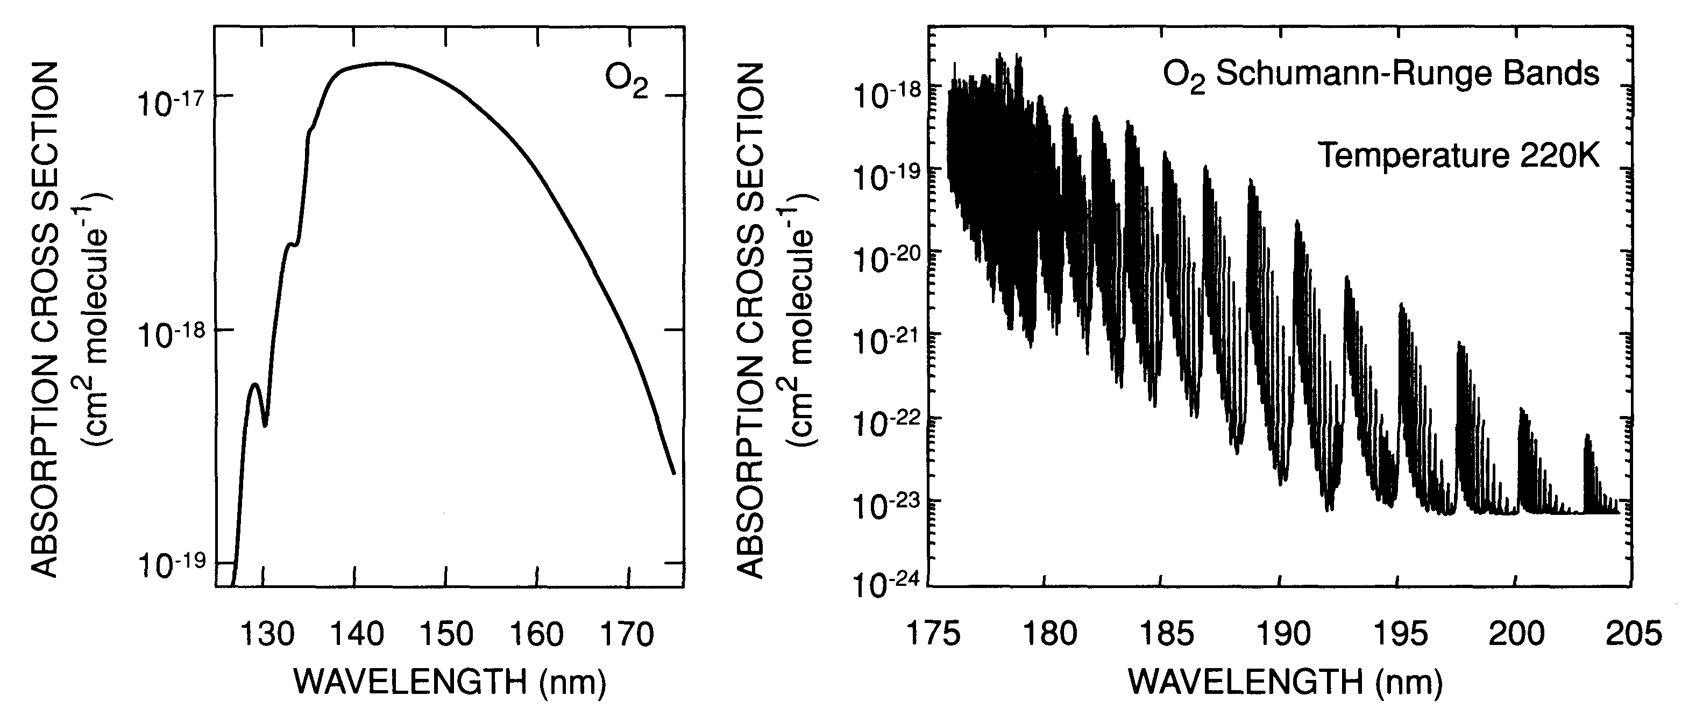
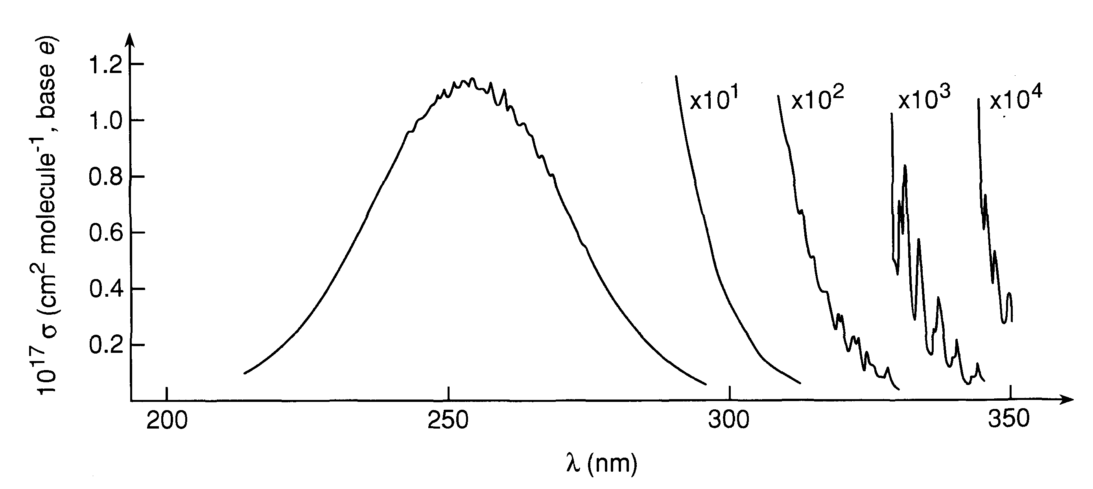
UV absorption by O₂ and O₃
O₂
O₃
Note the imperfect overlap between the absorption bands, ⇒ UV spectral window at ~205 nm
Notes:
two main species responsible for absorbing uv-portion of the sunlight: O₂ and O₃.
Note the imperfect overlap between the absorption bands, which results in the “uv window” noted earlier.

Slide 10
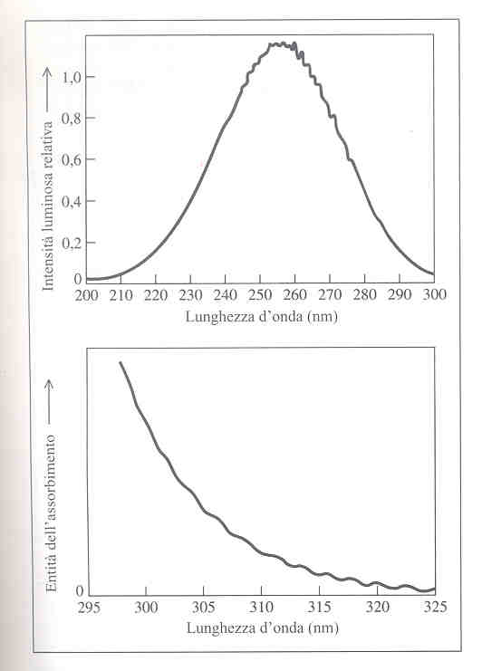
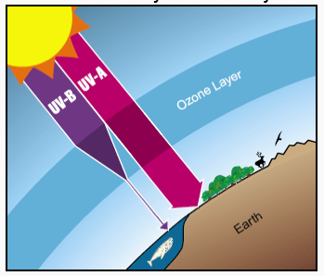
Ozone absorption
Hartley band
X rays
λ(nm)
VUV (120-190nm)
200
UV-C (190-280nm)
280
UV-B (280-320nm)
UV-C
320
UV-A (320-390nm)
400
VIS
750
Huggins band
IR
UV-B
Ozone layer: 15-30 km [O₃]_{max}= 5x10¹² molecule⋅cm⁻³
O₃ absorbs 97-99% of solar radiation in the 200-315 nm region
Notes:
UV region of the spectrum: vacuum UV (10 – 200 nm), UV-C (200 – 280 nm), UV-B (280 – 320 nm) and UV-A (320 – 380 nm)
O3 is a very efficient absorber of solar radiation between 200 and 300 nm and its formation and presence controls the stratospheric temperature profile. Ozone layer absorbs 97 to 99 percent of medium-frequency ultraviolet light, which otherwise would potentially damage exposed life forms near the surface
The main layer of ozone in the atmosphere is situated between 15 and 30 km and reaches a maximum concentration of around 5 × 1012 molecules cm−3 at 22 km, however, the maximum temperature at the top of the stratosphere occurs at around 50 km, well above the main ozone layer.
The peak in the absorption cross section of O2 occurs in the Schmann-Runge continuum at around 145 nm. For wavelengths less than175 nm O2 is dissociated into two oxygen atoms, one of which is electronically excited. This strong absorption prevents sunlight of wavelengths below 175 nm from penetrating below around 70 km. The oxygen atoms formed as a result of O2 photolysis react with other molecules of O2 to form ozone. Figure 3.7 shows the strong absorption cross sections of ozone occurring between 240 and 300 nm with a maximum value of 1.1 ×10−17 cm2 at 255 nm. As a result, above 60 km ozone is photolysed very efficiently back to O2 and atomic oxygen, reducing its concentration and favouring the existence of atomic oxygen.
The Herzberg continuum between 200 and 240 nm is responsible for photolysis of O2 below 60 km because the shorter wavelengths have already been removed (Fig. 3.5), while radiation of these wavelengths penetrates down to around 20 km.
Little O3 is produced high up in the atmosphere as the air density is low and there is little O2 to be photolysed or to subsequently react with the atomic oxygen formed by its photolysis. Density increases with descent through the atmosphere, favouring ozone formation via the combination of atomic and molecular oxygen, and the concentration of ozone increases to a maximum at around 20 to 25 km.
Lower in the stratosphere the overhead ozone column is now significant and absorbs much of the radiation between 200 and 290 nm, thus limiting photolysis of oxygen and slowing the rate of ozone formation. The concentration of ozone reduces and reaches a minimum by the tropopause where radiation of less than 290 nm is almost completely removed.
The absorption of UV radiation by both oxygen and ozone leads to their photolysis and the energy involved in these sunlight-induced reactions produces local warming. The temperature at a particular altitude will then be a combination of the rates of photolysis of the two oxygen species, in particular ozone, and the air density.
The rates of photolysis will depend on the local incidence of radiation and thus on the optical density of the atmosphere in the column above at a given wavelength. This in turn will be dependent on the overhead concentration profile of O2 and O3 themselves.
As the air density increases any products of photochemical processes that remain energetically excited are deactivated more rapidly via an increased chance of collisions, leading to an increase in temperature. Although the temperature profile is strongly linked to that of ozone, its maximum occurs not at the maximum ozone concentration, but above it and close to the region
where the photolytic formation and loss processes of ozone are most rapid.

Slide 11
The Ozone layer depletion problem
A decrease of about 1% in O₃ can increase the amount of UV-B radiation at ground by 2%
Why do we care about filtering UV light, and compromising the atmosphere’s ability to do so?
UV- C and B radiation risks
Humans: DNA damage, skin cancer, cataracts, suppressed immune system
plant life (photosynthesis)
single cell organisms
aquatic ecosystems (fitoplancton production…)
Notes:
An electronic book on Stratospheric Ozone http://www.ccpo.odu.edu/SEES/ozone/oz_class.htm
Although the concentration of the ozone in the ozone layer is very small, it is vitally important to life because it absorbs biologically harmful ultraviolet (UV) radiation coming from the sun. Extremely short or vacuum UV (10–100 nm) is screened out by nitrogen. UV radiation capable of penetrating nitrogen is divided into three categories, based on its wavelength; these are referred to as UV-A (400–315 nm), UV-B (315–280 nm), and UV-C (280–100 nm). UV-C, which is very harmful to all living things, is entirely screened out by a combination of dioxygen (< 200 nm) and ozone (> about 200 nm) by around 35 kilometres.
UV-B radiation can be harmful to the skin and is the main cause of sunburn and skin cancer. The ozone layer (which absorbs from about 200 nm to 310 nm with a maximal absorption at about 250 nm) is very effective at screening out UV-B; for radiation with a wavelength of 290 nm, the intensity at the top of the atmosphere is 350 million times stronger than at the Earth's surface. Nevertheless, some UV-B, particularly at its longest wavelengths, reaches the surface, and is important for the skin's production of vitamin D. Ozone is transparent to most UV-A, so most of this longer-wavelength UV radiation reaches the surface, and it constitutes most of the UV reaching the Earth. This type of UV radiation is significantly less harmful to DNA, although it may still potentially cause physical damage, premature aging of the skin, indirect genetic damage, and skin cancer.^{[7]}
L’occhio è una delle aree più sensibili alla penetrazione di luce in genere e di UV-B in particolare.

Slide 12
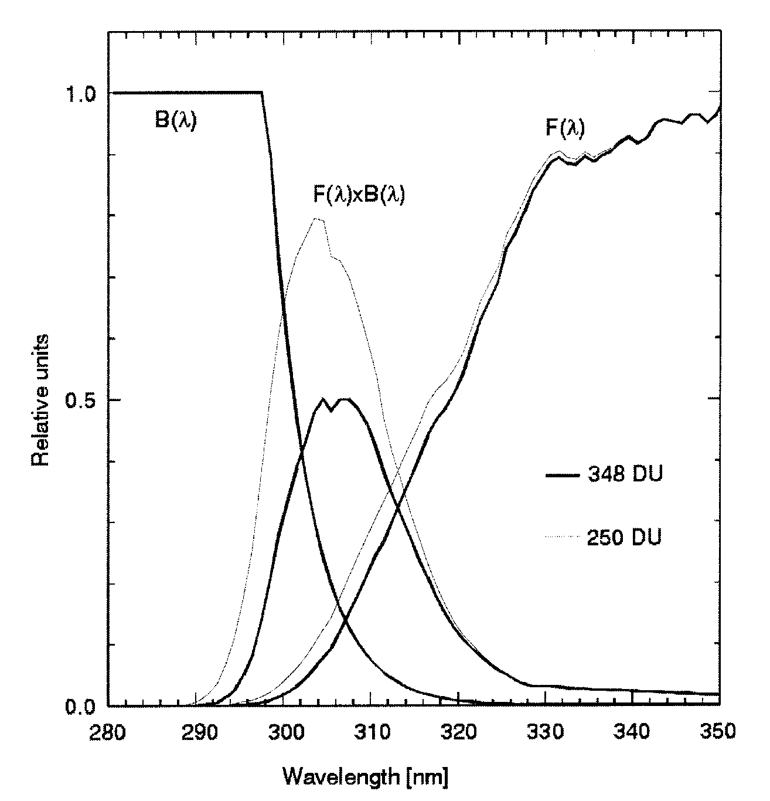
Health effects of Ozone
The effects of O₃ depletion can be roughly estimated by using the product of the DNA “action spectrum” B(λ) and the ground-level spectrum F(λ)
B(λ) is the biological “damage” function as a function of λ
F(λ) is the light that penetrates to ground level for two different column ozone levels: “normal” and “depleted.”
UV-C
UV-B
The product B(λ)F(λ) gives an indication of the additional biological damage potentially caused by ozone depletion
UV-C: most damaging region, but most strongly absorbed by O₃. Not affected by ozone depletion
UV-B: region with the greatest overlap between F(λ) and B(λ). It is most strongly affected by O₃ depletion
Notes:
simple idea: effects of ozone depletion can be estimated by using the product of the DNA “action spectrum” and the ground-level spectrum.
UV-C: most damaging region, but most strongly absorbed by O3. Not affected by ozone depletion (at typical levels) – any depletion merely causes UV-C to penetrate more deeply into the atmosphere, but still not reach ground level.
UV-A: causes some damage but is not really absorbed well by O3. For that reason the amount of ground-level UV-A is relatively unaffected by ozone depletion.
UV-B: this is the region with the greatest overlap between ground-level sunlight and action spectrum, and it lies on the “tail” of the O3 absorption spectrum. It is this region that is most strongly affected by ozone depletion.
define the Dobson Unit (DU): 100 DU = 1 mm thick pure O3 layer at one atmosphere.

Slide 13
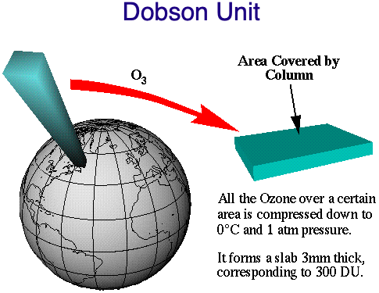
Dobson unit for O₃ column abundance
O₃ in a vertical column of air (from ground to TOA) is compressed in a single layer at 273 K and 1 atm pressure
The thickness of the layer (measured in 1/100 mm) is the column abundance of O₃ in DU
e.g. a thickness of 3mm = 300 DU (a normal value for O₃ in the atmosphere)
1DU = 2.69x10¹⁶ O₃ molecules/cm²
Notes:
define the Dobson Unit (DU): 100 DU = 1 mm thick pure O3 layer at one atmosphere.
Imagine that all the O3 in a vertical column of air (from ground to TOA) is concentrated in a single layer at 273K and 1 atm pressure. The thickness of the layer , measured in 1/100 mm is the column abundance of O3 in DU
1DU=2.69x1016 O3 molecules/cm2
A normal value is about 300DU (a layer of pure O3 at the surface of 3 mm)

Slide 14
Photolysis of Ozone
Complex photochemistry leading to O and O₂ in both ground and excited states
All (allowed) excited electronic transitions lead to O₃ above its lowest dissociation threshold
Transition into the ¹B₂ state ~255 nm (Hartley band) is strongest. Weaker transitions into other singlet states at ~600 nm (Chappuis bands) and 330 nm (Huggins bands)
Multiple dissociation pathways are available:
λ threshold
O₃ + hν → O(³P) + O₂(X ³Σ_{g}⁻) 1180 nm
→ O(³P) + O₂(a ¹Δ_{g}) 612 nm
→ O(¹D) + O₂(X ³Σ_{g}⁻) 411 nm
→ O(¹D) + O₂(a ¹Δ_{g}) 310 nm
lowest energy one
Notes:
The photolysis of ozone, which drives tropospheric chemistry, is particularly sensitive to the overhead column of stratospheric ozone.
Photolysis of ozone throughout the atmosphere leads to the formation of OH,
O3 + h v -> O (1 D ) + O2
O(1D)+H20-> OH+OH
which in turn is responsible for initiating the oxidation of a wide variety of atmospheric trace constituents, for example, methane:
OH + CH4 -> CH3 + H20
The photochemistry of ozone is very complex, as the relatively weak chemical bonds in ozone allow excited states of the O and O2 photoproducts
to be accessed. In fact, only now is a consensus being reached on the quantitative aspects of this photochemistry, particularly near the energy threshold
for O(lD) production near 310 nm. It is now believed (Ravishankara et al., 1998, and references therein) that four different photolysis channels are
occurring in the 290-350 nm spectral region, the region of importance for the generation of OH in the lower atmosphere, with the quantum yields for
these four channels varying with wavelength and temperature:
For atmospheric considerations, the key channels are those which produce O(1D), that is, those which lead to OH production. Interestingly, the energy
threshold for channel (C) is at about 308 nm, yet this process still occurs to longer wavelengths as a result of internal energy (vibrational and rotational)
contained in the ozone molecule itself, while channel (D) is a quantum mechanically“spin-forbidden” process whose occurrence was thought to be
unlikely. The figure below shows the O(’D) quantum yields near 200 K and 300 K (Filled circles = 203 K; open circles = 298 K). Channel (C) dominates below about 320 nm at 300 K, but is strongly
temperature dependent, while the near-constant contribution of the spin-forbidden channel (quantum yield about 0.06) is evident beyond about 320 nm.

Slide 15
Photolysis of Ozone
O₃ photolysis drives tropospheric chemistry
For tropospheric chemistry the most important aspect is production of O(¹D):
Photolysis thresholds:
O₃ + hν → O(¹D) + O₂(X ³Σ_{g}⁻) 411 nm
→ O(¹D) + O₂(a ¹Δ_{g}) 310 nm
Why do we care about OH?
OH is responsible for initiating the oxidation of a wide variety of atmospheric trace constituents, e.g. :
OH + CH₄ → CH₃ + H₂O
Notes:
The photolysis of ozone, which drives tropospheric chemistry, is particularly sensitive to the overhead column of
stratospheric ozone.
Photolysis of ozone throughout the atmosphere leads to the formation of OH,
O3 + h v -> O (1 D ) + O2
O(1D)+H20-> OH+OH
which in turn is responsible for initiating the oxidation of a wide variety of atmospheric trace constituents, for example, methane:
OH + CH4 -> CH3 + H20
The photochemistry of ozone is very complex, as the relatively weak chemical bonds in ozone allow excited states of the O and O2 photoproducts
to be accessed. In fact, only now is a consensus being reached on the quantitative aspects of this photochemistry, particularly near the energy threshold
for O(lD) production near 310 nm. It is now believed (Ravishankara et al., 1998, and references therein) that four different photolysis channels are
occurring in the 290-350 nm spectral region, the region of importance for the generation of OH in the lower atmosphere, with the quantum yields for
these four channels varying with wavelength and temperature:
For atmospheric considerations, the key channels are those which produce O(1D), that is, those which lead to OH production. Interestingly, the energy
threshold for channel (C) is at about 308 nm, yet this process still occurs to longer wavelengths as a result of internal energy (vibrational and rotational)
contained in the ozone molecule itself, while channel (D) is a quantum mechanically“spin-forbidden” process whose occurrence was thought to be
unlikely. The figure below shows the O(’D) quantum yields near 200 K and 300 K (Filled circles = 203 K; open circles = 298 K). Channel (C) dominates below about 320 nm at 300 K, but is strongly
temperature dependent, while the near-constant contribution of the spin-forbidden channel (quantum yield about 0.06) is evident beyond about 320 nm.

Slide 16
O₃ in the stratosphere: the Chapman cycle
Sydney Chapman (1920-30) propose a reaction mechanism to account for the ozone layer
Initiation:
bond energy of O₂=498 kJ/mol
R1: O₂ + hν (λ<240 nm) → O•(3P) + O•(3P)
Propagation (Ozone-oxygen cycle):
R2: O• + O₂ + M → O₃ + M+ E_{k}
bond energy of O₃~ 100 kJ/mol
R3: O₃ + hν (λ< 320 nm) → O₂ + O•(1D)
Removal:
R4: O₃ + O• → O₂ + O₂
Chemical energy released in R2 is converted into kinetic energy (E_{k}) → heating of stratosphere
(R5: O• + O• + M → O₂ + M)
Notes:
See http://acmg.seas.harvard.edu/people/faculty/djj/book/bookchap10.html
Creation: an oxygen molecule is split (photolyzed) by higher frequency UV light (top end of UV-B, UV-C and above) into two oxygen atoms (see figure):O₂ + ℎν → 2 O•Each oxygen atom then quickly combines with an oxygen molecule to form an ozone molecule:O• + O₂ → O₃
The ozone–oxygen cycle: the ozone molecules formed by the reaction above absorb radiation having an appropriate wavelength between UV-C and UV-B. The triatomic ozone molecule becomes diatomic molecular oxygen plus a free oxygen atom (see figure):O₃ + ℎν_{(240–310 nm)} → O₂ + OThe atomic oxygen produced quickly reacts with another oxygen molecule to reform ozone:O + O₂ → O₃ + E_{K}where E_{K} denotes the excess energy of the reaction which is manifested as extra kinetic energy. These two reactions form the ozone–oxygen cycle, in which the chemical energy released when O and O₂ combine is converted into kinetic energy of molecular motion. The overall effect is to convert penetrating UV-B light into heat, without any net loss of ozone. This cycle keeps the ozone layer in a stable balance while protecting the lower atmosphere from UV radiation, which is harmful to most living beings. It is also one of two major sources of heat in the stratosphere (the other being the kinetic energy released when O₂ is photolyzed into O atoms).
Removal: if an oxygen atom and an ozone molecule meet, they recombine to form two oxygen molecules:O₃ + O· → 2 O₂
And if two oxygen atoms meet, they react to form one oxygen molecule:
2 O· → O₂
This reaction is known to have a negative order of reaction of -1. The overall amount of ozone in the stratosphere is determined by a balance between production by solar radiation and removal. The removal rate is slow, since the concentration of O atoms is very low.
The net reaction will be 2 O₃ → 3 O₂
Certain free radicals, the most important being hydroxyl (OH), nitric oxide (NO) and atoms of chlorine (Cl) and bromine (Br), catalyze the recombination reaction, leading to an ozone layer that is thinner than it would be if the catalysts were not present.
Most of the OH and NO are naturally present in the stratosphere, but human activity, especially emissions of chlorofluorocarbons (CFCs) and halons, has greatly increased the Cl and Br concentrations, leading to ozone depletion. Each Cl or Br atom can catalyze tens of thousands of decomposition reactions before it is removed from the stratosphere.

Slide 17
The Chapman cycle
R2 fast*
R4 slow*
R1 slow*
* From laboratory measurements
R3 fast*
“odd-oxygen” species (O_{x}) are rapidly interconverted O_{x} = O + O₃
The overall mechanism is a net conversion of UV-B radiation in heat with steady state O₃ concentration
Notes:
Give the four Chapman reactions:
O₂ + hv → 2O (< 242nm)
O + O₂ + M → O₃ + M* (generates heat)
O₃ + hv → O₂ + O(¹D) (usually followed by rapid deactivation to ³P)
O + O₃ → 2O₂
Need to talk about the time frames of the reactions. In one cc, typical rates for the four reactions are:
10⁶ molecules of O₂ photodissociate per second
10⁵ molecules of O₃ react with O per second
10⁸-10⁹ “cycles” of O_{x} conversions occur per second
Thus, the typical “chain length” of the cycles is about 1000. In other words, the rate of interconversion among O_{x} species is (very roughly) one thousand times faster than the rate of O_{x} production or loss.

Slide 18
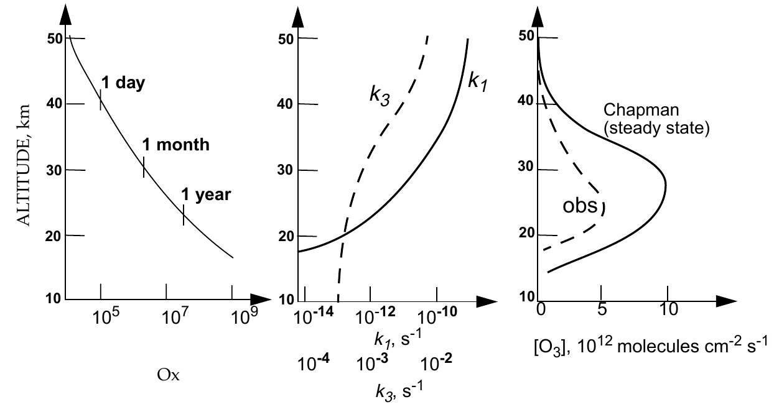
Evaluation of the Chapman’s model
O_{x} lifetimes
O₂ and O₃ photolisis rates
Calculated and observed O₃ vertical profiles
Qualitative agreement with observations:
  Predicts stratosphere as a source of ozone
  Predicts thermal inversion in the stratosphere
Quantitative agreement?
  Check by comparing measured ozone levels with those predicted by Chapman’s model
Notes:
according to Chapman, production of Ox (and hence O3) is by photodissociation of O2. The rate of this photodissociation is proportional to the uv light intensity that causes the photodissociation times the absolute concentration of dioxygen. Above the stratosphere there is plenty of uv light but fewer O2 molecules (air is thinner) while below the stratosphere there is plenty of O2 molecules but not much uv light. Thus it makes sense (qualitatively) that ozone is created in the stratosphere.
according to Chapman, main source of heat is the association reaction between atomic O and O2. The rate of this reaction is proportional to the product of O and O2 concentrations, which is at a maximum at the top of the stratosphere. The observed thermal profile in the stratosphere matches this product pretty well.
quantitative prediction using Chapman: set up a series of differential equations and solve for steady-state O3 concentration. The rate constants in Chapman’s equations will change with altitude, and so will the predicted SS ozone concs. Compare these predictions with the measured values will allow us to assess Chapman’s model; the nature of any disagreement may help us to see shortcomings in the model.

Slide 19
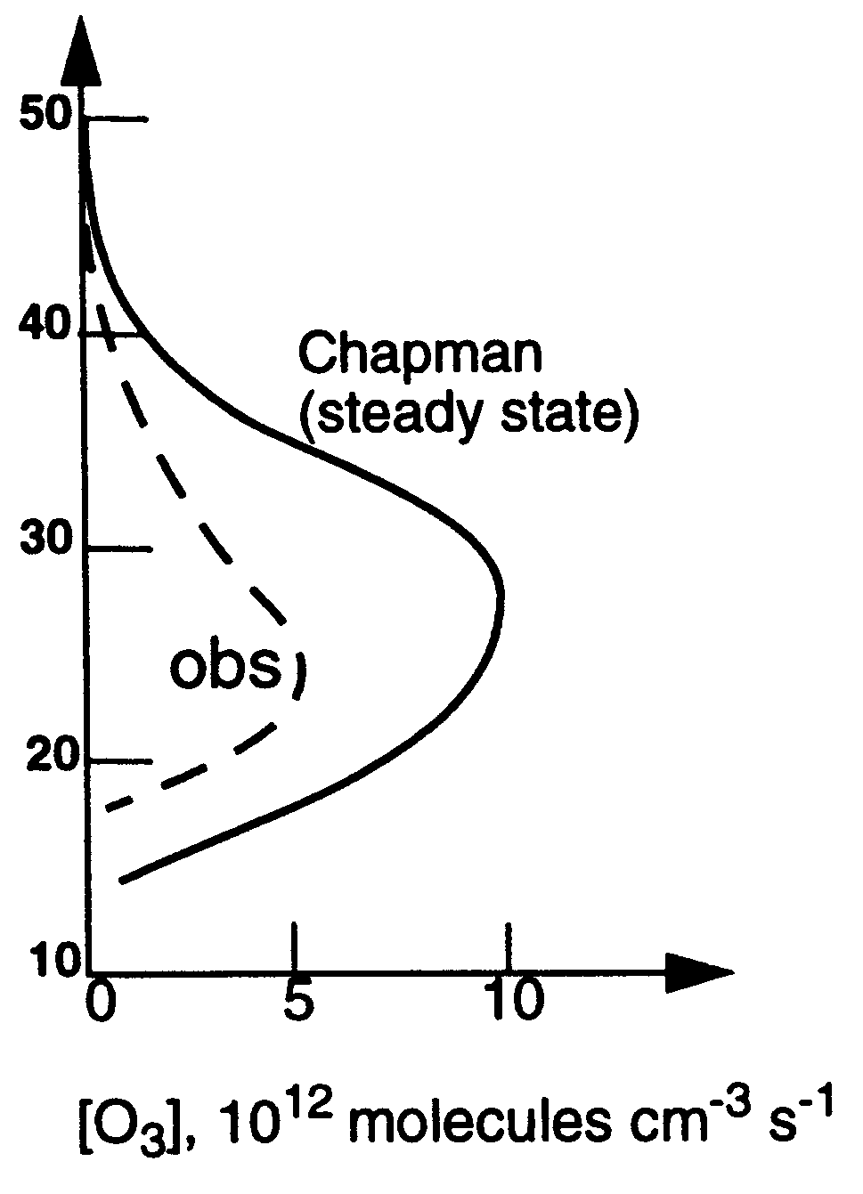
Problems with the Chapman cycle
Qualitative agreement: presence of an ozone layer at the right height; predicts thermal inversion. But…
Predicts too much ozone. What is wrong?
  Either there is an extra source of O_{x} OR
  There are other sinks: pathways that destroy ozone
Notes:
according to Chapman, production of Ox (and hence O3) is by photodissociation of O2. The rate of this photodissociation is proportional to the uv light intensity that causes the photodissociation times the absolute concentration of dioxygen. Above the stratosphere there is plenty of uv light but fewer O2 molecules (air is thinner) while below the stratosphere there is plenty of O2 molecules but not much uv light. Thus it makes sense (qualitatively) that ozone is created in the stratosphere.
accordingn to Chapman, main source of heat is the association reaction between atomic O and O2. The rate of this reaction is proportional to the product of O and O2 concentrations, which is at a maximum at the top of the stratosphere. The observed thermal profile in the stratosphere matches this product pretty well.
quantitative prediction using Chapman: set up a series of differential equations and solve for steady-state O3 concentration. The rate constants in Chapman’s equations will change with altitude, and so will the predicted SS ozone concs. Compare these predictions with the measured values will allow us to assess Chapman’s model; the nature of any disagreement may help us to see shortcomings in the model.

Slide 20
Missing element: catalytic destruction of O₃
Certain free radicals catalyze the recombination reaction R4 (O₃+O) → depletion of the O₃ layer
Four main “families” of chemicals responsible for catalyzing ozone destruction:
Nitrogen oxides: NO_{x}
  NO + NO₂
Hydrogen oxides: HO_{x}
  OH + HO₂
Chlorine: ClO_{x}
  Cl + ClO
Bromine: BrO_{x}
  Br + BrO
biogenic sources
anthropogenic sources (from CFCs)
Notes:
missing ozone “sink” is due to catalytic destruction of odd-oxygen. Four chemical “families” are responsible for this destruction
separate overhead: table with the entire chemical families. NOx is the portion of the NOy family that is actively involved in the Ox formation/destruction, etc.
separate handout with timeline of significant events in ozone layer history: discovery, Chapman, HOx and NOx proposal, SST debate, ClOx and CFCs, Nobel Prize, discovery of ozone hole, Montreal Protocol.

Slide 21
Missing element: catalytic destruction of O₃
A common type of catalytic destruction cycle of O₃ in the stratosphere (there are others)
O₃ + X → XO + O₂
O + XO → X + O₂
X is a catalyst
O₃ +O → 2O₂
Net reaction
Notes:
A catalytic cycle =a molecule significantly changes or enables a reaction cycle without being altered by the cycle itself. The example that we will see later today is the catalytic destruction of stratospheric ozone, which is carried out by the following mechanism:
Here, the radical X (which can be Cl, NO, Br, etc.) catalyzes the destruction of ozone and is regenerated in the process, thus allowing for the cycle to repeat over and over … “a little goes a long way”!

Slide 22
Sources of catalysts
Stratospheric NO_{x}
  Source: tropospheric N₂O
  Natural sources (mostly)
  10% increase since 1850 (ie, due to anthropogenic activities...mostly fertilizer application)
Stratospheric HO_{x}
  Source: tropospheric CH₄, H₂, H₂O
  Much is natural, however...
  150% increase in tropospheric CH₄ since 1850 (agricultural activities; landfills; other sources)
Stratospheric Cl and Br
  Almost entirely due to human activity
  Sources: tropospheric CFCs, HCFCs, halons

Slide 23

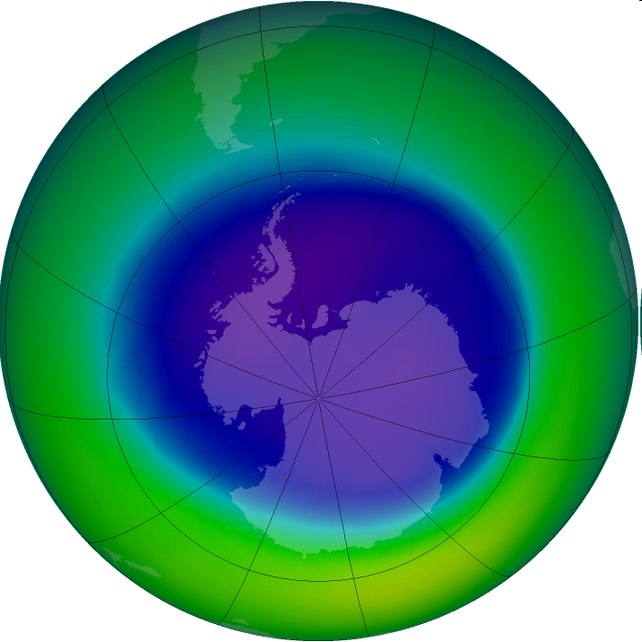
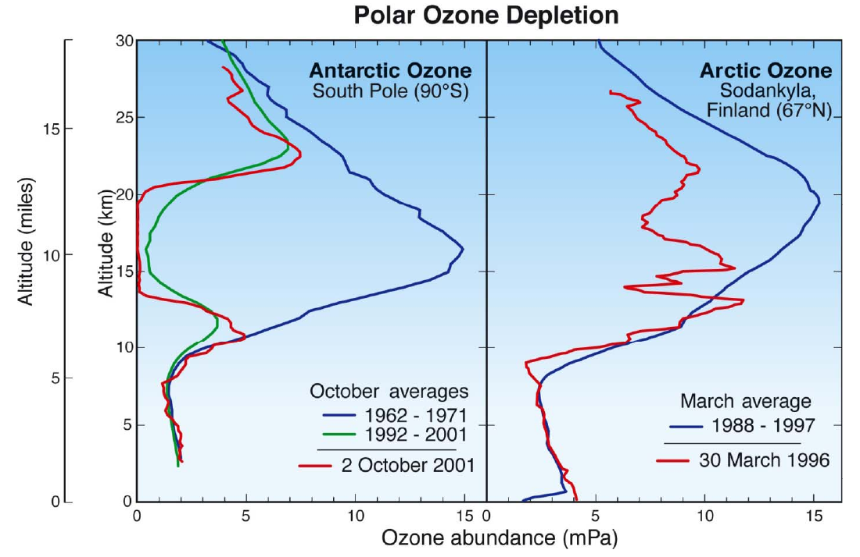
Stratospheric Ozone hole
Ozone hole in Sept 2005.
Source: NASA
The ozone hole is the region over Antarctica with total ozone 220 Dobson Units or lower. (The avg total column ozone in the atmosphere is about 300 DU.)
A reduction of O₃ of up to 70% that occurs seasonally (spring) in the stratosphere over polar regions. Record size reached in September 2000 (more than 15 million square miles, an area as large as the continent of North America).

Slide 24
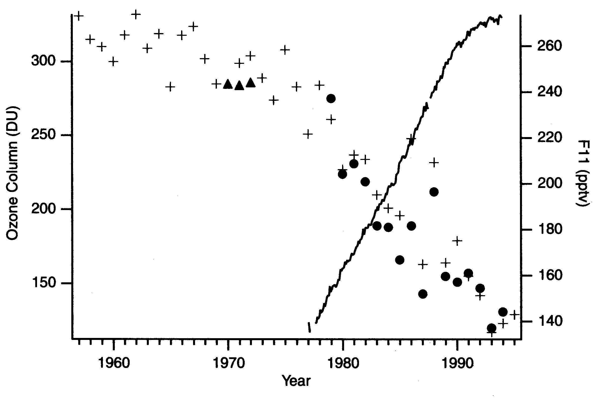
Stratospheric Ozone hole: detection
global tropospheric CFC-11
measured in October
+ Crosses are BAS (British Antarctic Survey) measurements
NASA satellite measurements. Measurements are October (early spring) averages
BAS reported their findings in 1985. NASA later verified their results.
Notes:
Hole detected from ground-based measurements taken by the British Antarctic Survey team
October (early Spring) measurements are shown here
BAS reported their findings in 1985 in the journal Nature
Ozone hole discovered during the negotiations that lead to the signing of the Montreal Protocol in 1987

Slide 25
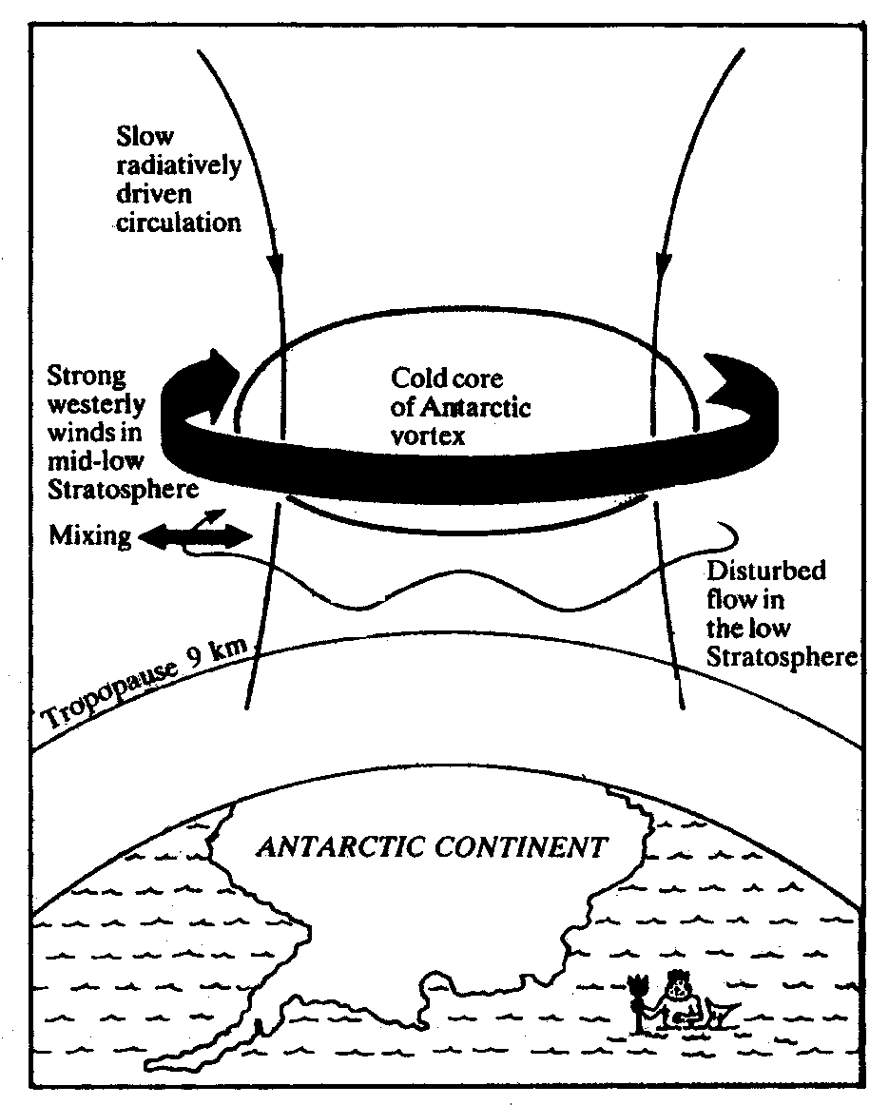
Why over Antarctiva?
Unique Feature of Antarctic Meteorology: Winter Vortex
Stratospheric Ozone hole: causes
Polar vortex develops during the winter
Atmosphere is effectively isolated from the rest of the southern hemisphere
Interior temperatures plummet during long winter night – large area is below 200K, and it can get as cold as 180K
Cold temperatures facilitate formation of Polar Stratospheric Clouds (H₂O ice + HNO₃)
Notes:
the strange meteorology of the Antarctic region is shown here (describe). Two main features: very low temperatures compared to “typical” for the stratosphere, and the region is isolated from the surroundings by the polar vortex jet streams

Slide 26
At the time, three competing theories
Stratospheric Ozone hole: causes
Chlorine-induced
  Supported by the timing (ozone hole began appearing in the 1970’s), BUT
  Existing chemical models inadequate (why only in Antarctica?)
Circulation-driven
  After sun rises, tropospheric upwelling “pushes” ozone out of the vortex (ozone displacement, not destruction) BUT why was it getting larger?
Solar storms
  NO_{x} created in upper stratosphere during winter BUT would be enough to cause the observed depletion?
Notes:
three groups of scientists: atmospheric chemists; meteorologists; astrophysicists, each with an explanation that “belongs” in their own field
some problems with the Cl theory:
why in the Antarctic and not elsewhere? Current models predicted a relatively modest (a couple of percent) ozone depletion, not 50%
very low concentrations of O after sunrise because uv light intensity is still quite low (so the main Cl/ClO loss cycle wouldn’t be very fast)
problem with circulation argument: what was different in the 1970’s and later? Why was it getting larger?
problems with the solar-storm argument: (i) would enough NOx be created in the thin upper stratosphere to cause such massive depletion? (ii) NOx loss cycle still requires atomic oxygen, so it might not be fast enough.

Slide 27
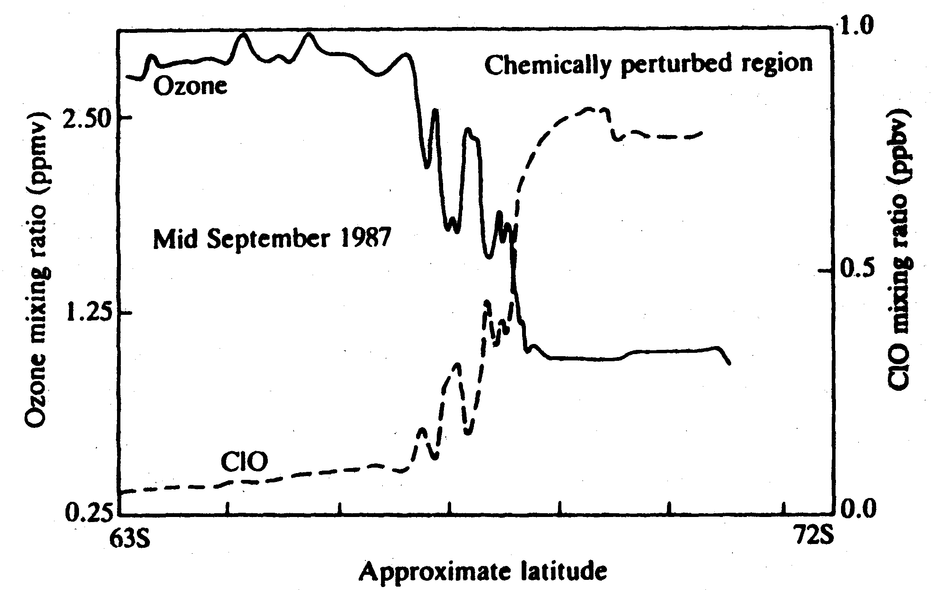
The “Smoking Gun” Points to Chlorine!
Stratospheric Ozone hole: causes
measurements from NASA’s Airborn Antarctic Ozone Expt (1989): anticorrelation between ClO and O₃
But where the Cl/ClO was coming from?
Notes:
the measurements plotted here were from NASA’s Airborn Antarctic Ozone Expt (AAOE). The figure was first published in 1989 (Anderson et al, “Ozone destruction by chlorine radicals within the Antarctic vortex: the spatial and temporal evolution of ClO/O3 anticorrelation based on in situ ER-2 data,” Journal of Geophysical Research, 1989, 94, 11465-479).

Slide 28
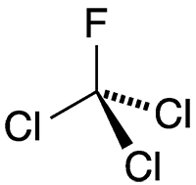
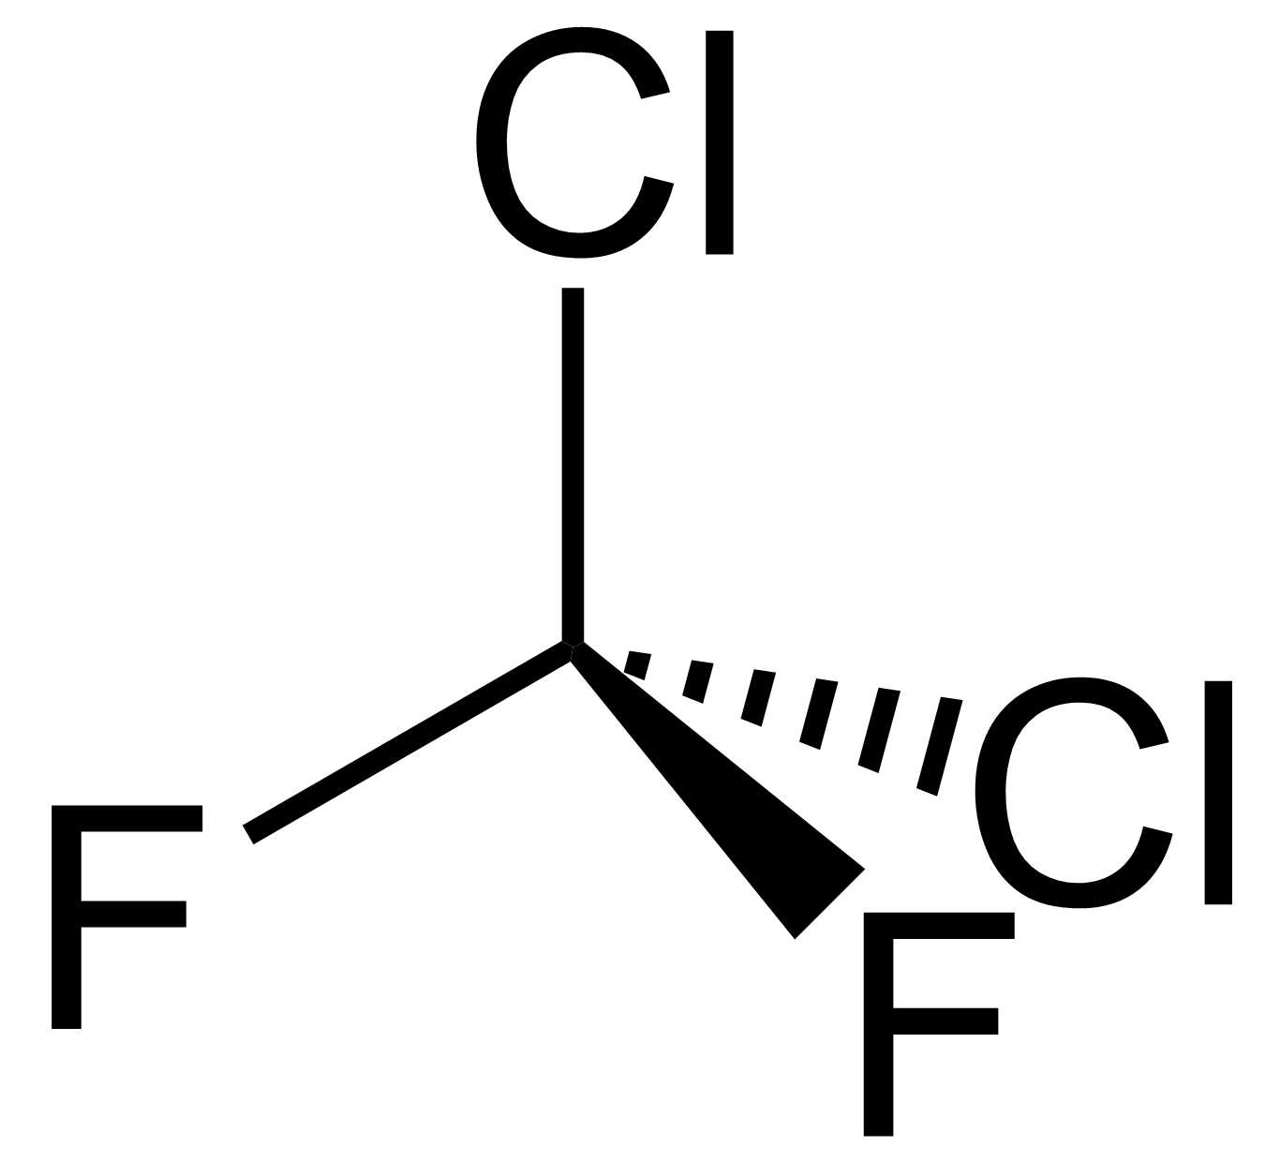
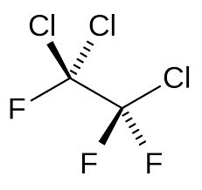
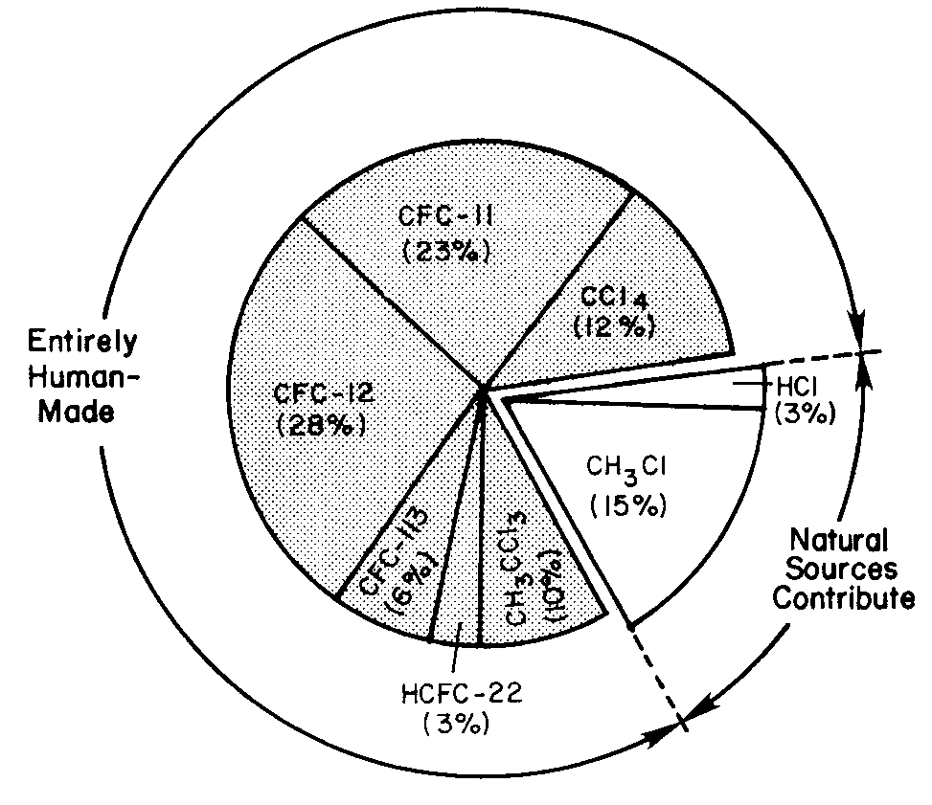
Chloro-fluoro-carbons (CFCs)
  CFCs are small molecules that contain chlorine, fluorine and carbon atoms. Usually there are only 1-2 carbon atoms.
  CFCs are sometimes called Freons (trade name for DuPont)
  CFCs are referred to by a number. The most common CFCs are:
CFC-11: CFCl₃
CFC-12: CF₂Cl₂
CFC-113:
CF₃CCl₃
Primary sources of chlorine entering the stratosphere (early 1990s)
Despite the fact that tropospheric concentration of HCl is far greater than of CFCs, it is not a great contributor of stratospheric chlorine
Notes:
CFCs, or Freons, were manufactured by DuPont for use as refrigerents. Hailed as the perfect chemical due to their nontoxic and unreactive nature, they were also used widely as solvents and as blowing agents.
1971: Lovelock made a suggestion (in letter in Nature) that CFCs could be used as markers for wind patterns and currents.
1973: Molina and Rowland commenced a study on the atmospheric fate of CFCs. Quickly became apparent that the usual “natural” sinks – photochem oxidation, wet deposition, and plant uptake – did not apply to CFCs. Their main tropospheric fate, then, was to cross into the stratosphere.
Once in the stratosphere, they photodissociated. Many absorbed in the “uv window” (200-220 nm) between the O₂ and O₃ absorption peaks. Thus, they photodissociated soon after crossing into the stratosphere. Molina and Rowland published their paper in Nature in 1974. They later won a Nobel Prize for their discovery, sharing it with Paul Crutzen, who first proposed the role of Nox in stratospheric ozone destruction.

Slide 29
Destruction of O₃ by CFCs
  CFCs in the troposphere are:
  unreactive to OH and other reactive radicals
  pretty insoluble in water (no wet precipitation)
  tropospheric lifetimes long enough that the majority of CFCs pass through the tropopause into the stratosphere
  CFCs in the stratosphere are subject to shorter wavelengths (i.e. more energetic photons):
  Absorb in the “UV window” (centered at 205 nm) between strong O₂ and O₃ absorption
  photodissociate in the bottom half of the stratosphere, by releasing Cl (and F atoms)
  Chlorine atoms deplete oddo oxygen (Ox) by the cycle (already seen):
CFCl₃ + hν → CFCl₂ + Cl (λ < 225 nm)
O₃ + Cl → ClO + O₂
O + ClO → Cl + O₂
O₃ + O → 2 O₂
Notes:
Arrivata qui il 24 November 2023 ripredenre e ripetere da qui
explain how the conc profiles are characteristic of species that (a) have long tropospheric lifetimes (long enough to be completely mixed) but (b) are destroyed in the stratosphere (due to uv photodissociation)
discuss the fate of CFCs in the stratosphere
remember the UV window? Most CFCs photodissociate in that spectral region, which means (unfortunately) that they can begin photodissociating almost as soon as they cross the troposphere.

Slide 30
Chlorine in the stratosphere
  Once released from CFCs, what happens to chlorine in the stratosphere? How does it leave the stratosphere?
  Chlorine undergoes a series of reactions to form a variety of compounds
  Some of these are active in depleting ozone: Cl, ClO
  Some other do not directly deplete ozone; these are chlorine reservoirs: HCl, ClONO₂, HOCl
  The most important (long-lived) stratospheric chlorine reservoir is HCl
  The reservoirs can become activated by various processes such as photodissociation or reaction with OH
  Loss of stratospheric chlorine occurs when they cross-back into the troposphere and are removed from the atmosphere
    Most common route: HCl crosses back, dissolves in water, and is washed out
Notes:
explain diagram. Further proof that CCly (most of which is anthropogenic) is the source of virtually all stratospheric chlorine
Note HCl is most important reservoir, followed by ClONO2. Compare to concs of ClOy.
note the concentrations. Active chlorine is in the ppt range (similar to HOx, less than NOx). Sum of all chlorine (CCly + ClOy) is about 3.7 ppbv if we multply CCly concs by the number of chlorines in the molecule (demonstrate this)

Slide 31
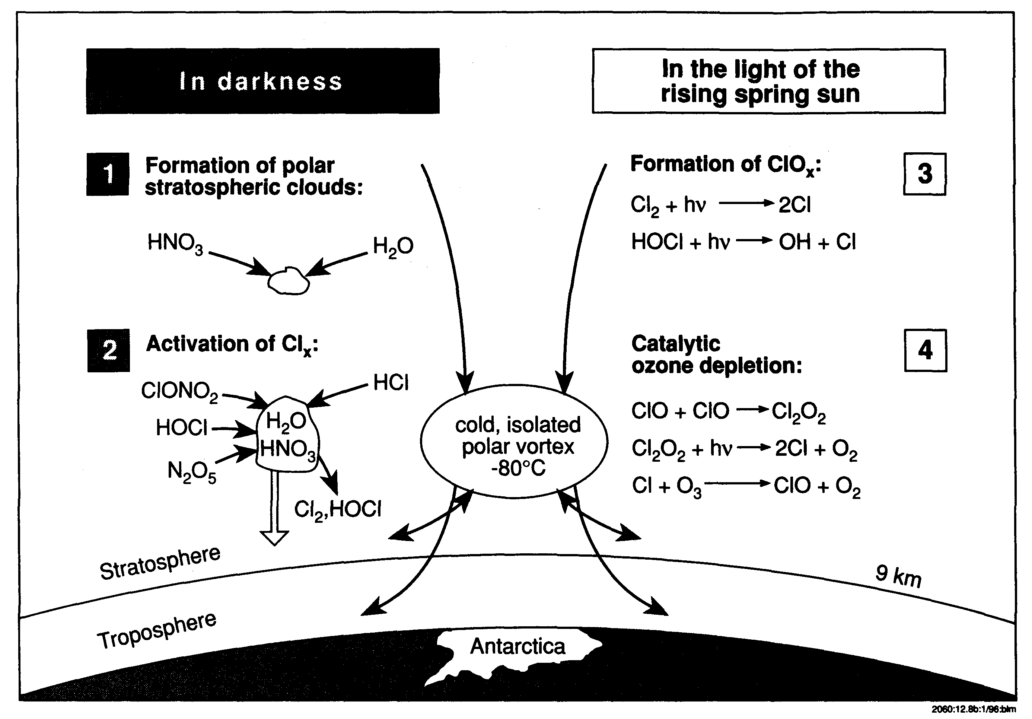
Stratospheric Ozone hole explained
Heterogeneous reactions take place on PSCs which radically alter the partitioning of chlorine species towards more active chlorine
Notes:
review again the sequence of events leading the the formation of the ozone hole

Slide 32
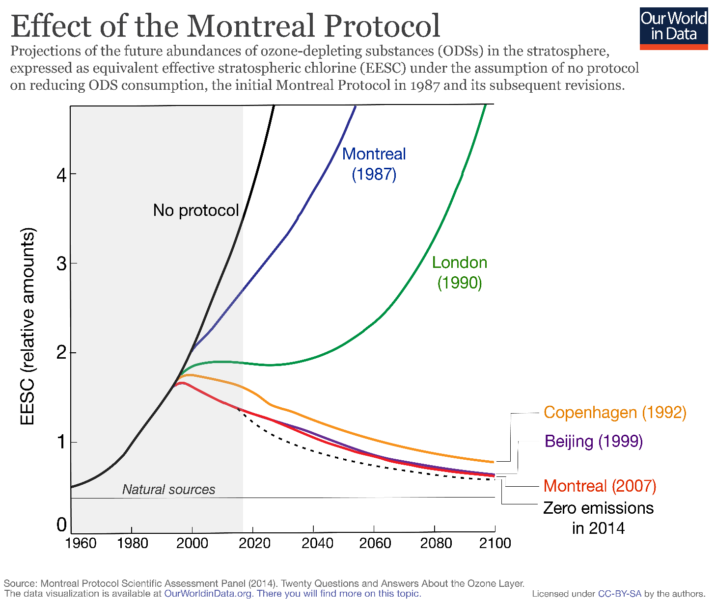
The Montreal protocol on CFCs
  Montreal Protocol: signed in 1987 by 46 countries. It entered into force in 1989.
  By 1996, developed countries phased out use of CFCs, halons and CCl4; developing countries had until 2010
https://ourworldindata.org/ozone-layer
Notes:
For details see https://ourworldindata.org/ozone-layer

Slide 33
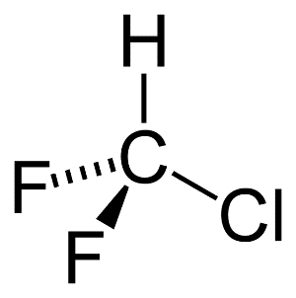
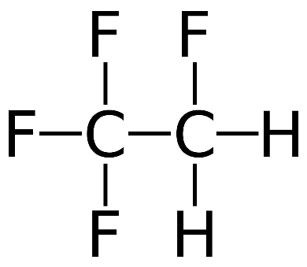
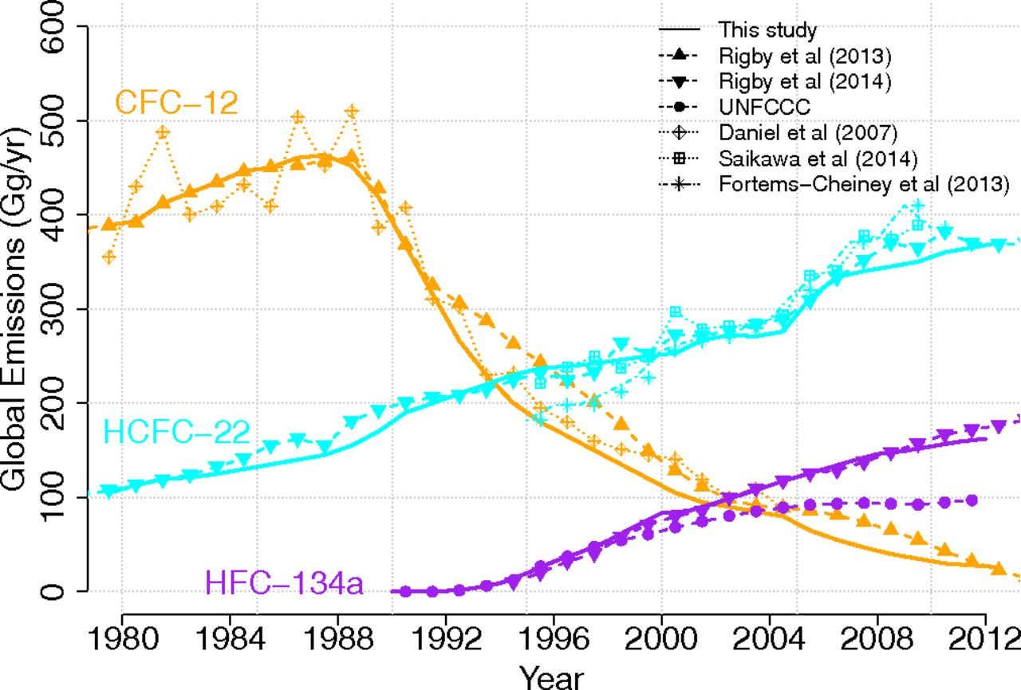
Alternatives to CFCs: HCFCs
  HCFCs are CFCs that contain hydrogen. This makes them more reactive to the OH radical, decreasing their tropospheric lifetime.
HCFC-22: CHClF₂
HFC-134a: CH₂FCF₃
  HCFCs (“soft CFCs”) destroy less stratospheric O₃ than CFCs (“hard CFCs”) because a smaller fraction of HCFCs “survive” to reach the stratosphere
However: HCFCs are potent greenhouse gases!
https://www.pnas.org/doi/10.1073/pnas.1417372111?cookieSet=1
Notes:
https://www.pnas.org/doi/10.1073/pnas.1417372111?cookieSet=1

Slide 34
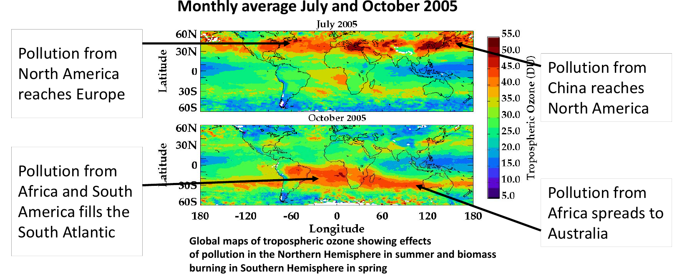
Tropospheric Ozone
  Tropospheric (lower altitude) O₃ is a toxic pollutant. As industrialization increases pollutants flow from one continent to another
  By combining O₃ measurements with simulations a clear picture of the O₃ transport appears
Notes:
Tropospheric ozone is only about 10% of the total amount of ozone contained in a vertical column in the atmosphere. However, this relatively small amount of tropospheric ozone has a great importance because it’s important role in the formation of photochemical air pollution and its oxidizing impact in the near surface layer

Slide 35
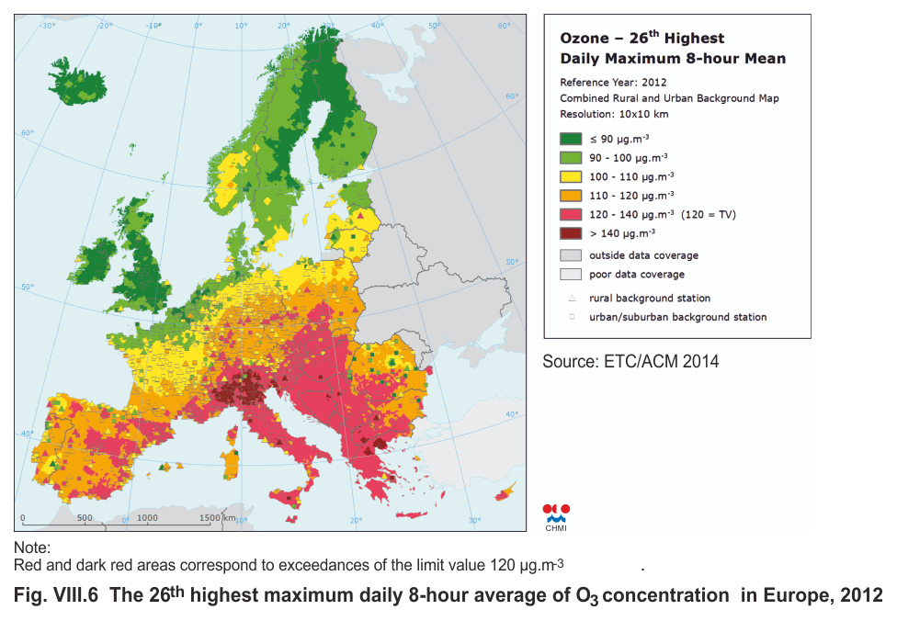
Tropospheric Ozone
Notes:
Tropospheric ozone is only about 10% of the total amount of ozone contained in a vertical column in the atmosphere. However, this relatively small amount of tropospheric ozone has a great importance because it’s important role in the formation of photochemical air pollution and its oxidizing impact in the near surface layer

Slide 36
Tropospheric O₃: a «criteria» pollutant
O₃ is one of the six principal pollutants (so called "criteria" air pollutants) for the US EPA (Environmental Protection Agency) https://www.epa.gov/criteria-air-pollutants#self
O₃ is a secondary air pollutant (not emitted directly to the atmosphere)
Effects:
  respiration (premature aging of lungs, asthma)
  phytotoxic (damage to vegetation and agricultural crops)
  principal agent of photochemical smog
  material damage (e.g. rubber)
  greenhouse effect (absorption in the IR at 9.6 μm)
O₃ regulates many other oxidants (e.g. OH)
Limit: 70 ppb (2015- EPA Ambient air quality standard) https://www.epa.gov/criteria-air-pollutants/naaqs-table
Notes:
http://elte.prompt.hu/sites/default/files/tananyagok/AtmosphericChemistry/ch08s02.html
Ozone is a secondary air pollutant that is not emitted directly to the atmosphere. Ozone is a major pollutant.
It does billions of dollars worth of damage to agricultural crops each year and is the principal culprit in photochemical smog.
O3 can reduce photosynthesis and slow the plant's growth. Increase sensitive plants' risk of: disease, damage from insects, effects of other pollutants, harm from severe weather.
Ozone abundances in the troposphere typically vary from less than 10 ppb over remote tropical oceans up to about 100 ppb in the upper troposphere, and often exceed 100 ppb downwind of polluted metropolitan regions

Slide 37
Tropospheric O₃ and OH radicals
O₃ in the troposphere is important because it generates OH radicals:
OH radicals initiate the atmospheric oxidation of a wide range of compounds in the atmosphere
  oxidation of both anthropogenic and biogenic organics
  referred to as ‘detergent of the atmosphere’
  typical concentrations near the surface ~10⁶ - 10⁷cm⁻³
  the main oxidant species in the troposphere
  very reactive, effectively recycled
Notes:
See details in file books/Rethinking the Ozone Problem in Urban and Regional Air_1991
Ozone can form by the recombination of an oxygen molecule and an oxygen atom, similarly as in the stratosphere. Nevertheless, O atom cannot form in the troposphere by the photodissociation of molecular oxygen, because this reaction requires short wavelength (λ < 242 nm) which is not available in the troposphere (due to the absorption by stratospheric ozone). In the troposphere, nitrogen dioxide is the only known compound that can produce O atom during it’s photodissociation at available radiation:
Both meteorology and photochemistry play important roles in local and global ozone chemistry.
Transport from the stratosphere represents a natural source of ozone.
VOC’s plus NOx make a photochemical source.
HOx reactions and dry deposition are sinks.

Slide 38
Tropospheric O₃ photochemistry
In clean tropospheric air there should be a net destruction of O₃:
CLEAN AIR
(1) O₃ + hν → O₂ + O(¹D)
(2) O(¹D) + H₂O → 2OH
(3) OH + O₃ → HO₂ + O₂
(4) HO₂ + O₃ → 2O₂ + OH
-----------------------------------------
(3+4) 2O₃ → 3O₂ NET
OH and HO₂ react with O₃ and destroy it

Slide 39
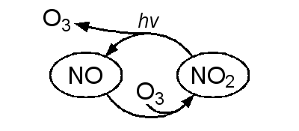
O₃ production in the troposphere
O₃ can form by recombination of O₂ and O (like in stratosphere) but O atoms cannot come from O₂ photolysis (requires λ < 242 nm, not available due to O₃ stratospheric absorption)
Photochemical production of O₃ in troposphere is tied to NOx (NO + NO₂) :
(1) NO₂ + hν (λ < 420 nm) → O(³P)+ NO
(2) O(³P) + O₂ + M → O₃ + M
(3) O₃ + NO → O₂ + NO₂
No net O₃ production, only recycling of O₃ and NOx
Notes:
See details in file books/Rethinking the Ozone Problem in Urban and Regional Air_1991
Ozone can form by the recombination of an oxygen molecule and an oxygen atom, similarly as in the stratosphere. Nevertheless, O atom cannot form in the troposphere by the photodissociation of molecular oxygen, because this reaction requires short wavelength (λ < 242 nm) which is not available in the troposphere (due to the absorption by stratospheric ozone). In the troposphere, nitrogen dioxide is the only known compound that can produce O atom during it’s photodissociation at available radiation:
Both meteorology and photochemistry play important roles in local and global ozone chemistry.
Transport from the stratosphere represents a natural source of ozone.
VOC’s plus NOx make a photochemical source.
HOx reactions and dry deposition are sinks.

Slide 40
O₃ production in the troposphere
O₃-NO-NO₂ photochemical steady state
consider the reactions just seen
NO₂ + hν (λ < 420 nm) → O(³P)+ NO j₁
O(³P) + O₂ + M → O₃ + M k₂
O₃ + NO → O₂ + NO₂ k₃
ignoring other reactions, during daylight this forms a fast cycle in steady-state for NO₂
d[NO₂]/dt = Prod - Loss = 0
k₃[NO][O₃] = j₁[NO₂]
[NO]/[NO₂] = j₁/k₃[O₃]
partitioning of NO_{x} between NO and NO₂ has important implications for [O3] in the troposphere

Slide 41
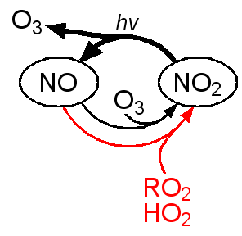
O₃ production in the troposphere
CO (or VOCs*, CH₄, NMHC**) in addition to NO_{x} are required for photochemical generation of O₃
DIRTY AIR:
(1) OH + CO → H + CO₂
(2) H + O₂ + M → HO₂ + M
(3) HO₂ + NO → NO₂ + OH
(4) NO₂ + hν → NO + O(³P)
(5) O(³P) + O₂ + M → O₃ + M
-------------------------------------------------
(1-5) CO + 2 O₂ → CO₂ + O₃ NET reaction
* VOCs = Volatile Organic Compounds
** NMHCs = Non Methane HydroCarbons
Notes:
The presence of peroxy radicals, from the oxidation of hydrocarbons, disturbs the O₃-NO-NO₂ cycle and leads to a net production of ozone.
The HO2 radical produced in (R2) reacts with NO to produce NO2 and another OH. NO2 leads to O that than recombines with O2 to generate netly O3.

Slide 42
What breaks the cycle?
O₃ production in the troposphere
Termination reactions:
OH· + NO₂ → HNO₃
HO₂· + HO₂· → H₂O₂
both HNO₃ and H₂O₂ will photolyze or react with OH to, in effect, reverse these pathways
  but reactions are slow (lifetime of several days)
  both H₂O₂ and HNO₃ are very soluble
    washout by precipitation
    dry deposition

Slide 43
O₃ production in the troposphere
A similar reaction sequence for methane CH₄ or heavier hydrocarbons:
(1) CH₄ + OH → CH₃ + H₂O
(2) CH₃ + O₂ + M → CH₃O₂ + M
(3) CH₃O₂ + NO → NO₂ + CH₃O
(4) CH₃O + O₂ → H₂CO + HO₂
(5) HO₂ + NO → NO₂ + OH
(6) NO₂ + hν → NO + O(³P)
(7) O(³P) + O₂ + M → O₃ + M
--------------------------------
(1-7) CH₄ + 4O₂ + hν → 2O₃ + H₂CO + H₂O NET reaction
With enough CO, VOCs, NOx the chain reactions can lead to increase in O₃ tropospheric concentration
Notes:
The presence of peroxy radicals, from the oxidation of hydrocarbons, disturbs the O₃-NO-NO₂ cycle and leads to a net production of ozone.
The RO2 radical produced in (R3) reacts with NO to produce NO2 and an organic oxy radical RO (eg CH3O)
NO2 goes on to photolyze and produce O3. The RO radical has several possible fates. It may react with O2, thermally decompose,
or isomerize.
Both meteorology and photochemistry play important roles in local and global ozone chemistry.
Transport from the stratosphere represents a natural source of ozone. VOC’s plus NOx make a photochemical source.
HOx reactions and dry deposition are sinks.

Slide 44
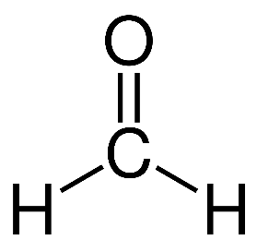
photolysis
O₃ production in the troposphere
CH₄ + 4O₂ + hν → 2O₃ + H₂CO + H₂O
(formaldehyde) will also undergo further reaction:
  HCHO + hν → H₂ + CO
→ H· + HCO
HCHO + OH → HCO + H₂O
reaction with OH
HCO + O₂ → HO₂· + CO
H· + O₂ → HO₂·
And the HO₂· can further react with NO thus producing more O₃

Slide 45
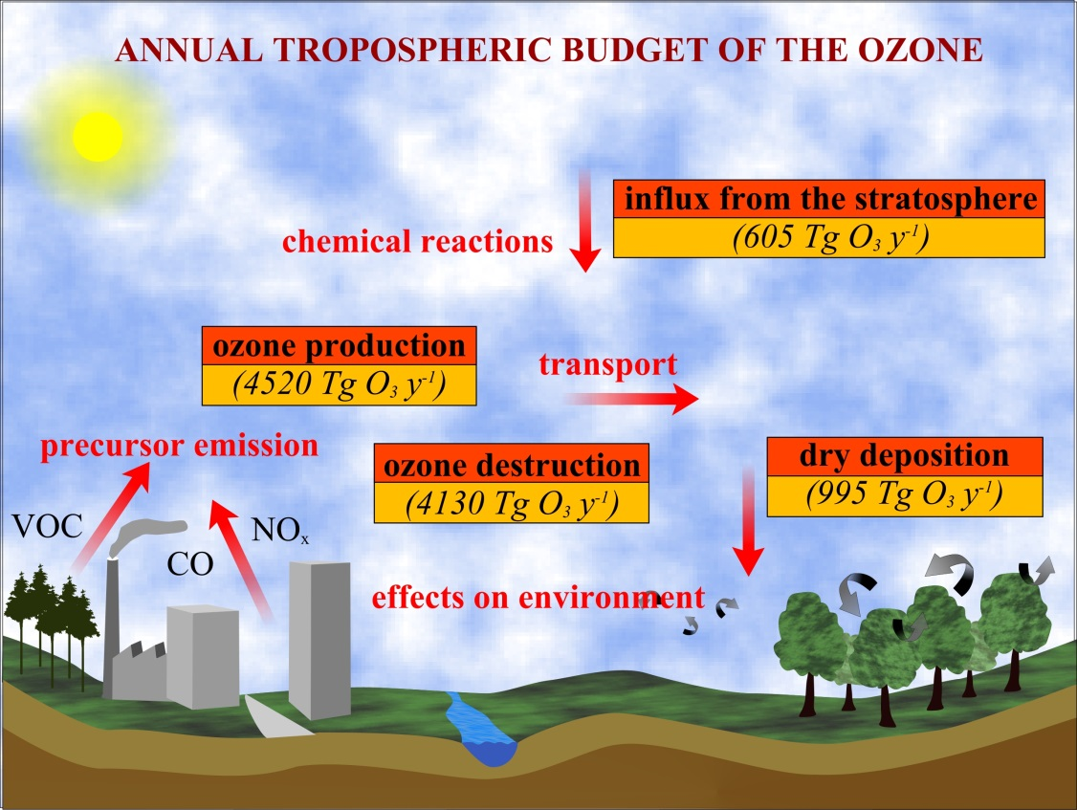
Tropospheric O₃ budget
O₃ lifetime: few weeks
Notes:
O3 can enter the troposphere from the stratosphere (most active regions of stratosphere-troposphere O3 exchange are in cyclonic regions of the upper troposphere, near the disturbed tropopause). But the major sources of tropospheric ozone are chemical reactions, when it forms from its precursor compounds (VOC, NOx). Globally annual average of photochemical destruction of tropospheric ozone is comparable with the production. Another sink process of tropospheric ozone is dry deposition, when ozone is settling from the atmosphere to different surfaces.
Ozone is transported to the troposphere from the stratosphere, and is also produced within the troposphere by photo-oxidation of volatile organic compounds (VOCs) and carbon monoxide (CO) in the presence of nitrogen oxides (NOx ≡ NO + NO2). These precursors have both anthropogenic and natural sources, and lifetimes ranging from minutes to years. Ozone has a lifetime of a few weeks and is eventually removed by photochemical loss and dry deposition.
Both meteorology and photochemistry play important roles in local and global ozone chemistry.
Transport from the stratosphere represents a natural source of ozone. VOC’s plus NOx make a photochemical source.
HOx reactions and dry deposition are sinks.

Slide 47
Da aggiungere il meccanismo che fa dipendere la [O3] dal rapport VOC/NOx
Per esempio spiegato qui:
https://www.eea.europa.eu/publications/TOP08-98/page004.html
This leads to the « ozone sinks » effect. It is specific to large metropolitan areas which concentrate NOx sources from road traffic and residential heating. As a consequence, ozone is consumed by NOx emissions through photochemical reactions and the [O3] in metropolitan areas is lower than in rural areas.
Spiegato anche in https://www.irceline.be/en/documentation/faq/why-are-ozone-concentrations-higher-in-rural-areas-than-in-cities
Sottolineare il fatto che siccome e’un meccanismo che ha bisogno della rad solare l’inquinamento si manifesta maggiormente
In estate e nelle heat waves, vedere e.g. I dati di Parigi qui
https://www.airparif.asso.fr/sites/default/files/documents/2021-10/BilanQA_IDF_2020_UK.pdf
2.2 Chemical formation of ozone
The photochemical chain reaction which produces ozone is initiated and maintained by reactive radicals. In the process, other products are formed such as peroxy acetyl nitrate, nitric acid, aldehydes, organic acids, particulates and many short-lived radical species. VOCs act as "fuel" in the ozone formation process, whereas NO functions more or less as a catalyst, since it is regenerated in the formation process. NO also plays a key role in the regeneration of the reactive radicals and the further progress of the reactions. The simplified photochemistry of ozone, which is in reality a complex and highly non-linear process, is shown in Box 1.
High concentrations of freshly emitted NO locally scavenge O3, a process leading to formation of NO2. Close to the sources this titration process can be considered as an ozone sink. In addition, high NO2 concentrations deflect the initial oxidation step of VOCs by forming other products (e.g. nitric acid), which prevents the net formation of O3. Because of these reactions, a decrease in NOx can lead to an increase in O3 at low VOC/NOx ratios, as is the case in cities. In this often called VOC-limited regime, emission control of organic compounds is more efficient to reduce peak values of ozone pollution locally.
As an air mass moves away from an urban centre its VOC/NOx ratio changes due to further photochemical reactions, meteorological processes and the occurrence of fresh emissions. The concentration of NOx decreases faster than that of VOC and consequently the VOC/NOx ratio is amplified. At high VOC/NOx ratios occurring in background situations, the chemistry tends towards the NOx-limited case and NOx reductions are considered more effective to reduce ozone in these situations. Recent work (Kramp et al., 1994; Flocke et al., 1994) indicates that the photochemistry in urban plumes proceeds faster than was previously assumed. The oxidation of VOCs leads to more ozone over a shorter time period, and to a faster removal of NOx. Hence the regime where ozone formation is controlled by the concentration of NOx is reached more quickly than previously thought (Borrell et al., 1995).
Box 1: The photochemistry of ozone formation in simplified form
VOC + OH + O2 ® RO2 + H2O
RO2 + NO + O2 ® NO2 + HO2 + CARB
HO2 + NO ® NO2 + OH
2(NO2 + hv +O2 « NO + O3)
net:
(NOx + OH +) VOC + 4O2 ® 2O3 + CARB + H2O (+ NOx + OH)
VOC stands for volatile organic compound and CARB for carbonyl compounds, which play the role of hydrocarbons in further oxidation steps. OH and HO2 are short-lived radicals which play an important role in the ozone formation process.
The complexity of the effect of NOx emission reductions on O3 formation can be illustrated by the "week-end effect". Dumont (1996) documented that O3 levels in Belgian conurbations were found to be significantly higher in the week-end than during the week. During "smog" summers the average afternoon peak was about 20% higher on Saturdays and Sundays in comparison to the "working day" afternoon peak. The opposite pattern occurred for NO2; this species was much lower on Saturdays and Sundays. However, the sum of O3 and NO2, often called Ox, was similar no matter what day was taken. This can be explained by less conversion of O3 by NO into NO2 as a result of the low level of NOx emissions during the week-end in Belgian cities (about 30% lower). In this case, this local ozone depletion effect is more important than the reduction of ozone from reduced precursor (NOx and VOC) emissions. Further ozone variations over weekdays suggest additional non-local contributions. In Austria, at stations in or near Vienna, average maximum ozone peak concentrations also show a distinct weekly pattern, however with lowest levels on Mondays and Tuesdays. This is believed to reflect ozone reduction from reduced precursor emission in a larger area, and the effect of transport (Schneider,1998). Brönniman and Neu (1997) conclude from analysis of Swiss data that there are two distinct patterns in the weekly cycle of ozone. When the meteorology is not favourable to ozone production higher concentrations were observed during the week-end. However, during favourable conditions the mean ozone peak on Sundays was 10-15% lower than on workdays.
It is worth noting that it is only as a result of initial and small NOx reductions, in the absence of concurrent reductions in VOC emissions, that the counter productive "week-end effect" may occur. To attain acceptable ozone levels, and to pass the initial counter-productivity threshold, abatement of a major fraction of both NOx and VOC emissions is necessary.
Notes:
Aggiungere un topic di progetto su: forecasting tropospheric O3 production
Da aggiungere il meccanismo che fa dipendere la [O3] dal rapport VOC/NOx
Per esempio spiegato qui:
https://www.eea.europa.eu/publications/TOP08-98/page004.html
This leads to the « ozone sinks » effect. It is specific to large metropolitan areas which concentrate NOx sources from road traffic and residential heating. As a consequence, ozone is consumed by NOx emissions through photochemical reactions and the [O3] in metropolitan areas is lower than in rural areas.
Spiegato anche in https://www.irceline.be/en/documentation/faq/why-are-ozone-concentrations-higher-in-rural-areas-than-in-cities

Slide 48
Bond breaking and ionization energies
Bond energies
ionization energies
 | eV | nm | eV | nm
NO₂ | 3.11 | 399 | 9.78 | 127
N₂O(N-N) | 4.43 | 280 | 12.89 | 96
N₂O(N-O) | 1.67 | 743
O₃ | 1.04 | 1192 | 12.52 | 99
H₂O | 5.12 | 242 | 12.61 | 98
CO₂ | 5.45 | 228 | 13.79 | 90
N₂ | 9.76 | 127 | 12.58 | 80
O₂ | 5.11 | 243 | 12.07 | 103
NO | 6.5 | 191 | 9.26 | 134
CO | 11.09 | 112 | 14.01 | 89
1 eV ≅ 96 kJ⋅mol⁻¹
Notes:
Preso da https://www.yumpu.com/en/document/view/37707507/photochemistry-in-the-atmosphere
Dove si TROVANO ALTRE COSE INTERESSANTI DA VEDERE

Slide 49
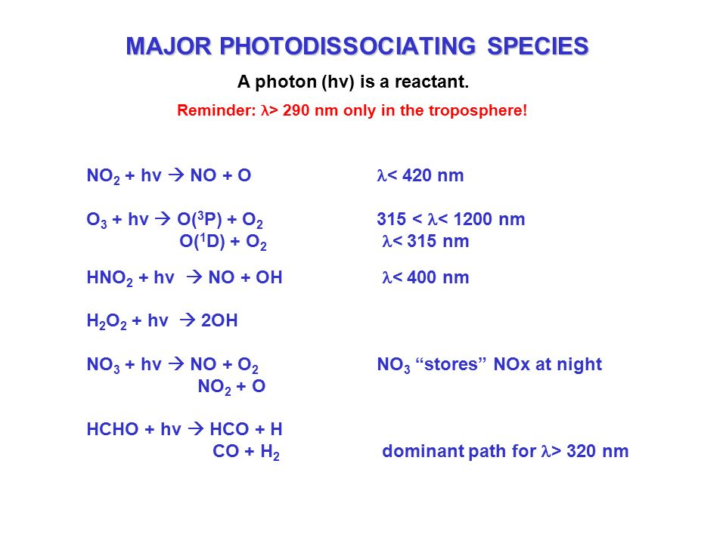

Slide 50
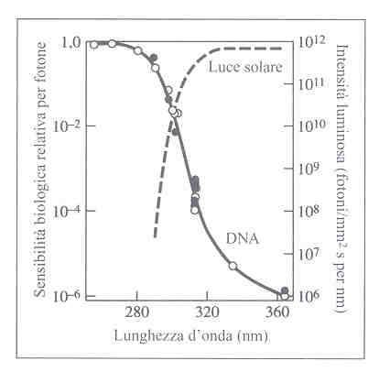
The Ozone layer depletion problem
A decrease of about 1% in O₃ can increase the amount of UV-B radiation at ground by 2%
UV-B radiation risks
Humans: DNA damage, skin cancer, cataracts, suppressed immune system
plant life (photosynthesis)
single cell organisms
aquatic ecosystems (fitoplancton production…)
Scientific Assessment of Ozone Depletion: 2014
An up-to-date understanding of ozone depletion https://www.esrl.noaa.gov/csd/assessments/ozone/2014/
Notes:
An electronic book on Stratospheric Ozone http://www.ccpo.odu.edu/SEES/ozone/oz_class.htm
Although the concentration of the ozone in the ozone layer is very small, it is vitally important to life because it absorbs biologically harmful ultraviolet (UV) radiation coming from the sun. Extremely short or vacuum UV (10–100 nm) is screened out by nitrogen. UV radiation capable of penetrating nitrogen is divided into three categories, based on its wavelength; these are referred to as UV-A (400–315 nm), UV-B (315–280 nm), and UV-C (280–100 nm). UV-C, which is very harmful to all living things, is entirely screened out by a combination of dioxygen (< 200 nm) and ozone (> about 200 nm) by around 35 kilometres.
UV-B radiation can be harmful to the skin and is the main cause of sunburn and skin cancer. The ozone layer (which absorbs from about 200 nm to 310 nm with a maximal absorption at about 250 nm) is very effective at screening out UV-B; for radiation with a wavelength of 290 nm, the intensity at the top of the atmosphere is 350 million times stronger than at the Earth's surface. Nevertheless, some UV-B, particularly at its longest wavelengths, reaches the surface, and is important for the skin's production of vitamin D. Ozone is transparent to most UV-A, so most of this longer-wavelength UV radiation reaches the surface, and it constitutes most of the UV reaching the Earth. This type of UV radiation is significantly less harmful to DNA, although it may still potentially cause physical damage, premature aging of the skin, indirect genetic damage, and skin cancer.^{[7]}
L’occhio è una delle aree più sensibili alla penetrazione di luce in genere e di UV-B in particolare.

