Slide 1

University of Trento
Master of Science in Environmental Meteorology https://international.unitn.it/environmental-meteorology
A.A. 2023-24
Environmental Physical Chemistry
Basic principles of photochemistry
Daniela Ascenzi
Dept. Physics, University of Trento, Italy
e-mail: daniela.ascenzi@unitn.it

Slide 2
Principles of photochemistry
Molecular eneregy levels
Higher energy levels of molecules are at discrete displacements from ground-state level
Energy quantization
Each molecule undergoing photochemical change absorbs one photon, the energy of which is exactly equal to the difference in energy between the ground-state level and one of the higher energy levels of the molecule
Photochemical reactivity is wavelength dependent due to the wavelength dependent absorption
Notes:
Thus dissociation typically occurs as the result of electronic transitions

Slide 3
Fundamental laws of photochemistry

Slide 4
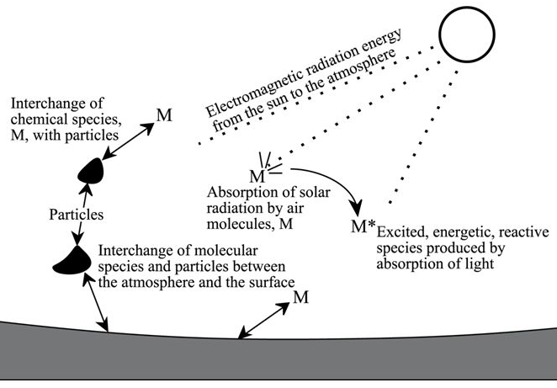
Photochemistry in the atmosphere
Photodissociation (=breaking apart of molecules upon absorption of solar radiation) plays a key role in atmospheric chemistry
Photodissociation
Photoproducts (highly reactive species) are the drivers for atmospheric chemistry
Notes:
Photodissociation, the breaking apart of molecules by solar radiation, plays a fundamental role in the chemistry of the atmosphere. The photodissociation
of trace species such as ozone and formaldehyde contributes to their removal from the atmosphere, but probably the most important role played by these photoprocesses is the generation of highly reactive atoms and radicals.
Photodissociation of trace species and the subsequent reaction of the photoproducts with other molecules is the prime initiator and driver for the bulk of atmospheric chemistry.

Slide 5
Photochemistry basics
Chemical reaction: formation or breaking of chemical bonds within or between molecules
Photochemical reaction: the energy required for activation or development is provided by electromagnetic radiation
Activation energies of ∼ 100 kJ/mol and bond energies of the order of 200-400 kJ/mol imply absorption of photons carrying an equivalent amount of energy
Notes:
Photodissociation, the breaking apart of molecules by solar radiation, plays a fundamental role in the chemistry of the atmosphere. The photodissociation
of trace species such as ozone and formaldehyde contributes to their removal from the atmosphere, but probably the most important role played by these photoprocesses is the generation of highly reactive atoms and radicals.
Photodissociation of trace species and the subsequent reaction of the photoproducts with other molecules is
the prime initiator and driver for the bulk of atmospheric chemistry.

Slide 6
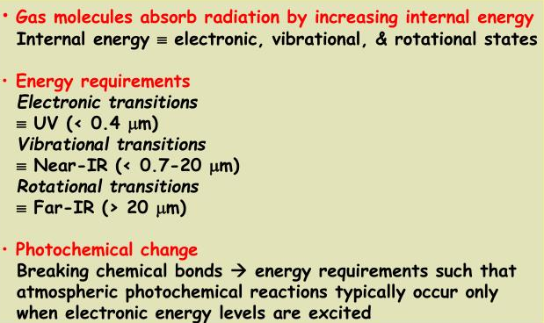
Energy transitions (summary)
Notes:
Thus dissociation typically occurs as the result of electronic transitions
Photon energies can be compared with bond energies of molecules. The energy
contained in photons of wavelengths near the red end of the visible spectrum is
comparable to the bond energies of rather loosely bound chemical species. For example, in
the ozone molecule, the O—O2 bond energy is about 105 kJ mol-1; in NO2, the O—NO
bond energy is about 300 kJ mol-1 (which corresponds to a wavelength of about 400 nm).
The lowest energy photons that are capable of promoting chemical reaction lie in the
visible region of the electromagnetic spectrum. Wavelengths at which chemical change
can occur correspond roughly to the energies at which electronic transitions in molecules
take place.

Slide 7
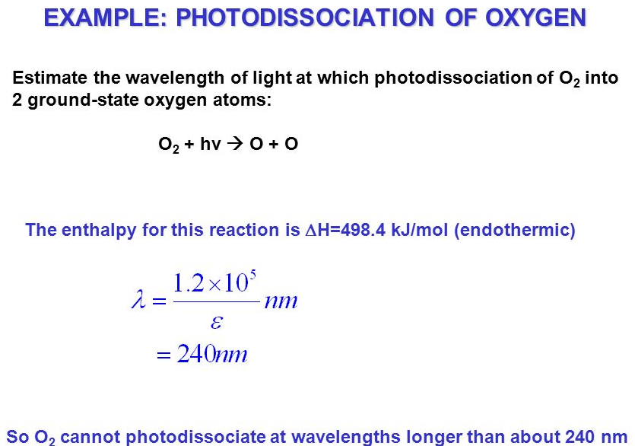
Energy requirements for photodissociation

Slide 8
Bond breaking and ionization energies
Bond energies
ionization energies
 | eV | nm | eV | nm
NO₂ | 3.11 | 399 | 9.78 | 127
N₂O(N-N) | 4.43 | 280 | 12.89 | 96
N₂O(N-O) | 1.67 | 743
O₃ | 1.04 | 1192 | 12.52 | 99
H₂O | 5.12 | 242 | 12.61 | 98
CO₂ | 5.45 | 228 | 13.79 | 90
N₂ | 9.76 | 127 | 12.58 | 80
O₂ | 5.11 | 243 | 12.07 | 103
NO | 6.5 | 191 | 9.26 | 134
CO | 11.09 | 112 | 14.01 | 89
1 eV ≅ 96 kJ⋅mol⁻¹
Notes:
Preso da https://www.yumpu.com/en/document/view/37707507/photochemistry-in-the-atmosphere
Dove si TROVANO ALTRE COSE INTERESSANTI DA VEDERE

Slide 9
Energy / wavelength relations
Typical ranges of λ and energies in the portion of the electromagnetic spectrum of interest in atmospheric chemistry:

Slide 10
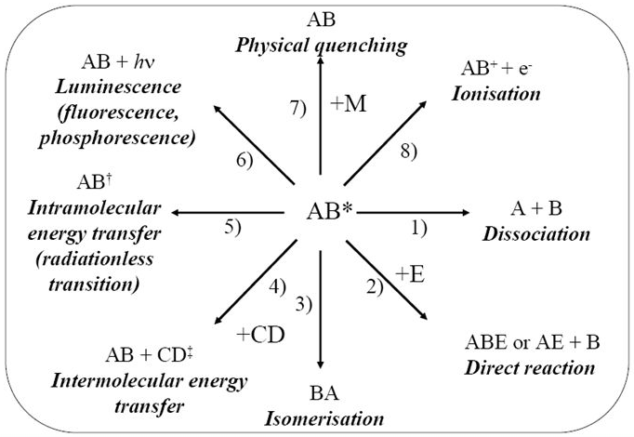
Fate of electronically excited molecules
Light absorption by molecule AB leads to an excited molecule:
The most relevant process for atmospheric chemistry is dissociation
Notes:
Fates of electronically excited molecules:
1. Photochemical processes: dissociation, isomerization, earrangements, reaction with another molecule
2. Photophysical processes: radiative transisions such as fluorescence (F), phosphorescence (P) + non radiative processes (energy of the excited state converted to translational motions by collisions and hence heat)
F Fluorescence= light emission due to transition from an upper to a lower state of the same multiplicity e.g. singlet-> singlet. Since it is allowed by the selection rule DeltaS=0 the process is fast and lifetime of the excited state is short (<msec in general microsec or shorter)
P phosphorescence=light emission due to transition from an upper to a lower state of different multiplicity e.g. triplet-> singlet. Since it is forbidden the process is slower and lifetime of the excited state can be long (>msec)
ISC (intersystem crossing). Intramolecular crossing from one electronic state to another of different multiplicity without emission of radiation (horizontal line in the Jab. diagram)
IC (internal conversion) intramolecular crossing from one electronic state to another of the same multiplicity without emission of radiation (horizontal line in the Jab. diagram)

Slide 11
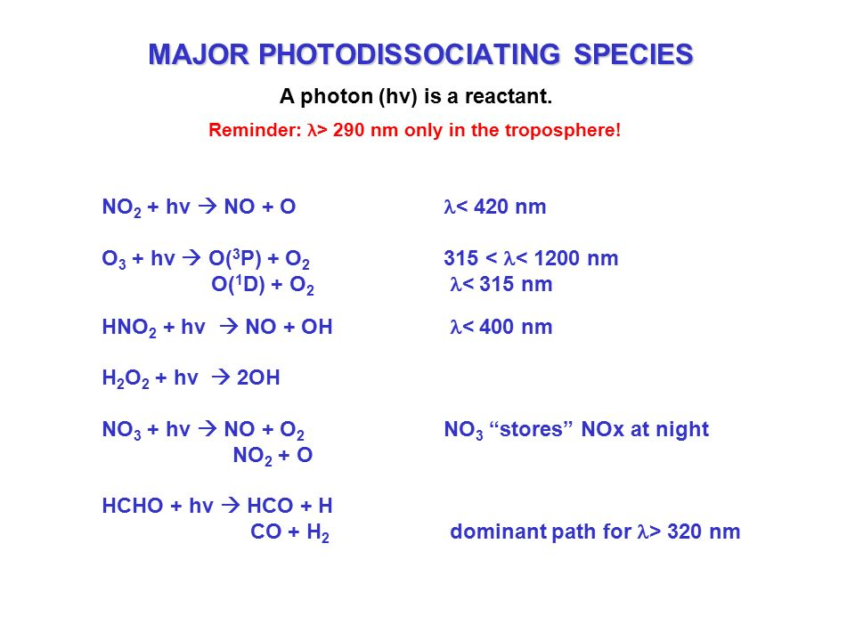

Slide 12
Photophysical processes
Non-radiative processes:
Radiative processes:
energy of AB* is transferred to other excited states of AB
energy of AB* is emitted as photons
Collisional processes:
energy of AB* converted by collisions
Notes:
Thus dissociation typically occurs as the result of electronic transitions
Fates of electronically excited molecules:
1. Photochemical processes: dissociation, isomerization, earrangements, reaction with another molecule
2. Photophysical processes: radiative transisions such as fluorescence (F), phosphorescence (P) + non radiative processes (energy of the excited state converted to translational motions by collisions and hence heat)
F Fluorescence= light emission due to transition from an upper to a lower state of the same multiplicity e.g. singlet-> singlet. Since it is allowed by the selection rule DeltaS=0 the process is fast and lifetime of the excited state is short (<msec in general microsec or shorter)
P phosphorescence=light emission due to transition from an upper to a lower state of different multiplicity e.g. triplet-> singlet. Since it is forbidden the process is slower and lifetime of the excited state can be long (>msec)
ISC (intersystem crossing). Intramolecular crossing from one electronic state to another of different multiplicity without emission of radiation (horizontal line in the Jab. diagram)
IC (internal conversion) intramolecular crossing from one electronic state to another of the same multiplicity without emission of radiation (horizontal line in the Jab. diagram)

Slide 13
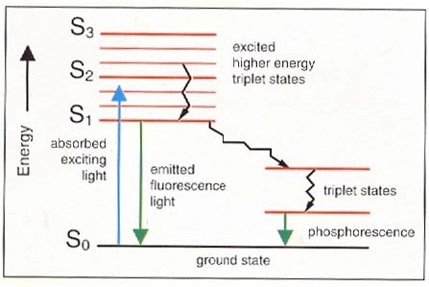
Radiative processes
Fluorescence
Light emission from AB* due to transition from upper to lower state of the same multiplicity (ΔS=0: S → S, T → T)
fast (lifetime 10⁻⁶s or shorter) because spin-allowed
Phosphorescence
Light emission from AB* due to transition from upper to lower state of different multiplicity (ΔS ≠ 0: S → T)
slower (lifetime 10⁻³ s or longer) because spin-forbidden
Notes:
Flurescence: light emission due to transition from an upper to a lower state of the same multiplicity e.g. singlet-> singlet. Since it is allowed by the selection rule DeltaS=0 the process is fast and lifetime of the excited state is short (<msec in general microsec or shorter)
P phosphorescence=light emission due to transition from an upper to a lower state of different multiplicity e.g. triplet-> singlet. Since it is forbidden the process is slower and lifetime of the excited state can be long (>msec)

Slide 14
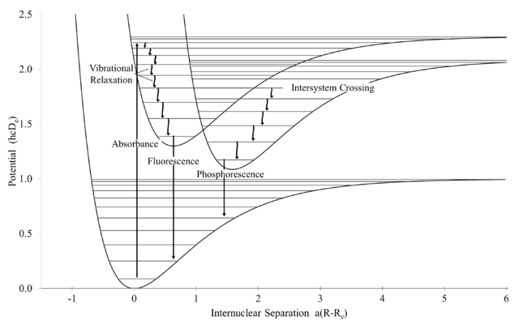
Non-radiative processes
Intramolecular energy transfers
The excited state AB* can transfer its energy to other states of similar energies
Transfer of energy (radiationless) between states with the same spin quantum number e.g. S₁ → S₀
Internal conversion (IC)
Intersystem crossing (ISC)
Transfer of energy (radiationless) between states with the different spin quantum number e.g. S₁ → T₀
Notes:
Flurescence: light emission due to transition from an upper to a lower state of the same multiplicity e.g. singlet-> singlet. Since it is allowed by the selection rule DeltaS=0 the process is fast and lifetime of the excited state is short (<msec in general microsec or shorter)
P phosphorescence=light emission due to transition from an upper to a lower state of different multiplicity e.g. triplet-> singlet. Since it is forbidden the process is slower and lifetime of the excited state can be long (>msec)
ISC (intersystem crossing). Intramolecular crossing from one electronic state to another of different multiplicity without emission of radiation (horizontal line in the Jab. diagram)
IC (internal conversion) intramolecular crossing from one electronic state to another of the same multiplicity without emission of radiation (horizontal line in the Jab. diagram)

Slide 15
Collisional deactivation
Relevant at high pressures (stratosphere)
Direct collisional deactivation of electronically excited states is unlikely
Likely transfer between quasi-resonant states
electronic | 10⁻¹⁵ s
Vibrational | 10⁻¹³ s
rotational | 10⁻¹² s
intermolecular energy transfer
+ M*
energy transferred to M goes in internal excitation
AB* + M → AB
physical quenching
+ M (high k.e.)
energy transferred to M goes in translational energy (heating of the gas mixture)
Notes:
At high pressures: collisional deactivation of A* (v’>0) can lose rotational and vibrational energy end up af A*(v’=0) by collisions with other molecules B. The energy transferred to B can either go as translation (heating of the gas mixture) or can contribute to internally excite B (vibrational, rot, electronic)
Timing of the collisions

Slide 16
Photophysical & chemical processes
Example of the sequence of photophysical and photochemical processes
Dissociative state
S₁
T₀
Vibrational relaxation(collisional)
dissociation
Potential energy
intersystem crossing
Phosphorescence (> msec)
absorption
Fluorescence (< msec)
absorption
S₀
Internuclear distance
Notes:
Arrivata qui lezione del 14 novembre 2023

Slide 17
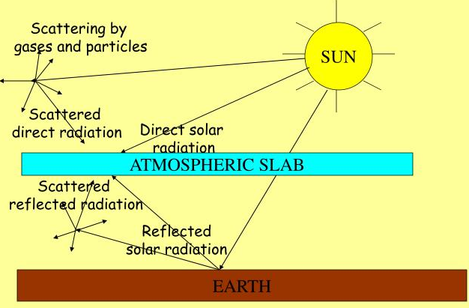
Scattering and absorption
Probability of encounter between photon (hν) and molecule drives photochemistry
Radiative quantity pertinent is photon flux from all directions (actinic flux)
Notes:
Sunlight drives the chemistry of the atmosphere by dissociating a number of molecules into fragments that are often highly reactive. Whether a molecule can be dissociated in the atmosphere depends on the probability of an encounter between a photon of appropriate energy and the molecule. The radiative quantity pertinent for photochemical reactions is the photon flux incident on the molecule from all directions, since it does not matter to the molecule from which direction a photon comes. The radiative flux from all directions on a volume of air is called the actinic flux (actinic means "capable of causing photochemical reactions"). We use the symbol I for the actinic flux to distinguish it from the irradiance E; I is usually expressed in units of photons cm- 2 s- 1 .

Slide 18
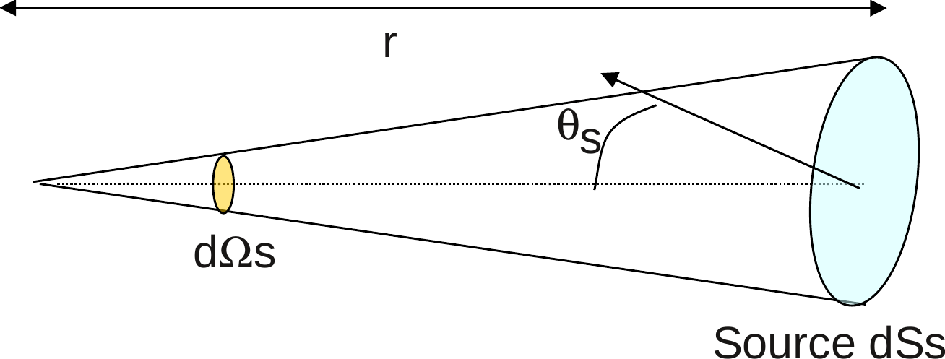
Spectral radiance, radiation flux, irradiance
Planck function B(λ,T):
is radiant intensity or spectral radiance of a blackbody: energy emitted per unit time (flux), per unit surface area and unit wavelength. Units: W⋅m⁻²⋅μm⁻¹⋅sr⁻¹
Spectral radiance changes with distance through space:
B(λ,T): spectral radiance emitted by a blackbody at the body’s surface. So B(λ,T)= L(λ) at the surface of the blackbody
spectral radiance at a given point in space, regardless of the source of the radiance
L(λ,θ,ϕ):
Notes:
See Fund_Atmosph_Modeling_Ch9_Radiative_energy_transfer.pdf
The essential energy flux in atmospheric chemistry is the flux of solar radiation. The radiant flux density F is the radiant energy flux across any surface element, without
consideration of the direction; F is measured in watts per square meter (W m- 2). The radiant flux density is called the irradiance E when the radiation is received on a
surface. Thus F and E are often used interchangeably. We will use F in general and E when we are referring specifically to the radiant flux density on a surface. The radiance
L is the radiant flux as a function of the solid angle dω crossing a surface perpendicular to the axis of the radiation beam; L is measured in watts per square meter per steradian (Wm- 2 sr-1). The radiance as a function of direction gives a complete description of the radiative field.
Consider a beam of radiation of radiance L crossing a surface dS with the beam axis
making an angle theta to the normal to dS (Figure 4.6). dS projects as dS cos 8 perpendicular to the beam axis of the radiation, and the radiant flux density dF on dS is
When the radiance L is independent of direction, the radiative field is called isotropic. In this case, (4.13) can be integrated over the half-space, Ω = 2π, and the relation between the irradiance and the radiance is E = πL. The irradiance on a horizontal surface is obtained from the incoming radiance by
integrating the radiance over the spherical coordinates θ and phi.

Slide 19
Spectral radiance, radiation flux, irradiance
L(λ,θ,ϕ)
Spectral radiance: (energy flux) , emitted from point (O) on a horizontal plane, passes through an incremental area dA_{s} at a distance r_{s} from the point of emission.
zenith angle (θ): the angle between the z-axis and the angle of emission
azimuth angle (φ): the horizontal angle between a reference axis (x-axis) and the line of emission
incremental solid angle
Integrating over all solid angles around the center of a sphere
Notes:
See Fund_Atmosph_Modeling_Ch9_Radiative_energy_transfer.pdf
The essential energy flux in atmospheric chemistry is the flux of solar radiation. The radiant flux density F is the radiant energy flux across any surface element, without
consideration of the direction; F is measured in watts per square meter (W m- 2). The radiant flux density is called the irradiance E when the radiation is received on a
surface. Thus F and E are often used interchangeably. We will use F in general and E when we are referring specifically to the radiant flux density on a surface. The radiance
L is the radiant flux as a function of the solid angle dω crossing a surface perpendicular to the axis of the radiation beam; L is measured in watts per square meter per steradian (Wm- 2 sr-1). The radiance as a function of direction gives a complete description of the radiative field.
Consider a beam of radiation of radiance L crossing a surface dS with the beam axis
making an angle theta to the normal to dS (Figure 4.6). dS projects as dS cos 8 perpendicular to the beam axis of the radiation, and the radiant flux density dF on dS is
When the radiance L is independent of direction, the radiative field is called isotropic. In this case, (4.13) can be integrated over the half-space, Ω = 2π, and the relation between the irradiance and the radiance is E = πL. The irradiance on a horizontal surface is obtained from the incoming radiance by
integrating the radiance over the spherical coordinates θ and phi.

Slide 20
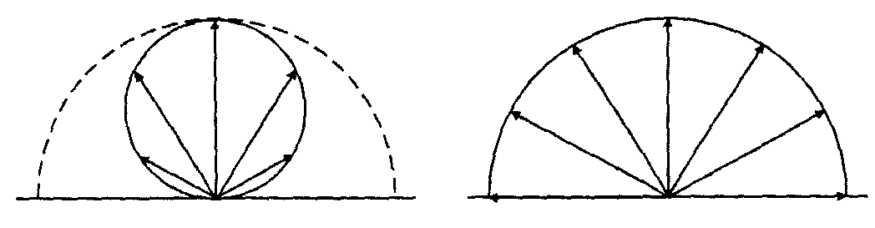
Spectral radiance, radiation flux, irradiance
In atmospheric models, two quantities related to spectral radiance L(λ,θ,ϕ) are commonly calculated:
Spectral actinic flux
Spectral irradiance
Integral of the spectral radiance over all solid angles of a sphere
Related to photons incident on an horizontal surface area
piranometers, solar panels
Notes:
See Fund_Atmosph_Modeling_Ch9_Radiative_energy_transfer.pdf
The essential energy flux in atmospheric chemistry is the flux of solar radiation. The radiant flux density F is the radiant energy flux across any surface element, without
consideration of the direction; F is measured in watts per square meter (W m- 2). The radiant flux density is called the irradiance E when the radiation is received on a
surface. Thus F and E are often used interchangeably. We will use F in general and E when we are referring specifically to the radiant flux density on a surface. The radiance
L is the radiant flux as a function of the solid angle dω crossing a surface perpendicular to the axis of the radiation beam; L is measured in watts per square meter per steradian (Wm- 2 sr-1). The radiance as a function of direction gives a complete description of the radiative field.
Consider a beam of radiation of radiance L crossing a surface dS with the beam axis
making an angle theta to the normal to dS (Figure 4.6). dS projects as dS cos 8 perpendicular to the beam axis of the radiation, and the radiant flux density dF on dS is
When the radiance L is independent of direction, the radiative field is called isotropic. In this case, (4.13) can be integrated over the half-space, Ω = 2π, and the relation between the irradiance and the radiance is E = πL. The irradiance on a horizontal surface is obtained from the incoming radiance by
integrating the radiance over the spherical coordinates θ and phi.

Slide 21
Spectral actinic flux
Actinic = capable of causing photochemical reactions.
It is the radiative flux from all directions on a volume of air
Spectral actinic flux I(λ): Integral of the spectral radiance over all solid angles of a sphere
When radiation propagates with equal intensity in all directions, L(λ) is independent of direction. In such cases, the radiance is called isotropic
I(λ) includes direct, scattered and reflected radiation coming from all directions
Notes:
It is important to distinguish the actinic flux from the spectral irradiance. The spectral irradiance E(λ) is the radiant energy crossing a surface (per unit surface area, time, and wavelength) and is calculated from L(Λ, θ,) as:
The factor cos θ reflects the change in the projected area of the surface as the angle of incidence is varied.
This factor does not appear in the expression for the actinic flux because the projected area and the pathlengths offset exactly. As the angle of incidence is changed from overhead (θ = 0°) to nearly glancing (θ → 90°), the energy (irradiance)
incident on the layer decreases, but the actinic flux remains unchanged because the lower intensity is exactly compensated for by the longer pathlength of light through the layer.

Slide 22
Spectral actinic flux
Spectral actinic flux I(λ): the quantity of light available to molecules at a particular point in the atmosphere and which, on absorption, drives photochemical processes in the atmosphere. Unit: W⋅cm⁻²
Flux as seen by a molecule in the center. Light detected isotropically: it is of no importance to the molecule where the photons are coming from
It is the relevant quantity to talk about photochemical processes
Notes:
Sunlight drives the chemistry of the atmosphere by dissociating a number of molecules into fragments that are often highly reactive. Whether a molecule can be dissociated in the atmosphere depends on the probability of an encounter between a photon of appropriate energy and the molecule. The radiative quantity pertinent for photochemical reactions is the photon flux incident on the molecule from all directions, since it does not matter to the molecule from which direction a photon comes. The radiative flux from all directions on a volume of air is called the actinic flux (actinic means "capable of causing photochemical reactions"). We use the symbol I for the actinic flux to distinguish it from the irradiance E; I is usually expressed in units of photons cm- 2 s- 1 .
From https://home.uni-leipzig.de/strahlen/web/general/en_index.php?goto=basic_quantities
Note the difference between irradiance and actinic flux density. On the left: Irradiance is related to a horizontal detection area. Photons are weighted with the cosine of their angle of incidence. This is why a low sun provides less heat to the Earth surface than a high sun. — On the right: Actinic flux density, for instance, as seen by an ozone molecule in the centre. Actinic flux density is detected isotropically, as it is of no importance to the molecule where the photons are coming from. As soon as a proper photon arrives, no matter whence, the molecule dissociates.

Slide 23
Spectral irradiance
Spectral irradiance F(λ): is the vertical component of spectral radiance, originating from all directions above a flat plane, that passes across the plane, per unit surface area, time, and wavelength
it is the vertical component of the spectral radiance, integrated over the hemisphere
above the x–y plane.
For a zenith angle of θ = 0◦, the irradiance impinging on the x–y plane is maximum. For a zenith angle of θ = 90◦, the irradiance impinging on the x–y plane is zero
Is the component of the spectral radiance normal to the x-y plane
Notes:
It is important to distinguish the actinic flux from the spectral irradiance. The spectral irradiance E(λ) is the radiant energy crossing a surface (per unit surface area, time, and wavelength) and is calculated from L(Λ, θ,) as:
The factor cos θ reflects the change in the projected area of the surface as the angle of incidence is varied.
This factor does not appear in the expression for the actinic flux because the projected area and the pathlengths offset exactly. As the angle of incidence is changed from overhead (θ = 0°) to nearly glancing (θ → 90°), the energy (irradiance)
incident on the layer decreases, but the actinic flux remains unchanged because the lower intensity is exactly compensated for by the longer pathlength of light through the layer.

Slide 24
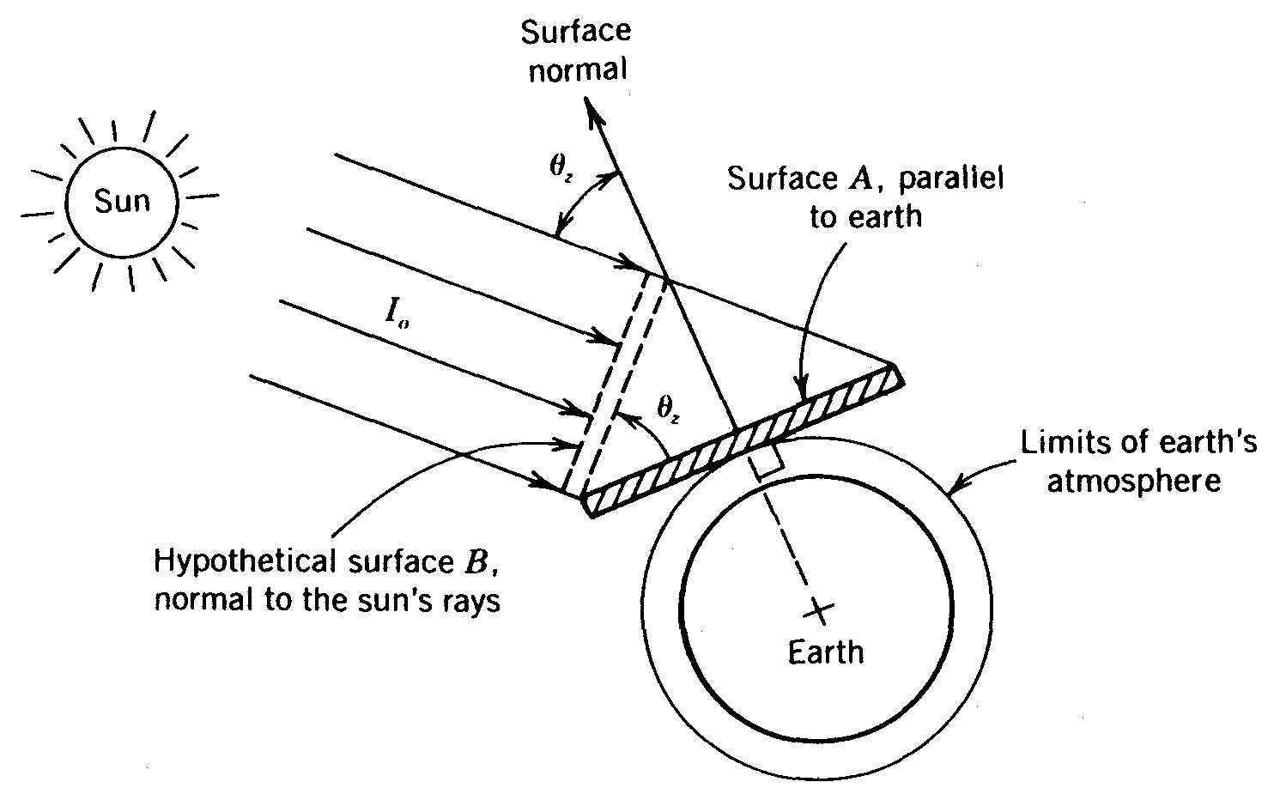
Spectral irradiance
The cosine effect:
The rate of solar energy falling on surfaces A and B is the same. But the area of surface A is greater than its projection (hypothetical surface B), making the rate of solar energy per unit area (i.e. the solar spectral irradiance), falling on surface A less than on surface B.
Notes:
Per descrizione del cosine effect vedi http://www.powerfromthesun.net/Book/chapter02/chapter02.html
Consider a flat surface parallel to the earth’s surface below. When this surface faces the sun (normal to a central ray), the solar irradiance falling on it will be I_{o} , the maximum possible solar irradiance. If the surface is not normal to the sun, the solar irradiance falling on it will be reduced by the cosine of the angle between the surface normal and a central ray from the sun.
This concept is described pictorially in Figure 2.6. It can be seen that the rate of solar energy falling on both surfaces is the same. However, the area of surface A is greater than its projection; hypothetical surface B, making the rate of solar energy per unit area (i.e. the solar irradiance), falling on surface A less than on surface B.
The solar irradiance falling on a surface parallel to the ground is
Reduction of radiation by the cosine of the angle between the solar radiation and a surface normal is called the cosine effect.

Slide 25
Spectral irradiance
Integrating the vertical component over the hemisphere above the x–y plane gives:
For isotropic emission:
Notes:
It is important to distinguish the actinic flux from the spectral irradiance. The spectral irradiance E(λ) is the radiant energy crossing a surface (per unit surface area, time, and wavelength) and is calculated from L(Λ, θ,) as:
The factor cos θ reflects the change in the projected area of the surface as the angle of incidence is varied.
This factor does not appear in the expression for the actinic flux because the projected area and the pathlengths offset exactly. As the angle of incidence is changed from overhead (θ = 0°) to nearly glancing (θ → 90°), the energy (irradiance)
incident on the layer decreases, but the actinic flux remains unchanged because the lower intensity is exactly compensated for by the longer pathlength of light through the layer.

Slide 26
Quantum yield
For molecules with n.atoms >2:
multiple dissociation pathways
What is the fraction of excited molecules leading to a specific dissociation channel?

Slide 27
Quantum yield
Primary quantum yield: related to different processes i stemming from the excitation of a molecule due to light absorption
by summing over all possible pathways i
Overall quantum yield: related to all possible pathways leading to a particular product (e.g. A)
by summing over all pathways j that yield product A
Due to the potential contribution of secondary processes (e.g. product of pathway j reacts with the reagent to give product of pathway i ) φ_{A} may be >1
Notes:
Quantum yield definition in Finlayson è un po diversa
Primary quantum yield

Slide 28
Quantum yield
Example: NO₃ + hν → products
Notes:
Quantum yield definition in Finlayson è un po diversa
Primary quantum yield

Slide 29
Brief recap: photochemistry
For molecules with n.atoms >2:
multiple dissociation pathways
Quantum yield
Notes:
Thus dissociation typically occurs as the result of electronic transitions
Fates of electronically excited molecules:
1. Photochemical processes: dissociation, isomerization, earrangements, reaction with another molecule
2. Photophysical processes: radiative transisions such as fluorescence (F), phosphorescence (P) + non radiative processes (energy of the excited state converted to translational motions by collisions and hence heat)
F Fluorescence= light emission due to transition from an upper to a lower state of the same multiplicity e.g. singlet-> singlet. Since it is allowed by the selection rule DeltaS=0 the process is fast and lifetime of the excited state is short (<msec in general microsec or shorter)
P phosphorescence=light emission due to transition from an upper to a lower state of different multiplicity e.g. triplet-> singlet. Since it is forbidden the process is slower and lifetime of the excited state can be long (>msec)
ISC (intersystem crossing). Intramolecular crossing from one electronic state to another of different multiplicity without emission of radiation (horizontal line in the Jab. diagram)
IC (internal conversion) intramolecular crossing from one electronic state to another of the same multiplicity without emission of radiation (horizontal line in the Jab. diagram)

Slide 30
Brief recap: photochemistry
Spectral actinic flux I(λ)= the radiative flux from all directions on a volume of air (integral of the spectral radiance over all solid angles)
Notes:
Sunlight drives the chemistry of the atmosphere by dissociating a number of molecules into fragments that are often highly reactive. Whether a molecule can be dissociated in the atmosphere depends on the probability of an encounter between a photon of appropriate energy and the molecule. The radiative quantity pertinent for photochemical reactions is the photon flux incident on the molecule from all directions, since it does not matter to the molecule from which direction a photon comes. The radiative flux from all directions on a volume of air is called the actinic flux (actinic means "capable of causing photochemical reactions"). We use the symbol I for the actinic flux to distinguish it from the irradiance E; I is usually expressed in units of photons cm- 2 s- 1 .

Slide 31
Rate of photochemical processes
Rate of photodissociation of a molecule, A, upon light absorption at wavelenght λ
(unit: [molecules]⋅[volume]⁻³⋅[time]⁻¹)
[A] is the concentration of A (in molecules⋅cm⁻³ or mol⋅l⁻¹)
k_{A} is the photodissociation rate coefficient (usually in s⁻¹)
k_{A} takes into account intensity of radiation (actinic flux I(λ)), the intrinsic strength of absorption by A, i.e. absorption cross section σ(λ), and the quantum yield φ(λ) for the specific photodissociation channel
photochemical rate constant
!! In some texts k_{A} is indicated as j_{A} to distinguish from other rate constants
Notes:
Rate of absorption can be expressed in term of the Lambert-Beer law for photons absorbed while passing a thin layer of air of length dL
dI/I = -sigma[A]dL
With I=
Problem: calculation of I(λ) is pretty complicate!!

Slide 32
Photochemical rates
photodissociation rate coefficient k_{A}
For derivation of k_{A} see last two slides
The rate of photolysis is the integral over the whole range of relevant wavelengths λ:
Unit: s⁻¹
The integral is often approximated by a ∑ over wavelength intervals Δλ (according to available resolution of I(λ)
k_{A} can be calculated (but not easily in atmosphere!!)
Notes:
The big issue is how to calculate the actinic flux

Slide 33
Factors affecting the actinic flux
Scattering and absorption by atmospheric molecules (e.g. ozone, aereosols, particulate matter)
Latitude, season and time of day (i.e. solar zenith angle)
Altitude above Earth’s surface
Surface reflection (albedo)
presence of clouds
direct dependence:
Actinic flux changes with z due to absorption of solar radiation by atmospheric gases
Altitude z
indirect dependence:
Absorption cross section of A changes with T (that changes with z)
Notes:
The general expression for the first-order rate coefficient kA for photodissociation of a species A is given by (4.39). Because the rate of a photolysis reaction depends on the spectral actinic flux I and because the spectral actinic flux varies with altitude in the atmosphere, the rate of photolysis reactions depends in general on altitude.
The altitude dependence of kA enters indirectly through the temperature dependence of the absorption cross section and directly through the altitude dependence of the spectral actinic flux, which can be written as I(z,λ).

Slide 34
Absorption of radiation by atmospheric gases
wavelength (μm)
Spectral window in the (300-800nm) ∼VIS
z=0 sea level
VIS
z=11 km
Absorption spectra are quite complex but indicate that in some spetral region absorption is so strong that NO solar energy reaches the surface
Notes:
Figure shows % absorption spectra due to atmospheric gases at sea level and at the top of the troposphere. The absorption spectra are quite complex, but they do indicate that absorption is so strong in some spectral regions that no solar energy in those regions reaches the surface of the Earth.

Slide 35
Absorption of radiation by atmospheric gases
O₂ and O₃ absorbs at λ<290 nm (0.29μm)
H₂O absorption is complicated but mostly in the IR region (where Sun and Earth emissions overlap)
Notes:
As we will see, absorption by O2 and O3 is responsible for removal of practically all the incident radiation with wavelengths shorter than 290 nm. On the other hand, atmospheric
absorption is not strong from 300 to about 800 nm, forming a "window" in the spectrum. About 40% of the solar energy is concentrated in the region of 400-700 nm. Water vapor
absorbs in a complicated way, and mostly in the region where the Sun's and Earth's radiation overlap.

Slide 36
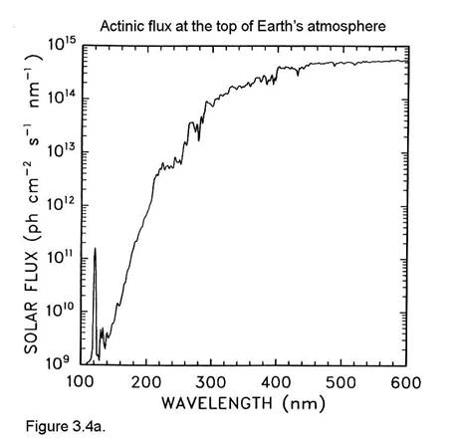
Altitude dependence of the actinic flux
Spectral actinic flux at the top of the Earth’s atmosphere
Spectral actinic flux I(λ, z) at various altitudes (z in km)
I(λ) below about 290 nm is decreased by strong absorption of solar energy by O₂ and O₃
Notes:
For wavelengths below about 1000nm (1 microm), the predominant absorbing species in the atmosphere are O2 and O3. The spectral solar actinic flux at various altitudes,
can, therefore, be computed fairly accurately by considering only the absorption by O2 and O3. The absorption cross sections of O2 and O3 are shown in
Figures 4.12 and 4.13. All the absorption shown in Figure 4.12 and 4.13 leads to dissociation.
The attenuation of radiation from the top of the atmosphere (TOA) to any altitude z is described by the Beer-Lambert Law (4.24),

Slide 37
Altitude dependence of the actinic flux
To calculate I(λ,z):
Spectral actinic flux I(λ, z) at various altitudes (z in km)
assume that for λ <1μm absorption is due only to O₂ and O₃
Use Lambert-Beer law with optical depth dependence on absorption cross sections for O₂ and O₃ to calculate attenuation of solar radiation from TOA (Top Of the Atmosphere) to altitude z:
with
: spectral actinic flux at TOA
optical depth τ
Notes:
For wavelengths below about 1000nm (1 microm), the predominant absorbing species in the atmosphere are O2 and O3. The spectral solar actinic flux at various altitudes,
can, therefore, be computed fairly accurately by considering only the absorption by O2 and O3. The absorption cross sections of O2 and O3 are shown in
Figures 4.12 and 4.13. All the absorption shown in Figure 4.12 and 4.13 leads to dissociation.
The attenuation of radiation from the top of the atmosphere (TOA) to any altitude z is described by the Beer-Lambert Law (4.24),

Slide 38
Altitude dependence of the actinic flux
σ(λ) O₃
σ(λ) O₂
Spectral actinic flux I(z, λ) at various altitudes (z in km)
Notes:
For wavelengths below about 1000nm (1 microm), the predominant absorbing species in the atmosphere are O2 and O3. The spectral solar actinic flux at various altitudes,
can, therefore, be computed fairly accurately by considering only the absorption by O2 and O3. The absorption cross sections of O2 and O3 are shown in
Figures 4.12 and 4.13. All the absorption shown in Figure 4.12 and 4.13 leads to dissociation.
The attenuation of radiation from the top of the atmosphere (TOA) to any altitude z is described by the Beer-Lambert Law (4.24),

Slide 39
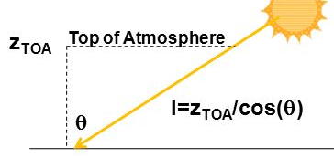
Atmospheric transmittance at surface 1.
We need to calculate:
Optical depth depends only on O₂ and O₃ absorption
Optical depth at the surface
c_{A} is the concentration of A species (equivalent of [A])
Neglecting the T dependence of the absorption cross section σ_{A} of molecule A:
Total atmospheric column density of A
(in molecules⋅cm⁻²)
Notes:
The optical depth of the atmosphere at the surface as a result of absorption by species A is given by where m = sec(theta) and where σA [T(Z), λ] is the absorption cross section of molecule A at temperature T(at altitude z). Here, the species of interest are O2 and O3. The total optical
depth at the surface is then the sum of those attributable to O2 and O3. To estimate Τ(0,Λ) for O2 and O3, we neglect the temperature dependence of the
absorption cross sections. Then (4.29) becomes for O2 and O3. The integral in tau is just the total column abundances (molecules cm-2) of species A

Slide 40
Atmospheric transmittance at surface 2.
Total atmospheric column density of A
(in molecules⋅cm⁻²)
Remember the vertical structure of atmosphere (in term of P or density ρ)
density of dry air at sea level (z=0)
Transform in number density (i.e. total number of air molecules in 1 cm³)
air molecules⋅cm⁻³
Notes:
The optical depth of the atmosphere at the surface as a result of absorption by species A is given by where m = sec(theta) and where σA [T(Z), λ] is the absorption cross section of molecule A at temperature T(at altitude z). Here, the species of interest are O2 and O3. The total optical
depth at the surface is then the sum of those attributable to O2 and O3. To estimate Τ(0,Λ) for O2 and O3, we neglect the temperature dependence of the
absorption cross sections. Then (4.29) becomes for O2 and O3. The integral in tau is just the total column abundances (molecules cm-2) of species A

Slide 41
Atmospheric transmittance at surface 3.
Total column density of air
(in molecules⋅cm⁻²)
with H≅7.4 km scale height
Total column density of O₂:
mix.ratio
molecules⋅cm⁻²
Notes:
The optical depth of the atmosphere at the surface as a result of absorption by species A is given by where m = sec(theta) and where σA [T(Z), λ] is the absorption cross section of molecule A at temperature T(at altitude z). Here, the species of interest are O2 and O3. The total optical
depth at the surface is then the sum of those attributable to O2 and O3. To estimate Τ(0,Λ) for O2 and O3, we neglect the temperature dependence of the
absorption cross sections. Then (4.29) becomes for O2 and O3. The integral in tau is just the total column abundances (molecules cm-2) of species A
The column abundance of O2 is (0.21)(2.6 × 1019)(7.4 × 105) =4.0 × 1024 molecules cm-2.

Slide 42
Atmospheric transmittance due to O₂
Optical depth at the Earth surface due to O₂ absorption
Let’s assume overhead Sun (cosθ=1)
Atmospheric transmittance to ground due to O₂ absorption is effectively 0 for the whole O₂ absorption band (λ<242 nm)
O₂ is an optically thick species in this region of wavelength
Notes:
In order to obtain an estimate of the atmospheric transmittance as a result of absorption by O2.
we can characterize each of the three absorption bands for O2 in Figure 4.12 by its
maximum cross section. For this calculation, let us take m = 1 (overhead sun). The result
Since F(0,Λ)/FTOA(Λ) is effectively zero for each of these bands, which extend up to
242 nm, we see that atmospheric O2 completely removes all radiation below
λ = 242 nm from reaching the Earth's surface. [In such a case, the species is called
optically thick in the region; conversely, for a species for which exp(-τ) 1, the
species is optically thin.]

Slide 43
Atmospheric transmittance due to O₃
Total column density of O₃:
molecules⋅cm⁻²
Optical depth at the surface due to O₃
Let’s assume overhead Sun (cosθ=1)
For λ>242 the atmosphere is transparent with respect to O₂
O₃ is the dominant absorber in the region 240-320 nm
Notes:
To estimate the transmittance resulting from O3 absorption, the cross section of which
is shown in Figure 4.13, we follow the same procedure as for O2, in which we approximate
the cross section of each band by its maximum value. Assuming a column abundance of O3
of 300 DU (recall 1 DU = 2.69 × 1016 molecules cm-2), the result is…
At wavelengths λ > 242 nm, the atmosphere is transparent with respect to O2. Ozone is
the dominant absorber in the range 240-320 nm.

Slide 44
Calculation of photolysis rates at altitude z
Photolysis rate coefficient for species A:
Assuming absortion only due to A, L.B law gives:
Neglecting T dep of σ_{Α}, the optical depth is:
Notes:
The photolysis rate coefficient of a species A can be expressed as a function of altitude:
Assume that the attenuation of radiation is due solely to absorption by species A. From the Beer-Lambert Law, I(z,λ) can be expressed as
If we neglect the z dependence of temperature, then:
To proceed further, consider the case in which the absorbing species A has a uniform mixing ratio, ξ A (e.g., O2); then, its concentration can be expressed in terms of the molecular air density as a function of altitude, nair (z):
Substituting you get kA (photolisis rate coefficient) at fixed z.
The photolysis rate at any altitude z is the product of jA (Z) and the number concentration of A, nA (z):

Slide 45
Calculation of photolysis rates at altitude z
Photolysis rate coefficient for species A:
Assuming absortion only due to A, L.B law gives:
Neglecting T dep of σ_{Α}, the optical depth is:
For absorbing species with uniform mixing ratio ξ_{A}:
photolysis rate coefficient k_{A}(z)
photolysis rate as a function of altitude:
Notes:
The photolysis rate coefficient of a species A can be expressed as a function of altitude:
Assume that the attenuation of radiation is due solely to absorption by species A. From the Beer-Lambert Law, I(z,λ) can be expressed as
If we neglect the z dependence of temperature, then:
To proceed further, consider the case in which the absorbing species A has a uniform mixing ratio, ξ A (e.g., O2); then, its concentration can be expressed in terms of the molecular air density as a function of altitude, nair (z):
Substituting you get kA (photolisis rate coefficient) at fixed z.
The photolysis rate at any altitude z is the product of jA (Z) and the number concentration of A, nA (z):

Slide 46
Calculation of photolysis rates at altitude z
The photolysis rate at any altitude is:
Two competing effects in the z dependence:
actinic flux decreases (due to increasing absorption from layers above)
Decrease in the rate
while altitude z decreases
concentration of A increases (due to the atmosphere increase in density)
increase in the rate
Photolysis rates may have a maximum at a certain z
The combination of these competing (opposite) effects gives rise to the formation of photochemical layers
(but not for species absorbing at λ>290 nm)
Notes:
As one descends toward the Earth's surface, the photolysis rate decreases because the overall actinic flux is decreasing due to increasing absorption in the layers above. As one ascends in the atmosphere, the concentration of the gas nA(z) simply decreases as the atmosphere's density thins out. These two competing effects combine to produce a maximum in the photolysis rate at a certain altitude. The altitude at which this rate is a maximum is the value of z at which.
This is not the case for molecules that are photolyzed at wavelenght longer that 290nm because in this region O2 and O3 do not absorb anymore and actinic flux does not change much with altitude
See Seinfeld and Pandis chap 4.8

Slide 47
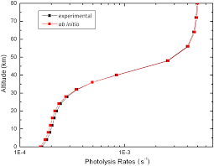
Example: photolysis rates at altitude z
For O₂ at SZA =0°
For O₃
rate coefficient: k_{O2}
rate:
k_{O2} ⋅[O₂]
rate coefficient: k_{O3}
Photolysis rate coefficient becomes altitude dependent below 40 km for
similar self-shielding reasons
Strong altitude dependence of the rate coefficient: the lower you go the less UV radiation capable of breaking O₂ is available (self-shielding)
Notes:
Photodissociation rate coefficient for O2, jo2, and O2 photolysis rate as a function
of altitude at solar zenith angle tetha = 0°. (

Slide 48
Summary photolysis and photochemistry
Given a generic reaction A + hν → B + C
k_{A}: first order photolysis rate coefficient of A (s⁻¹)
I(λ) – spectral actinic flux (n. photons·cm⁻²·s⁻¹·nm⁻¹)
Notes:
Once the actinic fluxes, quantum yields, and absorption cross sections have been summarized as in Table
the individual products q~v(A)~ for each wavelength interval can be calculated and summed to give k. Note that the individual reaction channels (9a) and (9b) are calculated separately and then added to get the total photolysis rate constant for the photolysis
of acetaldehyde. In this case, the photolysis rate constant for reaction (b) is zero because the quantum yield drops off rapidly
to zero above 290 nm, and at this large solar zenith

Slide 49
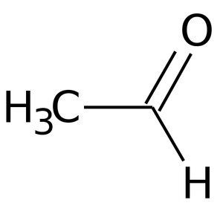
Example: photolysis of acetaldehyde CH₃CHO
Important for free radical generation in the troposphere
Four different set of products:
very low quantum yield
CH₃CO+H
Energetics of the different channels
Absorption cross sections for simple aldehydes
Notes:
Quantum yields for NO production in the photolysis of NO2 at 298K. Calculated QY due to internal energy (dotted line) and calculated dissociation due to collisions (dashed line) and the sum of the two calculations (solid line) that is in good agreement with the experimental quantum yield

Slide 50
Example: photolysis of acetaldehyde CH₃CHO
Let’s calculate the photolysis rate of CH₃CHO
cloudless day
at the Earth surface (z=0)
30°N latitude
time and date: 1st July, 6:00pm
Under the following assumption/conditions:
SZA θ
in the region of maximum absorption (240-330 nm)
channels (c) and (d) can be ignored (φ=0)
Other approximations:
Notes:
Quantum yields for NO production in the photolysis of NO2 at 298K. Calculated QY due to internal energy (dotted line) and calculated dissociation due to collisions (dashed line) and the sum of the two calculations (solid line) that is in good agreement with the experimental quantum yield

Slide 51
Example: photolysis of acetaldehyde CH₃CHO

Slide 52
Example: photolysis of acetaldehyde CH₃CHO
and the same for channel (b)
Actinic flux I_{ave}(λ) (10¹⁴ photons⋅cm⁻²s⁻¹)
Quantum yields for (a) and (b) reactions
φ_{(a)}⋅σ_{(a)}⋅I_{ave}⋅D
(10⁻⁶ s⁻¹)
φ_{(b)}⋅σ_{(b)}⋅I_{ave}⋅D
(10⁻⁶ s⁻¹)
D=0.966 correction to I_{ave}(λ) for earth-sun distance
Final result:
Notes:
Once the actinic fluxes, quantum yields, and absorption cross sections have been summarized as in Table
the individual products q~v(A)~ for each wavelength interval can be calculated and summed to give k. Note that the individual reaction channels (9a) and (9b) are calculated separately and then added to get the total photolysis rate constant for the photolysis
of acetaldehyde. In this case, the photolysis rate constant for reaction (b) is zero because the quantum yield drops off rapidly
to zero above 290 nm, and at this large solar zenith

Slide 53
O₂ photochemistry
Electronic ground state of O₂: X ³Σ_{g}⁻
Threshold λ for O₂ photodissociations
Notes:
Figure 3.4 shows an average vertical profile of ozone through the atmosphere compared to an average temperature profile. The main layer of ozone in the atmosphere is situated between 15 and 30 km and reaches a maximum concentration of around 5 × 1012 molecules cm−3 at 22 km, however, the maximum temperature at the top of the stratosphere occurs at around 50 km, well above the main ozone layer.
Ozone is formed from the photo-dissociation of molecular oxygen but is itself removed by photodissociation. Both O2 and O3 absorb ultraviolet (UV) light very strongly and prevent highly energetic radiation penetrating to lower altitudes.
The peak in the absorption cross section of O2 occurs in the Schmann-Runge continuum at around 145 nm. For wavelengths less than
175 nm O2 is dissociated into two oxygen atoms, one of which is electronically excited. This strong absorption prevents sunlight of wavelengths below 175 nm from penetrating below around 70 km. The oxygen atoms formed as a result of O2 photolysis react with other molecules of O2 to form ozone. Figure 3.7 shows the strong absorption cross sections of ozone occurring between 240 and 300 nm with a maximum value of 1.1 ×10−17 cm2 at 255 nm. As a result, above 60 km ozone is photolysed very efficiently back to O2 and atomic oxygen, reducing its concentration and favouring the existence of atomic oxygen.
The Herzberg continuum between 200 and 240 nm is responsible for photolysis of O2 below 60 km because the shorter wavelengths have
already been removed (Fig. 3.5), while radiation of these wavelengths penetrates down to around 20 km.
Little O3 is produced high up in the atmosphere as the air density is low and there is little O2 to be photolysed or to subsequently react with the atomic oxygen formed by its photolysis. Density increases with descent through the atmosphere, favouring ozone formation via the combination of atomic and molecular oxygen, and the concentration of ozone increases to a maximum at around 20 to 25 km.
Lower in the stratosphere the overhead ozone column is now significant and absorbs much of the radiation between 200 and 290 nm, thus limiting photolysis of oxygen and slowing the rate of ozone formation. The concentration of ozone reduces and reaches a minimum by the tropopause where radiation of less than 290 nm is almost completely removed.
The absorption of UV radiation by both oxygen and ozone leads to their photolysis and the energy involved in these sunlight-induced reactions produces local warming. The temperature at a particular altitude will then be a combination of the rates of photolysis of the two oxygen species, in particular ozone, and the air density.
The rates of photolysis will depend on the local incidence of radiation and thus on the optical density of the atmosphere in the column above at a given wavelength.
This in turn will be dependent on the overhead concentration profile of O2 and O3 themselves.
As the air density increases any products of photochemical processes that remain energetically excited are deactivated more rapidly via an increased chance of collisions, leading to an
increase in temperature. Although the temperature profile is strongly linked to that of ozone, its maximum occurs not at the maximum ozone concentration, but above it and close to the region
where the photolytic formation and loss processes of ozone are most rapid.

Slide 54
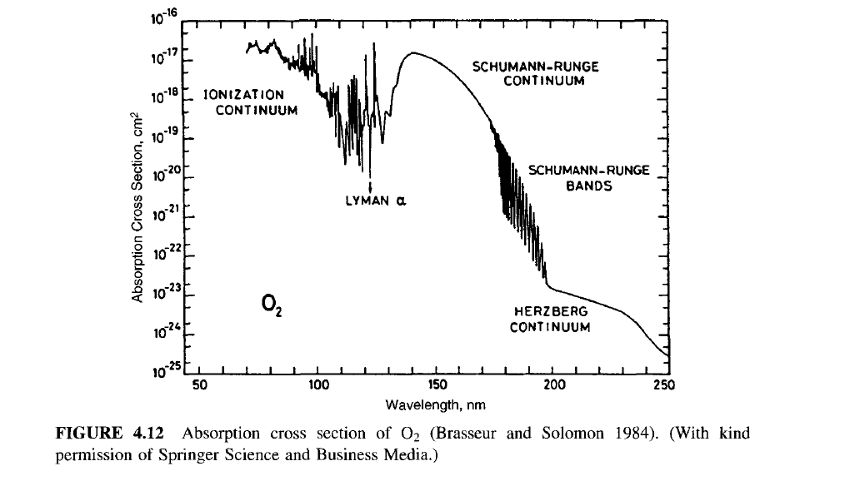
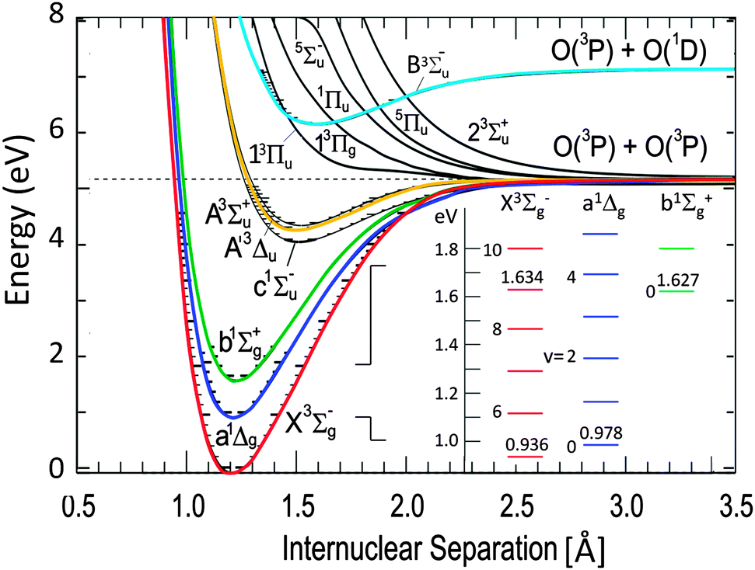
O₂ photochemistry
X ³Σ_{g}⁻ → B ³Σ_{u}⁻ allowed transition 175-130 nm Schumann-Runge continuum
hν
O₂ → O (³P) + O(¹D) for λ < 175 nm
Notes:
The peak in the absorption cross section of O2 occurs in the Schmann-Runge continuum at around 145 nm. For wavelengths less than
175 nm O2 is dissociated into two oxygen atoms, one of which is electronically excited. This strong absorption prevents sunlight of wavelengths below 175 nm from penetrating below around 70 km.

Slide 55
O₂ photochemistry
hν
O₂ → O (³P) + O(³P) for λ: 240-175 nm
X ³Σ_{g}⁻ → B ³Σ_{u}⁻ + crossing to ³Π_{u} (dissociative)
X ³Σ_{g}⁻ → A ³Σ_{u}⁺ (Herzberg) forbidden
Notes:
Figure 3.4 shows an average vertical profile of ozone through the atmosphere compared to an average temperature profile. The main layer of ozone in the atmosphere is situated between 15 and 30 km and reaches a maximum concentration of around 5 × 1012 molecules cm−3 at 22 km, however, the maximum temperature at the top of the stratosphere occurs at around 50 km, well above the main ozone layer.
Ozone is formed from the photo-dissociation of molecular oxygen but is itself removed by photodissociation. Both O2 and O3 absorb ultraviolet (UV) light very strongly and prevent highly energetic radiation penetrating to lower altitudes.
The peak in the absorption cross section of O2 occurs in the Schmann-Runge continuum at around 145 nm. For wavelengths less than
175 nm O2 is dissociated into two oxygen atoms, one of which is electronically excited. This strong absorption prevents sunlight of wavelengths below 175 nm from penetrating below around 70 km. The oxygen atoms formed as a result of O2 photolysis react with other molecules of O2 to form ozone. Figure 3.7 shows the strong absorption cross sections of ozone occurring between 240 and 300 nm with a maximum value of 1.1 ×10−17 cm2 at 255 nm. As a result, above 60 km ozone is photolysed very efficiently back to O2 and atomic oxygen, reducing its concentration and favouring the existence of atomic oxygen.
The Herzberg continuum between 200 and 240 nm is responsible for photolysis of O2 below 60 km because the shorter wavelengths have
already been removed (Fig. 3.5), while radiation of these wavelengths penetrates down to around 20 km.
Little O3 is produced high up in the atmosphere as the air density is low and there is little O2 to be photolysed or to subsequently react with the atomic oxygen formed by its photolysis. Density increases with descent through the atmosphere, favouring ozone formation via the combination of atomic and molecular oxygen, and the concentration of ozone increases to a maximum at around 20 to 25 km.
Lower in the stratosphere the overhead ozone column is now significant and absorbs much of the radiation between 200 and 290 nm, thus limiting photolysis of oxygen and slowing the rate of ozone formation. The concentration of ozone reduces and reaches a minimum by the tropopause where radiation of less than 290 nm is almost completely removed.
The absorption of UV radiation by both oxygen and ozone leads to their photolysis and the energy involved in these sunlight-induced reactions produces local warming. The temperature at a particular altitude will then be a combination of the rates of photolysis of the two oxygen species, in particular ozone, and the air density.
The rates of photolysis will depend on the local incidence of radiation and thus on the optical density of the atmosphere in the column above at a given wavelength.
This in turn will be dependent on the overhead concentration profile of O2 and O3 themselves.
As the air density increases any products of photochemical processes that remain energetically excited are deactivated more rapidly via an increased chance of collisions, leading to an
increase in temperature. Although the temperature profile is strongly linked to that of ozone, its maximum occurs not at the maximum ozone concentration, but above it and close to the region
where the photolytic formation and loss processes of ozone are most rapid.

Slide 56
O₂ photochemistry
Contribution of the various absorption regions to the photodissociation of O₂ as a function of altitude
Notes:
Figure 3.4 shows an average vertical profile of ozone through the atmosphere compared to an average temperature profile. The main layer of ozone in the atmosphere is situated between 15 and 30 km and reaches a maximum concentration of around 5 × 1012 molecules cm−3 at 22 km, however, the maximum temperature at the top of the stratosphere occurs at around 50 km, well above the main ozone layer.
Ozone is formed from the photo-dissociation of molecular oxygen but is itself removed by photodissociation. Both O2 and O3 absorb ultraviolet (UV) light very strongly and prevent highly energetic radiation penetrating to lower altitudes.
The peak in the absorption cross section of O2 occurs in the Schmann-Runge continuum at around 145 nm. For wavelengths less than
175 nm O2 is dissociated into two oxygen atoms, one of which is electronically excited. This strong absorption prevents sunlight of wavelengths below 175 nm from penetrating below around 70 km. The oxygen atoms formed as a result of O2 photolysis react with other molecules of O2 to form ozone. Figure 3.7 shows the strong absorption cross sections of ozone occurring between 240 and 300 nm with a maximum value of 1.1 ×10−17 cm2 at 255 nm. As a result, above 60 km ozone is photolysed very efficiently back to O2 and atomic oxygen, reducing its concentration and favouring the existence of atomic oxygen.
The Herzberg continuum between 200 and 240 nm is responsible for photolysis of O2 below 60 km because the shorter wavelengths have
already been removed (Fig. 3.5), while radiation of these wavelengths penetrates down to around 20 km.
Little O3 is produced high up in the atmosphere as the air density is low and there is little O2 to be photolysed or to subsequently react with the atomic oxygen formed by its photolysis. Density increases with descent through the atmosphere, favouring ozone formation via the combination of atomic and molecular oxygen, and the concentration of ozone increases to a maximum at around 20 to 25 km.
Lower in the stratosphere the overhead ozone column is now significant and absorbs much of the radiation between 200 and 290 nm, thus limiting photolysis of oxygen and slowing the rate of ozone formation. The concentration of ozone reduces and reaches a minimum by the tropopause where radiation of less than 290 nm is almost completely removed.
The absorption of UV radiation by both oxygen and ozone leads to their photolysis and the energy involved in these sunlight-induced reactions produces local warming. The temperature at a particular altitude will then be a combination of the rates of photolysis of the two oxygen species, in particular ozone, and the air density.
The rates of photolysis will depend on the local incidence of radiation and thus on the optical density of the atmosphere in the column above at a given wavelength.
This in turn will be dependent on the overhead concentration profile of O2 and O3 themselves.
As the air density increases any products of photochemical processes that remain energetically excited are deactivated more rapidly via an increased chance of collisions, leading to an
increase in temperature. Although the temperature profile is strongly linked to that of ozone, its maximum occurs not at the maximum ozone concentration, but above it and close to the region
where the photolytic formation and loss processes of ozone are most rapid.

Slide 57
Ozone photochemistry
Complex photochemistry leading to O and O₂ in both ground and excited states
All (allowed) excited electronic transitions lead to O₃ above its lowest dissociation threshold
Transition into the ¹B₂ state ~255 nm (Hartley band) is strongest. Weaker transitions into other singlet states at ~600 nm (Chappuis bands) and 330 nm (Huggins bands)
Multiple dissociation pathways are available:
λ threshold
O₃ + hν → O(³P) + O₂(X ³Σ_{g}⁻) 1180 nm
→ O(³P) + O₂(a ¹Δ_{g}) 612 nm
→ O(¹D) + O₂(X ³Σ_{g}⁻) 411 nm
→ O(¹D) + O₂(a ¹Δ_{g}) 310 nm
lowest energy one
Notes:
The photolysis of ozone, which drives tropospheric chemistry, is particularly sensitive to the overhead column of
stratospheric ozone.
Photolysis of ozone throughout the atmosphere leads to the formation of OH,
O3 + h v -> O (1 D ) + O2
O(1D)+H20-> OH+OH
which in turn is responsible for initiating the oxidation of a wide variety of atmospheric trace constituents, for example, methane:
OH + CH4 -> CH3 + H20
The photochemistry of ozone is very complex, as the relatively weak chemical bonds in ozone allow excited states of the O and O2 photoproducts
to be accessed. In fact, only now is a consensus being reached on the quantitative aspects of this photochemistry, particularly near the energy threshold
for O(lD) production near 310 nm. It is now believed (Ravishankara et al., 1998, and references therein) that four different photolysis channels are
occurring in the 290-350 nm spectral region, the region of importance for the generation of OH in the lower atmosphere, with the quantum yields for
these four channels varying with wavelength and temperature:
For atmospheric considerations, the key channels are those which produce O(1D), that is, those which lead to OH production. Interestingly, the energy
threshold for channel (C) is at about 308 nm, yet this process still occurs to longer wavelengths as a result of internal energy (vibrational and rotational)
contained in the ozone molecule itself, while channel (D) is a quantum mechanically“spin-forbidden” process whose occurrence was thought to be
unlikely. The figure below shows the O(’D) quantum yields near 200 K and 300 K (Filled circles = 203 K; open circles = 298 K). Channel (C) dominates below about 320 nm at 300 K, but is strongly
temperature dependent, while the near-constant contribution of the spin-forbidden channel (quantum yield about 0.06) is evident beyond about 320 nm.

Slide 58
Photolysis of Ozone
For tropospheric chemistry the most important aspect is production of O(¹D) (and thus OH formation) :
Energetics of O(¹D) production:
λ threshold
O₃(singl.) + hν → O(¹D) + O₂(X ³Σ_{g}⁻) 411 nm
→ O(¹D) + O₂(a ¹Δ_{g}) 310 nm
spin-forbidden
spin-allowed
Dissociation threshold is at 310 nm (spin-allowed channel). However O(¹D) products are experimentally observed up to 330 nm
T = 298K
T = 203K
Why??
Notes:
The photolysis of ozone, which drives tropospheric chemistry, is particularly sensitive to the overhead column of
stratospheric ozone.
Photolysis of ozone throughout the atmosphere leads to the formation of OH,
O3 + h v -> O (1 D ) + O2
O(1D)+H20-> OH+OH
which in turn is responsible for initiating the oxidation of a wide variety of atmospheric trace constituents, for example, methane:
OH + CH4 -> CH3 + H20
The photochemistry of ozone is very complex, as the relatively weak chemical bonds in ozone allow excited states of the O and O2 photoproducts
to be accessed. In fact, only now is a consensus being reached on the quantitative aspects of this photochemistry, particularly near the energy threshold
for O(lD) production near 310 nm. It is now believed (Ravishankara et al., 1998, and references therein) that four different photolysis channels are
occurring in the 290-350 nm spectral region, the region of importance for the generation of OH in the lower atmosphere, with the quantum yields for
these four channels varying with wavelength and temperature:
For atmospheric considerations, the key channels are those which produce O(1D), that is, those which lead to OH production. Interestingly, the energy
threshold for channel (C) is at about 308 nm, yet this process still occurs to longer wavelengths as a result of internal energy (vibrational and rotational)
contained in the ozone molecule itself, while channel (D) is a quantum mechanically“spin-forbidden” process whose occurrence was thought to be
unlikely. The figure below shows the O(’D) quantum yields near 200 K and 300 K (Filled circles = 203 K; open circles = 298 K). Channel (C) dominates below about 320 nm at 300 K, but is strongly
temperature dependent, while the near-constant contribution of the spin-forbidden channel (quantum yield about 0.06) is evident beyond about 320 nm.

Slide 59
Photolysis of Ozone
Contribution to O(¹D) quantum yield
T = 298K
at λ < 310: spin-allowed process: O(¹D) +O₂ (¹Δ)
T = 203K
at λ > 310: two different processes are responsible
1. “Hot-band absorption”: absorption from internally excited (vibr+rot) O₃ molecules. T dependent: population of the vibrationally excited state decrease with decreasing T
2. spin-forbidden process: O(¹D) +O₂ (³Σ). T independent, major source of O(¹D) at λ > 325 nm. Upper limit for quantum yield φ_{D}=0.06
Notes:
The photolysis of ozone, which drives tropospheric chemistry, is particularly sensitive to the overhead column of
stratospheric ozone.
Photolysis of ozone throughout the atmosphere leads to the formation of OH,
O3 + h v -> O (1 D ) + O2
O(1D)+H20-> OH+OH
which in turn is responsible for initiating the oxidation of a wide variety of atmospheric trace constituents, for example, methane:
OH + CH4 -> CH3 + H20
The photochemistry of ozone is very complex, as the relatively weak chemical bonds in ozone allow excited states of the O and O2 photoproducts
to be accessed. In fact, only now is a consensus being reached on the quantitative aspects of this photochemistry, particularly near the energy threshold
for O(lD) production near 310 nm. It is now believed (Ravishankara et al., 1998, and references therein) that four different photolysis channels are
occurring in the 290-350 nm spectral region, the region of importance for the generation of OH in the lower atmosphere, with the quantum yields for
these four channels varying with wavelength and temperature:
For atmospheric considerations, the key channels are those which produce O(1D), that is, those which lead to OH production. Interestingly, the energy
threshold for channel (C) is at about 308 nm, yet this process still occurs to longer wavelengths as a result of internal energy (vibrational and rotational)
contained in the ozone molecule itself, while channel (D) is a quantum mechanically“spin-forbidden” process whose occurrence was thought to be
unlikely. The figure below shows the O(’D) quantum yields near 200 K and 300 K (Filled circles = 203 K; open circles = 298 K). Channel (C) dominates below about 320 nm at 300 K, but is strongly
temperature dependent, while the near-constant contribution of the spin-forbidden channel (quantum yield about 0.06) is evident beyond about 320 nm.

Slide 60
Hot band absorption
For O₃ (but also NO₂) photodissociation quantum yields do not drop immediately to zero below the dissociation threshold. This effect is explained by channeling the internal energy of molecules into the dissociation process
λ threshold
NO₂ + hν → NO + O 399 nm
Internal energy and kinetic energy (collisions with bath gas) contribute to the yield below threshold
Notes:
Quqntum yields for NO production in the photolysis of NO2 at 298K. Calculated QY due to internal energy (dotted line) and calculated dissociation due to collisions (dashed line) and the sum of the two calculations (solid line) that is in good agreement with the experimental quantum yield

Slide 61
Absorption and photolysis of NO₂
NO₂: one of the few atmospheric molecules that absorbs and photolyze in the VIS range (contributes to brown air colour of polluted cities, in addition to aereosols)
Photolysis generates O₃ in the troposphere (see O₃ slides)
Absorption cross sections are structured + non trivial dependence on T, P
NO₂ absorption spectrum T=298K
Notes:
Quqntum yields for NO production in the photolysis of NO2 at 298K. Calculated QY due to internal energy (dotted line) and calculated dissociation due to collisions (dashed line) and the sum of the two calculations (solid line) that is in good agreement with the experimental quantum yield
Since no solar radiation of wavelength shorter than about 290 nm reaches the troposphere, the absorbing species of interest from the point of view of tropospheric
chemistry are those that absorb in the portion of the spectrum above 290 nm. Nitrogen dioxide is an extremely important molecule in the troposphere; it absorbs over the entire visible and ultraviolet range of the solar spectrum in the lower atmosphere

Slide 62
Absorption and photolysis of NO₂
Photolysis has almost 100% yield at λ<397.8 nm:
NO₂ + hν → O(³P) + NO(X ²Π)
In the region 398-415 nm: still partial photodissociation due to contributions of internal energy (but φ declines with increasing λ)
Above 410 nm, no photodissociation and electronic excitation can result in:
fluorescence
NO₂* → NO₂ + hν
NO₂* + O₂ → NO₂ + O₂(a ¹Δ_{g})
NO₂* + N₂ → NO₂ + N₂(v>0)
electronic energy transfer
electronic to vibrational
energy transfer
Notes:
Quqntum yields for NO production in the photolysis of NO2 at 298K. Calculated QY due to internal energy (dotted line) and calculated dissociation due to collisions (dashed line) and the sum of the two calculations (solid line) that is in good agreement with the experimental quantum yield
At lambda longer than 397.8 nm there is not enough energy to break the N-O bond. The point at which dissociation fails to occur is not sharp because the individual
molecules of NO2 do not possess a precise amount of ground-state energy prior to absorption. The gradual transition area (370-420 nm) corresponds to a variation in
ground-state energy of about 40 kJ mol-1. This transition curve can be shifted slightly to
longer wavelengths by increasing the temperature and therefore increasing the groundstate
energy of the system.

Slide 63
Calculation of photolysis rates at altitude z
The photolysis rate at any altitude is:
Two competing effects in the z dependence:
actinic flux decreases (due to increasing absorption from layers above)
Decrease in the rate
while altitude z decreases
concentration of A increases (due to the atmosphere increase in density)
increase in the rate
Photolysis rates may have a maximum at a certain z
maximum occurs at z value when
Notes:
As one descends toward the Earth's surface, the photolysis rate decreases because the overall actinic flux is decreasing due to increasing absorption in the layers above. As one ascends in the atmosphere, the concentration of the gas nA(z) simply decreases as the atmosphere's density thins out. These two competing effects combine to produce a maximum in the photolysis rate at a certain altitude. The altitude at which this rate is a maximum is the value of z at which.
This is not the case for molecules that are photolyzed at wavelenght longer that 290nm because in this region O2 and O3 do not absorb anymore and actinic flux does not change much with altitude
See Seinfeld and Pandis chap 4.8

Slide 64
NO₂ photolysis rate: altitude dependence
NO₂ photolysis occurs with about the same rate throughout the atmosphere
NO₂ absorption (and photolysis) is occurring at λ>300 nm
In this region no absorption from O₂ and O₃ → actinic flux I(λ) is practically constant with altitude z
k_{NO2} is practically constant with altitude (z)
Notes:
visible NO2 photolysis occurs with about the same rate throughout the atmosphere because.
The majority of NO2 photolysis occurs for λ > 300 nm. Since in this region of the spectrum there is virtually no absorption by O2 and O3, the actinic flux is essentially independent of altitude (see Figure 4.11), and as a result, kNO2 is nearly independent of altitude. For the same reason, kNO2 does not drop off with increasing solar zenith angle as rapidly as that for molecules that absorb in the region of λ > 300 nm.

Slide 65
Absorption and photolysis of CFC
(chloroflourocarbons)
Photolysis rates k_{CFC} as a function of z
Absorption spectra of CFCs
CFCl₃
CF₂Cl₂
CF₃Cl
Photolysis rate coefficients will be large at high altitude, due to larger I(λ)
No other CFC sinks than photolysis (CFC are largely unreactive)
All CFCs have maximum absorptions in the UV (λ<220 nm)
Photolysis of CFC in the stratosphere provides Cl source leading to O₃ destruction (1995 Nobel prize in Chemistry to Crutzen, Molina & Rowland)

Slide 66
The end

Slide 67

Exercise n. 1
Using the barometric law estimate the column density of O₂ in the atmosphere. By how much does atmospheric O₂ attenuate solar radiation at around 170 nm (σ ≈ 10⁻¹⁷ cm²⋅molec⁻¹) at noon (air mass = 1)? Assume that O₂ molar fraction is 21% (independent of altitude) and T = 270 K.
Note: Use the value H=7.5 km for the scale height, and assume an air pressure at the surface of 1 atm

Slide 68
Exercise n. 1
Solution: The barometric laws expressed in terms of density (or concentration) is:
The column density of O2 is obtained by integrating over the whole height of the atmosphere:
with
The density of air c_{air}(0) in number of molecules cm⁻³ is as usual given by:
Colum density of O₂:
molecules⋅cm⁻²

Slide 69
Exercise n. 1
Solution (cont):
Colum density of O₂:
molecules⋅cm⁻²
The optical depth can be calculated by :
Optical depth due to O₂:
So the attenuation is 100%
Notes:
Photodissociation, the breaking apart of molecules by solar radiation, plays a fundamental role in the chemistry of the atmosphere. The photodissociation
of trace species such as ozone and formaldehyde contributes to their removal from the atmosphere, but probably the most important role played by these photoprocesses is the generation
of highly reactive atoms and radicals.
Photodissociation of trace species and the subsequent reaction of the photoproducts with other molecules is
the prime initiator and driver for the bulk of atmospheric chemistry.

Slide 70
Exercise n. 2
The absorption cross sections (as a function of λ) for nitric acid (HNO₃) are shown in the graph hereby. The quantum yield for the photodissociation reaction: HNO₃ + hν → OH + NO₂ is approximately 1 from 200 to 340 nm. Estimate the photodissociation natural lifetime of HNO₃ at an altitude of 40 km and at a SZA of 20° (use the actinic flux values reported in the following slide)
Absorption cross section of HNO₃

Slide 71
Hint for solution: See the example done at lesson on the photodissociation of acetaldehyde
Results for k_{HNO3} ∼2.45 x10⁻⁵ s⁻¹
So natural lifetime is τ =1/k = 4.08x10⁴ s ∼ 1.13 hours

Slide 72
Exercise n. 3
The photodissociation coefficients for several atmospheric trace compounds as a function of altitude are shown in the graph. Estimate the photodissociation lifetimes of N₂O and HONO at 20 km and compare them with the characteristic times for vertical transport in the stratosphere (≈ 2 years). Which of the two species will be more likely to be transported in the stratosphere?

Slide 73
Exercise n. 3
The photodissociation coefficients for several atmospheric trace compounds as a function of altitude are shown in the graph. Estimate the photodissociation lifetimes of N₂O and HONO at 20 km and compare them with the characteristic times for vertical transport in the stratosphere (≈ 2 years). Which of the two species will be more likely to be transported in the stratosphere?
Solution. From the graph one can get the photodissociation rate coefficient k at 20 km for N₂O (k≈10⁻¹⁰ s⁻¹) and for HONO (k≈10⁻³ s⁻¹). Being a first order process the natural lifetime is given by τ=1/k.
The species that will be more likely to be transported in the stratosphere is the one with the longer lifetime, i.e. N₂O.

Slide 74
Exercise n. 4
Small amounts of O₃ are generated from O atoms coming from O₂ photolysis at 248 nm, even though this wavelength is beyond the energetic threshold for O₂ dissociation from its ground electronic state.
Using the heats of formation in the table, calculate the maximum wavelength at which O₂ can photodissociate. (Not all the heat of formations in the table are necessary to solve the problem)

Slide 75
Exercise n. 4
Small amounts of O₃ are generated from O atoms coming from O₂ photolysis at 248 nm, even though this wavelength is beyond the energetic threshold for O₂ dissociation from its ground electronic state.
b) Given that the force constant for the O-O bond in O₂ is k=1140 Nm⁻¹, show that if ground-electronic state O₂ has one vibrational quantum of energy, this will be sufficient to cause dissociation on absorption of 248 nm light. Assume that O₂ behaves like a simple harmonic oscillator (see slides 04b_Molecular spectroscopy).

Slide 76
Exercise n. 4
Solution a)

Slide 77


Exercise n. 4
Solution b)
One quantum of vibrational energy corresponds to the energy difference E(v=1)-E(v=0)
ΔE=E(v=1)-E(v=0)=$\frac{h}{2π}\sqrt{\frac{k}{μ} }$
E(v)$=\frac{h}{2π}\sqrt{\frac{k}{μ}}\left(v+\frac{1}{2}\right)$
Since E_{tot} is bigger than the ΔH calculated at point a) (498.4 kJ/mol) the excitation to v=1 is sufficient to cause dissociation
1eV = 1.602 x 10 -19 J = 96.5 kJ/mol

Slide 78
Exercise n. 5
Using the force constant for O₂ k=1140 Nm⁻¹, and assuming a simple harmonic oscillator behavior, calculate the highest possible vibrational level that ground electronic state O₂ could be produced upon photolysis of O₃ at 290 nm if the oxygen atom generated is:
in ground-state O(³P) or
in electronically excited state O(¹D)
c) Using results from problem n. 4, calculate the vibrational energy level in which O₂ can be generated by O₃ photolysis at 243 nm

Slide 79
Exercise n. 5
Solution
O₃ + hv→ O(³P)+O₂
So the highest possible vibrational level is v=15
b) Same calculation as in a) with
So the highest possible vibrational level is v=5

Slide 80
Exercise n. 5
Solution
c) Using results from problem n. 4, calculate the vibrational energy level in which O₂ can be generated by O₃ photolysis at 243 nm
Assuming O₃ + hv→ O(³P)+O₂
So the vibrational energy level in which O₂ can be produced is v=20

Slide 81
Photochemical rates: derivation
Consider an atmospheric layer of thickness dz : quantity of light incident on the top surface (area dS) with direction θ,ϕ is radiance L(λ,θ,ϕ) in photons⋅s⁻¹⋅cm⁻²⋅sr⁻¹
n. photons entering the layer:
From Lambert-Beer law n. photons absorbed by A, while light travels pathlength m(θ) is prop. to n. molecules in infinitesimal volume m(θ)dS and to absorption cross section σ_{A}:
absorption cross section (in cm²⋅molecules)
concentration of A (in molecules⋅cm⁻³)
infinitesimal volume (in cm⁻³), with pathlength m(θ) = dz /cosθ
For each absorbed photon the probability that A dissociates into a specific channel is φ_{A} (quantum yield):
Notes:
Consider an atmospheric layer of infinitesimal vertical thickness dz, illuminated from above. The quantity of light incident on the top surface of the layer depends on the direction of incidence of the light, as defined by the spherical coordinates θ, phi. This dependence is specified by the spectral radiance L( λ, θ, phi), expressed in units of photons s- 1cm- 2 nm-1 sr-1.
The number of photons entering the layer (through ds, in time dt, from solid angle dω) is:
For an infinitesimally thin layer, the Beer-Lambert law can be used to compute the number of photons absorbed in time dt in wavelength
range dλ as:
where sigma is absorption cross section (cm2molec-1), [A] is concentration of A molecules (in molecules cm-3) m(θ) is the pathlength
m(θ) = dz/cos θ
For each photon absorbed, the probability that the molecule will dissociate is the quantum yield.) Thus the number of molecules dissociated in time dt in wavelength range dλ is

Slide 82
Photochemical rates: derivation
Total n. of dissociations of A in the volume, in time dt, from integration over solid angle ω, upper surface S of the layer and wavelength λ:
volume dV
time
divide by dV⋅dt to get:
actinic flux I(λ)
photodissociation rate coefficient k_{A}
Notes:
The total number of dissociations dNA occurring in the volume in a time interval dt is obtained by integrating over all solid angles, over the upper surface of the layer, and over all wavelengths:
The first factor on the right-hand side (RHS) is just the total volume of the layer, which can be brought to the left-hand side (LHS) along with dt to produce

Slide 84
Assorbimento di luce nell’ UV e VIS: la fotochimica
Requisito energetico:
O₂ → 2O
E=492 kJ/mole
Ma l’ossigeno non assorbe a 243 nm......
Occorrono due livelli alla giusta enegia ed il rispetto delle regole di selezione.
Per esempio la conservazione dello spin elettronico totale
singoletto → singoletto
tripletto→ tripletto
singoletto → tripletto
Di norma viene assorbito un solo fotone alla volta

Slide 85
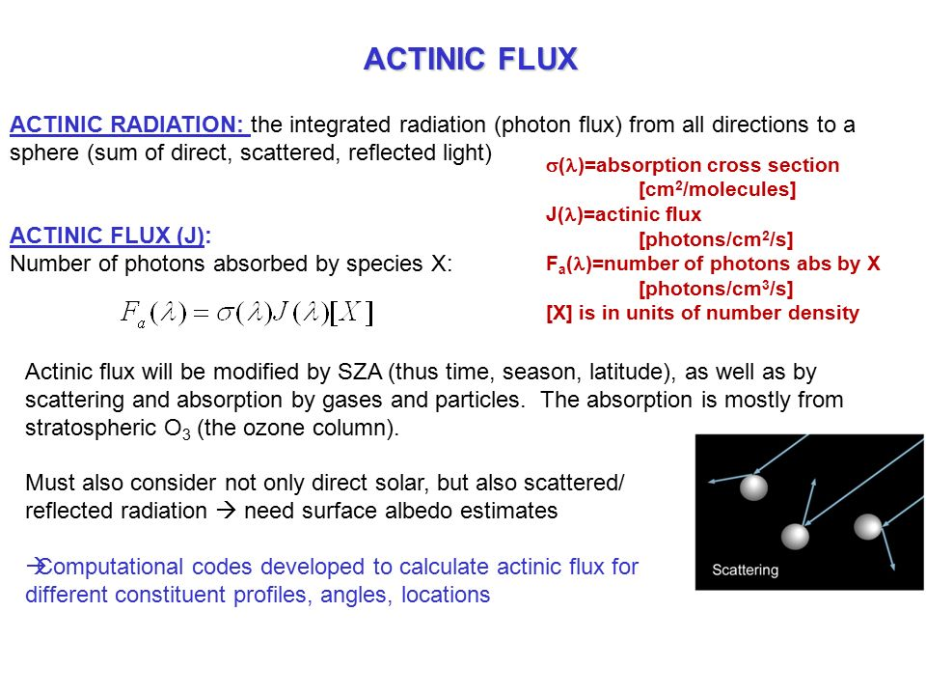

Slide 86
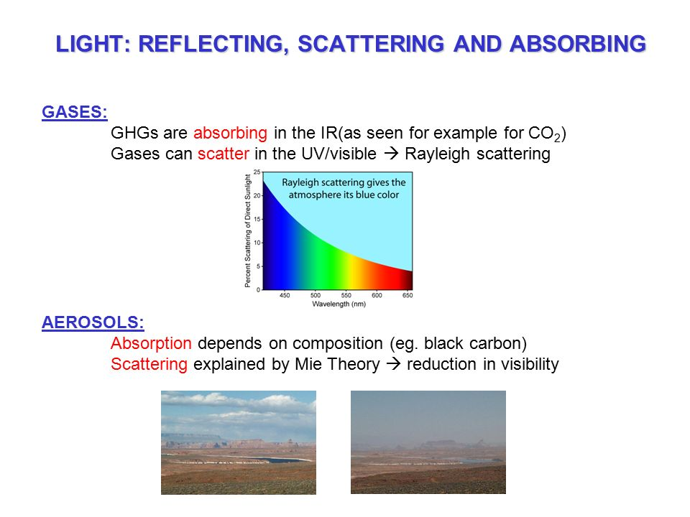

Slide 87
Photochemistry fundamentals come in Seinfeld Pandis
https://www.ems.psu.edu/~brune/m532/m532_ch3_photochemistry_fundamentals.html
Qui per dissociation e predissociation ed esempio O3
https://slideplayer.com/slide/5377521/

Slide 88
Radiation flux, irradiance and radiance
F: radiant flux density
Radiant energy flux across any surface element (without consideration of direction). Unit: W⋅m⁻²
E: irradiance
E ↔ F: interchanged
Radiant energy flux received on a flat surface. Unit: W⋅m⁻²
L(θ,ϕ) : radiance
Radiant energy flux as a function of solid angle dω crossing a surface perpendicular to the beam radiation axis. Unit: W⋅m⁻²⋅sr⁻¹
dS⋅cosθ
Radiant flux density on dS
for isotropic L after integration over the half-space
Notes:
From Seinfled and Pandis p. 107
The essential energy flux in atmospheric chemistry is the flux of solar radiation. The radiant flux density F is the radiant energy flux across any surface element, without
consideration of the direction; F is measured in watts per square meter (W m- 2). The radiant flux density is called the irradiance E when the radiation is received on a
surface. Thus F and E are often used interchangeably. We will use F in general and E when we are referring specifically to the radiant flux density on a surface. The radiance
L is the radiant flux as a function of the solid angle dω crossing a surface perpendicular to the axis of the radiation beam; L is measured in watts per square meter per steradian (Wm- 2 sr-1). The radiance as a function of direction gives a complete description of the radiative field.
Consider a beam of radiation of radiance L crossing a surface dS with the beam axis
making an angle theta to the normal to dS (Figure 4.6). dS projects as dS cos 8 perpendicular to the beam axis of the radiation, and the radiant flux density dF on dS is
When the radiance L is independent of direction, the radiative field is called isotropic. In this case, (4.13) can be integrated over the half-space, Ω = 2π, and the relation between the irradiance and the radiance is E = πL. The irradiance on a horizontal surface is obtained from the incoming radiance by
integrating the radiance over the spherical coordinates θ and phi.

Slide 89
For better explanation of radiometric quantities see
https://light-measurement.com/basic-radiometric-quantities/
https://en.wikipedia.org/wiki/Radiative_flux

