Slide 1

University of Trento
Master of Science in Environmental Meteorology https://international.unitn.it/environmental-meteorology
A.A. 2023-24
Environmental Physical Chemistry
Quantum structure of atoms and molecules and (simplified) spectroscopy
Daniela Ascenzi
Dept. Physics, University of Trento, Italy
e-mail: daniela.ascenzi@unitn.it

Slide 2
Quantum structure of atoms &molecules
In the case of H atom:
SCHRÖDINGER’S EQUATION
by solving the equation
wavefunction (orbital)
energy of the orbitals
n principal (energy)
l angular
m magnetic
l =0 → s
l =1 → P
l =2 → d
Quantum numbers
probability density

Slide 3
Quantum structure of atoms & molecules
Hydrogen atom and hydrogenoids (i.e. Atoms with one electron only): energy levels of the atomic orbitals
Z²
E_{i} =
-R₀·
n²
n=1, 2, 3…∞
Z = atomic number (nuclear charge)
H has Z=1, He⁺ has Z=2...
Interaction with light can induce changes in the electron distribution

Slide 4
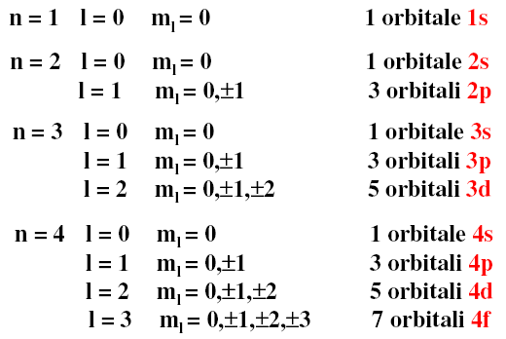
Quantum numbers and orbitals
n =1, 2, 3… ∞
ℓ =0, 1, 2, 3 … (n-1)
m_{ℓ} = - ℓ, -(ℓ -1), …0… +(ℓ -1), + ℓ

Slide 5
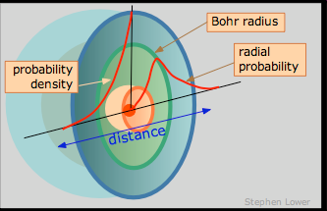
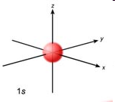
Quantum structure of atoms & molecules
H atom wavefunction
Ψ_{n,l,ml} = R_{n,l}(r)Y_{l,ml}(θ,ϕ)
angular part
Radial part
Probability density
is the probability of finding the electron in a spherical shell depth dr placed at a distance r from the nucleus
Ψ²(r)
s type orbital
r²R²(r)
r²R²(r)
Notes:
The factor r^2 in front accounts for the increasing volume of spherical shells at greater distances from the nucleus.
La distribuzione di probabilità radiale è piccola vicino al nucleo perché il volume del guscio sferico è piccolo e presenta un massimo alla distanza a cui è più probabile trovare l’elettrone. Siccome «integro» sulle due variavili angolari questo tipo di rappresentazione da luogo a delle curve in un grafico in funzione di r (distanza del punto preso in consideratione dal nucleo). La densità di prob radiale è una funzione che presenta (almeno) un massimo e va a zero per r=0 e per r=inf. Per r=0 è chiaro perchè la prob di trovare l’elettrone in un guscio sferico posto sul nucleo è nulla. Anche all’infinito devo avere prob nulla. Il massimo viene fuori dal fatto che la prob di trovare l’elettrone nel guscio all’aumentare di r diminuisce, ma il volume del guscio sferico che prendiamo in considerazione aumenta e questi due meccanismi competitivi determinano un punto di massimo.

Slide 6
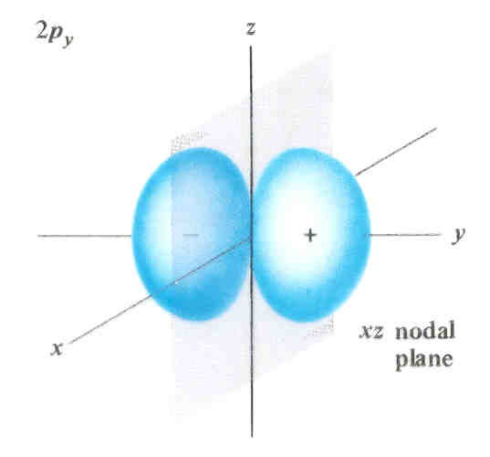
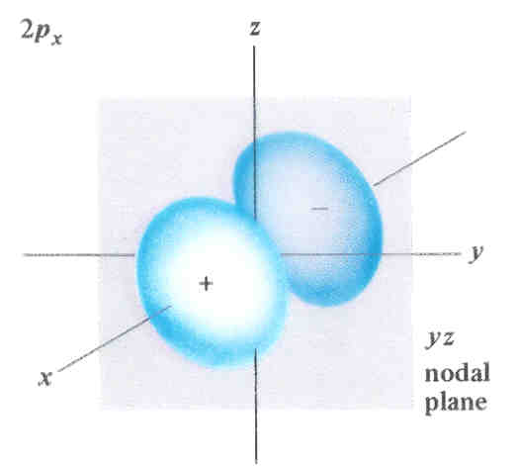
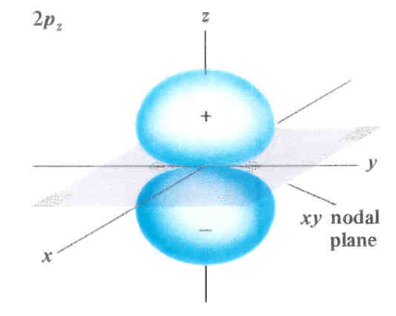
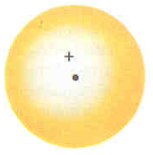
Quantum structure of atoms & molecules
2s
2p_{y}
2p_{x}
2p_{z}
d type orbitals
Notes:
The factor r^2 in front accounts for the increasing volume of spherical shells at greater distances from the nucleus.
La distribuzione di probabilità radiale è piccola vicino al nucleo perché il volume del guscio sferico è piccolo e presenta un massimo alla distanza a cui è più probabile trovare l’elettrone. Siccome «integro» sulle due variavili angolari questo tipo di rappresentazione da luogo a delle curve in un grafico in funzione di r (distanza del punto preso in consideratione dal nucleo). La densità di prob radiale è una funzione che presenta (almeno) un massimo e va a zero per r=0 e per r=inf. Per r=0 è chiaro perchè la prob di trovare l’elettrone in un guscio sferico posto sul nucleo è nulla. Anche all’infinito devo avere prob nulla. Il massimo viene fuori dal fatto che la prob di trovare l’elettrone nel guscio all’aumentare di r diminuisce, ma il volume del guscio sferico che prendiamo in considerazione aumenta e questi due meccanismi competitivi determinano un punto di massimo.

Slide 7
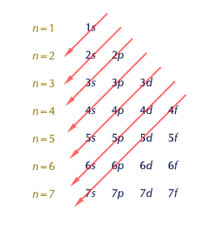
Multielectronic atoms: energy ordering
Energy levels of the atomic orbitals in multielectron atoms
The ordering of energy levels depends on n+l.
It is:
n: 1<2<3<4...
l: s<p<d... (for the same n)
Electronic configurations of atoms:
List of orbitals occupied by electrons in an atom in its ground state (i.e. state of the lowest energy
Notes:
L’effeto di penetrazione degli orbitali s è responsabile del fatto che gli orbitali 4s si trovano ad una energia inferiore rispetto a quelli 3p, pur avendo un n maggiore

Slide 8
Multielectronic atoms: aufbau principle
Rules: In an atom in its ground state
1. Each electron that is added goes in the available orbital at the lowest energy
2. Pauli principle: an orbital can be occupied by a maximum of 2 electrons with antiparallel spin
3. Hund’s rule: orbitals having the same energy (degenerate) are completely filled only after all the other degenerate orbitals are half-filled (maximum multiplicity rule)
np
has less energy than
np

Slide 9
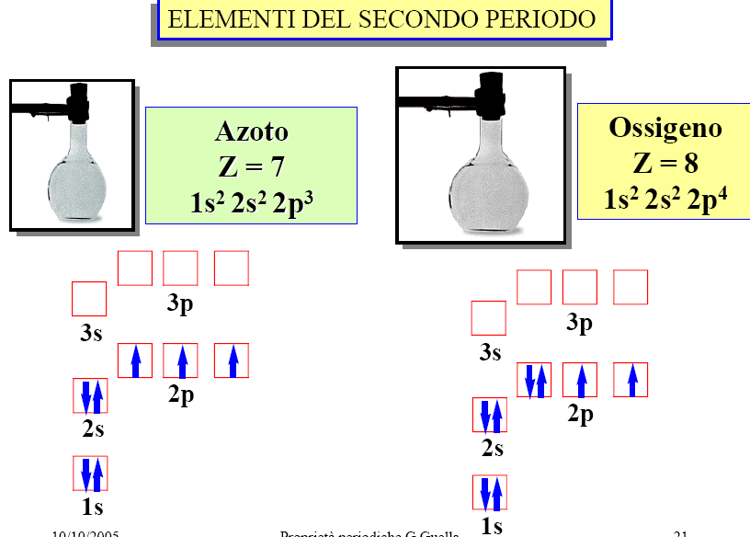
SECOND PERIOD ELEMENTS
Nitrogen
Oxigen

Slide 10
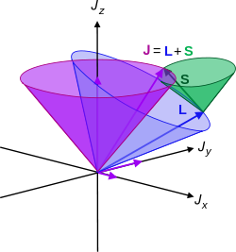
Multielectronic atoms and term symbols
Quantum numbers for electrons in atoms
n: principal (n=1, 2, 3…) defines the energy of the orbital
l : angular or orbital (l =0,…n-1) defines energy + shape
m: magnetic (-l, -l+1…,+l) projection of l along an axis
s: spin (only +1/2 or -1/2)
In multielectron atoms
In the vector model of atoms orbital angular (l_{i}) and spin (s_{i}) momenta can couple → total angular momenta L, S, J
coupling of all l_{i} → L total orbital angular mom.
coupling of all s_{i} → S total spin angular mom.
coupling of L and S → J total angular mom.

Slide 11
Multielectronic atoms and term symbols
Term symbol: abbreviated description of the (total) angular momentum quantum numbers in a multi-electron atom
Given an electronic configuration:
e.g. for O 1s²2s²2p⁴
each energy level occupancy of the atom is described by a term symbol (usually assuming spin-orbit coupling)
: total spin quantum number
projections of S
: spin multiplicity
: total orbital angular momentum
capital letters in series are used to indicate different L values:
projections of L
: total angular momentum
Notes:
Term symbol: abbreviated description of the (total) angular momentum quantum numbers in a multi-electron atom. Each energy level of an atom with a given electron configuration is described by not only the electron configuration but also its own term symbol, as the energy level also depends on the total angular momentum including spin. The usual atomic term symbols assume LS coupling (also known as Russell-Saunders coupling or spin-orbit coupling). The ground state term symbol is predicted by Hund's rules.
For light atoms, the spin-orbit interaction (or coupling) is small so that the total orbital angular momentum L and total spin S are good quantum numbers. The interaction between L and S is known as LS coupling, Russell-Saunders coupling or Spin-Orbit coupling. Atomic states are then well described by term symbols of the form
^{2S+1}L_{J}where
S is the total spin quantum number. 2S + 1 is the spin multiplicity, which represents the number of possible states of J for a given L and S, provided that L ≥ S. (If L < S, the maximum number of possible J is 2L + 1).^{[2]} This is easily proved by using J_{max} = L + S and J_{min} = |L - S|, so that the number of possible J with given L and S is simply J_{max} - J_{min} + 1 as J varies in unit steps.J is the total angular momentum quantum number.L is the total orbital quantum number in spectroscopic notation. The first 17 symbols of L are:
Capital letters in the series (S;P;D; F;G, . . . )
correspond to different values of the orbital angular momentum L (0, 1, 2, 3, 4, . . . ).

Slide 12
Multielectronic atoms and term symbols
Examples:
identifies the state of an atom with:
spin multiplicity
L=0
J=1/2
doublet
spin multiplicity
L=0
J=0
singlet
spin multiplicity
L=1
J=2
triplet
but a ³P state can have J=2, 1, 0 So also the following terms are possible:
spin multiplicity
L=2
J=2
singlet
Notes:
2S1=2 identifies a state with L D 0 (state S), total spin S D 1
2, resulting in a
doublet (multiplicity 2S C 1 D 2) and with J D 1
2 (J D L C S D 0 C 1
2 D 1
2 ).

Slide 13
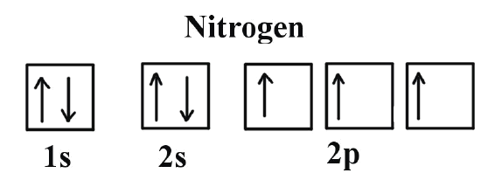
Term symbols: the N atom
The electronic term symbols for equivalent-electron configurations can be calculated
Nitrogen atom
three equivalent p electrons (l=1) with n=2
All the possible arrangements of three electrons on three equivalent p orbitals
statistical weight (=2J+1)
Energy (kJ/mol)
0
lowest energy level
(ground state)
∼230
excited levels
∼345
Notes:
Complete shell configurations, i.e. p6, always give the 1S term.

Slide 14
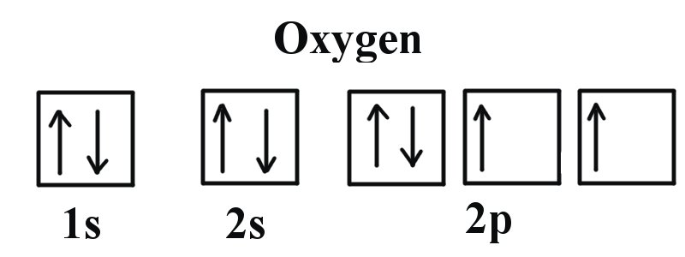
Term symbols: the O atoms
The electronic term symbols for equivalent-electron configurations can be calculated
Oxygen atoms
four equivalent p electrons (l=1) with n=2
statistical weight (=2J+1)
Energy (kJ/mol)
0
lowest energy level
(ground state)
1.9
2.7
excited levels
190
404
Notes:
Complete shell configurations, i.e. p6, always give the 1S term.

Slide 15

Exercise n. 1
Term symbols and atomic spectra: how many and what J values are possible for the following term symbols: ¹S, ²P, ³P, ³D, ²D, ¹D, ⁴D?
Hints:
Solution:
¹S only J=0;
²P has J=3/2 and ½
³P has J=2,1,0
³D has J=3, 2, 1
²D has J=5/2 and 3/2
¹D has J=2
⁴D has J=7/2, 5/2, 3/2 and 1/2

Slide 16
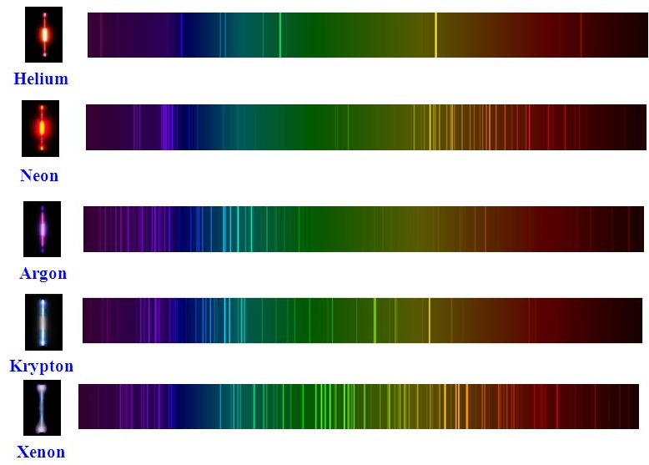
Atomic spectra
Transitions are between different electronic energy levels
Spectra are made of lines
Not so relevant for atmospheric chemistry
What happens in the case of molecules?

Slide 17
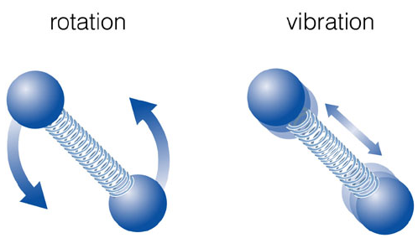
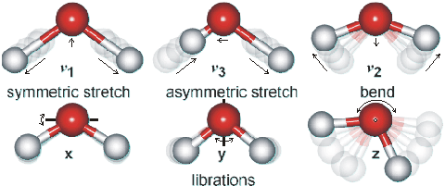
Molecular energy levels
1. Electron distributions
2. Relative motions of atoms
translations
rotations
vibrations
Interaction with light can induce changes in rotations, vibrations and electron distributions
E_{tot} = E_{int} + E_{tras}
E_{int} = E_{ele} + E_{vib} + E_{rot}
Notes:
When dealing with molecules, in addition to electronic motions it needs to be taken into account the relative motions of atoms with respecto to each other.
Light

Slide 18
Molecular energy levels
Notes:
When dealing with molecules, in addition to electronic motions it needs to be taken into account the relative motions of atoms with respecto to each other.
Light

Slide 19
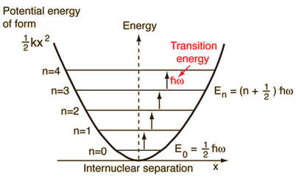
Molecular vibrations (diatomic molecules)
Harmonic oscillator model
E_{int} = E_{ele} + E_{vib} + E_{rot}
Hook’s law
when put into the Schroedinger eq.
v =vibrational quantum number = 0,1,2,....
For v=0 zero point energy
= reduced mass of the molecule
k = force constant (strenght) of the bond
Selection rule for light absorption/emission:
electric dipole moment of the molecules must change during the vibration → only molecules with permanent dipole moments (heteronuclear diatomics) are active
Notes:
Simple model: vibrating spring that changes the distance from the equilibrium position Re. Atoms experience a force (Hook’s law) that is proportional to the displacement and tends to restore them at equilibrium.
This is a simple model
Selection rules: the rationale behind is that the movement of the molecules has to generate an oscillating electric field that can interact with the e.m. radiation field to generate absorption/emission. For omonuclear diatomic molecules the vibration does not generate a dipole moment and therefore such molecules will not absorbe radioation in the IR

Slide 20
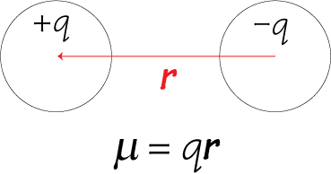
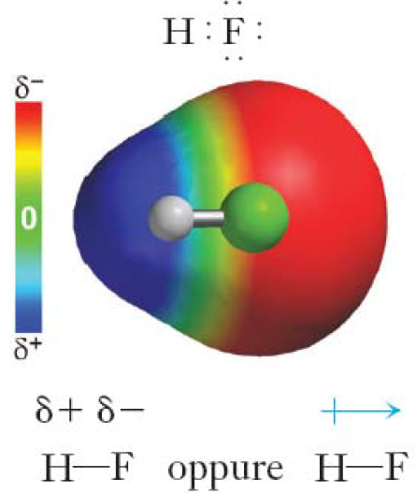
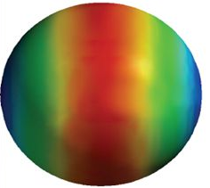
Electric dipole moment in molecules
The (electric) dipole moment µ of a diatomic molecule is a measurement of the separation of two opposite electrical charges (of equal value)
µ is a vector with module equal to the charge (q) multiplied by the distance (r)
between them
Heteronuclear diatomics
Have polar covalent bonds: due to the different electronegativity of the atoms there is an asymmetric distribution of electron density (the baricenter of + and – charges does not coincide)
Homonuclear diatomics
pure covalent bonds: same electronegativity of the atoms gives no asymmetry in the distribution of electron density
µ = 0
µ ≠ 0
e.g. CO, HCl, NO
e.g. H₂, O₂, N₂
Notes:
Simple model: bond as a vibrating spring that changes the distance from the equilibrium position Re. Atoms experience a force (Hook’s law) that is proportional to the displacement and tends to restore them at equilibrium.
This is a simple model Selection rules: the rationale behind is that the movement of the molecules has to generate an oscillating electric field that can interact with the e.m. radiation field to generate absorption/emission. For omonuclear diatomic molecules the vibration does not generate a dipole moment and therefore such molecules will not absorbe radioation in the IR

Slide 21
Molecular vibrations (diatomic molecules)
vibrational levels distances decrease with increasing v
For real molecules the potential is not harmonic (h.o. model is ok only for low vibrational levels)
Electronic ground state
Potential energy
Anharmonic oscillator
D₀
v=2
v=1
Vibrational levels
v=0
D₀ = dissociation energy
Internuclear distance
v =vibrational quantum number = 0,1,2,....
anharmonicity constants
equilibrium
dissociation
Selection rule for light absorption/emission:
weaker “overtone” transitions can occur
Notes:
Simple model: vibrating spring that changes the distance from the equilibrium position Re. Atoms experience a force (Hook’s law) that is proportional to the displacement and tends to restore them at equilibrium.
This is a simple model

Slide 22
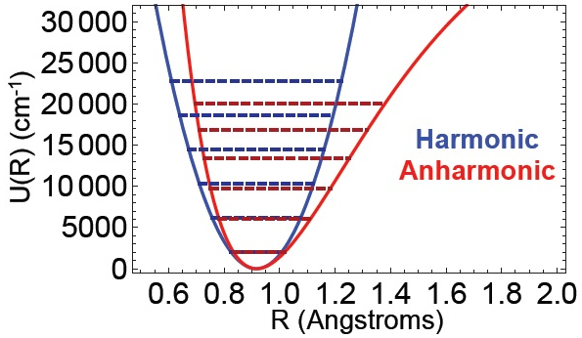
Molecular vibrations (diatomic molecules)
Harmonic vs Anharmonic energy levels
The harmonic transition frequencies are consistently larger than the anharmonic transition frequencies
Notes:
Simple model: vibrating spring that changes the distance from the equilibrium position Re. Atoms experience a force (Hook’s law) that is proportional to the displacement and tends to restore them at equilibrium.
This is a simple model

Slide 23
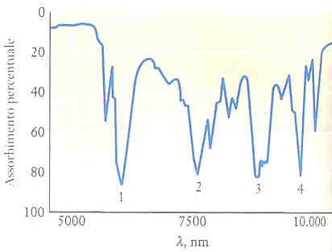
Effect of IR radiation
Molecular vibration
vibrational energy levels splittings are ∼10³ cm⁻¹
absorption in the IR
(10-10⁴ cm⁻¹ / 0.1-1000 μm / 0.3-10² GHz)
A change in the dipole moment during vibration is necessary
N₂ ed O₂ do NOT absorb in the IR
vibr. splittings are much larger than thermal energy so only v=0 is populated at T=280-290K
Notes:
Simple model: vibrating spring that changes the distance from the equilibrium position Re. Atoms experience a force (Hook’s law) that is proportional to the displacement and tends to restore them at equilibrium.
This is a simple model

Slide 24
Energy distribution of gases
Thermal energy is the average kinetic energy of molecules in a gas. It is related to the temperature (T):
At T=290K: 3/2RT= 3.6 kJ/mol (thermal energy)
A vibrational energy splitting with ω =10³ cm⁻¹ corresponds to
Boltzmann distribution:
For a quantum system in equilibrium at a certain T the probability of the system being in state with energy E is proportional to e^{−ΔE/kT}
k: Boltzmann constant= R/N_{a}
v=1
RT= 2.4 kJ/mol
v=0
Notes:
Simple model: vibrating spring that changes the distance from the equilibrium position Re. Atoms experience a force (Hook’s law) that is proportional to the displacement and tends to restore them at equilibrium.
This is a simple model

Slide 25
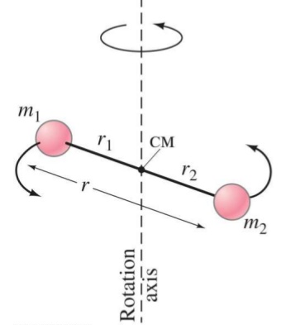
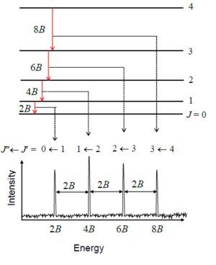
Molecular rotation (diatomic molecules)
Rigid rotor model
E_{int} = E_{ele} + E_{vib} + E_{rot}
A diatomic molecule can rotate around a vertical axis
rotational energy is quantized (at fixed R_{e}):
J : rotational quantum number =0,1,2,....
rotational constant
reduced mass
moment of inertia
Notes:
Simple model: vibrating spring that changes the distance from the equilibrium position Re. Atoms experience a force (Hook’s law) that is proportional to the displacement and tends to restore them at equilibrium.
This is a simple model
When exposed to light a molecule can absorb

Slide 26
Molecular rotation (diatomic molecules)
E_{int} = E_{ele} + E_{vib} + E_{rot}
Electronic ground state
Potential energy
rotational levels
Internuclear distance
The electric dipole moment of the molecules must change during the rotation → only molecules with permanent dipole moments (heteronuclear diatomics) are active (pure rotations)
Selection rule for light absorption/emission:
Notes:
Simple model: vibrating spring that changes the distance from the equilibrium position Re. Atoms experience a force (Hook’s law) that is proportional to the displacement and tends to restore them at equilibrium.
This is a simple model
When exposed to light a molecule can absorb

Slide 27
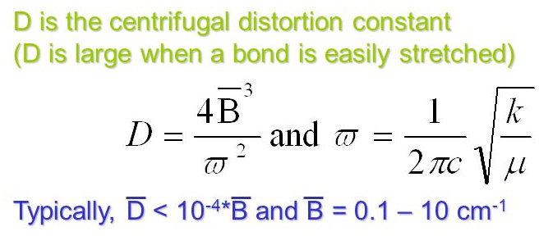
Molecular rotation (diatomic molecules)
Non rigid rotor model
account for bond vibrations (dynamic nature of the bond)
Selection rule for light absorption/emission:
with ΔJ=0 not always permitted
Notes:
Simple model: vibrating spring that changes the distance from the equilibrium position Re. Atoms experience a force (Hook’s law) that is proportional to the displacement and tends to restore them at equilibrium.
This is a simple model
When exposed to light a molecule can absorb

Slide 28
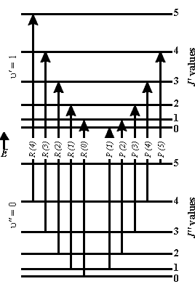
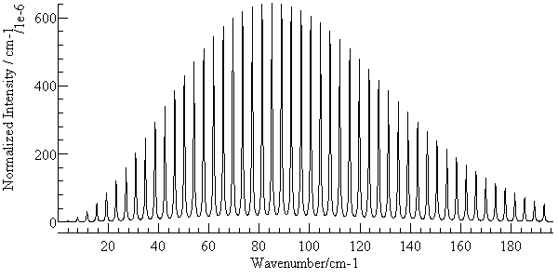
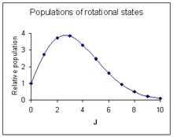
Effect of MW/IR radiation
molecular rotations
Rotational energy levels splittings are smaller than vibrational ones (∼0.1-10 cm⁻¹)
Absorption in the MW/far IR
splittings are much smaller (∼0.1 kJ/mol) than thermal energy so rotational levels above J=0 are significantly populated at T=280-290K
Notes:
Simple model: vibrating spring that changes the distance from the equilibrium position Re. Atoms experience a force (Hook’s law) that is proportional to the displacement and tends to restore them at equilibrium.
This is a simple model
When exposed to light a molecule can absorb

Slide 29
Exercise n. 2
An HCl molecule has a force constant of k=516 N m⁻¹. The reduced mass (μ) of HCl is 1.63×10⁻²⁷ kg. Calculate the fundamental vibrational frequency (ν_{vib}) and the corresponding wavenumber and wavelength.
In what region of the electromagnetic spectrum would the transition from v=0 to v=1 fall? (assume an hamonic oscillator)
Hint:

Slide 30
Exercise n. 2
An HCl molecule has a force constant of k=516 N m⁻¹. The reduced mass (μ) of HCl is 1.63×10⁻²⁷ kg. Calculate the fundamental vibrational frequency (ν_{vib}) and the corresponding wavenumber and wavelength.
In what region of the electromagnetic spectrum would the transition form v=0 to v=1 fall?
Solution: These values imply ω = 5.63 × 10¹⁴ s−1, ν = 89.5 THz (1 THz = 10¹² Hz), # = 2990 cm⁻¹, λ = 3.35 μm. These characteristics correspond to electromagnetic radiation in the infrared region

Slide 31
Vibration and rotations
Molecules can simultaneously rotate AND vibrate
Example: HF in the ground electronic state
Still a good approximation:
E_{int} = E_{ele}+E_{vib}+E_{rot}
Rotational level manifolds for different vibrational quanta overlap with each other
A possible ro-vibrational transition:
HF molecular constants
Notes:
Q branch is not possible in a biatomic due to the rotational selection rule on DeltaJ=+-1
The intensities of the lines are due to the relative population of the initial vibro-rotational state. High J states are state
Peaks are doublets due to the presence of two chlorine isotopes having different masses and hence values of the rorational constant

Slide 32
Vibration-rotation
Example: the vibro-rotational spectrum of HCl
R branch
P branch
Q branch
R branch
P branch
Notes:
Q branch is not possible in a biatomic due to the rotational selection rule on DeltaJ=+-1
The intensities of the lines are due to the relative population of the initial vibro-rotational state. High J states are state
Peaks are doublets due to the presence of two chlorine isotopes having different masses and hence values of the rorational constant

Slide 33
Electronic transitions (diatomics)
Electronic states of diatomic molecules are described by different quantum numbers:
Λ component of the total electronic angular momentum L along the internuclear axis
=0 → Σ
=1 → Π
=2 → Δ ...
electronic excited states
S total electron spin quantum number:
S =0, 1… for even electron numbers
S =1/2, 3/2… for odd electron numbers
dissociative
Spin multiplicity:
2S+1
S =0 → 2S+1=1 singlet
S=1/2 → 2S+1=2 doublet
S=1 → 2S+1=3 triplet
Potential energy
v=1
electronic ground state
singlet sigma state
v=0
Examples:
Internuclear distance
triplet delta state

Slide 34
Electronic transitions (diatomics)
Other quantum numbers:
Ω for some molecules
where Σ: vector component of S along the internuclear axis
g / u symbols (only for homonuclear molecules): inidicate sign change of the wavefunction for reflection through the center of the molecule (“g” no change; “u” change)
+ / - symbols (only for Σ states): parity of the wavefunction for reflection through a plane containing the two nuclei
List of allowed transitions
Selection rules:
But: not so clear-cut; “forbidden” transitions may occur with small probabilities
Notes:
Examples of allowed transitions are reported in the table on the left

Slide 35
Effect of VISIBLE radiation
electronic excitation
Valence electrons (in molecular orbitals) can be excited into orbitals at higher energies.
Spacing among electronic levels are larger than vibrational ones (>10⁴-10⁵ cm⁻¹)
Absorption in the VIS/UV
Molecules can undergo an ET upon absorption of VIS/UV photons
Simultaneous electr.+vibr.+ rot. transitions
Relaxed selection rules:
(no restrictions on Δv)
(but only for transitions among Ω=0 states)
Frank-Condon principle
Time for ET so short (∼10⁻¹⁵ s) that internuclear distance cannot change
«vertical» transitions
Notes:
S

Slide 36
Potential energy curves for electronic transitions
Type 1: bound-bound transitions
At room T → only v’’=0 is populated
Frank-Condon principle: the transition is vertical
Transition probability is proportional to the product of the vibrational wavefunctions of the initial and final states (maximum for maximum overlap):
CONTINUUM
STRUCTURED
Progression of vibrational bands
The most intense one is to the v’ for which the overlap is maximum
Transition to v’=4 in the upper electronic state is the most intense one

Slide 37
Potential energy curves for electronic transitions
Type 2: Bound-dissociative
No minimum in the PE (potential energy) curve of the upper electronic state(s)
Dissociation of the AB molecule occurs immediately after absorption of light
Dissociation can generate A and B in their ground or excited (A*) states
structureless spectrum

Slide 38
Potential energy curves for electronic transitions
More complex cases & predissociation
Mixed situation: some repulsive and some bound upper electronic states that «cross» each other
Example:
X = ground electr. state of AB molecule
E = bound excited state
R = repulsive state
Transitions to E (up to v’=2) give a structured spectrum
Transitions to E can lead to dissociation (into A+B) and structureless spectrum if cross over to R state occurs (predissociation)
If the photon energy is high enough transition to E can yield A + B* (continuum)

Slide 39
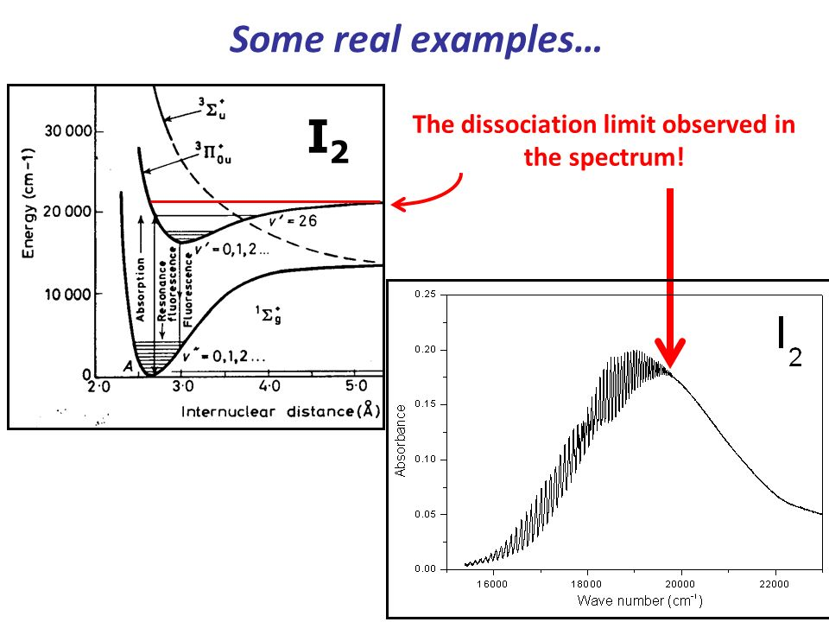
Electronic transitions (diatomics)

Slide 40
Polyatomic molecules: rotations
Similar concepts but spectra are much more complex!!
Rotations
(Up to) 3 different axes of rotation → different moment of inertia (I_{a}, I_{b}, I_{c}) → different rotational constant (A, B, C)
Notes:
Similar concepts but spectra are much more complex:
3 different rotation axes hence 3 different rotational constants, A, B, C
Molecules of n atoms will have 3n-6 vibrational degrees of freedom, 3n-5 in the special case of linear polyatomic. Give the example of H2O in which 3n-6=3 different vibration modes. Some or all of them will absorbe radiation + overtones (i.e. Delta v>1) or combination bands (i.e. absorption at an energy corresponding to the sum of two or more fundamental vibrations) are more likely than for diatomics

Slide 41
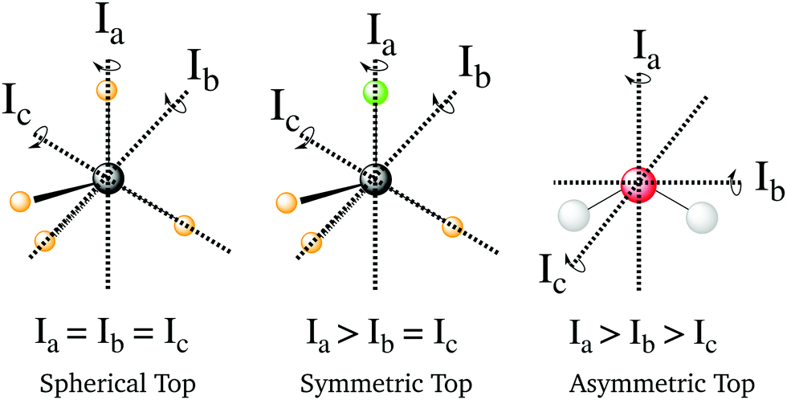
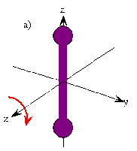
Polyatomic molecules: rotations
Classification of molecules on the basis of I_{a}, I_{b}, I_{c}
I_{a}=0, I_{b}=I_{c}
Linear molecules
Notes:
Similar concepts but spectra are much more complex:
3 different rotation axes hence 3 different rotational constants, A, B, C
Molecules of n atoms will have 3n-6 vibrational degrees of freedom, 3n-5 in the special case of linear polyatomic. Give the example of H2O in which 3n-6=3 different vibration modes. Some or all of them will absorbe radiation + overtones (i.e. Delta v>1) or combination bands (i.e. absorption at an energy corresponding to the sum of two or more fundamental vibrations) are more likely than for diatomics

Slide 42
Polyatomic molecules: rotations
Types of molecules
Notes:
Similar concepts but spectra are much more complex:
3 different rotation axes hence 3 different rotational constants, A, B, C
Molecules of n atoms will have 3n-6 vibrational degrees of freedom, 3n-5 in the special case of linear polyatomic. Give the example of H2O in which 3n-6=3 different vibration modes. Some or all of them will absorbe radiation + overtones (i.e. Delta v>1) or combination bands (i.e. absorption at an energy corresponding to the sum of two or more fundamental vibrations) are more likely than for diatomics

Slide 43
Polyatomic molecules: rotations
Selection rules
Linear molecules:
Must be asymmetric to have electric dipole moment. Symmetric ones are not MW active
Notes:
Similar concepts but spectra are much more complex:
3 different rotation axes hence 3 different rotational constants, A, B, C
Molecules of n atoms will have 3n-6 vibrational degrees of freedom, 3n-5 in the special case of linear polyatomic. Give the example of H2O in which 3n-6=3 different vibration modes. Some or all of them will absorbe radiation + overtones (i.e. Delta v>1) or combination bands (i.e. absorption at an energy corresponding to the sum of two or more fundamental vibrations) are more likely than for diatomics

Slide 44
Polyatomic molecules: vibrations
Vibrations
In polyatomic molecules any vibrational motion can be expressed as the superposition of a finite amount of normal vibrational modes, each having its own set of energy levels
Any molecule with n atoms has 3n degrees of freedoms (DOF):
Translational degrees of freedom = 3
  specify the motion of the CM (center of mass) of the molecule
Rotational DOF = 2 (if linear) or 3 (if non linear)
  Describe orientation of the molecule about its CM
Vibrational DOF = 3n – 5 (if linear) or 3n – 6 (if non linear)
  Describe relative position of the nuclei
Vibrational DOF (N_{vib}) represent the maximum number of normal vibrational modes of a molecule
Notes:
Similar concepts but spectra are much more complex:
3 different rotation axes hence 3 different rotational constants, A, B, C
Molecules of n atoms will have 3n-6 vibrational degrees of freedom, 3n-5 in the special case of linear polyatomic. Give the example of H2O in which 3n-6=3 different vibration modes. Some or all of them will absorbe radiation + overtones (i.e. Delta v>1) or combination bands (i.e. absorption at an energy corresponding to the sum of two or more fundamental vibrations) are more likely than for diatomics

Slide 45
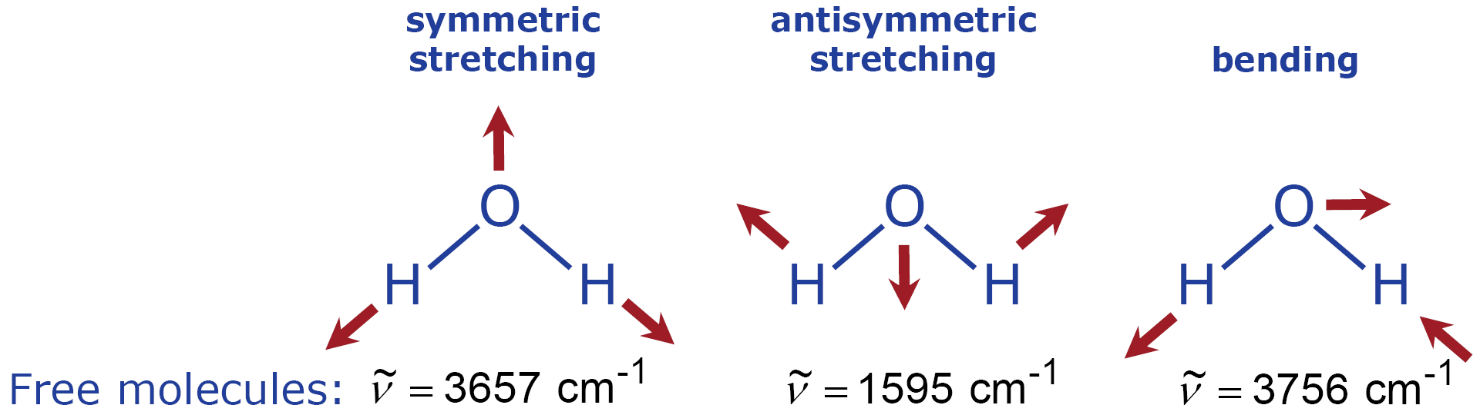
Polyatomic molecules: vibrations
Harmonic oscillator approx for polyatomic molecules
Motion of a polyatomic molecule: approximated as the motion of N_{vib} harmonic ooscillators, each having a fundamental frequency ν_{i} (with i=1... N_{vib}) ⇒ normal vibrational modes
Example: a non linear triatomic molecule has Nvib=3 and the vibrational states are represented by (ν₁, ν₂, ν₃)
H₂O n=3 has 3x3-6=3 different vibrational modes, N_{vib}=3
bending
antisymmetric
stretching
₁
₂
₃
=2.74 μm
=6.25 μm
=2.66 μm
Notes:
Similar concepts but spectra are much more complex:
3 different rotation axes hence 3 different rotational constants, A, B, C
Molecules of n atoms will have 3n-6 vibrational degrees of freedom, 3n-5 in the special case of linear polyatomic. Give the example of H2O in which 3n-6=3 different vibration modes. Some or all of them will absorbe radiation + overtones (i.e. Delta v>1) or combination bands (i.e. absorption at an energy corresponding to the sum of two or more fundamental vibrations) are more likely than for diatomics

Slide 46
Polyatomic molecules: vibrations
Numbering (identification) convention of vibrational modes
Notes:
Similar concepts but spectra are much more complex:
3 different rotation axes hence 3 different rotational constants, A, B, C
Molecules of n atoms will have 3n-6 vibrational degrees of freedom, 3n-5 in the special case of linear polyatomic. Give the example of H2O in which 3n-6=3 different vibration modes. Some or all of them will absorbe radiation + overtones (i.e. Delta v>1) or combination bands (i.e. absorption at an energy corresponding to the sum of two or more fundamental vibrations) are more likely than for diatomics

Slide 47
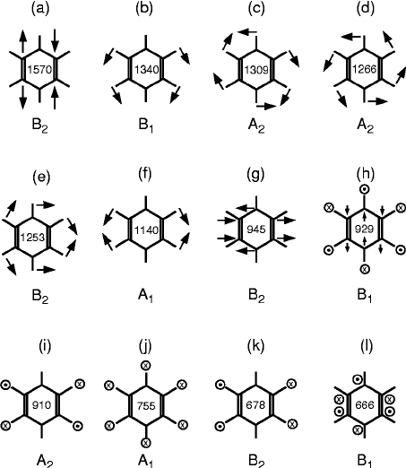
Polyatomic molecules: vibrations
Example 2: C₆H₆ n=12 has
3x12-6=30 different vibrational modes (only 6 are shown in the figure), N_{vib}=30
Selection rule for pure vibrational transitions
If dipole moment does NOT change during normal mode motion ⇒ that normal mode is IR inactive
The number of IR active normal modes determine the number of absorption bands in the IR spectrum

Slide 48
Polyatomic molecules: vibrations
Types of bands
In H₂O all the normal vibrational modes are IR active

Slide 49
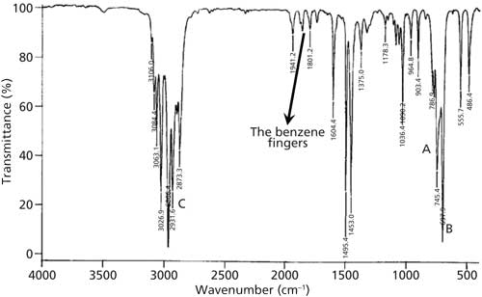
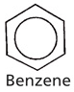
Spectra of polyatomic molecules
Complexity of the absorption spectrum increases very quickly with n
New types of bands become possible:
Sequence bands: one vibration excited while maintaining excitation in another vibration (allowed) e.g.
Combination bands: two different vibrations excited simultaneously (forbidden in harm. approximation)
Overtone bands: (like in diatomics, forbidden in harmonic approx.)
overtone bands (the benzene fingers)

Slide 50
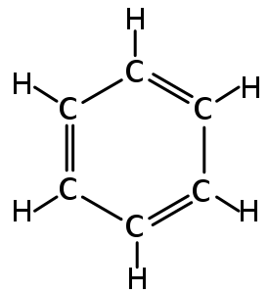
Exercise n. 3
Benzene (C₆H₆) is an atmospheric pollutant emitted from vehicle exhausts and other combustion and industrial processes. It has the structure shown here. Calculate the number of vibrational modes possible for benzene and determine what type of rigid rotor (spherical, symmetric top, asymmetric top) it can be approximated with
Hint:
Since it is NOT a linear molecule the number of vibrational modes is given by 3n-6

Slide 51
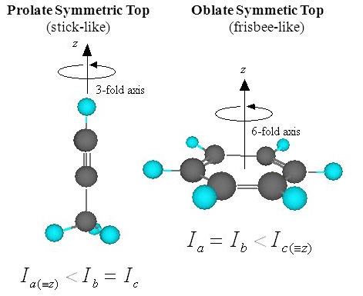
Exercise n. 3
Benzene (C₆H₆) is an atmospheric pollutant emitted from vehicle exhausts and other combustion and industrial processes. It has the structure shown here. Calculate the number of vibrational modes possible for benzene and determine what type of rigid rotor (spherical, symmetric top, asymmetric top) it can be approximated with.
Solution: 3n-6=3x12-6=30 (possible vibrational frequencies). The molecule does NOT have a dipole moment, so only some of those frequencies will be IR active (those generating a dipole moment during the vibration).
Benzene has only two different moment of inertia (since the third one is equal to one of the two others) and therefore is a symmetric top rotor. In particular it is an oblate symmetric top (i.e. it rotates like a frisbee)
Oblate symmetric top rotors: A=B<C
Prolate symmetric top rotors: A<B=C

Slide 52
The IR spectrum of H₂O
H₂O is a strongly
asymmetric top:
A = 27.9 cm-1
B = 14.5 cm-1
C = 9.3 cm-1
Overtone and
combination
bands are
relatively intense
(only selected
bands shown in
the graph)
Overtones
Combination bands
e.g.
Notes:
Similar concepts but spectra are much more complex:
3 different rotation axes hence 3 different rotational constants, A, B, C
Molecules of n atoms will have 3n-6 vibrational degrees of freedom, 3n-5 in the special case of linear polyatomic. Give the example of H2O in which 3n-6=3 different vibration modes. Some or all of them will absorbe radiation + overtones (i.e. Delta v>1) or combination bands (i.e. absorption at an energy corresponding to the sum of two or more fundamental vibrations) are more likely than for diatomics
Show an IR spectrum of H2O vapour in the region 1300-4000 cm-1 to have an idea of the complexity

Slide 53
The IR spectrum of H₂O
Combination band in the vibrational spectrum of H₂O
ν₁+ν₃ combination band – a pure vibrational transition
No obvious pattern in the spectrum (this is very
typical for asymmetric
tops)
Notes:
Show an IR spectrum of H2O vapour in the region 1300-4000 cm-1 to have an idea of the complexity

Slide 54
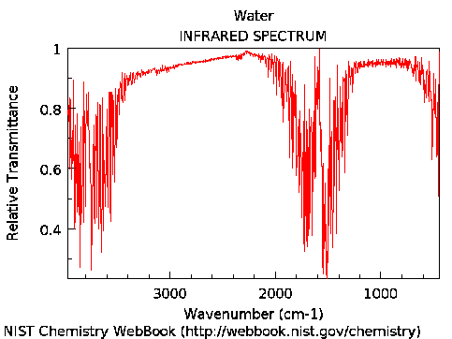
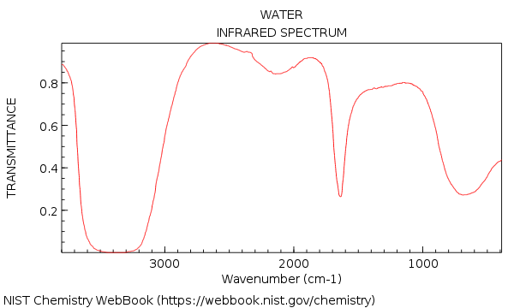
The IR spectrum of H₂O
Gas phase
ν₁
ν₃
ν₂
Liquid phase
Notes:
Show an IR spectrum of H2O vapour in the region 1300-4000 cm-1 to have an idea of the complexity

Slide 55
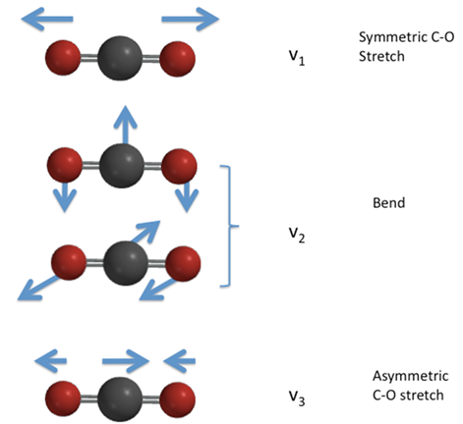
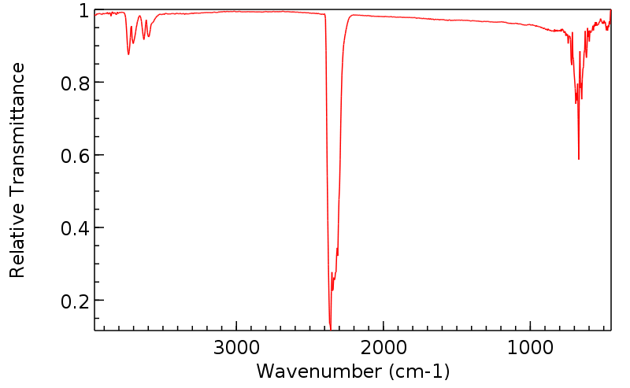
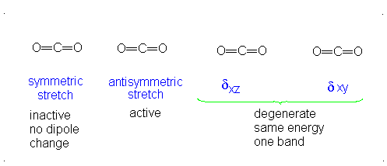
The IR spectrum of CO₂
CO₂ (n=3) hence 3x3-5=4 normal vibr. modes (of which 2 are degenerate, the ν₂ )
ν₁=7.5 μm
IR inactive
CO₂ has no permanent electric dipole moment (μ=0) for fixed atoms.
ν₂ and ν₃ vibrational modes: IR actives (a dipole moment is generated that changes during the vibration)
ν₁ mode: IR inactive (no dipole moment is generated during the vibration)
ν₂=15 μm
ν₃=4.3 μm
overtones/
combinations
Notes:
v3 fundamental in CO2 is a parallel band (dipole moment oscillates parallel to the symmetry axis) and it is the strongest vibrational band-> DJ =0 is forbidden (no Q branch)
v2 fundamental in CO2 is a perpend band (dipole moment oscillates perpend to the symmetry axis) and it has P, Q and R branches but it is less intense.
However it is mot effective for grenhouse effect due to the better matching of vibrational frequences with solar and terrestrial Planck emission functions
See:
https://slideplayer.com/slide/5151101/

Slide 56
Polyatomic molecules: vibrations
Types of bands
In CO₂ one normal vibrational modes are IR active

Slide 57
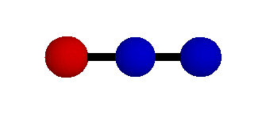

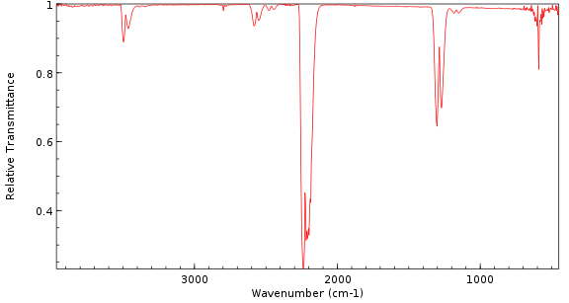
The IR spectrum of N₂O (nitrous oxide)
N₂O (n=3) hence 3x3-5=4 normal vibrational modes (of which 2 are degenerate, the ν₂)
symmetric stretch
ν₁ = 1298.3 cm⁻¹
= 7.8 μm
N₂O has a permanent electric dipole moment (μ≠0)
All ν₁ ,ν₂ and ν₃ vibrational modes are IR actives due to the presence of changes in the dipole moment during the vibrations
bending
ν₂ = 596.3 cm⁻¹
= 17 μm
asymmetric stretch
ν ₃ = 2282.2 cm⁻¹
= 4.5 μm
ν₂
overtones/
combinations
ν₁
ν₃
Notes:
Similar concepts but spectra are much more complex:
3 different rotation axes hence 3 different rotational constants, A, B, C
Molecules of n atoms will have 3n-6 vibrational degrees of freedom, 3n-5 in the special case of linear polyatomic. Give the example of H2O in which 3n-6=3 different vibration modes. Some or all of them will absorbe radiation + overtones (i.e. Delta v>1) or combination bands (i.e. absorption at an energy corresponding to the sum of two or more fundamental vibrations) are more likely than for diatomics
Show an IR spectrum of H2O vapour in the region 1300-4000 cm-1 to have an idea of the complexity

Slide 58
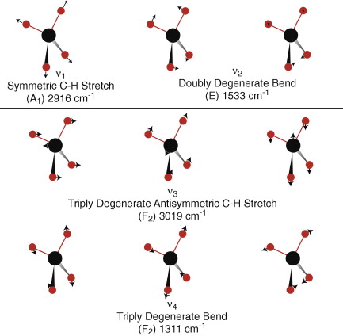
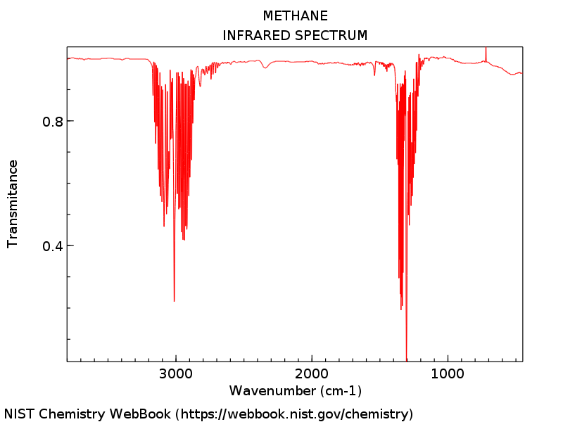
The IR spectrum of CH₄
CH₄ (n=5) hence 3x5-6=9 normal vibrational modes. The highly symmetric shape of CH₄ means that some modes are degenerate (only 4 different frequencies ν)
Due to the absence of permanent electric dipole moment some modes are IR inactive.
The active modes are:
inactive
inactive
asymmetric C-H stretch
ν₃= 3019 cm⁻¹
= 3.3 μm
bending
ν₄ = 1306 cm⁻¹
= 7.6 μm
IR active
IR active
ν₄
ν₃
See the vibrational mode movie: https://www.chem.purdue.edu/jmol/vibs/ch4.html
Notes:
The highly symmetric shape of the methane means that only two of the vibrational modes depicted below interact directly with infrared light (o₃ and o₄ -- the ones where the carbon and hydrogen both move), and these modes are the most likely to absorb or scatter infrared heat radiation from the Earth before it can escape to space. The normal modes depicted below were modeled using hybrid density functional theory (B3LYP) and the cc-pVTZ basis set. Harmonic frequencies calculated by Gray and Robiette (1979, Mol. Phys. 37:1901-1920) are also shown. These are based on a force-field model fitted to spectroscopic measurements.

Slide 59
The IR spectrum of CH₄
See the vibrational mode movies at the following pages:
https://www.chem.purdue.edu/jmol/vibs/ch4.html
http://www2.ess.ucla.edu/~schauble/MoleculeHTML/CH4_html/CH4_page.html
Notes:
ARRIVATA QUI il 7 ottobre 2022

Slide 60
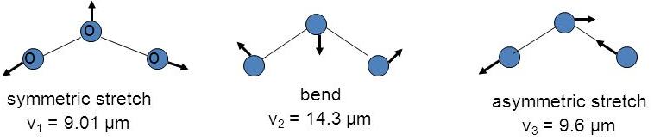
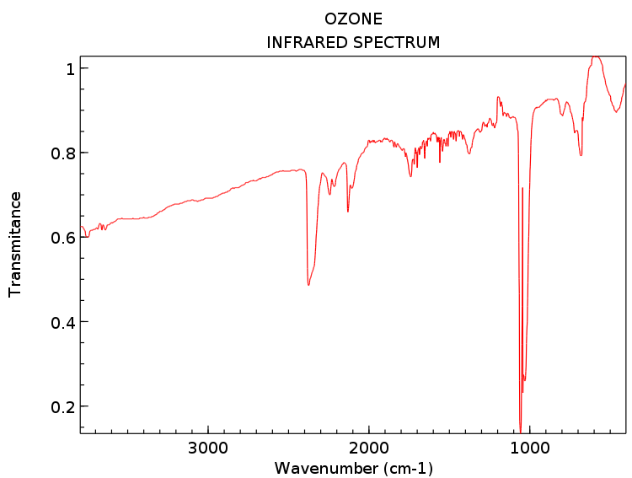
The IR spectrum of O₃
O₃ (n=3) hence 3x3-6=3 normal vibrational modes (non linear triatomic - asymm. top similar to H₂O). All modes are IR active
symmetric stretch
ν₁= 1103 cm⁻¹
= 9.01 μm
bending
ν₂= 701 cm⁻¹
= 14.3 μm
asymmetric stretch
ν₃= 1042 cm⁻¹
= 9.6 μm
ν₂
ν₁ and ν₃ are both strong and close in frequency
impurities
overtones/
combinations
ν₁
ν₃

Slide 61
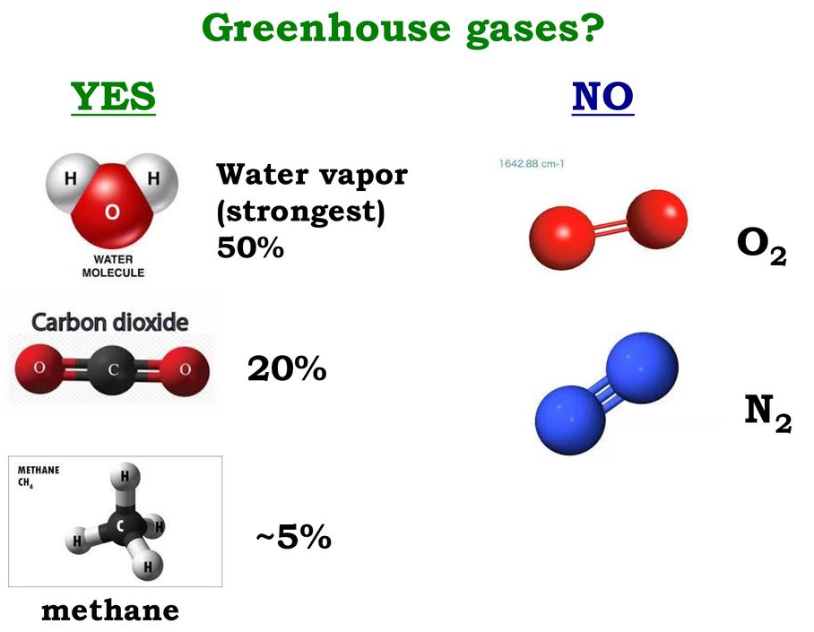
Spectroscopy and greenhouse potential

Slide 62
Effect of UV radiation
ionization
dissociation
Direct exposure of organisms (animals and vegetals) to UV can have serious fisiological and biological effects due to damages to biomolecules (e.g. DNA) caused by photons with λ<400 nm
UV radiations diveded in:
UV-A 400-320 nm
UV-B 320-290 nm
UV-C 290-200 nm

Slide 63
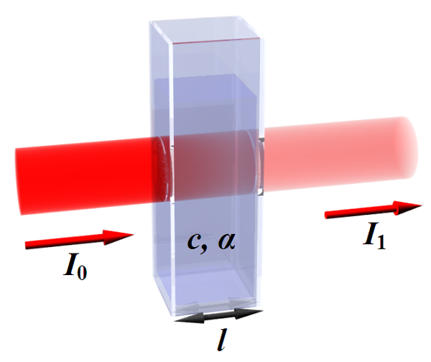

Light absorption: Lambert-Beer law
Sample (length l and concentration c)
light source
c, ε
Transmitted monocromatic flux (λ)
Incident monocromatic radiation flux (λ)
Transmittance T (%) = 100 ⋅ I₁ / I₀
Absorbance A = -log(T/100)=-log(I₁/I₀) = log(I₀/I₁)
«Log» is base 10 logarithm
Notes:
A parallel monocromatic light beam of wavenght l and intensity I0 passes through a sample of length l containing an absorber at a certain concentration c. If light at this wavlenght is absorbet there will be an attenuation in the light transmitted through the sample. We can define the transmittance and the absorbance.
As light passes through the sample it will undergo a reduction in intensity that is proportional to the path lenght where the absorbing molecules are.
For most tropospheric situatuation LB law can be considered valid. But pay attention when measurements arte done in the lab.
Deviations are possible at high concentrations (A>1) due to:
1. fenomeni chimici dipendenti dalla concentrazione (dissociazioni, associazioni, reazioni delle molecole assorbenti)
2. presenza di particellato in soluzione
3. effetti strumentali: radiazione non-monocromatica, luce dispersa, fluttuazioni in intensità della sorgente….

Slide 64
Light absorption: Lambert-Beer law
The intensity of the radiation absorbed by the sample is given by the Lambert-Beer law:
α =costant
c= sample concentration
l = path length
c, ε
Hence the absorbance (A) can be expressed as:
ε= α/2.303 molar extintion (or absorptivity) coefficient
in mole/cm³
in cm²·mole⁻¹
optical depth τ
What units for ?
in cm
(A is dimensionless)
in molecule/cm³
in cm²·molecule⁻¹
σ: absorption cross section
Notes:
The LB law allows the calculation of the decay in intensity of a light beam due to absorption by the molecules in a medium
A parallel monocromatic light beam of wavenght l and intensity I0 passes through a sample of length l containing an absorber at a certain concentration c. If light at this wavlenght is absorbet there will be an attenuation in the light transmitted through the sample. We can define the transmittance and the absorbance.
As light passes through the sample it will undergo a reduction in intensity that is proportional to the path lenght where the absorbing molecules are.
For most tropospheric situatuation LB law can be considered valid. But pay attention when measurements arte done in the lab.
Deviations are possible at high concentrations (A>1) due to:
1. fenomeni chimici dipendenti dalla concentrazione (dissociazioni, associazioni, reazioni delle molecole assorbenti)
2. presenza di particellato in soluzione
3. effetti strumentali: radiazione non-monocromatica, luce dispersa, fluttuazioni in intensità della sorgente….

Slide 65
Physical interpretation of σ
Notes:
A parallel monocromatic light beam of wavenght l and intensity I0 passes through a sample of length l containing an absorber at a certain concentration c. If light at this wavlenght is absorbet there will be an attenuation in the light transmitted through the sample. We can define the transmittance and the absorbance.
As light passes through the sample it will undergo a reduction in intensity that is proportional to the path lenght where the absorbing molecules are.
For most tropospheric situatuation LB law can be considered valid. But pay attention when measurements arte done in the lab.
Deviations are possible at high concentrations (A>1) due to:
1. fenomeni chimici dipendenti dalla concentrazione (dissociazioni, associazioni, reazioni delle molecole assorbenti)
2. presenza di particellato in soluzione
3. effetti strumentali: radiazione non-monocromatica, luce dispersa, fluttuazioni in intensità della sorgente….

Slide 66
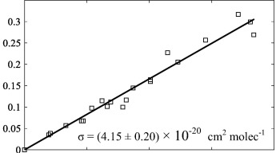
Measurement of absorption cross sections
The measurement of σ is, in principle, trivial and it requires: a light source (e.g. lamp), a cell to contain the molecule of interest, a spectral filter (monochromator), a detector (sensitive and with linear response to the intensity of the radiation at the frequency of interest)
Measurements are repeated for several concentrations at each wavelength of interest
log(I₀/I)
The absorption cross section (σ) is obtained from the slope of the linear best fit of data
slope = σ
concentration*path length (molec·cm⁻²)
Non trivial: measurements are difficult because of impurities, especially when σ are very small (<10⁻²⁰ cm^{2·}molec⁻¹)
Notes:
The LB law allows the calculation of the decay in intensity of a light beam due to absorption by the molecules in a medium
A parallel monocromatic light beam of wavenght l and intensity I0 passes through a sample of length l containing an absorber at a certain concentration c. If light at this wavlenght is absorbet there will be an attenuation in the light transmitted through the sample. We can define the transmittance and the absorbance.
As light passes through the sample it will undergo a reduction in intensity that is proportional to the path lenght where the absorbing molecules are.
For most tropospheric situatuation LB law can be considered valid. But pay attention when measurements arte done in the lab.
Deviations are possible at high concentrations (A>1) due to:
1. fenomeni chimici dipendenti dalla concentrazione (dissociazioni, associazioni, reazioni delle molecole assorbenti)
2. presenza di particellato in soluzione
3. effetti strumentali: radiazione non-monocromatica, luce dispersa, fluttuazioni in intensità della sorgente….

Slide 67
Justification of Lambert-Beer law
If you need more details....
Notes:
A parallel monocromatic light beam of wavenght l and intensity I0 passes through a sample of length l containing an absorber at a certain concentration c. If light at this wavlenght is absorbet there will be an attenuation in the light transmitted through the sample. We can define the transmittance and the absorbance.
As light passes through the sample it will undergo a reduction in intensity that is proportional to the path lenght where the absorbing molecules are.
For most tropospheric situatuation LB law can be considered valid. But pay attention when measurements arte done in the lab.
Deviations are possible at high concentrations (A>1) due to:
1. fenomeni chimici dipendenti dalla concentrazione (dissociazioni, associazioni, reazioni delle molecole assorbenti)
2. presenza di particellato in soluzione
3. effetti strumentali: radiazione non-monocromatica, luce dispersa, fluttuazioni in intensità della sorgente….

Slide 68
Exercise n. 4
A sample at 25 °C contains 1 Torr of molecules of interest with absorption cross section σ=3x10⁻²¹ cm²⋅molec⁻¹ and 1 mTorr of impurity with σ=2x10⁻¹⁸ cm²⋅molec⁻¹.
What is the total absorbance assuming a path length of 50 cm?
Hint: It requires the application of the Lamber-Beer’s law:

Slide 69
Exercise n. 4
A sample at 25 °C contains 1 Torr of molecules of interest with absorption cross section σ=3x10⁻²¹ cm²⋅molec⁻¹ and 1 mTorr of impurity with σ=2x10⁻¹⁸ cm²⋅molec⁻¹.
What is the total absorbance assuming a path length of 50 cm?
Solution: It requires the application of the Lamber-Beer’s law:
Since there are two absorbing species with different σ and concentrations, they both contribute to the absorbance in the following way:
Where c₁ and c₂ are the density of sample and impurity (in molecules⋅cm⁻³) and the temperature is T=298K

Slide 70

Light absorption in the atmosphere
Intensity of solar radiation (SW) reaching a certain region of the atmosphere (or Earth’s surface) depends on:
nature of the gas/particles present in the atmopshere
their concentrations
path length
Approximate regions of maximum light absorption in the atmosphere
Only radiation with λ>290 nm penetrates in the troposphere, shorther λ are attenuated by absorption (from O₂, N₂, O₃)
Notes:
The fig on the left is the altitude corresponding to maximum light absorption by the indicated species

Slide 71
Absorption spectra of O₂
Schumann-Runge continuum
Schumann-Runge bands
O₂ absorbs strongly in the 120-175 nm region, the Schumann-Runge continuum (occurring in the thermosphere)
and in the Schumann-Runge bands, 175-205 nm (occurring in the mesosphere and upper stratosphere)
A number of overlapping features are present in the 200-245 nm (Herzberg continuum), but quite weak
Notes:
0 2 absorbs strongly in the 100-175 nm region, the Schumann-Runge continuum, and attenuates this radiation in the thermosphere
(ie., at altitudes above 80 km). Absorption by O2 in the Schumann-Runge bands, 175-205 nm, occurs predominantly in the mesosphere and upper
stratosphere. Because of the structured nature of these absorption bands, wavelengths near band minima penetrate deeper into the stratosphere than wavelengths near band maxima. O2 also possesses a number of overlapping absorption features in the 200-245 nm, collectively known as the Herzberg continuum. However, these bands are quite weak, and ozone becomes the dominant attenuator of incoming solar radiation in the 210-300 nm region.

Slide 72

Absorption spectra of O₂
Potential energy curves for ground and excited states of O₂
X-B transition: Schumann-Runge (120-205 nm)
continuum due to dissociation of B state in O(³P)+ O(¹D)
X-A forbidden transition (-/+): Herzberg
continuum (190-300 nm) weak absorption
X-a and X-b are forbidden due to spin (triplet→singlet)
Notes:
To understand the origin of the absorption bands in O2 we need to understand from what transitions they come from
The fact that the lowest excited levels

Slide 73
Absorption spectra of O₃
Hartley band
Huggins bands
Chappuis band
O₃ absorbs strongly in the 200-300 nm region (the Hartley band). Stratospheric O₃ is responsible for the cut-off of UV solar radiation in the troposphere (λ<290).
Huggins bands (300-360 nm) and Chappuis bands (440-850 nm) are much weaker
Notes:
The strongest absorption, in the 200- to 300-nm region, is known as the Hartley bands. It is this absorption
that is responsible for the so-called "actinic cutoff"

Slide 74


Dependence on the path length
Solar zenith angle (SZA)
θ: the angle between the local normal to Earth’s surface on a point and a line between that point and the sun
SZA changes with:
time of day
latitude
time of year
Dependence on time of day
Notes:
Aside form the altitude, the path length through the atmosphere critically depends on the time of day and geographical location. Path length can be calculated using the flat atmosphere approximation for zenith angles under 80º. Beyond that, Earth curvature and atmospheric refraction start to matter.
We define the solar zenith angle θs as the angle between the local normal to Earth's surface and a line between a point on Earth's surface and the sun. See more at:
http://www.atmos.albany.edu/facstaff/brose/classes/ATM623_Spring2015/Notes/Lectures/Lecture11%20--%20Insolation.html
http://www.cotf.edu/ete/modules/ozone/ozatmo.html
The sun's angle from the vertical or solar zenith angle, is determined by the latitude, time of year, and time of day. In the Northern Hemisphere, the sun shines directly overhead at noon at the Tropic of Cancer on the first day of summer, at the equator on the first day of spring and autumn, and directly overhead at the Tropic of Capricorn on the first day of the winter.

Slide 75

Solar zenith angle (SZA)
Dependence on latitude and time of year
In the Northern Hemisphere, the sun shines directly overhead at noon at the Tropic of Cancer on the first day of summer, at the equator on the first day of spring and autumn, and directly overhead at the Tropic of Capricorn on the first day of the winter.
Notes:
We define the solar zenith angle θs as the angle between the local normal to Earth's surface and a line between a point on Earth's surface and the sun.
See more at:
http://www.atmos.albany.edu/facstaff/brose/classes/ATM623_Spring2015/Notes/Lectures/Lecture11%20--%20Insolation.html
http://www.cotf.edu/ete/modules/ozone/ozatmo.html
The sun's angle from the vertical or solar zenith angle, is determined by the latitude, time of year, and time of day.

Slide 76

SZA and air mass (m or A.M.)
“Flat earth” approximation for L (path length of direct solar radiation traveling through the atmosphere to a fixed point on the surface):
only for θ<60°
where h: length of vertical path through the atmosphere
Air mass (AM)
In some textbooks the air mass is indicated with m
Notes:
The path length L for direct solar radiation traveling through the earth's atmosphere to a fixed point on the earth's surface can be estimated geometrically using this Fig. This "flat earth" approximation is accurate for zenith angles < 60 ~ One can approximate L using cos(theta) = h/L
A common term used to express the path length traversed by solar radiation to reach the earth's surface is the air mass, m, defined as
With reference to Fig. 3.14, for zenith angles less than 60 ~ , m ~- L / h ~- sec 0. (W)
At larger angles, corrections for curvature of the atmosphere and refraction must be made to L and m.

Slide 77
Concentrations
Column density S of a gas in atmosphere: integral of the number density along a certain path
The unit of measure for S_{n} is molecules/cm²
It can also be defined in terms of concentrations expressed in mass per volume (mass mixing ratio)
The unit of measure for S_{m} is μg/cm²
Frequently used path: the total (vertical) atmospheric column density V:
integrated vertically from the surface to infinity (or TOA)
Notes:
What about concentrations of gases (in particular trace gases?). We have said that they change according to the altitude (due to changes in T and P)
Infact a useful category for specifying trace gas abundances is the column density S, which is defined as the integral of the number density along a certain path in the atmosphere:
The unit of Sn, and column densities in general, is molecules per cm2. In analogy to the mass mixing ratio cm, the mass column density Sm can be
defined as:

Slide 78


Slide 79
Total IR absorption spectrum for the atmosphere
Notes:
Blackbody spectra representative of the sun (left) and the Earth (right). The wavelength scale is logarithmic rather
than linear as in Fig. 4.6, and the ordinate has been multiplied by wavelength in order to retain the proportionality between
areas under the curve and intensity. In addition, the intensity scales for the two curves have been scaled to make the areas under
the two curves the same; (b) Spectrum of monochromatic absorptivity of the part of the atmosphere that lies above the 11-km
level; (c) spectrum of monochromatic absorptivity of the entire atmosphere

Slide 80
The IR spectrum of CO₂
CO₂ (n=3) hence 3x3-5=4 normal vibr. modes (of which 2 are degenerate, the ν₂ )
ν₁=7.5 μm
IR inactive
CO₂ has no permanent electric dipole moment (μ=0) for fixed atoms.
ν₂ and ν₃ vibrational modes: IR actives (a dipole moment is generated that changes during the vibration)
ν₁ mode: IR inactive (no dipole moment is generated during the vibration)
ν₂=15 μm
ν₃=4.3 μm
overtones/
combinations
Notes:
v3 fundamental in CO2 is a parallel band (dipole moment oscillates parallel to the symmetry axis) and it is the strongest vibrational band-> DJ =0 is forbidden (no Q branch)
v2 fundamental in CO2 is a perpend band (dipole moment oscillates perpend to the symmetry axis) and it has P, Q and R branches but it is less intense.
However it is mot effective for grenhouse effect due to the better matching of vibrational frequences with solar and terrestrial Planck emission functions
See:
https://slideplayer.com/slide/5151101/

Slide 81


The IR absorption spectrum of CO₂ in atmosphere
ν₃
ν₂
The ν₂ fundamental in CO₂ is weaker than the ν₃ but it is most active in atmosphere due to the better matching of its vibrational frequency with solar and terrestrial Planck emission functions

Slide 82
The IR spectrum of N₂O (nitrous oxide)
N₂O (n=3) hence 3x3-5=4 normal vibrational modes (of which 2 are degenerate, the ν₂)
symmetric stretch
ν₁ = 1298.3 cm⁻¹
= 7.8 μm
N₂O has a permanent electric dipole moment (μ≠0)
All ν₁ ,ν₂ and ν₃ vibrational modes are IR actives due to the presence of changes in the dipole moment during the vibrations
bending
ν₂ = 596.3 cm⁻¹
= 17 μm
asymmetric stretch
ν ₃ = 2282.2 cm⁻¹
= 4.5 μm
ν₂
overtones/
combinations
ν₁
ν₃
Notes:
Similar concepts but spectra are much more complex:
3 different rotation axes hence 3 different rotational constants, A, B, C
Molecules of n atoms will have 3n-6 vibrational degrees of freedom, 3n-5 in the special case of linear polyatomic. Give the example of H2O in which 3n-6=3 different vibration modes. Some or all of them will absorbe radiation + overtones (i.e. Delta v>1) or combination bands (i.e. absorption at an energy corresponding to the sum of two or more fundamental vibrations) are more likely than for diatomics
Show an IR spectrum of H2O vapour in the region 1300-4000 cm-1 to have an idea of the complexity

Slide 83

The IR absorption spectrum of N₂O in atmosphere
The ν₁ fundamental at 7.8 μm adds up to the 7.6 μm from CH₄ and broadens and strengthens absorption in this region
As for CO₂, the ν₃ at 4.5 μm is less significant because at the edge of the Planck functions (for both Sun and Earth)

Slide 84
The IR spectrum of CH₄
CH₄ (n=5) hence 3x5-6=9 normal vibrational modes. The highly symmetric shape of CH₄ means that some modes are degenerate (only 4 different frequencies ν)
Due to the absence of permanent electric dipole moment some modes are IR inactive.
The active modes are:
inactive
inactive
asymmetric C-H stretch
ν₃= 3019 cm⁻¹
= 3.3 μm
bending
ν₄ = 1306 cm⁻¹
= 7.6 μm
IR active
IR active
ν₄
ν₃
See the vibrational mode movie: https://www.chem.purdue.edu/jmol/vibs/ch4.html
Notes:
The highly symmetric shape of the methane means that only two of the vibrational modes depicted below interact directly with infrared light (o₃ and o₄ -- the ones where the carbon and hydrogen both move), and these modes are the most likely to absorb or scatter infrared heat radiation from the Earth before it can escape to space. The normal modes depicted below were modeled using hybrid density functional theory (B3LYP) and the cc-pVTZ basis set. Harmonic frequencies calculated by Gray and Robiette (1979, Mol. Phys. 37:1901-1920) are also shown. These are based on a force-field model fitted to spectroscopic measurements.

Slide 85

IR absorption spectrum of CH₄ in atmosphere
3.3 μm
7.6 μm
Both ν₃ and ν₄ are relevant

Slide 86
The IR spectrum of O₃
O₃ (n=3) hence 3x3-6=3 normal vibrational modes (non linear triatomic - asymm. top similar to H₂O). All modes are IR active
symmetric stretch
ν₁= 1103 cm⁻¹
= 9.01 μm
bending
ν₂= 701 cm⁻¹
= 14.3 μm
asymmetric stretch
ν₃= 1042 cm⁻¹
= 9.6 μm
ν₂
ν₁ and ν₃ are both strong and close in frequency
impurities
overtones/
combinations
ν₁
ν₃

Slide 87

IR absorption spectrum of O₃ in atmosphere
The ν₂ fundamental at 14.3 μm is masked by the 15 μm CO₂ band.
ν₁ and ν₃ are both strong and close in frequency, often seen as one band at 9.6 μm
The 9.6 μm band sits in the middle of 8-12 μm H₂O window and near peak of the Earth’s Planck function
Quite strong 4.7 μm band but near edge of Planck functions

Slide 88
The IR spectrum of H₂O
ν₂
Gas phase
ν₃
ν₁
Notes:
Show an IR spectrum of H2O vapour in the region 1300-4000 cm-1 to have an idea of the complexity

Slide 89

The IR absorption spectrum of H₂O in atmosphere
All three fundamentals give strong contribution (saturation) + overtones and combinations. Absorption at λ > 10-15 μm is due to pure rotational spectrum

Slide 90
Bibliography on atomic and molecular spectroscopy
General text on molecular spectroscopy:
P. Atkins & J. de Paula “Atkins’ Physical Chemistry” ed. 8th (or any other edition) – Section Structure
–Molecular spectroscopy 1: rotational and vibrational spectra
–Molecular spectroscopy 2: electronic transitions
More specific texts:
G. Herzberg, “Atomic spectra and atomic structure” 1944
G. Herzberg, “Molecular Spectra and Molecular Structure” 3 book series (1939-1950)
  I. Spectra of diatomic molecules
  II. IR and Raman spectra of polyatomic molecules
  III. Electronic spectra and electronic structure of polyatomic molecules
J.M. Hollas, Modern Spectroscopy, Wiley 2004

Slide 92
Measurements techniques for atmospheric gases
Spectroscopic techniques are a powerful variety:
highly sensitive
very specific
universally usable
give absolute results
potential for remote sensing

Slide 93
Spectroscopic techniques for chemical analysis
Notes:
The product rho times s is the total amount of absorber along the light path, hence the measure gives also the total n. of molecules
Far vedere tecniche di spettroscopia utilizzate per remote sensing tipo Differential Optical Absorption Spectroscopy (DOAS) http://www.iup.uni-bremen.de/doas/doas_tutorial.htm

Slide 94
Spectroscopic techniques for chemical analysis
Notes:
The product rho times s is the total amount of absorber along the light path, hence the measure gives also the total n. of molecules
Far vedere tecniche di spettroscopia utilizzate per remote sensing tipo Differential Optical Absorption Spectroscopy (DOAS) http://www.iup.uni-bremen.de/doas/doas_tutorial.htm

Slide 95
Spectroscopic techniques for chemical analysis
Frequency range
IR spectroscopy
UV/VIS absorption spectroscopy
Spectroscopic technique/instruments

Slide 96

Spectroscopic techniques for chemical analysis: DOAS
The Differential Optical Absorption Spectroscopy (DOAS):
a method to determine the concentrations of atmospheric trace gases from remote sensing measurements of light in the UV, visible, and NIR spectral range.
Absorption spectroscopy: light travelling through the atmosphere is partly absorbed by trace constituents along the way following Lambert Beer's law of absorption
: intensity at the end of a light path
: absorption strength of the species of interest at wavelength λ
: initial intensity
s: length of the light path
: concentration of the absorber
: total amount of the absorber along the light path
Notes:
The product rho times s is the total amount of absorber along the light path, hence the measure gives also the total n. of molecules
Far vedere tecniche di spettroscopia utilizzate per remote sensing tipo Differential Optical Absorption Spectroscopy (DOAS) http://www.iup.uni-bremen.de/doas/doas_tutorial.htm

Slide 97

Application to remote sensing: DOAS
The Absorption cross section:
The ability to absorb photons (at various λ) can be determined in the lab. It usually depends on T and often also on pressure which has to be taken into account in the data analysis.
Example:
NO₂ overall absorption cross section and highlight of the region used for NO₂ retrieval (inset). Only the rapidly changing features in the spectrum are used.
Why?
to avoid problems with extinction by scattering or changes in the instrument throughput, only signals that vary rapidly with wavelength are analysed (thus the differential in DOAS)
Notes:
The product rho times s is the total amount of absorber along the light path, hence the measure gives also the total n. of molecules
Far vedere tecniche di spettroscopia utilizzate per remote sensing tipo Differential Optical Absorption Spectroscopy (DOAS) http://www.iup.uni-bremen.de/doas/doas_tutorial.htm

Slide 98
IR of CH4
https://slideplayer.com/slide/5151101/
For air pollution monitoring with IR spectroscopy see:
https://www.azocleantech.com/article.aspx?ArticleID=849
https://www.osa-opn.org/home/articles/volume_26/november_2015/features/air-quality_monitoring_in_the_mid-infrared/
https://slideplayer.com/slide/4178834/

