Slide 1

University of Trento
Master of Science in Environmental Meteorology https://international.unitn.it/environmental-meteorology
A.A. 2023-24
Environmental Physical Chemistry
Light/matter interaction and basic principles of spectroscopy
Daniela Ascenzi
Dept. Physics, University of Trento, Italy
e-mail: daniela.ascenzi@unitn.it

Slide 2
Importance of spectroscopy & photochemistry
1. Most chemical processes in the atmosphere are initiated by light
photolysis of O₃ generates OH, the most important atmospheric oxidizer
O₃ + hν → O₂ + O(¹D)
O(¹D) + H₂O → 2 OH
solar photodissociation of many atmospheric molecules is often much faster than any other chemical reactions involving them. Some examples:

Slide 3
Importance of spectroscopy & photochemistry
2. Absorption of solar (and Earth) radiation by molecules directly influences the Earth energy balance
grenhouse effect (CO₂, H₂O, N₂O, CFCs)
stratospheric temperature inversion (O₃ photochemistry)
3. Spectroscopy of atmospheric molecules is used to detect them in situ
OH is detected via an electronic transition (at 310 nm)
NH₃ is detected via its fundamental vibrational transition at 1065 cm⁻¹
....

Slide 4
Solar radiation: initiator of atmospheric reactions
Average thermal energy of collisions:
RT = 8.3145 J⋅K⁻¹⋅mol⁻¹ × T (K)
RT = 2.48 kJ⋅mol⁻¹ at 300 K
Atmospheric chemistry on Earth is driven by light (photolysis), not by thermal excitation!!!
Energy of light photons:
red light (700 nm) = 170 kJ⋅mol⁻¹
blue light (450 nm) = 266 kJ⋅mol⁻¹
Typical bond strengths:
O-O bond in O₂ = 495 kJ⋅mol⁻¹
C-H, O-H, C-O bonds ∼ 400 kJ⋅mol⁻¹
Cl-Cl bond in Cl₂ = 243 kJ⋅mol⁻¹

Slide 5
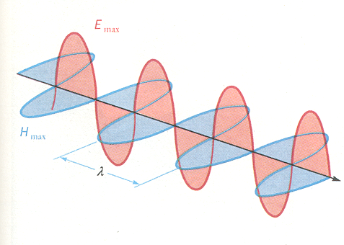
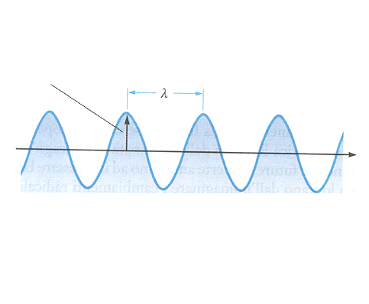
What is light/radiation
Radiation is the emission or propagation of energy in the form of an electromagnetic wave (or a photon)
E_{max}
Light: electromagnetic radiation propagating in space
wavelength
H_{max}
amplitude
λ
c=3,00×10⁸ m/s = ν×λ
c = velocity of light (m⋅s⁻¹)
ν = frequency (s⁻¹=Hz)
λ = wavelength (m)
Notes:
Wavelenght= distance betweem 2 consecutive peaks (or valley)
Frequency= number of complete cicles passing a fixed point in 1 sec

Slide 6
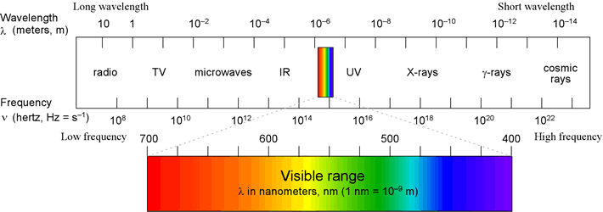
Light - The electromagnetic spectrum
Notes:
Frequency and wavelenght are inversely proportional

Slide 7
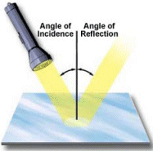


Light - classical
Classical (wave-like) properties of light
Specular reflection
refraction
( n=c/v )
diffusion (scattering)

Slide 8
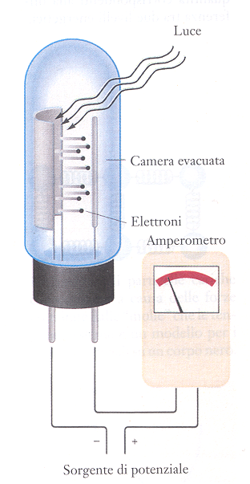
Light - quantum
photons
Photoelectric effect (Einstein)
electrons
Light=flux of discrete units (i.e. quanta) called photons (particles with 0 mass)
E_{photon} = hν
h=6.626 x 10⁻³⁴ J s
Planck’s constant
= hc/λ = hcω
with ω=1/ λ wavenumber (cm⁻¹)
eV (electron-volt) is another common energy unit
for one mole
1 eV = 1.602 x 10⁻¹⁹ J
1 eV = 96.49 kJmol⁻¹
1 einstain = one mole of quanta/photons
E_{photon} = N_{a}hν=N_{a}hc/λ=1.196×10⁵/λ kJ einstain⁻¹
Notes:
Observation: when certain metals are exposed to light, and electric current can be made to flow in a circuit. Only wavelengths shorter than a threshold make this happen. The energy in each electron is proportional to 1/lambda, and the number of electrons depends on the intensity of the light. This is how a solar cell works
Aggiungere particle like:
The energy of a quantum of light (photon) is related to its frequency by the Planck relation E=hv=hc/lambda

Slide 9
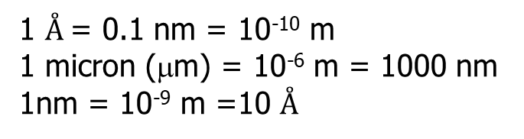
Energy & wavelengths units
Some relationships between commonly used energy units
Relationships between wavelengths units
1 $Å$= 0.1 nm = 10⁻¹⁰ m
1 micron (μm) = 10⁻⁶ m = 1000 nm
1nm = 10⁻⁹ m =10 $Å$
Useful Constants
Planck’s constant h=6.626 x 10⁻³⁴ J⋅s
Speed of light c=2.9979x10⁸ m ⋅ s⁻¹
Avogadro’s n. Na=6.022x10²³ mol⁻¹
(eV)
x 96.4853 kJ⋅mol⁻¹
x 23.0605 kcal⋅mol⁻¹
x 8065.54 cm⁻¹
x 11604 K
Notes:
Frequency and wavelenght are inversely proportional

Slide 10
The electromegnatic spectrum
Typical wavelenghts, frequencies, wavenumbers and energies for various regions of the EM spectrum
Notes:
Frequency and wavelenght are inversely proportional

Slide 11

Exercise n. 1
Photons: energy, frequency, wavelengths and conversions
^{Calculate} the frequency (ν), energy (E) and wavenumber (ω) of a green photon, having a wavelength λ =530 nm
Solution:
wavelength 530 nm = 5.3×10⁻⁷ m= 5.3×10⁻⁵ cm
frequency ν = c/λ = 3.00 ×10⁸ m·s⁻¹ /5.3×10⁻⁷ m=5.66×10¹⁴ Hz (s⁻¹)
energy E = hν=6.626x10⁻³⁴ J·s · 5.66×10¹⁴ s⁻¹= 3.75×10⁻¹⁹ J = 2.34 eV
energy (of 1 mole) = 2.34×96.49=226 kJ·mol⁻¹
wavenumber ω = 1/λ = 1/5.3×10⁻⁵ cm= 18868 cm⁻¹

Slide 12
Exercise n. 2
Calculate the energy carried by a mole of photons having a wavelength λ =320 nm (near UV)
Solution:
Photon energy per mole:
λ in nm
ω in cm⁻¹

Slide 13
Types of radiation important in lower atmosphere
UV and visible radiation (λ=100-800 nm)
excites bonding electrons in molecules
capable of breaking bonds in molecules (→ photodissociation)
UV photons (λ=100-300 nm) have most energy, can break stronger bonds
IR radiation (λ=0.8 - 300 μm)
excites vibrational motions in molecules
With very few exceptions IR is not energetic enough to break bonds and initiate photochemical processes
MW radiation (λ = 0.5 - 300 mm)
excites rotational motions in molecules
Notes:
Frequency and wavelenght are inversely proportional

Slide 14
Photophysical and chemical processes
energy (hν)
photoionization (e⁻ emission)
UV-VIS and UV
photodissociation (bond breaking)
UV-VIS
electronic excitation
visible (VIS)
vibration
infrared (IR)
rotation
microwaves
Notes:
This light interacts with molecules in the atmosphere that can absorb the energy carried by the radiation and transfer it to other molecules (e.g. via collisions) or

Slide 15
Photochemical processes
Several important chemical processes in the atmosphere are initiated by light absorption
VIS-UV light
radicals
Example 1
NO₂ + hν (λ< 420 nm) → NO• + O•
O • + O₂ + M → O₃
photochemical smog
Example 2
UV light
O₃ + hν (λ< 336 nm) → O(¹D) + O₂
O(¹D) + H₂O → 2OH•
Major source of OH (primary oxidant for organics, VOC)
Notes:
Example 1:
NO2 dissociates to two reactive species (radicals). Important reaction: it is the only anthropogenic source of ozone in the troposphere, due to the reaction of O atoms with oxygen mediated by collisions with a third body. This is the starting point of a series of chemical processes that created the well known photochemical smog. Emission of NO2 from car exhauts or combustion processes in air
Example 2:
O3 dissociation in the troposphere is occurring by light absorption in the UV to generate O atom in an electronically excited state. This process is very important in the troposphere because is the mayor source for production of the OH radical (both in clean and polluted air). The OH is one of the main player in pollution chemistry because it oxidises organic compounds and VOC in a series of chain reactions. Since OH is photogenerated is a mayor oxidant primarily during day-light hours

Slide 16
Photon energies and bond dissociation energies
One mole of photons in the near UV (λ =320 nm) carries
an energy of 374 kJ mol⁻¹ (see exercise 2)
This energy is sufficient to break:
weak chemical bonds (e.g. O₂-O in ozone ∼100kJ/mol)
moderately strong C-H bonds (e.g. formaldehyde ∼368 kJ/mol)
O₃ + hν (λ< 336 nm) → O(¹D) + O₂

Slide 17
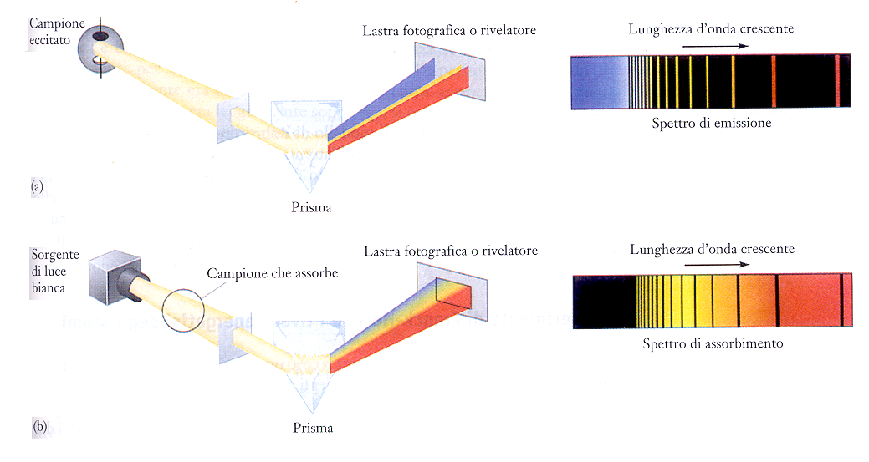
Light-matter interaction
Emissions of photons
n=3
n=2
n=1
n=3
n=2
ΔE = hν
Absorption of photons
n=1
Notes:
ARRIVATA QUI IL 27 settembre 2022

Slide 18
Light-matter interaction
Absorption
Atoms/molecules in the gas phase absorb light when the energy carried by the photons matches a difference in the internal energy levels of the atom/molecule
n=3
n=2
ΔE = hν
Emission
n=1
Atoms/molecules in the gas phase emit light at defined energies (frequencies) corresponding to differences in the internal energy levels of the atom/molecule
n=3
n=2
ΔE = hν
n=1

Slide 19
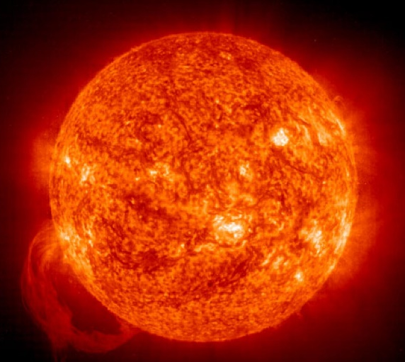
Radiation balance
>99.9% of the energy on Earth comes from the Sun
Total energy from the Sun → ∼1.7x10¹⁷ W (J/s)
Internal heat of the Earth → ∼4x10¹³ W (J/s)
Light in the atmosphere comes from the Sun (shortwavelenght) or from reflection/emission from Earth (longwavelenght)
Notes:
Sun ->� 1.7 x 10¹⁷ W to Earth, of which 60% reaches the surface.
Earth heat -> 4 x 10¹³ W to surface. i.e. ~4500 times more energy from Sun than from Earth's interior!
Light in the atmosphere comes from the Sun (and it has a distrubution in wavelenght that is peaked in the visible region) or it is reflected/emitted from Earth.

Slide 20
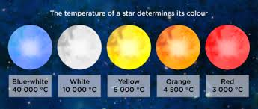
Solar radiation: black-body emission
The Sun: a spherical light source of diam=1.4x10⁶ km located 1.5x10⁸ km away – parallel beams (collimation angle ∼±0.25°, see later)
The radiation spectrum emitted by the Sun (or any star) can be approximated to a black body emission at a certain temperature T
Notes:
Arrivata qui 17 ottobre 2023
Sun: spherical light source of diameter 1.4x10^6 km located 1.5x10^8 km away. Matter emits radiation if its temperature is above 0 K (absolute zero). An object
that absorbs radiation at all wavelengths incident on it necessarily emits radiation at all wavelengths. This ideal material is called a black body; solid objects, such as the the earth, or liquid water, behave almost as black bodies. Planck showed that the intensity of light that is emitted from a black body as a function of wavelength (") or frequency (#), is given by the following function
(now called the Planck function):
(units: Watts m-2 m-1; 1 W % 1 J s-1) is the amount of energy in light with lambda between l and l+dl passing through surface with area 1 m2 each second.
Planck’s Law indicates that the temperature of an object determines the intensity of radiation emitted by the object at any wavelength, provided that the object can absorb radiation at that wavelength.
The amount of energy radiated from a body depends largely on the temperature of the body. It has been demonstrated experimentally that at a given temperature there is a
maximum amount of radiant energy that can be emitted per unit time per unit area of a body. This maximum amount of radiation for a certain temperature is called the
blackbody radiation.

Slide 21
What is a black body?
An idealized physical system that absorbs EM radiation at all frequencies completely and at any incidence angle
A cavity is a good approximation of a black body
No real body can absorb more than a blackbody
If a body only absorbs radiation partially it is called a «grey» body
Solid objects can behave as black bodies
Notes:
This ideal material is called a black body; solid objects, such as the the earth, or liquid water, behave almost as black bodies. Planck showed that the intensity of light that is emitted from a black body as a function of wavelength (") or frequency (#), is given by the following function
(now called the Planck function):
(units: Watts m-2 m-1; 1 W % 1 J s-1) is the amount of energy in light with lambda between l and l+dl passing through surface with area 1 m2 each second.
Planck’s Law indicates that the temperature of an object determines the intensity of radiation emitted by the object at any wavelength, provided that the object can absorb radiation at that wavelength.
The amount of energy radiated from a body depends largely on the temperature of the body. It has been demonstrated experimentally that at a given temperature there is a maximum amount of radiant energy that can be emitted per unit time per unit area of a body. This maximum amount of radiation for a certain temperature is called the
blackbody radiation.

Slide 22
Black body emission
Idealized system
Perfect emitter: at every frequency, it emits as much or more thermal radiative energy as any other body at the same temperature
It is a diffuse emitter: the energy is radiated isotropically, independent of direction
A black body in thermal equilibrium (constant T) emits EM radiation (black-body radiation) according to Planck's law
Planck function: λ dependence of light intensity emitted by a black body
h: Planck’s constant
c: light velocity
k_{B}: Boltzmann constant
B_{λ}(T) units: W⋅m⁻²⋅ m⁻¹
Notes:
It is an ideal emitter: at every frequency, it emits as much energy as – or more energy than – any other body at the same temperature.
2. It is a diffuse emitter: the energy is radiated isotropically, independent of direction.
A star or planet often is modeled as a black body, and EM radiation emitted from these bodies as black-body radiation. The figure shows a highly schematic cross-section to illustrate the idea. The photosphereof the star, where the emitted light is generated, is idealized as a layer within which the photons of light interact with the material in the photosphere and achieve a common temperature T that is maintained over a long period of time. Some photons escape and are emitted into space, but the energy they carry away is replaced by energy from within the star, so that the temperature of the photosphere is nearly steady. Changes in the core lead to changes in the supply of energy to the photosphere, but such changes are slow on the time scale of interest here. Assuming these circumstances can be realized, the outer layer of the star is somewhat analogous to the example of an enclosure with a small hole in it, with the hole replaced by the limited transmission into space at the outside of the photosphere. With all these assumptions in place, the star emits black-body radiation at the temperature of the photosphere. Using this model the effective temperature of stars is estimated, defined as the temperature of a black body that yields the same surface flux of energy as the star. If a star were a black body, the same effective temperature would result from any region of the spectrum. For example, comparisons in the B (blue) or V(visible) range lead to the so-called B-V color index, which increases the redder the star,[37]with the Sun having an index of +0.648 ± 0.006.[38] Combining the U (ultraviolet) and the B indices leads to the U-B index, which becomes more negative the hotter the star and the more the UV radiation. Assuming the Sun is a type G2 V star, its U-B index is +0.12.[39] The two indices for two types of stars are compared in the figure with the effective surface temperature of the stars assuming they are black bodies. It can be seen that there is only a rough correlation. For example, for a given B-Vindex from the blue-visible region of the spectrum., the curves for both types of star lie below the corresponding black-body U-B index that includes the ultraviolet spectrum, showing that both types of star emit less ultraviolet light than a black body with the same B-V index. It is perhaps surprising that they fit a black body curve as well as they do, considering that stars have greatly different temperatures at different depths.[40] For example, the Sun has an effective temperature of 5780 K,[41] which can be compared to the temperature of thephotosphere of the Sun (the region generating the light), which ranges from about 5000 K at its outer boundary with the chromosphere to about 9500 K at its inner boundary with theconvection zone approximately 500 km (310 mi) deep. (from Wikipedia)

Slide 23
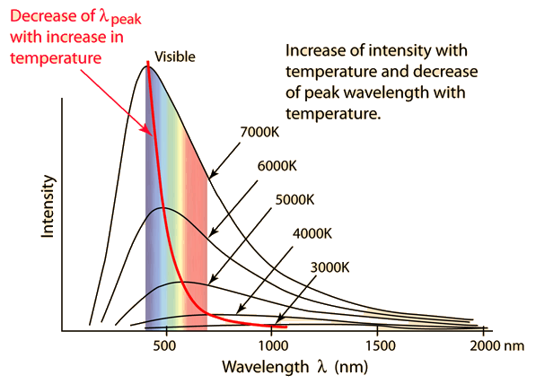

Black-body: temperature dependence
T of an object (blackbody) determines the intensity of radiation emitted by the object at any wavelength
What happens when T changes?
2.
1.
Notes:
A piece of metal heated by a blow torch first becomes "red hot" as the very longest visible wavelengths appear red, then becomes more orange-red as the temperature is increased, and at very high temperatures would be described as "white hot" as shorter and shorter wavelengths come to predominate the black body emission spectrum. Before it had even reached the red hot temperature, the thermal emission was mainly at longer infrared wavelengths, which are not visible; nevertheless, that radiation could be felt as it warms one's nearby skin.
Wien's displacement law states that the black body radiation curve for different temperature peaks at a wavelength is inversely proportional to the temperature. The shift of that peak is a direct consequence of the Planck radiation law, which describes the spectral brightness of black body radiation as a function of wavelength at any given temperature. However, it had been discovered by Wilhelm Wien several years before Max Planck developed that more general equation, and describes the entire shift of the spectrum of black body radiation toward shorter wavelengths as temperature increases.
Formally, Wien's displacement law states that the spectral radiance of black body radiation per unit wavelength, peaks at the wavelength λ_{max} given by:

Slide 24
Black-body: Wien displacement law
Position of λ_{max} is inversely proportional to T and it can be calculated by:
Wien’s law: black body radiation curve for different T peaks at a wavelength that is inversely proportional T (in K)
b Wien displacement constant
b = 2.8978×10⁻³ [m]⋅[K]
= 2898 [μm]⋅[K]
Notes:
The position of the maximum with lambda can be calculated by finding the zero of the derivative of the Planck function.
Wien's displacement law states that the black body radiation curve for different temperature peaks at a wavelength is inversely proportional to the temperature. The shift of that peak is a direct consequence of the Planck radiation law, which describes the spectral brightness of black body radiation as a function of wavelength at any given temperature. However, it had been discovered by Wilhelm Wien several years before Max Planck developed that more general equation, and describes the entire shift of the spectrum of black body radiation toward shorter wavelengths as temperature increases.
Formally, Wien's displacement law states that the spectral radiance of black body radiation per unit wavelength, peaks at the wavelength λ_{max} given by:
here T is the absolute temperature in kelvins. b is a constant of proportionality called Wien's displacement constant, equal to 2.8977729(17)×10⁻³ m⋅K^{[1]}, or to obtain wavelength in micrometers, b ≈ 2900 μm·K. If one is considering the peak of black body emission per unit frequency or per proportional bandwidth, one must use a different proportionality constant. However, the form of the law remains the same: the peak wavelength is inversely proportional to temperature, and the peak frequency is directly proportional to temperature.
Wien's displacement law may be referred to as "Wien's law", a term which is also used for the Wien approximation.

Slide 25
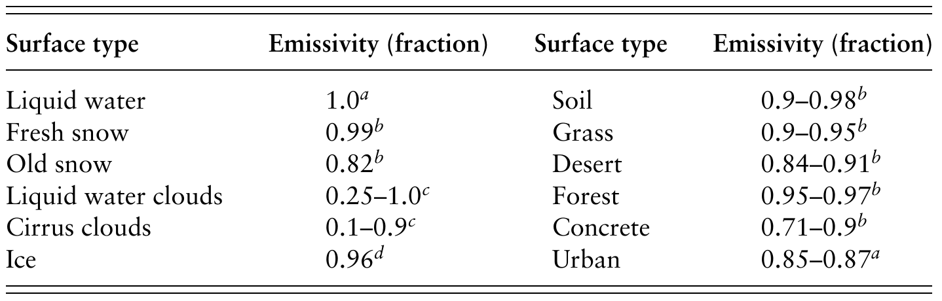
Black-body vs real bodies
Real substances are generally not perfect emitters. Instead, they usually emit a fraction of the radiance that a blackbody emits. Radiance of a real body is e_{λ}:
e_{λ} = ε_{λ} B_{λ}(T)
ε_{λ} (dimensionless) is the emissivity of the substance = the fraction (≤1) of B_{λ}(T) actually emitted. Emissivities depend on wavelength.
Emissivities for some surface types in the IR part of the EM spectrum
Notes:
Real substances are generally not perfect emitters. Instead, they usually emit a fraction of the radiance that a blackbody emits. The radiance (W m−2 μm−1 sr−1)
actually emitted by any substance is approximately
The table gives emissivities for some surface types in the infrared part of the electromagnetic spectrum.

Slide 26
Black-body vs real bodies
Absorptivity (a_{λ}) is the fraction (≤1) of incident radiation that a substance actually absorbs.
Kirchoff’s law:
a_{λ} = ε_{λ}
In thermodynamic equilibrium, the emissivity and absorptivity of a substance equal each other = the efficiency at which a substance absorbs radiation equals that at which it emits radiation.
A perfect emitter (ε_{λ} =1) is also a perfect absorber of radiation (a_{λ} = 1) and a blackbody.
Notes:
Suppose a blackbody object is placed in a vacuum enclosed by blackbody walls. Over time, the temperatures of the object and walls equalize. If Kirchoff’s law did not hold at this point, a net heat transfer would occur between the object and the walls
even though the object and w0all temperatures are the same. Such a heat transfer violates the second law of thermodynamics. Thus, the absorptivity and emissivity of a substance must equal each other in equilibrium.

Slide 27
Solar spectral irradiance
The Sun can be very well approximated with a blackbody at T∼5800 K
Spectral irradiance from the Sun (solid line) compared with that of a blackbody at 5777 K (dashed line)
monochromatic irradiance: radiant flux per unit surface area and unit wavelength.
Units: W⋅m⁻²⋅μm⁻¹ or W⋅m⁻²⋅nm⁻¹ according to the units used for λ
Irradiance: radiant flux (i.e. power) emitted/received per unit surface area.
Units: W⋅m⁻²
Notes:
The position of the maximum with lambda can be calculated by finding the zero of the derivative of the Planck function.
Wien's displacement law states that the black body radiation curve for different temperature peaks at a wavelength is inversely proportional to the temperature. The shift of that peak is a direct consequence of the Planck radiation law, which describes the spectral brightness of black body radiation as a function of wavelength at any given temperature. However, it had been discovered by Wilhelm Wien several years before Max Planck developed that more general equation, and describes the entire shift of the spectrum of black body radiation toward shorter wavelengths as temperature increases.
Formally, Wien's displacement law states that the spectral radiance of black body radiation per unit wavelength, peaks at the wavelength λ_{max} given by:
here T is the absolute temperature in kelvins. b is a constant of proportionality called Wien's displacement constant, equal to 2.8977729(17)×10⁻³ m⋅K^{[1]}, or to obtain wavelength in micrometers, b ≈ 2900 μm·K. If one is considering the peak of black body emission per unit frequency or per proportional bandwidth, one must use a different proportionality constant. However, the form of the law remains the same: the peak wavelength is inversely proportional to temperature, and the peak frequency is directly proportional to temperature.
Wien's displacement law may be referred to as "Wien's law", a term which is also used for the Wien approximation.

Slide 28
Sun and Earth irradiance
At the temperature of the Sun’s surface (≈5800K) λ_{max} is in the visible (green-yellow ∼480 nm)
relative irradiance
wavelength (μm)
At the mean T of the Earth surface (T≈288 K) λ_{max} is in the IR (∼9-10 μm)
Notes:
Earth's global mean surface/atmospheric temperature is T ~ 255 K -- The peak wavelength of the radiation emitted by the Earth is l ~ 10 mm , in the infrared range not visible
to human eyes. That Earth is at all visible from space is because it reflects sun light, which contains a substantial visible band
Human body (T ~ 300K) also emits infrared radiation not visible to human eyes; We cannot "see" each other at night (unless aided by artificial light, or by a pair of infrared goggles)

Slide 29
Exercise n. 3
The brightest star visible from any part of Earth is Sirius, in the constellation Canis Major. The surface temperature of Sirius is 9940K. Calculate the maximum position of its emission spectrum (in nm). What colour should you expect Sirius to have?
Hint: We need to apply Wien’s law:
b = 2898 [μm]⋅[K]

Slide 30
Exercise n. 3
The brightest star visible from any part of Earth is Sirius, in the constellation Canis Major. The surface temperature of Sirius is 9940K. Calculate the maximum position of its emission spectrum (in nm). What colour should you expect Sirius to have?
Solution: Star emissions can be modelled as blackbody emissions. By applying the Wien’s law the peak wavelength can be related to the T of the emitter:
with T in K. Hence:
This corresponds to a wavelength outside the visible region (in the UV) but since the star will have a broad emission spectrum it will most likely look bluish to a human eye

Slide 31
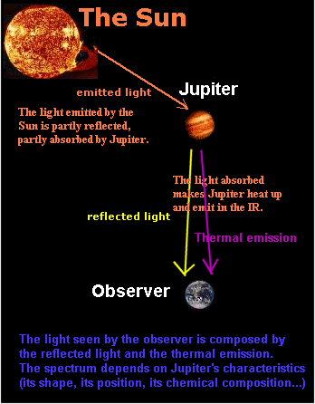
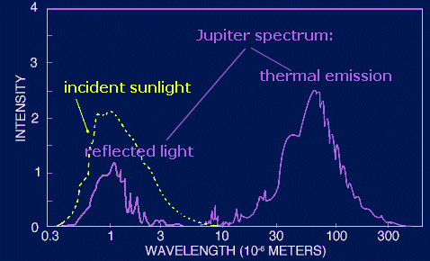
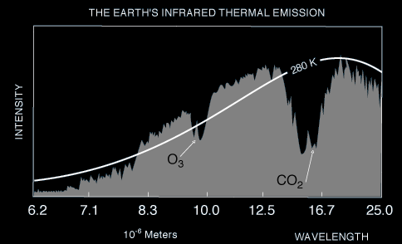
Light emitted from planetary bodies
Notes:
In observing spectral emission/absorption features in a planetary atmosphere, one must consider the primary sources of the continuum spectra.
Reflected sunlight is generally in the UV, visible and near-infrared wavelengths. Example: Uranus and Neptune appear green/blue due to the presence of methane in their atmospheres. Methane absorbs the red part of the visible spectrum, causing mostly green/blue light to be reflected.
Thermal radiation: From the ‘surface’ or deeper atmospheric layers of the planet, generally peaks in the infrared and radio wavelengths due to the temperature of the ‘surface’ generating a black body radiation curve.

Slide 32
Radiation flux
The total flux emitted by a blackbody radiator F_{B} (i.e. power emitted across a unit surface over the whole spectrum) can be obtained by integration of the Planck function over wavelength λ
wavelength
Stefan-Boltzmann law
= 5.672×10⁻⁸ [W]⋅[m⁻²]⋅[K⁻⁴]
F_{B}(T) in [W]⋅[m⁻²]
Notes:
Deriving the Stefan–Boltzmann Law using the Planck's law.
The law can be derived by considering a small flat black body surface radiating out into a half-sphere. This derivation uses spherical coordinates, with φ as the zenith angle and θ as the azimuthal angle; and the small flat blackbody surface lies on the xy-plane, where φ = ^{π}/₂.
The intensity of the light emitted from the blackbody surface is given by Planck's law :
{\displaystyle I(\nu ,T)={\frac {2h\nu ^{3}}{c^{2}}}{\frac {1}{e^{\frac {h\nu }{kT}}-1}}.}where{\displaystyle I(\nu ,T)\,} is the amount of power per unit surface area per unit solid angle per unit frequency emitted at a frequency {\displaystyle \nu \,} by a black body at temperature T.
{\displaystyle h\,} is Planck's constant
{\displaystyle c\,} is the speed of light, and
{\displaystyle k\,} is Boltzmann's constant.
The quantity {\displaystyle I(\nu ,T)~A~d\nu ~d\Omega } is the power radiated by a surface of area A through a solid angle dΩ in the frequency range between ν and ν + dν.
The Stefan–Boltzmann law gives the power emitted per unit area of the emitting body,
{\displaystyle {\frac {P}{A}}=\int _{0}^{\infty }I(\nu ,T)d\nu \int d\Omega \,}To derive the Stefan–Boltzmann law, we must integrate Ω over the half-sphere and integrate ν from 0 to ∞. Furthermore, because black bodies are Lambertian (i.e. they obey Lambert's cosine law), the intensity observed along the sphere will be the actual intensity times the cosine of the zenith angle φ, and in spherical coordinates, dΩ = sin(φ) dφ dθ.
{\displaystyle {\begin{aligned}{\frac {P}{A}}&=\int _{0}^{\infty }I(\nu ,T)\,d\nu \int _{0}^{2\pi }\,d\theta \int _{0}^{\pi /2}\cos \phi \sin \phi \,d\phi \\&=\pi \int _{0}^{\infty }I(\nu ,T)\,d\nu \end{aligned}}}Then we plug in for I:
{\displaystyle {\frac {P}{A}}={\frac {2\pi h}{c^{2}}}\int _{0}^{\infty }{\frac {\nu ^{3}}{e^{\frac {h\nu }{kT}}-1}}d\nu \,}To do this integral, do a substitution,
{\displaystyle u={\frac {h\nu }{kT}}\,}
{\displaystyle du={\frac {h}{kT}}\,d\nu }which gives:
{\displaystyle {\frac {P}{A}}={\frac {2\pi h}{c^{2}}}\left({\frac {kT}{h}}\right)^{4}\int _{0}^{\infty }{\frac {u^{3}}{e^{u}-1}}\,du.}The integral on the right is standard and goes by many names: it is a particular case of a Bose-Einstein integral, or the Riemann zeta function, {\displaystyle \zeta (4)}, or the Polylogarithm. The value of the integral is {\displaystyle {\frac {\pi ^{4}}{15}}}, giving the result that, for a perfect blackbody surface:
{\displaystyle j^{\star }=\sigma T^{4}~,~~\sigma ={\frac {2\pi ^{5}k^{4}}{15c^{2}h^{3}}}={\frac {\pi ^{2}k^{4}}{60\hbar ^{3}c^{2}}}.}Finally, this proof started out only considering a small flat surface. However, any differentiable surface can be approximated by a bunch of small flat surfaces. So long as the geometry of the surface does not cause the blackbody to reabsorb its own radiation, the total energy radiated is just the sum of the energies radiated by each surface; and the total surface area is just the sum of the areas of each surface—so this law holds for all convex blackbodies, too, so long as the surface has the same temperature throughout. The law extends to radiation from non-convex bodies by using the fact that the convex hull of a black body radiates as though it were itself a black body.

Slide 33
Radiation flux: Sun and Earth
outward radiative energy flux (per unit area) at the Sun surface
But how much of this flux reaches the Earth?

Slide 34
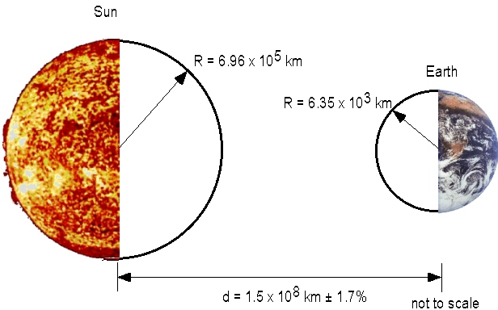
The Solar constant
Total radiative energy output of the Sun at its surface is:
R_{S}=6.96x10⁵ km
R_{E}=6.35x10³ km
surface area of the Sun
area of the big sphere centered at the Sun and radius equal to d
=1 A.U.
d = 1 A.U.
W⋅m⁻²
Solar constant
Notes:
Solar radiation has an average intensity of approximately 1370 W m−2 at the distance of the Earth from the Sun, often referred to as the solar
constant, S, but varies with time on a wide variety
of scales.

Slide 35
The Solar constant
Solar constant S₀ is radiation per unit area received on top of the Earth atmosphere when the Earth is at its mean distance from the Sun
Solar irradiance at the top of the atmosphere is a mean value:
The Earth’s orbit is elliptical
  The Sun-Earth distance varies by 3.3% (aphelion and perihelion)
Variations in the Sun activity (solar magnetic activity cycle) → small variations
Sun rotation period on its axis of 27 days → small variations (0.1-0.3%)
Changes in Earth’s orbit have been connected to glaciation periods in the Earth’s history:
Earth's tilt changes from 22° to 24.5° and back every 41,000 years
Month of closest E-S approach changes over 19,000 and 24,000 years cycles
Shape of Earth’s orbit (nearly circular/elliptical) changes with a 10⁵ year cycle
Notes:
Solar radiation has an average intensity of approximately 1370 W m−2 at the distance of the Earth from the Sun, often referred to as the solar constant, S, but varies with time on a wide variety of scales.
The Sun rotates with a period of 27 days and both active, brighter regions known as faculae and less active, darker regions known as sunspots face the Earth during each rotation. The output
from these different regions of the Sun varies by between 0.1 to 0.3% of the total fl ux. The number of sunspots on the surface of the Sun varies with
a cycle of 11 years, causing variations in radiative flux at the top of the Earth’s atmosphere of the order of 1%. Lower frequency variations in the solar flux, again of the order of 1–2%, have
also been inferred from isotopic abundance measurements.
From Seinfeld-Pandis:
The amount of solar radiation reaching Earth and Earth's changing orientation to the Sun have been the major causes for climatic change throughout its history. If the Sun's radiation intensity declined by 5-10% and there were no other compensating factors, ice would engulf the planet in less than a century. Although no theory exists to predict future changes in solar output, the effect of changes in Earth's orbit as it travels around the Sun is beginning to be understood. During the past million years, Earth has experienced 10 major and 40 minor episodes of glaciation. All appear to have been controlled by three so-called orbital elements that vary cyclically over time:
1. Earth's tilt changes from 22° to 24.5° and back again every 41,000 years.
2. The month when Earth is closest to the Sun also varies over cycles of 19,000 and 24,000 years. Currently, Earth is closest to the Sun in January. This month-of-closest-approach factor can make a difference of 10% in the amount of solar radiation reaching a particular location in a given season.
3. The shape of Earth's orbit varies from being nearly circular to being more elliptical with a period of 100,000 years.

Slide 36
Solar constant and average energy flux
The effective area of the Earth receiving sunlight at any time (i.e. cross section of the Earth) is:
But the total surface of the Earth is:
Average* energy per unit surface (of the Earth) is:
W⋅m⁻²
* Average over day/night, winter/summer, all latitudes
Assumption: sunlight beams reaching the Earth are parallel
Notes:
The effective area of the Earth receiving sunlight at any one time is given by piR2, where R is the radius of the Earth, yet the total area of the Earth is 4pR2, so the average
radiant flux over the Earth is given by S/4.
NB 342 Wm2 is the

Slide 37
«Plane parallel» assumption
Notes:
Solar radiation has an average intensity of approximately 1370 W m−2 at the distance of the Earth from the Sun, often referred to as the solar constant, S, but varies with time on a wide variety
of scales.

Slide 38
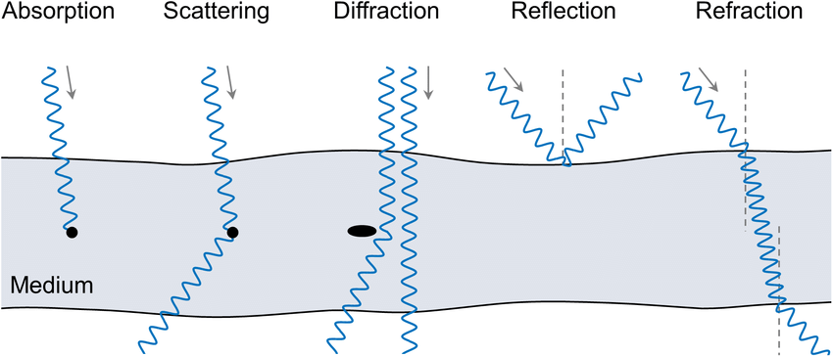
Interaction of light with matter
Radiation emitted from the Sun passes through space and the atmosphere to another body. Upon reaching the second body the radiation can be absorbed, scattered, reflected, diffracted, refracted (diffr+refr=transmitted)
* a gas molecule, a liquid drop, solid/liquid particle or surfaces
Notes:
Once emitted, radiation passes through space or air to another body. Upon reaching the second body, the radiation can be reflected, scattered, absorbed, refracted,
dispersed, or transmitted. Each of these processes is discussed in this chapter.

Slide 39
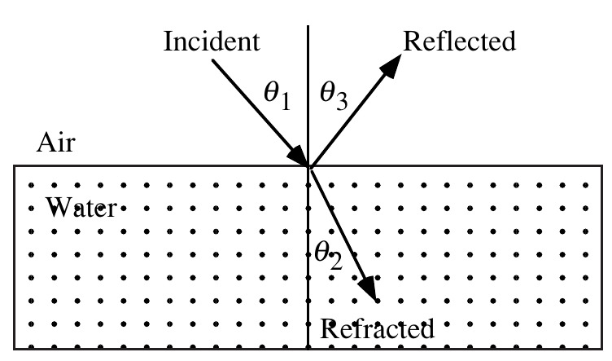
Reflection
A wave (or photon) of radiation is absorbed by an object and reemitted at an angle (called angle of reflection) equal to the angle of incidence. No energy is lost during absorption and reemission.
The reflectivity of a surface is called albedo = the fraction of sunlight incident on a surface that is reflected. Albedos are wavelength-dependent.

Slide 40
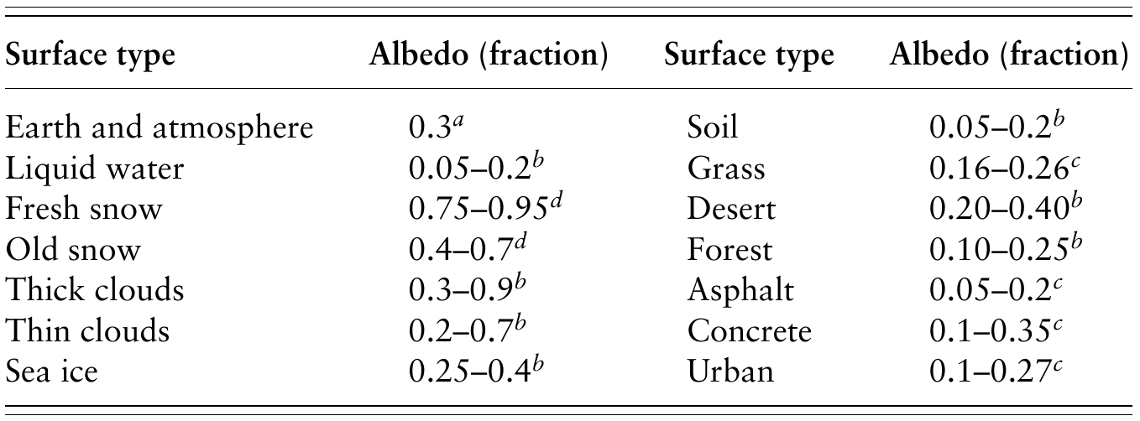
Reflection
Albedos averaged over the visible spectrum for several
surface types

Slide 41
Albedo
Notes:
The earth’s albedo (fraction of solar radiation *reflected* to space) was first measured by observing earthshine on the moon, reflected back to earth and visible just after the new moon. It is now
measured from spacecraft. About 33% of the solar energy incident on the earth is reflected back to space, A=0.33.
Most of the reflection of solar radiation from earth is due to clouds, with help from sea ice and glacial ice in Antarctica and Greenland, plus snow and deserts (albedo 0.6—0.9).
The albedo of the earth’s surface is mostly much lower than 0.33, about .07 for land with vegetation, 0.05-0.1 for the ocean.).
Thus the albedo, and the entire energy budget of earth, is sensitive to cloudiness and ice cover, factors that change on both weather and climate time scales (short and long times).

Slide 42
Albedo
albedo coefficient
Globally on Earth:
19+6+5= 30% reflected light (α_{P}=0.3)
70% absorbed by the Earth system
(45% from surface and 25% from atmosphere)
Notes:
How to estimate Earth’s albedo: two-thirds of Earth’s surface is covered with water, which has an albedo of 5–20 percent (typical value of 8 percent), depending largely on the angle of the Sun. Soils and forests also have low albedos. Much of the Earth–atmosphere reflectivity is due to clouds and ice, which have high albedos.

Slide 43
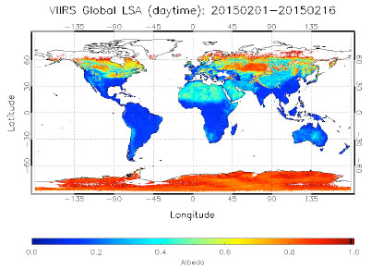
Albedo
Variations (in space and time) due to:
different reflective properties of the Earth surface (oceans have small albedos ice/snow has high ones)
weather (presence of clouds)
climate (ice cover)
Notes:
Surface albedo, defined as the ratio between shortwave radiation reflected by Earth's surface and shortwave radiation incident at the surface, is a function of both solar illumination and the reflective properties of the Earth's surface.

Slide 44
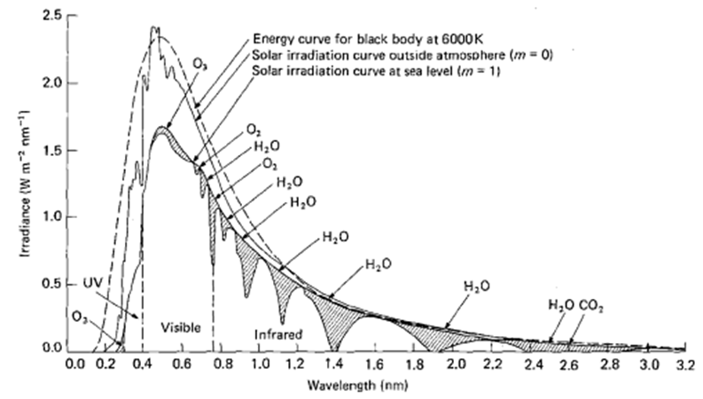
Solar irradiance spectrum
Effect of the atmosphere: it absorbs solar (and terrestrial radiation) in a highly λ-dependent manner.
Solar spectrum is strongly modulated by atmospheric scattering and absorption
This has many implications for Earth’s global environment and life on this planet
Notes:
The atmosphere absorbs solar and terrestrial radiation in a highly wavelength-dependent manner. This has many important implications for
Earth's global environment and life on earth in general.
Solar flux spectrum outside the atmosphere is very close to a blackbody emission spectrum at 5770 K. The same spectrum at sea level presents some holes where the intensity drops down quite sharply. This is due to the fact that molecules present in the atmosphere absorb the radiation

Slide 45
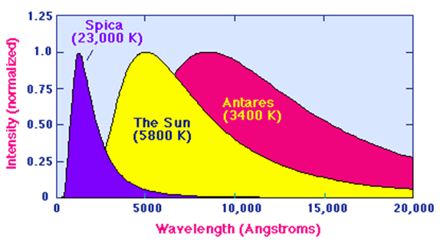
Solar irradiance spectrum
Basic spectrum of sunlight:
Sun: intensity peaks in the VIS part of the spectrum and decreases in the UV and IR. Within the VIS the spectrum can be further subdivided into the primary colours
Notes:
Spica (Virgo constellation) and Antares (Scorpione)

Slide 46
Radiative transfer at molecular level
Molecules (and particles) in the atmosphere can absorb the radiation and start a series of processes (according to λ)
ionization
dissociation/reactivity
internal excitation
Energy transfer to other molecules (heating)
λ
Notes:
This light interacts with molecules in the atmosphere that can absorb the energy carried by the radiation and transfer it to other molecules (e.g. via collisions) or
In order to calculate the rate at which atmospheric molecules are excited, it is necessary to know what radiation is available at various altitudes in the atmosphere. For this, a knowledge of the solar spectrum is required, as well as an understanding of how this radiation is attenuated as it penetrates the Earth’s atmosphere.

Slide 47
Exercise n. 3
Jupiter is 7.8×10⁸ km from the Sun, and it has an average albedo coefficient α= 0.73. Calculate the average solar energy flux received by Jupiter and the average flux that the planet reflects into space.
Data: Sun radius R_{s}=6.96×10⁵ km T_{sun}=5780 K
Stefan-Boltzmann constant
= 5.672×10⁻⁸ [W]⋅[m⁻²]⋅[K⁻⁴]
Hint:

Slide 48
Exercise n. 3
Jupiter is 7.8×10⁸ km from the Sun, and it has an average albedo coefficient α= 0.73. Calculate the average solar energy flux received by Jupiter and the average flux that the planet reflects into space.
Solution: It is requested first to calculate the average energy per unit surface received by Jupiter. Given d= 7.8×10⁸ km and Rs=6.96×10⁵ km and taking into account the factor 4 due to the reduced effective area of the planet receiving the Sun’s light we can write:
W⋅m⁻²
The fraction of this energy reflected back to space is given by the albedo coefficient, so:
Energy reflected to space = 12.54×0.73=9.15 W⋅m⁻²
Energy received by Jupiter (planet+atmosphere) = 12.54×(1-0.73)=3.39 W⋅m⁻²

Slide 49
Useful constants
Notes:
Photodissociation, the breaking apart of molecules by solar radiation, plays a fundamental role in the chemistry of the atmosphere. The photodissociation
of trace species such as ozone and formaldehyde contributes to their removal from the atmosphere, but probably the most important role played by these photoprocesses is the generation
of highly reactive atoms and radicals.
Photodissociation of trace species and the subsequent reaction of the photoproducts with other molecules is
the prime initiator and driver for the bulk of atmospheric chemistry.

Slide 50
Notes:
Photodissociation, the breaking apart of molecules by solar radiation, plays a fundamental role in the chemistry of the atmosphere. The photodissociation
of trace species such as ozone and formaldehyde contributes to their removal from the atmosphere, but probably the most important role played by these photoprocesses is the generation
of highly reactive atoms and radicals.
Photodissociation of trace species and the subsequent reaction of the photoproducts with other molecules is
the prime initiator and driver for the bulk of atmospheric chemistry.

Slide 51
1 a.m.u. (atomic mass unit) =1.6605x10⁻²⁷ kg
Notes:
Photodissociation, the breaking apart of molecules by solar radiation, plays a fundamental role in the chemistry of the atmosphere. The photodissociation
of trace species such as ozone and formaldehyde contributes to their removal from the atmosphere, but probably the most important role played by these photoprocesses is the generation
of highly reactive atoms and radicals.
Photodissociation of trace species and the subsequent reaction of the photoproducts with other molecules is
the prime initiator and driver for the bulk of atmospheric chemistry.

