Slide 1

University of Trento
Master of Science in Environmental Meteorology https://international.unitn.it/environmental-meteorology
A.A. 2023-24
Environmental Physical Chemistry
Basic principles of chemical kinetics
Daniela Ascenzi
Dept. Physics, University of Trento, Italy
e-mail: daniela.ascenzi@unitn.it

Slide 2
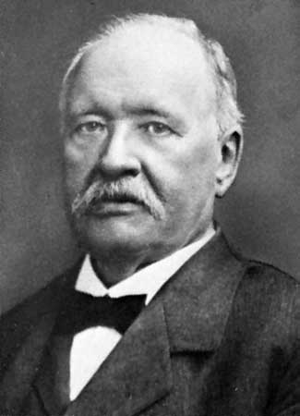
Factors affecting the rate constant k
Dependence on the temperature T
Arrhenius equation
ln(k)
slope is –E_{a}/R
k = rate constant
E_{a} = activation energy
A = pre-exponential factor
R= gas constant
1/ T
Rate constant decreases with decreasing temperature
Arrhenius (1887)
Svante Arrhenius

Slide 3
Arrhenius equation
Rate constant increases with increasing temperature
But not for ALL reactions!!
Termolecular reactions generally slow down as T increases
Lifetime of AB* with respect to decomposition back to reactants (k₂) decreases as T increases
the probability of AB* being stabilized by a collision with M falls with increasing T

Slide 4
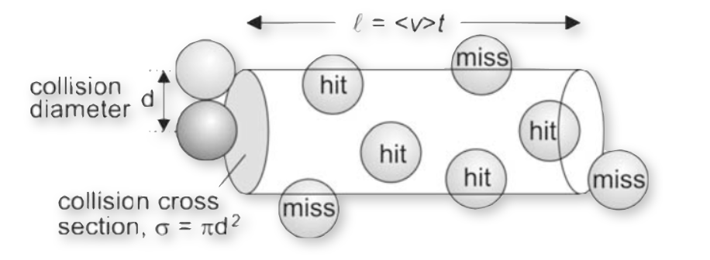
Reaction velocity and collision theory
velocity of a bimolecular elementary reaction:
v = (collision density) x (energy factor) x (steric factor)
1. Collision density (Z) among A and B
From kinetic theory of gases:
  Collision frequency for one A molecule (z):
is the number of collisions made by one molecule of A with all the B molecules in a certain time divided by the time interval.
Take a cylinder of a certain length l and area (σ_{C}) such that when A molecule travel inside the cylinder it will hit the B molecules that are contained inside the cylinder.
  n_{A}, n_{B} : density (molecules⋅cm⁻³)
  T: temperature (K)
  σ_{C}: collision cross section (cm²)
  μ: reduced mass of A and B
  k_{B}: Boltzmann constant
Notes:
As the name suggests, simple collision theory represents one of the most basic attempts to develop a theory capable of predicting the rate constant for an elementary bimolecular reaction of
the form A + B → P. We begin by considering the factors we might expect a reaction rate to depend upon. Obviously, the rate of reaction must depend upon the rate of collisions between the reactants. COLLISION FREQUENCY: number of collisions made by one molecule of A with all the B molecules in a certain time divided by the time interval. If a take a cylinder of a certain length l and area such that when A molecule travel inside the cylinder it will hit the B molecules that are contained inside the cylinder.
However, not every collision leads to reaction. Some colliding pairs do not have enough energy to overcome the activation barrier, and any theory of reaction rates must take this
energy requirement into account. Also, it is highly likely that reaction will not even take place on every collision for which the energy requirement is met, since the reactants may need to collide in
a particular orientation (e.g. SN2 reactions) or some of the energy may need to be present in a particular form (e.g. vibration in a bond coupled to the reaction coordinate). In summary, there are
three aspects to a successful reactive collision, and we might expect an expression for the rate of a bimolecular reaction to take the following form.
ν = (encounter rate) (energy requirement) (steric requirement)

Slide 5

Reaction velocity and collision theory
velocity of a bimolecular elementary reaction:
v = (collision density) x (energy factor) x (steric factor)
1. Collision density (Z) among A and B
  Collision frequency for one A molecule (z):
  z = volume⋅density(B) / time
  = σ_{C}<v>t ⋅n_{B} / t = σ_{C}⋅<v>⋅n_{B}
  Collision density (Z):
multiply for the concentration (density) of A molecules
  Z = z⋅n_{A} = σ_{C}<v>⋅ n_{A} n_{B}
  mean relative velocity <v>
Notes:
As the name suggests, simple collision theory represents one of the most basic attempts to develop a theory capable of predicting the rate constant for an elementary bimolecular reaction of
the form A + B → P. We begin by considering the factors we might expect a reaction rate to depend upon. Obviously, the rate of reaction must depend upon the rate of collisions between the reactants. COLLISION FREQUENCY: number of collisions made by one molecule of A with all the B molecules in a certain time divided by the time interval. If a take a cylinder of a certain length l and area such that when A molecule travel inside the cylinder it will hit the B molecules that are contained inside the cylinder.
However, not every collision leads to reaction. Some colliding pairs do not have enough energy to overcome the activation barrier, and any theory of reaction rates must take this
energy requirement into account. Also, it is highly likely that reaction will not even take place on every collision for which the energy requirement is met, since the reactants may need to collide in
a particular orientation (e.g. SN2 reactions) or some of the energy may need to be present in a particular form (e.g. vibration in a bond coupled to the reaction coordinate). In summary, there are
three aspects to a successful reactive collision, and we might expect an expression for the rate of a bimolecular reaction to take the following form.
ν = (encounter rate) (energy requirement) (steric requirement)

Slide 6
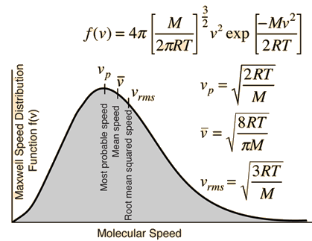
Collision theory: mean relative velocity
<v>: mean relative velocity
Temperature (T) is a measure of the kinetic energy of a gas (e.g. air) molecule. At a given T the speeds at which molecules travel are statistically distributed according to the Maxwell-Boltzmann distribution
From this distribution various «averaged» speeds can be defined, that are related to the T (in K):
The mean relative velocity
<v> or v
R universal gas constant
M molar mass
k_{B} Boltzmann constant
μ molecular mass (reduced mass if A and B different)
Notes:
To calculate features of a perfect gas that are related to collisions, a point is regarded as being surrounded by a sphere of diameter d. A molecule will hit another molecule if the centre of the former lies within a circle of radius d. The collision cross-section is the target area, pd 2.

Slide 7
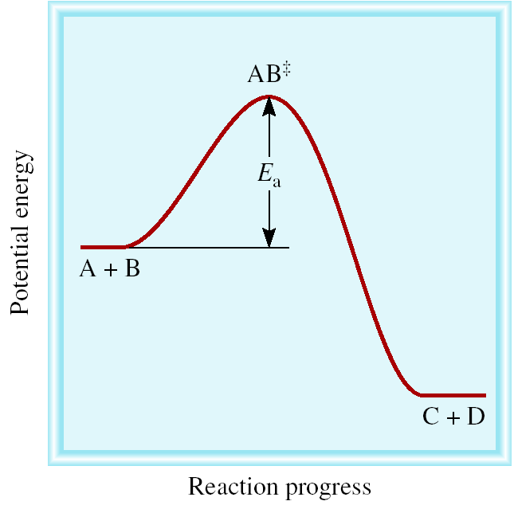
Reaction velocity and collision theory
Activation energy for Reaction
  The activation energy (E_{a}) is the amount of energy for reactants to overcome an energy barrier on way to forming products
  even exothermic processes can have E_{a} ≠ 0
Notes:
Energia di attivazione: la minima energia richiesta per iniziare una reazione chimica. For a Maxwell-Boltzmann distribution of molecular speeds, the fraction of collisions for which the
energy is high enough to overcome the activation barrier is exp(-Ea/RT).
However, not every collision leads to reaction. Some colliding pairs do not have enough energy to overcome the activation barrier, and any theory of reaction rates must take this
energy requirement into account.

Slide 8
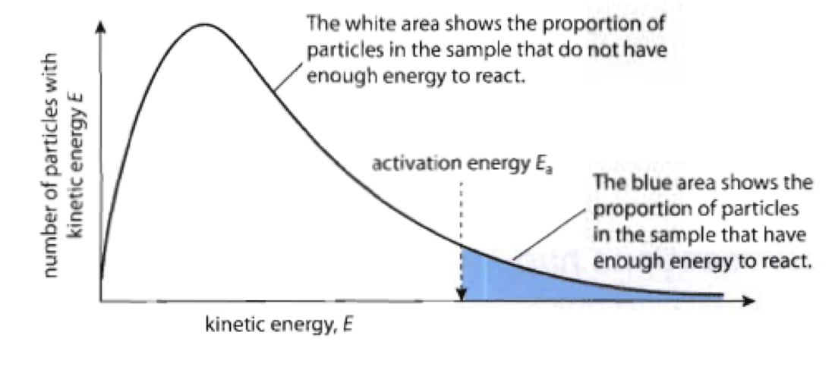
Reaction velocity and collision theory
2. Energy factor
Maxwell-Boltzmann distribution of molecular velocities
n. of energetically allowed collisions scales with the fraction of molecules with kinetic energy > E_{a}:
  exp(-E_{a} /RT)
Notes:
Energia di attivazione: la minima energia richiesta per iniziare una reazione chimica. For a Maxwell-Boltzmann distribution of molecular speeds, the fraction of collisions for which the
energy is high enough to overcome the activation barrier is exp(-Ea/RT).
However, not every collision leads to reaction. Some colliding pairs do not have enough energy to overcome the activation barrier, and any theory of reaction rates must take this
energy requirement into account.

Slide 9
Reaction velocity and collision theory
3. Steric factor P
  Relative orientation of reagents affects reaction probability:
Example:
CH₃I + Cl → CH₃Cl + I (Walden inversion)
leads to reaction
Non reactive
  reactive cross
  section σ_{R}
  σ_{R} = P ⋅ σ_{C}
  collision cross
  section σ_{C}
  0 ≤ P ≤ 1 → σ_{R} is always a fraction of σ_{C}
Notes:
Experimentally, measured rates are often found to be up to an order of magnitude smaller than those calculated from simple collision theory, suggesting that features such as the relative
orientation of the colliding species is important in determining the reaction rate. We account for the disagreement between experiment and theory by introducing a steric factor, P, into our expression for the reaction rate. Alternatively, we can replace the collision cross section, σC, with a reaction cross section σR, where σR = PσC. Usually, P is considerably less than unity, but values greater than one are also possible. An example is the ‘harpoon reaction’ between Rb and Cl2. The reaction mechanism involves an electron transfer at large separations to form Rb+ + Cl2
-, after which the electrostatic attraction between the two ions guarantees reaction. P is large because the reaction cross section is determined by the electron transfer distance, which is much larger than the collision diameter.
Problemi di questo modello:
(i) It does not account for the fact that, unless the collision is head on, not all of the kinetic energy of the two reactants is available for reaction. Conservation of angular momentum
means that only the kinetic energy corresponding to the velocity component along the relative velocity vector of the reactants actually contributes to the collision energy.
(ii) The energy stored in internal degrees of freedom in the reactants (vibrations, rotations etc) has been ignored. For reactions involving large molecules, this often leads to a large
discrepancy between simple collision theory and experiment, though this is partly corrected for by the inclusion of the steric factor, P. This problem is largely solved in another theory
known as transition state theory, which you will learn about next year.

Slide 10
Reaction velocity and collision theory
Teoria delle collisioni e velocità di reazione
velocity of a bimolecular elementary reaction:
v = (collision density) x (energy factor) x (steric factor)
k(T): Arrhenius rate constant
Notes:
Experimentally, measured rates are often found to be up to an order of magnitude smaller than those calculated from simple collision theory, suggesting that features such as the relative
orientation of the colliding species is important in determining the reaction rate. We account for the disagreement between experiment and theory by introducing a steric factor, P, into our expression for the reaction rate. Alternatively, we can replace the collision cross section, σC, with a reaction cross section σR, where σR = PσC. Usually, P is considerably less than unity, but values greater than one are also possible. An example is the ‘harpoon reaction’ between Rb and Cl2. The reaction mechanism involves an electron transfer at large separations to form Rb+ + Cl2
-, after which the electrostatic attraction between the two ions guarantees reaction. P is large because the reaction cross section is determined by the electron transfer distance, which is much larger than the collision diameter.
Problemi di questo modello:
(i) It does not account for the fact that, unless the collision is head on, not all of the kinetic energy of the two reactants is available for reaction. Conservation of angular momentum
means that only the kinetic energy corresponding to the velocity component along the relative velocity vector of the reactants actually contributes to the collision energy.
(ii) The energy stored in internal degrees of freedom in the reactants (vibrations, rotations etc) has been ignored. For reactions involving large molecules, this often leads to a large
discrepancy between simple collision theory and experiment, though this is partly corrected for by the inclusion of the steric factor, P. This problem is largely solved in another theory
known as transition state theory, which you will learn about next year.
While most reactions with which we deal in atmospheric chemistry increase in rate as the temperature increases, there are several notable exceptions. The first is the case of termolecular reactions, which generally slow down as the temperature increases. This can be rationalized qualitatively on the basis that the lifetime of the excited bimolecular complex formed by two of the reactants with respect to decomposition back to reactants decreases as the temperature increases, so
that the probability of the excited complex being stabilized by a collision with a third body falls with increasing temperature.

Slide 11
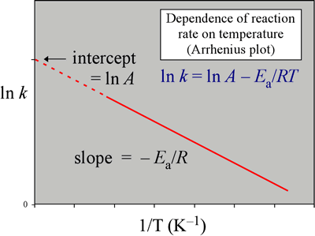
Arrhenius plots
Teoria delle collisioni e velocità di reazione
Measurements of k values at different temperatures (T)
Plotted on a log scale, so a fit to Arrhenius expression appears as a line
Activation energy can be determined from the slope
Notes:
Experimentally, measured rates are often found to be up to an order of magnitude smaller than those calculated from simple collision theory, suggesting that features such as the relative
orientation of the colliding species is important in determining the reaction rate. We account for the disagreement between experiment and theory by introducing a steric factor, P, into our expression for the reaction rate. Alternatively, we can replace the collision cross section, σC, with a reaction cross section σR, where σR = PσC. Usually, P is considerably less than unity, but values greater than one are also possible. An example is the ‘harpoon reaction’ between Rb and Cl2. The reaction mechanism involves an electron transfer at large separations to form Rb+ + Cl2
-, after which the electrostatic attraction between the two ions guarantees reaction. P is large because the reaction cross section is determined by the electron transfer distance, which is much larger than the collision diameter.
Problemi di questo modello:
(i) It does not account for the fact that, unless the collision is head on, not all of the kinetic energy of the two reactants is available for reaction. Conservation of angular momentum
means that only the kinetic energy corresponding to the velocity component along the relative velocity vector of the reactants actually contributes to the collision energy.
(ii) The energy stored in internal degrees of freedom in the reactants (vibrations, rotations etc) has been ignored. For reactions involving large molecules, this often leads to a large
discrepancy between simple collision theory and experiment, though this is partly corrected for by the inclusion of the steric factor, P. This problem is largely solved in another theory
known as transition state theory, which you will learn about next year.
While most reactions with which we deal in atmospheric chemistry increase in rate as the temperature increases, there are several notable exceptions. The first is the case of termolecular reactions, which generally slow down as the temperature increases. This can be rationalized qualitatively on the basis that the lifetime of the excited bimolecular complex formed by two of the reactants with respect to decomposition back to reactants decreases as the temperature increases, so
that the probability of the excited complex being stabilized by a collision with a third body falls with increasing temperature.

Slide 12
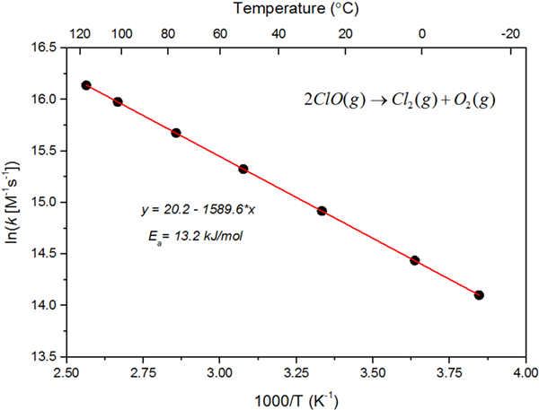
Examples of Arrhenius Plots
Teoria delle collisioni e velocità di reazione
Arrhenius plot for the reaction:
ClO + ClO →Cl₂ + O₂
Arrhenius plot for the reaction:
O(¹D) + N₂ → O(³P)+ N₂
What is going on??

Slide 13
Non-Arrhenius temperature dependences
Teoria delle collisioni e velocità di reazione
It formally corresponds to a negative activation energy
O(¹D) + N₂
Negative activation energies ARE possible and they
are often an indication that the reaction proceeds via the formation of an intermediate complex
O(³P) + N₂
N₂O

Slide 14
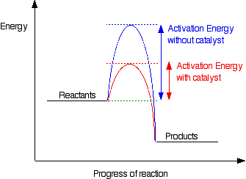
Catalysis and catalysts
The catalyst in a reaction provides an alternative reaction mechanism with smaller activation anergies
mechanism without catalyst
mechanism
with catalyst

Slide 15

Exercise n. 12 - Kinetics
The rate of the second-order decomposition of acetaldehyde (CH₃CHO) was measured over the range 700-1000K, and the rate constant that were found are reported in the Table. Determine the activation energy (E_{a}) and the pre-exponential factor (A) according to the Arrhenius expression for the rate constant
k=A⋅exp(-Ea/RT)
Temperature (K) | k (mol⁻¹⋅dm³s⁻¹)
700 | 0.011
730 | 0.035
760 | 0.105
790 | 0.343
810 | 0.789
840 | 2.17
910 | 20.0
1000 | 145

Slide 16
Exercise n. 12 - Kinetics
The rate of the second-order decomposition of acetaldehyde (CH₃CHO) was measured over the range 700-1000K, and the rate constant that were found are reported in the Table. Determine the activation energy (E_{a}) and the pre-exponential factor (A) according to the Arrhenius expression for the rate constant k=A⋅exp(-Ea/RT)

Slide 17
Molecular collisions: collision frequency and mean free path
z collision frequency (average rate of collisions made by one molecule A with the other molecules B)
ρ_{C} collision cross section
<v> mean relative velocity
n number density of the B molecules
To estimate the collision frequency of atmospheric molecules we need to estimate the three above paramenters. Let’s start with:
1. <v> mean relative velocity
Notes:
To calculate features of a perfect gas that are related to collisions, a point is regarded as being surrounded by a sphere of diameter d. A molecule will hit another molecule if the centre of the former lies within a circle of radius d. The collision cross-section is the target area, pd 2.

Slide 18
Molecular collisions: collision frequency and mean free path
1. <v> mean relative velocity – Numerical example
Example 1: Calculate the mean speed of O₂ molecules in a sample at T= 25 °C
Result:
R = 8.3143 J⋅K⁻¹⋅mol⁻¹
T = 25+273=298K
M = 32 g⋅mol⁻¹ = 0.032 kg⋅mol⁻¹
m⋅s⁻¹
Example 2: Calculate the mean speed of N₂ molecules in a sample at T= 15 °C
Mean relative velocity of molecules in a gas is proportional to the square root of T
Result:
R = 8.3143 J⋅K⁻¹⋅mol⁻¹
T = 15+273=288K
M = 28 g⋅mol⁻¹ = 0.032 kg⋅mol⁻¹
m⋅s⁻¹
Notes:
To calculate features of a perfect gas that are related to collisions, a point is regarded as being surrounded by a sphere of diameter d. A molecule will hit another molecule if the centre of the former lies within a circle of radius d. The collision cross-section is the target area, pd 2.

Slide 19
Molecular collisions: collision frequency and mean free path
2. σ_{C} collision cross section
Target area of a molecule (related to molecular dimensions+interaction potentials). Assuming the molecule to be a hard sphere with diameter d, the collision cross section is πd ² (area of a circle with radius=d)
Notes:
To calculate features of a perfect gas that are related to collisions, a point is regarded as being surrounded by a sphere of diameter d. A molecule will hit another molecule if the centre of the former lies within a circle of radius d. The collision cross-section is the target area, pd 2.

Slide 20
Molecular collisions: collision frequency and mean free path
3. n number density of the B molecules
From the ideal gas law: density (in mol⋅volume⁻¹)
in molecules⋅volume⁻¹
Example: Calculate the number density of gas molecules in a sample at 800 mbar and T= 15 °C
R = 0.0821 l⋅atm⋅K⁻¹⋅mol⁻¹
T = 15+273=288K
P = 800 mbar = 800/1013.25=0.7895 atm
molecules⋅cm⁻³
Notes:
To calculate features of a perfect gas that are related to collisions, a point is regarded as being surrounded by a sphere of diameter d. A molecule will hit another molecule if the centre of the former lies within a circle of radius d. The collision cross-section is the target area, pd 2.

Slide 21
Molecular collisions: collision frequency and mean free path
z collision frequency (average rate of collisions made by one molecule A with the other molecules B)
ρ_{C} collision cross section
<v> mean relative velocity
n density of the B molecules
Example: Calculate the collision frequency z among N₂ molecules in a sample at 800 mbar and T= 15 °C
nm² =
m² (see point 2. before)
m⋅s⁻¹ (see point 1. before)
molecules⋅cm⁻³ (see point 3. before)
molecules⋅m⁻³
collisions⋅s⁻¹
Hence:
and the time between two collisions is 1/z=
s
(a.k.a. time of flight)
Notes:
To calculate features of a perfect gas that are related to collisions, a point is regarded as being surrounded by a sphere of diameter d. A molecule will hit another molecule if the centre of the former lies within a circle of radius d. The collision cross-section is the target area, pd 2.

Slide 22
Molecular collisions: collision frequency and mean free path
λ mean free path : the average distance that a gas molecule travels between two collisions
Given that the average speed is the mean distance divided by time taken for the journey
Then:
Example: Calculate the mean free path λ for N₂ molecules in a sample at 800 mbar and T= 15 °C
m² (see point 2. before)
molecules⋅m⁻³ (see point 3. before)
Hence:
Notes:
Because speed is distance travelled divided by the time taken for the journey, the average speed, is the
average length of the flight of a molecule between collisions (that is, the mean free path, λ) divided by
the time of flight (1/z). It follows that the mean free path and the collision frequency are related by

Slide 23
Mean free path in atmosphere
λ mean free path : the average distance that a gas molecule travels between two collisions
How do you expect λ to change with increasing altitude?
λ increses with increasing altitude (z) due to the (exponential) decrease of the air density
Notes:
Arrivata qui il 13 ottobre

Slide 24
Laboratory Techniques for Determining
Rate Constants of Gas-Phase Reactions
Measurement of the absolute value of k
A + B → products
Let’s assume a first order law:
generate A (and B)
measure their concentration
as a function of time
You need to:
Major techniques:
(fast) flow reaction systems
flash-photolysis systems
cavity ring down systems
tecniques for measurements of σ(E) (cross section), from which k(T) can be obtained:
Notes:
To study the reaction kinetics of a relatively reactive species A with a reactant B, one normally follows the
loss of small amounts of A in the presence of a great excess of B. This requires then that one be able first to
generate A and second to monitor its concentration as a function of time. Ideally, to fully elucidate the reaction
mechanism, one would also monitor the concentrations of intermediates and products. As we shall see,
in practice, for many reactions this proves to be much more difficult than to simply determine the rate constant itself.

Slide 25
Laboratory Techniques for Determining
Rate Constants of Gas-Phase Reactions
But what if we have second (or third) order laws?
A + B → products
Work under pseudo-first order conditions : use a great excess of one of the two reagents so that it can be treated as constant
linear plot with slope =
The absolute rate coefficient k is the slope of a plot of k’ against the corresponding [B]₀ values
different starting
[B]₀ values
ln[A]
[B]₀ (10¹³ molecules ⋅cm⁻³)
Notes:
That is, A decays exponentially with time determined by (k[B]0), as if it were a first-order reaction. Thus
under these so-called pseudo-first-order conditions, a plot of ln[A] against time for a given value of [B]0 should be linear with a slope equal to (-k17[B]o).
These plots are carried out for a series of concentrations of [B] 0 and the values of the corresponding decays determined see for example a typical plot of OH resonance fluorescence intensity
as a function of reaction time in the presence of increasing concentrations of at 373 K
Increasing concentration of excess reactant increases loss rate of OH
– Note there is measurable loss rate of OH in absence of excess reactant
• Time scale is less than 30 ms!
– First points are at t > 5 ms so that production of OH can go to completion
Finally, the absolute rate constant of interest, k , is the slope of a plot of the absolute values of these decay rates against the corresponding values of [B] o. Some examples are discussed below.
To study the reaction kinetics of a relatively reactive species A with a reactant B, one normally follows the loss of small amounts of A in the presence of a great excess of B. This requires then that one be able first to generate A and second to monitor its concentration as a function of time. Ideally, to fully elucidate the reaction
mechanism, one would also monitor the concentrations of intermediates and products. As we shall see,
in practice, for many reactions this proves to be much more difficult than to simply determine the rate constant itself.

Slide 26
Laboratory Techniques for Determining
Rate Constants of Gas-Phase Reactions
Measurement of the relative value of k (i.e. a ratio k₁/k₂)
Competition between two different reactions for A with reagents X₁ and X₂:
By monitoring, for instance, [X₁] and [X₂] with time: [A] can be eliminated and the ratio k₁/k₂ is obtained:
Notes:
Relative values:
In the simplest case, determining relative rate constants for a reactive species A is based on a competition between two reactions with two different reagents
X1 and X2 are the reactants that compete for A, and P1 and P2 are the respective products of these reactions.
By monitoring the concentrations of the reactants X1 and X2, the concentrations of the products P1 and P2, or the change in the concentration of one of
these as the second reactant is added with time, one can obtain the rate constant ratio k1/k 2.
For example, if X1 and X2 are monitored, the relevant rate laws are as follows:

Slide 27
Flow reaction techniques
Flow techniques are used to study reactions occurring on timescales of 1-10⁻³ s
1- In the simplest flow method, reactants are mixed at one end of a flow tube, and the composition of the reaction mixture is monitored at one or more positions further along the tube. If the flow velocity along the tube is known, then measurements at different positions provide information on concentrations at different times after initiation of reaction
2- Alternatively, the detector may be in a fixed position, but a moveable injector may be used to inject one of the reactants into the flow tube at different positions relative to the detector in order to study the time dependence of the reaction mixture composition

Slide 28
Fast-flow (discharge) systems
Genaration of reagent A (free radicals via discharge systems)
Fiexd position detector
Movable inlet for reagent B
Flow tube (speed 1000 cm⋅s⁻¹)
Reagents A and B are mixed (in presence of large amount of inert gas) in a flow tube
A (also a free radical via a discharge system) is generated and enters at the upstream end of the tube
B is inserted at different distances from the detector via a movable inlet
As the mixture travels along the flow tube, A and B react
Decay of A along the flow tube is measured as a function of time (i.e. distance)
Notes:
See description of techniques in: https://chem.libretexts.org/Textbook_Maps/General_Chemistry/Book%3A_Chem1_(Lower)/17%3A_Chemical_Kinetics_and_Dynamics/17.7%3A_Experimental_methods_of_chemical_kinetics
flow tube in which the reactants A and B are mixed in the presence of a large amount of an inert "bath gas" (e.g. He or Ar). As the mixture
travels down the flow tube at relatively high linear flow speeds (typically 1000 cm s - l ) , A and B react. The decay of A along the length of the flow tube, that is,
with time, is followed. In most of these systems, discharges are used to generate A or another species that is a precursor to A. The reactive species is generated
in a microwave discharge and enters at the upstream end of the flow tube, and the second reactant is added through one port, C or D, of a movable inlet. The detector is fixed at the downstream end of the flow tube and the reaction time is varied by moving the mixing point for C and D (i.e., the movable inlet) relative to the fixed detector.
At typical linear flow speeds of 1000 cm/s, 1 cm along the tube corresponds to ~ 1-ms reaction time. Thus a flow tube of length 1 m can be used to study
reactions at reaction times up to 100 ms.

Slide 29
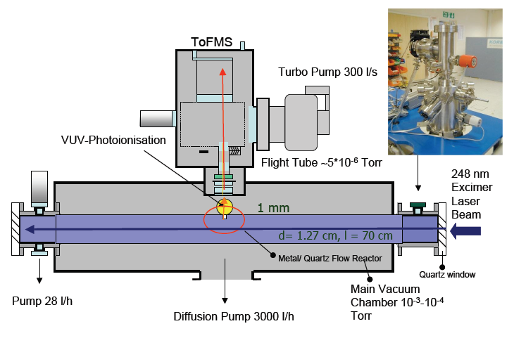
Flash-photolysis & laser pump-probe techniques
In flash photolysis, reaction is initiated by a pulse of light (flash or pump) that dissociates a suitable precursor molecule in the reaction mixture to produce a reactive species initiating reaction. The concentration of the reactive species is then monitored as a function of time (fast detection)
The shortest timescale over which reactions may be studied using this technique is determined by the duration of the ‘flash’.
In the past, the flash was provided by a discharge lamp (ca. μs – ms)
In modern experiments the flash is provided by a laser pulse (typical duration few nanoseconds, 1 ns = 10⁻⁹ s)
For very fast reactions, laser pulses as short as a few tens of femtoseconds (1 fs = 10⁻¹⁵ s) are used.

Slide 30
Laser flash-photolysis
Notes:
This technique relies on flash (ie fast) photolysis to generate the reactive species A. Resonance or induced
fluorescence is used to monitor the decay of A but evolution of the techniques used time-resolved absortion spectroscopies (e.g. in the IR) with ultrashort laser pulses to interrogate the product molecules.

Slide 31
Cavity ring-down methods
Absorption spectroscopy with high sensitivity
Sequential loss of light intensity due to the repeated travelling of a light beam across a sample cell
Decay of intensity profile changes with concentration of the absorbing species (either reactant or product)
High sensitivity
Good time resolution (10⁻⁵ s)
General applicability and simple experiment
Notes:
The cavity ring down method is based on the sequential loss of light intensity as a light pulse repeatedly traverses the length of a
cell during multiple reflections between two mirrors. Loss of intensity occurs both during reflection at the mirrors and, if an absorbing gas is present, by its
absorption as well. As will be seen shortly, the change in the time profile of the light transmitted through mirror B when an absorber is present
The advantages of the cavity ring down technique
are its high sensitivity (fractional absorptions per pass
of ~ 10 -6) and good time resolution ( ~ 10 .5 s). In addition, it has the usual advantages associated with absorption spectrometry--e.g., most species can be detected
through light absorption at specific wavelengths and is experimentally relatively simple to carry out. Typical examples of its application to processes of
interest for atmospheric chemistry are the measurement of the kinetics of the reaction of the vinoxy radical with 02 and the kinetics of the C2H 5 + C2H 5 and C2H50 2 + C2H50 2
reactions. In addition, it has been shown to be useful for probing surface processes as well when combined with total internal reflection
techniques sent can be used to follow the concentration of the absorber and hence to carry out kinetic studies.

Slide 32
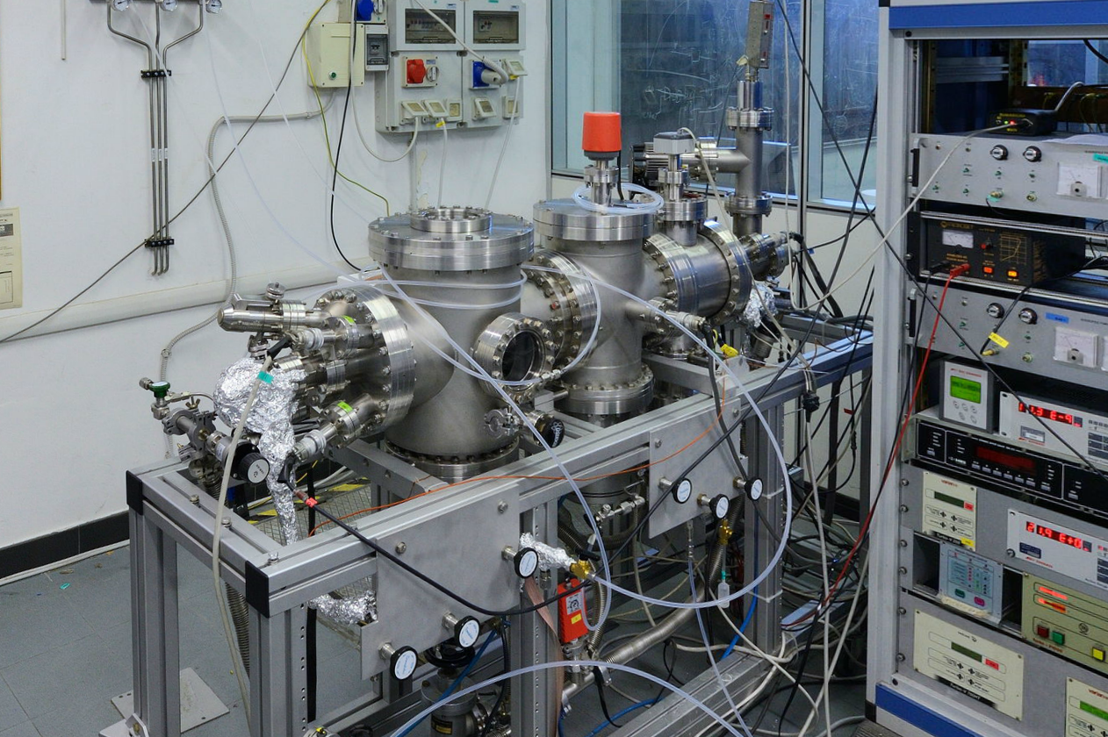
Techniques for cross section measurements
The Guided Ion Beam method
For reactions involving ions
neutral reagent
A⁺ + B → C⁺ + D
Q-MS filter 2
Ion source
Q-MS filter 1
octupole 2D trap & collision cell
detector
The Guided Ion Beam set-up@ Trento University
Detector
ion source
Observables:
Product intensities (+branching ratios) vs kinetic energy in all directions, σ(E)
collision cell
Notes:
to realize the experiment it requires the following set-up.
it is a tandem mass spectrometer with 2 quadrupoles that select masse of the parent and the products. by using an EI source we create the ions that collide with the neutral target inside an octupole ion-guide, surrounded by a collision cell. The octuple traps the ions in the transversal directions and forces them to move towards the detection area.
at the end of the instrument we have an electron multiplier that detects all the ions.

Slide 33
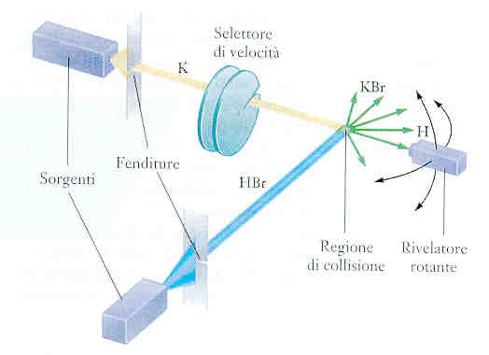
Techniques for cross section measurements
For reactions involving radicals
A + B → C + D
velocity selector
A
C
Crossed molecular beam set-up @ Perugia University
D
Molecular beam sources of A and B
slits
B
collision region
rotating detector
Observables:
Product intensities vs lab scattering angle (Θ): differential cross sections σ(E,Θ)
Product intensities vs kinetic energy at fixed Θ

Slide 34
Exercise n. 13 - Kinetics
Calculate the collision frequency, z, and the collision density, Z, in carbon monoxide (CO), R = 180 pm at 25 °C and 100 kPa.
What is the percentage increase when the temperature is raised by 10 K at constant volume?

Slide 35
Exercise n. 13 - Kinetics
Calculate the collision frequency, z, and the collision density, Z, in carbon monoxide (CO), R = 180 pm at 25 °C and 100 kPa.
What is the percentage increase when the temperature is raised by 10 K at constant volume?
Hints:
Collision frequencies
Mean velocity
Collision density

Slide 36
Exercise n. 13 - Kinetics
Solution. The collision frequency z is given by:
Given R as the molecular dimension (diameter of the molecule) we can calculate the collision cross section as:
The mean velocity is:
The density is:
The collision density Z is given by:
A raise in T of 10K means an increase of 10/298*100=3.36%
The overall dependence of z on T is from the mean velocity because if T is increase at constant volume the density will not change, hence is T^{1/2}

Slide 37
Exercise n. 14 - Kinetics
For collisions between molecules having a radius ≈ 0.2 nm and a molar mass of 50 g⋅mol⁻¹.
Calculate what can be the maximum value for the rate coefficient at 298 K.
if the real rate coefficient is 2.5x10⁻¹³ cm³⋅molecule⁻¹s⁻¹, what is the approximate probability of reaction during one collision?
Hints:
Rate constant expression:

Slide 38
Exercise n. 14 - Kinetics
Solution. The rate constant is:
And the maximum value is observed for P=1 and E_{a}=0, so that:
If k_{real} = 2.5x10⁻¹³ cm³⋅molecule⁻¹s⁻¹ the approximate probability of reaction is given by:

Slide 40
REAZIONI A CATENA
H_{2(g)} + Cl_{2(g)} → 2 HCl_{(g)}
Meccanismo ipotizzato:
Cl₂ + luce → 2Cl innesco
Cl + H₂ → HCl + H
H + Cl₂ → HCl + Cl
2Cl + M → Cl₂ + M termine
propagazione
Importanti nelle fiamme, esplosioni, reazioni di polimerizzazione

Slide 41
Notes:
Aggiungere il concetto di T ed energia cinetica media delle molecole di aria preso da
Fund_Atmosph_Modeling_Ch2_Atmosph_struct_thermodynamics.pdf in books

Slide 43
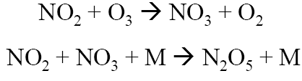

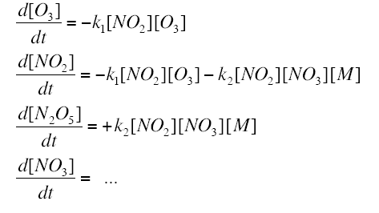

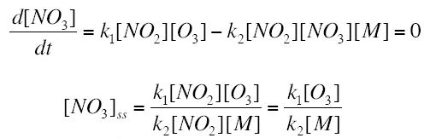


two elementary steps
DA DARE COME ESERCIZIO
applying the steady state approximation

