Slide 1

University of Trento
Master of Science in Environmental Meteorology https://international.unitn.it/environmental-meteorology
A.A. 2023-24
Environmental Physical Chemistry
Fundamentals
Daniela Ascenzi
Dept. Physics, University of Trento, Italy
e-mail: daniela.ascenzi@unitn.it

Slide 2
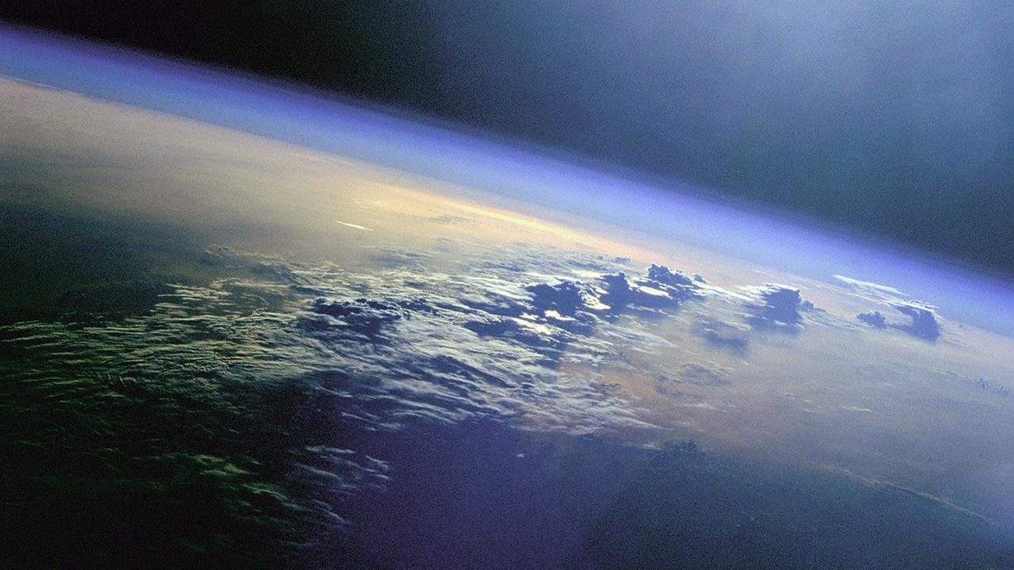
The Earth atmosphere
Atmosphere:
mass 5.3x10¹⁸ kg
thickness ∼2x10² km
Earth:
mass 5.97x10²⁴ kg
radius 6.37x10³ km
The atmosphere has a thickness ∼ 2% of the Earth radius (very thin layer)
>99% of the mass in the first 15-20 km
Earth
6,37×10³ km
Notes:
Whole atmosphere has a thickness that is about 2% earth rad, but to the top of the stratosphere (50km) is only about less than 0.8% of the radius. It is a fragile shield around our planet, but upon which life as we know it depends on Earth
Atmosfera massa 5.14 x 1018 kg spessore ~2 x 102 km
Troposfera ~10-12 km 99,9% massa
Terra massa 5.97 x 1024 kg diametro ~1,27 x 104 km
Mass of the atmosphere can be estimated by knowing the chemical composition and how the pressure chnages with altitudes

Slide 3
How (and where) do we start?
Describe the general physical characteristics
mass, temperature, vertical extent, motions
Describe the major and minor components
concentrations (absolute and relative amounts)
Develop a physico-chemical framework to:
Predict how a species evolves in time and space
Apply this framework to give answers to topic questions:
Why is the atmosphere mainly N₂, O₂, H₂O and CO₂?
How are humans affecting this composition?
What are the implications of such changes?
...
Notes:
Lo stato termodinamico dell’atmosfera è definito da P,T e d (approx. gas ideale). Major and minor components of gases.
Here we talk about these two topics

Slide 4

Measures of atmospheric composition
How do we describe the amounts of chemicals in the atmosphere?
The atmosphere contains gases (mostly) + some liquids/solids (aerosols and clouds)
Gases:
ideal gas law
Aerosols and clouds:
size, number, composition, phase state
mass and volume of particles per volume of air

Slide 5
Thermodynamics of gases
Thermodynamic state of the atmosphere (mixture of ideal gases) is defined by P (pressure), T (temperature), V (volume) and n (mole numbers)
equation of state for an ideal gas
n. moles
density
numerically equal to the molecular mass MW (in a.m.u.)
=8.3145 J⋅K⁻¹⋅mol⁻¹ or Pa⋅m³⋅K⁻¹⋅mol⁻¹
= 0.082058 L⋅atm⋅K⁻¹⋅mol⁻¹
universal gas constant
Notes:
Eq. of states for the atm as a thermodynamic system the physical variables are: Because the max pressure that we have is about 1 bar the ideal approximation is valid at all altitudes

Slide 6
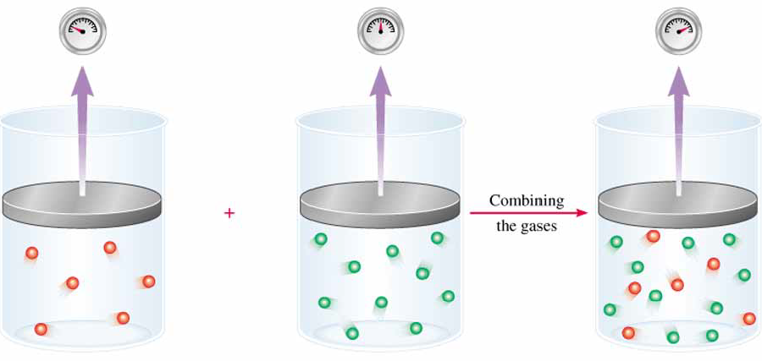
Mixture of ideal gases
Dalton’s law: total pressure P_{tot} of a mixture of gases is the sum of the partial pressures of each component
partial pressure P_{i}: notional pressure of that gas if it alone occupied the entire volume of the original mixture at the same T
T, V constant
P₁
P₂
P_{tot}=
P₁
+
P₂

Slide 7
Mixture of ideal gases
molar fraction of the i-th component
In terms of density:
Hence:
is the average molar mass of the gaseous mixture
Example: dry air
N₂ 78.08% O₂ 20.95% Ar 0.934% + traces
Molar fractions: x(N₂)=0.7808; x(O₂)=0.2095; x(Ar)=0.00934
Notes:
Lo stato termodinamico dell’atmosfera è definito da P,T e d (approx. gas ideale)

Slide 8
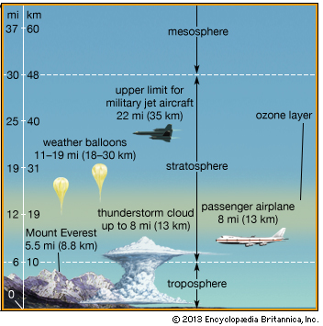
General physical characteristics
Vertical structure of the atmosphere:
Pressure
Density
Temperature
Notes:
Before going into details of the compositions we need to introduce the general physical characteristics of the atmosphere

Slide 9
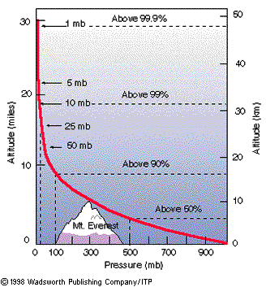
Vertical structure: pressure
At any height z above ground, air pressure (force/area) is due to the weight of all the air lying above z. Hence atmospheric pressure decreases with altitude
where “=“ is for an isothermal atmosphere
P₀ : pressure at reference level (sea level, z=0)
H (scale height) = 7-8 km (for the lowest 100 km of atmosphere)
Notes:
Air pressure at any height in the atmosphere is due to the force per unit area exerted by the weight of all of the air lying above that height. Consequently, atmospheric pressure decreases with increasing height above the ground (in the same way that the pressure at any level in a stack of foam mattresses depends on how many mattresses lie above that level).
At any point on the Earth’s surface, the atmosphere exerts a downward force on the underlying surface due to the Earth’s gravitational attraction.The downward
force, (i.e., the weight) of a unit volume of air with density is given by F=mg.
In the lowest 100 km of the atmosphere, the scale height ranges roughly from 7 to 8 km.

Slide 10
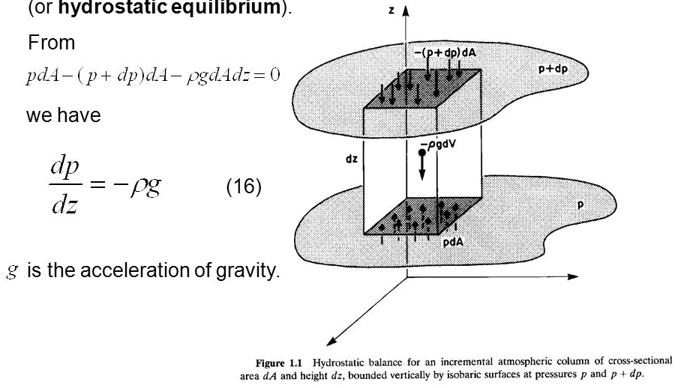
Vertical structure: pressure
where does it come from?
integration of the hydrostatic balance equation (Stevin law) in the case of T=cost
infinitesimal air parcel
For derivation see (for instance) Wallace and Hobbs Chapter 3.2 “The hydrostatic equation”
Notes:
Derivation of the expression for an isothermal atmosphere is from the integration of the Stevin law (hydrostatic balance)
Hydrostatic balance equation: when an incremental air column experiences no net force in the vertical direction it is in hydrostatic equilibrium. By balances the forces exterted at the top and bottom layer of the infinitesimal air parcel in the volum dV=dAdz we obtain:

Slide 11
Pressure dependence derivation
Hydrostatic equation (Stevin’s law)
g = 9.81 m/s² (at z=0)*
assuming T, g and MW_{a} constants with z it can be integrated:
with
H : scale height
* also g changes with the distance from the center of the Earth, but very little: g=9.77 m/s² for z=11km
Notes:
M_{air} = 28,97 g/mol
R = 8.3144 m³ Pa/(K mol)
H=RT/Mag
Con R=8.3144 m^3*Pascal/(K*mol) con 1Pascal=1kg/(m*s2) e quindi 8.3144 m2kg/(K*s2*mol)
T= media tra 288 e 216 K in troposfera (usiamo 268K come media)
Ma= 28.97 g/mol = 0.02897 kg/mol average molar mass of dry air
g (acceleration) = 9.81 m/s2
Hence H = 8.3144*268/(0.02897*9.81) = 7840 m = circa 8 km e circa 8.5 al suolo con T=288
NB: the acceleration due to gravity changes with the distance from the center of the Earth, but not by much. Calling g0 the gravity on the surface, it can be expressed by the formula:
g=g0*[Re/(Re+z)^2 with Re= Earth average radius=6371 km and z at the top of the tropopause being about 11 km
so g0=9.8065 m/s2 and g(11km)=9.77 m/s2
T (troposphere): 288-216 K

Slide 12
Pressure dependence derivation
What is the numerical value of the scale height (H)?
MW_{a} (average molar mass of dry air) = 0.02897 kg⋅mol⁻¹
R (universal gas constant) = 8.3145 m³·Pa·K⁻¹·mol⁻¹ = + = 8.3145 J·K⁻¹·mol⁻¹
T (temperature in K) = 252 K, an average T for the troposphere between bottom (288 K) and top (216 K)
g (acceleration) = 9.81 m·s⁻²
H = 7373 m
For values representative of lower altitudes (e.g. the first 2000 m from sea level an higher average T should be used (e.g. 268K) to get H=7.8 km
Notes:
M_{air} = 28,97 g/mol
R = 8.3144 m³ Pa/(K mol)
H=RT/Mag
Con R=8.3144 m^3*Pascal/(K*mol) con 1Pascal=1kg/(m*s2) e quindi 8.3144 m2kg/(K*s2*mol)
T= media tra 288 e 216 K in troposfera (usiamo 268K come media)
Ma= 28.97 g/mol = 0.02897 kg/mol average molar mass of dry air
g (acceleration) = 9.81 m/s2
Hence H = 8.3144*268/(0.02897*9.81) = 7840 m = circa 8 km e circa 8.5 al suolo con T=288
NB: the acceleration due to gravity changes with the distance from the center of the Earth, but not by much. Calling g0 the gravity on the surface, it can be expressed by the formula:
g=g0*[Re/(Re+z)^2 with Re= Earth average radius=6371 km and z at the top of the tropopause being about 11 km
so g0=9.8065 m/s2 and g(11km)=9.77 m/s2
T (troposphere): 288-216 K

Slide 13
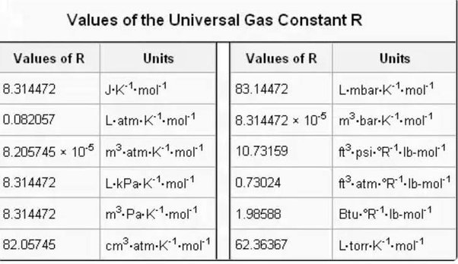
Values of R (universal gas constant)
R (universal gas constant) = 8.3145 m³·Pa·K⁻¹·mol⁻¹ = + = 8.3145 m·N·K⁻¹·mol⁻¹ = 8.3145 J·K⁻¹·mol⁻¹
Notes:
M_{air} = 28,97 g/mol
R = 8.3144 m³ Pa/(K mol)
H=RT/Mag
Con R=8.3144 m^3*Pascal/(K*mol) con 1Pascal=1kg/(m*s2) e quindi 8.3144 m2kg/(K*s2*mol)
T= media tra 288 e 216 K in troposfera (usiamo 268K come media)
Ma= 28.97 g/mol = 0.02897 kg/mol average molar mass of dry air
g (acceleration) = 9.81 m/s2
Hence H = 8.3144*268/(0.02897*9.81) = 7840 m = circa 8 km e circa 8.5 al suolo con T=288
NB: the acceleration due to gravity changes with the distance from the center of the Earth, but not by much. Calling g0 the gravity on the surface, it can be expressed by the formula:
g=g0*[Re/(Re+z)^2 with Re= Earth average radius=6371 km and z at the top of the tropopause being about 11 km
so g0=9.8065 m/s2 and g(11km)=9.77 m/s2
T (troposphere): 288-216 K

Slide 14
Vertical structure: density
Density (ρ) decreases with height in the same manner as pressure
As already seen the ideal gas law for a mixture of gases (air) can be written as:
: density of air
MW_{a} : average molar mass of dry air (28.97 g⋅mol⁻¹)
R : universal gas constant
T : temperature (in K)
Vertical variations >> horizontally and temporally
Standard atmosphere (horiz+time average)
Notes:
These vertical variations in pressure and density are much larger than the corresponding horizontal (variations that drive the meteorological processes)
and time variations. Hence it is useful to define a standard atmosphere, which represents the horizontally and temporally averaged structure of
the atmosphere as a function of height only, as shown in the Fig.

Slide 15
Units for pressure and conversions
Unit | Symbol
mm of mercury | mmHg
atmospheres | atm
hectoPascal | hPa
millibars | mb or mbar
1 atm = 760 mmHg =1013.25 mb
1 Pa = 1 N·m⁻²= 1kg·m⁻¹·s⁻²
1 hPa = 1 mb
Conversions:
Standard sea-level pressure = 1 atm = 1013.25 hPa
We can calculate density of (dry) air at sea-level (assuming T=288 K =15 °C)

Slide 16

Exercise n. 1
Calculate at approximately what height above sea level (z) does half the mass of the atmosphere lie above and the other half lie below.
[Hint: use the barometric equation with scale height H= 7.5 km and neglect the small vertical variation of g with height]

Slide 17
Exercise n. 1
Calculate at approximately what height above sea level (z) does half the mass of the atmosphere lie above and the other half lie below. [Hint: use the barometric equation with scale height H= 7.5 km and neglect the small vertical variation of g with height]
Solution: The pressure at the Earth surface is equal to the weight (per unit area) of the overlying column of air. The same is true for the pressure at any altitude z.
We need to use the barometric equation:
to calculate at what z we have P(z)=P₀/2, i.e. 1013/2=506 hPa.
By substituting in the equation above we have:
Note: Because the pressure at a given height in the atmosphere is a measure of the mass that lies above that level, it is sometimes used as a vertical coordinate instead of height. In terms of mass, the ∼500 hPa level, situated at about 5 km above sea level, is roughly halfway up to the top of the atmosphere

Slide 18
Exercise n. 2
Assuming an exponential pressure and density (ρ) dependence of dry air with scale height H = 7.5 km, estimate:
the height in the atmosphere at which the pressure is equal to 1 hPa
the height in the atmosphere at which the dry air density is equal to 1 kg⋅m⁻³ and
Other assumptions: assume standard sea level temperature T (15 °C) and pressure P (1 atm)

Slide 19
Exercise n. 2
Assuming an exponential pressure and density (ρ) dependence of dry air with scale height H = 7.5 km, estimate:
the height in the atmosphere at which the pressure is equal to 1 hPa
the height in the atmosphere at which the dry air density is equal to 1 kg⋅m⁻³ and
Other assumptions: assume standard sea level temperature T (15 °C) and pressure P (1 atm)
Solution Pressure and density scale with height in the same manner:
And they can be rearranged to give:
Given P₀=1013 hPa (= 1 atm) for point a) one gets:
km
For point b), the value for ρ₀ can be obtained from P₀ assuming an average sea level T of 288K:
Hence:

Slide 20
Exercise n. 3
Assuming a global average for the atmospheric pressure at sea level of 985 hPa, estimate the total mass of the atmosphere and compare it to the mass of the Earth M_{E}= 6.0x10²⁴ kg.
Useful constants:
Earth radius R_{E}=6.37x10³ km
g₀=9.807 m⋅s⁻² gravity acceleration at sea level
[Hint: use the definition of average atmospheric pressure as force/unit surface]

Slide 21
Exercise n. 3
Assuming a global average for the atmospheric pressure at sea level of 985 hPa, estimate the total mass of the atmosphere and compare it to the mass of the Earth M_{E}= 6.0x10²⁴ kg (Earth radius R_{E}=6.37x10³ km, g₀=9.807 m⋅s⁻² gravity acceleration at sea level).
Solution: Given the definition of average atmospheric pressure as the force exerted by a column of air having mass m over a certain area:
From which we get:
with g₀= 9.807 m⋅s⁻², R_{E}=6.37x10⁶ m, P=98500 Pa (N⋅m⁻² =kg⋅s⁻²⋅m⁻¹) c
kg
Ratio between mass of the atmosphere (m) and of the Earth (in %) is:
in ppm (by mass)

Slide 22
Exercise n. 4
If at 0 °C the density of dry air (MW=28.97 g⋅mol⁻¹) alone is 1.275 kg⋅m⁻³ and the density of water vapour alone is 4.770x10⁻³ kg⋅m⁻³, what is the total pressure exerted by a mixture of the dry air and water vapour at 0 °C?

Slide 23
Exercise n. 4
If at 0 °C the density of dry air (MW=28.97 g⋅mol⁻¹) alone is 1.275 kg⋅m⁻³ and the density of water vapour alone is 4.770x10⁻³ kg⋅m⁻³, what is the total pressure exerted by a mixture of the dry air and water vapour at 0 °C?
Solution. From Dalton’s law of partial pressures the total pressure exerted by a mixture of dry air and water vapour is given by the sum of their partial pressures. Given the densities, partial pressures can be obtained using:
For dry air (MW=28.97 g⋅mol⁻¹) and density 1.275 g⋅L⁻¹ hence:
For water vapour (MW=18.0 g⋅mol⁻¹) and density 4.770x10⁻³ g⋅L⁻¹ we have:
Hence the total pressure exerted by the mixture is:

Slide 24
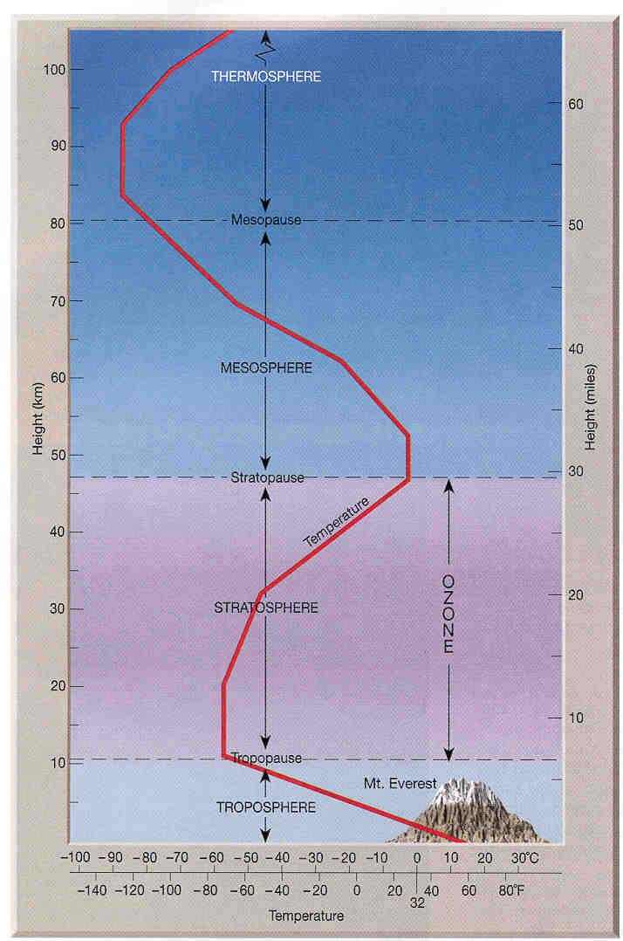
Vertical structure: temperature
Troposphere: T decrease with height (z) (heating from the surface+adiabatic rise)
Lapse rate Γ
=6.5 °C⋅km⁻¹
for humid air. Γ for dry air ∼10 °C⋅km⁻¹
(water condensation releases heat of vaporization thus warming slightly the atmosphere)
(positive, T inversions: sign change of Γ)
      T decreases with altitude → rapid vertical mixing
      up to 10 - 15 km (according to latitudine)
      accounts for 80% of the mass of the atmosphere
      most meteorological phenomena occurs here
      particles/pollutants emitted are cleansed by precipitations → short residence times
Notes:
The tropo(turning or changing)sphere accounts for 80% of the mass of the atmosphere, is relatively well mixed due to the fact that hot air from ground can raise to tropopause in a few days or less. Most of the meteorological phenomena occurs here. It is continually being cleansed or scavenged of aerosols by cloud droplets and ice particles, some of which subsequently fall to the ground as rain or snow. Since warm 'parcels' of air are less dense than colder air, warmer air is buoyant and tends to rise up from Earth's surface towards the top of the troposphere. If you've ever watched cumulonimbus thunderstorm clouds form and grow on a hot summer day, you've seen this rising air in action. The air in the troposphere is 'well mixed' because it is constantly churning and 'turning over' as warm air at the surface rises and colder, denser air at altitude descends to take its place. Embedded within the troposphere are thin layers in which temperature increases with height (i.e., the lapse rate is negative). Within these so-called temperature inversions it is observed that vertical mixing is strongly inhibited.
For dry air lapse rate can be higher (bout 10 degrees per km) due to the presence of water than when T decreases condenses releasing its heat of vaporization and warming slightly the atmosphere

Slide 25
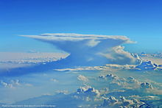
Vertical structure: temperature
Stratosphere: T increase with z due to heat released by reactions involving light, O₃ and O₂
O₃ + light → O₂ + O + heat
O + O₂ + M → O₃ + M*
      up to 45 - 50 km
      T increses with altitude → slow vertical mixing («strato» = layered)
      particles removal by precipitations strongly inhibitied → long residence times
anvil shape of cloud tops at the tropopause due to stratification
Notes:
Within the strato-(layered)-sphere, vertical mixing is strongly inhibited by the increase of temperature with height. The characteristic anvil shape created by the spreading of cloud tops generated by intense thunderstorms and volcanic eruptions when they reach the tropopause level, as illustrated in Fig. 1.10, is due to this strong stratification. Cloud processes in the stratosphere play a much more limited role in removing particles injected by volcanic eruptions and human activities than they do in the troposphere, so residence times of particles tend to be correspondingly longer in the stratosphere.
For example, the hydrogen bomb tests of the 1950s and early 1960s were followed by hazardous radioactive fallout events involving long-lived stratospheric debris that occurred as long as 2 years after the tests.
Stratospheric air is extremely dry and ozone rich. The absorption of solar radiation in the ultraviolet region of the spectrum by this stratospheric ozone layer is critical to the habitability of the Earth.
Heating due to the absorption of ultraviolet radiation by ozone molecules is responsible for the temperature maximum 50 km that defines the stratopause.

Slide 26
Vertical structure: temperature
Thermo+Exo=ionosphere
Exosphere
      interface with space
      very low densities escape of light particles
Thermosphere:T increase with z due to absorption of light (and release as heat) during photodissociation+photoionization
O₂+light → O₂⁺,O⁺, O,..
N₂+light → N₂⁺,N⁺, N,..
      up to 120-130 km
      T changes (500-2000K) with solar emissions
Mesosphere:T decrese with z due decreasing O₃ concentration at higher altitudes
      up to 80 - 90 km
Notes:
Arrivata qui nelle 3 ore di lezione del 19 settembre 2023
Above the ozone layer lies the mesosphere (meso connoting “in between”), in which temperature decreases with height to a minimum that defines the mesopause.
The increase of temperature with height within the thermosphere is due to the absorption of solar radiation in association with the dissociation of diatomic nitrogen and oxygen molecules and the stripping of electrons from atoms. These processes, referred to as photodissociation and photoionization, are discussed in more detail in Section 4.4.3. Temperatures in the Earth’s outer thermosphere vary widely in response to variations in the emission of ultraviolet and x-ray radiation from the sun’s outer atmosphere.
Thermosphere+exosphere and part of the mesosphere are called ionosphere to indicate the presence of ions due to high energy photons from the Sun

Slide 27
Composition of the atmosphere
Today’s atmosphere contains:
Gases
Water in condensed form (clouds/precipitation)
Microscopic solid particles (particulate/aerosols)
Notes:
Pristine atmosphere was different (you will most likely have a lesson on the origin of the Earth’s atmosphere). Atmospheres can modify in geological times

Slide 28
Chemical composition of gases
Average composition of dry air at ground level (in % by volume)
Nitrogen N₂ 78,08
Oxygen O₂ 20,95
Argon Ar 0,934
Carbon dioxide CO₂ 0,035
Neon Ne 0,0018
Helium He 0,0005
Methane CH₄ 0,0002
Kripton Kr 0,0001
Hydrogen H₂ 0,00005
Nitrous oxide N₂O 0,00003
Carbon monoxide CO 0.00001
Xenon Xe 0,00001
Ozone O₃ 1-10 x 10⁻⁶
Nitrogen dioxide NO₂ 2 x 10⁻⁶
Ammonia NH₃ 6 x 10⁻⁷
Sulphur dioxide SO₂ 2 x 10⁻⁷
Principal
components
Trace gases
Notes:
The atmosphere is composed of a mixture of gases in the proportions here shown, where fractional concentration by volume is the same as that based on numbers of molecules, or partial pressures exerted by the gases. The fractional concentration by mass of a constituent is computed by weighting its fractional concentration by volume by its molecular weight.
(N2) and (O2) dominate, and argon (Ar) is present in much higher concentrations than the other noble gases (neon, helium, krypton, and xenon).
Water vapour is not indicated because its concentrations can change a lot according to T and latitude, so it is customary to list the percentages of the various constituents in relation to dry air. Ozone concentrations are also highly variable.
Among the atmosphere’s trace gaseous constituents are molecules containing carbon, nitrogen, and sulfur atoms that were formerly incorporated into the cells of living organisms. These gases enter the atmosphere through the burning of plant matter and fossil fuels, emissions from plants, and the decay of plants and animals. The chemical transformations that remove these chemicals from the atmosphere involve oxidation, with the hydroxyl (OH) radical playing an important role. Some of the nitrogen and sulfur compounds are converted into particles that are eventually “scavenged” by raindrops, which contribute to acid deposition at the Earth’s surface.
This is the actual composition of the Earth’s atmosphere. The primordial atmosphere was different:
Essentially N2 and CO2 with trace amounts of H2O, CH4, carbon monoxide (CO), and hydrogen (H2): a weakly reducing atmosphere.
e.g. The amount of O2 was lower – cyanobacteria and photosynthesis. Before theadvent of these type of bacteria, other bacteria existed (which have "extremophile" descendants today) which thrived in the absence of oxygen, relying on sulfate for their energy needs. When? About 2.45 billion years. The evidences (the Great Oxidation Event):
the isotopic ratio of sulfur transformed, indicating that for the first time oxygen was becoming a significant component of Earth's atmosphere
oxidized iron began to appear in ancient soils and bands of iron were deposited on the seafloor
Other changes: H2 was more abundant but due to its low mass have an high escape rate. CH4 was more abundant

Slide 29
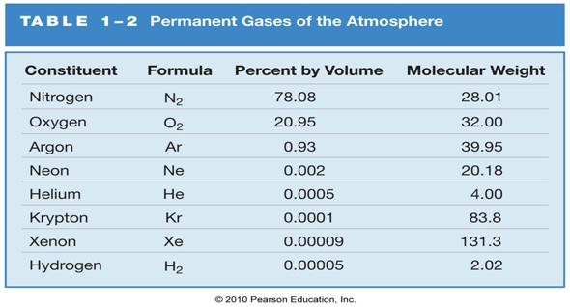
Chemical composition of gases
Permanent gases: form a constant proportion of the atmosphere and have long residence times (10³-10⁶ years)
Variable gases: vary in concentration in time and space
H₂O but also CO₂, O₃ and trace gases from natural and anthropogenic emissions
Notes:
The main constituents of the dry atmosphere are nitrogen (78.084% by volume), oxygen (20.946% by volume) and argon (0.934% by volume), but much lower concentrations other noble gases can also be found (Table 1.4).
Based on the quantity, major components and trace gases can be defined. Another distinction is on permanent and variable gases
Concentrations of these gases do not vary substantially in time and space (in the lower 80 km layer of the atmosphere) and therefore they are called permanent gases.
For rare gases there are no sources (no cycles) so this is

Slide 30
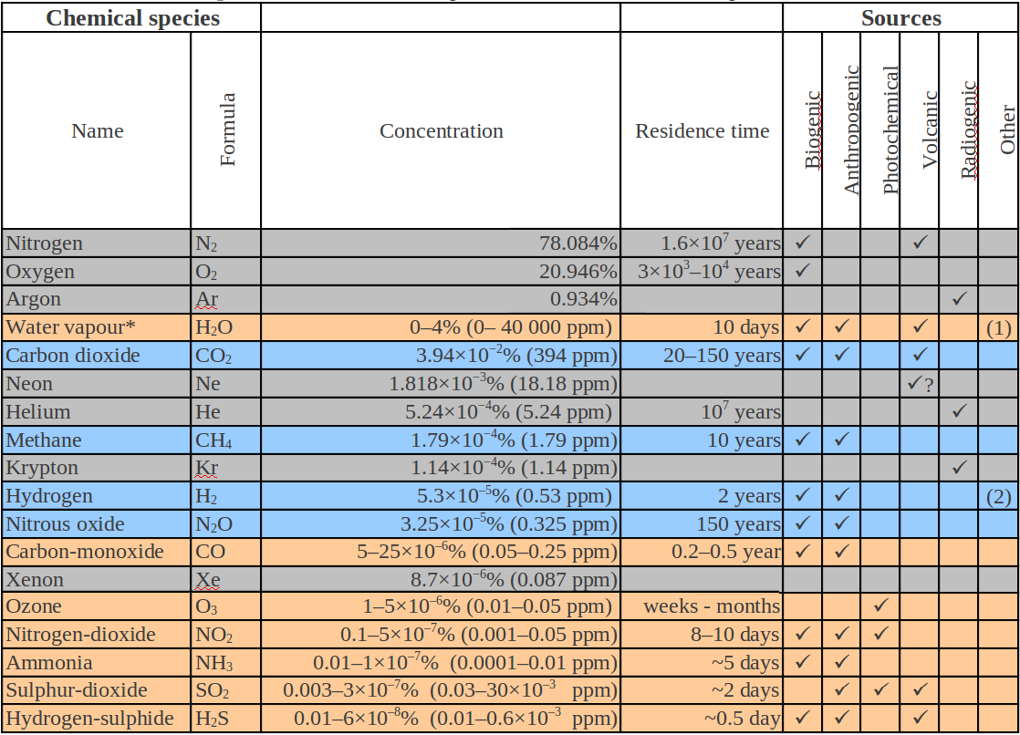
Residence time
=average time spent by a particle in atmosphere
Under steady-state conditions (i.e. slow changes in globally averaged concentrations) the rate of injection equals the rate of removal
Residence time (or turn over, or lifetime):
: amount of the constituent in the atmosphere (in kg)
: the rate of removal (in kg⋅s⁻¹) from the atmosphere
constant gases
variable gases
highly variable
Notes:
The residence time (or removal time or lifetime) is an average amount of time that a particle or substance spends in a particular system (as the atmosphere)
Steady-state =when the globally averaged concentration of a trace constituent in atm. does not change significantly over a given time period. In this case, the rate at which the constituent is injected into (and/or produced within) the atmosphere must equal the rate at which it is removed from the atmosphere. Under such steady-state conditions, the residence time is:
defined as the amount of the compound in the atmosphere divided by the rate at which this compound removed from the atmosphere.
According to residence time, constant and variable (and sometimes highly variable) gases can be distinguished in this table.
The abundances of constant gases has remained the same over geological timescales, while residence time generally means years in case of variable gases and days in case of highly variable gases

Slide 31
Units of concentration and conversions
Mixing ratio (C_{x}): is a mole fraction, i.e. molecules (or moles) of a given species/total n. molecules (or moles). Pure number, no unit
It can also be expressed in terms of volume of gas/total volume of air (since volume of ideal gas is proportional to number of moles)
Example: mixing ratio of N₂ in dry air C_{N2} = 0.78
ppm = part per million (1/10⁶)
ppb = part per billion (1/10⁹)
ppt = part per trillion (1/10¹²)
for trace gases
Example: O₃ mixing ratio 1-10ppm
C_{x} is constant with respect to changes in air density
Notes:
The mixing ratio of a gas has the virtue of remaining constant when the air density changes (as happens when the temperature or the pressure changes). Consider a balloon filled with room air and
allowed to rise in the atmosphere. As the balloon rises it expands, so that the number of molecules per unit volume inside the balloon decreases; however, the mixing ratios of the different gases in the
balloon remain constant. The mixing ratio is therefore a robust measure of atmospheric composition.

Slide 32
Units of concentration and conversions
Number density (N_{x}): n. molecule of a species in a given volume of air (usually 1 cm³). Unit is molecules⋅cm⁻³
N_{x} is the proper measure for
calculation of reaction rates
optical properties of the atmosphere
Mixing ratios can be converted in number density by applying ideal gas law and N_{a} (Avogadro’s number=6.0221x10²³ molecules/mole)
Example: O₃ concentrations as a function of altitude expressed in number density and mixing ratio
Notes:
The loss rate of X by this reaction is equal to the frequency of collisions between molecules of X and Y multiplied by the probability that a collision will result in chemical reaction. The
collision frequency is proportional to the product of number densities nXnY.
Another important application of number densities is to measure the absorption or scattering of a light beam by an optically active gas. The degree of absorption or scattering depends on the number
of molecules of gas along the path of the beam and therefore on the number density of the gas.

Slide 33


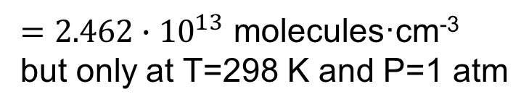
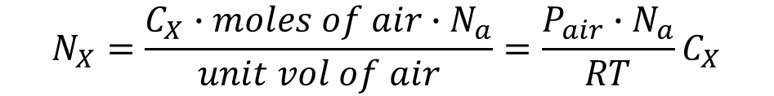

Units of concentration and conversions
Mixing ratios conversion to number density :
number density of air (at P_{air} and T)
$$⋕molecules X =C_{X}∙moles of air∙N_{a}$$
$$N_{X}=\frac{C_{X}∙moles of air∙N_{a}}{unit vol of air}=\frac{P_{air}∙N_{a}}{RT}C_{X}$$
Assuming air at P=1atm and T=298K and expressing volumes in cm³:
$$\frac{P_{air}∙N_{a}}{RT}=\frac{1atm∙6.0221∙{10}^{23}molecules∙{mol}^{−1}}{0.08206∙{10}^{3}{cm}^{3}atmK^{−1}{mol}^{−1}298K}=$$
= $2.46∙{10}^{19}$ molecules·cm⁻³
N_{X} is not conserved when P or T changes!!
$N_{X}=2.46∙{10}^{19}∙C_{X}$ molecules·cm⁻³
Example:
C_{x}= 1ppm =10⁻⁶ corresponds to
$N_{X}=2.46∙{10}^{19}∙{10}^{−6}$ molecules·cm⁻³
$=2.462∙{10}^{13}$ molecules·cm⁻³
but only at T=298 K and P=1 atm

Slide 34
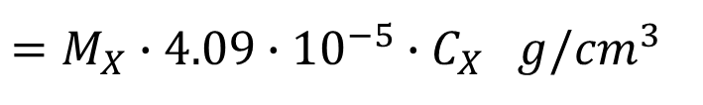
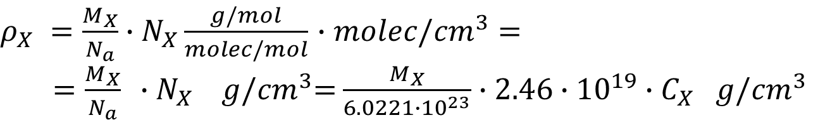
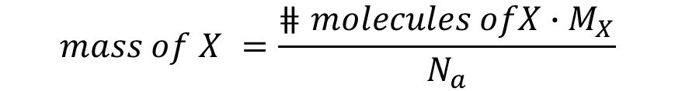
Units of concentration and conversions
Mass per volume (ρ_{X}): mass of a species (in g or μg=10⁻⁶g) in a unit volume (either cm³ or m³) of air. Units can be g⋅cm⁻³ or μg⋅m⁻³
ρ_{X} should not be confused with the density of a substance, i.e. weight per volume of substance
Number density (molecules⋅cm⁻³ ) can be converted in mass per volume (g⋅cm⁻³) using the molar masses (M_{X}) of the species
$$mass of X =\frac{⋕molecules ofX∙M_{X}}{N_{a}}$$
$ρ_{X} =\frac{M_{X}}{N_{a}}$ $∙N_{X}\frac{g/mol}{molec/mol}$ $∙molec$/${cm}^{3}=$
$=\frac{M_{X}}{N_{a}} ∙N_{X}$ $g$/${cm}^{3}$= $\frac{M_{X}}{6.0221∙{10}^{23}}$ $∙2.46∙{10}^{19}∙C_{X} g$/${cm}^{3}$
at P=1atm, T=298K
ρ_{X} is also not conserved when P or T changes!!
$=M_{X}$ $∙4.09∙{10}^{−5}∙C_{X} g$/${cm}^{3}$

Slide 35
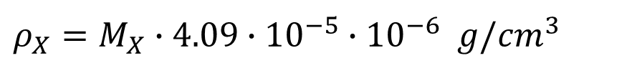


Units of concentration and conversions
Mixing ratios conversion to mass per volume:
Example: C_{x}= 1ppm =10⁻⁶ corresponds to
$ρ_{X}=M_{X}$ $∙4.09∙{10}^{−5}∙{10}^{−6} g$/${cm}^{3}$
$$=M_{X}∙4.09∙{10}^{−11}g∙{cm}^{−3}$$
given that:
$1 g∙{cm}^{−3}=\frac{{10}^{6} μg}{{10}^{−6}m^{3}}={10}^{12}$ $μg∙m^{−3}$
$$ρ_{X}=M_{X}∙4.09∙{10}^{−11}∙{10}^{12}=M_{X}∙40.9 μg∙m^{−3}$$
The conversion between μg⋅m⁻³ and mixing ratios can be summarized as:

Slide 36
Exercise n. 5
The mixing ratio of CO₂ is currently about 418 ppm throughout the atmosphere. Calculate the number density of air and of CO₂ at sea level, assuming a P_{air}=1013 hPa and T=0 °C
Useful constants:
Avogadro’s number
Universal gas constant
Conversion units:
1 atm = 1013.25 hPa

Slide 37

Exercise n. 5
The mixing ratio of CO₂ is currently about 418 ppm throughout the atmosphere. Calculate the number density of air and of CO₂ at sea level, assuming a P_{air}=1013 hPa and T=0 °C .
Solution:
P_{air}=1013 hPa≈1 atm T=273K, hence the number density of air is:
$$\frac{P_{air}∙N_{a}}{RT}=\frac{1atm∙6.0221∙{10}^{23}molecules∙{mol}^{−1}}{0.08206∙{10}^{3}{cm}^{3}atmK^{−1}{mol}^{−1}273K}=$$
= $2. 69∙{10}^{19}$ molecules·cm⁻³
The mixing ratio of CO₂ is C_{CO2}=418·10⁻⁶=4.18·10⁻⁴, hence:
$N_{CO2}=2.69∙{10}^{19}∙4.18∙{10}^{−4}=1.124∙{10}^{16}$ molecules·cm⁻³

Slide 38
Examples: abundances of trace gases
Mixing ratios independent on T and P (→conserved during vertical transport)
Concentrations/number densities: relevant for calculation of chemical reaction rates and radiative properties. Spectroscopic measurement techniques give results in number density/conc’s, not mixing ratios.
Notes:
arrivata qui rivederla venerdi 24 settembre

Slide 39
Water in the atmosphere
Water is the only substance that can be present in any of its three phases (solid, liquid, gas)
Phase diagram of H₂O
Importance to determine how the state of water in atmosphere depends on environmental variables
Notes:
From the phase rule, the number n of independent variables determining the equilibrium of c chemical components between a number p of different phases is
given by n = c + 2 – p
In the case of the equilibrium of liquid water with its vapor there is only one component and two phases. Thus the equilibrium is determined by one single independent variable; at a given
temperature T, there is only one saturation vapor pressure PH2O,SAT(T) for which liquid and gas are in equilibrium.

Slide 40
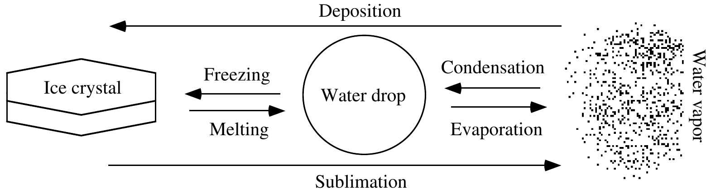
Water in the atmosphere: phase changes of H₂O
Energy is released
the energy released/absorbed is called latent heat
Energy is absorbed
Freezing (melting) at 0 ◦C releases (absorbs) energy ∼333.5 J g⁻¹
Deposition (sublimation) at 0 ◦C releases (absorbs) ∼2835 J g⁻¹
Condensation (evaporation) releases (absorbs) 2510 J g⁻¹ at 0◦C and 2259 J g⁻¹ at 100 ◦C
Notes:
During condensation, freezing, and solid deposition of a substance, energy is released. During evaporation, melting, and sublimation, energy is absorbed. The
stored energy released or the energy absorbed during such processes is called latent heat. Latent heat absorbed (released) during evaporation (condensation) is latent
heat of evaporation. It varies with temperature
Sources of liquid water: sea spray emission, volcanos, combustion, condensation of water vapor, and melting of ice crystals.
Sinks of liquid water include evaporation, freezing, and sedimentation to the surface of aerosol particles, fog drops, drizzle, and raindrops.
Ice in the atmosphere forms from freezing of liquid water and solid deposition of water vapor. Losses of ice occur by sublimation to the gas phase, melting to the
liquid phase, and sedimentation to the surface.

Slide 41
Water in the atmosphere
Water vapour (∼ 0.25% of the mass of the atmosphere) concentrations are highly variable (T, latitude, time of day)
Relative Humidity (RH)
partial pressure of water vapour in air at a certain temperature T
saturated vapour pressure of water at T
At the tropics
100% RH and T = 30ºC →
H₂O mixing ratio (C_{H2O}) = 4.3 %
At the Poles
50% RH and T = -20 ºC →
H₂O mixing ratio (C_{H2O}) = 0.1 %
average H₂O concentration ∼1 %
Notes:
Water vapour (0.25% of the mass of the atmosphere) highly variable concentrations ranging from around 10 parts per million by volume (ppmv) in the coldest regions of the Earth’s atmosphere up to as much as 5% by volume in hot, humid air masses; a range of more than three orders of magnitude. Because of the large variability of water vapor concentrations in air, it is customary to list the percentages of the various constituents in relation to dry air.
Major sources of water vapor to the air are evaporation from soils, lakes, streams, rivers, and oceans, sublimation from glaciers, sea ice, and snow packs, and transpiration from plant leaves. Water vapor is also produced during fuel combustion and many gas-phase chemical reactions. Approximately 85 percent of water in the atmosphere originates from ocean surface evaporation. Sinks of water vapor are condensation to the liquid phase, ice deposition to the solid phase, transfer to the ocean and other surfaces, and gas-phase chemical reaction. The mixing ratio of water vapor varies with location. When temperatures are low, water vapor readily condenses as a liquid or deposits as ice, so its gas-phase mixing ratio is low. Over the North and South Poles, water vapor mixing ratios are almost zero. When temperatures are high, liquid water readily evaporates and ice readily
sublimates to the gas phase, so water vapor mixing ratios are high. Over equatorial waters, where temperatures are high and evaporation from ocean surfaces occurs readily, the atmosphere contains up to 4 percent or more water vapor by volume. Water vapor is not only a greenhouse gas (a gas that readily absorbs thermal-infrared radiation), but also a chemical reactant and carrier of latent heat.

Slide 42
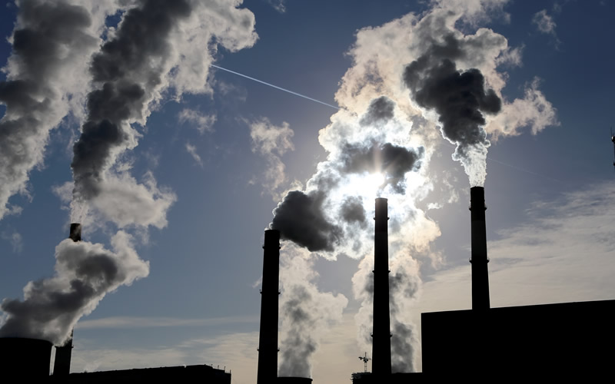
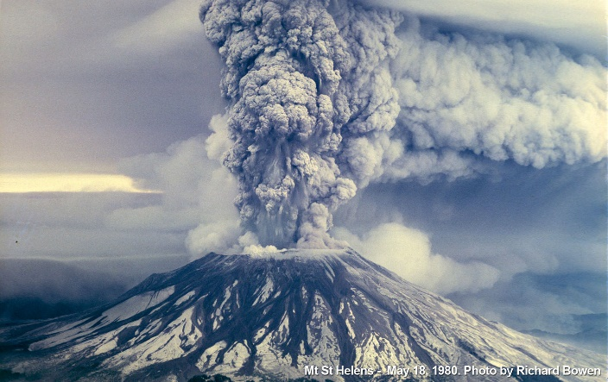
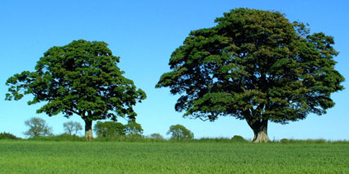
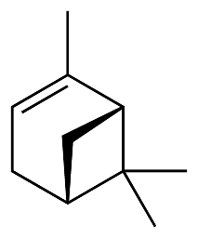
Gaseous chemicals
Primary species: species directly emitted into the atmosphere (e.g. CO₂, SO₂, NO, CO)
Secondary species: species formed as products of chemical/physical transformation of primary components (e.g. O₃)
anthropogenic
Emission sources
natural
biogenic
e.g. O₂ and VOCs from plants, decays of material incorporated in living organisms
Notes:
Emissions. Chemical species are emitted to the atmosphere by a variety of sources. Some of these sources, such as fossil fuel
combustion, originate from human activity and are called anthropogenic. Others, such as photosynthesis of oxygen,
originate from natural functions of biological organisms and are called biogenic. Still others, such as volcanoes, originate from
non-biogenic natural processes.
Among the atmosphere’s trace gaseous constituents are molecules containing carbon, nitrogen, and sulfur atoms that were formerly incorporated into the cells of living organisms. These gases enter the atmosphere through the burning of plant matter and fossil fuels, emissions from plants, and the decay of plants and animals. The chemical transformations that remove these chemicals from the atmosphere involve oxidation, with the hydroxyl (OH) radical playing an important role. Some of the nitrogen and sulfur compounds are converted into particles that are eventually “scavenged” by raindrops, which contribute to acid deposition at the Earth’s surface.
Trace species emitted directly into the atmosphere are termed to have primary sources, e.g. trace gases such as SO2, NO and CO. Those trace species formed as a product of chemical and/or physical transformation of primary pollutants in the atmosphere e.g. ozone, are referred to as having secondary sources or being secondary species.
Emissions into the atmosphere are often broken down into broad categories of anthropogenic or ‘man-made sources’ and biogenic or natural sources with some gases also having geogenic sources.
See other things not so useful in https://slideplayer.com/slide/6901628/

Slide 43
Types of sources
Notes:
• Chemistry. Reactions in the atmosphere can lead to the formation and removal of species.
• Transport. Winds transport atmospheric species away from their point of origin.
• Deposition. All material in the atmosphere is eventually deposited back to the Earth’s surface. Escape from the atmosphere to outer space is negligible because of the Earth’s
gravitational pull. Deposition takes two forms: “dry
deposition” involving direct reaction or absorption at the
Earth’s surface, such as the uptake of CO2 by photosynthesis;
and “wet deposition” involving scavenging by precipitation.

Slide 44
Sources of some trace gases
Notes:
Per descrizione vedi Hewitth Kackson lists a selection of the trace gases and their major sources
For the individual emission of a primary pollutant there are a number of factors that need to be taken into account in order to estimate the emission strength, these include the range and type of sources and
the spatial and temporal distributions of the sources. Often these factors are compiled into socalled emission inventories that combine the rate of emission of various sources with the number and type of each source and the time over which the emissions occur.

Slide 45
Primary trace gases
Emission strength depends on:
range and type of sources
spatial/temporal distribution of sources
NM=non methane
emission inventories (see an example for the UK in the graph, but available also at global scale)
UK emission statistics by UNECE (United Nations Economic Commission of Europe) 2002
Notes:
Emission inventories list a selection of the trace gases and their major sources
For the individual emission of a primary pollutant there are a number of factors that need to be taken into account in order to estimate the emission strength, these include the range and type of sources and the spatial and temporal distributions of the sources. Often these factors are compiled into so called emission inventories that combine the rate of emission of various sources with the number and type of each source and the time over which the emissions occur. The graph shows the UK emission inventory for a range of primary pollutants ascribed to different source.
For instance SO2 has strong sources from public power generation whereas ammonia has strong sources from agriculture.
Also emission maps Figure 5.3 shows the (2002) 1 km × 1 km emission inventories for SO2 and NO2 for the UK. In essence, the data presented in Fig. 5.2 have
been apportioned spatially according to the magnitude of each source category (e.g. road transport, combustion in energy production and
transformation, solvent use). For example, in Fig. 5.3a (Plate 3a), the major road routes are clearly visible, showing NO2 has a major automotive source (cf. Fig. 5.2). It is possible to scale the
budgets of many trace gases to a global scale

Slide 46


Emission inventories
ITALY emission inventories_ISPRA 2022
EU emission inventories 1990-2018

Slide 47
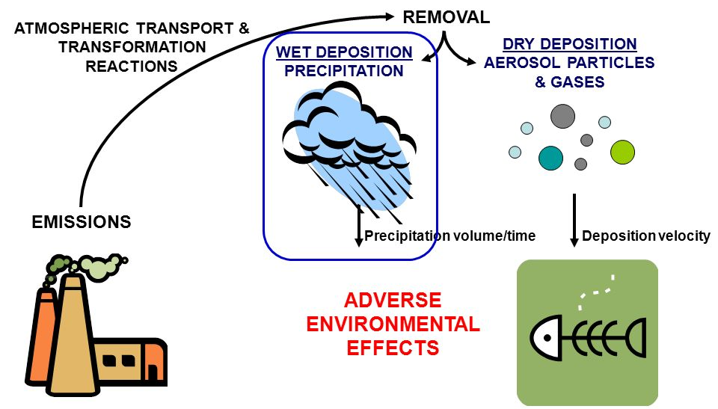
Types of sinks
Wet deposition: falling hydrometeors (rain, snow) carry trace species to the surface
Dry deposition: gravitational settling, turbulent transport
In situ removal: chemical transformations within the atmosphere
Atmospheric transport: winds transport species away from their point of origin
Notes:
• Chemistry. Reactions in the atmosphere can lead to the formation and removal of species.
• Transport. Winds transport atmospheric species away from their point of origin.
• Deposition. All material in the atmosphere is eventually deposited back to the Earth’s surface. Escape from the atmosphere to outer space is negligible because of the Earth’s
gravitational pull. Deposition takes two forms: “dry deposition” involving direct reaction or absorption at the Earth’s surface, such as the uptake of CO2 by photosynthesis; and “wet deposition” involving scavenging by precipitation.

Slide 48
Timescales of atmospheric processes
time scale processes measurement techniques
1/10 s turbulence Eddy flux
1 s OH radical chemistry Laser-induced fluorescence
1 min NO_{x} chemistry chemiluminescence
1 h ozone formation gas chromatography
1 day CH₂O lifetime flask/filter samples
1 week synoptic events
1 month CO lifetime,
O₃ tropospheric lifetime
1 year ENSO (“El Nino“)
10 years CH₄ lifetime snow profiles
100 years CFC lifetime
> 100 years ecosystem changes ice cores
Notes:
El Niño–Southern Oscillation (ENSO) is an irregular periodic variation in winds and sea surface temperatures over the tropical eastern Pacific Ocean, affecting the climate of much of the tropics and subtropics

Slide 49
Links between temporal (lifetimes) and spatial scales
A trace gas is only susceptible to a given transport process, if its chemical lifetime is longer than the timescale of the transport process
Temporal (lifetime) and spatial scales of trace gases are tightly linked (see diagram)

Slide 50
Links between temporal (lifetimes) and spatial scales
Example:
The lifetime of CH₄ is about 8-10 years. CH₄ mixes efficiently between the northern (NH) and southern hemisphere (SH), because the time scale of interhemispheric mixing is only about 1.7 years.
NO_{x} emitted in the NH, on the other hand, is not transported into the SH.
Notes:
Preso da DOAS book p. 29 – Average lifetimes (residence times) of gases in the atmosphere ramge from seconds to millennia. Accordingly transport can occur on scales reaching from a few meters to the global scale

Slide 51
Particulate matter (atmospheric aerosols)
Non gaseous matter present in the form of particles of various dimensions
Sources: both natural and anthropogenic (dust, smoke, sea spray, volcanic ash)
Dimensions: from nanometers (10⁻⁹ m) to 10-100 μm (10⁻⁶ m)
Residence times: from few days (troposphere) to months/years (stratosphere)
Aerosols can influence:
visibility (light scattering and absorption)
climate change (light scattering alters the amount of solar radiation reaching the surface)
health (fine particles <2.5-10 μm induce severe pulmonary diseases)
Notes:
Although aerosols and cloud droplets account for only a minute fraction of the mass of the atmosphere, they mediate the condensation of water vapour in the atmospheric branch of the hydrologic cycle,
they participate in and serve as sites for important chemical reactions, and they give rise to electrical charge separation and a variety of atmospheric optical effects.

Slide 52
Summary: vertical structure
from Hewitt-Jackson-”Atmospheric Science For Environmental Scientists”

Slide 53
Exercise n. 6
A typical concentration of OH radicals in the lower troposphere is 5x10⁵ molecules⋅cm⁻³. Express this concentration in terms of the mixing ratio unit ppt, assuming T=25 °C and P=1 atm
Useful constants:
Avogadro’s number
Universal gas constant

Slide 54
Exercise n. 6
A typical concentration of OH radicals in the lower troposphere is 5x10⁵ molecules⋅cm⁻³. Express this concentration in terms of the mixing ratio unit ppt, assuming T=25 °C and P=1 atm.
Solution At the given P and T the number density of air is given by:
The mixing ratio in ppt is given by:

Slide 55
Exercise n. 7
N₂O (nitrous oxide) is a trace atmospheric gas with a fractional concentration (by volume) equal to 0.00003% (assumed to be independent of altitude).
Calculate its mixing ratio (in ppm and ppb).
Calculate its number density at sea level (assuming air pressure=1000 hPa and temperature T=15 °C) and
at an altitude at of 2 km
(Hint: assume a lapse rate in T of 6.5 °C⋅km⁻¹)
Conversion units:
1 atm = 1013.25 hPa

Slide 56
Exercise n. 7
N₂O (nitrous oxide) is a trace atmospheric gas with a fractional concentration (by volume) equal to 0.00003% (assumed to be independent of altitude).
Calculate its mixing ratio (in ppm and ppb).
Calculate its number density at sea level (assuming air pressure=1000 hPa and temperature T=15 °C) and
at an altitude at of 2 km (Hint: assume a lapse rate in T of 6.5 °C⋅km⁻¹)
Solution: 0.00003% = 3x10⁻⁷= mole N₂O/moles air = C_{N2O}
C_{N2O} in ppm = 3x10⁻⁷x10⁶ = 0.3 ppm
C_{N2O} in ppb = 0.3x1000 = 300 ppb
b) We need to calculate the density of air (N_{air} in number of molecules per litre) at pressure=1000 hPa and temperature T=15 °C at sea level
Hence the number density of N₂O (N_{N2O}) at sea level will be:

Slide 57
Exercise n. 7
c) And at an altitude at of 2 km ?
We need to calculate the density of air at z=2 km, using the ideal gas law (we need to estimate a T and a P at this altitude)
and
Hence density of air:
And the number density of N₂O at 2 km:

Slide 58
Exercise n. 8
According to US regulatory air quality standards the maximum amount of carbon monoxide (CO) to be present in outdoor air is 40000 μg⋅m⁻³. Express this concentration in units of ppm (assuming P=1atm and T=25 °C).
Useful constants:
Avogadro’s number
Universal gas constant

Slide 59
Exercise n. 8
According to US regulatory air quality standards the maximum amount of carbon monoxide (CO) to be present in outdoor air is 40000 μg⋅m⁻³. Express this concentration in units of ppm (assuming P=1atm and T=25 °C).
Solution Let’s first convert the given concentration in mass/volume from μg⋅m⁻³ into μg⋅liter⁻¹:
40000 μg⋅m⁻³ = 40000/1000 μg⋅L⁻¹=40 μg⋅L⁻¹. Then we calculate the number of air molecules present in 1 litre of air at P=1atm and T=25 °C. It is given by (see Q5):
Now we calculate the number of molecules corresponding to 40 μg of CO (MW=28.01 g/mol):
These are the CO molecules present in 1 L of air. Hence the mixing ratio in ppm is given by:

Slide 60
Exercise n. 9
A sample of air has a volume equal to 5 litres, a temperature of T=30 °C and a relative humidity (%RH) of 92%. Calculate the number density (i.e. molecules·cm⁻³) of water and the absolute number of H₂O molecules in that sample, knowing that the saturated vapour pressure of water at T=30 °C is 31.8 mmHg
Useful constants:
Avogadro’s number
Universal gas constant
Conversion of units:
1 atm = 760 mmHg
Notes:
Photodissociation, the breaking apart of molecules by solar radiation, plays a fundamental role in the chemistry of the atmosphere. The photodissociation
of trace species such as ozone and formaldehyde contributes to their removal from the atmosphere, but probably the most important role played by these photoprocesses is the generation
of highly reactive atoms and radicals.
Photodissociation of trace species and the subsequent reaction of the photoproducts with other molecules is
the prime initiator and driver for the bulk of atmospheric chemistry.

Slide 61
Exercise n. 9
A sample of air has a volume equal to 5 litres, a temperature of T=30 °C and a relative humidity (%RH) of 92%. Calculate the number density (i.e. molecules·cm⁻³) of water and the absolute number of H₂O molecules in that sample, knowing that the saturated vapour pressure of water at T=30 °C is 31.8 mmHg
Solution % RH is defined as:
Hence
It can be converted in atm units
The density of water (in number of molecules per litre or per cm³) is as usual given by:
From this we can calculate the number of H₂O molecules in the 5 litres sample:
Notes:
Photodissociation, the breaking apart of molecules by solar radiation, plays a fundamental role in the chemistry of the atmosphere. The photodissociation
of trace species such as ozone and formaldehyde contributes to their removal from the atmosphere, but probably the most important role played by these photoprocesses is the generation
of highly reactive atoms and radicals.
Photodissociation of trace species and the subsequent reaction of the photoproducts with other molecules is
the prime initiator and driver for the bulk of atmospheric chemistry.

Slide 62
Useful constants -1

Slide 63
Useful constants -2

Slide 64
Useful constants -3

Slide 66
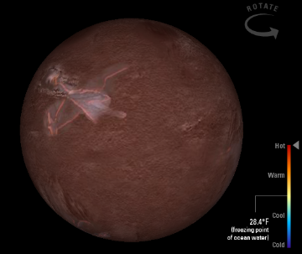
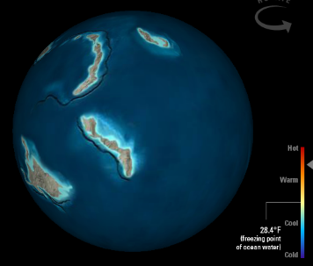
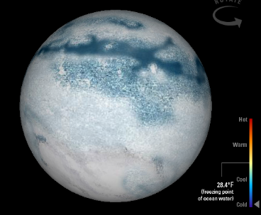
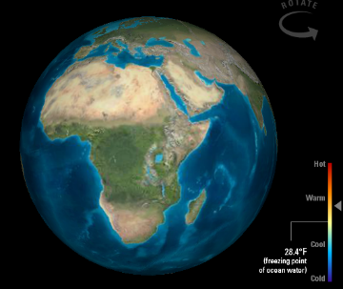
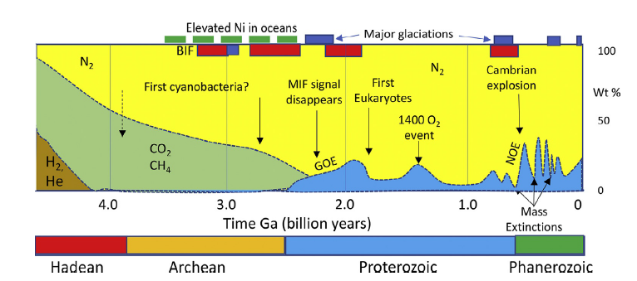
Origin and evolution of the Earth’s atmosphere
Earth and the Solar system formed about 4.5 billion years ago
Was the atmosphere the same from the beginning?
What are the processes that led to the formation of an atmosphere?
Still many uncertainties
https://www.smithsonianmag.com/science-nature/travel-through-deep-time-interactive-earth-180952886/
Notes:
So far we have briefly described the present state of Earth’s atmosphere. But have you ever asked yourself:
You did this atmosphere came into existence?
We should start

Slide 67
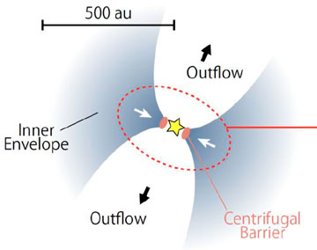
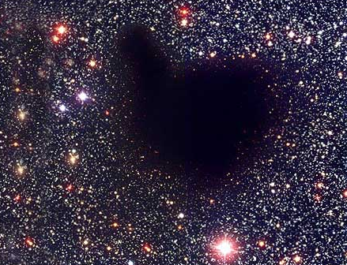
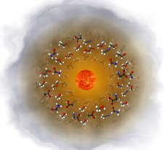
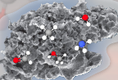
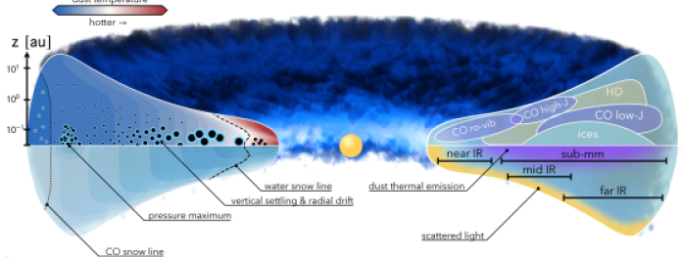
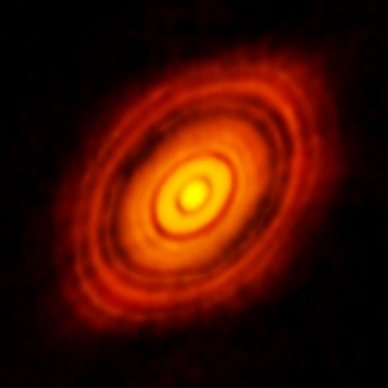
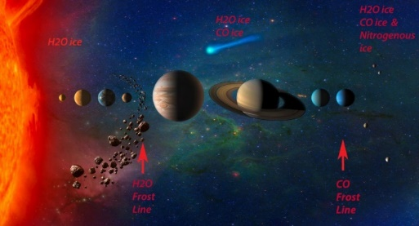
Formation of the Solar system
STEP1: pre-stellar core
STEP2: protostar
Size ~5-100 au
Duration ~ 10⁴ yr?
Hot corino
Size ~10⁴ au
Duration ~ 10⁵ yr
gas+dust → icy
mantle formation
icy mantle sublimation
interstellar clouds:
~1% dust
~99% gas
STEP3: protoplanetary disk
STEP4: planetary system
planets
comets
meteorites
asteroids
Size ~10-200 au
Duration ~ 10⁶ yr
Dust agglomeration
Small objects (planetesimals) accreted or combined together to build larger opjects (planets)
Notes:
The earliest stage is PRESTELLAR CORES Atoms and molecules in the gas-phase freeze-out onto the cold surfaces of the sub-micron dust grains, forming the so-called icy grain mantles. Condensation of molecular cloud material that starts accreting towards the center: T decrease to ∼10 K and n increase to ∼10⁵ cm⁻³
Protostellar envelopes. Collapse proceeds, gravitational energy converted into radiation, envelope around central object warms up (hot core/corinos). Due to angular momentum conservation a fraction of matter is ejected outwards from the poles (supersonic jets/outflows) Shock regions: where jets encounter the gas of the cloud Warm and dense regions: T ∼100 K and n ∼10⁷ cm⁻³
Due to the warm up the molecules frozen in grain mantles acquire mobility and form new, more complex species.
When T the mantle sublimation temperature, in the so-called hot corinos, the molecules in the mantles sublimate back in the gas
phase, where they react and form new, more complex, molecules.
Protoplanetary disks. Conservation of angular momentum causes the rotation to increase as the nebula radius decreases.
The envelope dissipates and the rotation causes the cloud to flatten out—much like forming a flat pizza out of dough—and take the form of a disk (protoplanetary disk). Inner regions hot – outer regions cold
In the hot regions, close to the central object, new complex molecules are synthesized by reactions between the species formed in the protostellar phase. In the cold regions of the disk, where the vast majority of matter resides, the molecules formed in the protostellar phase freeze-out again onto the grain mantles, where part of the ice from the prestellar phase may still be present. The process of “conservation and heritage” begins.
Molecules are astrochemical clocks, they are the observing tools through which astronomers get information about the age of an object but also about its physical conditions. Detection of molecules give information about the formation and evolution of a solar system,
Immagine del ciclo di formazione di una stella: si parte da nube diffusa (molecole più semplici) per via della bassa densità. Poi il collasso gravitazionale porta ad un aumento di densità molecole più complesse) e continuando ancora si ha formazione di un nucleo centrale attorno a cui ruotano clumps di gas e polveri (protostar), disco di accrescimento che poi evolve in un sistema solare. E'in questa fase che ci si aspetta la formazione delle molecole prebio che possono venire inglobate nei pianeti. Poi la stella muore (supernova o planetary nebula) e la massa persa viena "risputata"
nello spazio.
Riciclo costante di materiale tra ISM e le stelle. La composizione chimica dei vari ambienti dell’ISM è determinata dalla storia passata delle stelle vicine che espellono la maggior parte della materia nucleare tramite venti stellari e esplosioni di supernove. La composizione chimica del mezzo interstellare è un bilancio tra processi di crescita (reazioni chimiche), processi di distruzione (via UV lights from star, cosmic rays, high T, shock waves…) e processi di condensazione e successive reazioni sui grani
It all starts in a relatively dense (in astrophysical terms) cloud of gas and dust. This cloud condenses forming a pre-stellar core that evolves into a protostar and a protoplanetary disk, and ultimately a planetary system is born (molecules are detected in planets but also in the leftover –comets asteroids, interplanetary dust), which might even include a planet in the so-called habitable zone, where liquid water can exist.
Each step is characterised by a specific chemical composition, which depends on the physical status and previous history of the object. To understand our own origins, we need to understand what happened during the earliest phases of the formation of the Solar System. To this end, we have, on the one hand, the final products of the formation process of the Solar System, i.e. the Earth, other planets, small bodies and the “leftovers” of the process, namely comets, asteroids
and Interplanetary Dust Particles (IDPs). Traces of the earliest phases of the Solar System formation are hidden in the chemical composition of some material of its most primitive objects:
comets, the unaltered meteorites class of “carbonaceous chondrites” and the IDPs.
On the other hand, we have the possibility to study the earliest phases of the formation of Solar-like planetary systems via observations and physical-chemical models and simulations of their earliest
stages: prestellar cores, protostars and protoplanetary disks, the three major first steps in the Solar-like star formation process. Each step is characterised by a specific chemical composition, which depends
on the physical status and previous history of the object. These objects, therefore, provide us with a key to unveil the message hidden in the primitive Solar System objects.
The chemical composition of present Solar-like planetary-forming systems can be used to unveil the history of the nascent Solar System

Slide 68
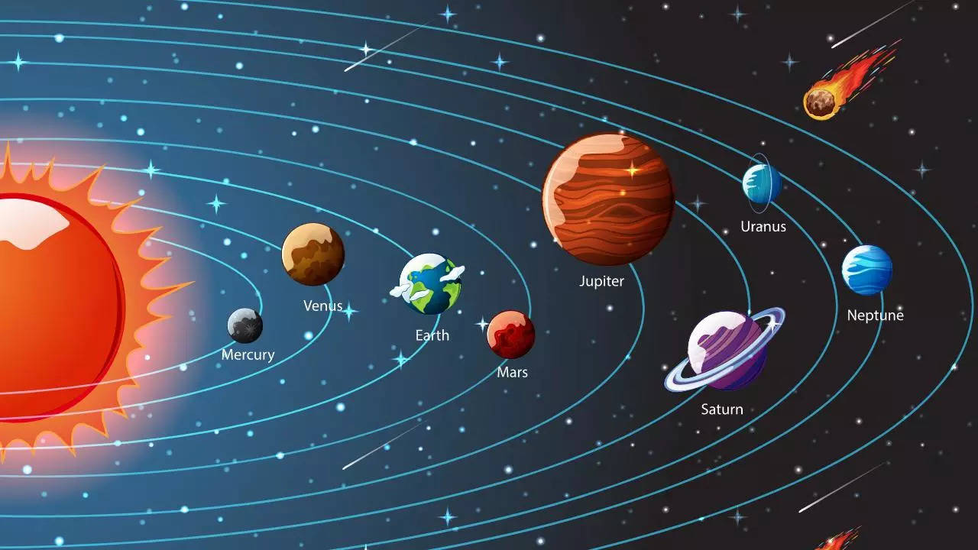
Timescale for Solar system formation
Unit of measure: 1 Gy = 1 billion (1x10⁹) years
Sun: 4.60 Gy
Earth: 4.54 Gy
Moon: 4.53 - 4.42 (more recent estimate) Gy
Emergence of life on Earth: 4.0-3.8 Gy
Age of the Universe: 13.772±0.059 Gy
The other rocky planets (Mercury, Venus, Mars) formed during the same period
Notes:
So far we have briefly described the present state of Earth’s atmosphere. But have you ever asked yourself:
You did this atmosphere came into existence?
We should start

Slide 69
Differentiation of the Earth
Early Earth was mostly molten («liquid rock») due to high temperatures (heat released from the accretion process and radioactive decay)
differentiation of the Early earth
https://www.youtube.com/watch?v=YKM6xhBK738
https://www.slideshare.net/KhanImran5975/how-did-atmosphere-form
https://pages.uoregon.edu/drt/Classes/201_99/Rice/differentiation.html
Notes:
So far we have briefly described the present state of Earth’s atmosphere. But have you ever asked yourself:
You did this atmosphere came into existence?
We should start

Slide 70
The first atmosphere
Similar to the Sun’s composition (mainly hydrogen and helium)
It was quickly lost due to:
a) gravity of the Earth was not strong enough to prevent such light gases to escape into space
Notes:
So far we have briefly described the present state of Earth’s atmosphere. But have you ever asked yourself:
You did this atmosphere came into existence?
We should start

Slide 71
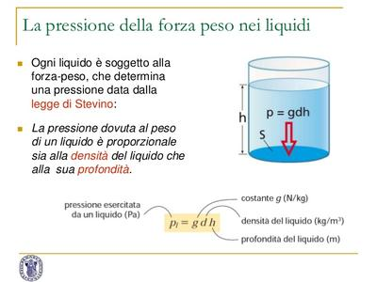
Pressure dependence derivation
The atmosphere can be assumed in hydrostatic equilibrium
For derivation see Wallace and Hobbs Chapter 3.2 “The hydrostatic equation”
Notes:
Stevin’s law defines

