Slide 1

University of Trento
Master of Science in Environmental Meteorology https://international.unitn.it/environmental-meteorology
Environmental Physical Chemistry
Daniela Ascenzi
Dipartimento di Fisica
A.A. 2023-24

Slide 2

Presentation - contact details
Daniela Ascenzi
Physics Dept. (Povo0) –
Laboratory of Atomic and Molecular Physics
https://molecular.physics.unitn.it/
Tel: 0461-281693
e-mail: daniela.ascenzi@unitn.it
No fixed office hours: to get an appointment send me an e-mail with your requests and preferred date/time for meeting

Slide 3
Introduction
Syllabus –program:
focus on physical chemistry of the atmosphere
Organization (timetable, lectures’ structure,
assessment methods…)
Atmospheric physical chemistry: introduction to topics and structure of the Earth atmosphere

Slide 4

Lesson timetable
Tuesday 14:30-17:30 (mostly 2hours, when necessary 3h)
Friday 10:30-12:30

Slide 5
Lesson timetable
Workload: 6 CFU credits (60 hours* of lessons including exercises, presentations, classroom works)
5 hours/week on 14 weeks =70
* 1 hour= 45-50 min of lesson + 10-15 min break

Slide 6
Course goal
Overview of atmospheric chemistry and fundamentals so that at the end you will:
will have a firm foundation in the topics covered (see next slides)
Explain the chemical and physical mechanisms behind main atmospheric chemistry issues (e.g. ozone depletion, air pollution, acid rain, aerosol and clouds formation, photochemical smog, ) and how they can affect global warming and climate change
Critically evaluate and participate in public discussions on atmospheric chemistry issues (e.g. global warming, stratospheric ozone depletion, photochemical smog, air pollution…)

Slide 7
Course program (see Syllabus)
Atmospheric physical chemistry: introduction to topics and structure of the Earth atmosphere
Chemical thermodynamics and kinetics (gas phase rates…)
Principles of spectroscopy and photochemistry
Thermodynamics of liquids and solutions
Particles, aerosol and clouds (physical and chemical
properties, nucleation processes, formation, growth…)
Biogeochemical cycles in the atmosphere (C, N, O and S)
Atmospheric pollutants (properties, formation, destruction)
[Radiation interaction with atmospheric compounds
  (greenhouse effect, very simple models of greenhouse effect)]
  [Atmospheres of other (solar) planets & satellites]

Slide 8

Course organization
Lectures
power point presentations, problem solving (i.e. exercises/numerical examples),
students’ presentations (if time permits…)
Lessons’ material (slides in pdf + other useful material e.g. recent literature) available on the Moodle platform of the course
Interactive mode
Lectures are for you, not us. Please interact!

Slide 9
How to access the Moodle platform
go to the page: https://webapps.unitn.it/gestionecorsi/
2) click on 'Sei uno studente? (are you a student?) in order to see your courses' list
3) enter your UniTrento username and password
4) click on 'Corsi online ai quali sei iscritto' (Online courses you are enrolled in) and search the course you are interested in
5) enter>>if you do not find that course, click on 'Corsi online ai quali potresti iscriverti' (Online courses you can enroll in) and search the course.
6) once you have found the course, click on it and enter.

Slide 10
Assessment method
  final written exam, structured in the form of open questions and exercises
  final project Choose a topic (from a list provided by me) for further investigation, write a ∼10-15 page report and give a 15-20 minute presentation (followed/preceded by a short discussion on failed questions and exercises at the written tests)

Slide 11
Reference textbooks
B.J. Finlayson-Pitt, J.N. Pitts, Jr. “Chemistry of the Upper and Lower Atmosphere” Academic Press 2000
G. Brasser, J.J. Orlando, G.S. Tyndall “Atmospheric Chemistry and Global Change” Oxford University Press 1999
J.H. Seinfeld, S.N. Pandis “Atmospheric Chemistry and Physics - From air pollution to climate change” J.Wiley & Sons 2006
J.M. Wallace, P.V. Hobbs “Atmospheric Science – An introductory survey” Elsevier 2005
I. Lee, R. Kump, James F. Kasting, Robert G. Crane “The earth system”- 3rd ed. Pearson 2009
P. Atkins, J. de Paula, “Elements of Physical Chemistry” OUP 2009 (or any other edition)
Available in the Mesiano (or Povo1) Library

Slide 12
Introduction: Environmental Chemistry
Atmospheric chemistry & physics
the study of sources, reactions, transport, and fate of chemical entities in the air, water, and soil environments, as well as their effects on human health and the natural environment
Notes:
This is a very wide and interdisciplinary topic and it will be impossible in this course to treat it completely. So we will focus on the part that deals with air (hence the physical chemistry of the atmosphere) Requires knowledge from several fields.
Focus on Environmental chemistry of the atmosphere. Air, with consequences on what happens on grounds (e.g. It affects precipitations since clouds formation occurs in the atmosphere)

Slide 13
Goals of Atmospheric Chemistry
To develop a good understanding of the chemical and physical processes which control the amounts and spatial and temporal distributions of atmospheric constituents
Multidisciplinary approach
computer modelling
chemistry
Chemistry of the Earth’s atmosphere (and other planets)
physics
meteorology
volcanology
oceanography
geology
Notes:
Atmospheric chemistry is a branch of atmospheric science in which the chemistry of the Earth's atmosphere and that of other planets is studied. It is a multidisciplinary approach of research and draws on environmental chemistry, physics, meteorology, computer modeling, oceanography, geology and volcanology and other disciplines. Research is increasingly connected with other areas of study such as climatology.
The composition and chemistry of the Earth's atmosphere is of importance for several reasons, but primarily because of the interactions between the atmosphere and living organisms. The composition of the Earth's atmosphere changes as result of natural processes such as volcano emissions, lightning and bombardment by solar particles from corona. It has also been changed by human activity and some of these changes are harmful to human health, crops and ecosystems. Examples of problems which have been addressed by atmospheric chemistry include acid rain, ozone depletion, photochemical smog, greenhouse gases and global warming. Atmospheric chemists seek to understand the causes of these problems, and by obtaining a theoretical understanding of them, allow possible solutions to be tested and the effects of changes in government policy evaluated.

Slide 14

Goals of Atmospheric Chemistry
Why?
The atmosphere protects/sustains life (interaction with biosphere)
Plays a critical role in Earth’s energy balance
Couples land, oceans, equator and poles
Atm. composition changes with time (human activities, natural events). Some changes may affect ecosystems, human health, crops…
Notes:
Atmospheric chemistry is a branch of atmospheric science in which the chemistry of the Earth's atmosphere and that of other planets is studied. It is a multidisciplinary approach of research and draws on environmental chemistry, physics, meteorology, computer modeling, oceanography, geology and volcanology and other disciplines. Research is increasingly connected with other areas of study such as climatology.
The composition and chemistry of the Earth's atmosphere is of importance for several reasons, but primarily because of the interactions between the atmosphere and living organisms. The composition of the Earth's atmosphere changes as result of natural processes such as volcano emissions, lightning and bombardment by solar particles from corona. It has also been changed by human activity and some of these changes are harmful to human health, crops and ecosystems. Examples of problems which have been addressed by atmospheric chemistry include acid rain, ozone depletion, photochemical smog, greenhouse gases and global warming. Atmospheric chemists seek to understand the causes of these problems, and by obtaining a theoretical understanding of them, allow possible solutions to be tested and the effects of changes in government policy evaluated.

Slide 15
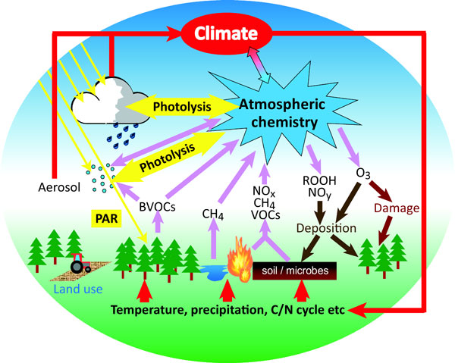
Goals of atmospheric chemistry
Atmospheric chemistry is influenced by processes occurring outside (Sun) and on Earth (natural and anthropogenic emissions)
Atmospheric chemistry has influences on:
Living organisms (health & environmental issues)
climate
weather
Notes:
Atmospheric chemistry is a branch of atmospheric science in which the chemistry of the Earth's atmosphere and that of other planets is studied. It is a multidisciplinary approach of research and draws on environmental chemistry, physics, meteorology, computer modeling, oceanography, geology and volcanology and other disciplines. Research is increasingly connected with other arenas of study such as climatology.
The composition and chemistry of the Earth's atmosphere is of importance for several reasons, but primarily because of the interactions between the atmosphere and living organisms. The composition of the Earth's atmosphere changes as result of natural processes such as volcano emissions, lightning and bombardment by solar particles from corona. It has also been changed by human activity and some of these changes are harmful to human health, crops and ecosystems.

Slide 16
What is atmospheric chemistry?
It’s the study of the factors controlling the amounts and types of chemical species that make up the atmosphere
The “atmosphere” and the chemical species in it are one and the same
Atmosphere as a fluid (physical approach). In this course this fluid will be seen as a collection of interacting atoms and molecules
Interactions result in important phenomena
  at local, regional and global scales (spatial scale)
  in timescales from sec to years (temporal scale)
Notes:
Kinetics: temporal aspects in the changes of the composition of chemicals

Slide 17

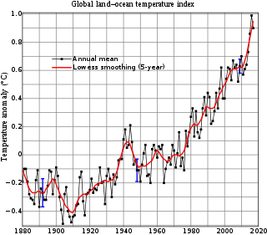
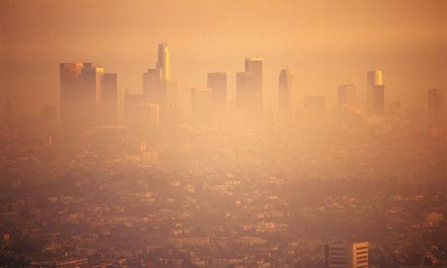
«Famous» atm. chemistry phenomena
acid rain
greenhouse effect
Antarctic ozone “hole
global warming
urban smog
Notes:
Some phenomena your are very familiar are examples of problems addressed by atmospheric chemistry. They include… Atmospheric chemists seek to understand the causes of these problems, and by obtaining a theoretical understanding of them, allow possible solutions to be tested and the effects of changes in government policy evaluated.
acid rain caused by sulfur dioxide emissions from coal-fired electric power plants located hundreds and, in some cases, thousands of kilometers upwind. The sources of the acidity are gaseous oxides of sulphur and nitrogen (SO2, NO, NO2, and N2O5) that dissolve in microscopic cloud droplets to form weak solutions of sulfuric and nitric acids that may reach the ground as raindrops.
A major discovery of the 1980s was the Antarctic “ozone hole”: the disappearance of much of the stratospheric ozone layer over the southern polar cap each spring. The ozone destruction was found to be caused by the breakdown of chlorofluorocarbons (CFCs), a family of synthetic gases that was becoming increasingly widely used for refrigeration and various industrial purposes.
Photochemical smog is the chemical reaction of sunlight, nitrogen oxides and volatile organic compounds in the atmosphere, which leaves airborne particles and ground-level ozone
Knowledge gained from atmospheric chemistry research has been instrumental in the design of policies to control and ultimately reverse the
spread of acid rain and the ozone hole. The unresolved scientific issues surrounding greenhouse warming caused by the buildup of carbon dioxide and other trace gases released into the atmosphere by human activities pose a new challenge for atmospheric chemistry

Slide 18
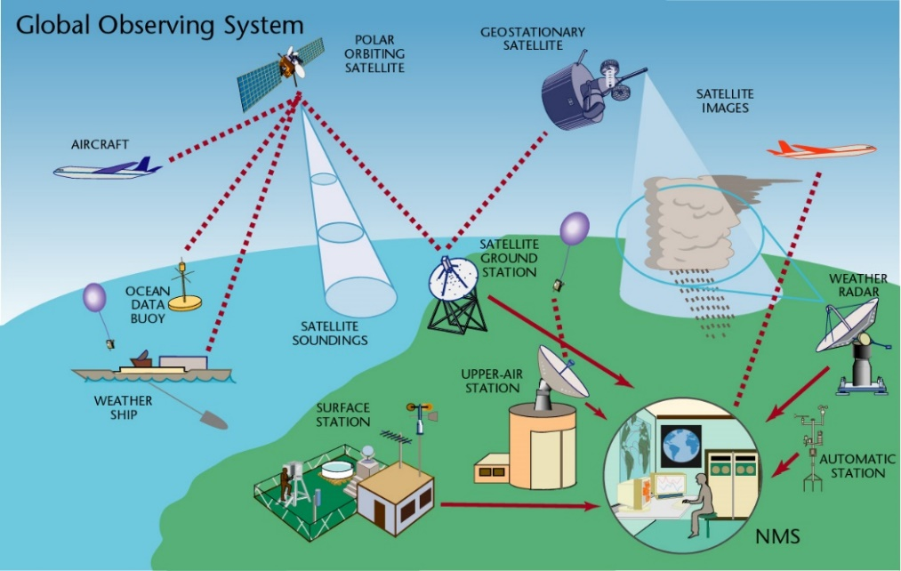
Atmospheric chemistry & meteorology
Developments in atmospheric sciences has led to continuos improvements in forecast skills
day-to-day evolution
hazardous weather events
nowcasting
Global observing system, dynamic merging of real-time data from:
satellite/balloon/aircrafts
ground/in situ
For: weather forecasting, climate monitoring, ecosystems studies
Notes:
Historically, the development of atmospheric sciences, has been driven by the need for more accurate weather forecasts. In popular usage the term “meteorologist,” a synonym for atmospheric scientist, means “weather forecaster.” During the past century, weather forecasting has evolved from an art that relied solely on experience and intuition into a science that relies on numerical models based on the conservation of mass, momentum, and energy.
Today’s weather forecasts address not only the deterministic, day-to-day evolution of weather patterns over the course of the next week or two, but also the likelihood of hazardous weather events (e.g., severe thunderstorms, freezing rain) on an hour-by-hour basis (so called “nowcasting”), and departures of the climate (i.e., the statistics of weather) from seasonally adjusted normal values out to a year in advance.
Weather forecasting has provided not only the intellectual motivation for the development of atmospheric science, but also much of the infrastructure. What began in the late 19th century as an assemblage of regional collection centers for real time teletype transmissions of observations of surface weather variables has evolved into a sophisticated observing system in which satellite and in situ measurements of many surface and upper air variables are merged (or assimilated) in a dynamically consistent way to produce optimal estimates of their respective three-dimensional fields over the entire globe. This global, real time atmospheric dataset represents both an extraordinary technological achievement and an exemplar of the benefits that can derive from international cooperation. Today’s global weather observing system is a vital component of a broader Earth observing system, which supports a wide variety of scientific endeavors, including climate monitoring and studies of ecosystems on a global scale
Improvement of forecast skill with time from 1981 to 2003. The ordinate is a measure of forecast skill, where 100% represents a perfect forecast of the hemispheric flow pattern at the 5-km level. The upper pair of curves is for 3-day forecasts, the middle pair for 5-day forecasts, and the lower pair for 7-day forecasts. In each pair, the upper curve that marks the top of the band of shading represents the skill averaged over the northern hemisphere and the lower curve represents the skill averaged over the southern hemisphere. Note the continually improving skill levels (e.g., today’s 5-day forecasts of the northern hemisphere flow pattern are nearly as skillful as the 3-day forecasts of 20 years ago). The more rapid increase in skill in the southern hemisphere reflects the progress that has been made in assimilating satellite data into the forecast models.

Slide 19
Introduction: in this course
photochemistry
spectroscopy
phase transitions
Homogeneous/heterogeneous reactions
equilibria in solutions
kinetics
thermodynamic
Atmospheric chemistry & physics
nucleation
Propedeutic for:
Atmospheric chemistry and Biogeochemistry (II year)
Air pollution monitoring (I year)
Notes:
But this course will focus on the air (atmosphere) and the idea is to provide fundamental physical chemistry concepts (both teoretical and experimental) and apply them
to chemical problems in atmospheric physical chemistry natural environment
Air pollution modelling: how to develop models (dynamics)

