Slide 1
Insegnare STEAM
con la realtà aumentata
Grzegorz Karwasz
Lezione 5: Matematica – regina delle scienze
Parte III: Didattica digitale ed aumentata
«Inutile perdere il tempo per operazioni che con la mia invenzione qualsiasi contadino potrà fare» (W. Leibniz)
Notes:
Pierwszy slajd
1

Slide 2
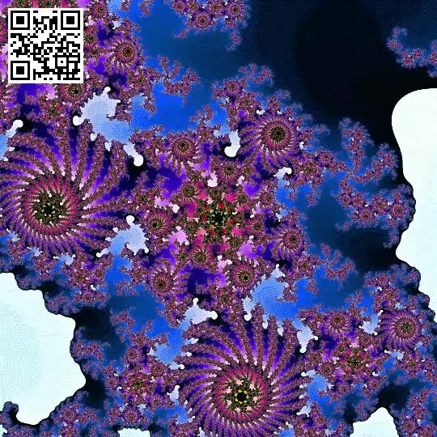

Ancora i frattali
Il triangolo di Sierpinski
https://giphy.com/gifs/animation-trippy-psychedelic-xUPGcxdhS5isNwqsuY

Slide 3

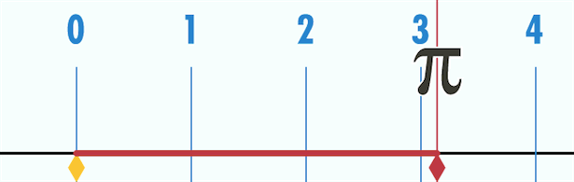
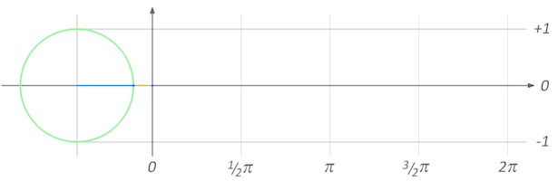
Ancora il numero pi-greco
https://archive.nerdist.com/three-gifs-that-make-pi-instantly-understandable/

Slide 4
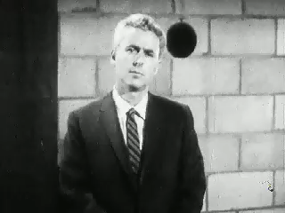
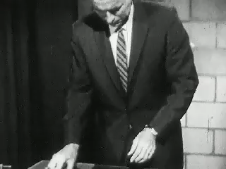
Due esempi del moto

Slide 5
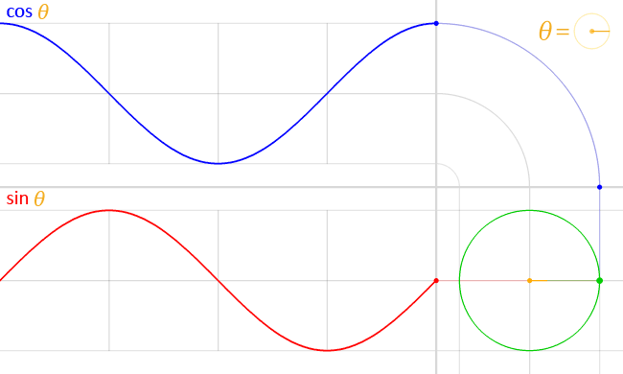
Il cerchio è la somma di seno e coseno
x = cos θ
y = sin θ
https://commons.wikimedia.org/wiki/File:Circle_cos_sin.gif

Slide 6


La cicloide (per matematici) oppure brachisto-crona (per fisici)
https://en.wikipedia.org/wiki/Cycloid

Slide 7
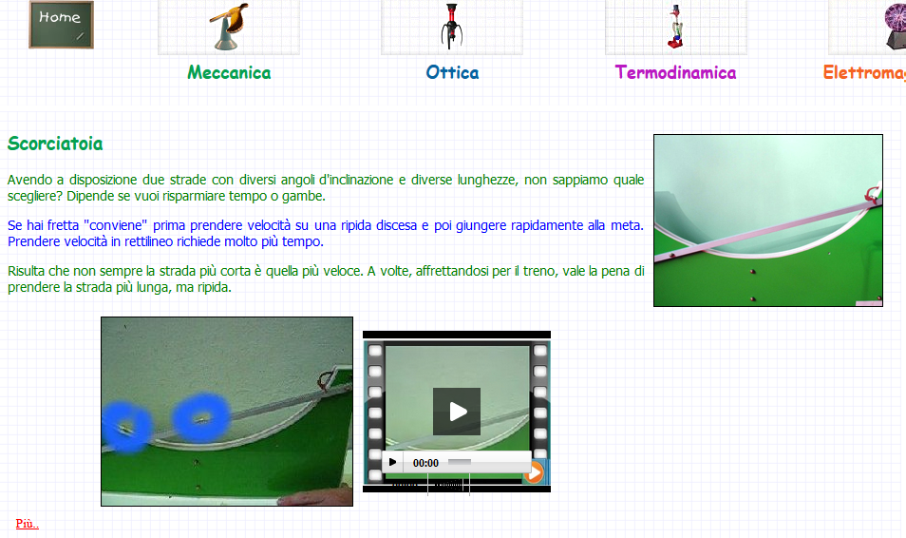
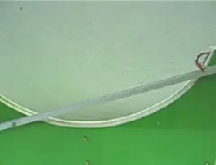
Brachistrocrona (J. Bernoulli)
http://dydaktyka.fizyka.umk.pl/zabawki1/index-it.html

Slide 8
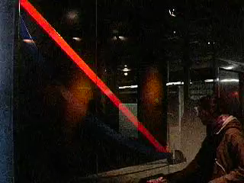
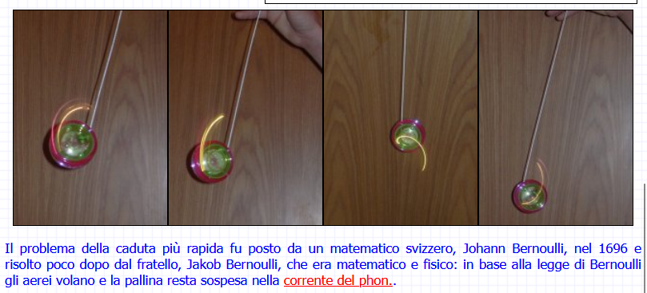
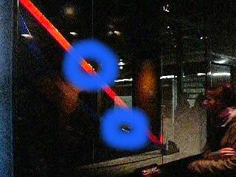
Brachistrocrona (J. Bernoulli)
http://dydaktyka.fizyka.umk.pl/zabawki1/files/mech/faster-it.html

Slide 9

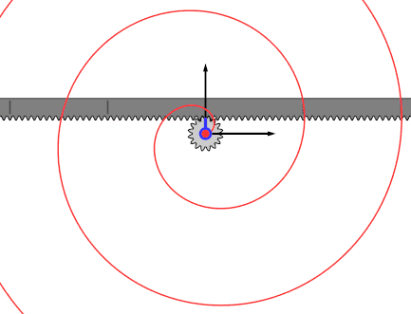
Spirale di Archimede
r = a + b·θ
https://upload.wikimedia.org/wikipedia/commons/0/00/Archimedean_Spiral_animation_with_Gears_positive_tracing.gif
https://en.wikipedia.org/wiki/Archimedean_spiralAtacama Large Millimeter Array image of LL Pegasi

Slide 10
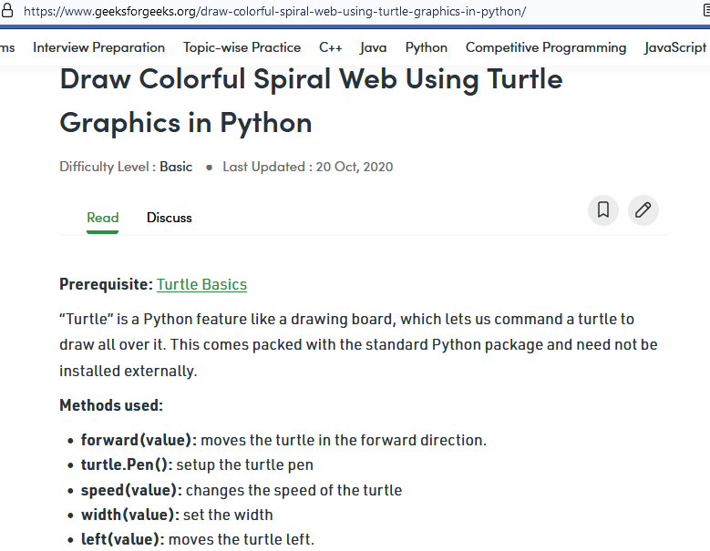
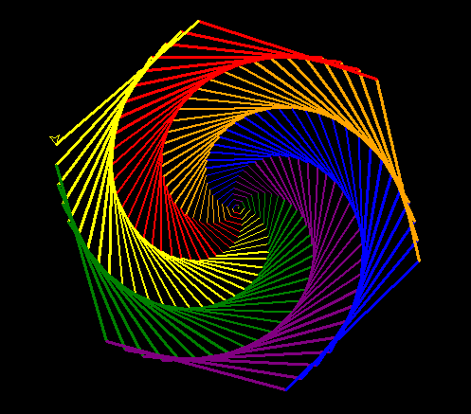
Una spirale più bella

Slide 11
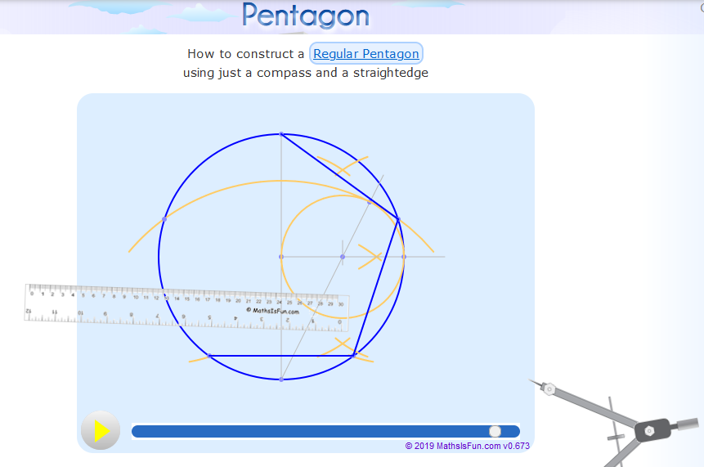
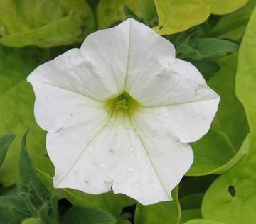
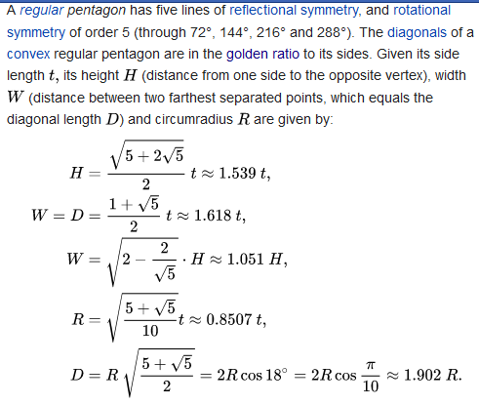
Math is Fun: pentagono regolare
https://en.wikipedia.org/wiki/Pentagon
https://www.mathsisfun.com/geometry/construct-pentagon.html

Slide 12
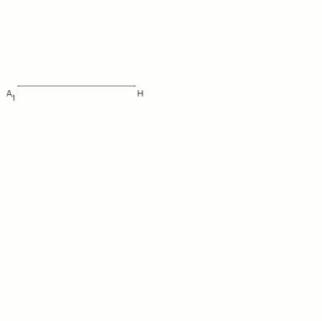

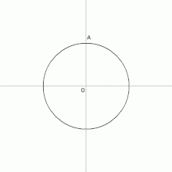
Pentagono regolare: due altre costruzioni
https://upload.wikimedia.org/wikipedia/commons/thumb/9/96/Regular_Pentagon_Using_Carlyle_Circle.gif/220px-Regular_Pentagon_Using_Carlyle_Circle.gif
https://en.wikipedia.org/wiki/Pentagon#/media/File:01-Pentagon-Euklid_Animation.gif

Slide 13

Il problema del piastrellista
A regular pentagon cannot appear in any tiling of regular polygons. First, to prove a pentagon cannot form a regular tiling (one in which all faces are congruent, thus requiring that all the polygons be pentagons), observe that 360° / 108° = 31⁄3 (where 108° Is the interior angle), which is not a whole number; hence there exists no integer number of pentagons sharing a single vertex and leaving no gaps between them. More difficult is proving a pentagon cannot be in any edge-to-edge tiling made by regular polygons:
The maximum known packing density of a regular pentagon is approximately 0.921, achieved by the double lattice packing shown. In a preprint released in 2016, Thomas Hales and Wöden Kusner announced a proof that the double lattice packing of the regular pentagon (which they call the "pentagonal ice-ray" packing, and which they trace to the work of Chinese artisans in 1900) has the optimal density among all packings of regular pentagons in the plane.^{[15]} As of 2020, their proof has not yet been refereed and published.

Slide 14
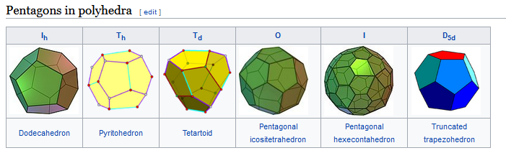
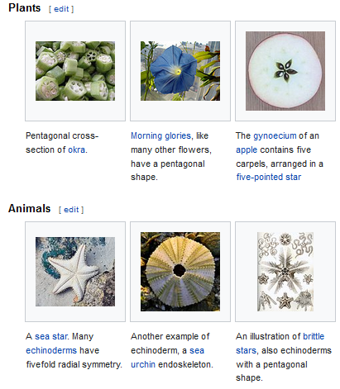
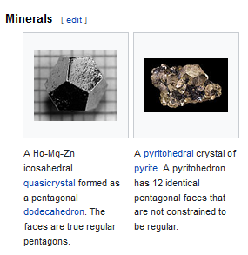
Il pentagono in natura
https://en.wikipedia.org/wiki/Pentagon

Slide 15
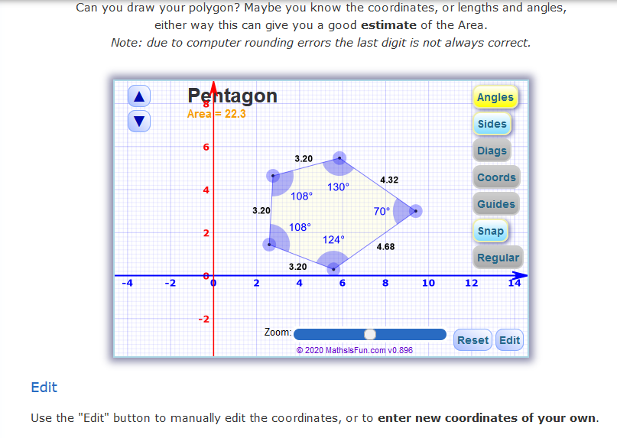
Math is Fun
https://www.mathsisfun.com/geometry/area-polygon-drawing.html

Slide 16
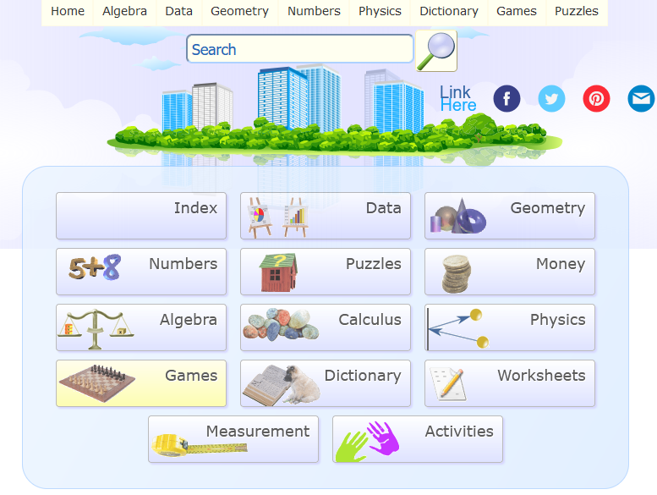
Math is Fun
https://www.mathsisfun.com/

Slide 17
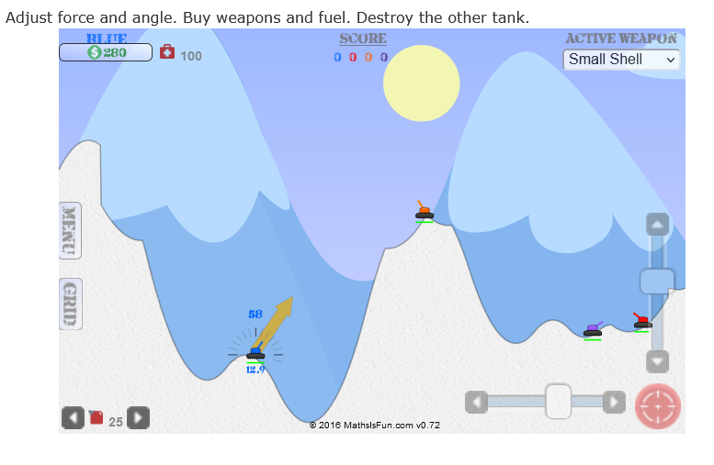
Math is Fun: la battaglia di carri armati
https://www.mathsisfun.com/games/tanks2.html

Slide 18
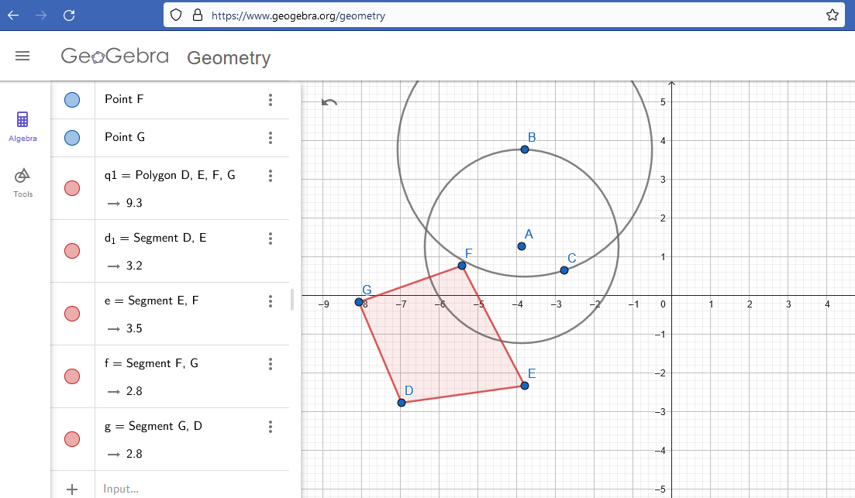
Lo strumento didattico serio: Geogebra

Slide 19
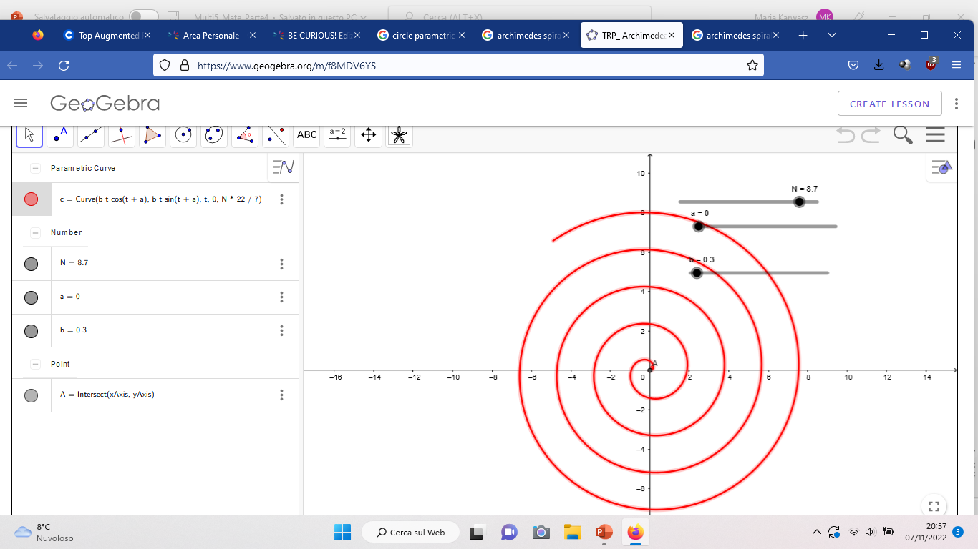
Lo strumento didattico serio: Geogebra
Equazione parametrica

Slide 20
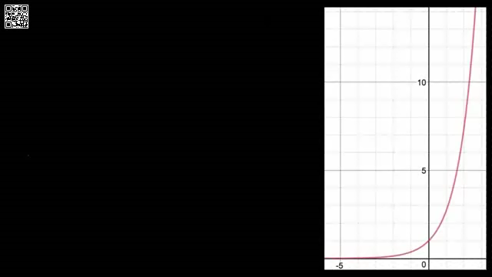
Khan’s Academy
https://www.khanacademy.org/math/ap-calculus-ab/ab-differentiation-1-new/ab-2-7/v/derivative-of-ex

Slide 21
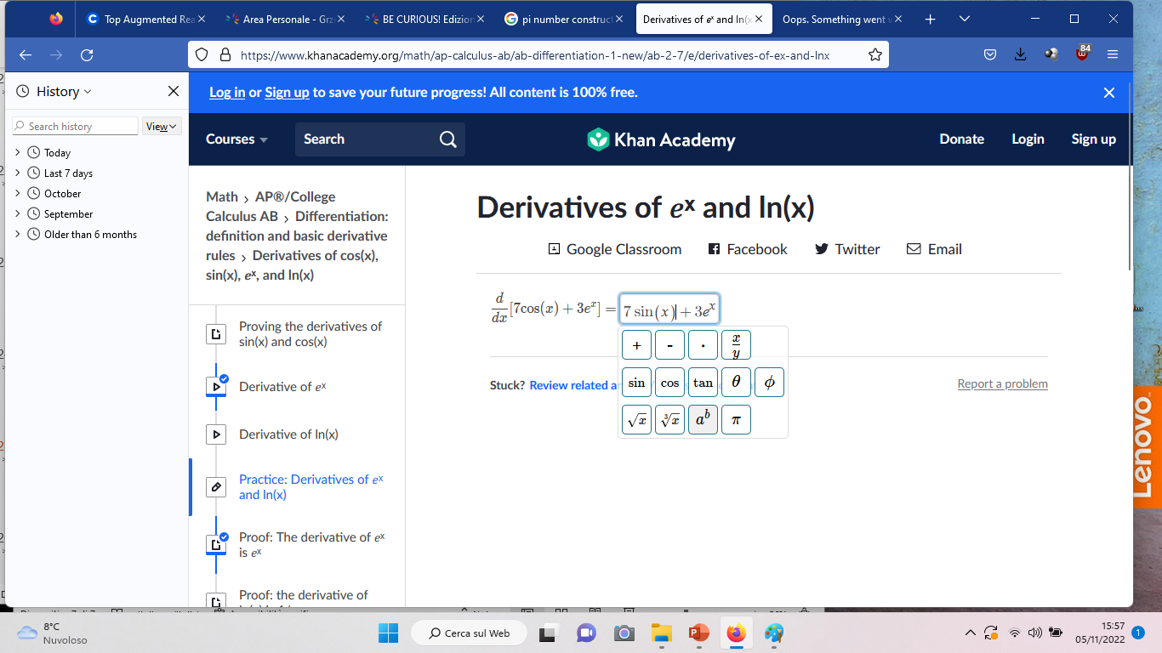
Khan’s Academy

Slide 22
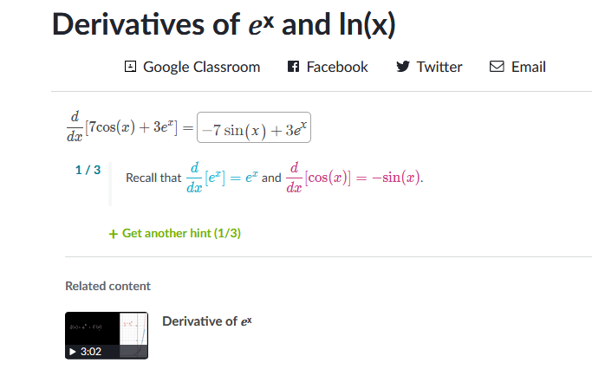
https://www.khanacademy.org/math/ap-calculus-ab/ab-differentiation-1-new/ab-2-7/e/derivatives-of-ex-and-lnx

Slide 23
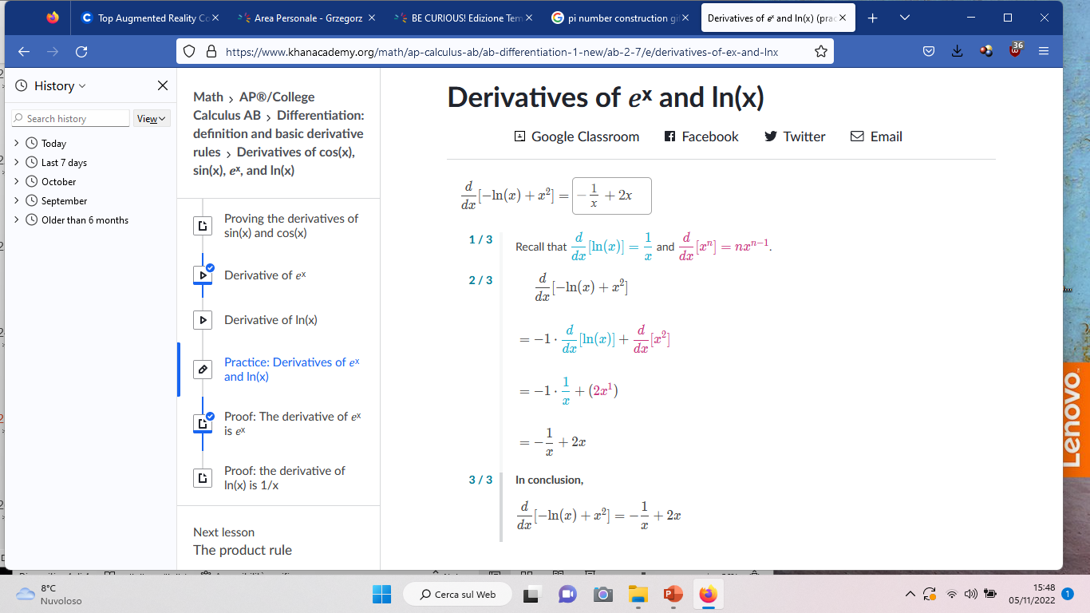
Khan’s Academy

Slide 24
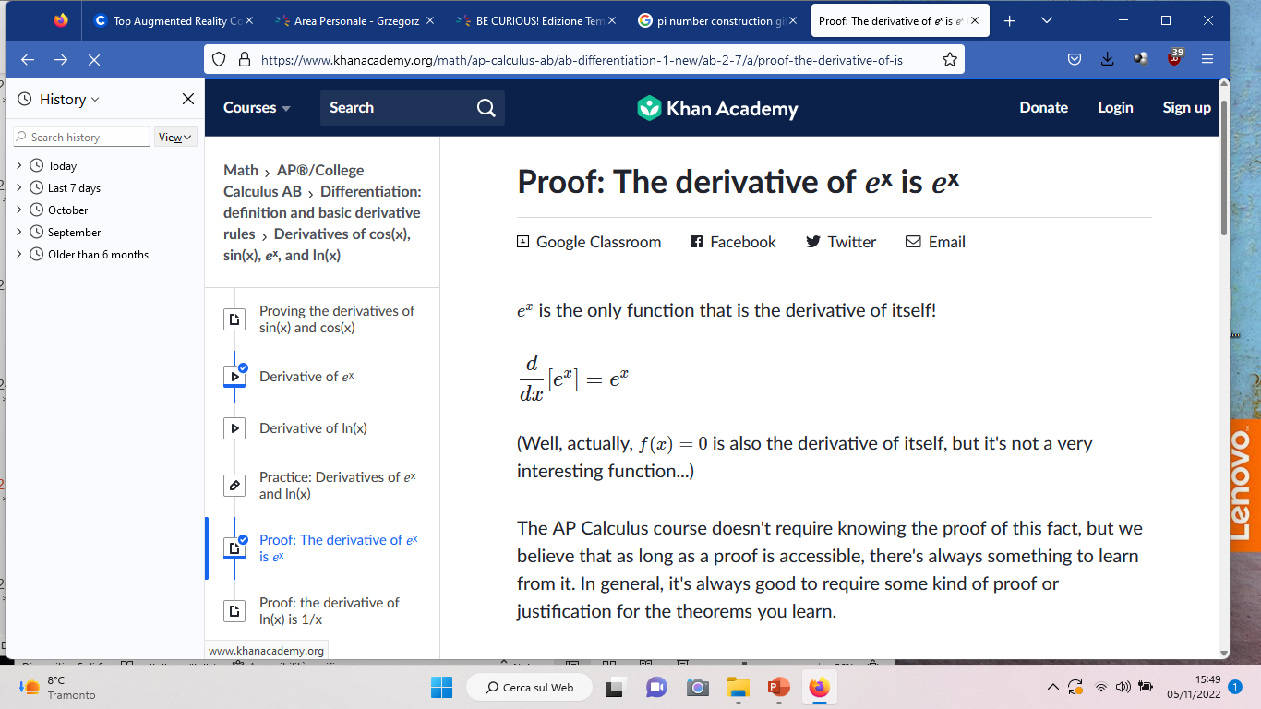
Khan’s Academy
https://www.khanacademy.org/math/ap-calculus-ab/ab-differentiation-1-new/ab-2-7/v/derivative-of-ex

Slide 25
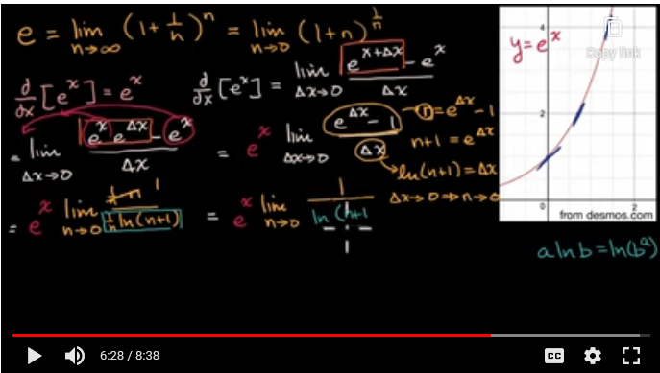
Khan’s Academy
https://www.khanacademy.org/math/ap-calculus-ab/ab-differentiation-1-new/ab-2-7/v/derivative-of-ex

Slide 26

Anche bambini

Slide 27


Slide 28

Khan Academy for Kids
https://www.youtube.com/watch?v=EEV-nPQiqnE

Slide 29
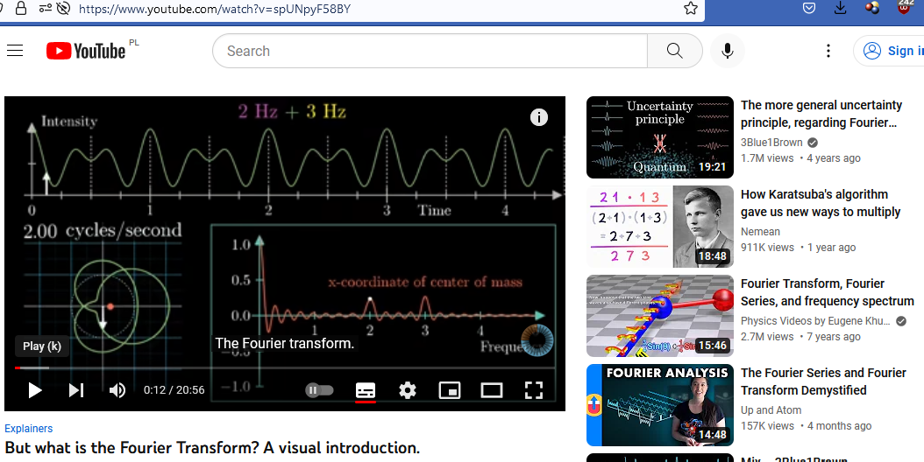
Ci ricordiamo l’acustica? Trasformata di Fourier
https://www.youtube.com/watch?v=spUNpyF58BY

Slide 30
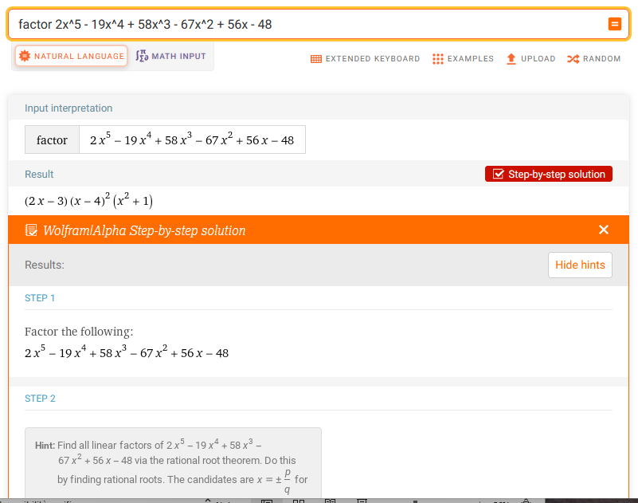
wolfram.com
Mathematica wolframalfa.com
Scomposizione dei polinomi
Suggerimenti passo per passo
per es. «cerchiamo i divisori del 48»

Slide 31
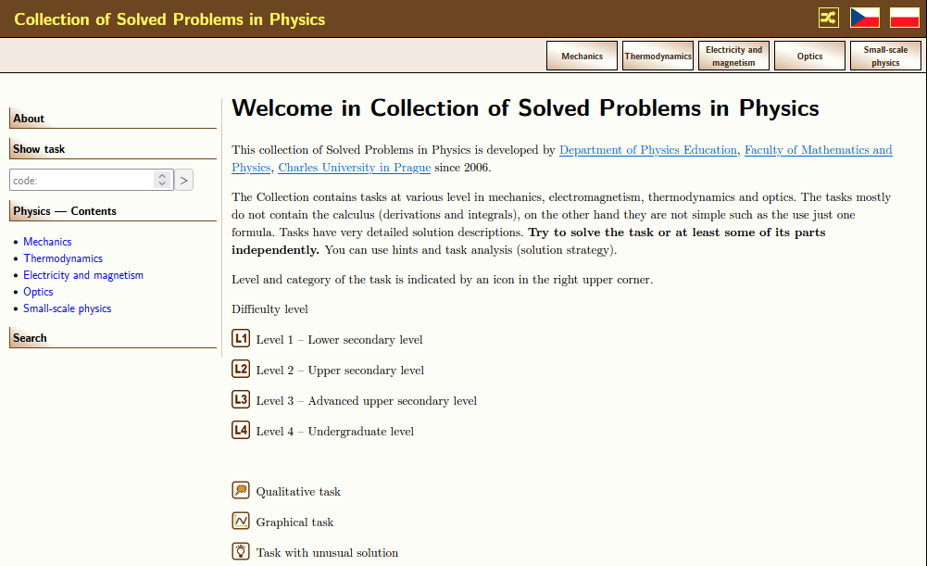
Anche per Fisica «abbiamo» creato un sito simile
http://physicstasks.eu/en

Slide 32
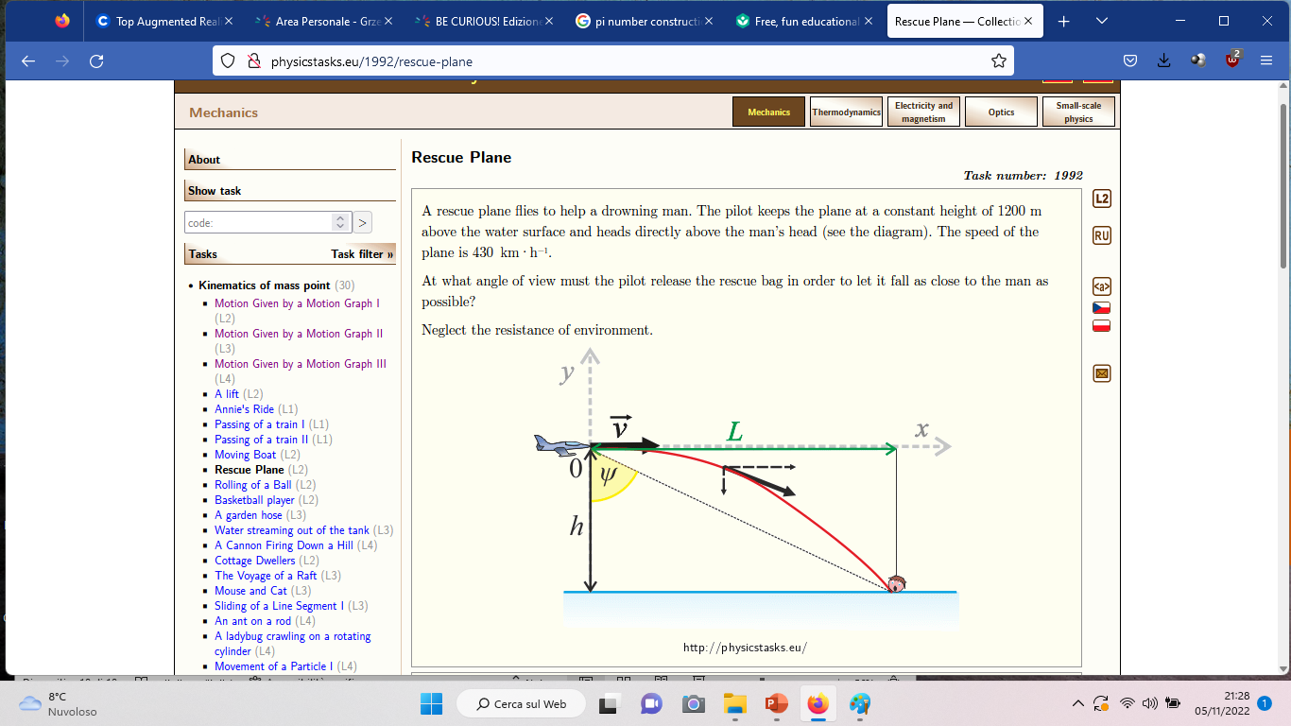

Slide 33
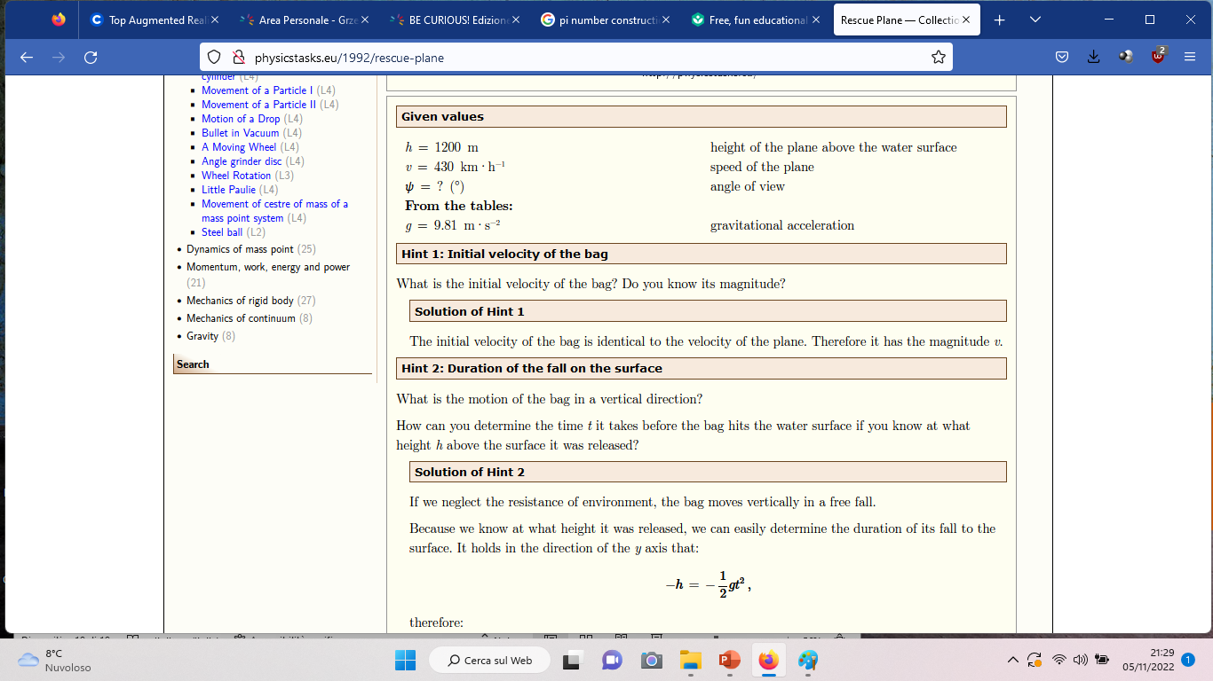

Slide 34
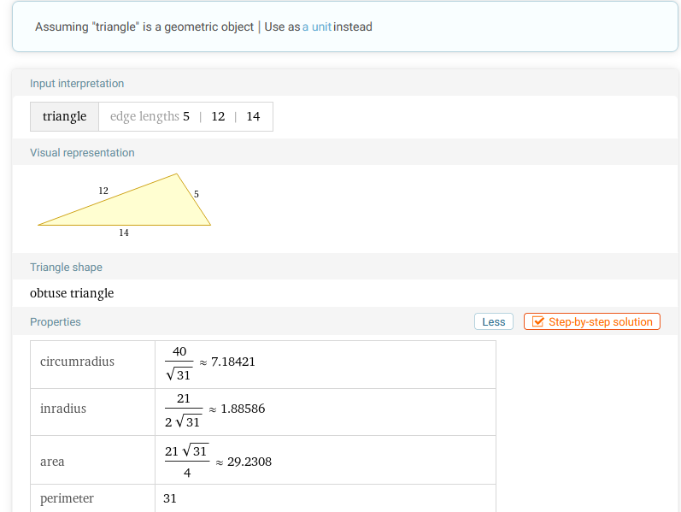
wolfram.com geometria
https://www.wolframalpha.com/input?i=5%2C+12%2C+14+triangle

Slide 35
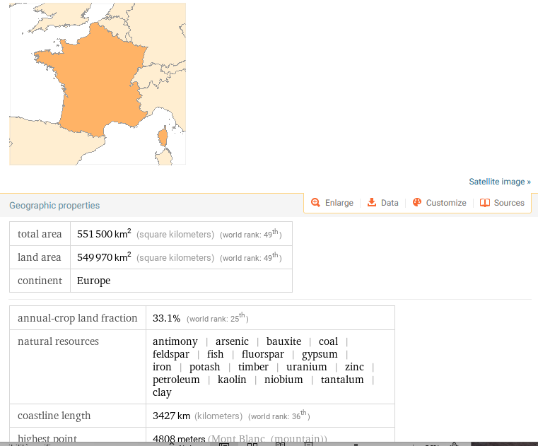
wolframalpha:
Persino la geografia
https://www.wolframalpha.com/input?i=France

Slide 36
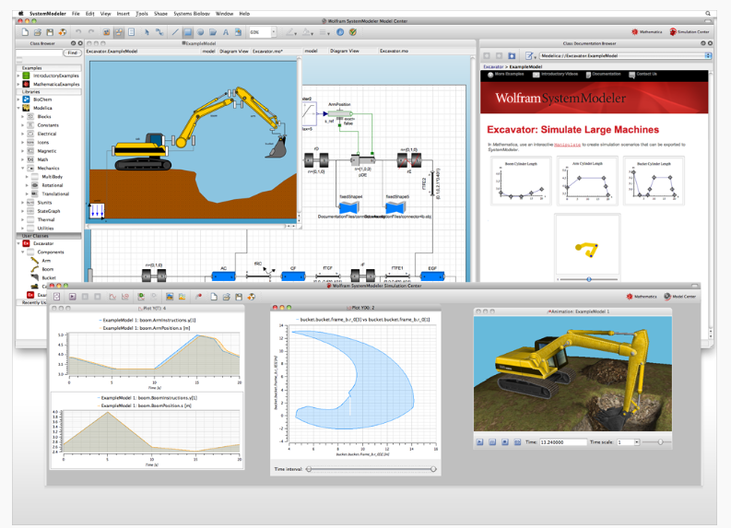
Modello della scavatrice, con tanto di ricambi
https://www.mathematica.pl/?wolfram-systemmodeler,251

Slide 37
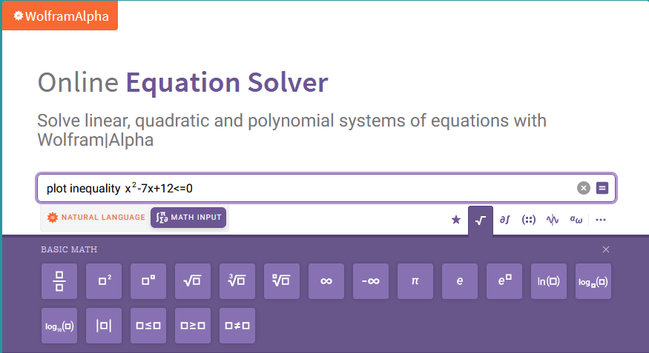
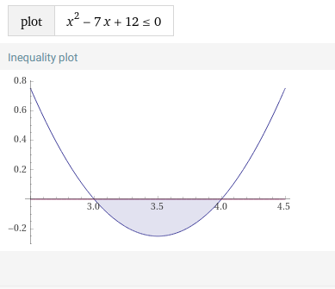
On-line equation solver
https://www.wolframalpha.com/calculators/equation-solver-calculator

Slide 38
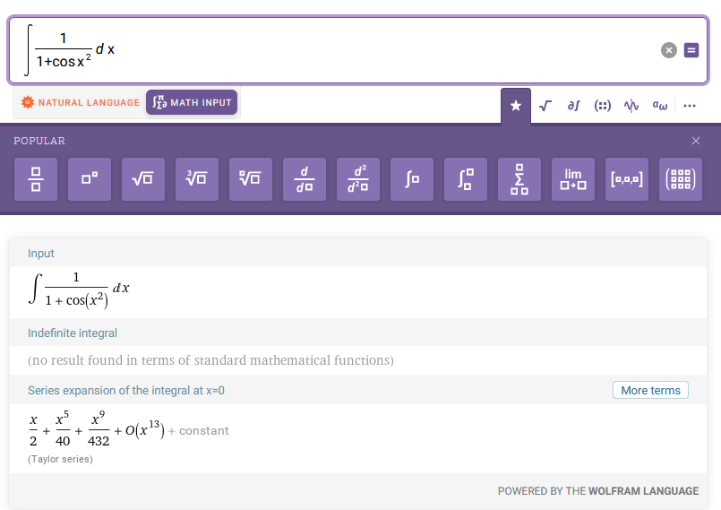

On-line equation solver
Tra poco basterà un conto su wolfram.com per passare la maturità…

Slide 39
Il riassunto
La matematica è, senza dubbio, utile, ma può essere in ugual modo dilettevole
Un arduo compito (per l’insegnante, il ministero che definisce cv, gli editori) di trovare un giusto equilibrio, che unisca la didattica, il divertimento, e la scienza…
Grazie per la vostra attenzione!
G. Karwasz, J. Kruk Idee ed implementazioni della didattica interattiva, UMK, Torun, 2011

