Slide 1
Individualizzazione ed la personalizzazione dell’insegnamento
Grzegorz Karwasz
Professor in Experimental Physics
- Dipartimento di Fisica Tecnica e Matematica Applicata, Politecnico di Danzica
- Dipartimento di Fisica, Universita’ di Trento
- Facoltà di Fisica, Astronomia e Informatica Applicata, Universita’ Nicolao Copernico, Torun, Polonia
karwasz@fizyka.umk.pl

Slide 2
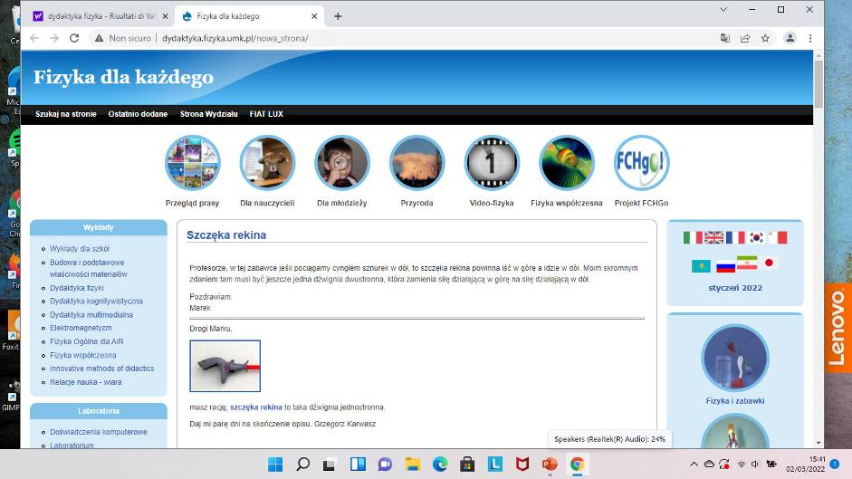
http://dydaktyka.fizyka.umk.pl
3 mln di visitatori dal 2009

Slide 3
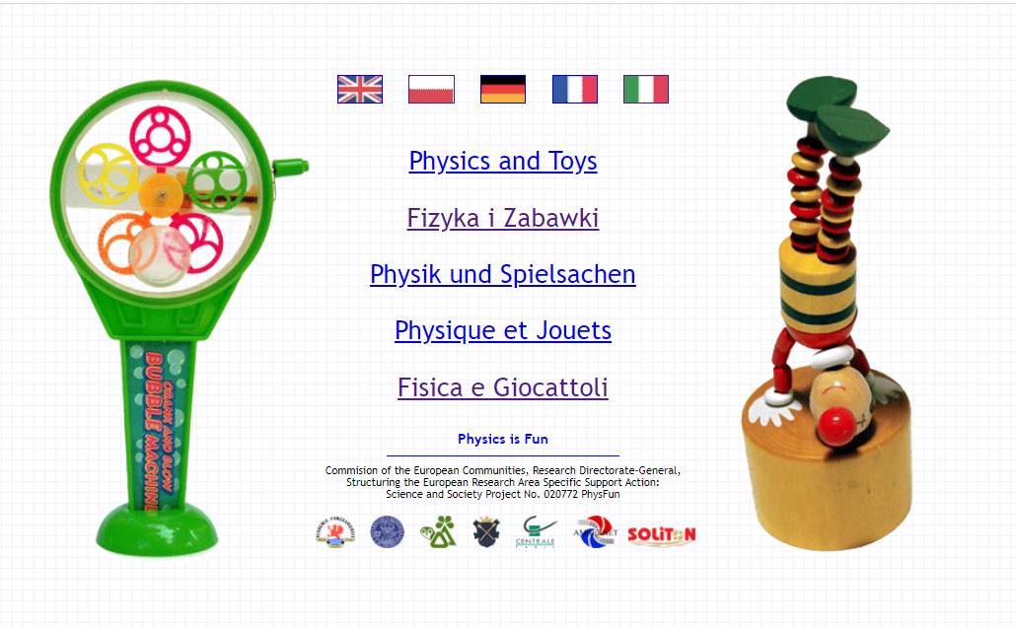
Physics and Toys
http://dydaktyka.fizyka.umk.pl/zabawki1/

Slide 4
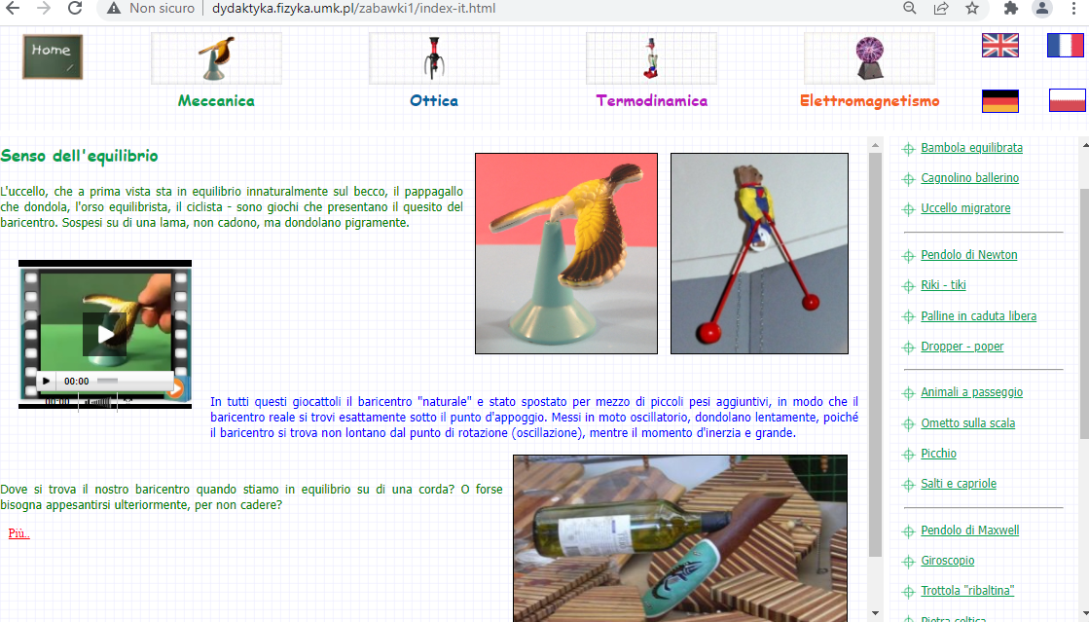
Fisica e giocattoli
http://dydaktyka.fizyka.umk.pl/zabawki1/index-it.html

Slide 5
Lezioni e laboratori, mostre interattive

Slide 6
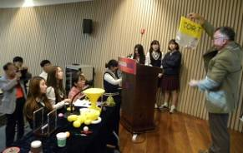
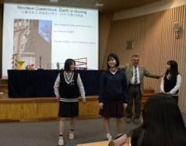
Physics is Fun:
Why do objects fall?
Grzegorz Karwasz
Didactics of Physics Division
Nicolaus Copernicus University
Toruń, Poland
송미영
선임 연구원
플라즈마물성데이터 센터
플라즈마물성연구팀 / 원천기술연구부/
플라즈마기술연구센터 /국가핵융합연구소

Slide 7
„Didattica”
Didacto (gr.) „insegno”
Didattica <gr. didaktikós = insegnante, correttivo>
Una disciplina della pedagogia – scienza su metodi di insegnare ed imparare.
correggere, moralizzare
Didassia – i metodi applicati, cioè la prassi d’insegnare
dīdūco [dīdūco], dīdūcis, diduxi, diductum, dīdūcĕre
verbo transitivo III coniugazione
1 allargare, aprire, staccare, distendere
2 disgiungere, separare, dividere
3 sciogliere, disfare, rompere, strappare
In altre parole: insegnare = dividere, analizzare, allargare
Dizionario parole straniere PWN, Warszawa, 1972
Dizionario lingua latina

Slide 8
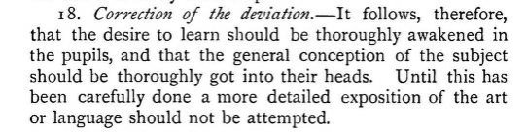
Jan Amos Comenius in „Didactica Magna” (1657) defined it differently:
„DIDACTIC signifies the art of teaching”
Didactics is such a teaching that is:
- durable
efficient (i.e. fast and cheap)
pleasant
Chapt. XVIII/ 18

Slide 9
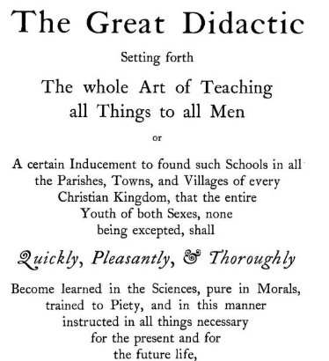
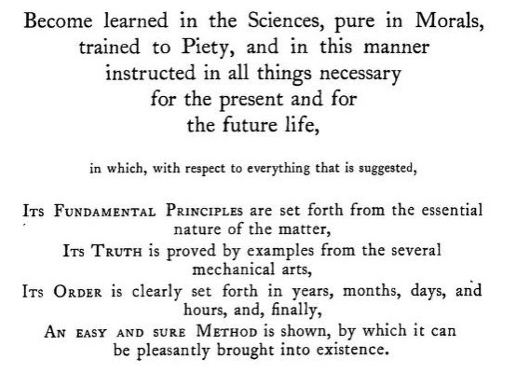
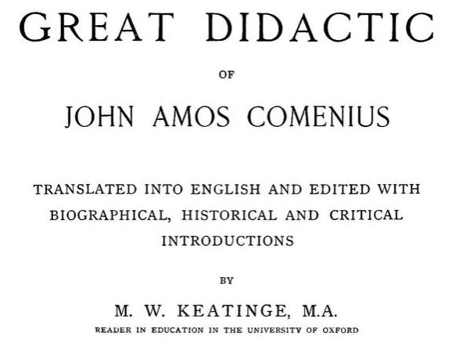
„Great Didactic”
https://archive.org/details/cu31924031053709/page/n7

Slide 10
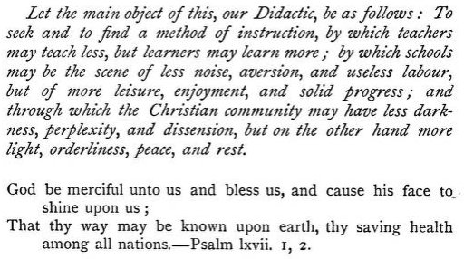
„Great Didactic”
Trovare un modo d’insegnare che l’insegnante insegni meno ma gli studenti imparino di più, che la scuola sia luogo di meno rumore, aversione e di lavoro inutile ma di più tempo libero, piacere, e di solido progresso
https://archive.org/details/cu31924031053709/page/n7

Slide 11
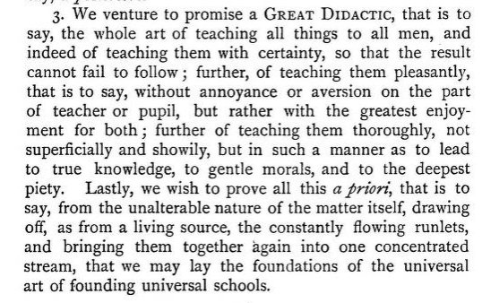
„Great Didactic”
Insegnare in modo piacevole, senza noia o l’avversione, ma con gioia
Insegnare in modo preciso, non superficialmente o vistosamente
Per arrivare alla vera sapienza, morale gentile, e profonda carità
https://archive.org/details/cu31924031053709/page/n7

Slide 12
„John Amos Comenius”
applied effective teaching based on the natural gradual growth from simple to more comprehensive concepts, supported lifelong learning and development of logical thinking by moving from dull memorization, presented and supported the idea of equal opportunity for impoverished children, opened doors to education for women, made instruction universal and practical.
These texts were all based on the same fundamental ideas:
(1) learning foreign languages through the vernacular;
(2) obtaining ideas through objects rather than words;
(3) starting with objects most familiar to the child to introduce him to both the new language and the more remote world of objects;
[GK: neo-realism, hyper-constructivism]
(4) giving the child a comprehensive knowledge of his environment, physical and social, as well as instruction in religious, moral, and classical subjects;
(5) making this acquisition of a compendium of knowledge a pleasure rather than a task; and
(6) making instruction universal.
https://en.wikipedia.org/wiki/Comenius

Slide 13
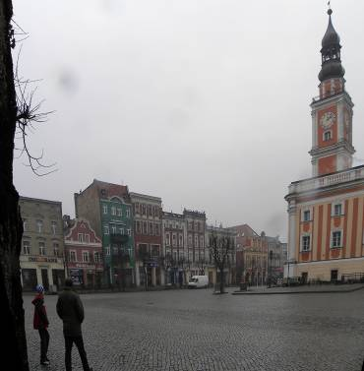
Leszno: a forgotten cultural heritage
Nancy, the capital of Lotaryngia of Prince Stanisław Leszczyński
Leszno, a „sleeping” town
PWSZ im. Komeńskiego in Leszno
Foto Maria Karwasz
„Going downhill”

Slide 14
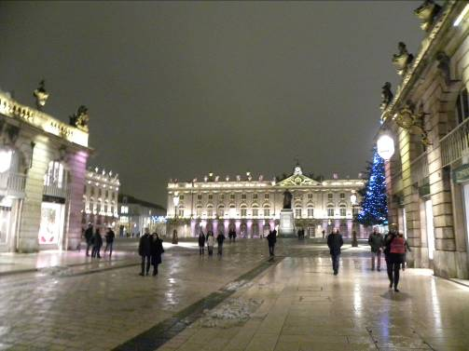
Leszno: a forgotten cultural heritage
Nancy, the capital of Lotaryngia of Prince Stanisław Leszczyński
Leszno, a „sleeping” town
PWSZ im. Komeńskiego in Leszno
Foto Maria Karwasz
„Going downhill”

Slide 15
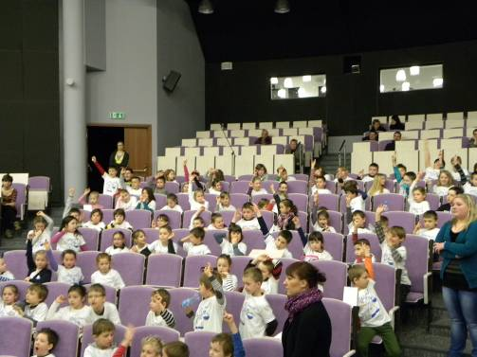
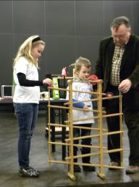
Leszno: a forgotten cultural heritage
Nancy, the capital of Lotaryngia of Prince Stanisław Leszczyński
Leszno, a „sleeping” town
PWSZ im. Komeńskiego in Leszno
Foto Maria Karwasz
„Going downhill”

Slide 16
Leszno: a forgotten cultural heritage
Nancy, the capital of Lotaryngia of Prince Stanisław Leszczyński
Neo-realism/ hyper-constructivism/ inter-disciplinarity
Leszno, a „sleeping” town
PWSZ im. Komeńskiego in Leszno
Foto Maria Karwasz
„Going downhill”

Slide 17
In ogni scienza dobbiamo definire:
Il ricercatore (il soggetto: professore, studente, allievo, medico, un amatore etc.)
L’oggetto di ricerca (un atomo, una galassia, una piante, un manoscritto medioevale etc.)
Lo strumento (microscopio, scanner, UV camera, acceleratore di particelle, etc.)
Il metodo (deduttivo, osservazione della natura, tessuti artificiali, induzione, comparazione, tomo-grafia, tracciamento radioattivo etc.)

Slide 18
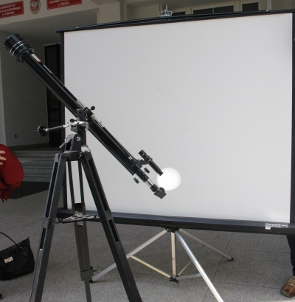
Nella didattica vigono le stesse regole come nelle scienze (umanistiche ed ‘esatte’)
Il ricercatore: di solito l’insegnante, o il direttore, ma anche l’ispettore scolastico, istituto di studi sul Sistema di educations, dipertimento delle didattica dell’università, il dipartimento dell’OCSE (test PISA) etc.
e l’oggetto (??)
http://dydaktyka.fizyka.umk.pl/nowa_strona/?q=node/550

Slide 19
L’oggetto dello studio della didattica è
L’oggetto è: - le conoscenze acuisite dallo studente
Il percorso didattico che ha condotto alle conoscenze attuali
Le limitazioni sociali del presente modo di pensare
i.e. nella sua totalità = studente + società
Allora la didattica, anche delle scienze, è una disciplina profondamente umanistica: richiede competenze nella psicologia, pedagogia, cultura, filosofia, storia etc.

Slide 20
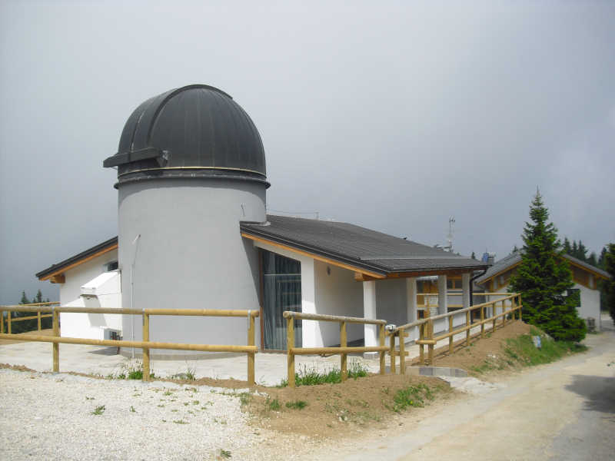
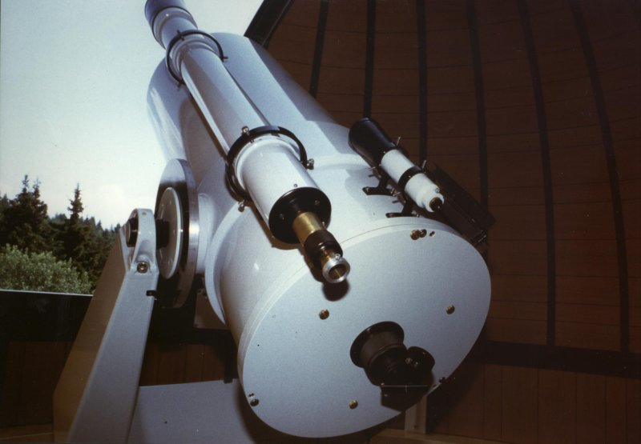
Tele-scopio
Museo Civico Rovereto, Monte Zugna, Trentino
Foto: Museo Civivo Rovereto

Slide 21
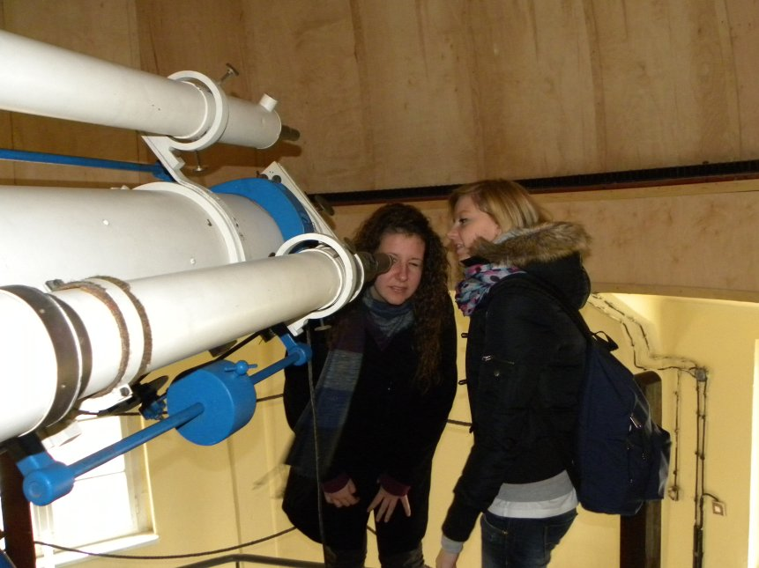
Soggetto ↔ Oggetto
Piwnice, III 2011
Liceum Rosmini di Trento „Sulle orme del Copernico”
Proggetto e l’implementazione: Maria Moser, Maria Karwasz,
G. Karwasz, Lezione: A. Strobel)
Foto: M. Karwasz

Slide 22
In didattica vengono definiti:
Principi: (i) andare per passi, della difficoltà crescente, (ii) riferimenti alle applicazioni prattiche, (iii) illustrazione, (iv) approccio individuale, (v) collaborazione di gruppo, etc.
Metodi: lezione frontale, laboratorio, esercitazioni, lezione interattiva, teatro, gita scolastica, conversatorio etc.
Mezzi (sussidi): lavagna e gesso, presentazione multimediale, collezione di rocce, video, strumentazione di laboratorio etc.
Oggettivi: d’élite, vocazionale (professionale), generale (liceo), livello di base etc. – ogni paese, ogni istituzione e in ogni periodo definisce gli oggettivi diversi.

Slide 23
Riassumendo, la didattica, come ogni attività umana definisce i suoi:
Principi
Metodi
Mezzi (dispositivi)
Quest’è il cosiddetto paradigma di ogni scienza:
l’oggetto e il metodo
In pedagogia viene distinta la pedagogia, i.e. la scienza sull’educazione e la pedagogìa, i.e. la prassi dell’educazione
Nella didattica non c’è questa distinzione – forse la teoria della didattica si dovrebbe chiamare didagogia.

Slide 24
I principi della didattica sono, per esempio,
Della difficoltà crescente
Di semplicità (accessibilità)
Dell’illustrazione
Dell’attività dello studente
Del collegamento tra la teoria e la prattica
Dell’efficienza
D’individualizzazione e di collaborazione di gruppo

Slide 25
Didactics, as every (human) research activity defines its:
Objects (who performs the research)
Subject (on whom the research is performed)
Instruments (microscope, telescope etc.)
Didactics of physics (DoP) differs from physics: the subject of Physics is the external (i.e. physical) world: atoms, crystals, galaxies.
A classical definition would say, that the subject of activity of DoP is the knowledge of physics (by students): that is correct – we check this knowledge
But it is more: the subject is the image of physics in the mind of the student
Even more: it is the process of gaining knowledge by student
Or: the whole mind of the student (what and why he knows wrong)

Slide 26
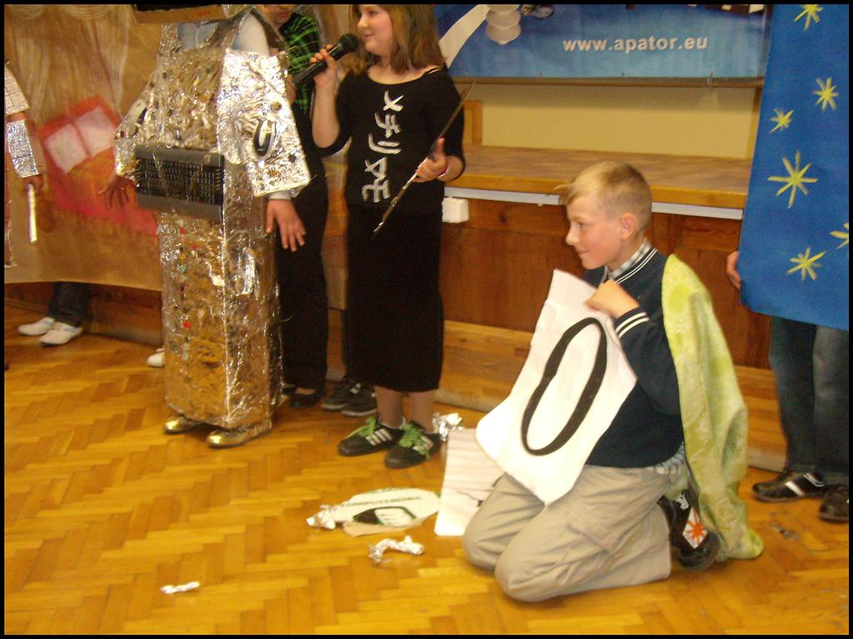
I metodi della didattica sono, per esempio:
Lezione
Narrazione
Seminario
Laboratorio
Workshop
Metodo del progetto
Presentazioni di studenti
Teatro didattico
http://dydaktyka.fizyka.umk.pl/nowa_strona/?q=node/86
Libro programmato (narrazione iper-construttivista)
Lezione con esperimenti interattivi
etc.

Slide 27
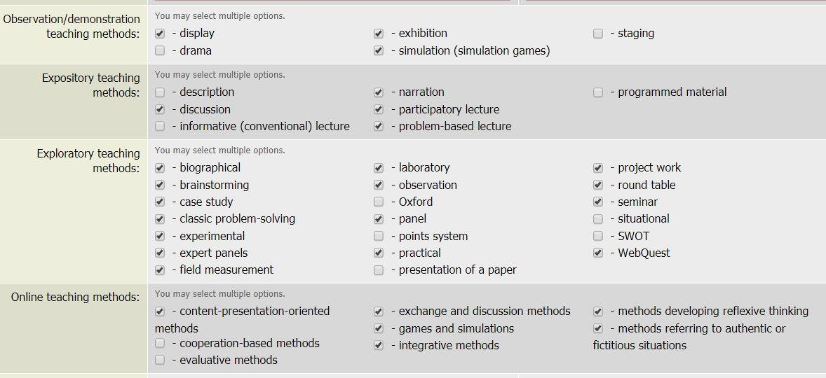
and many, many more, depending on the local/ instant idea and the subject
You are expected to practice all of them…
© UMK

Slide 28
Didactical measures (means, subsidies) are, for example
Textbook
Script
Collection of solved problems
Didactical posters
Measurement equipment
Computer
Herbarium
Compass
Multimedia (files, collections, didactical paths, encyclopedia, multimedia textbooks, video lessons etc.

Slide 29
But both the principles, methods and means are subjected to the goal
that is to give the young people the eduction (i.e. the knowledge plus formation)
-------
This, obviously, is a noble goal, so very general i.e. enigmatic
(In Polish one says that with good intents the hell is paved)
In the real life, different goals are defined in different realities.

Slide 30
and so these real, instant goals may be very different
that as many as possible pupils pass the entrance exam to the university (= high level, to everybody)
that school „produced” as many as possible laureates from Olympian games
that school achieves 100% rate of maturity exam
that the school is well classified in rankings [who organizes these rankings and what kind of qualification he/she represents in pedagogy, didactics, science?]
that the teacher gets job for the next year what is not the best from the point of view of the pupil/ parent/ society”

Slide 31
A much better goal would be:
assure the student, in his/her adult life, a civilisation success, where by „civilisation” we understand both:
economic one (i..e. the possibility of welfare for her/him and their family), and
cultural one, i.e. ability to participate, support, and possibly create cultural goods: artifacts – arts, music, literature etc.
In other words, the individual, particular goal of the pupil and his/her parents, coincides with the broader, global and social goal.
Never in the education the goal can be: „we want more students to enter Physics Faculty (see Weber’s law of sociology)” or „we want more scientists”.

Slide 32
And didactics of physics has smth in common with all these principles?
Quite a lot! The aim is not to teach Newton’s laws themselves, but practical ability to „use” them in practical life: like it is done by an infant as soon as he/she starts to understand the law of gravity, of the center of mass, of the point of support, of the dynamic and static friction – i.e. as soon as he starts practicing a bi-pedal, vertical locomotion position.
In a way, that he/she understands that on the curve the the centrifugal force rises as the square of the velocity F=mv²/r
that the coefficient of friction is less than 1, so the breaking path is linger
that frozen, winter air is dry, so it is worth opening the window in winter not in summer; but for a short time only, to exchange the air, and in this way to pump-out water vapour, but open for a short time, not to make the walls cold, what would bring an opposite effect.
that a microwave oven does not worm-up dry food, so it can be even damaged, if there is not enough (liquid) water inside
that the traces on the sky behind the airplanes do forecast the change of the weather (in upper atmosphere wet air is arriving)
that in sauna one can die suffocated as the total pressure, according to Dalton’s law) is the sum of partial pressures, etc.

Slide 33
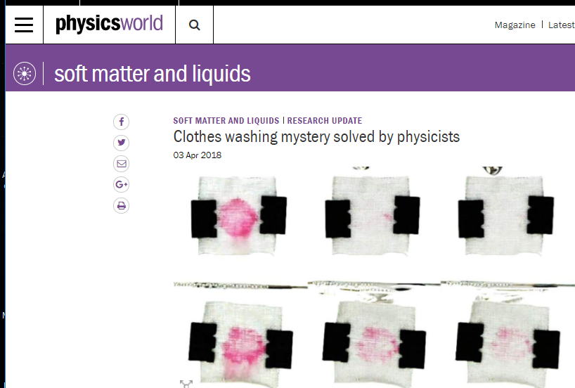
Didactics of physics, both for triggering the research interest and for knowledge transmission and for opening minds may,
use all different achievements of the „professional” physics, like the scientific research in subject of washing clothes (in cold water)
https://physicsworld.com/a/clothes-washing-mystery-solved-by-physicists

Slide 34
So, didactix of physics should also assure three kinds of competences:
knowledge: the friction depends on the on the coefficient f and the force of the pressure; in other words, for the truck and for the automobile the path of breaking is exactly the same; and as the coefficient of the friction is smaller than 1, the path of breaking can not be smaller than _ _ _
abilities: find the force components on the ropes and supports of a bridge; finding the systems of breaking that taking into account that the coefficient of the static friction is higher than the coefficient of the dinamic friction (i.e. an ABS system)
social competences: nothings will save us from „falling out” from the curve, if we do not reduce the velocity down to the value indicated on the road sign (especially with the rain) and not obeying it we risk not only own life but also of the passengers.
https://www.youtube.com/watch?v=j-zczJXSxnw
https://www.youtube.com/watch?v=qPNxMGu9XlI
https://www.youtube.com/watch?v=25Lt6ulrdtg

Slide 35
The fundamental requirement of effective didaxis, i.e. practical teaching based on a reasonable didactics is teaching:
such subjects and questions
with such methods
and with using such measures (means),
→ that will allow
formation in the student’s mind the knowledge which is durable, useful and linked to positive emotions during the process of learning.
At the same time, no subject may gain sucha place in (always limited) curriculum of the students that no place is left for other subjects and/or the emotional/ intelectual/ physical harmony in his/her development is compomised. This requirement is a part of so-called Pedagogical Contents Knowledge (Shulman, 1987).

Slide 36
Resuming, didactics is not an enigmatic science on teaching
(in Polish: „nauka o nauczaniu”)
about some general and everywhere applicable methods, as these are well defined already from times of Comenius (it is worth consulting him, anyhow)
but practical, concrete, current and local capacity of diagnosis of educational difficulties (of the pupil, student, teacher, and the whole national system).
However, diagnosis in itself is completely useless, and even irritating: a recipe (i.e. a medicine) must be given, i.e. concrete measures (methods, means, hierarchy of principles) to solve these local and current problems.
Thank you for your attention

Slide 37
La tête bien faite*
Teaching Science in XXI Century
Grzegorz Karwasz
Zakład Dydaktyki Fizyki UMK
*Edgar Morin, La tête bien faite
„Głowa dobrze zrobiona. Reforma edukacji i reforma myślenia” Seuil, Paris, 1999

Slide 38
R + D Global shares
R + D Global shares
L’Europa deve darsi da fare!
http://ec.europa.eu/research/era/docs/en/facts&figures-european-commission-key-figures2008-2009-en.pdf

Slide 39
L’interesse per la fisica e chimica nella scuola media in Inghilterra casca a picco
nei primi due anni d’insegnamento

Slide 40

1. EU (2007) „Rocards’ Report”

Slide 41
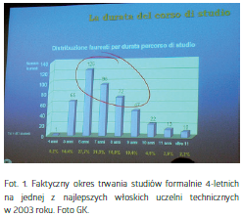
„Nowy uniwersytet potrzebny od zaraz”
- Zmiana systemu nauczania na
„zdecydowanie” boloński
- Działania dla podniesienia wiedzy
matematyczno-przyrodniczej w szkole
średniej

Slide 42
UE (2007): Rocard’s Report
New pedagogy (!)

Slide 43
1. EU Treaty (2010)

Slide 44

1. USA: no student left behind
http://www.edweek.org/ew/section/multimedia/no-child-left-behind-overview-definition-summary.html
S. Goldman (1999): teaching that includes active involvement of pupils,
previously reserved only for selected schools, become available to all.

Slide 45
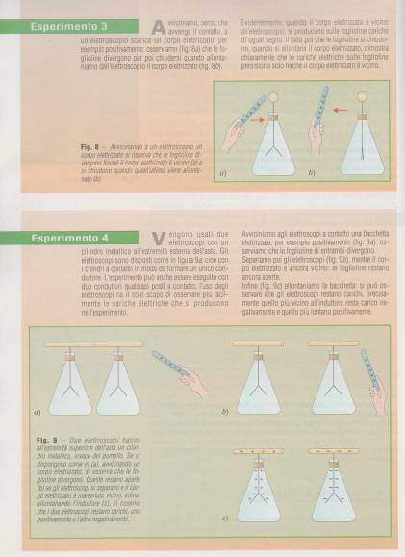
Elettrostatica
(Troppo) dettagliato percorso
sperimentale (anzi, storico)
senza deduzione
„Troppa esemplificazione
porta all’infantilismo”

Slide 46
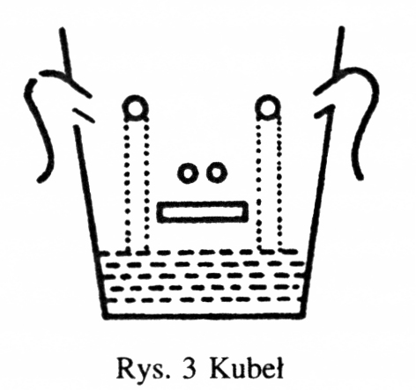
Karl Popper: Kubłowa teoria umysłu
„Nasze różne zmysły są więc źródłem naszej wiedzy – są one źródłami albo wejściami do naszego umysłu. Teorii tej nadałem nazwę kubłowej teorii umysłu. Kubłową teorię umysłu najlepiej przedstawia poniższy rysunek.
„Nasz umysł jest kubłem z początku pustym albo prawie pustym, do którego wpada poprzez zmysły (albo poprzez lejek do napełniania go od góry [zwany szkołą]) materiał, który gromadzi się tam i podlega procesowi trawienia.
Karl Popper, Wiedza obiektywna. Ewolucyjna teoria epistemologiczna, PWN 2010, str. 81

Slide 47
Edgar Morin: „La testa ben fatta”
C’è un’inadeguatezza sempre più ampia, profonda e grave tra i nostri saperi disgiunti, frazionati, suddivisi in discipline da una parte, e realtà o problemi sempre più polidisciplinari, trasversali, multidimensionali, transnazionali, globali planetari dall’altra.
In queste condizioni, i giovani perdono le loro attitudini naturali a contestualizzare i saperi e a integrarli nei loro insiemi.
Dietro alla sfida del globale e del complesso si nasconde un’altra sfida, quella dell’espansione incontrollata del sapere. L’accrescimento ininterrotto delle conoscenze edifica una gigantesca torre di Babele, rumoreggiante di linguaggi discordanti. La torre ci domina perché noi non possiamo dominare i nostri saperi. Eliot diceva: ”Dov’è la conoscenza che periamo nell’informazione?”
[…] Non riusciamo e integrare le nostre conoscenze per indirizzare le nostre vite. Da ció emerge il senso della seconda parte della frase di Eliot: „ Dov’è la saggezza che perdiamo nella conoscenza?”

Slide 48
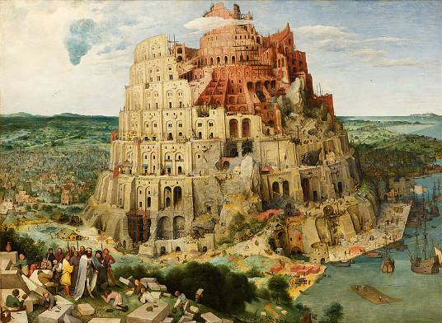
Edgar Morin: „Głowa dobrze zrobiona”: wieża Babel wiedzy
„Bezustanne narastanie wiedzy buduje gigantyczną wieżę Babel, hałaśliwą wieloma, niezgodnymi językami. Wieża góruje na nami, bo my nie jesteśmy w stanie górować nad naszą wiedzą. Eliot pisał: Gdzie jest wiedza, którą gubimy w informacji?
Co więcej, wiedze fragmentaryczne służy jedynie zastosowaniom technicznym. Nie potrafią łączyć się, aby stać się pożywką dla myśli, która potrafi rozważać sytuację człowieka, w łonie życia, na Ziemi, na świecie, i która potrafi sprostać wielkim wyznaniom naszych czasów.
Nie jesteśmy w stanie zintegrować naszej wiedzy, aby ukierunkować nasze życie. Z tego wynika sens drugiego zdania Eliota: Gdzie mądrość, którą gubimy w wiedzy?
Edgar Morin, La tête bien faite, (Głowa dobrze zrobiona. Reforma edukacji i reforma myślenia) Seuil, Paris, 1999, wyd. włoskie Raffaello Cortina, Milano, 2000, str. 9 (tłum. GK)

Slide 49
Le tre funzioni cognitive
Interrogarsi
Capire
Divertirsi
Ludica: Che beeello! [Musei di scienza]
Didattica: Ma, come semplice! [Scuola]
Para-scientifica: Oh Dio! Non capisco niente! [Universita’]
Attualmente le tre funzioni (nella scuola, all’universita’ etc.)
sono disgiunte
G. Karwasz, J. Kruk, Introduzione alla didattica interattiva, Ed. Sci. UMK, 2011 (in polacco)

Slide 50

„Construttivismo”
Raporto TALIS, OECD, 2011
La scuola Italiana, secondo l’esperto Europeo (GK) e’ tra le migliori in Europa.
L’unica statistica, dove l’Italia rimane dopo paesi meno rinomati, e’ sull’approccio
costruttivista.

Slide 51
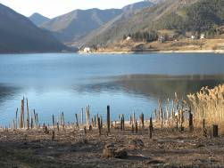

Due concetti didattici (GK)
1. Iper-costruttivismo
Lago di Ledro (TN)
Per insegnare non ho bisogno di nessun libro ne dispositivo: la mia classe già sa tutto. Basta individuare, chi nella classe lo sa. (E l resto sa lo zio google).
Jerome Bruner: „quando l’allievo da’ una risposta sbagliata, probabilmente ha risposto a un’altra domanda (i.e. non ha capito la domanda, o quella ricevuta era troppo difficile per lui)
La lezione come in percorso sulle palaffiti.

Slide 52
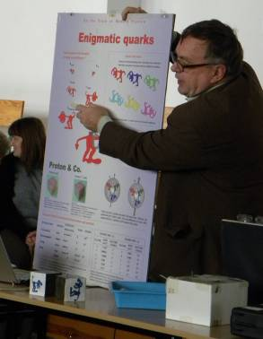
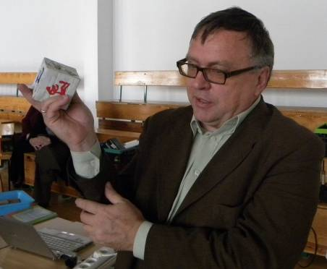
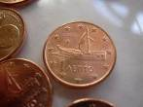
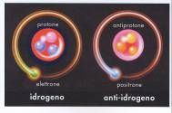
Strategies for Cognitive Pedagogy: Neo-realism
Nel mondo «virtuale» un vero oggetto da toccare diventa una prelibatezza
Tutto che si può mostrare, bisogna mostrare, e anche di più.
E’ un valore di autenticita’: imparare provando, con le mani proprie (non per „sentito dire”)

Slide 53
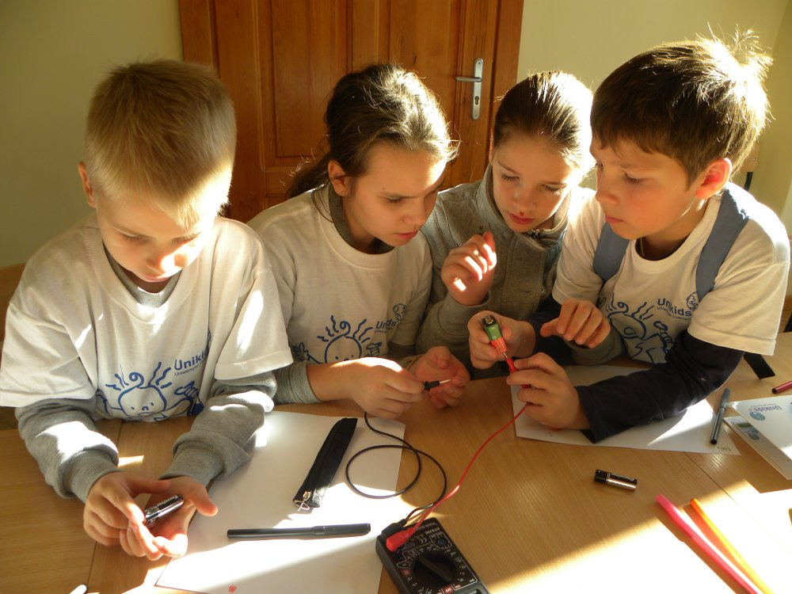
Hyper-konstruktywizm ↔ pedagogika

Slide 54
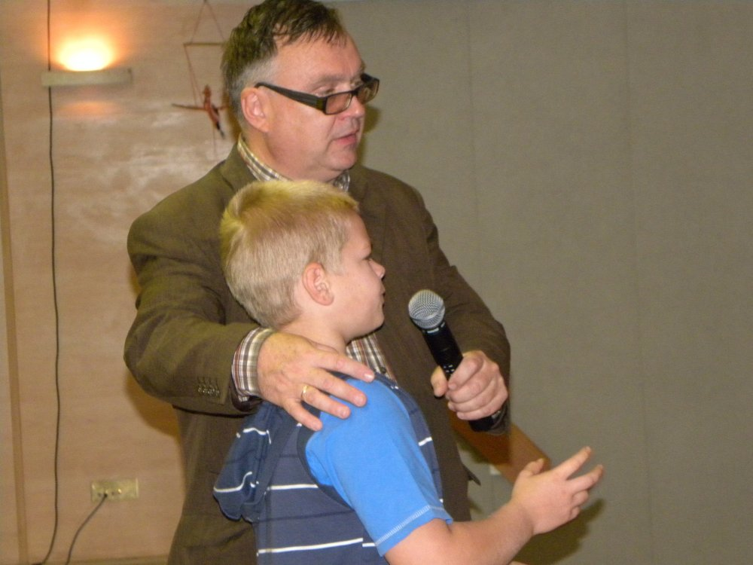
Hyper-konstruktywizm ↔ pedagogika

Slide 55
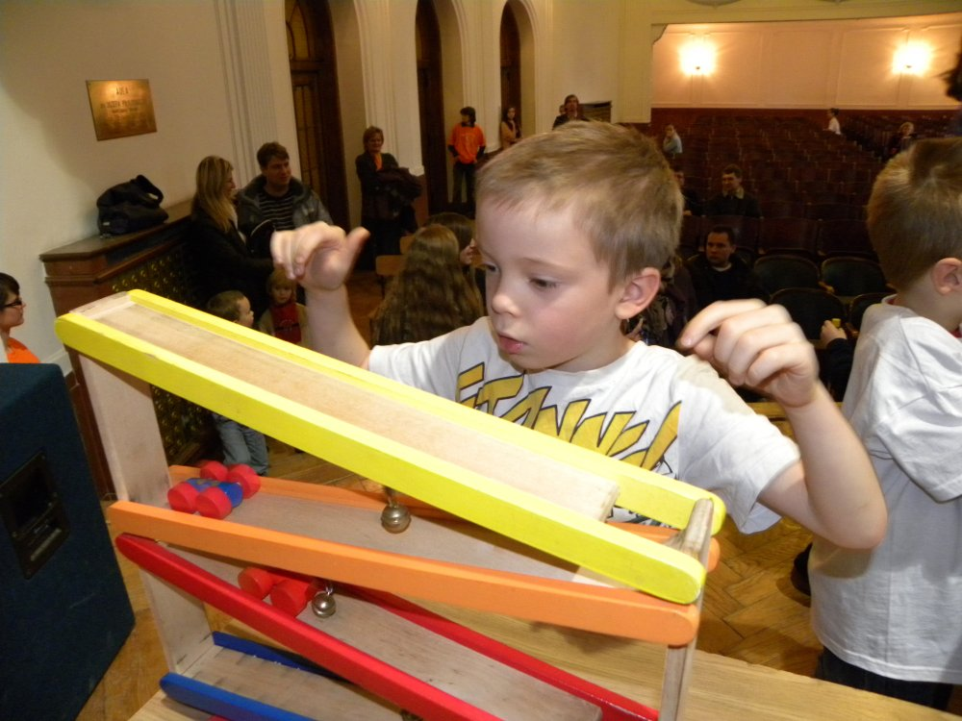
Hyper-konstruktywizm ↔ pedagogika

Slide 56
Hyper-konstruktywizm ↔ pedagogika

Slide 57
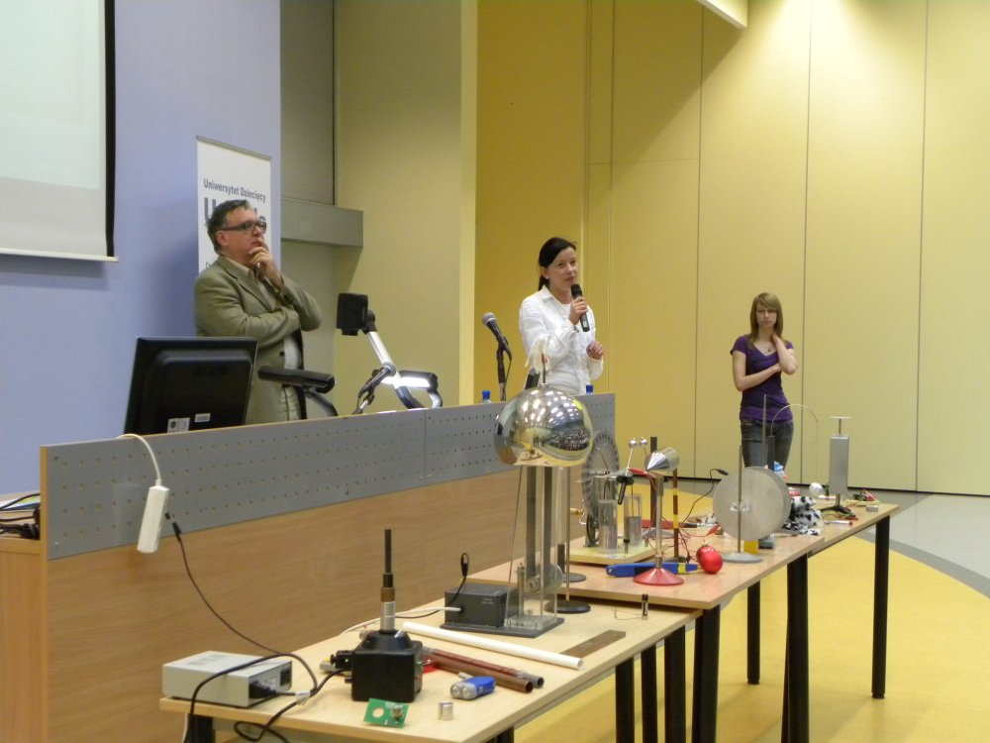
Uniwersytety Dziecięce UniKids
– odbiorca niezwykle wymagający
G. Karwasz, Mały astronom. Przewodnik dla dzieci, Publicat, Poznań, 2016

Slide 58
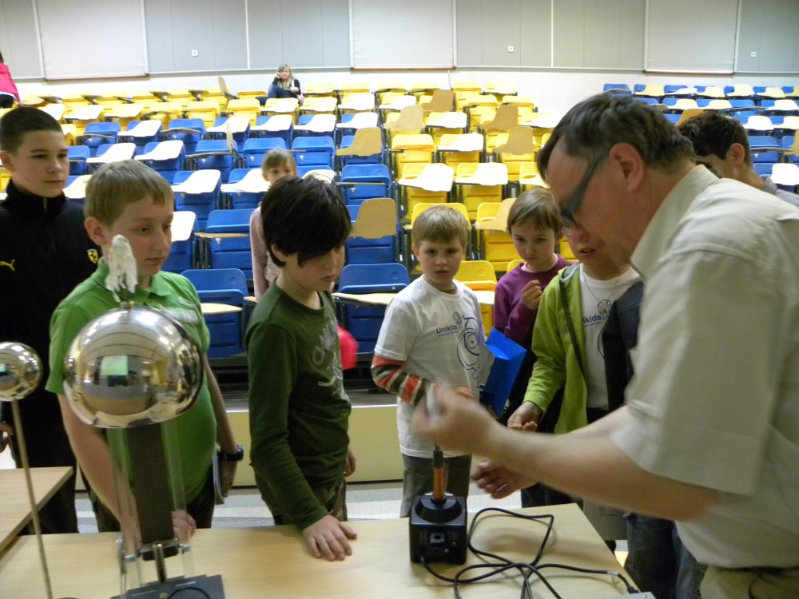
Uniwersytety Dziecięce UniKids
– odbiorca niezwykle wymagający
G. Karwasz, Mały astronom. Przewodnik dla dzieci, Publicat, Poznań, 2016

Slide 59
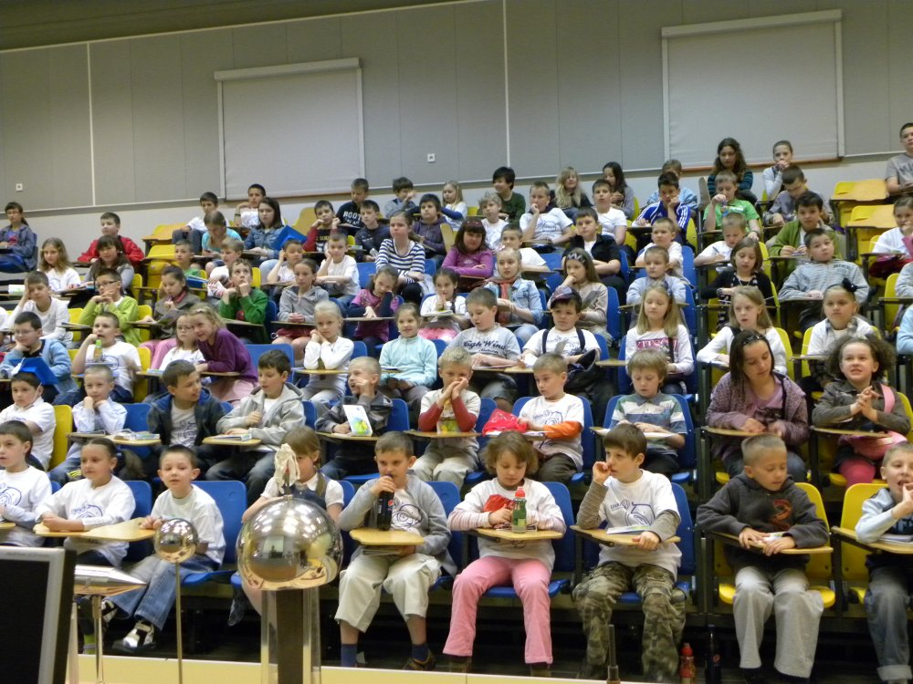
Uniwersytety Dziecięce UniKids
– odbiorca niezwykle wymagający
G. Karwasz, Mały astronom. Przewodnik dla dzieci, Publicat, Poznań, 2016

Slide 60
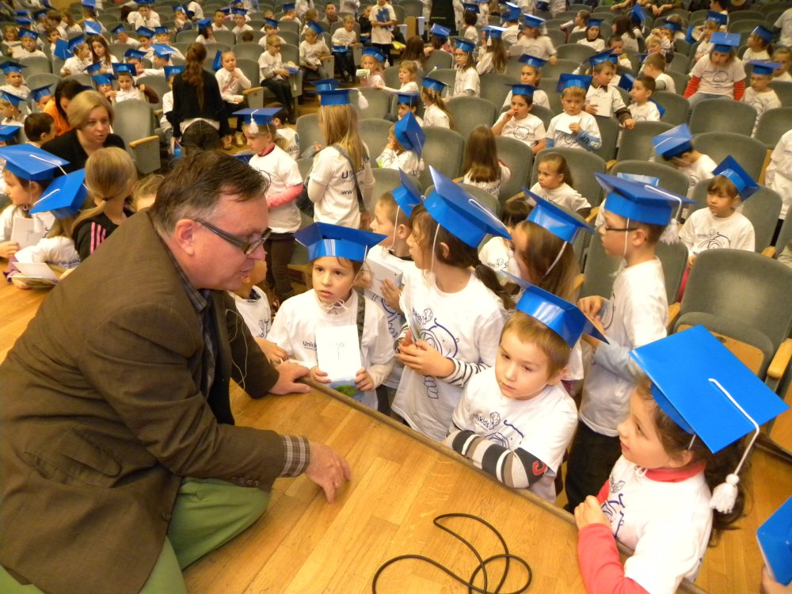
Uniwersytety Dziecięce UniKids
– odbiorca niezwykle wymagający
G. Karwasz, Mały astronom. Przewodnik dla dzieci, Publicat, Poznań, 2016

Slide 61
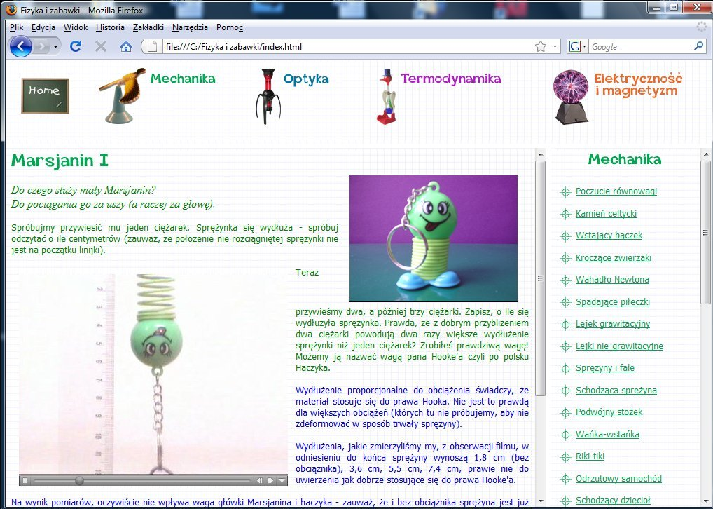
Świat obiektów realnych
(i ich wirtualnych zwierciadeł)
G. Karwasz i in. „Fizyka i zabawki” PAP Słupsk, 2004

Slide 62
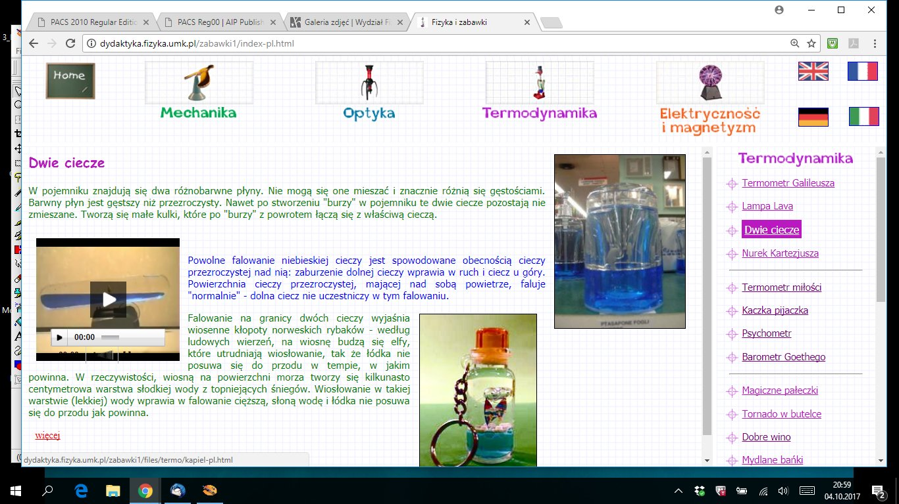
Zaczepić uwagę, a później pociągnąć

Slide 63

Neo-realizm
Wszystko może zostać pokazane, i to na wiele sposobów („mediów”): doświadczenie, model, schemat

Slide 64
«La didattica»
La didattica non è una scienza (e prassi) dell’insegnare ed imparare
La didattica è una scienza (e prassi) capace di individuare (e risolvere) i problemi nel percorso d’insegnamento e dello studio
Didattica innovativa:
digitale, interdisciplinare, personalizzata
(sorprendente, innovativa, innaspettata)

Slide 65
Pedagogical Contents Knowledge
Lee Shulman (1987)

Slide 66
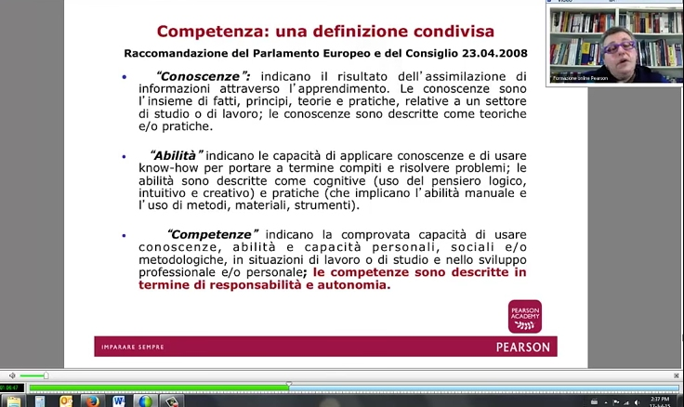
Creare cv didattico via le competenze
https://www.youtube.com/watch?v=0DpkqGFVSjw
Franca Da Re: Webinar "Costruzione del curricolo per competenze "
I.C. Volta Mandello del Lario

Slide 67
Piero Crispiani: „Didattica cognitivista”
Una concezione attiva e plastica della mente (pensiero, intelligenza, processi cognitivi) e delle sue espressioni (cultura, linguaggi, comportamenti) costituisce lo sfondo di consapevolezze sulle quali ricucendo le più fondate connessioni scientifiche con il razionalismo filosofico per un verso ed il cognitivismo psicologico per l’altro, nella seconda metà del ‘900 prende forma una visione tendenzialmente nuova sia del lavoro mentale che delle procedure educative e terapiche.
Tali espressioni veicolano luoghi teorici nel segno della complessità, pluralità, imprevedibilità, produttività, protagonismo e responsabilità, che si congiungono in una pratica dell’educazione, dell’insegnamento dell’organizzazione didattica che meglio si configura in riferimento ad un insieme di paradigmi che esibiscono un unitario collante nella valorizzazione dell’attività mentale autentica ed individuale del soggetto pensante. (p.11)

Slide 68
Secolo XXI

Slide 69
XXI Century Science

Slide 70
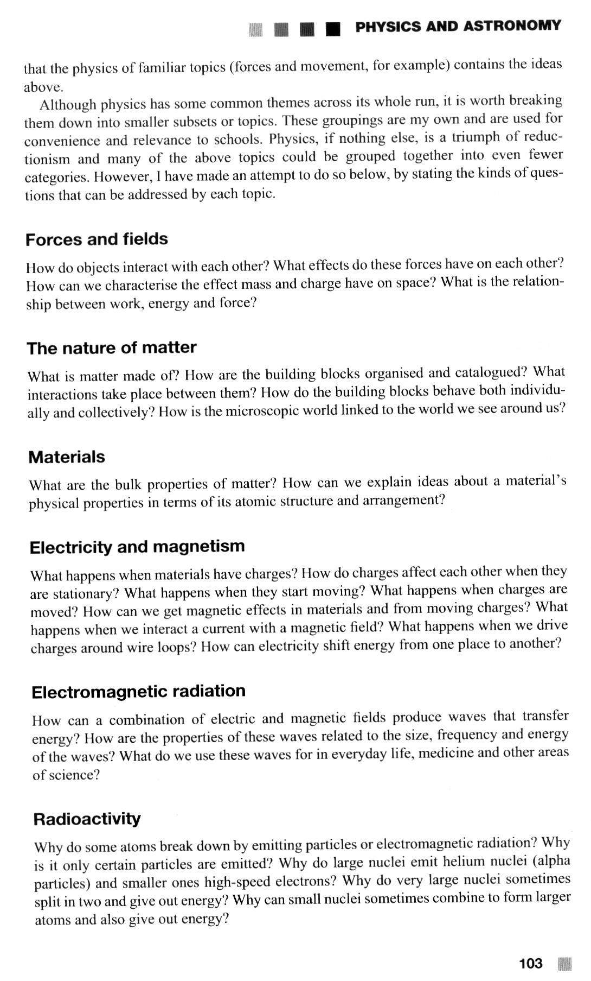
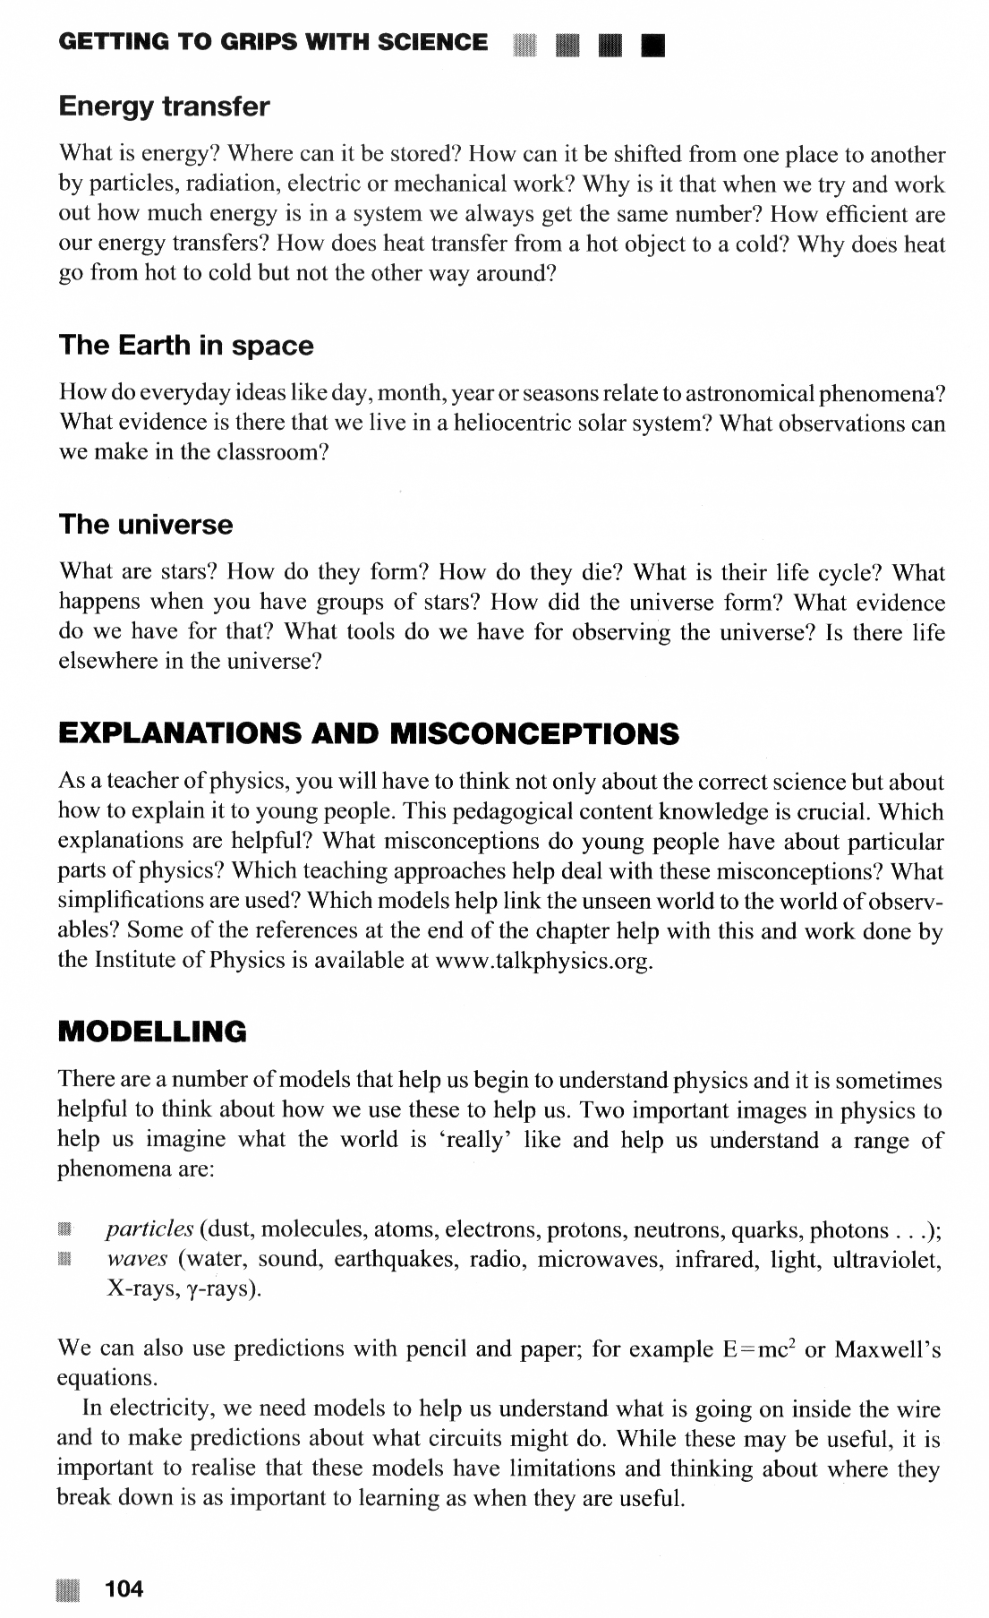
Rob Tiplis (2015): Learning to Teach Science

Slide 71
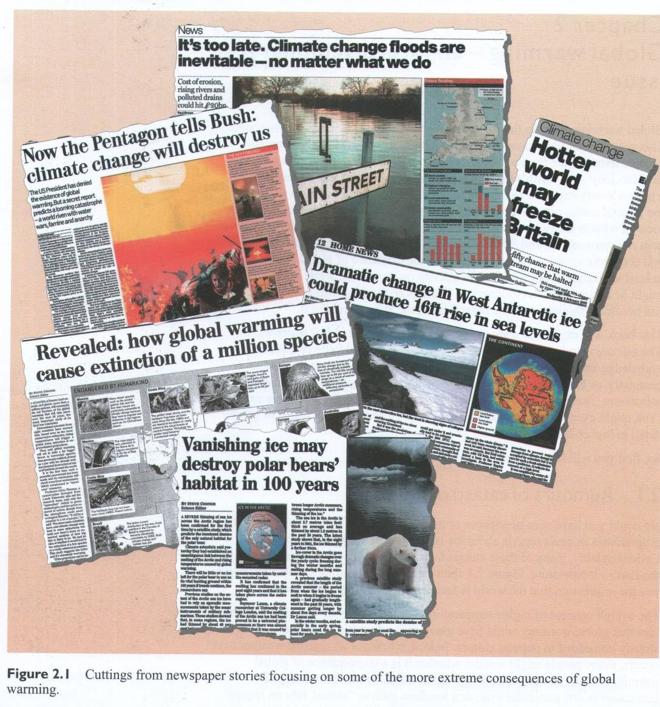
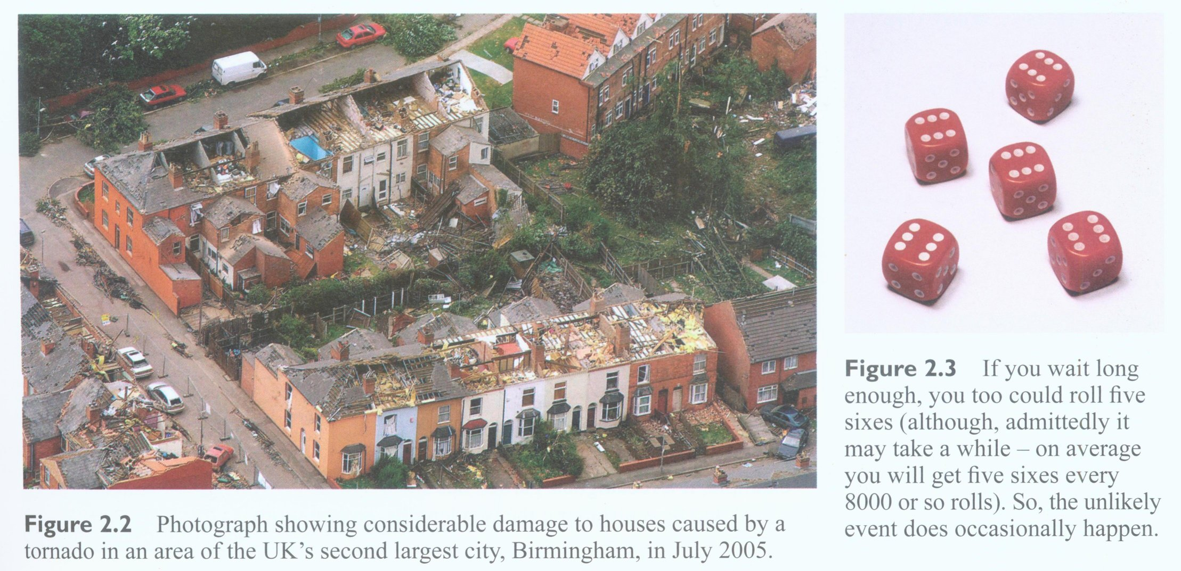
Riferimento alla sensibilità sociale

Slide 72
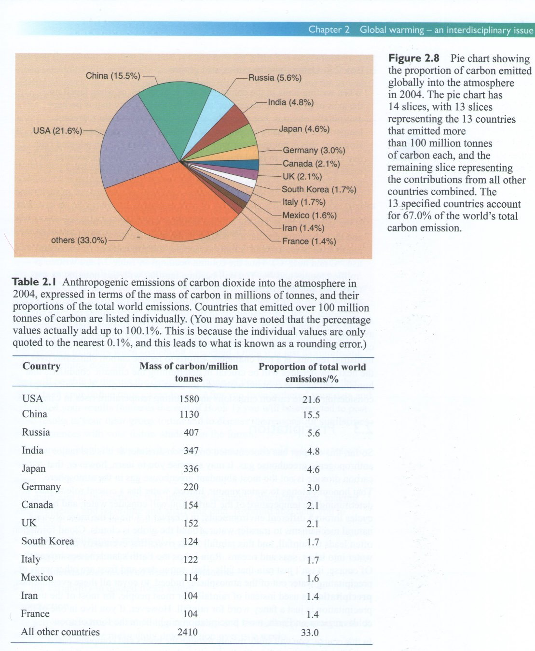
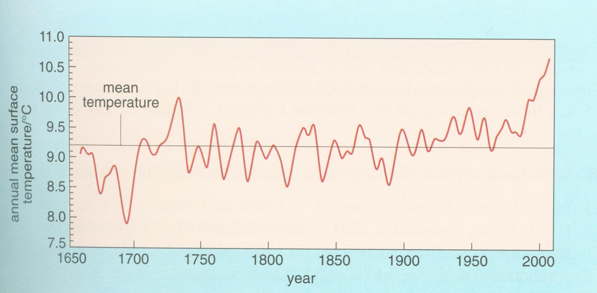
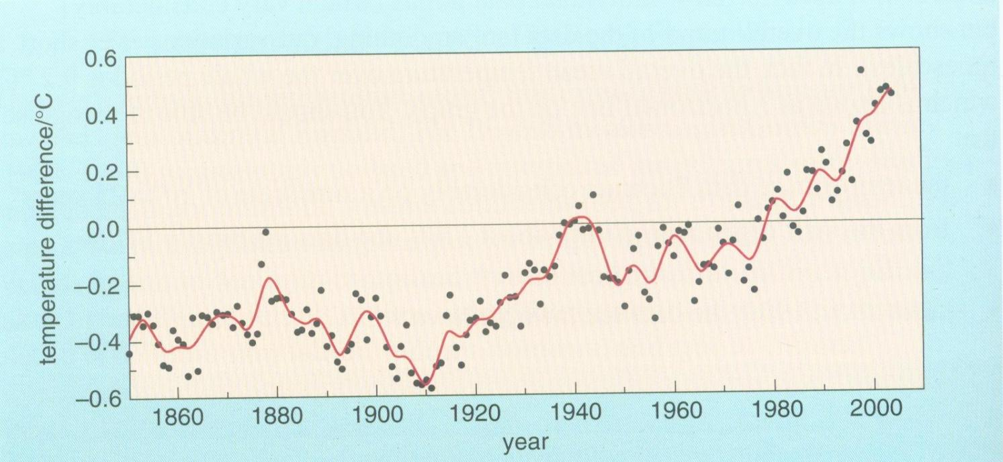
Tranversal competences

Slide 73
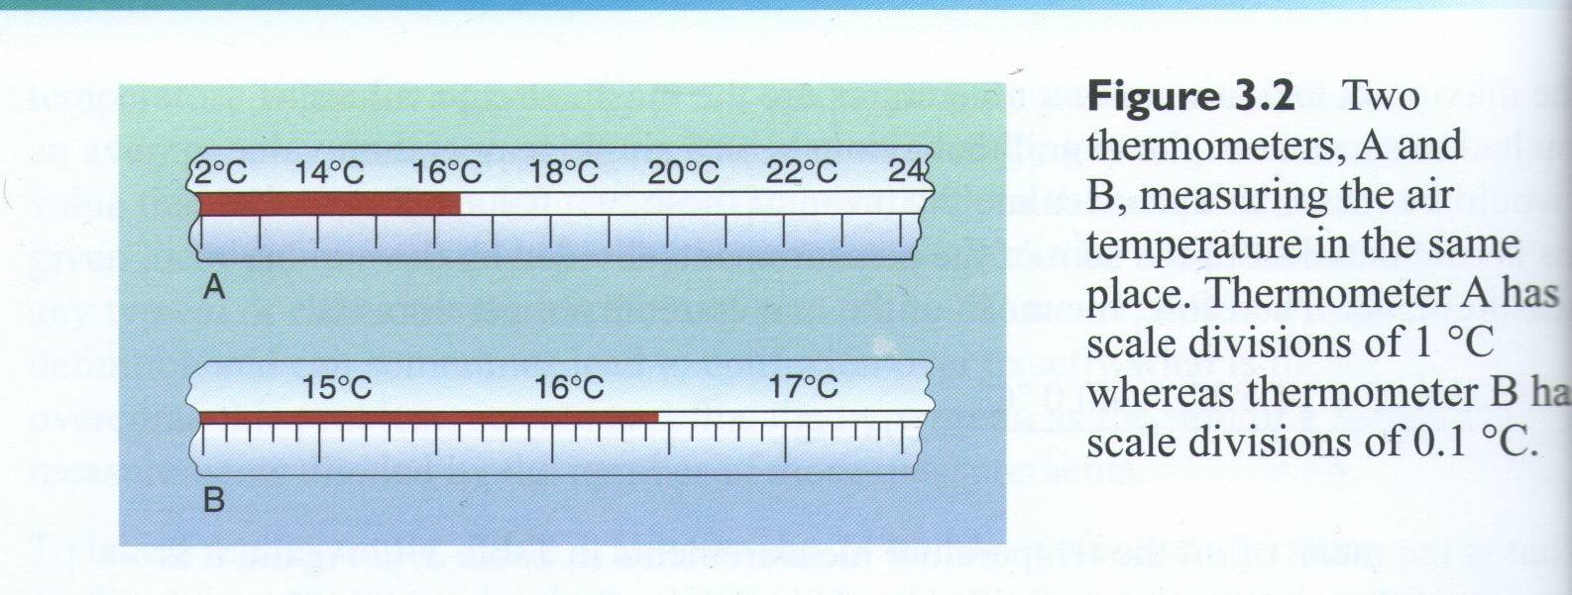
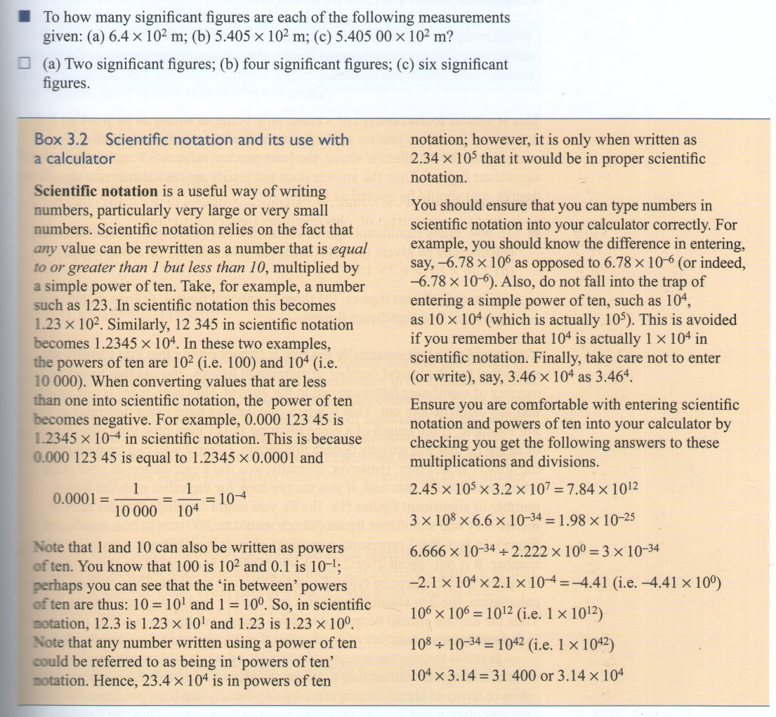


Richiedere solo questo che abbiamo insegnato

Slide 74

Imparare porta gioia

Slide 75

Imparare porta gioia

Slide 76

Imparare porta gioia

Slide 77

Una sequenza di esperimenti diventa una storia narrativa
The teacher is happy
that smbd undertook
the pedagogical function
Hewelianum, Gdańsk, 2011, foto MK

Slide 78

Una sequenza di esperimenti diventa una storia narrativa
The teacher is happy
that smbd undertook
the pedagogical function
Hewelianum, Gdańsk, 2011, foto MK

Slide 79

Una sequenza di esperimenti diventa una storia narrativa
The teacher is happy
that smbd undertook
the pedagogical function
Hewelianum, Gdańsk, 2011, foto MK

Slide 80


Divertirsi ad ogni livello
Sappiamo bene: perche’ oggetti cadono?
Esposizione del problema
Esperimento interattivo
Macerata (2015)

Slide 81

Divertirsi ad ogni livello
Well known question: why do objects fall?
Esposizione del problema
Esperimento interattivo
Spiegazione „da soli”
Macerata (2015)

Slide 82
«Didattica cognitivista»
Didattica tradizionale = insegnare (e studiare)
Lo scopo della didattica tradizionale: far sapere (i.e. un insieme delle informazioni, chiamato «sapienza»)
Nel mondo odierno (AD 2022) le informazioni sono pan-disponibili, i.e. sempre, su ogni cosa ed ovunque. Non ha senso insegnare le informazioni
Ma diventa sempre più difficile «districarsi» nella giungla delle informazioni. Così le stesse si rendono non solo inutili ma addirittura disturbanti
Lo scopo allora non è la sapienza, ma la saggezza

Slide 83

OECD: „AHELO”
Fare le domande
Fare le domande
…
→ Saper indurre l’allievo a fare domande
Testing student and university performance globally: OECD’s AHELO, OECD 2010
http://www.oecd.org/document/22/0,3746,en_2649_35961291_40624662_1_1_1_1,00.html

