Slide 1
Insegnare STEAM
con la realtà aumentata
Grzegorz Karwasz
Lezione 8: Computer-guided experiments
Notes:
Pierwszy slajd
1

Slide 2
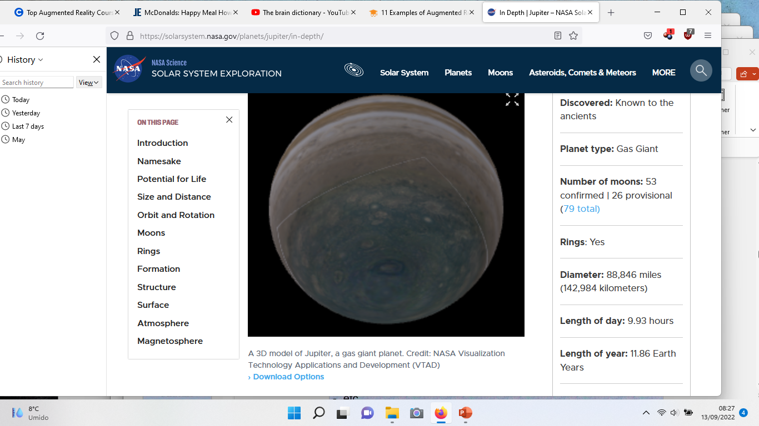
Internet interattivo
https://solarsystem.nasa.gov/planets/jupiter/in-depth/

Slide 3
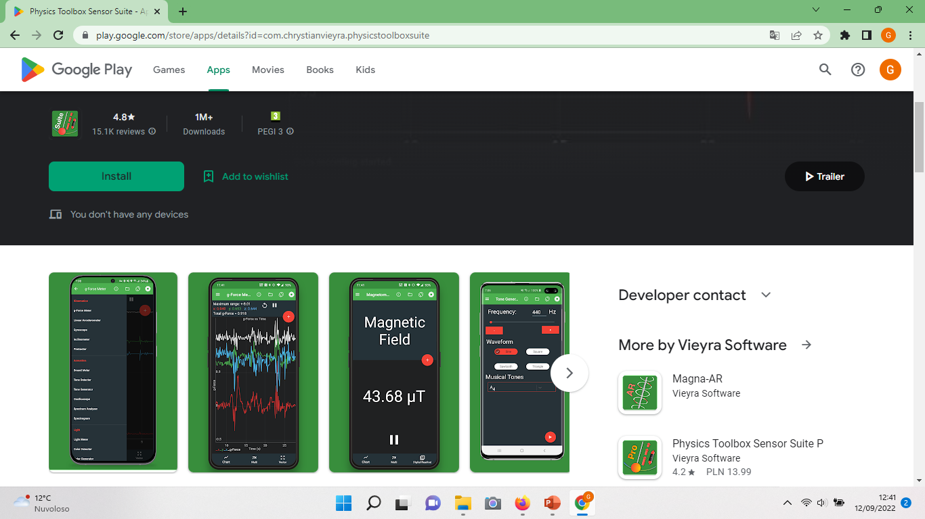
Partiamo dalla fine, cioè da Android

Slide 4
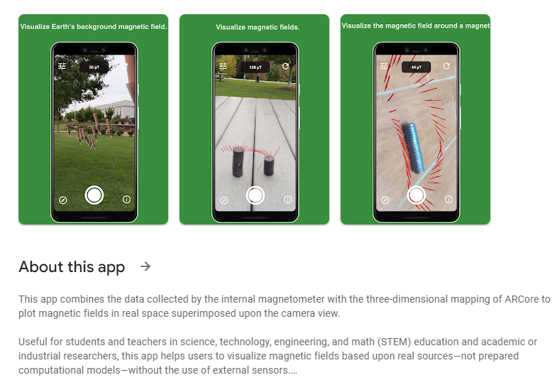
Campo magnetico terrestre
Una vera applicazione con Realtà Aumentata:
la mappa del campo magnetico inserito nella vista panoramica

Slide 5
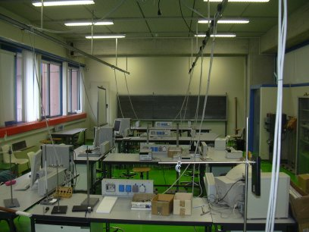
Laboratorio di fisica via computer (Uni Udine)

Slide 6
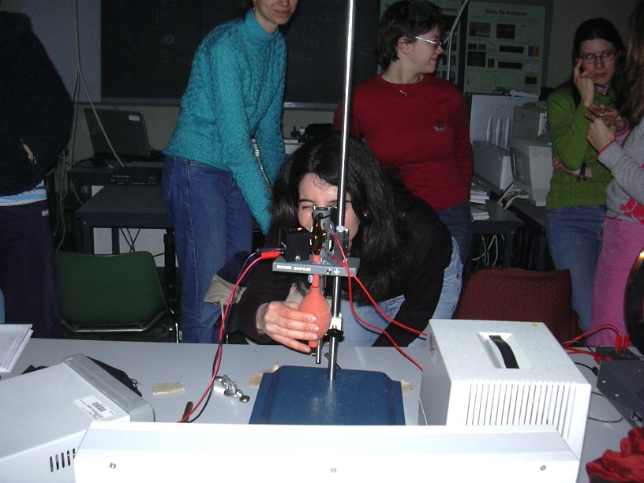
Computer guided experiments
↔ experiments in Modern Physics
Studia nauczycielskie – Uniwersytet w Udine

Slide 7
Computer - guided experiments
Four aspects:
computer – chosen measurements standard and software
physical – sensor or reader, for ex. of position, using reflection of ultrasounds,
electronic – signal from the reader, for ex. piezo-electric, crystal is amplified and converted to a sequence of bits sent to the computer,
didactical – ability to choose these experiments, which can be done more efficiently (precisely, time saving, more clear) and which assure better (cognitive) transmission of observation
At all levels errors are possible: this is modern didactics

Slide 8
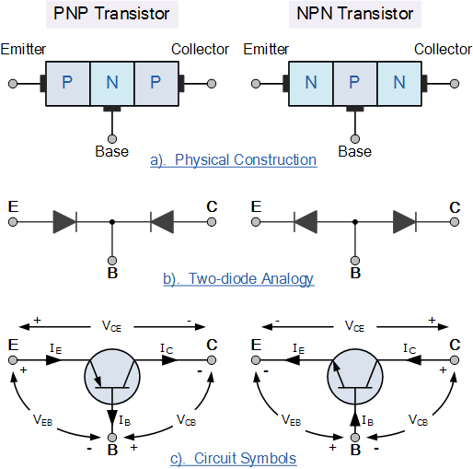
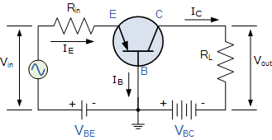
Transient-resistor
Base thin (50 μm)
Junction C-B polarized
„inversely”
Injection of carriers into Base:
in E-C circuit the current starts to flow
https://www.electronics-tutorials.ws/transistor/tran_1.html

Slide 9
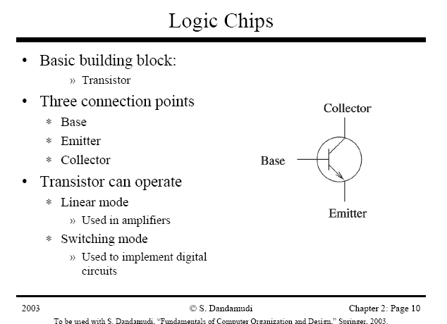
„transistor” (1947) = transient resistor

Slide 10
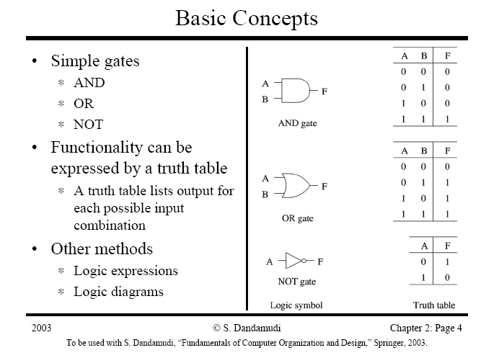
Mathematical (Boole’s) logic

Slide 11
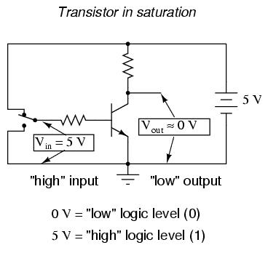
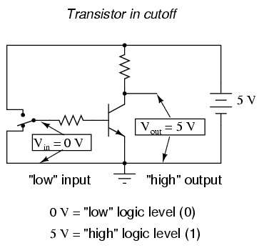
Transistor in digital circuits
R_{tranz}=0
R_{tranz}=∞

Slide 12
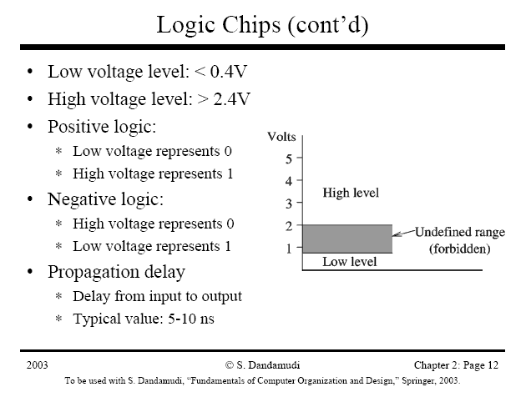
states „0” & „1”

Slide 13
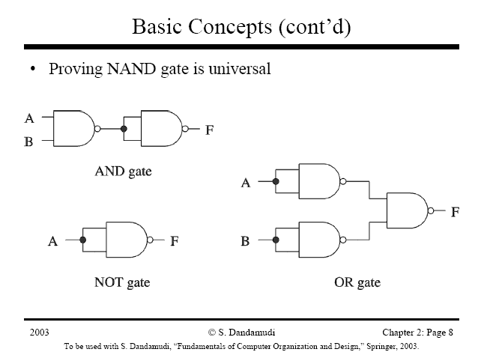
Universal gate, i.e. „NAND” = no-and
http://www.scs.carleton.ca/~sivarama/org_book/org_book_web/slides/chap_1_versions/ch2_1.pdf

Slide 14
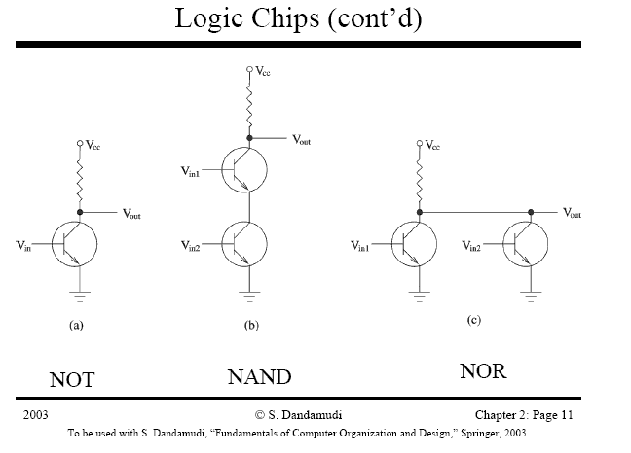
NAND & other gates

Slide 15
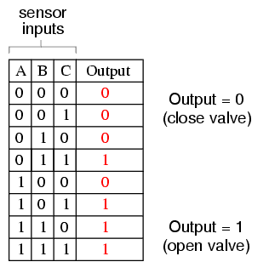
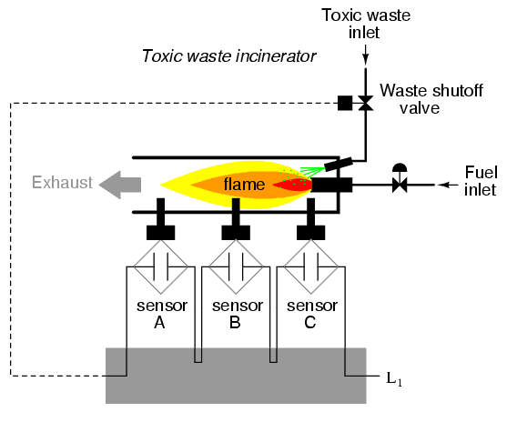
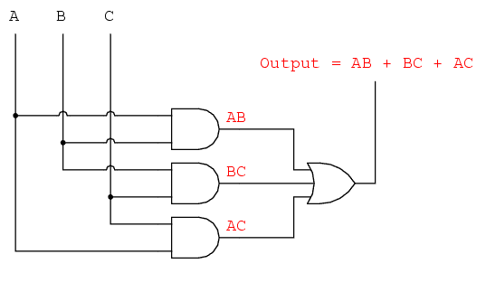
1° goal: burning sensor
(min. two signals OK!)
http://openbookproject.net//electricCircuits/Digital/DIGI_7.html

Slide 16
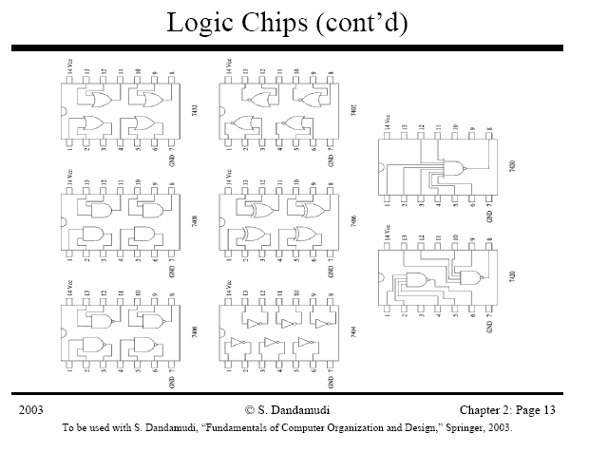
Integrated circuits = black „bugs”,
http://www.scs.carleton.ca/~sivarama/org_book/org_book_web/slides/chap_1_versions/ch2_1.pdf

Slide 17
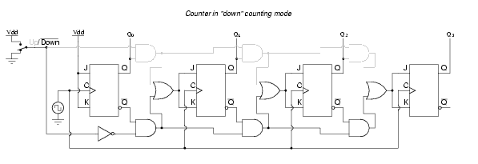
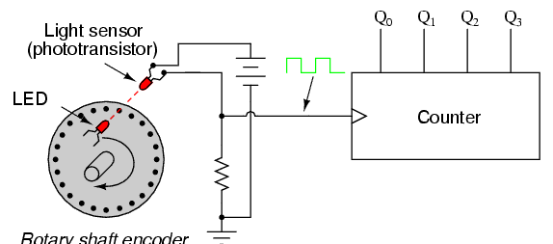
Position counter
http://openbookproject.net//electricCircuits/Digital/DIGI_10.html

Slide 18
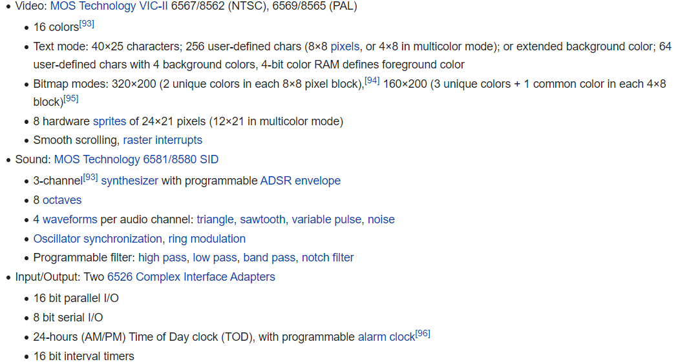
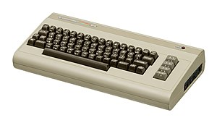
C64 (1984): two clocks, sound generator, AD converters (paddles) etc.
https://en.wikipedia.org/wiki/Commodore_64

Slide 19
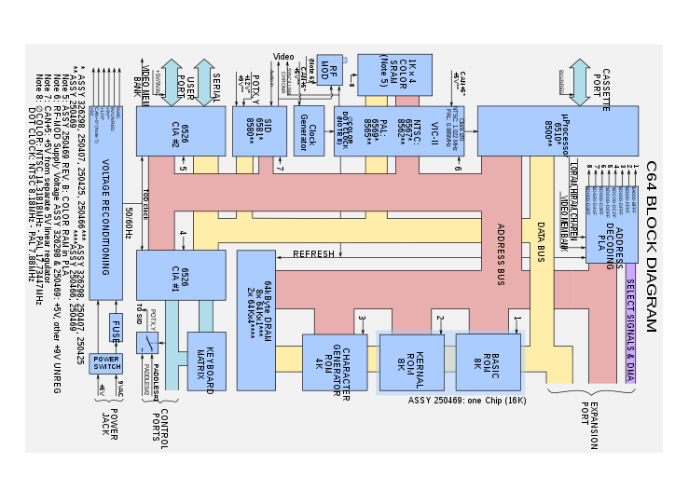
Commodore 64 (cont.ed)
C64 was able to prepare morning coffee
and speak

Slide 20
VALUE OF USING ON-LINE SENSORS IN DIDACTIC LABORATORY
Social, methodological-disciplinary and practical reasons lead to the using of computer in school laboratory:
Our everyday life is full of computerized objects and IT is important, on social level, to prepare young students to this continue evolution, with information, adequate experiences, methodologies and critical instruments to understand and use such apparatuses.
In research laboratories computers manage data and are integral part of the investigation. So on-line experiments may allow students to understand contents and methods characterizing physics.
On practical level, on-line experiments offer efficiency, time-saving, reliability, precision, reproducibility of data, all with quite cheap instruments. Moreover they allow an immediate and direct contact with the phenomenon, advancing a laboratory open to the personal construction of ideas and new occasion of learning, thanks to the following potentialities:

Slide 21
VALUE OF USING ON-LINE SENSORS IN DIDACTIC LABORATORY
POTENTIALITIES
- Extension of the possibility of
observation of events too much quick or slow as regards manual measures
2. measures in rather inaccessible places
3. collecting data easily, favouring in this way the comparison of diagrams and graphs, the search of characteristics and initial conditions, various considerations about the analyzed system (e.g. energetic)

Slide 22
VALUE OF USING ON-LINE SENSORS IN DIDACTIC LABORATORY
POTENTIALITIES
4. study of non linear processes, like the transitory in several types of phenomena, thanks to the quick data acquisition (not possible in traditional laboratory, where measures regards the variation of quantities in initial and final equilibrium states). This allows familiarity with experimental situations and theoretical closely examination based on experimental evidence
These possibilities make the experimentation in school closer to the reality and, thus, more interesting and stimulating, so that phenomena may be analyzed in their completeness and interpretative models easily understood

Slide 23
VALUE OF USING ON-LINE SENSORS IN DIDACTIC LABORATORY
POTENTIALITIES
- Improving of quality of measures, in reliability and sensitivity, that allows both advanced and base experiments, these last in several deeper ways, to encounter the interests of students, so that the laboratory becomes culturally stimulating.
- Time-saving (collecting quickly data on-line) and good reproducibility, that favour the conceptualization and the focusing of the attention on data, on planning and manual aspects (choose of the experiment and Its assembly), on physic problem, on the description of the characteristics of phenomena, on the comparison between different experimental situations.
- Collecting a lot of data, that limits the introduction of hypothesis and allows the use of statistic methods

Slide 24
VALUE OF USING ON-LINE SENSORS IN DIDACTIC LABORATORY
POTENTIALITIES
- Attention to conceptual aspects of procedure of measurement: setting and calibration of the system, chose of measure interval, sensitivity, resolution, time of data acquisition.
- Real time graphs of time depending (and not) phenomena, whose understanding (of role and meaning) may help in overcoming some cognitive problems (e.g. lacking in capability of execution and use of graphs) thanks to the following potentialities:
visual impact favours the analysis of the phenomenon
2. the possibility to follow, in real time, the evolution of the phenomenon and/or the characteristics of collected data stimulates the search of interpretations, common discussion, the comparison of ideas, analysis and selection of meaningful parts, the determination of questions and problems to test.

Slide 25
VALUE OF USING ON-LINE SENSORS IN DIDACTIC LABORATORY
POTENTIALITIES
3. in explorative activities, in which student compares sensorial information with signals collected by the sensors, the graph favours the rationalization of sensations and the enucleation of interpretative hypothesis.
4. collecting several graphs for each event makes graph a familiar representative tool.
- Developing of planning capability, comparison between data collected in different times and conditions, comparison between phenomena describable through similar formal relations.
and so on…

Slide 26
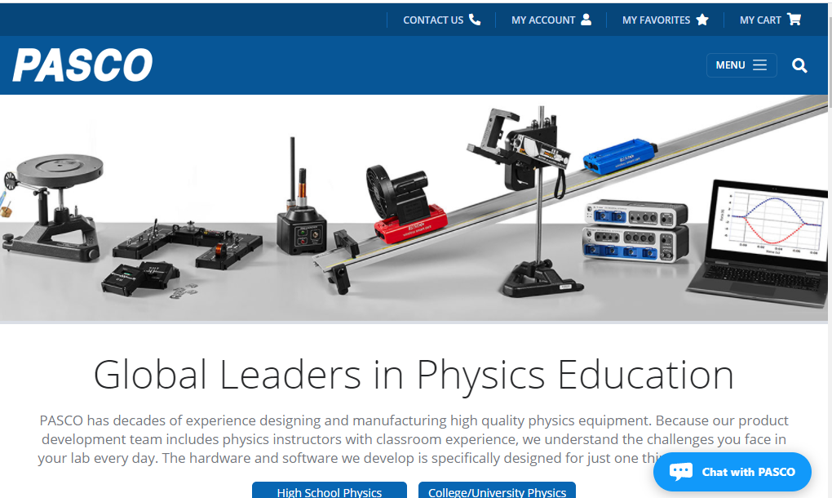
Many different standards

Slide 27
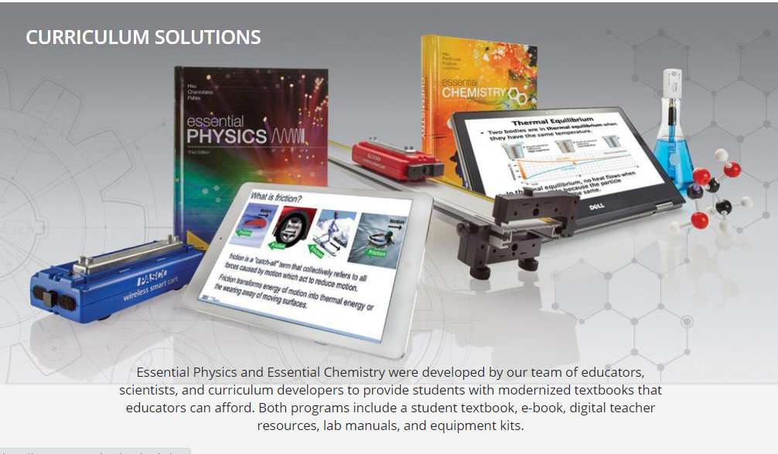
Didactical packages

Slide 28
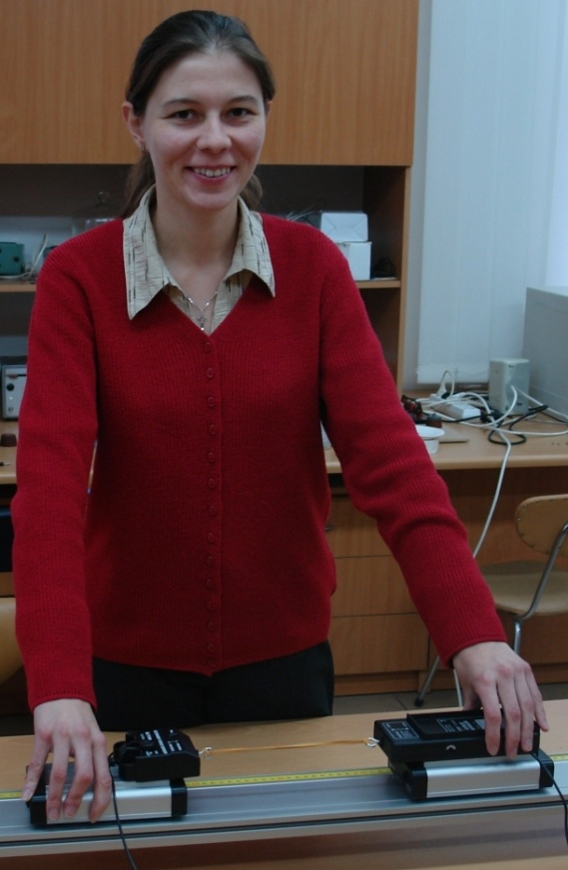
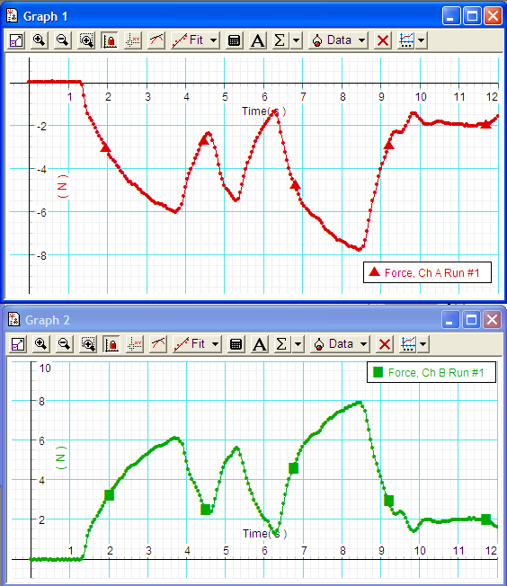
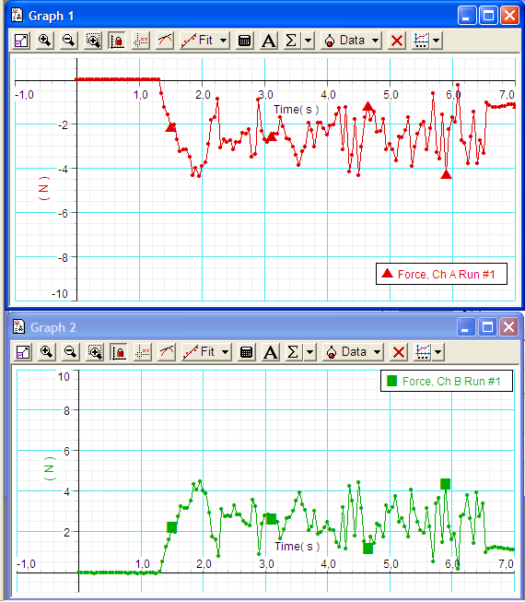
From measurement to representation
3rd law of Newton

Slide 29
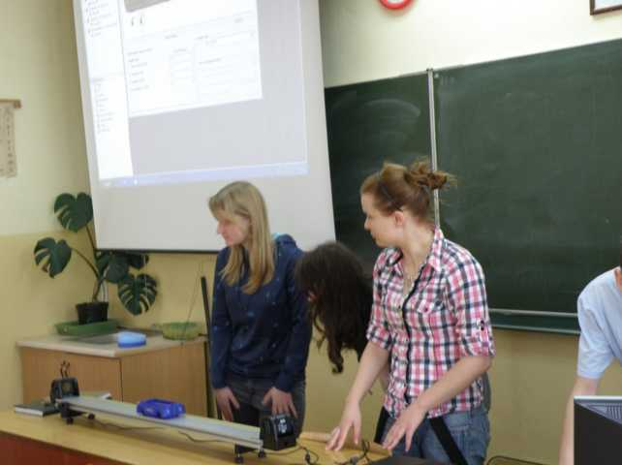
From a real experiment to its mathematical abstraction
VIII LO Toruń, fot. J. Kosicki
Notes:
29

Slide 30
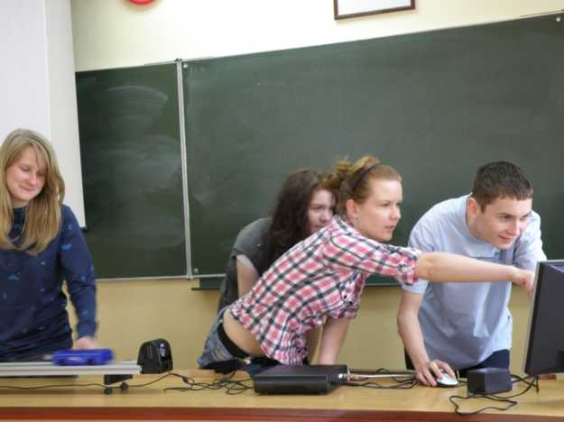
From a real experiment to its mathematical abstraction
VIII LO Toruń, fot. J. Kosicki
Notes:
30

Slide 31
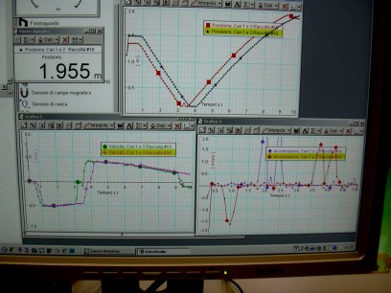
From a real experiment to its mathematical abstraction
G. Karwasz, Univerista’ di Udine
Notes:
31

Slide 32
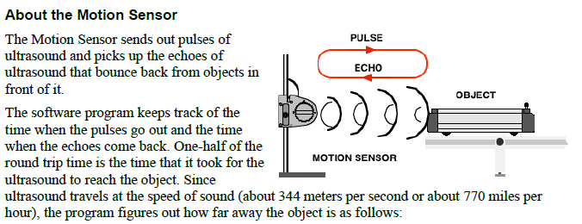
Instructions (Pasco)

Slide 33
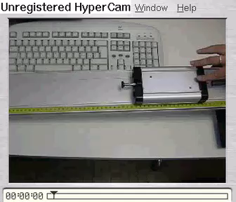
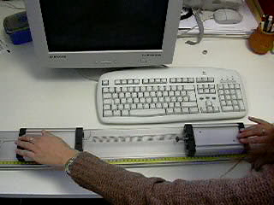
Moti oscillatori, moti accoppiati

Slide 34
Implementation in lower secondary

Slide 35
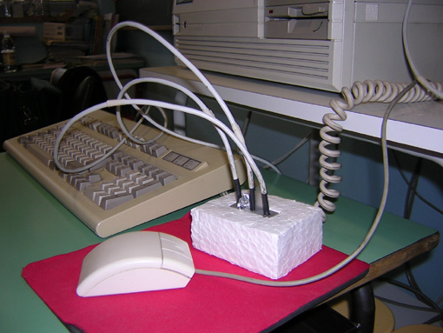
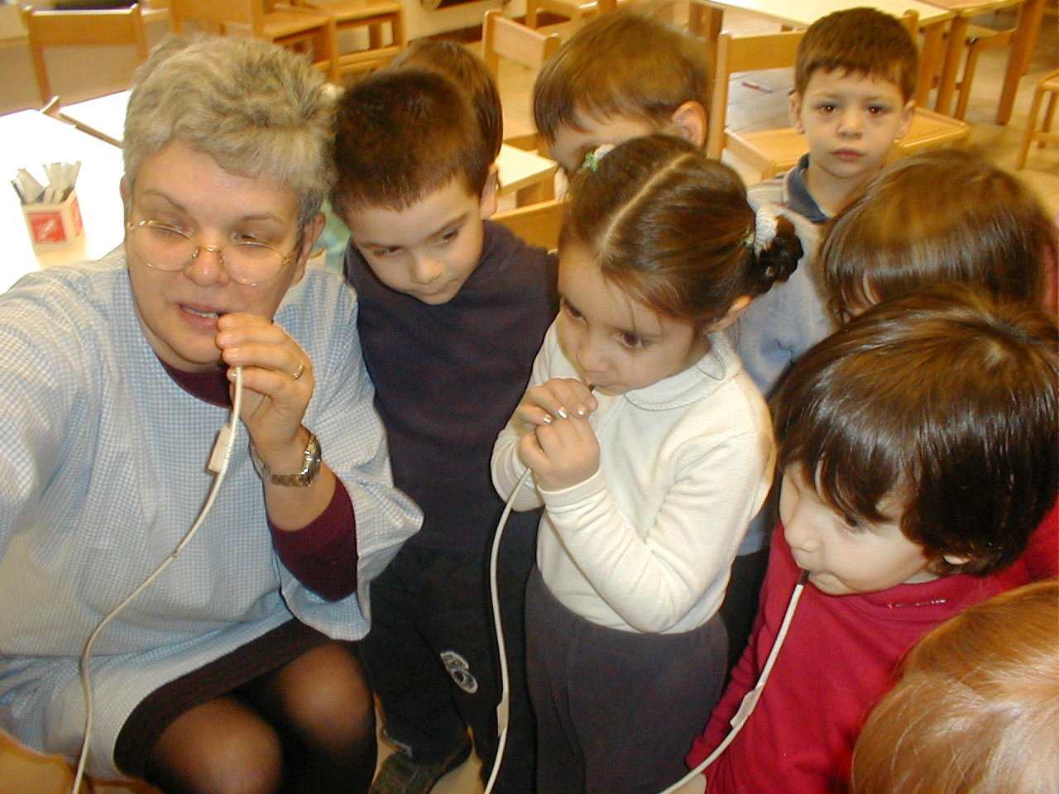
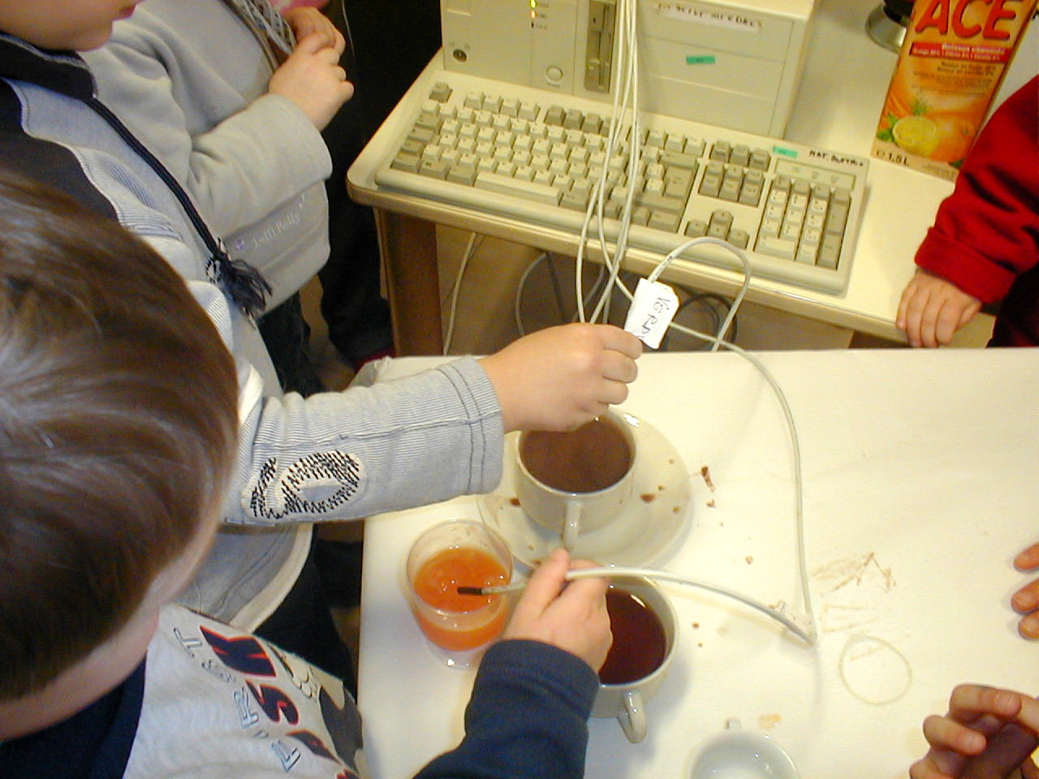
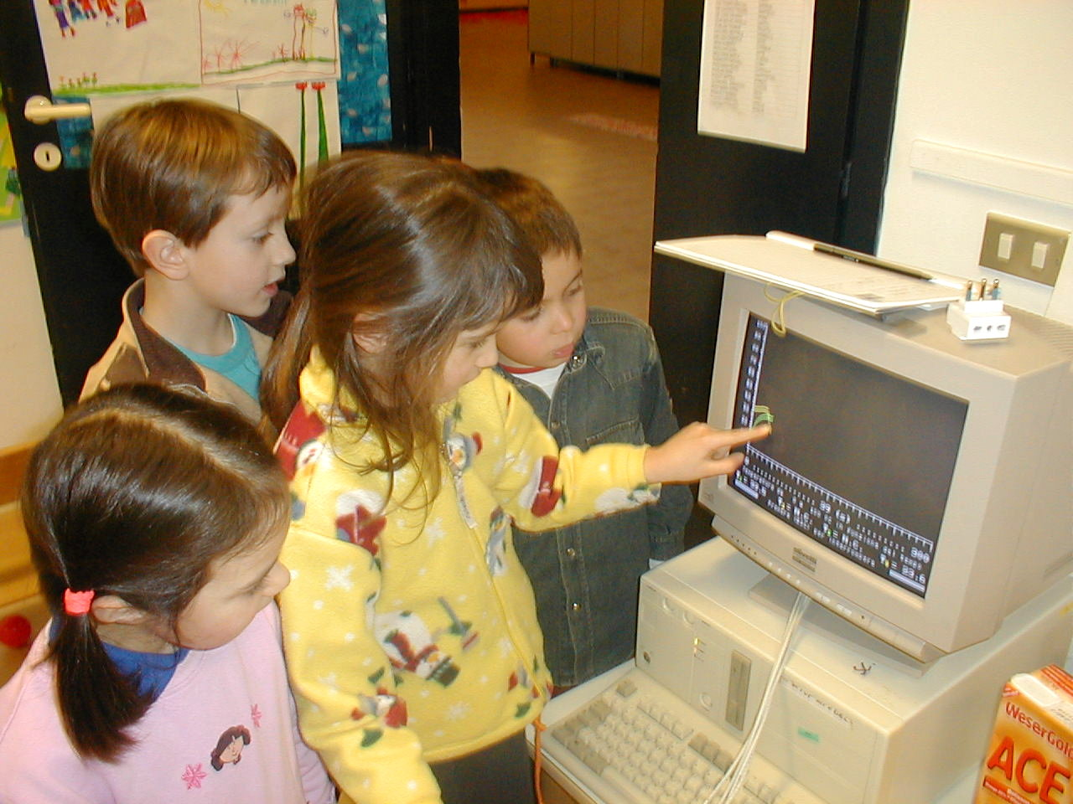
Real-time temperature vs time measurement with termocrono (UniUdine/ UMK)
Termocrono is a system based on on-line sensors to make four contemporary real-time measures of temperature that allows to follow thermodynamic processes. The connection to the computer is via USB.
The system consists of an hardware and a software part.
Michelini, Postępy Fizyki, Nr 6 (2009)

Slide 36
REAL-TIME TEMPERATURE VS TIME MEASUREMENT WITH TERMOCRONO
EXAMPLES OF MEASURES
D) Fig. shows data obtained when the four sensors are covered with different masses of aluminium (0, 2, 4 and 10g) and putted in a big mass of warmer water (isothermic).
The dependence of the time to reach equilibrium on the mass of aluminium allows to understand the meaning of time of response of a system and to calculate It.
It is possible to study the exponential low to reach equilibrium.

Slide 37
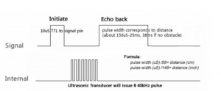
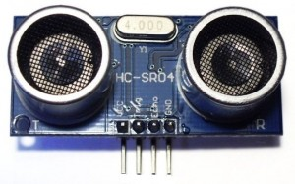
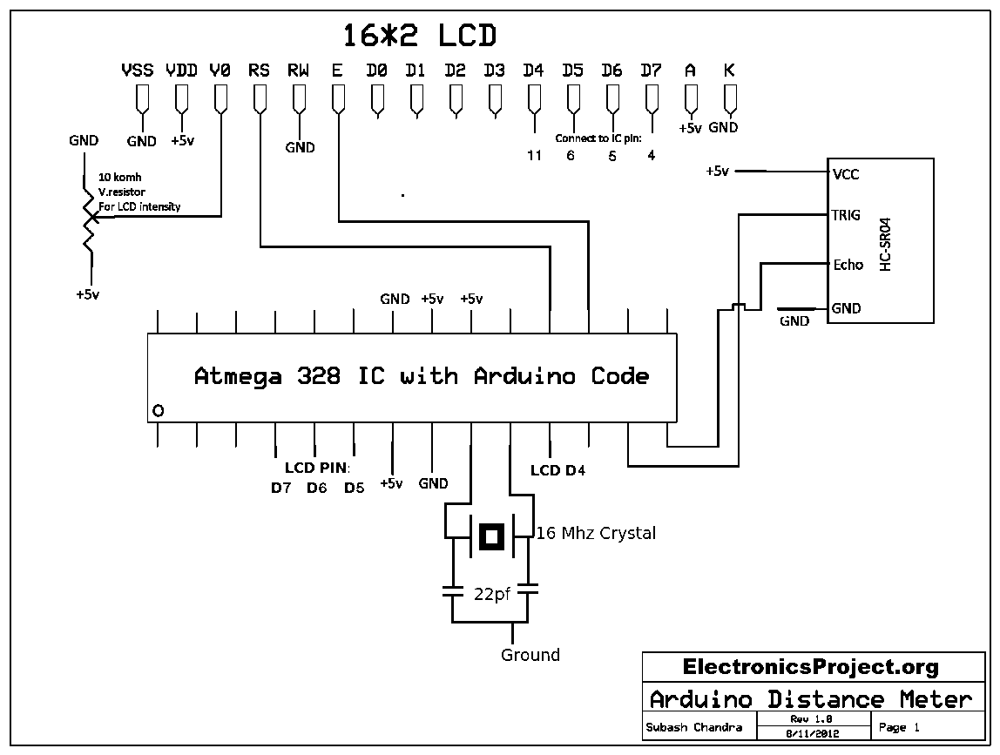
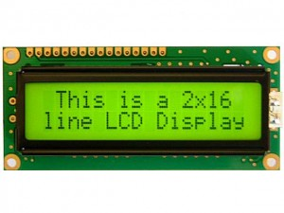
Arduino [King of Italy, 1002 DC]: distance meter
Simple, cheap, well explained
http://www.electronics-tutorial.net/electronicsvd/arduino-projects/

Slide 38
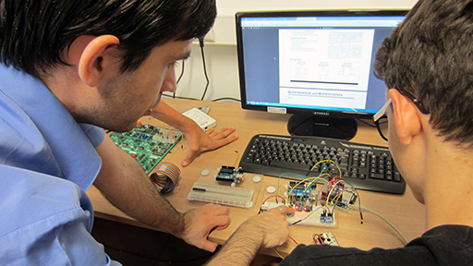
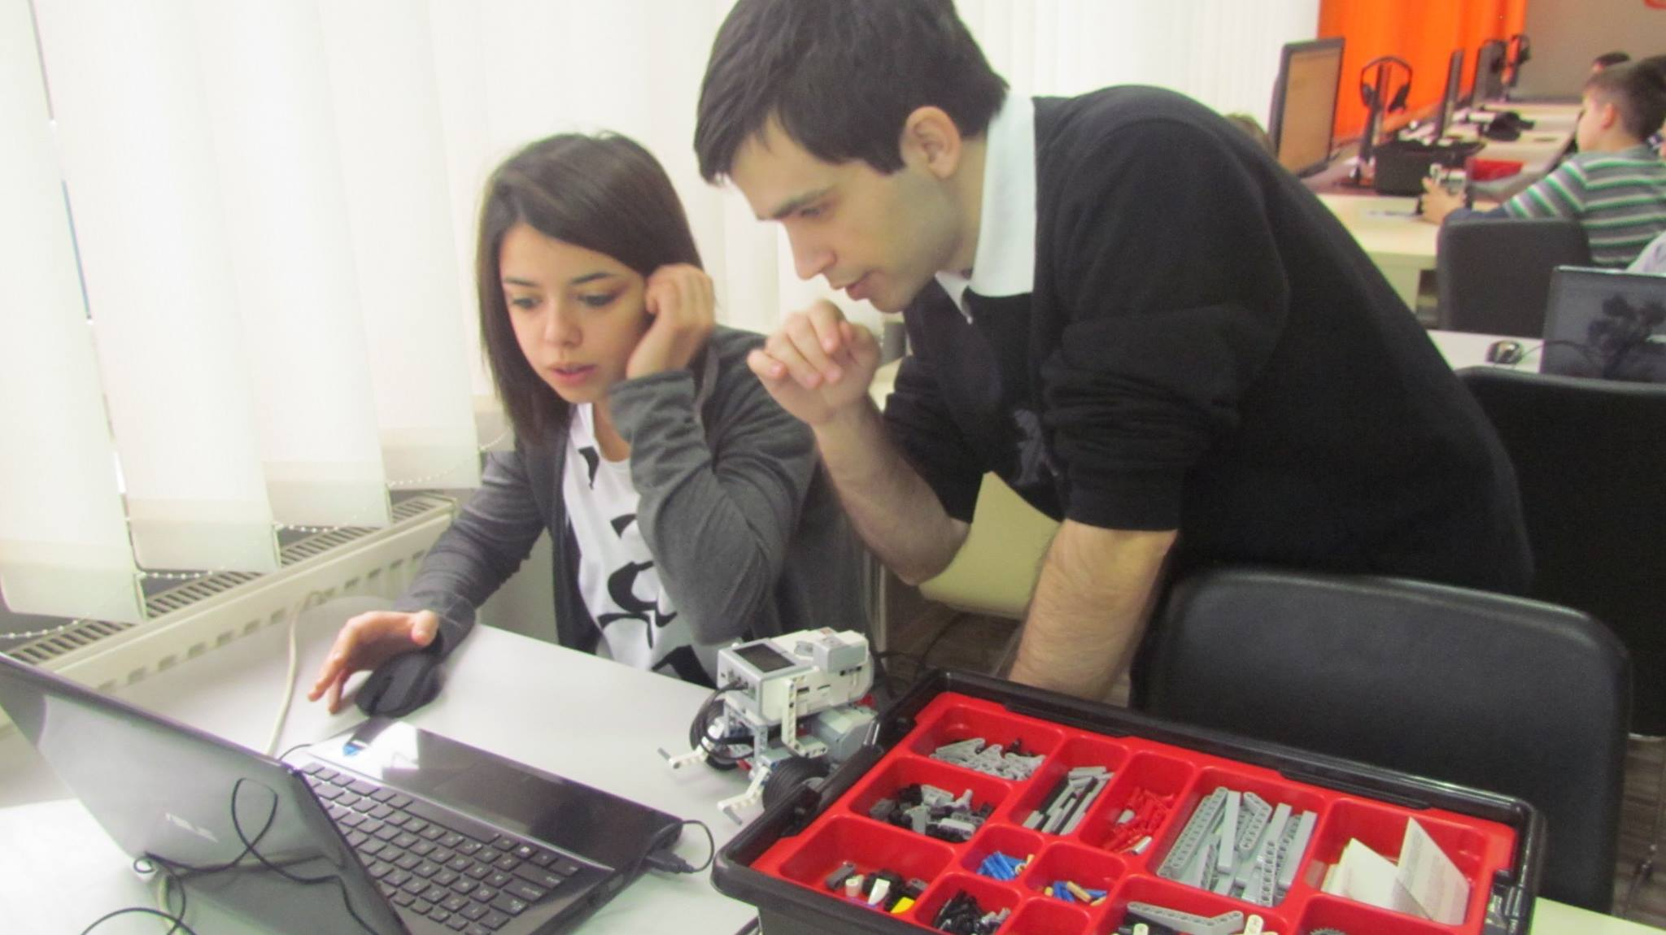
Arduino & Mindstorms: applications
© mgr Mikołaj Karawacki

Slide 39
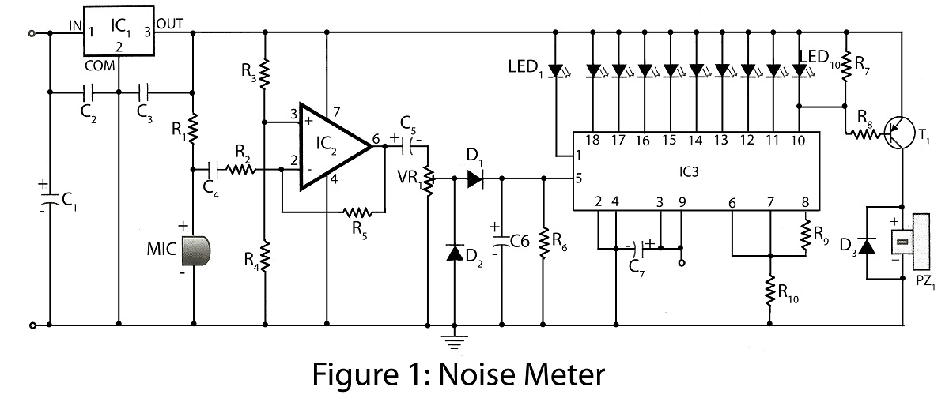
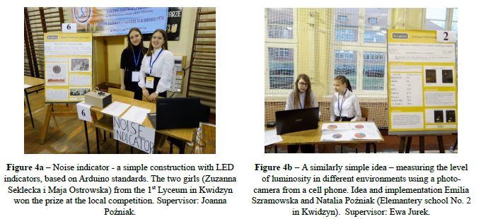
Arduino: noise meter
The future belongs to you
https://electronicsproject.org/noise-meter/

Slide 40
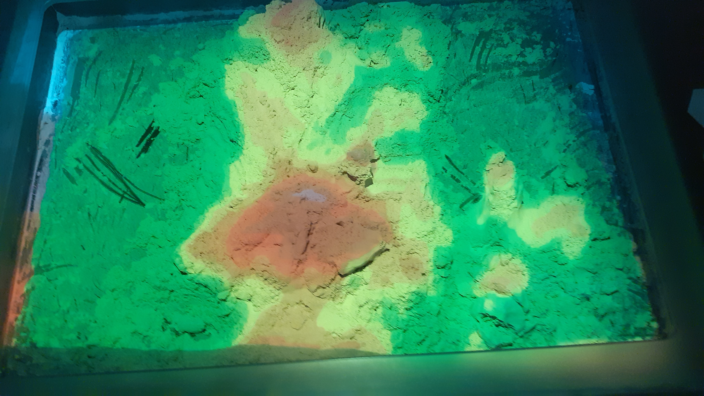
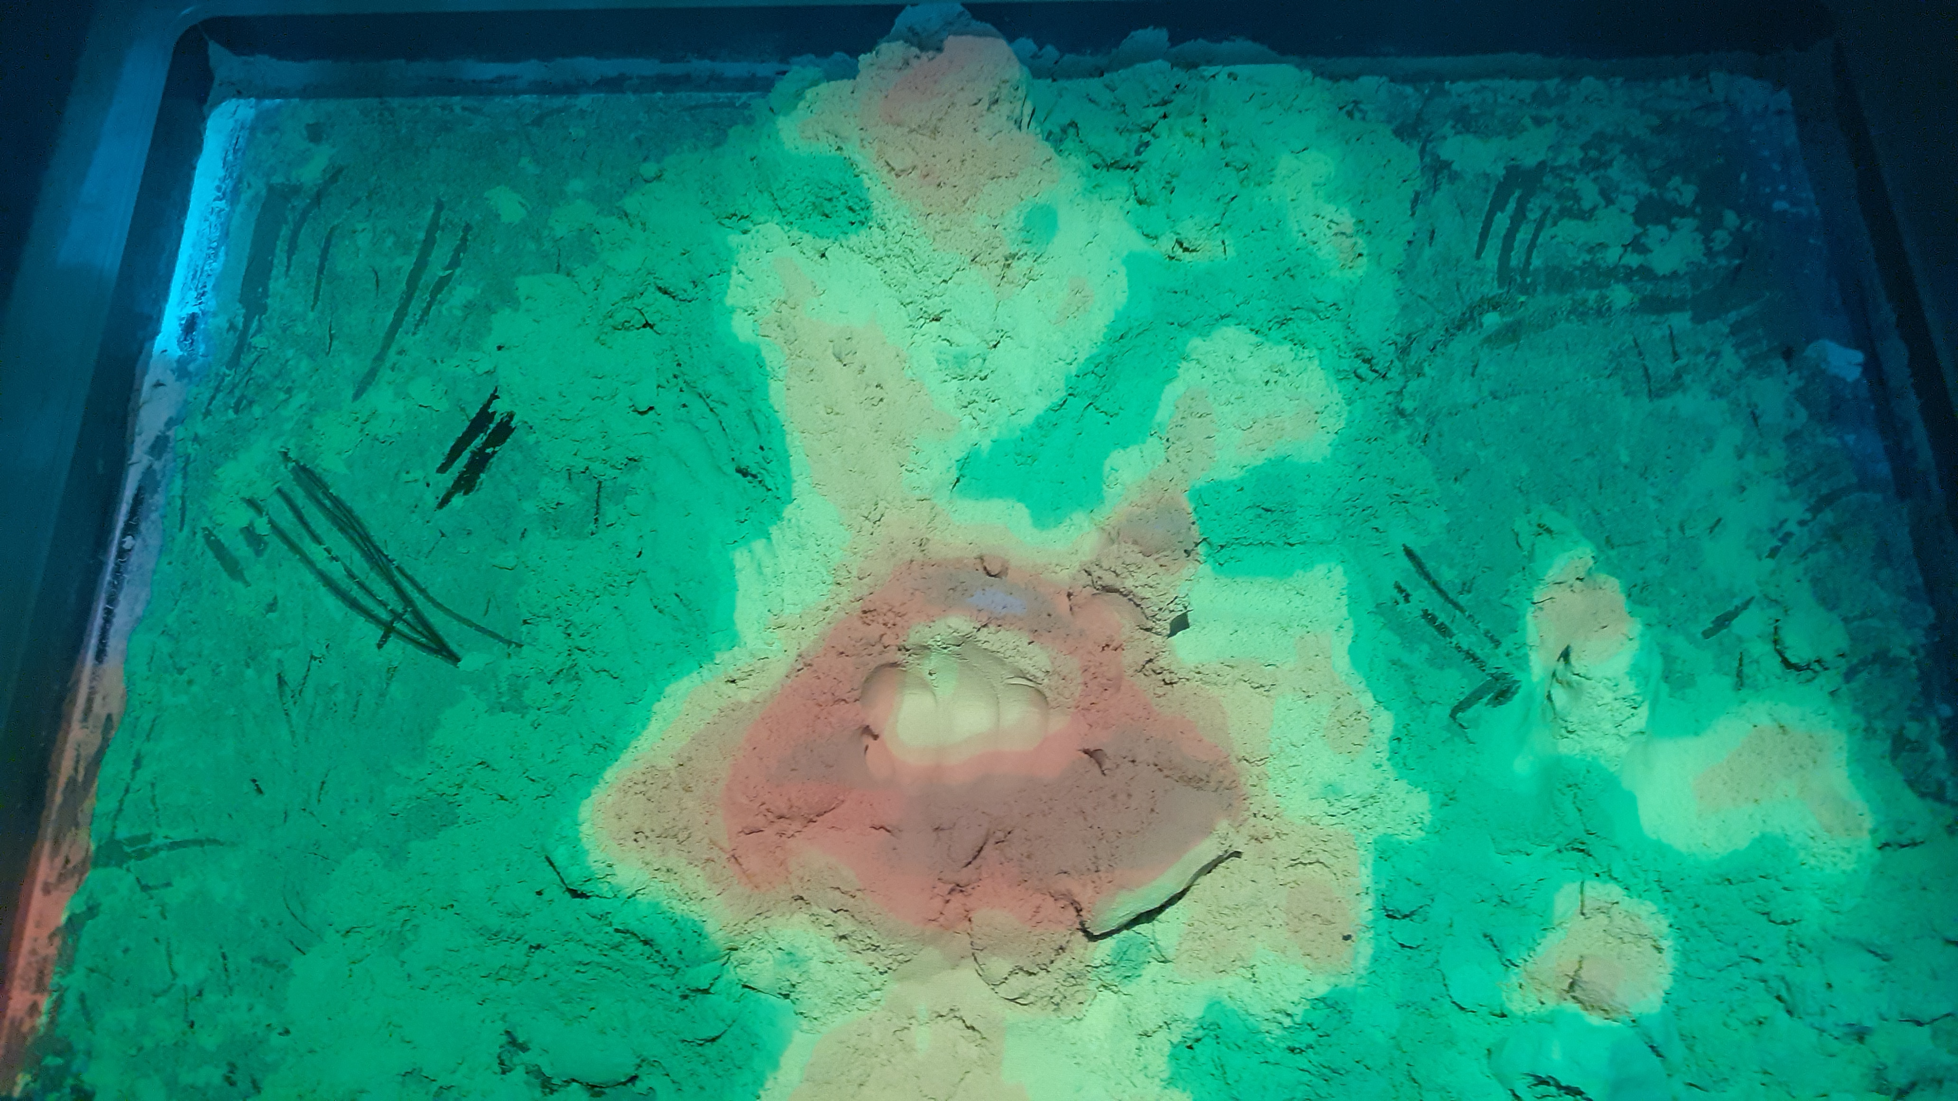
Varie: isoipse (Hevelianum, Gdansk)
Il rivelatore della distanza fa scansione e manda al proiettore un «pattern» di illuminazione

Slide 41
On-line experiments
Kaiserslautern Physics

