Slide 2
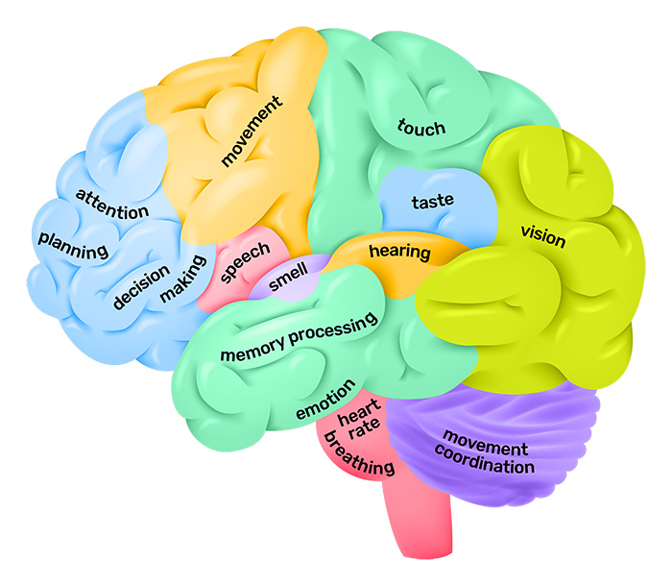
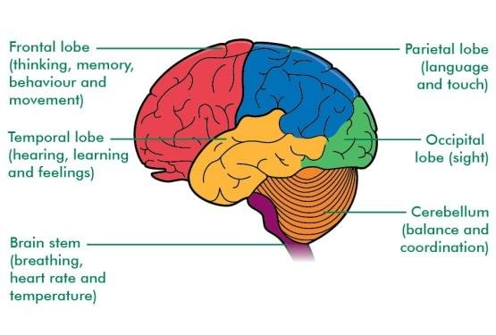
Cervello umano – una costruzione più complicata dell’intero universo
https://qbi.uq.edu.au/brain/brain-anatomy/lobes-brain
https://www.researchgate.net/figure/Brain-lobes-with-its-functions-3_fig2_340865332

