Slide 1

Atomic Physics for ITER
Grzegorz P. Karwasz
Institute of Physics
Faculty of Physics, Astronomy and Applied Informatics,
University Nicolaus Copernicus , 87100 Torun, Poland
KazNU, Almaty,
15.06.2024

Slide 2
Outline:
Rationale: what is needed?
Experimental methods for electron-molecule cross
sections
4. Case study: recommended CSs for e⁻ + CH₄
5. Semiempirical estimations: C, Be, W – like species
6. Theoretical progress (for ligth targets)
7. Theory for C, Be, W, ...
8. Conclusions: how to proceed?

Slide 3
Rationale: edge and divertor plasma
Guillemaut et al. Nucl.Fusion 54 (2014) 093012

Slide 4
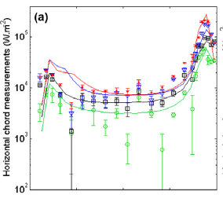
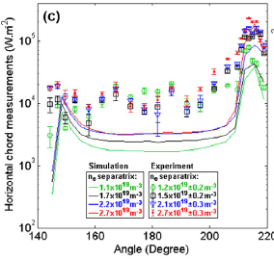
Rationale: electron T and power irradiated
Electron temperature during
three points of density ramp:
good agreement
Power irradiated (0.5-1.5 MW) simulation:
JET-C <10% JET-ILW factor 3!
Guillemaut et al. Nucl.Fusion (2014)

Slide 5
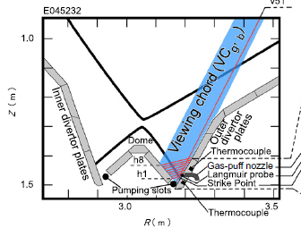
Carbon sputtering by CH₄ and C₂H_{y} ions
Nakano et al. Nucl.Fusion 54 (2014) 043004

Slide 6
2. Partial cross sections:
Data needed:
I Neutrals (H, C, C₂, Be, BeH₂, CH₄)
1. Total cross section
elastic scattering e+A →e+A
rotational excitation e+CH₄ (J=0) → e+CH₄ (J=2)
vibrational excitation e+AB(v=0) → e+AB(v>0)
electron attachment (dissociative) e+AB → A⁻ + B
electronic excitation e+A →e+A*
emission lines: A* → A + hv
neutral dissociation e+AB → A + B + e
emisison from dissociation e + AB → A* + B + e + hv
ionization e+A →A⁺+2e
dissociative ionization e+AB → A + B⁺ + 2°
ionization into excited states e + A → (A⁺)* + 2e

Slide 7
2. Partial cross sections:
Data needed: II Positive ions (BeH⁺)
Recombination: A⁺ + e → A
1a. dissociative recombination: AB⁺ + e → A* + B
vibrational excitation e+AB(v=0) → e+AB(v>0)
electronic excitation e+A⁺ →e + A^{+*}
double ionization e+A⁺ → A²⁺ + 2e

Slide 8
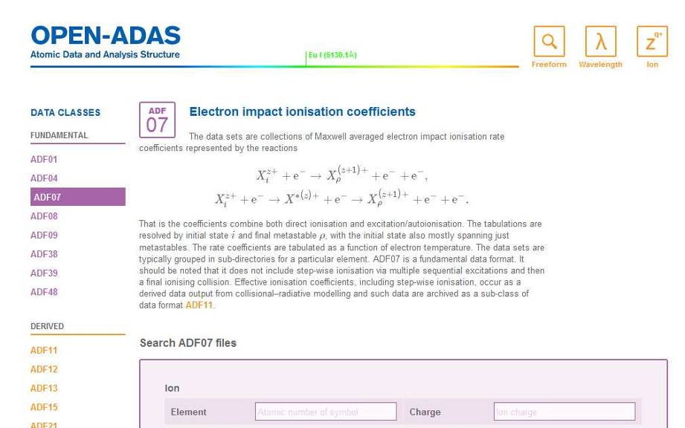
Databases

Slide 9
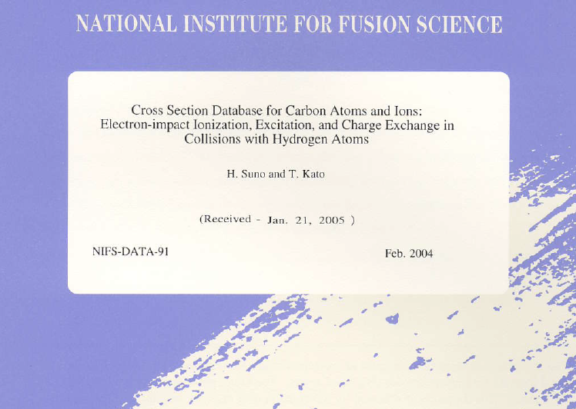
Databases

Slide 10
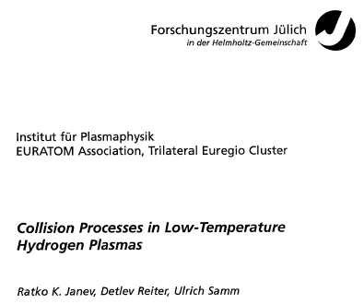

Databases

Slide 11
https://www-amdis.iaea.org/meetings/.../Mason-VAMDC-2012-09-06.pdf

Slide 13
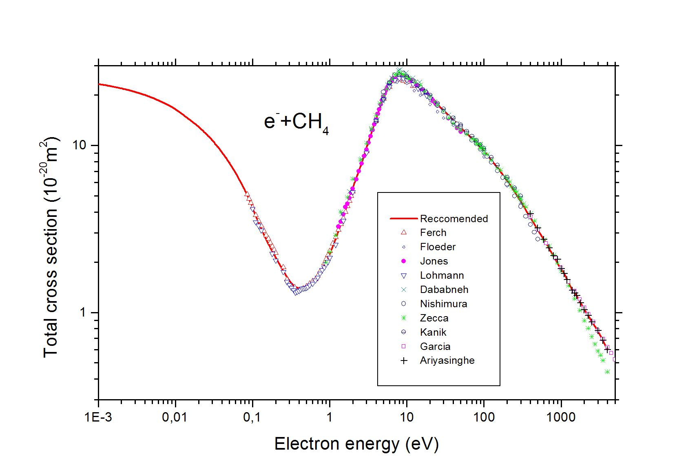
Experimental methods: total
attenuation method I = I₀ exp(-σnL); precision <5%
H. Nishimura et al.,
J.Phys. Soc. Japan 72 (2003) 1080
NF₃
M.-Y. Song et al., to be published B. Goswami et al. PRA 88 (2013) 032707

Slide 14
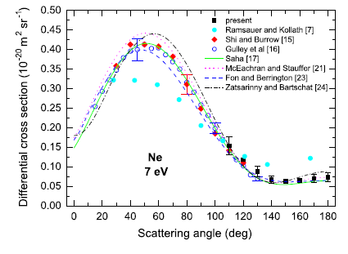
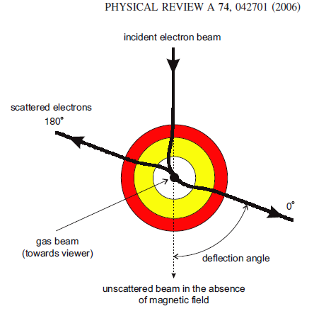
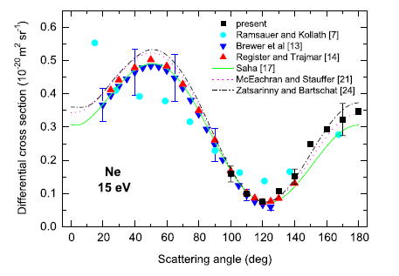
Experimental methods: elastic
I. Linert, B. Mielewska, G. King, and M. Zubek, PRA (2006)

Slide 15
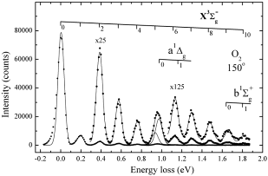
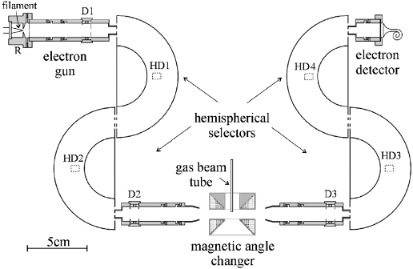
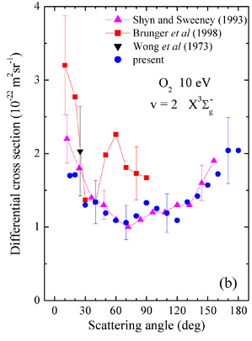
Experimental methods: excitation (electronic, vibrational)
e⁻ + O₂ (v=0) – e⁻ + O₂ (v=0, 1, 2, etc.)
Experiments by:
I. Linert, M. Zubek (Gdansk) J. Phys. B 39 (2006)
M. Khakoo et al. (Fullerton California)
M. Allan (Freiburg University)

Slide 16
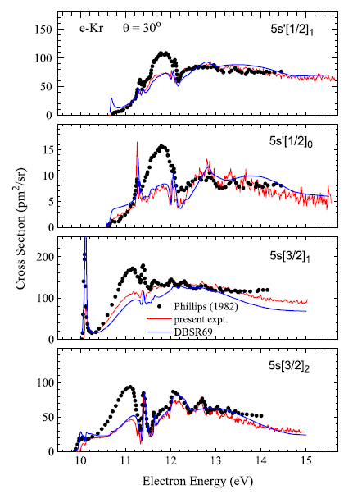
Experimental methods: electronic, vibrational, DA
M. Allan, O. Zatsarinny. K. Bartschat, PRA (2011) Kr: experiment and Dirac R-matrix

Slide 17
Experimental methods: ionization (1)
WF₆→
WF₅⁺ > WF₂⁺>
WF₃⁺ ≈ WF₄⁺
Accuracy: ±15%
R. Basner, M. Schmidt, K. Becker, Int. J. Mass Spectr. 233 (2004) 25

Slide 18
Experimental methods: ionization (2)
SiCl⁺ from single, double, triple ionization of SiCl₄
B. G. Lindsay et al., JCP 129 (2004), S J King nad S D Price, JCP134 (2011) 074311

Slide 19
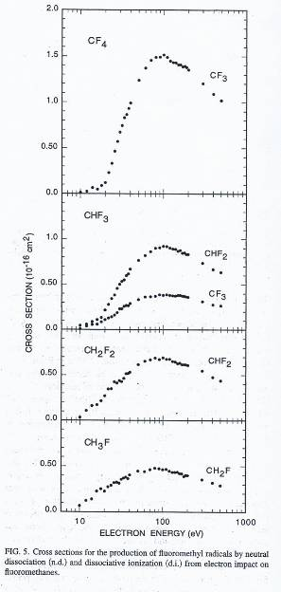
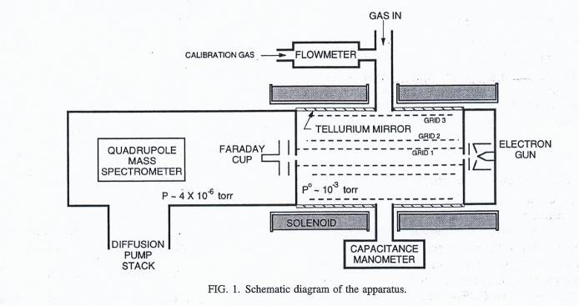
Dissociation into neutrals (CF₄, CH₃F…)
volatile organotellurides
x 3
x 2
x 1
Additivity rule:
cross section = sum of paths
Motlagh and Moore, JCP109 (1988) 432

Slide 20
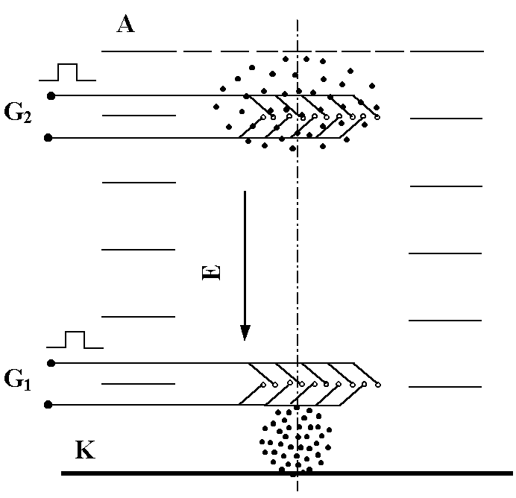
Diffusion coefficients → electronic distribution function n_{e} (r, v, t)

Slide 21
Methane: swarm in mixtures
0%, 1.03%, 5.13% Ar
Y. Nakamura, in M.-Y.Song et al.,
to be publisked

Slide 22
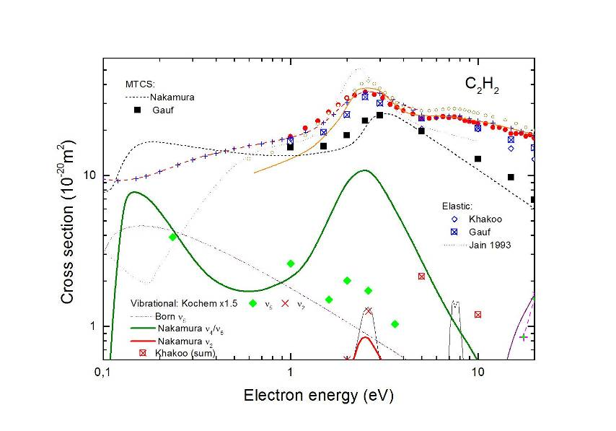
Acetylene: swarm ↔ beam: vibrational, MTCS
Swarm MTCS and vibrational (Nakamura, 2010)
seem to be better than beam measurement (Kochem, 1986)

Slide 23
Review case study: CH₄
1. Total cross section: ±5%
M.-Y. Song, J. S. Yoon, H. Cho, Y. Itikawa, G. Karwasz, V. Kukooulin, Y. Nakamura, J. Tennyson,
to be published

Slide 24
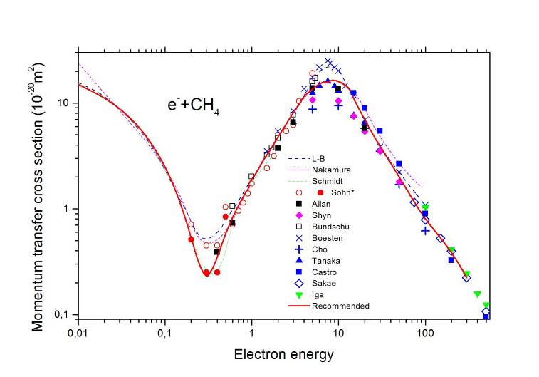
Review case study: CH₄
2. Momentum transfer (and elastic) cross sections: ±15%
M.-Y. Song, J. S. Yoon, H. Cho, Y. Itikawa, G. Karwasz, V. Kukooulin, Y. Nakamura, J. Tennyson,
to be published

Slide 25
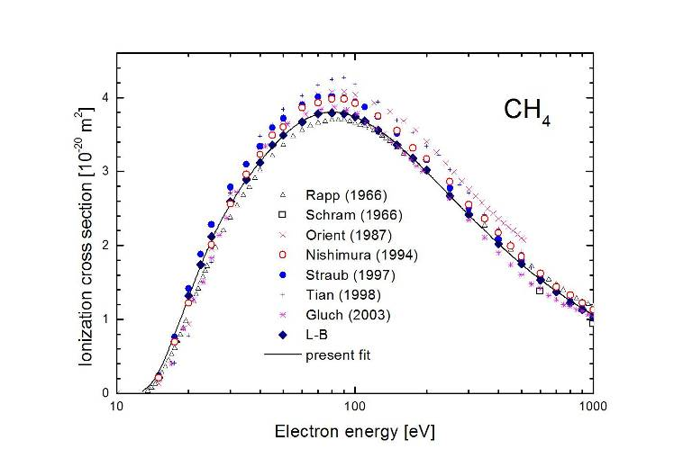
Review case study: CH₄
3. Ionization total: ±10%
M.-Y. Song, J. S. Yoon, H. Cho, Y. Itikawa, G. Karwasz, V. Kukooulin, Y. Nakamura, J. Tennyson,
to be published

Slide 26
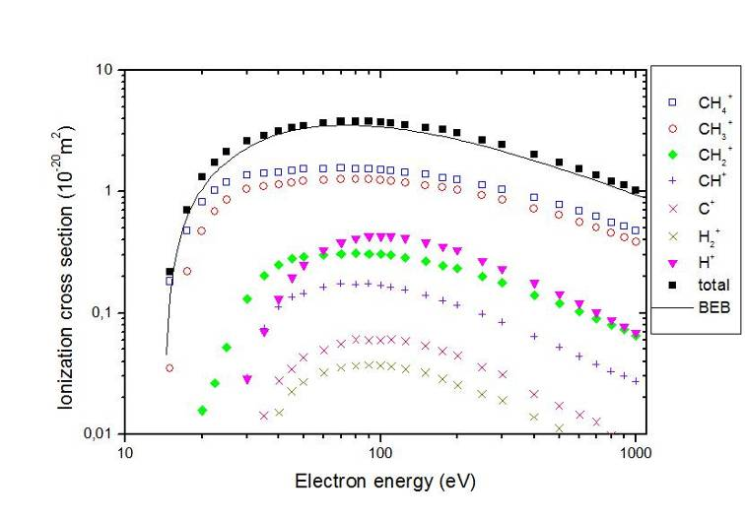
Review case study: CH₄
3a. Ionization partial: ±10%
M.-Y. Song, J. S. Yoon, H. Cho, Y. Itikawa, G. Karwasz, V. Kukooulin, Y. Nakamura, J. Tennyson,
to be published

Slide 27
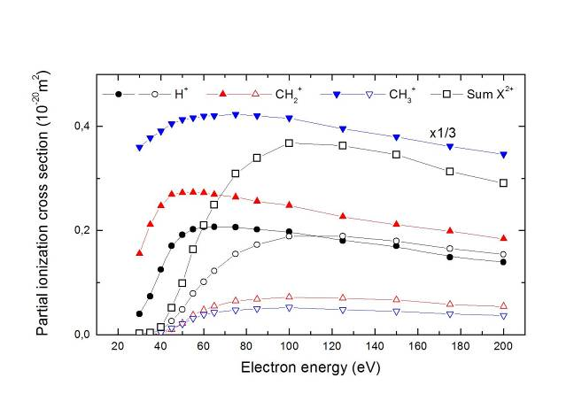
Review case study: CH₄
3a. Ionization partial: channel resolved
e.g. e + CH₄ → CH₃⁺ + H⁺ + 2e
or e + CH₄ → (CH₄⁺)* + e → CH₃⁺ + H⁺ + 2e
or e + CH₄ → CH₃ + H⁺ + e
Experimental data (coincidence measurements): Ward et al.. 2011
to be done...

Slide 28
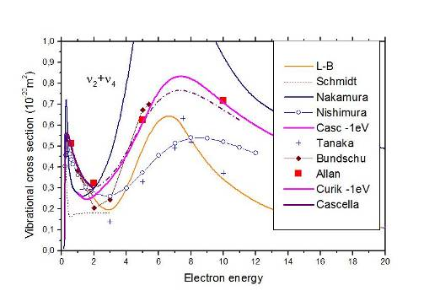
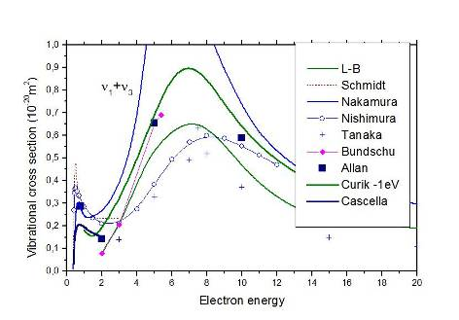
Review case study: CH₄
4. Vibrational: disagreement between swarm, beam, theory
M.-Y. Song, J. S. Yoon, H. Cho, Y. Itikawa, G. Karwasz, V. Kukooulin, Y. Nakamura, J. Tennyson,
to be published

Slide 29
Review case study: CH₄
5. Electronic excitation: reasonable agreement between
dissociation into-neutrals experiment and R-Matrix calculation
W. J. Brigg, J. Tennyson, M. Plummer
J. Phys. B 47 (2014) 185203
R-Matrix

Slide 30
Review case study: CH₄
6. Rotational excitation: experiment (Kochem et al.. 1985) really
difficult; cross sections from R-matrix calculations adopted
W. J. Brigg, J. Tennyson, M. Plummer, J. Phys. B 47 (2014) 185203
R-Matrix

Slide 31
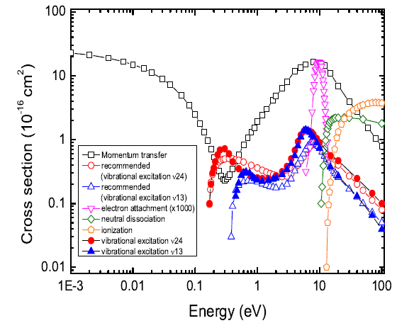
CH₄ - overview
M.-Y. Song, J. S. Yoon, H. Cho, Y. Itikawa, G. Karwasz, V. Kukooulin, Y. Nakamura, J. Tennyson,
to be published

Slide 32
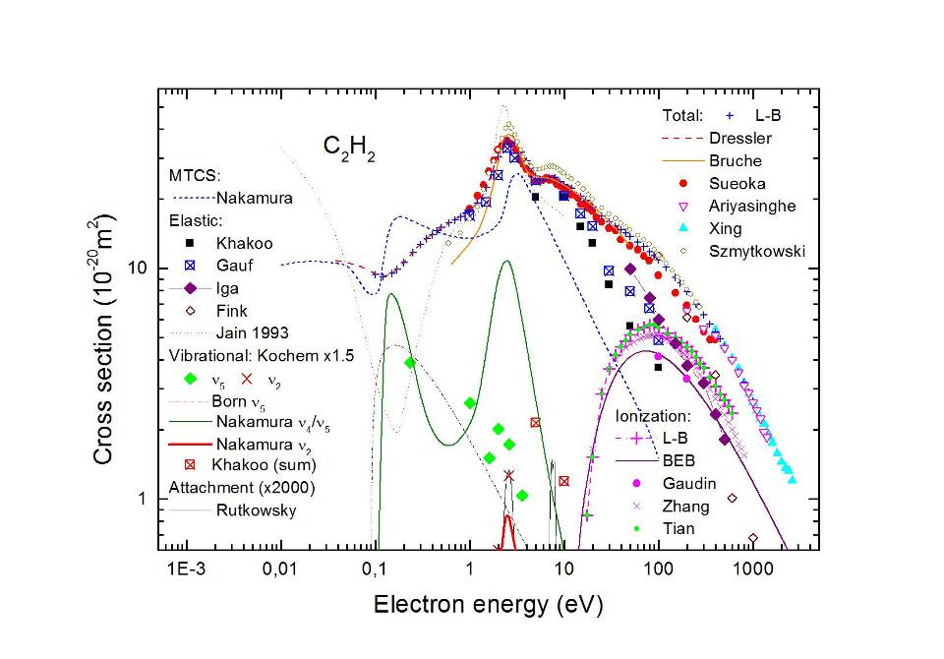
C₂H₂ - preliminary
M.-Y. Song, J. S. Yoon, H. Cho, Y. Itikawa, G. Karwasz, V. Kukooulin, Y. Nakamura, J. Tennyson,
work in progress

Slide 33
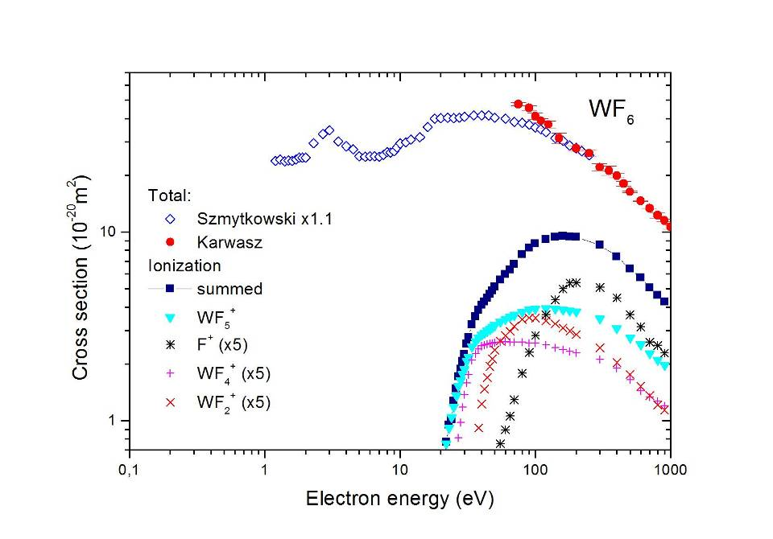
WF₆ - few data
?
?
GK, work in progress

Slide 34
Semi-empirical methods - zero-energy cross section:
Langevin, Voigth-Wannier
Allan et al., Advances At. Mol. Phys. (2004)

Slide 35
Searching analogies (2):
„resonances” in total cross sections
G. Karwasz, K. Fedus, FS&T (2013), experimental data: Szmytkowski and collaborators

Slide 36
Semi-empirical methods: elastic (MERT)
Link between elastic, total, MTCS: in some simple cases, and low energies
CH₄
K. Fedus, G. Karwasz, Eur. J. Phys. D (2014)

Slide 37
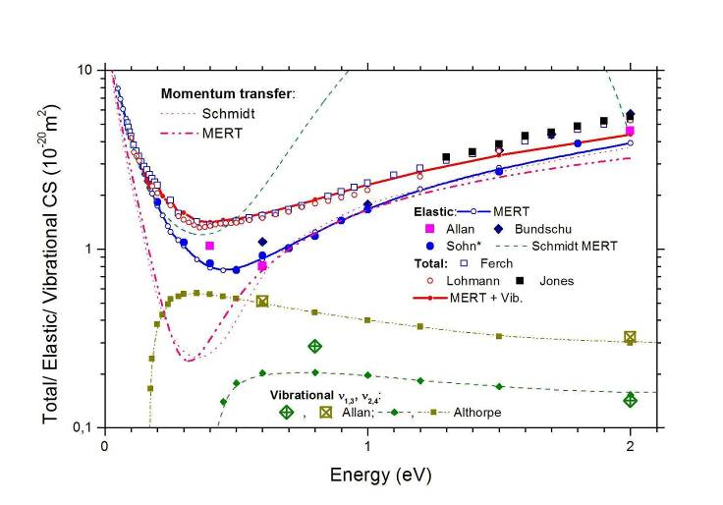
Semi-empirical methods: elastic (MERT)
Link between elastic, total, MTCS: in some simple cases, and low energies
CH₄
K. Fedus, G. Karwasz, Eur. J. Phys. D (2014)

Slide 38
Semi-empirical methods: vibrational (Born)
G.P.Karwasz, A.Zecca, R.S.Brusa, La Rivista del Nuovo Cimento 24 No.4 (2001) 1-101

Slide 39
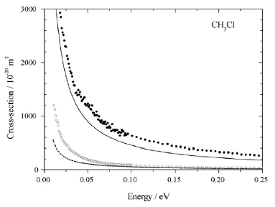
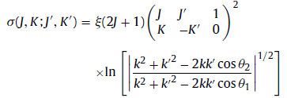
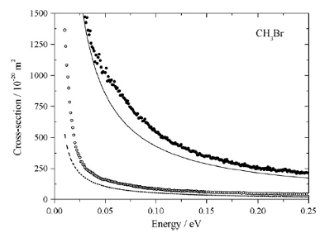
Rotational, very low energy limit (Born):
Polar molecules:
N C Jones et al. Intr. J. Mass Spectr. 277 (2008) 91

Slide 40
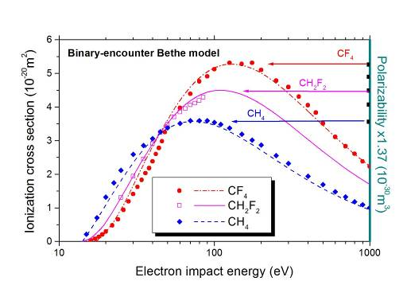
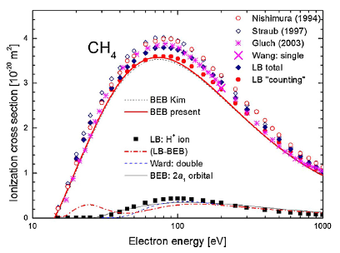
Ionization: semiempirical formulae
Normalized energies: t= E/I_{n}, u_{n}=E_{kin} / I_{n} Only two values needed from QCh
Y.-K. Kim and M. E. Rudd, Phys. Rev. A 50 (1994) 3954
G. Karwasz, P. Mozejko, M.-Y. Song, Int. J. Mass Spectrometry (2014)

Slide 41


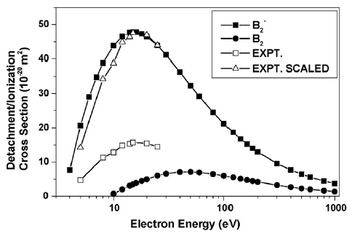
Electron detachment(D-M): B₂^{-,} BO⁻, O₂⁻, CN⁻)
Deutsche-Mark formalism
H. Deutsch et al. Int. J. Mass Spectr. 277 (2008) 151

Slide 42
Searching analogies (1): partitioning into elastic & ionization
G. P. Karwasz, J.Phys. B 28 (1995) 1301-9
A. Zecca, G. P. Karwasz, R. S. Brusa and T. Wróblewski,
Int. J.Mass Spectr. 223-224 (2003) 205

Slide 43
High energies: in search for additivity rule
CH₄, CF₄, SiH₄, ... WF₆ → CH₂F₂, SiF₄ ...
→ H, C, Si, ... W
G. Karwasz et al., Phys. Rev. A 59 (1999) 1341

Slide 44
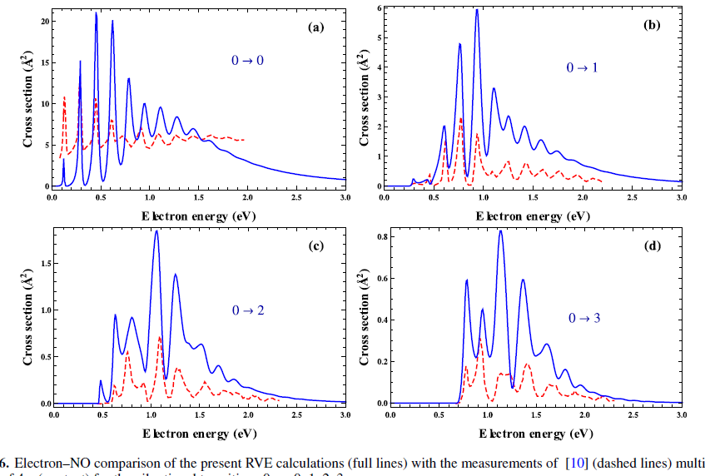
Theoretical progress: resonances in NO (R-matrix)
Laporta, ... J Tennyson, Plasma Sources Sci. Technol. 21 (2012) 055018

Slide 45
Swarm analysis: resonances in NO
M. Josic, J. Mechlińska-Drewko, Z. Petrovic, G. Karwasz, Chem. Phys. Lett. (2003)

Slide 46
Overlapping resonances: NO (swarm analysis)
M. Josic, J. Mechlińska-Drewko, Z. Petrovic, G. Karwasz, Chem. Phys. Lett. (2003)

Slide 47
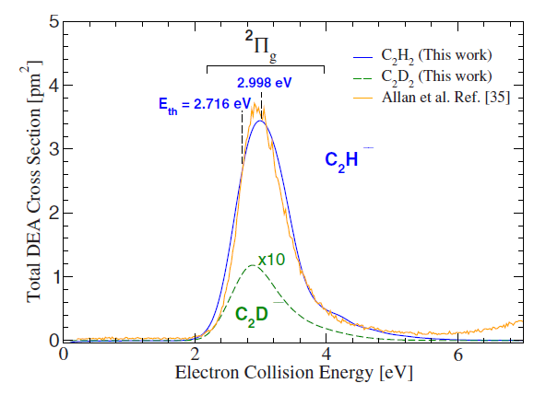
Theoretical progress - Kohn variational: dissociative attachment (C₂H₂)
S. T. Chorou and A. E. Orel, Phys. Rev. A. 77 (2009) 042079

Slide 48
Theoretical progress: dissociative recombination (N₂⁺ + e⁻ → N* + N* )
S. L. Guberman, J. Chem. Phys. 139 (2013) 124318
also Tennyson and collaborators, PRA (2014)

Slide 49
C₂⁻ – electron detachment, electronic excitation
solid line – with Born correction
broken – without Born correction
Halnova, Gorkenfield, J Tennyson, JPB 41 (2008)
UK Molecular R-matrix code: electronic, rotational

Slide 50
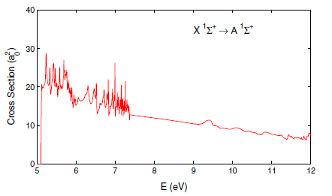
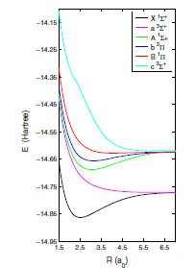
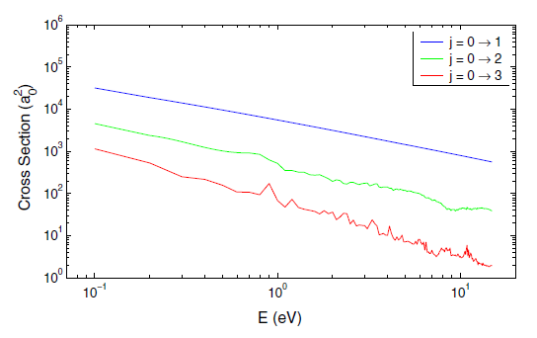
BeH⁺ – electronic and rotational excitation
K Chakrabarti and J Tennyson, Eur. Phys. J. D 66 (2012) 31
UK Molecular R-matrix code: electronic, rotational

Slide 51
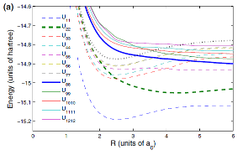
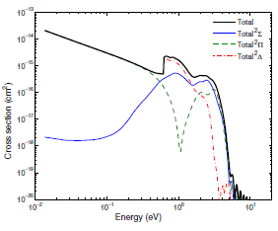

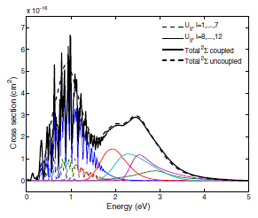
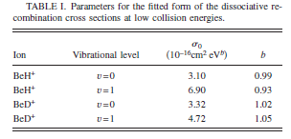
BeH⁺ dissociative recombination
X ² Σ ⁺
X ² Σ ⁺
Roos,..Orel, PRA 80 (2009) 012501
Variational Kohn method
σ/E^{b}

Slide 52
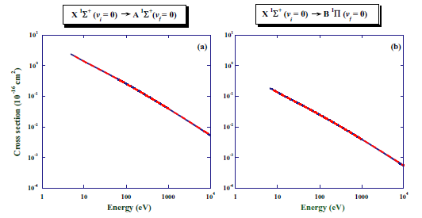
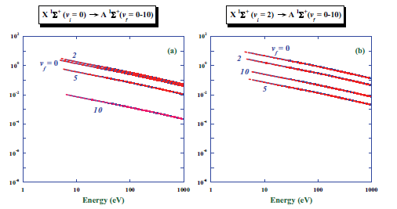
BeH⁺ – electronic and vibrational excitation
R Celiberto, R K Janev, D Reiter, Plasma Phys. Control. Fusion 54 (2012) 035012
Coulomb-Born approximation: cross sections, excitation rates T=0.1-10,000 eV)

Slide 53
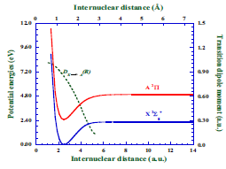
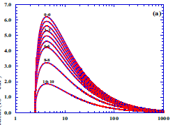
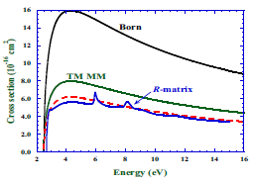
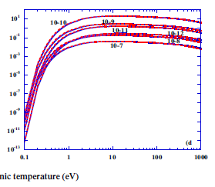
BeH: electronic and vibrational excitation
X ² Σ ⁺ (v=0) → A ²П (v’)
Cross section
Rate coefficients
R Celiberto, K L Baluja and R K Janev, Plasma Sources Sci. Technol. 22 (2013) 015008
Mott-Massey Schr. eq.

Slide 54
Metals: Hg, Au, Ru
Au, Y, Ru, Ag
Hg
A. Z. Msezane, Z. Felfli, D Sokolovski
J. Phys.: Conf Series, 388 (2012) 042002
Thomas-Fermi potential
K. Jost and B. Ohnemus,
Phys. Rev. A 19 (1979) 641

Slide 55
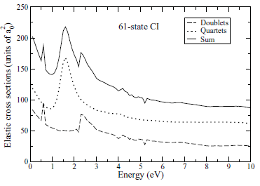



Metal molecules (B₂): electronic excitation
J. S. Rajvanshi & K. L. Baluja, Phys. Rev. A 86 (2012) 032794: R-Matrix

Slide 56
Conclusions – state of art
Total cross sections (for “easy” molecules) OK
Elastic (and therefore total also): theory OK
Vibrational: theory on a promising way
Ionization: abundant data and models
Dissociative attachment (and dissociative
neutralization) – theory proves OK, work needed
6. Electronic excitation (and dissociation)
– remains the most challenging

Slide 57
Conclusions (2) - perspectives:
„Physical” cross sections still needed
„Chemical” cross sections even more
Reviews for new targets: Be, BeH₂, W ?
Simple theories and scalling laws useful
Advanced theories „at reach”
Lab experiments still needed
and ITER-like experiment even more
→ constructing cooperative networks

Slide 58


Acknowledgments:
Greetings
from Toruń!

