Slide 1
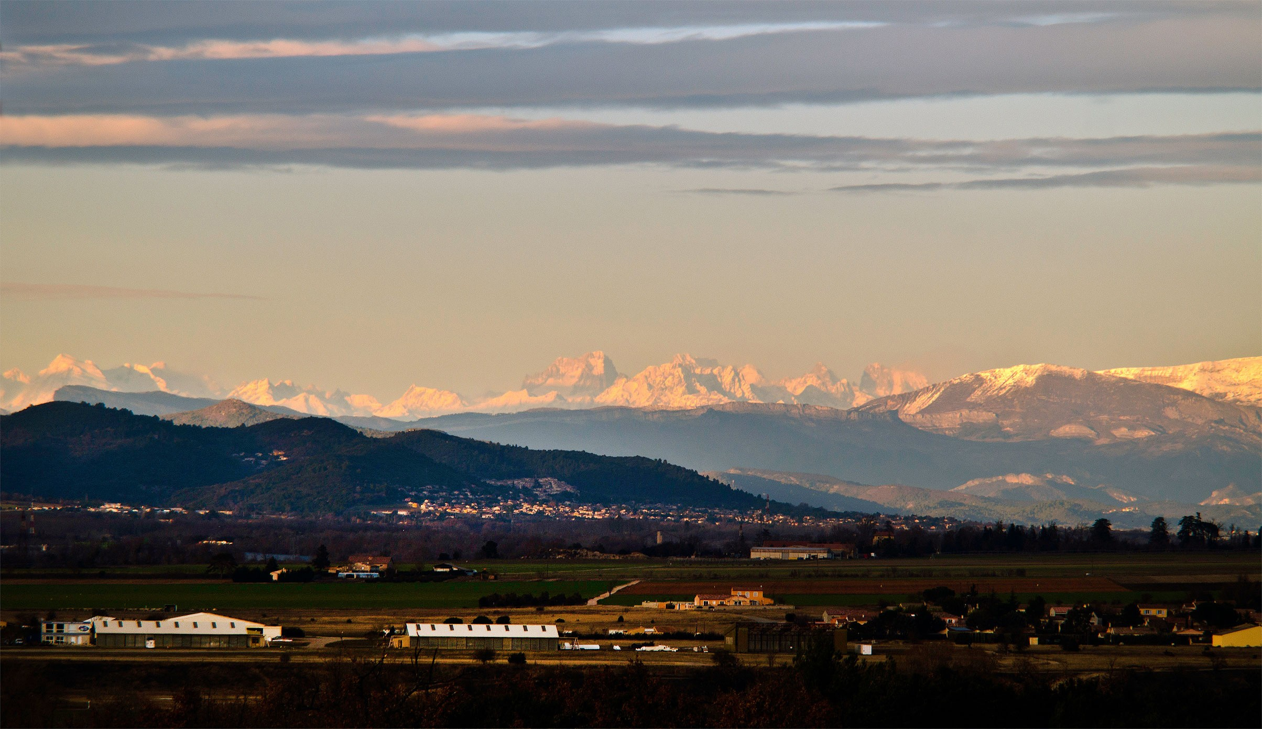
Progress towards Fusion Energy at ITER
D.J. Campbell
ITER Organization, Route de Vinon sur Verdon, CS90 046, 13067 St Paul-lez-Durance, France
Acknowledgements:
Many colleagues in the ITER Organization, Domestic Agencies, ITPA and the international fusion programme
The views and opinions expressed herein do not necessarily reflect those of the ITER Organization.

Slide 2





What is ITER?
ITER is a major international collaboration in fusion energy research involving China, the EU (plus Switzerland), India, Japan, the Russian Federation, South Korea and the United States
The overall programmatic objective:
  to demonstrate the scientific and technological feasibility of fusion energy for peaceful purposes
The principal goal:
  to design, construct and operate a tokamak experiment at a scale which satisfies this objective
ITER is designed to confine a DT plasma in which α-particle heating dominates all other forms of plasma heating:
  ⇒ a burning plasma experiment

Slide 3
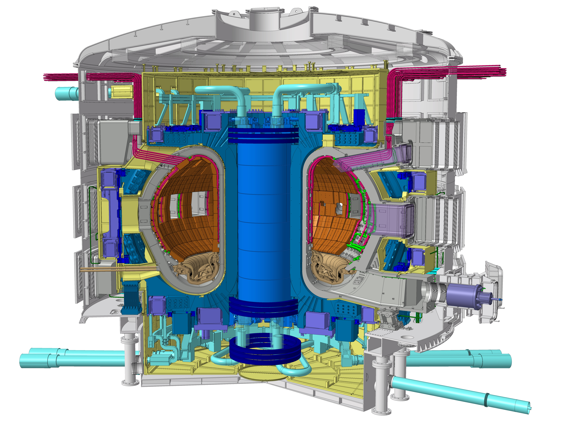
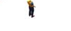
The ITER Mission
ITER Program Objective:
  to demonstrate the scientific and technological feasibility of fusion energy for peaceful purposes
Key Technical Goals:
  achieve extended burn of a DT plasma with dominant alpha-particle heating (Q ≥ 10, ~500 s)
  develop steady-state fusion power production as ultimate goal
  integrate and test all essential fusion power reactor technologies and components
  demonstrate safety and environmental acceptability of fusion
ITER tokamak

Slide 4
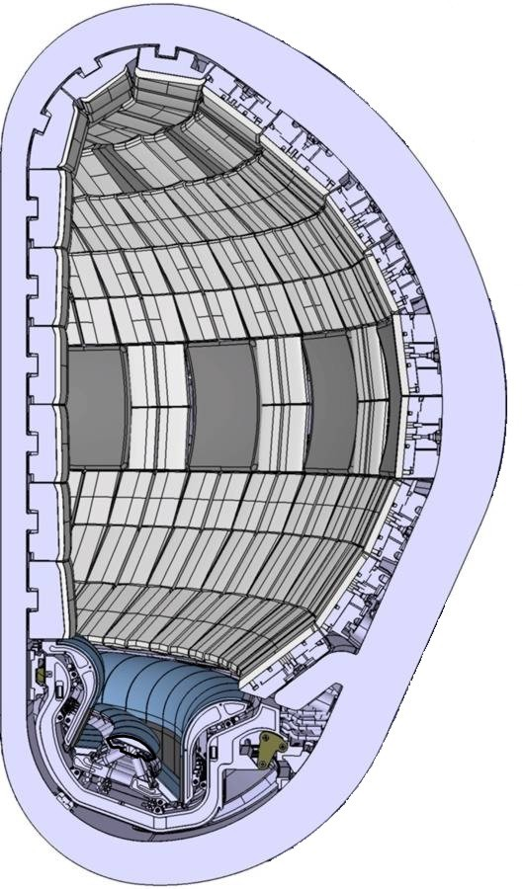
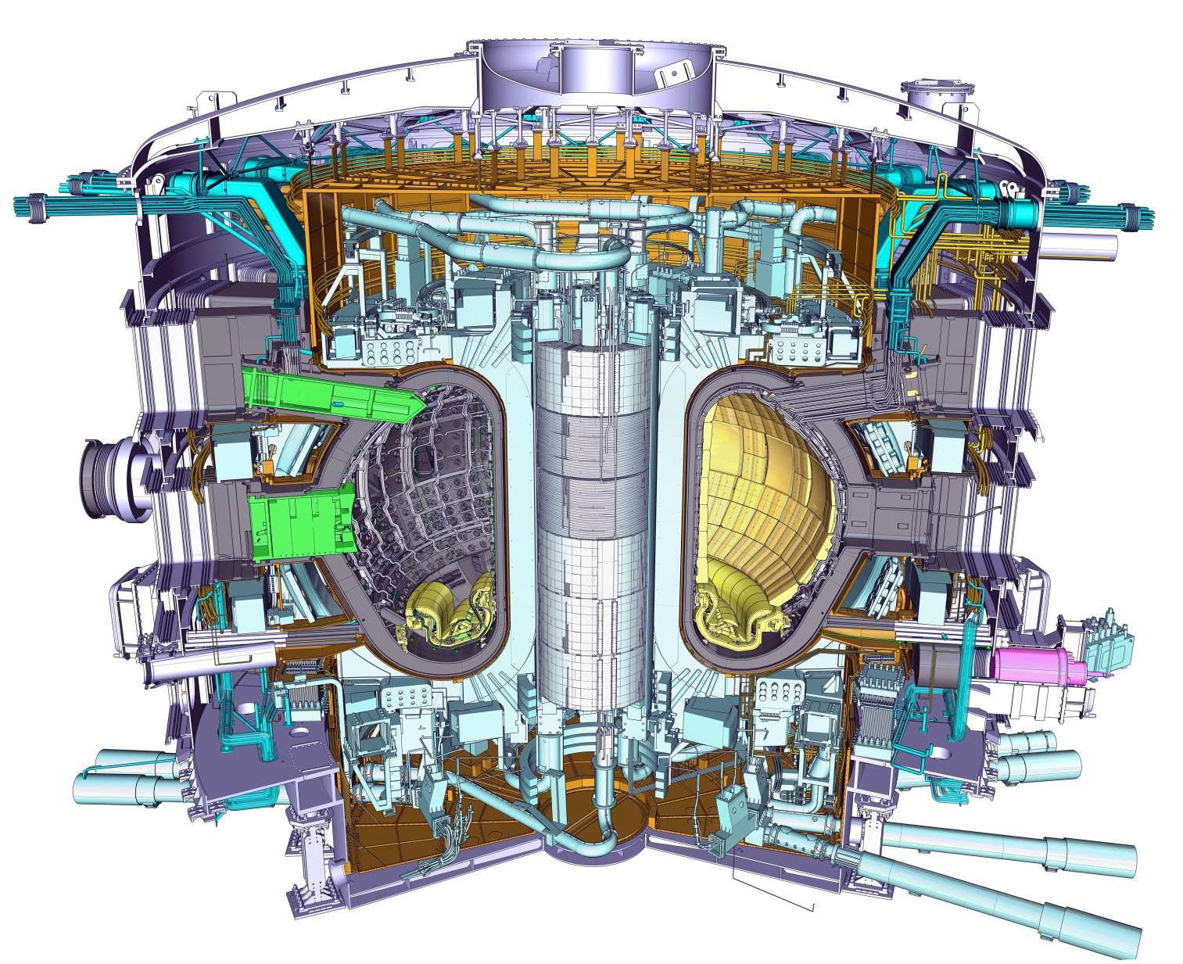

The ITER Tokamak
Be
h=29 m
W
R=6 m

Slide 5
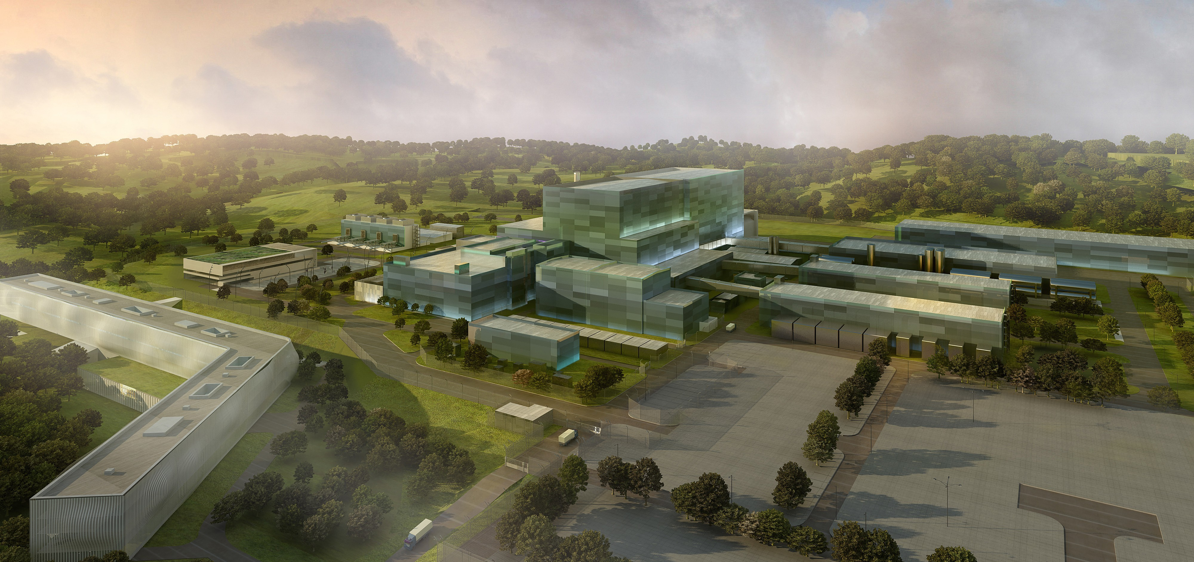
Synopsis
Fusion power production in ITER: the physics basis
ITER construction status
The ITER Research Plan
Elements of ITER physics and technology research
Notes:
THE objectives set out for ITER are basically two:
ONE: to obtain and study a plasma where the alfa particle heating is dominating all other forms of heating.
ITER will operate with a value of capital Q greater than 10.
The fusion power in ITER will be about 500MW, the input power about 50MW.
And TWO: it has to integrate the technology required for future use of fusion as an energy source

Slide 6
Plasma fusion performance
Temperature - T_{i}: 1-2 × 10⁸ K (10-20 keV)
(~10 × temperature of sun’s core)
Density - n_{i}: 1 × 10²⁰ m⁻³
(~10⁻⁶ of atmospheric particle density)
Energy confinement time - τ_{E}: few seconds (∝ current × radius²)
(plasma pulse duration ~1000s)
Fusion power amplification: ⇒ Present devices: Q ≤ 1
 ⇒ ITER: Q ≥ 10
⇒ ’Controlled ignition’: Q ≥ 30

Slide 7
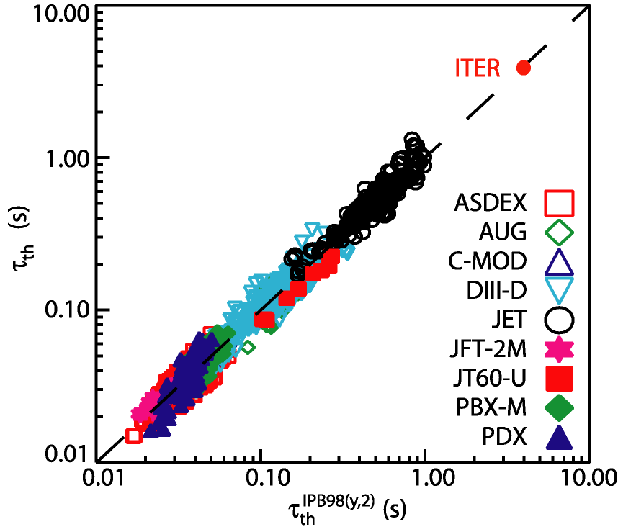
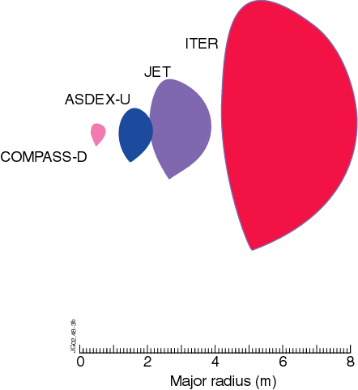
Plasma Confinement: τ_{E} Scaling
Turbulent transport in fusion plasmas difficult to predict quantitatively:
  so, we use scaling experiments to predict the level of energy confinement in ITER
  H-mode turns out to be robust enough to provide the basis for the ITER design ⇒ significant reduction in size of device
Major Radius
Plasma Current
Input Power
τ_{th} ∝ I_{p}R²P^{-2/3}

Slide 8
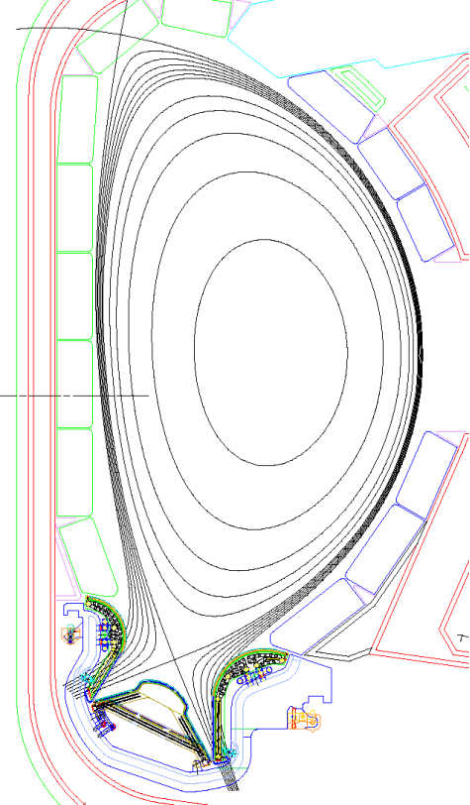
ITER: fusion power production
D₂,T₂ Fuel
ITER Plasma:
R/a: 6.2 m /2 m
Volume: 830 m³
Plasma Current: 15 MA
Toroidal field: 5.3 T
Density: 10²⁰ m⁻ ³
Peak Temperature: 2×10⁸ K
Fusion Power: 500 MW
Plasma Burn 300 - 500 s
(“Steady-state” ~3000 s)
Blanket:
neutron absorber
Power Plant
Li-->T
High temperature
D⁺+T⁺
He⁺⁺(3.5MeV)
n(14.1MeV)
Divertor:
particle and heat exhaust
He, D₂,T₂, impurities

Slide 9
ITER is making a successful transition from detailed design to construction
Large scale prototyping of major components is preparing the ground for series manufacture
Significant manufacturing activities and construction work are already underway in several critical path areas
In November 2012, the French Government authorized the creation of the installation nucléaire de base ITER
Substantial expansion of on-site construction activities is planned in the coming months

Slide 10
ITER – Tokamak Core Components
d ~ 30 m
Central Solenoid (6)
(Nb₃Sn)
Cryostat
(SS)
Thermal Shield
(SS)
Internal Coils
(Cu)
Poloidal Field Coils (6)
(NbTi)
Toroidal Field Coils (18)
(Nb₃Sn)
Shielding Blanket Modules (SS/ Be)
h ~ 29 m
Correction Coils (18)
(NbTi)
Vacuum Vessel
(SS)
Divertor
(SS/ W)

Slide 11
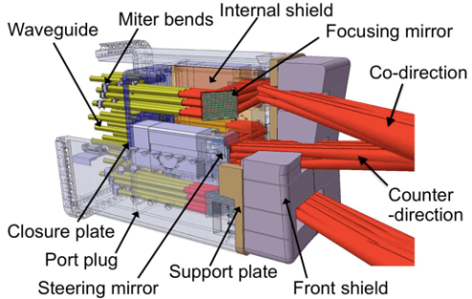
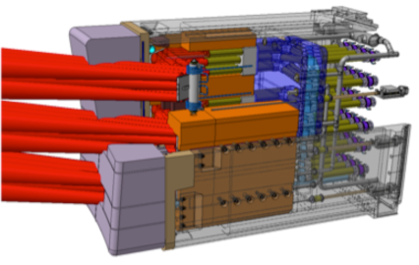
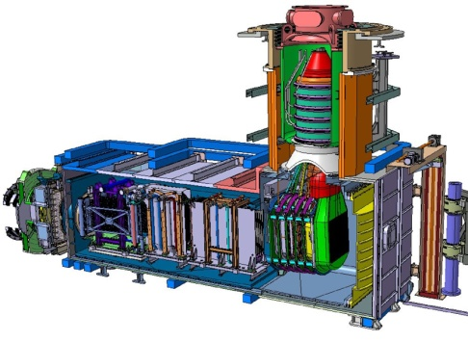
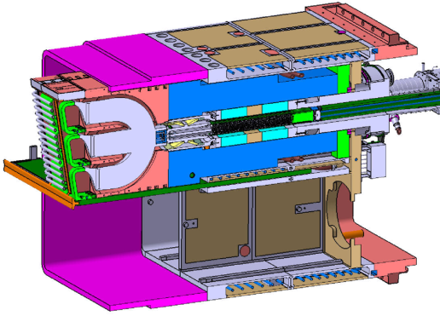
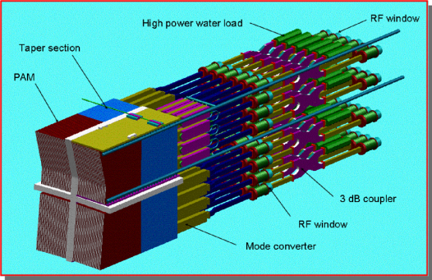
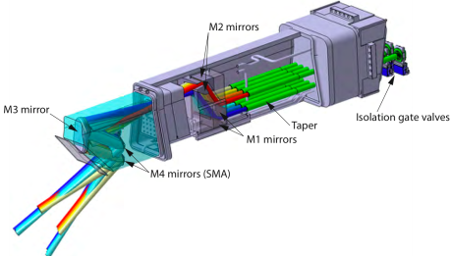

ITER heating and current drive systems
NB
Neutral Beam - 1 MeV
33MW* +16.5MW#
Bulk current drive limited modulation
IC
Ion Cyclotron 40-55MHz
20MW* +20MW#
Sawtooth control modulation < 1 kHz
EC
Electron Cyclotron 170GHz
20MW* +20MW#
NTM/sawtooth control modulation up to 5 kHz
LH
Lower Hybrid ~5 GHz
0MW* +40MW#
Off-axis bulk current drive
*Baseline Power
#Possible Upgrade

Slide 12
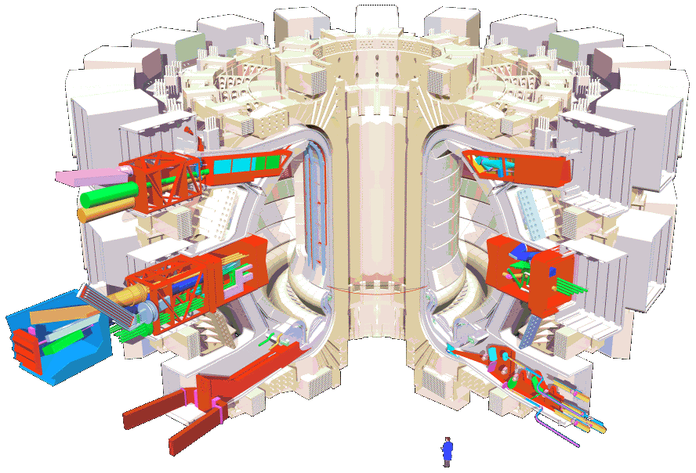
Analyzing the Plasma - ITER Diagnostics
VESSEL WALL
(Distributed Systems)
UPPER PORT
(12 used)
EQUATORIAL PORT
(6 used)
DIVERTOR CASSETTES
(16 used)
DIVERTOR PORT
(6 used)
About 40 large scale diagnostic systems are foreseen:
  Diagnostics required for protection, control and physics studies
  Measurements from DC to γ-rays, neutrons, α-particles, plasma species
  Diagnostic Neutral Beam for active spectroscopy (CXRS, MSE ….)

Slide 13
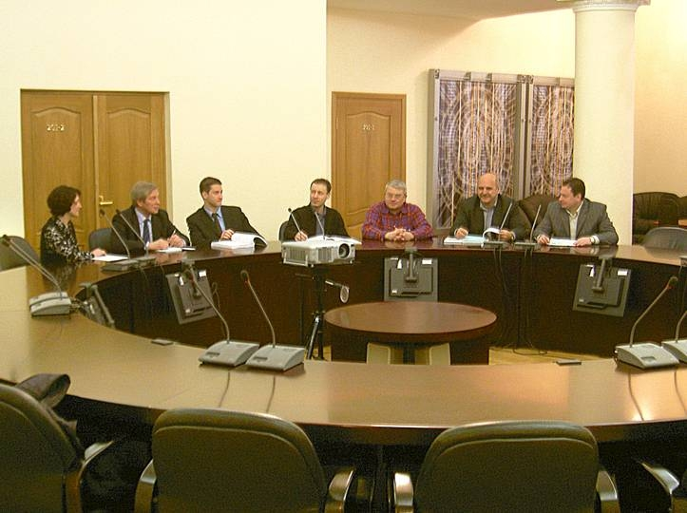
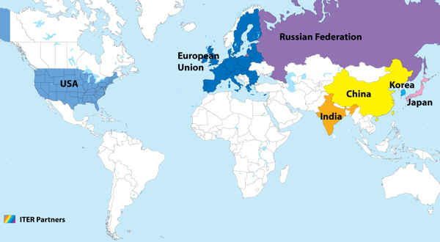
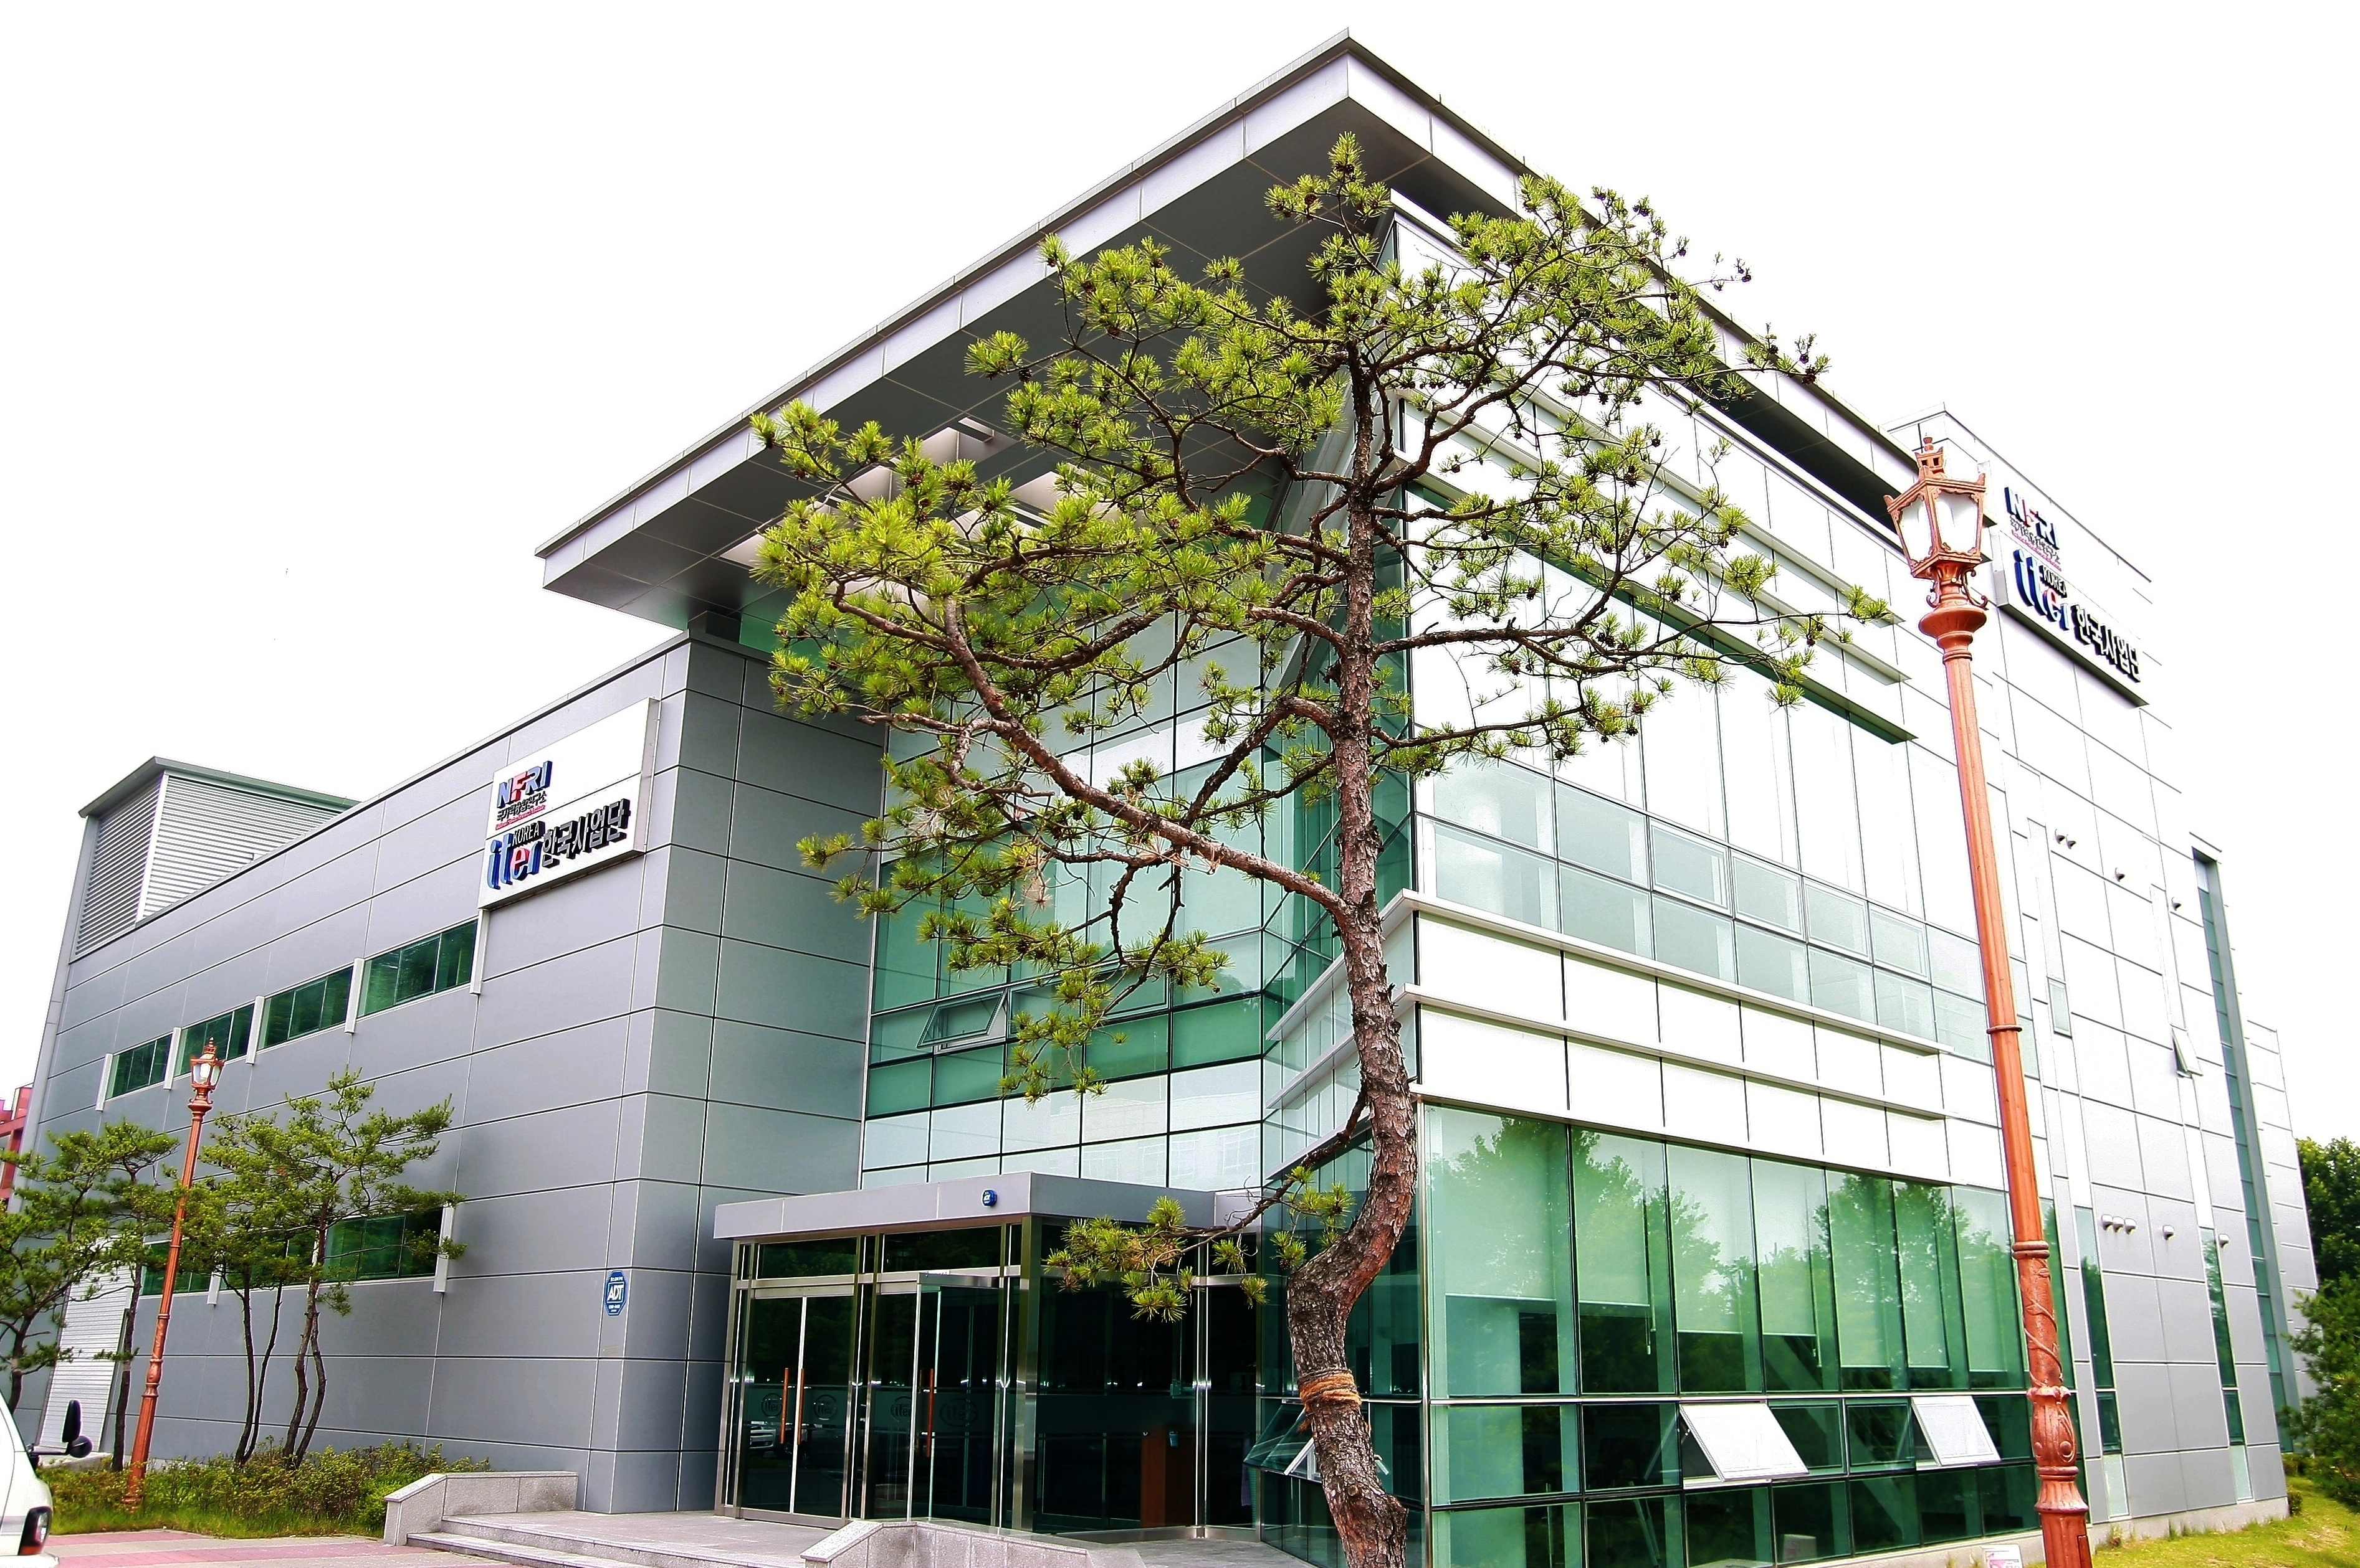
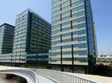
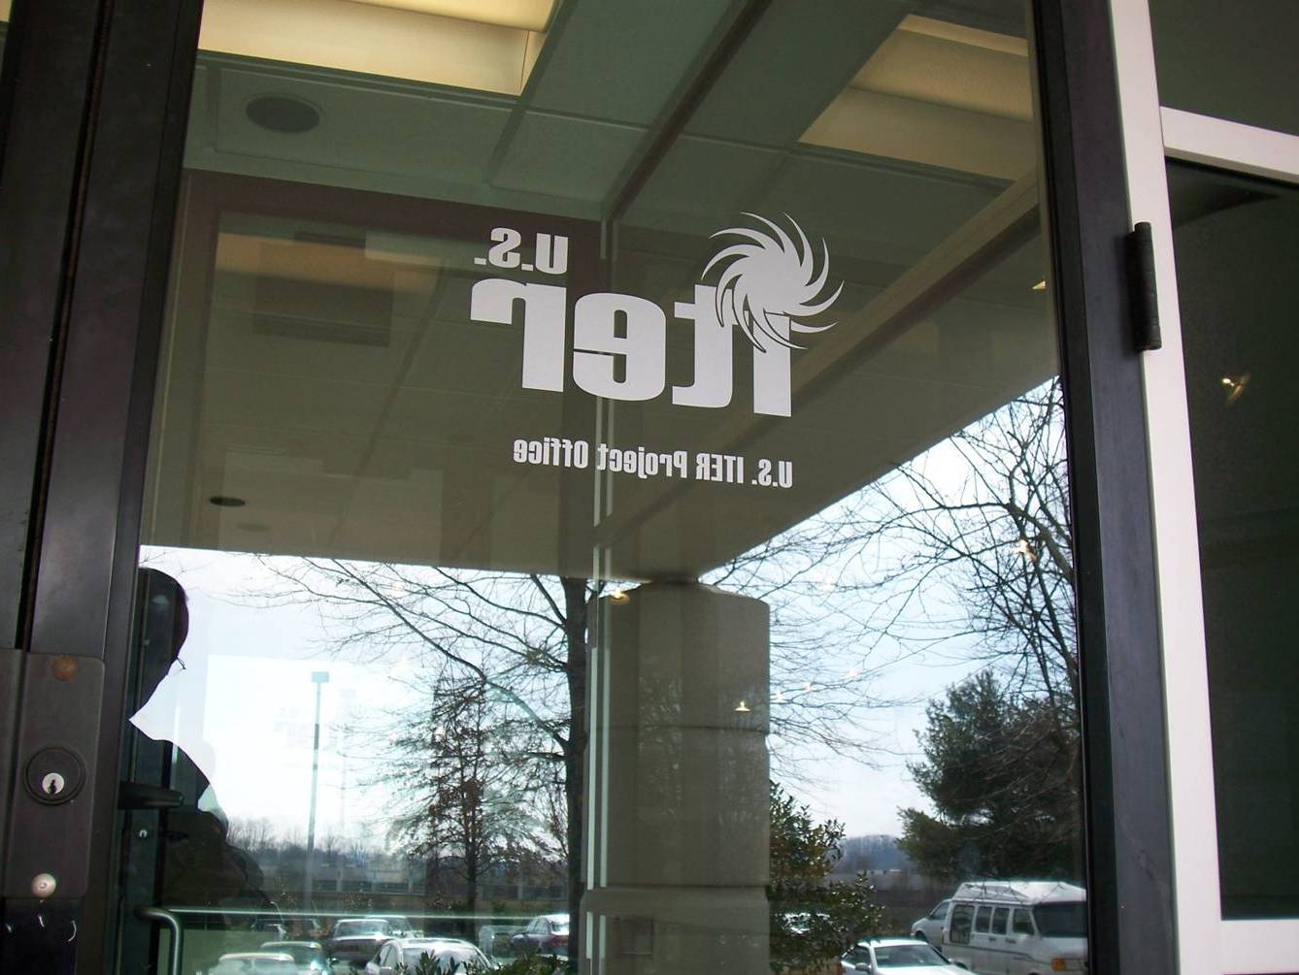
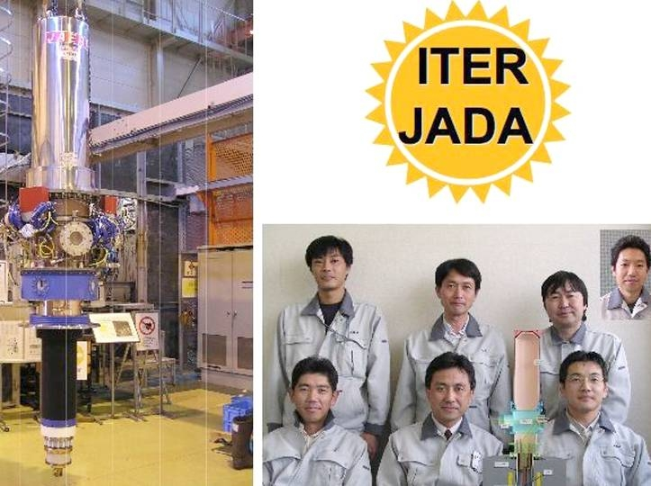
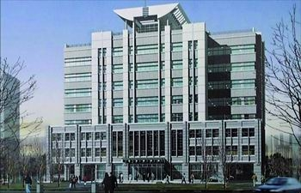
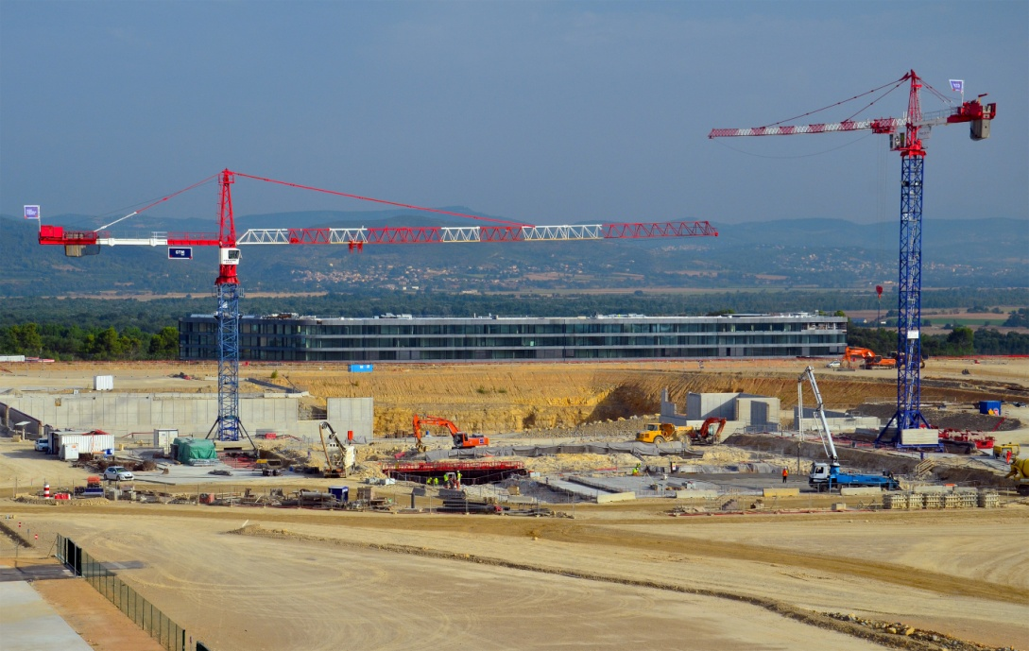

ITER – A Major International Collaboration
90% of ITER components will be supplied “in-kind” by the Members through their Domestic Agencies
*
This approach necessitates the integration of ITER management, design and procurement activities across the globe
Notes:
13

Slide 14
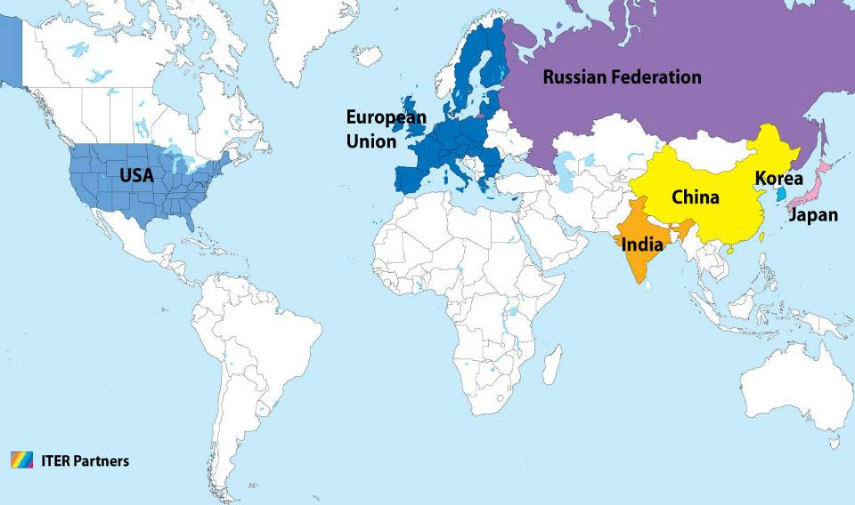
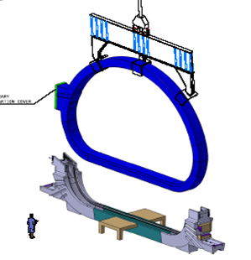
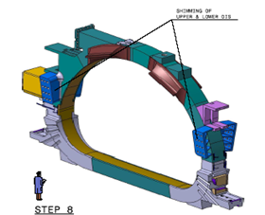
TF Coils – A Global Collaboration
TF Coil
TF coil cases
Conductor
Japan
Japan
China
Europe
South Korea
Japan
Russia
United States
Europe

Slide 15
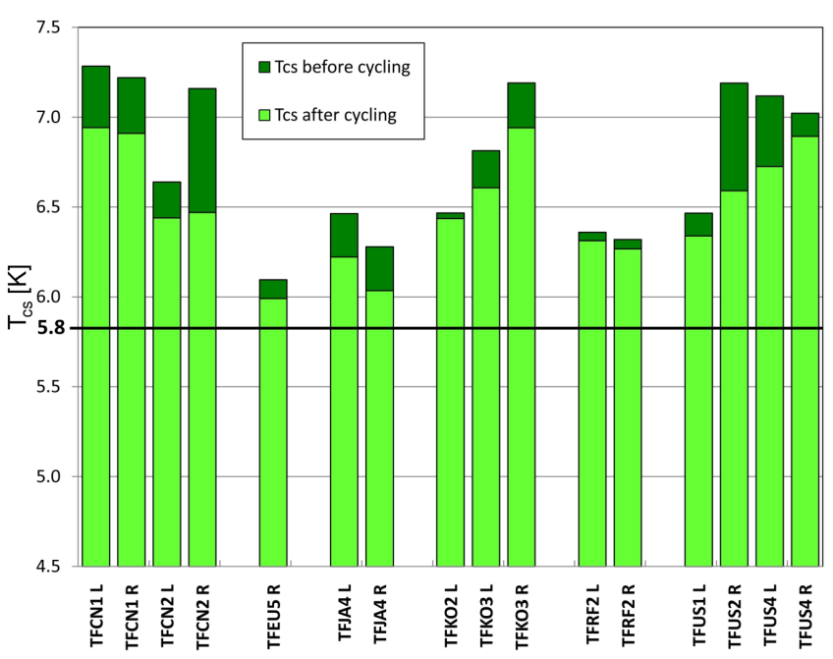


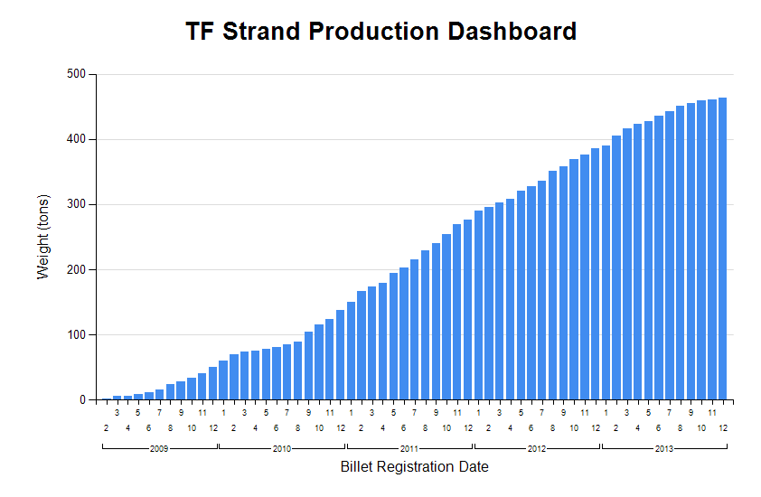
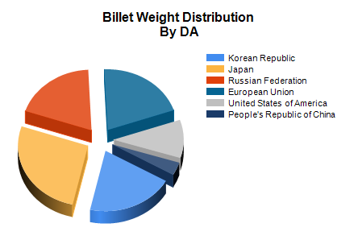
TF Conductor Production
All TF conductor qualification samples were manufactured at CRPP and enabled supplier qualification in all 6 DAs involved in TF conductor production
Currently, virtually all of required >500t of Nb₃Sn strand has been produced around the world
TF Qualification Sample Summary
TF Strand Production Summary

Slide 16
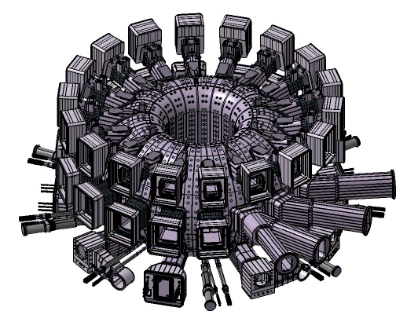
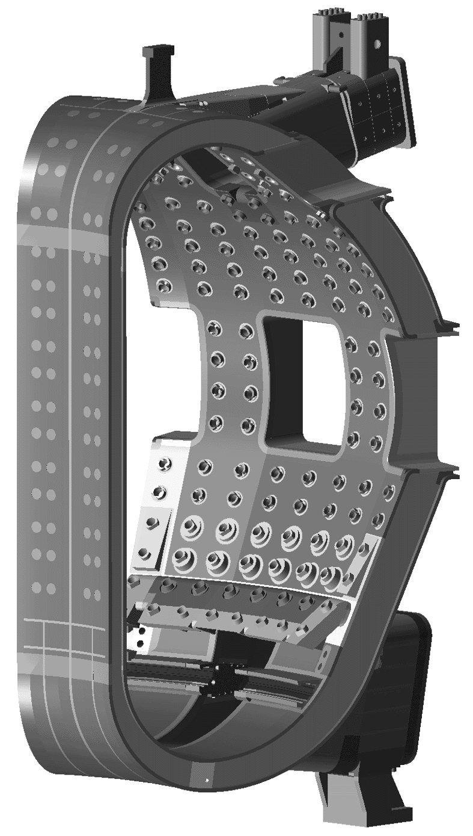
Vacuum Vessel Manufacturing Contracts Awarded
Vacuum Vessel is a double-walled stainless steel structure
  19.4m outer diameter, 11.3m height, 5300 tonnes
  provides primary tritium confinement barrier
VV sector, port and in-wall shielding PAs signed (EU, KO, RF, IN)
  industrial contracts awarded in each area by corresponding DA

Slide 17
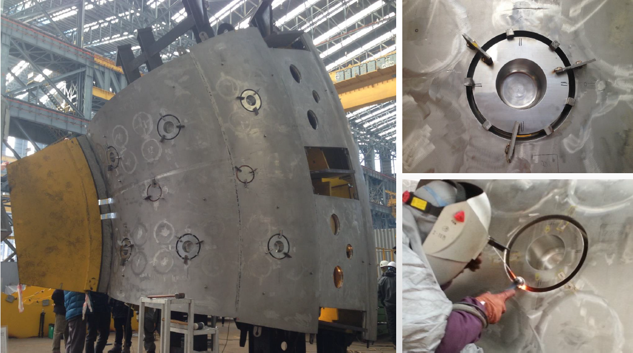
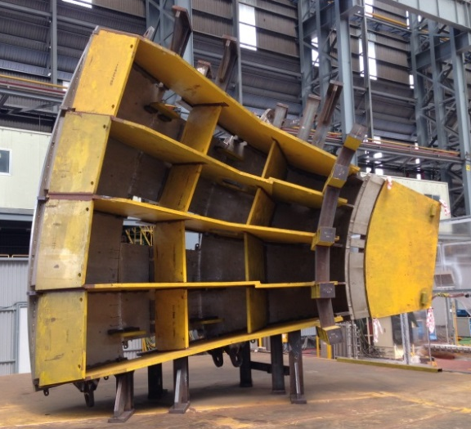
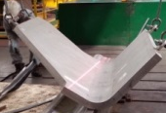
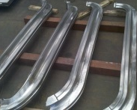
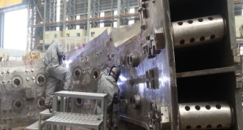
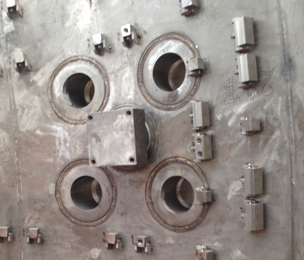
ITER Vacuum Vessel Prototyping
Fabrication of Upper Segment (PS2)
Welding of Centering Keys and Inter-Modular Keys
Port Stub
R&D for IVC Rail Support

Slide 18
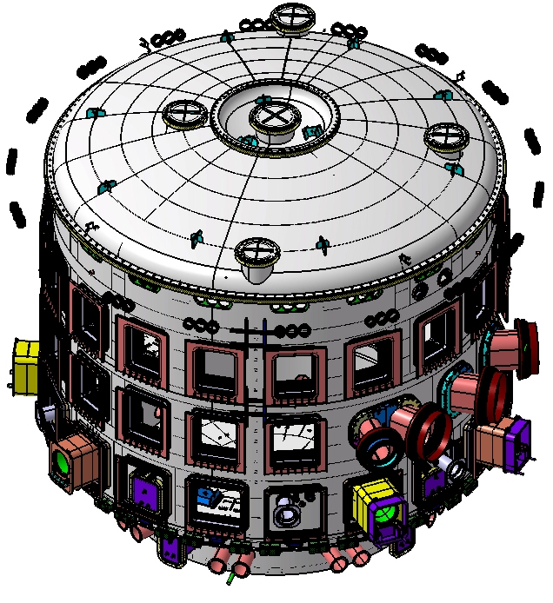
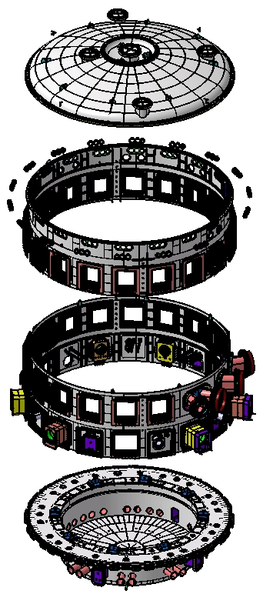
Cryostat
Top Lid
Upper Cylinder
Lower Cylinder
304L Stainless steel
40 – 180 mm thick
Diameter: 29.4 m/ Height: 29 m
Weight ~3500 tonnes
Base pressure < 10⁻⁴ mbar
Transfers loads to tokamak complex floor
Base Section
IN-DA signed PA September 2011
Contract awarded in August 2012
Notes:
18

Slide 19
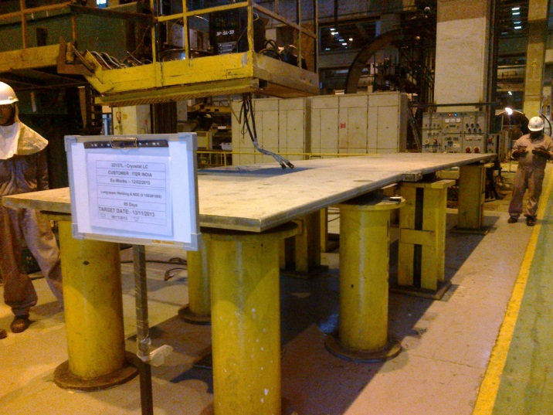
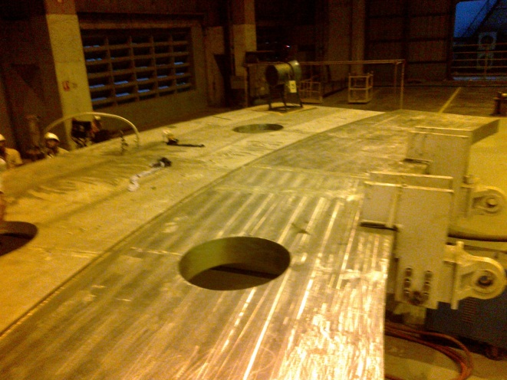
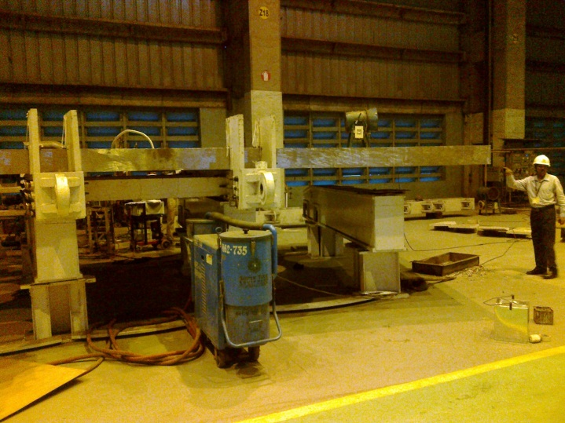
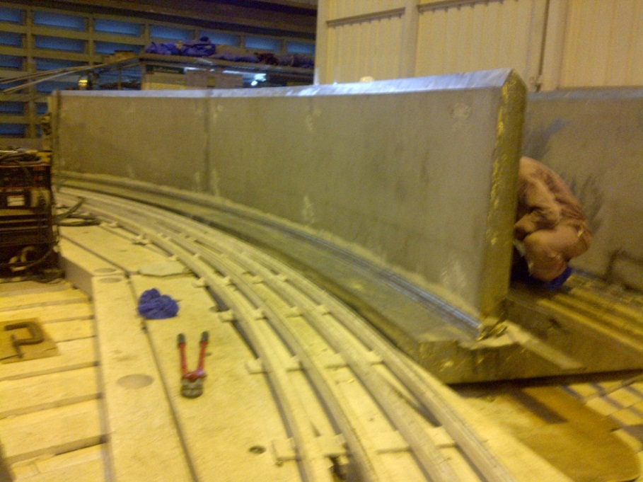
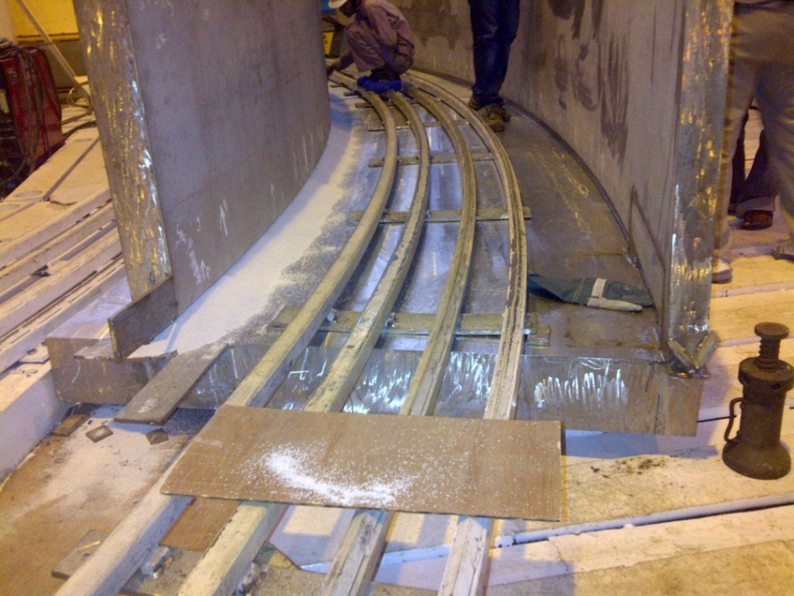
40° Prototype Cryostat Base Section
Cryostat pedestal ring- top plate 200 mm and skirt plate 105 mm thick welded together
Cryostat pedestal ring- bottom plate (180 mm & side plates (120 & 80 mm thick being welded
Notes:
19

Slide 20
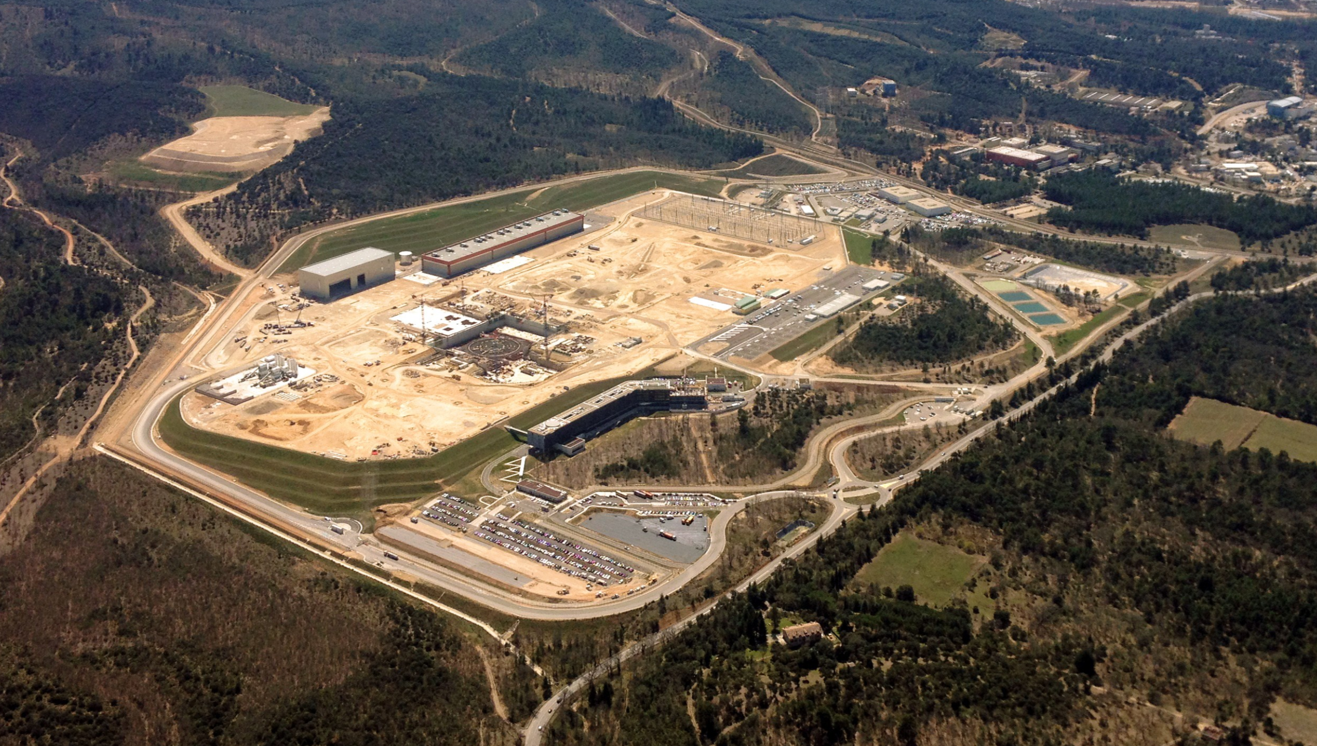
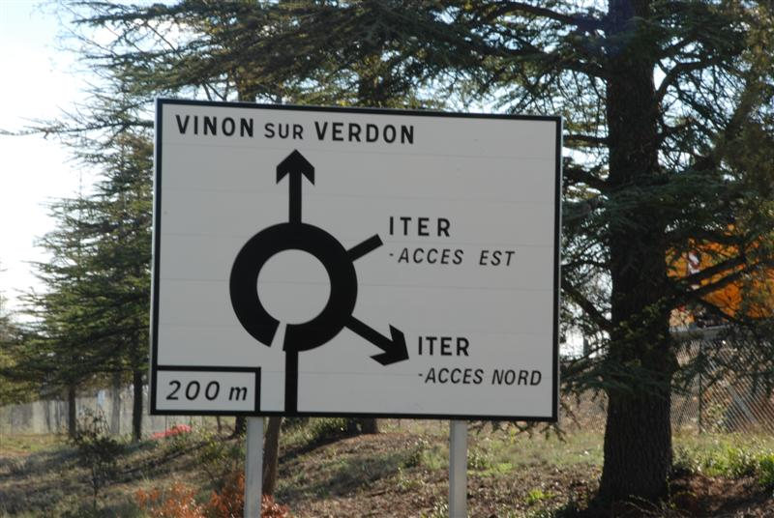
Aerial views of platform – April 2014
ITER Construction at St Paul-lez-Durance
PF Coil Winding Building
Cryostat Workshop (IN)
400 keV Substation
Tokamak Complex
ITER Headquarters

Slide 21
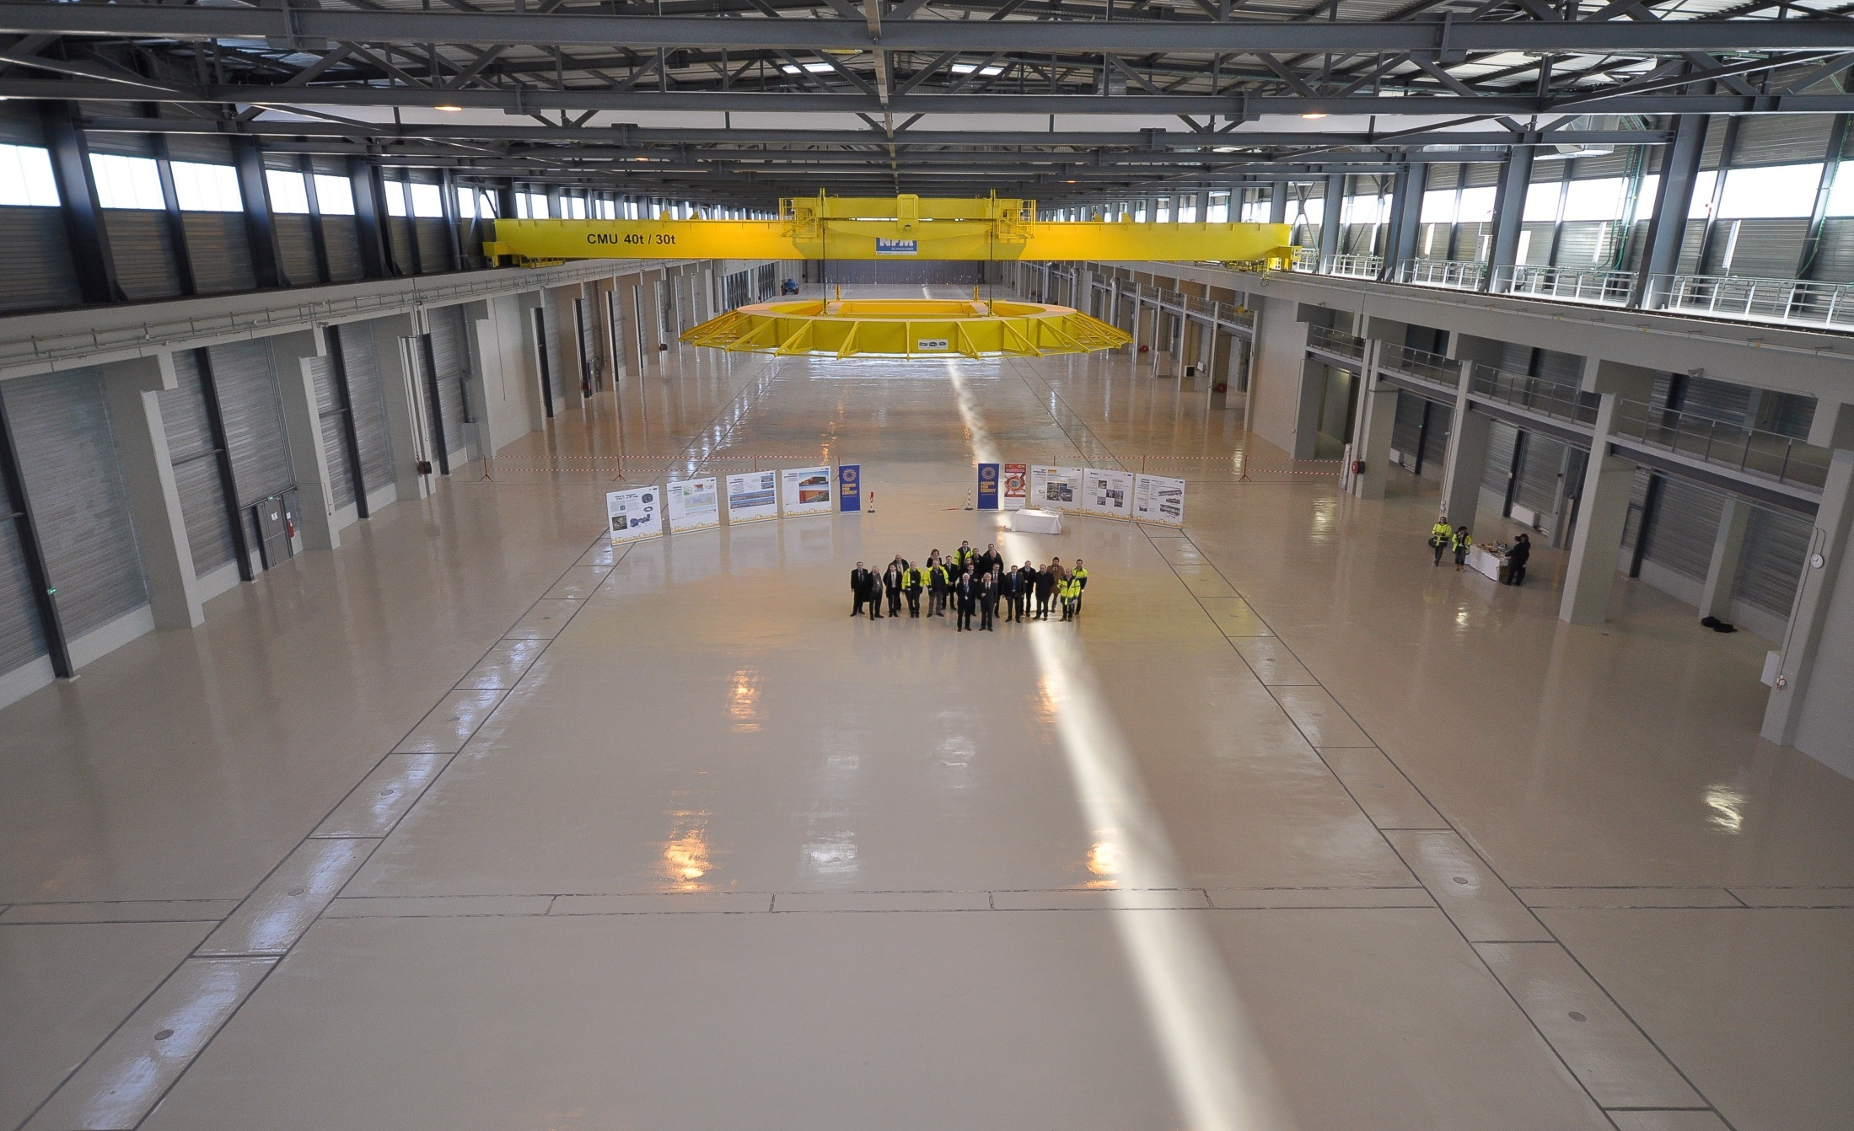
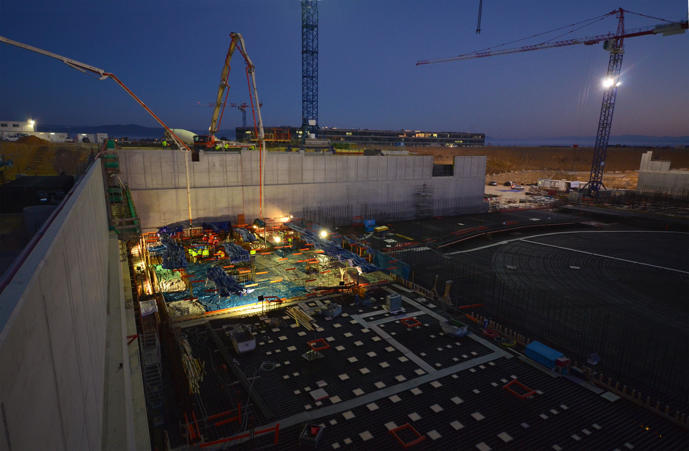
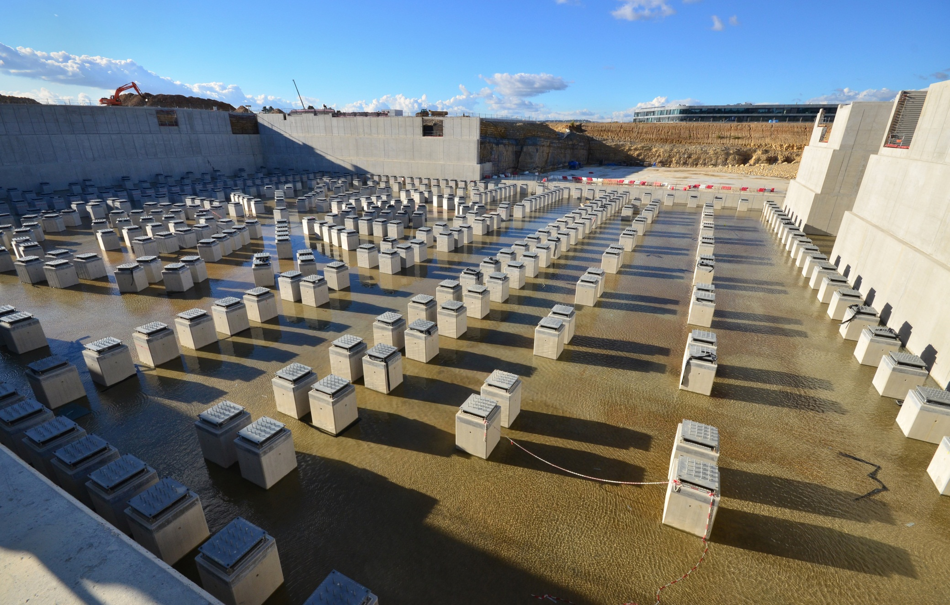


ITER Construction at St Paul-lez-Durance
Tokamak Complex Seismic Piles
PF Coil Winding Building
Tokamak Complex Concrete Pour
Tokamak Complex Construction with new ITER HQ Building
Cryostat Workshop

Slide 22


ITER Construction at St-Paul-lez-Durance
Construction of Assembly Hall begins
B2 slab complete and cranes in place for Tokamak Complex construction

Slide 23

ITER Site Overview (~2020)
39 buildings and technical areas, 180 hectares
POWER SUPPLIES
TOKAMAK BUILDING
OFFICE BUILDING

Slide 24
ITER Research Plan – Rationale
The ITER Research Plan has been developed to analyze the programme towards high fusion gain DT operation:
  allows programme logic to be developed and key operational challenges to be identified and addressed during ITER construction
  supports planning of installation and upgrade programme accompanying operation
  provides insight into principal physics risks impacting on experimental programme
  ⇒ R&D priorities in current research programmes
  encourages exploration of issues in burning plasma physics which are likely to be encountered on route to Q = 10 and beyond

Slide 25

ITER Research Plan – Structure
0
1
2
3
4
5
6
7
8
9
10
TBM Program
EM-TBM
TN-TBM
NT/TM-TBM
INT TBM
Hydrogen/ Helium
Develop plasma scenarios
Commission Control, H&CD, Diagnostics
Disruptions, Disruption Mitigation
H-modes (helium)
ELM control
Deuterium
Deuterium H-modes
DT scenario preparation
Trace tritium experiments
DT
Fusion power production
Q=10
Towards long pulse
more DT
Towards the future

Slide 26
Research Plan Structure and Activities
Non-active operation:
  plasma operation to ~3.5 MA to establish initial divertor operation
  disruption loads, disruption detection, avoidance and mitigation
  development of plasma operation to ~7.5 MA/ 2.65 T
  H-mode operation and ELM Control
  demonstration of 15 MA/ 5.3 T operation
Nuclear operation:
  development of deuterium H-modes and preparation of DT scenarios
  initial DT operation to short-pulse Q=10
Subsequently, long-pulse Q=10 scenarios and ‘advanced’ operational scenarios will be developed, including non-inductive steady-state operation

Slide 27
Risk Assessment ⇒ Key R&D Needs
Top 12 risks associated with plasma operation and their potential consequences have been identified; mitigation strategies (and implications) have been developed – top 6 are:
  Disruption loads and effectiveness of disruption mitigation
  Uncertainty in H-mode power threshold scaling
  Effectiveness of ELM mitigation schemes
  Vertical stability control limited by excessive noise (or failure of in-vessel coils)
  Availability of reliable high power heating during non-active phase of programme (⇒ H-mode access)
  Acceptable “divertor” performance with tungsten PFCs over required range of plasma parameters

Slide 28
ITER reference plasma scenarios
The set of DT reference scenarios in ITER is specified via illustrative cases in the Project Requirements:
⇒ Design Basis plasma scenarios

Slide 29


ITER Plasma Scenario - ELMy H-mode
A Q ≥ 10 scenario with:
I_{p}=15 MA, P_{aux}=40 MW, P_{fus}~500 MW
T (keV)
n (10¹⁹ m⁻³))
30
10
24
8
18
6
12
4
6
2
0
5.0
6.0
7.0
8.0
0
R (m)
P (MW), Q
120
80
40
0
Current Ramp-up Phase
-40
100
200
300
400
500
600
Time (s)

Slide 30

Steady-State Operation
Discovery of internal transport barriers ⇒ “advanced scenarios”
plasma with reversed central shear +
sufficient rotational shear
internal transport barrier
⇒ enhanced confinement
reduced current operation +
large bootstrap current fraction
active mhd control
reduced external current drive +
current well aligned for mhd stability and confinement enhancement
Steady-state operation +
High fusion power density
But development of an integrated plasma scenario satisfying all reactor-relevant requirements remains challenging

Slide 31
What’s different about ITER physics and operation ?
Burning plasma: self-heated by α-particles
  non-linearity in total heating power due to dependence on plasma profiles
  MHD: sawtooth stabilization by α-particles, fast particle modes
Plasma control (position, shape, fuelling, heating, stability, exhaust)
  time constant for position control is >1s ⇒ very easy to damage plasma-facing components (e.g. on inner wall of vacuum chamber)
  very complex control matrix
Very high stored energy
  disruptions, ELMs, melting of metallic PFCs
High plasma current (15 MA for Baseline Q = 10 scenario)
  runaway electron damage of PFCs, huge disruption forces
High ion fluence (integrated plasma flux) to PFCs
  erosion of PFCs and migration of wall material, dust formation

Slide 32
Conclusions
Since the establishment of the ITER Baseline in July 2010, the ITER project has moved fully into the Construction Phase
  on-site construction of the Tokamak Complex is underway
  Domestic Agencies have launched large scale manufacturing contracts for many major components
  extensive prototyping is ongoing in preparation for series manufacture
  there has been substantial progress in design and R&D for In-Vessel Components, Plasma Auxiliary Systems, Remote Handling, TBM etc
ITER Organization has been authorized to establish the installation nucléaire de base ITER
An extensive international collaboration is active in pursuing physics R&D for ITER in support of the preparations for ITER operation
Successful exploitation of ITER will realize the limitless possibilities of fusion energy, and open new areas of research in fusion plasma physics and fusion technology, including tritium breeding

Slide 33

Thank you for your attention

Slide 34
Backup Slides

Slide 35
Plasma Control
A magnetically confined plasma is a complex state
  it cannot be created and sustained without a sophisticated feedback control system
Free energy which is available within the plasma tends to generate turbulence and magnetohydrodynamic instabilities (mhd) which reduce plasma confinement quality
  great effort is expended within plasma control to sustain a high quality plasma capable of producing significant fusion power
In a thermonuclear plasma with significant fusion power, additional control requirements are imposed in ensuring the fusion power can be sustained for extended periods
  failures of the control system lead to conditions which tend to reduce fusion power or extinguish the plasma
At this stage of R&D, significant (uncontrolled) excursions in fusion power appear unlikely (ie burn point is stable)
  measures exist to control and suppress such excursions

Slide 36

Plasma Control on ITER
Ensure that physics objectives of any discharge are met
Provide first level of machine protection (other levels above)
Measurements:
>50 systems
thousands of data channels
Actuators:
Magnets,
Heating and current drive systems,
Fuelling and pumping
~20 in total
Plasma Control System (PCS)
~20 parameters controlled simultaneously
timescales from 1 ms to several seconds
(blink of an eye ~50-80 ms)
Requires state of the art control schemes
Notes:
Neural network = réseau de neurones si tu veux faire “le bon français qui traduit tout”
Application programming = interface de programmation

Slide 37



Test Blanket Modules - Tritium Breeding
n + ⁶Li → T + ⁴He + 4.8MeV
n + ⁷Li → T + ⁴He + n - 2.47MeV
TBM ports
TBM
TBM Port Plug (exploded view)
Three dedicated stations for testing up to six tritium breeding concepts

Slide 38

Component transport
Component Transport
For heaviest components: vacuum vessel sectors, toroidal field coils, poloidal field coil 1 and 6
Road upgrades from south coast to Cadarache complete and paid for by regional funding (115 M€)
ITER itinerary ~104 km by road + 32 km by barge

Slide 39




Component Transport
352 wheel test convoy carrying 800 ton load (33 m long, 9 m wide, 10 m high) trialled in September 2013 and March/April 2014
  2 power generators developing 730 horse power
Journey lasts 4 nights
Crossing Etang de Berre (32 km)

