Slide 1
XIII Seminarium Komputer w Szkolnym Laboratorium Przyrodniczym
Uniwersytet Mikołaja Kopernika
December 3, 2020
From narrativity in science to stories of forces of nature
Hans U. Fuchs
Center for Narrative in Science, Winterthur, Switzerland
and
Department of Education, Free University of Bolzano, Italy

Slide 2
This is the first of two related talks on Stories of Forces of Nature.
The second—which presents examples and detailed analysis of stories—will be presented tomorrow (December 4, 2020) by Federico Corni of the Free University of Bolzano, Italy.
In this first talk, I will argue how we know that science has a narrative core and how stories (of forces of nature) can be scientific. It is meant to lay the groundwork for the second presentation of tomorrow.

Slide 3
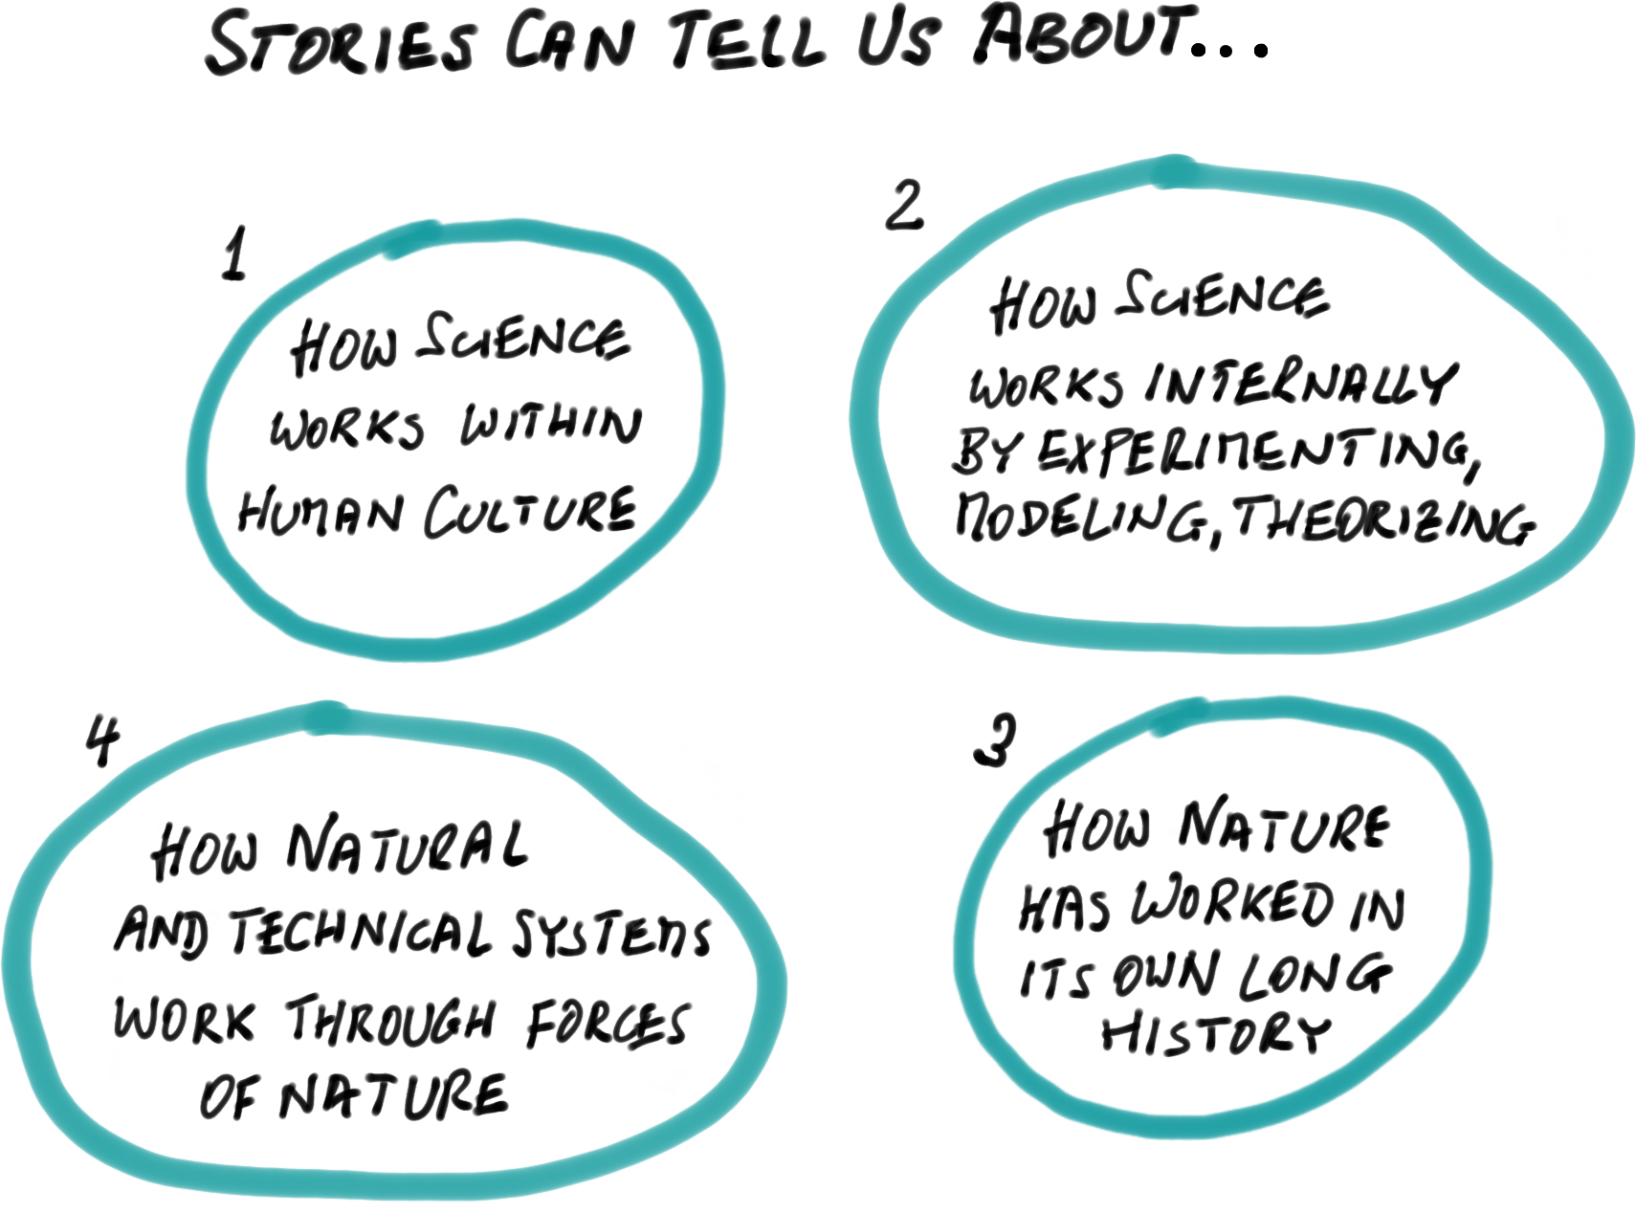
What Narrative Can Do for Us in Science…
Science as part of human culture
What is science? How is it done?
Experiencing and understanding nature and science
Natural history
Most of the uses of narrative in science are extrinsic—meaning that they are about science.
We are interested in intrinsic narratives in science in the deep sense that narratives (stories) can be science, just like experiments, models, simulations, and theories.
→
Particularly for understanding, recounting, and learning about our encounters with forces of nature

Slide 4
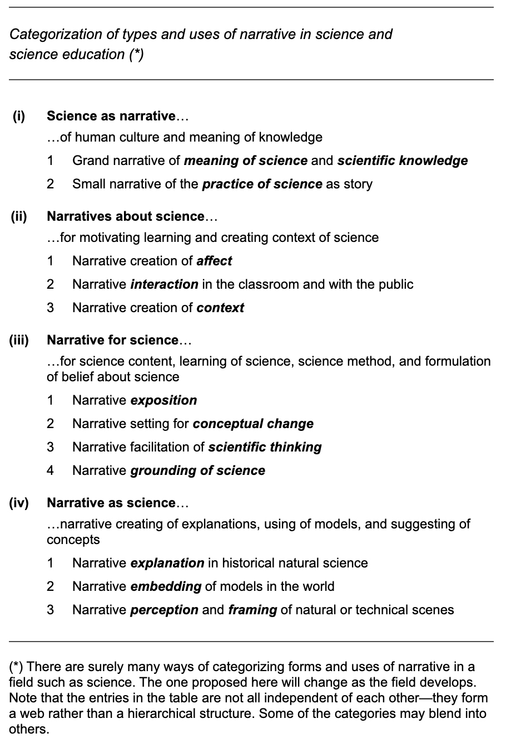
Types of Uses of Narrativ in Science
A more detailed characterization of types of narrative used around and in science…
(i) Science as narrative of human culture and meaning of knowledge;
(ii) Narratives about science, for motivating learning and creating contexts for science;
(iii) Narrative for science, for science content, learning of science, science method, and formulation of belief about science; and
(iv) Narrative as science, i.e., narrative creating of explanations, using of models, and suggesting of concepts.
Typology of Uses of Narrative in Science—From Positioning Science in Culture through Creating Affect to Providing Explanations and Suggesting Concepts
http://www.narrativescience.org/Argument/Argument_Fuchs_01.html

Slide 5
A fundamental relation between stories (of forces of nature) and scientific models
An observation that is relevant for the use of stories (of forces of nature) in the practice of scientific modeling and simulation:
We can draw up and analogy between narrative and the scientific practice of modeling of dynamical systems…
Story
Story-World
↔︎
↔︎
Simulation
Model

Slide 6
Overview
Some general issues when dealing with stories where natural agents take center stage…
What are Forces of Nature?
What are Stories?
Polarities as generators of tension for stories
How are stories of Forces of Nature possible?
Narrative experience
Narrative experience interacting with direct physical experience of FoN
The interaction of emotion and reason

Slide 7
Stories of Forces of Nature
Why are we interested in and concentrate upon the issue of stories of Forces of Nature?
Consider an application of great future importance for humanity and our planet:
Regenerative and CO2-neutral energy supply and use
The example confronts us with…
PV-Cell
Hydrogen and oxygen storage
complex systems
natural and technical systems in which we need to identify mechanisms in order to understand and subsequently design processes
processes/phenomena that play out in the inter-actions of forces of nature
the need for learning how to created models of mechanisms in which forces of nature are at play
Fuel Cell
An experimental kit for producing hydrogen with the help of light and later using the hydrogen as a fuel in fuel cells for some practical everyday purpose.

Slide 8
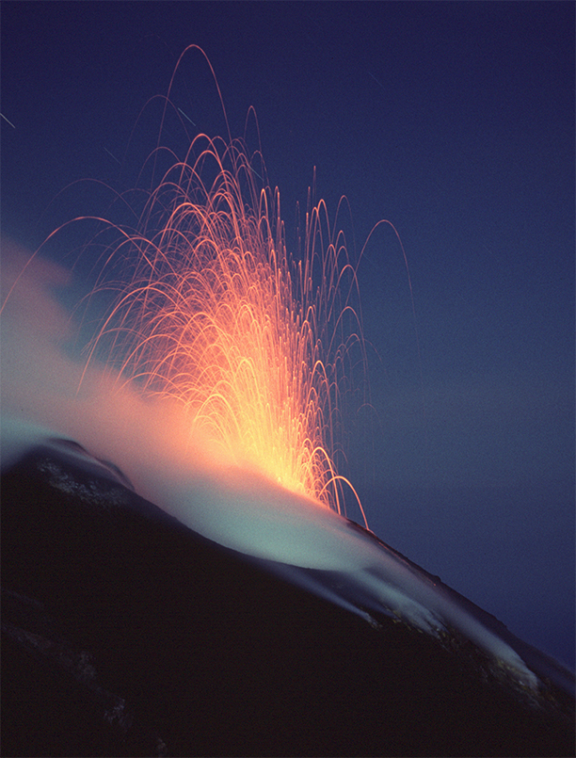
Forces of Nature
We experience activity in nature as Forces of Nature
Modern macroscopic physics (→ continuum physics) is a science of Force of Nature
We understand Forces of Nature through the power of our imagination
Forces of Nature are understood and represented narratively: We can tell stories of Forces of Nature and their interactions
Power is a general category of human experience: there are social, psycholo-gical, cultural and natural forces (*)
© Tom Pfeiffer, VolcanoDiscovery GbR
(*)
A note to physicists: The term force used here has noting to do with force in mechanics!

Slide 9
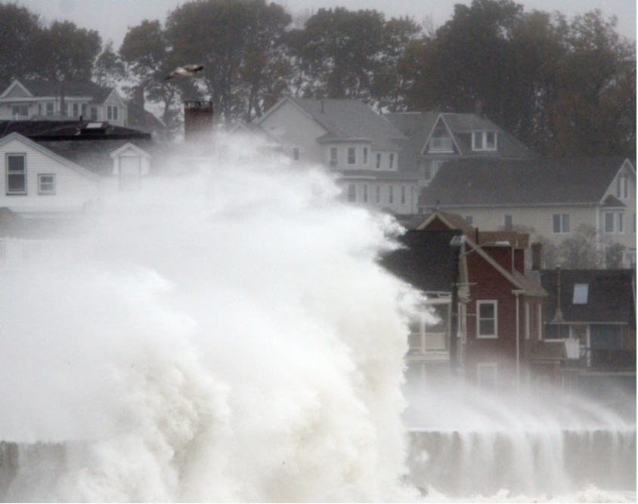
Examples of Forces of Nature
Rain and wind (water and other fluids)
Fire and ice (heat and cold)
Lightning (electricity)
Soil and moisture
Food and medicines
Motion (linear and rotational motion)
The physicists’ version
Fluids
Heat
Electricity
Substances
Gravity
Motion
But there are also social and psychological forces
Justice
Anger
Pain
Music
Love
The military
The market

Slide 10
Imaginative/Figurative Structure of Forces of Nature
We experience Forces in general and Forces of Nature in particular as perceptual units (gestalts).
As a gestalt or shape or figure, a force is experienced as a powerful agent.
We recognize these gestalts as having 3 fundamental characteristics:
Intensity and tension (in physics → intensive quantity, potential)
Extension, size, amount (in physics → extensive quantity, often as fluidlike quantity)
Power (in physics → rendered formal through the energy principle)
These aspects/characteristics form part of our imagination. We use image schemas (that result from recurrent bodily interactions with our environments) and project them metaphorically upon the aspect(s) of the phenomena in question.

Slide 11
Examples of linguistic rendering of imaginative/figurative Structure of Forces of Nature
Examples for heat:
How do you collect heat in a passive solar house?
This means heat flows “downhill” from hot to cold.
… heat is an agent of vast importance in chemical reactions and engineering processes
Law of the dependence of the active force of heat upon the tempera… (R. Clausius)
This exterior heat lets the crust become crispy
Heat makes me dizzy…

Slide 12
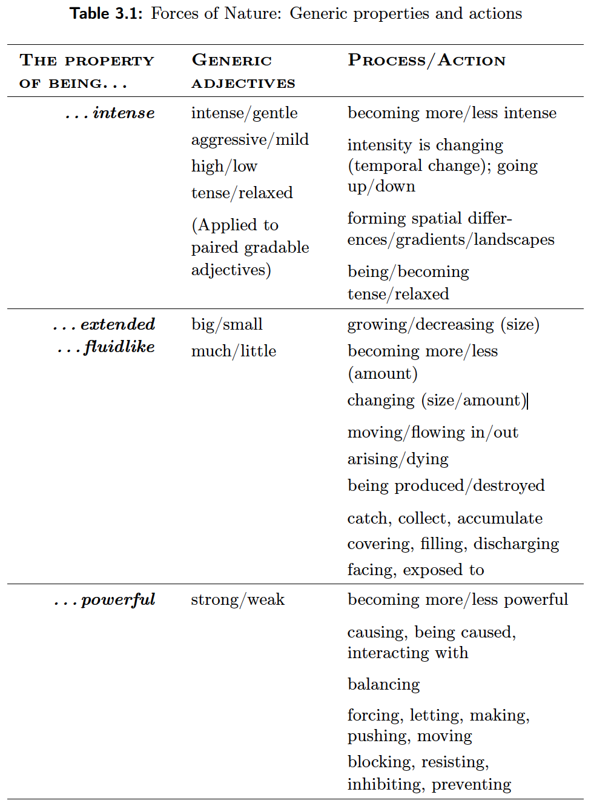
Linguistic forms befitting our experience of Forces of Nature
How to use natural language in a manner that it preserves—rather than violates!—our imagination regarding the experience of for-ces of nature…
Overall, the following grammatical forms go with the basic aspects/characteristics of a force (of nature):
Intensity → Adjectives
Extensions → Nouns
Power/Force → Verbs

Slide 13
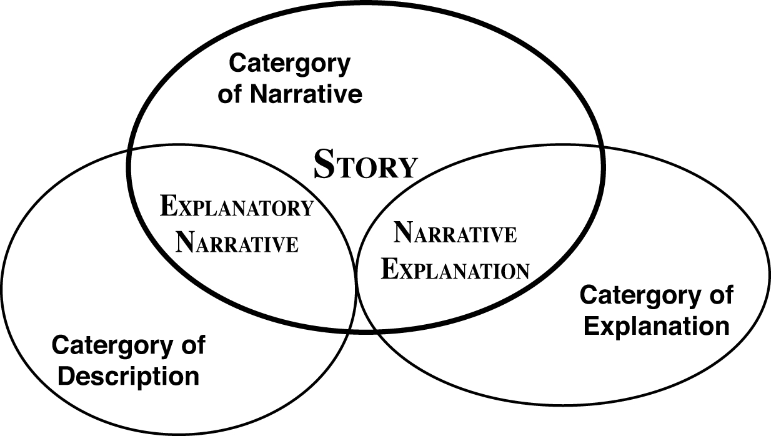
What are Stories?
Stories as prototypical narratives
David Herman (2009): Basic Elements of Narrative
Narrative as a radial category
Story the prototypical member of the category of narrative. There are non-central members that relate to the categories of description and explanation, so-called explanatory narratives and narrative explanations. (Herman, 2009)
Stories are narratives that include all of the following elements (Herman, 2009):
events;
(conscious) experiencing of events by agents;
tension for creating events; and
reason or occasion for telling by a narrator.

Slide 14
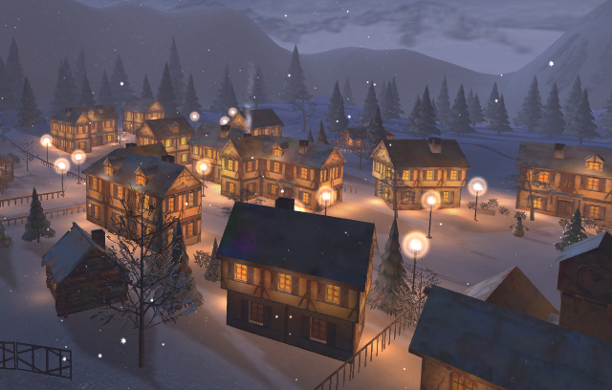
A Winter Story
A story by H. & R. Fuchs
A small town called Little Hollow lay in a hollow surrounded by a high plain. People had settled in that place because small streams collected on the plain and flowed down into the hollow and through their town as a nice gentle river. This the people of Little Hollow liked a lot. But there was something they liked a lot less: Winters in Little Hollow were harsh.
As the last of the warmth of late Fall left the plain surrounding Little Hollow, cold found its way into the area and spread out. Because the plain was so wide, the cold of winter had to spread pretty thinly, so it was not all that cold up there. Moreover, even in the midst of winter, the Sun managed to send some warming rays onto the plain. The snow that fell on the plain was not so cold either, but it was plenty, and the people of Little Hollow loved to go up to the plain for cross country skiing. The little kids went there to build beautiful snowmen.

Slide 15
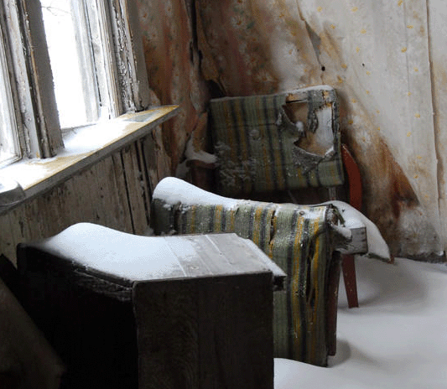
A Winter Story (contd.)
But in Little Hollow, things were different. The cold of winter knew a good place where it could do its job much more easily of making everything and everybody cold. It could flow into the hollow where the town had been built. It could collect there and it knew it would not be driven out so easily by a little bit of wind as could happen on the plain. And the Sun could not reach the town that easily, also because of fog that often lay over Little Hollow and made everything gray. More and more cold could collect in Little Hollow, and it got colder and colder as the winter grew stronger. The temperature fell and fell.
The people of Little Hollow cursed winter and its cold. They knew that the cold would find its way into their homes if they were not careful to close windows and doors. The cold could even sneak in through tiny cracks between walls and windows, so the people had learned to build their homes well to make it hard for cold to flow in. Still, without the sophisticated and strong heaters in their homes, people knew they could never survive winter. At times when much cold had collected in their town, when it had become terribly cold and the temperature was very, very low, the fires in the furnaces had to work very hard to fight the cold. The people in their homes made sure that the heat produced by the furnaces would always balance the cold so that their homes felt comfortably warm.

Slide 16
A Winter Story (contd.)
For the children of Little Hollow, the cold of winter was not so bad. They dressed warmly so their body heat would be conserved, and played hard when they were outside. But even for them, the thick cold of winter had mischief in mind. It went into the snow lying on the ground to make it very cold as well and this made the snow drier and harder to work with. The children could not form snowballs, and it was much more difficult to build snowmen. They had to wait until winter had grown somewhat tired, and the cold was slowly driven out of Little Hollow. When there was less cold and the temperature was a little higher, the snow became warmer and much more fun to play with.
When that happened the cold of winter knew its time had come. The warmth of early Spring would grow stronger and drive the cold out of the hollow. The cold knew it had to accept its defeat but it also knew very well it would be back…
Animation of Winter Story →

Slide 17
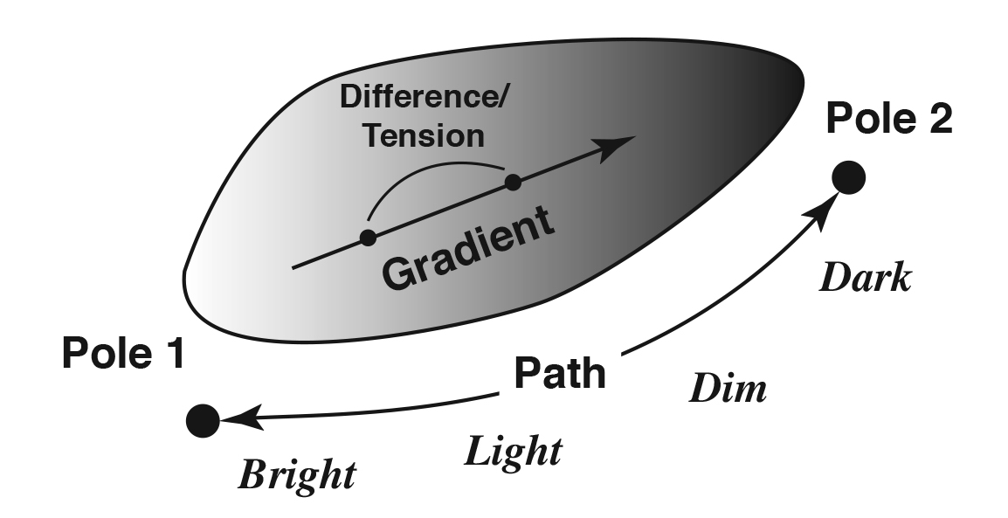
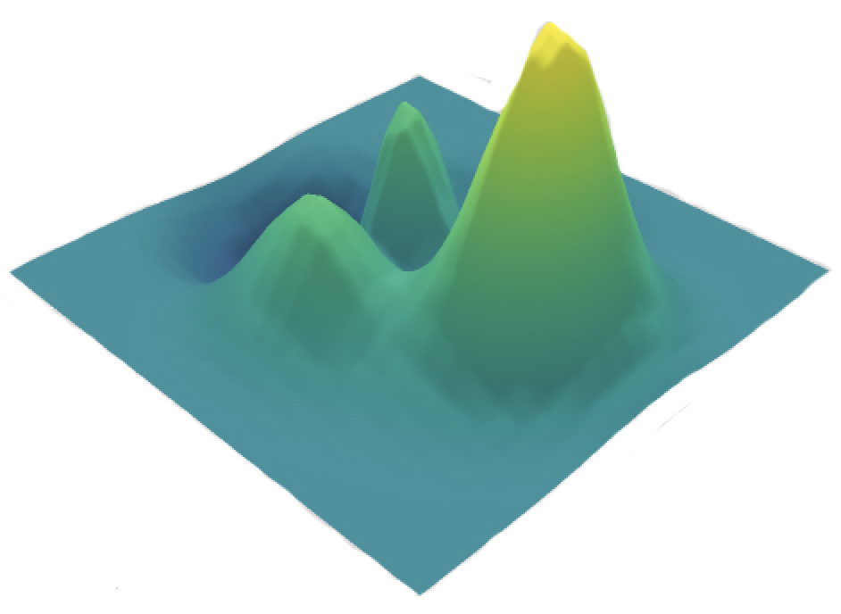
Polarities, Binary Oppositions,
and Gradients: Origin of tensions
An important element of feeling and thought is related to so-called Polarities. Simple examples of physical polarities are light-dark or hot-cold.
The term Binary Opposition, in contrast, may be used to denote the contrast (opposition) between the poles of a polarity and thus set up a dichotomy or duality.
Brightness as Polarity
In contrast to a duality, a polarity allows for “gray” between “white” and “black.” It generates a path between the poles which can be described as a gradient (going in a preferred direction).
Gradients are slopes
in “landscapes”

Slide 18
Polarities as generators of tensions for stories
Polarity as generator of tensions that are fundamental for setting up the basic frame/scene for a story…
Mythic thought is intimately related to thinking with polarities
Polarity is not the same as duality
Polarity seems to be related to the experience of time as cyclical
See also
Gabor Gyori and lren Hegedus (1993): Is everything black and white in conceptual oppositions? Issues in Cognitive Linguistics. In Leon de Stadler & Christoph Eyrich: Proceedings of the International Cognitive Linguistics Conference.
See in particular Section 3 (pp.59-62) for a discussion of image schemas and binary opposites / polarities
An observation of development of language (Dario L, after he was about 20 months old):
Initially, for polar concepts, he used only one word:
Open-close → open; up-down → up; warm-cold → cold
This suggests that a polarity is experienced as a unit/gestalt.

Slide 19
Basic story structure
Kieran Egan (1988): Primary Understanding: Education in Early Childhood.
Important elements of such stories … include a beginning that sets up an expectation; this expectations has an affectively engaging quality, and such a quality is most commonly achieved by setting binary opposites into conflict with one another. The central part of this story involves the elaboration of this binary conflict, and the end comes with its satisfaction or resolution or mediation (p. 116).
Binary opposites → Polarities

Slide 20
Story Structure
Kieran Egan on the meaning of stories…
Egan K. (1988): Primary Understanding: Education in Early Childhood.
[…] one may explain the impulse toward stories as a reflection of some fundamental structure of the mind. […] We know that things generally become meaningful within contexts, within boundaries and limits. […] The story is the linguistic unit that, as it were, brings its boundaries with it. […] a story is the linguistic unit that can ultimately fix the affective meaning of the events that compose it (p. 100).
A crucial aspect of stories, then, is that they are narratives that orient our affective responses to events. […] As long as we remain unsure how to feel about the events, we know we have not reached the completion of the larger unit. […] If we are to try to separate out the kind of meaning proper to the story, then, it is something that involves our emotions (p. 101).
The kind of meaning that is unique to stories, and that stories are uniquely responsible for organizing, is what I am calling “affective meaning.” […] One reason why stories provide affective meaning is that, unlike the complexity of everyday events, they end. […] What makes them stories is that their ending completes and satisfies whatever was raised in their beginnings and elaborated in their middles (p. 102).
The story is the archetypical form in which bits are organized together into a greater coherent whole (p. 113).

Slide 21
Story Structure (contd.)
Kieran Egan on Story Form, Story Grammar, Story Schema…
Egan K. (1988): Primary Understanding: Education in Early Childhood.
Important elements of such stories […] include a beginning that sets up an expectation; this expectation has an affectively engaging quality, and such a quality is most commonly achieved by setting binary opposites into conflict with one another. The central part of the story involves the elaboration of this binary conflict, and the end comes with its satisfaction or resolution or mediation. (Egan, 1988, p. 116)
Our beginning then, needs to set up some binary conflict or problem and our end needs to resolve it in some way, if we are to take advantage of stories’ power to be affectively engaging. (Egan, 1986, p. 31)
My point here is simply to stress that underlying stories there are abstract forms, plots, sets of rules that determine the structuring and organization of events to create a particular kind of meaning. (Egan, 1988, p. 108)
As our story-sense, our sense of the grammar of stories, becomes more sophisticated, fed by many stories, so the conceptions of causality inherent in such stories become more sophisticated. That is to say, following increasingly sophisticated stories is among other things, the development of one’s conception of causality. […] It is, again, in the enrichment and sophistication of this affective causality that logical and scientific conceptions of causality are hatched. (Egan, 1988, p. 121)

Slide 22
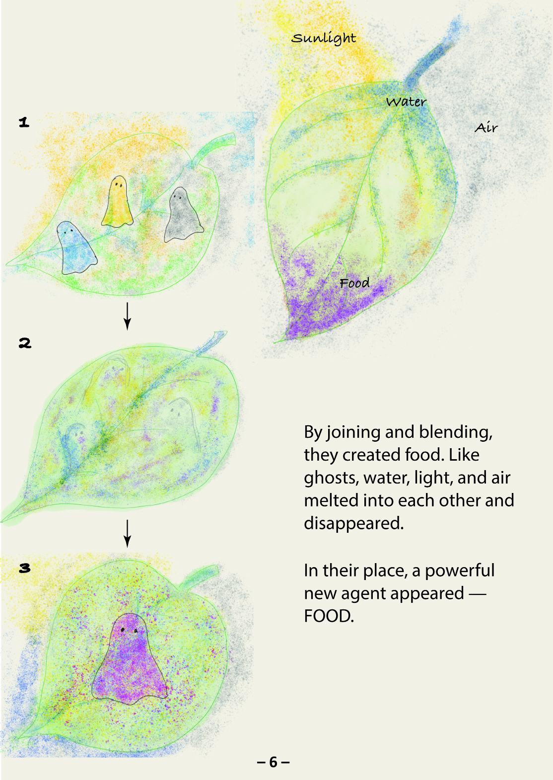
How are stories of FoN possible?
Since our experience of FoN is intimately linked to polarities and tensions, we already seem to have in important ingredient of stories.
However, we also experience agents…
Linguistic evidence for the cognitive reality of agency in Forces of Nature
Metaphoric language using basic schematic understanding shows how we talk about Forces of Nature: we treat them as agents (both in everyday life and in scientific discourse).
Examples for heat:
How do you collect heat in a passive solar house?
This means heat flows “downhill” from hot to cold.
… heat is an agent of vast importance in chemical reactions and engineering processes
Law of the dependence of the active force of heat upon the tempera… (R. Clausius)
This exterior heat lets the crust become crispy
Heat makes me dizzy…
Summary: Stories, i.e., prototypical narratives, are possible for forces of nature because we experience nature as agentive. Powerful agents acting and being acted upon appear in our mind.
→
←

Slide 23
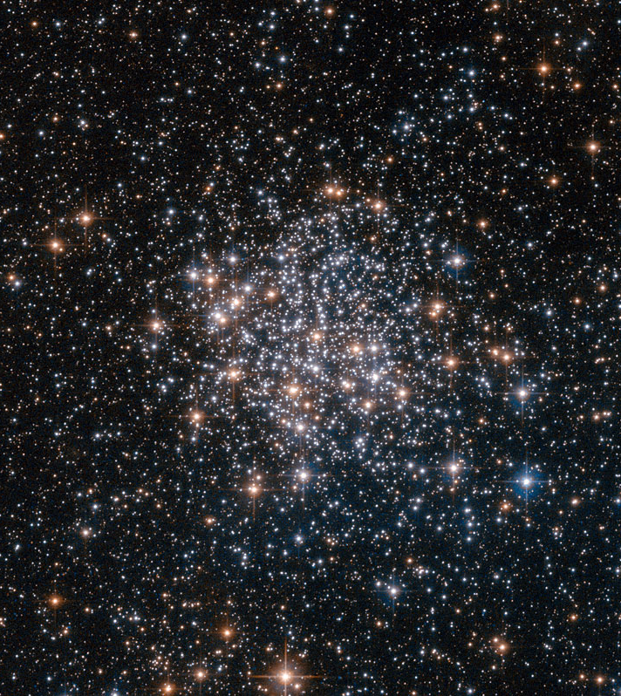
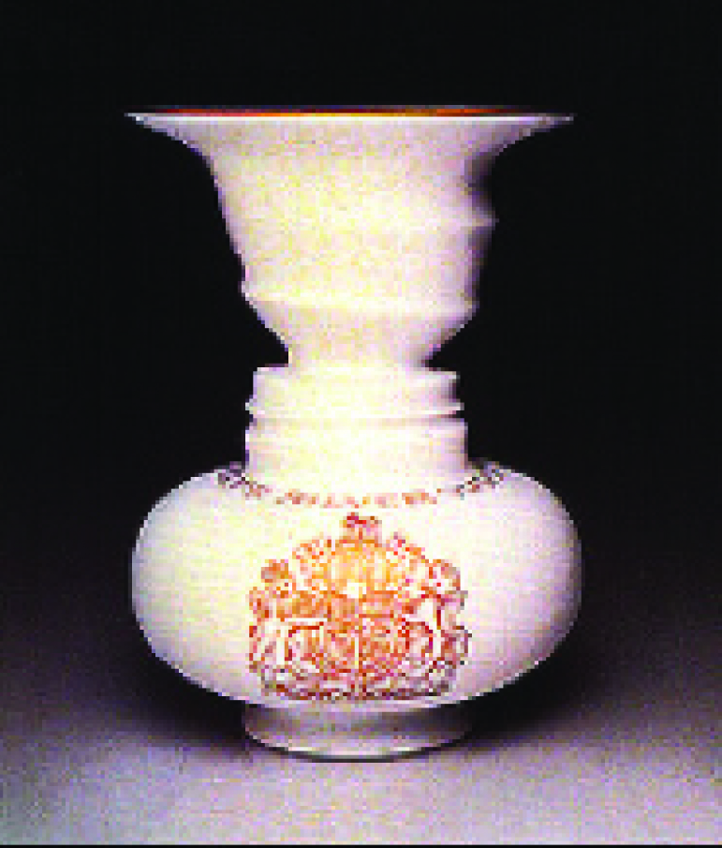
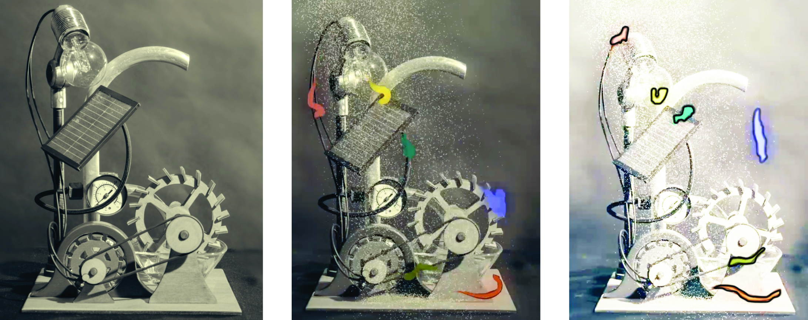
How are stories of FoN possible? (contd.)
Perspective 1: Objects (parts of mechanisms) interacting as the explanation for “everything”
Bodies are figures; they move against a ground we can call a potential landscape.
The problem with this perspective is that we cannot create dynamical models based upon it.
Perspective 2 after Figure-Ground-Reversal: Agents representing forces of nature appear as figures, bodies become the ground…
… and the agents are moving through a potential landscape.
Figure-Ground
Reversal

Slide 24
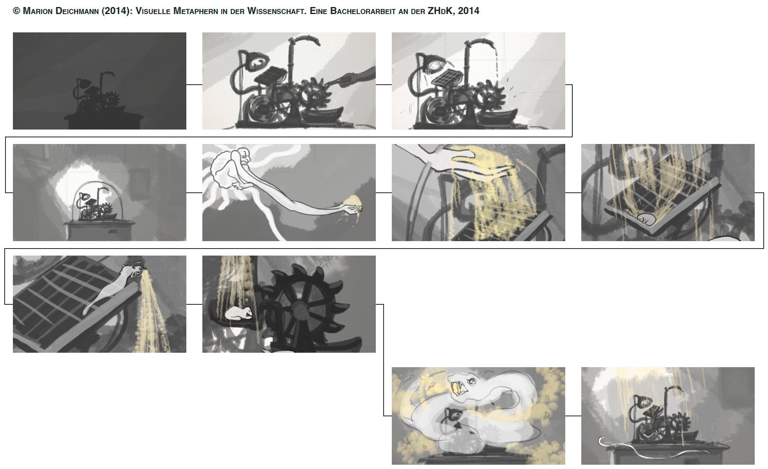
An example of imaginative rendering of Forces of Nature

Slide 25
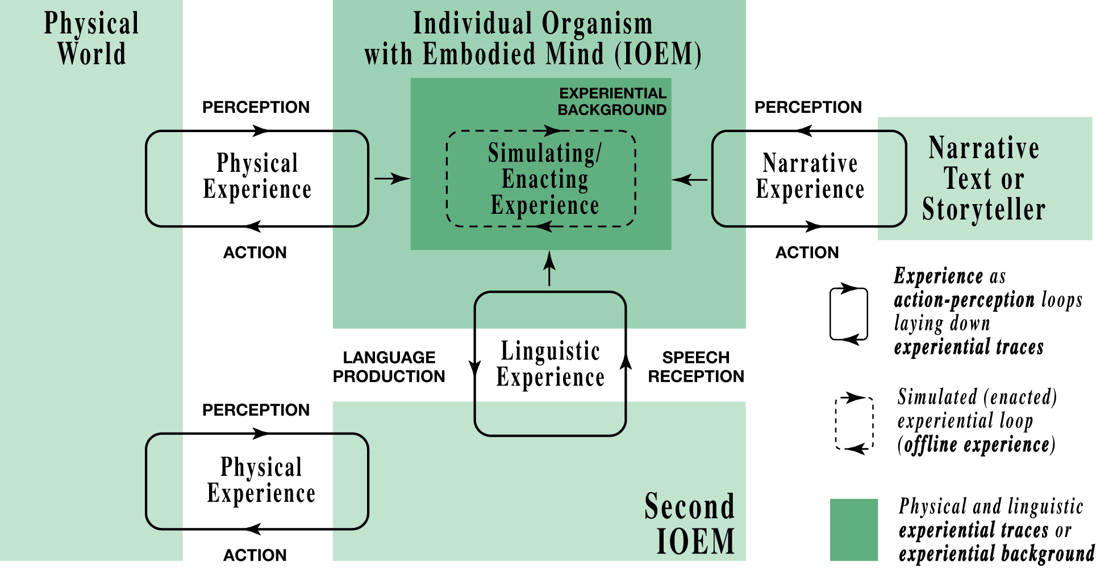
A model of “Experiencing”
in Joint Action
Interaction of two different types of experience in an individual
Experience
of stories
Direct experience of the physical world

Slide 26
Experience…
Experience is not what happens to you, it’s what you do with what happens to you.
Aldous Huxley, Texts and Pretexts, 1932

Slide 27
Experientiality of Narrative
Caracciolo M. (2014). The Experientiality of Narrative—An Enactive Approach. Berlin, de Gruyter. Chapter 4.
The following excerpts from Caracciolo (2014, Chapter 4) describe how experientiality of narrative arises and why it compares to direct experience…
However, peoples’ imaginings can also take on a sensory aspect, resulting in … “mental imagery” or “sensory imagination.”
On this view of simulation … performing a mental simulation involves, simply enough, imagining undergoing and experience…
What a perceptual experience and a simulated perceptual experience have in common is a structure of sensorimotor patterns… [Readers draw] on memories of past interactions with the world (“experiential traces”).
… sensory imagination acts by simulating (or enacting) a hypothetical perceptual experience on the basis of one’s experiential background, and this accounts for its experiential quality.
[We can] explain how readers can simulate the bodily-perceptual experience of a character. […] stories usually invite readers to engage in meaningful ways with the experience of characters.

Slide 28
Experientiality of Narrative (contd.)
[Quoting Hutto, 2006, in Radical Enactivism: Focus on the Philosophy of Daniel D. Hutto; Richard Menary, ed.] The kind of understanding “what-it-is-like” to have such and such an experience […] involves undergoing and/or imagining experiences both of acting and of being acted upon.
[Quoting Goldman, 2006] To enactively imagine seeing something, you must “try” to undergo the seeing—or some aspect of the seeing—despite the fact that no appropriate visual stimulus is present.
… sketchy and non-pictorial models are constructed through a process that simulates perception, since it is not only cognitive, but experiential. Accordingly, while reading a text, readers enact the story-world…
The reader’s engagement with narrative texts … can simulate the on-line, embodied responding that characterizes our basic interaction with the real world; this similarity explains the bodily-perceptual dimension of our sensory imaginings.
The problem with the idea that readers adopt the character’s perspective is that it can seem to reify the character’s experience by presenting it as an object that pre-exists the reader’s interaction with the text. On the contrary, I would argue that the character’s perspective can only be simulated, or rather enacted, by the reader while reading. … There is no stand-in for the character’s experience here, but only linguistic—expressive—pointers that cue readers into attributing an experience to a fictional being because of their own familiarity with bodily experience.

Slide 29
Metaphors in a story
Caracciolo M. (2014). The Experientiality of Narrative—An Enactive Approach. Berlin, de Gruyter.
On the form of language in stories…
… as suggested by David Lodge (20012), narrative and literature have a special tool for showing readers how to enact a given experience: metaphorical language. Through metaphors and similes, the reader is invited to imagine experiences “both of acting and of being acted upon” (Hutto, 2006).
See also Fuchs (2013b), Fuchs, Contini, Dumont, Landini & Corni (2018)

Slide 30
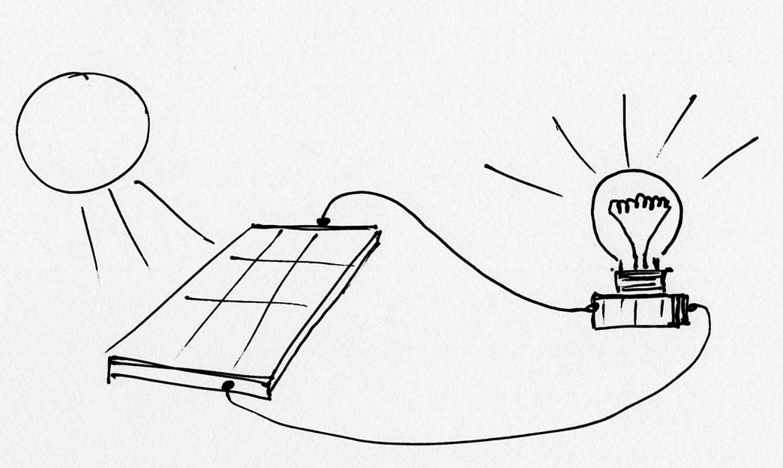
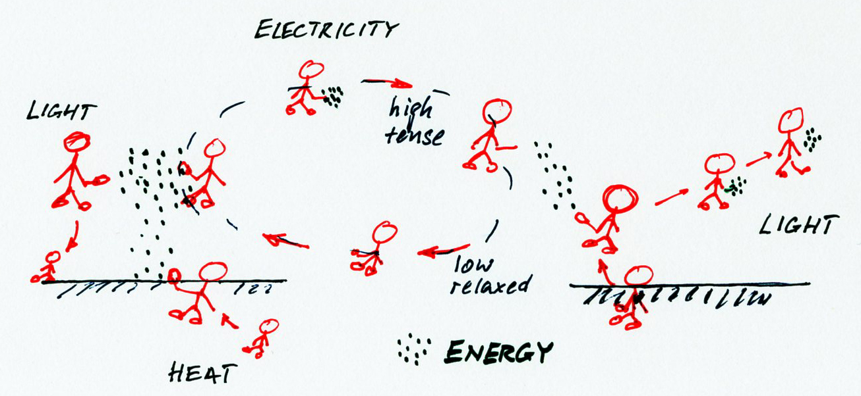
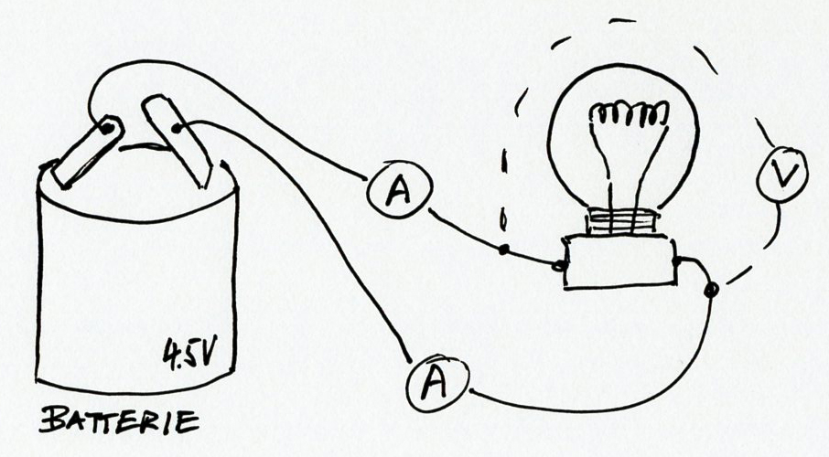
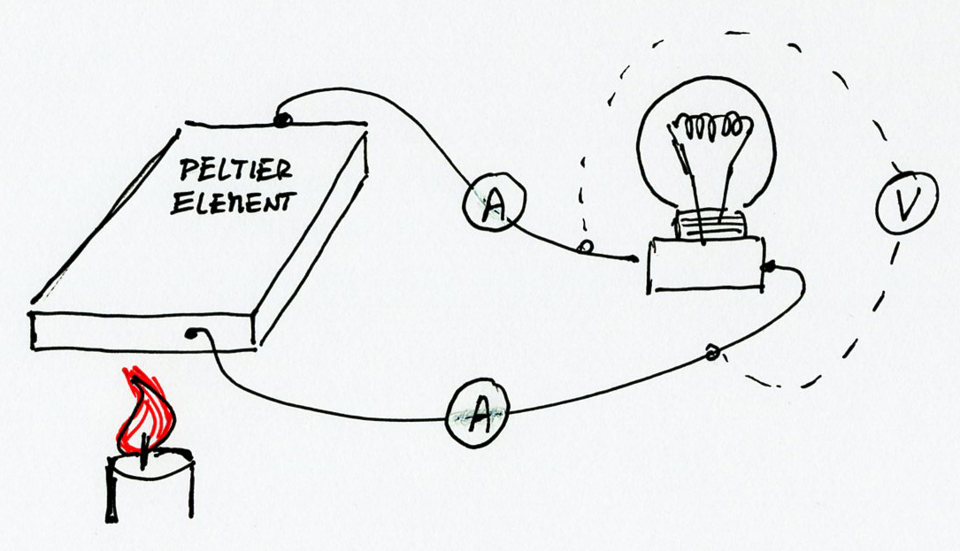
Play-Acting Stories of Forces of Nature
PV cell
Lamp
→
Photovoltaic generator and lamp
Kids play-acting the processes in the system—they represent the forces of nature; energy is represented as confetti.
Variations on a theme…
Battery and lamp
Thermoelectric generator and lamp

Slide 31
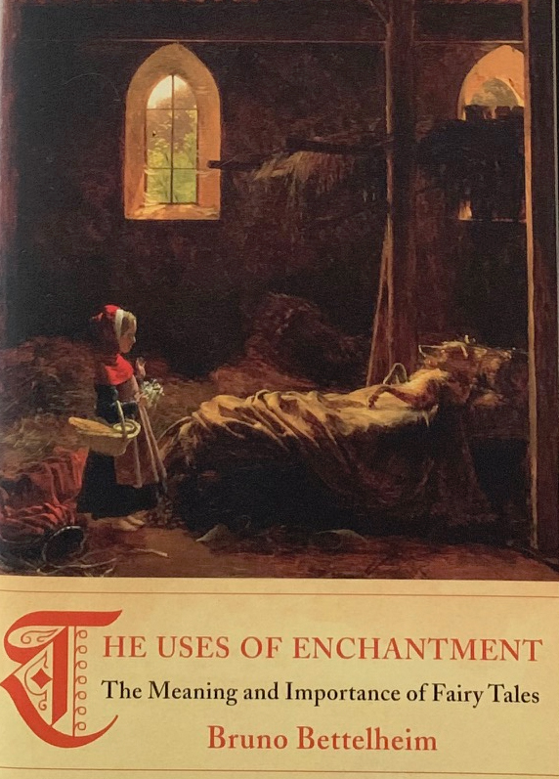
References
Caracciolo M. (2014). The Experientiality of Narrative—An Enactive Approach. Berlin, de Gruyter.
Corni F. (2013): Corni, F. (ed.) (2013). Le scienze nella prima educazione. Un approccio narrativo a un curricolo interdisciplinare. Trento: Centro Studi Erickson.
Egan K. (1986): Teaching as Story Telling. London, Ontario: The Althouse Press.
Egan K. (1988): Primary Understanding: Education in Early Childhood. New York and London: Routledge.
Egan K. (1997): The Educated Mind: How Cognitive Tools Shape Our Understanding. Chicago: University of Chicago Press.
Egan K. (2013): Il contributo della fantasia alla costruzione del senso della realtà nei bambini. In F. Corni (Ed.), Le scienze nella prima educazione, Erickson, Trento, Italy.
Fuchs H. U. (2013a): Il significato in natura. In F. Corni (Ed.), Le scienze nella prima educazione, Erickson, Trento, Italy.
Fuchs H. U. (2013b): Costruire e utilizzare storie sulle forze della natura per la comprensione primaria della scienza. In F. Corni (Ed.), Le scienze nella prima educazione, Erickson, Trento, Italy.
Fuchs H. U. (2015): From stories to scientific models and back: Narrative framing in modern macroscopic physics. International Journal of Science Education, 37(5–6), 934–957.
Fuchs H. U., Contini A., Dumont E., Landini A., & Corni F. (2018). How metaphor and narrative interact in stories of forces of nature. In Hanne M. & Kaal A. (eds.): Narrative and Metaphor in Education. London UK: Routledge.
Hampe B. (2005): From perception to meaning. Image schemas in cognitive linguistics. Berlin: Mouton de Gruyter.
Herman D. (2009): Basic Elements of Narrative. Blackwell, London.
Johnson M. (1987): The meaning of the body. Chicago, IL: University of Chicago Press.
Lakoff G. & Johnson M. (1980): Metaphors we live by. Chicago, IL: University of Chicago Press.

